Slide 1
MEMORY, SCHEMA THEORY
AND THEIR RELIABILITY
(Dec 2019 syllabus revision)
IB Psychology LAJM

Slide 2
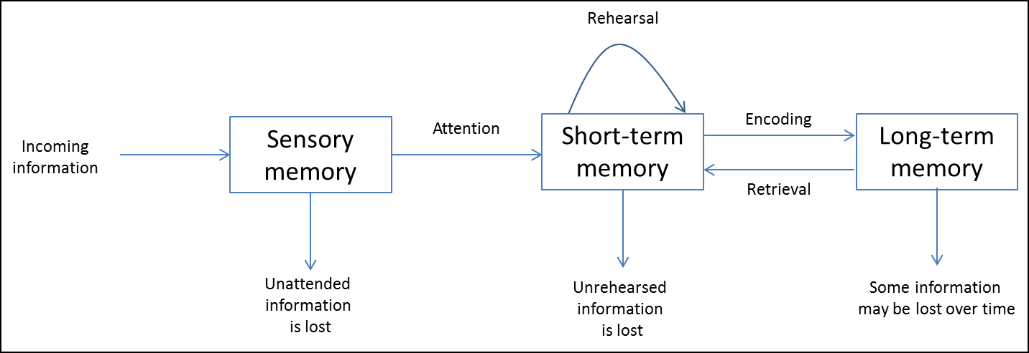
Models of memory
MULTI-STORE MODEL OF MEMORY
(Atkinson & Shiffrin, 1968)
Review the functions of the parts of this model
from pages 132–134 and your memos

Slide 3
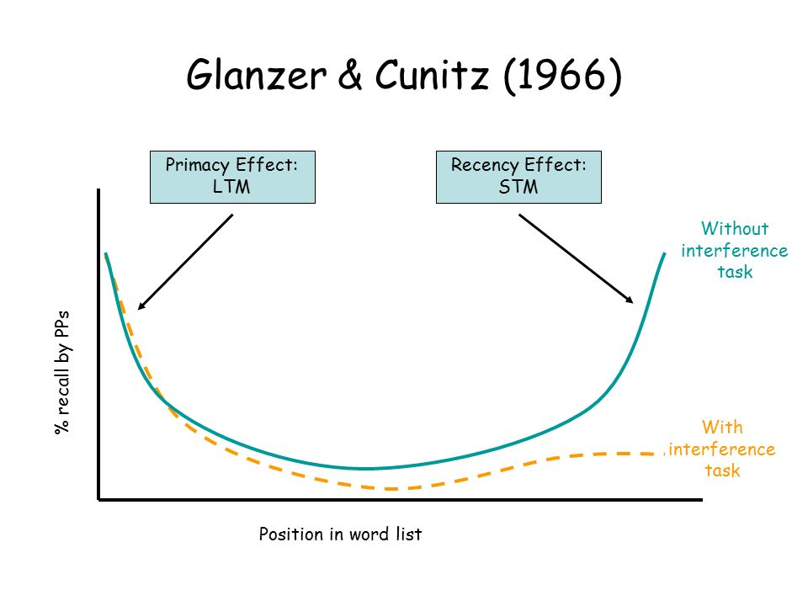
TASK
Review Sperling (1960), Glanzer and Cunitz (1966) and the case of H.M. from pages 134-136 and from the TED-ed video

Slide 4

TASK
Review the criticism of the multi-store memory model from pages 136–137 and your memos
  What are the strengths and limitations of this model?
  Do a TEACUP analysis

Slide 5
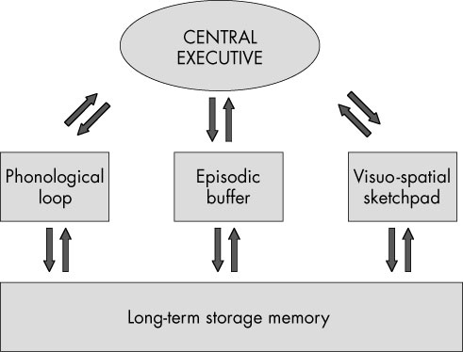
Models of memory
WORKING MEMORY MODEL
(Baddeley and Hitch, 1974)

Slide 6
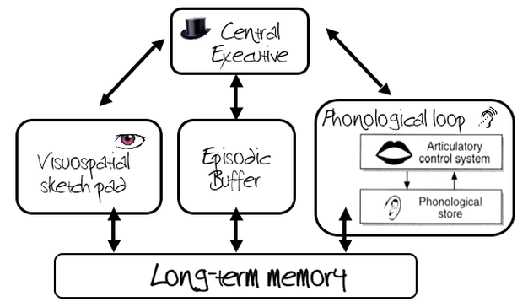
TASK
Review the the functions of the parts in the working memory from page 137 and your memos

Slide 7
TASK
Review at least TWO of the studies on right from pages 138-139 and from the teacher’s materials
Conrad and Hull (1964)
Baddeley and Hitch (1974)
Baddeley, Thompson and Buchanan (1975)
Baddeley, Lewis and Vallar (1984)
Baddeley (1996)
Quinn and McConnel (1996)

Slide 8
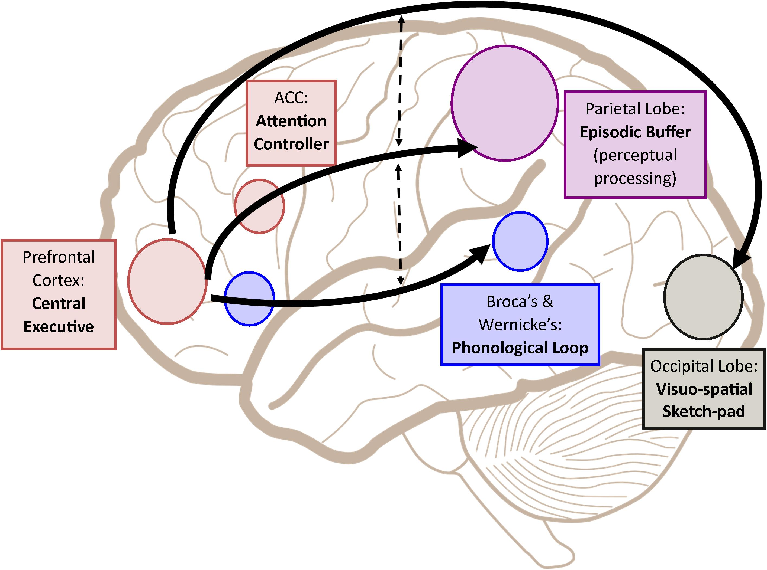
TASK
Review the evaluation of the working memory model on page 139
  What are the strengths and limitations of this model?
  Do a TEACUP analysis

Slide 9
TASK
”Models of memory: Study two memory models”
Review multi-store memory model and working memory model
Review at least ONE study per each model for SAQs
Review at least TWO studies for ERQs (can be the same as for SAQs)

Slide 10
TASK
”Schema theory: Study one example of schema theory”
Review schemas and schema theory
Search for at least TWO studies related to schema processing
How do schemas influence
memory functions?

Slide 11

TASK
What are the pros and the cons of schemas?
  How do they facilitate and/or complicate the way we process information and guide our behaviour?
What are the strengths and limitations of schema theory?
  Do a TEACUP analysis

Slide 12
TASK
”Reconstructive memory: Study one example of reconstructive memory”
Review the theory of reconstructive memory
Search for at least TWO studies related to reconstructive memory
How can schema processing
distort our memory?

Slide 13
TASK
Reread the sample responses related to the questions below:
  “Contrast two research methods used in the study of cognitive processes”
  “Contrast two models of memory with reference to research studies”
  “To what extent is one cognitive process reliable?”
After reading the responses, pay attention to the examiner’s comments
What could you learn from these samples?

Slide 14
Past questions
Discuss schema theory in relation to cognitive processing (M21 TZ2)
Evaluate one or more studies investigating reconstructive memory (M21 TZ1)
How would you answer these essay questions?
Create sketch responses
Compare your ideas to the markscheme

Slide 15
Picture sources
Garfield model <http://backreaction.blogspot.com/2008/04/emergence-and-reductionism.html> Accessed 26th of October 2020.
Multi-store model of memory <http://m.annals.yonsei.ac.kr/news/articleView.html?idxno=1692> Accessed 27th of November 2017.
Memory lapse <https://www.brainhq.com/brain-resources/memory/memory-lapses/> Accessed 26th of October 2020.
Glanzer and Cunitz (1966) <https://slideplayer.com/slide/7812447/> Accessed 26th of October 2020.
Tree memory <https://theconversation.com/a-memory-pill-cognitive-neurosciences-contributions-to-the-study-of-memory-109707> Accessed 26th of October 2020.
Working memory model <http://aspsychologyblackpoolsixth.weebly.com/working-memory-model.html> Accessed 28th of October 2020.
STM brain structures <https://www.frontiersin.org/articles/10.3389/fpsyg.2018.00401/full> Accessed 28th of October 2020.
Information <http://www.aiim.org> Accessed 23rd of November 2017.

