Slide 1
MEMORY, SCHEMA THEORY AND THEIR RELIABILITY (Dec 2019 syllabus revision)
IB Psychology LAJM

Slide 2
Models of memory
What is a model?
Physical representation what a psychological phenomenon could look like
Hypothetical construct

Slide 3
Models of memory
MULTI-STORE MODEL OF MEMORY
(Atkinson & Shiffrin, 1968)

Slide 4
TASK
Read pages 132–134 and complete the teacher’s handout

Slide 5
TASK
Review Sperling (1960), Glanzer and Cunitz (1966) and the case of H.M. from pages 134-136 and from the TED-ed video

Slide 6
TASK
Read pages 136–137 and summarise the criticism of the multi-store memory model in your own words
What are the strengths and limitations of this model?
Do a TEACUP analysis

Slide 7
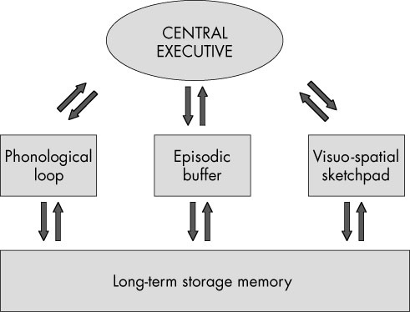
Models of memory
WORKING MEMORY MODEL
(Baddeley and Hitch, 1974)

Slide 8
TASK
Read page 137 and summarize the main functions of the parts in the working memory model in your own words

Slide 9
TASK
Read pages 138-139 and the teacher’s handout
Review at least TWO of the studies on right
Conrad and Hull (1964)
Baddeley and Hitch (1974)
Baddeley, Thompson and Buchanan (1975)
Baddeley, Lewis and Vallar (1984)
Baddeley (1996)
Quinn and McConnel (1996)

Slide 10
TASK
Read the evaluation of the working memory model on page 139
What are the strengths and limitations of this model?
Do a TEACUP analysis

Slide 11
TASK
”Schema theory: Study one example of schema theory”
Review schemas and schema theory
Search for at least TWO studies related to schema processing
How do schemas influence
memory functions?

Slide 12
TASK
What are the pros and the cons of schemas?
How do they facilitate and/or complicate the way we process information and guide our behaviour?
What are the strengths and limitations of schema theory?
Do a TEACUP analysis

Slide 13
TASK
”Reconstructive memory: Study one example of reconstructive memory”
Review the theory of reconstructive memory
Search for at least TWO studies related to reconstructive memory
How can schema processing
distort our memory?

Slide 14
TASK
Read the sample responses related to the questions below:
“Contrast two research methods used in the study of cognitive processes”
“Contrast two models of memory with reference to research studies”
“To what extent is one cognitive process reliable?”
After reading the responses, pay attention to the examiner’s comments
How could these responses be improved?
Make amendments

Slide 15
Sources
Crane, J. & Hannibal, J. (2009). Psychology Course Companion. Oxford: Oxford University Press.
Gray, P. & Bjorklund, D. (2014). Psychology (7th edition). New York: Worth Publishers.
Popov, A., Parker, L. & Seath, D. (2017). IB Psychology Course Companion (2nd Edition). Oxford: Oxford University Press.

Slide 16
Picture sources
Garfield model <http://backreaction.blogspot.com/2008/04/emergence-and-reductionism.html> Accessed 26th of October 2020.
Multi-store model of memory <http://m.annals.yonsei.ac.kr/news/articleView.html?idxno=1692> Accessed 27th of November 2017.
Memory lapse <https://www.brainhq.com/brain-resources/memory/memory-lapses/> Accessed 26th of October 2020.
Glanzer and Cunitz (1966) <https://slideplayer.com/slide/7812447/> Accessed 26th of October 2020.
Tree memory <https://theconversation.com/a-memory-pill-cognitive-neurosciences-contributions-to-the-study-of-memory-109707> Accessed 26th of October 2020.
Working memory model <http://aspsychologyblackpoolsixth.weebly.com/working-memory-model.html> Accessed 28th of October 2020.
STM brain structures <https://www.frontiersin.org/articles/10.3389/fpsyg.2018.00401/full> Accessed 28th of October 2020.
Information <http://www.aiim.org> Accessed 23rd of November 2017.

