Slide 1
THE RELATIONSHIP BETWEEN GENETICS AND BEHAVIOUR
(Dec 2019 syllabus revision)
IB Psychology LAJM

Slide 2
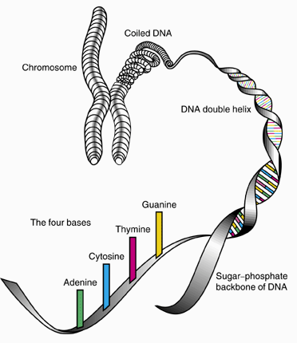
TASK
Review the following concepts:
  Genes and DNA
  Allele
  Genetic similarity and heritability
  Evolution
  Gene expression
  Epigenetics
  Methylation

Slide 3

Study one gene and its link to behaviour
5-HTT gene
  Serotonin transporter gene
  Regulates the reuptake of serotonin at brain synapses
  Partially determines how strongly stressful events will influence depressive symptoms

Slide 4
TASK
Review the Caspi et al (2003) study from your memos and/or from page 291
  How does the 5-HTT gene influence depressive behaviour?
Review the Chiao and Blizinsky (2010) study from your memos and/or from pages 291–292
  How is the 5-HTT gene associated with cultural factors?
  How does this study contribute to the idea
  of gene-environment interaction?

Slide 5
Study one gene and its link to behaviour
Kendrell et al (2005)
  Replication of Caspi et al (2003)
  Random sample of 549 adult twins
  Interview regarding stressful life events
  (SLEs) and reference to statistical data with computer algorithm
  Individuals with short alleles at the 5-HTT gene were more sensitive to the depressing effects of all SLEs than were those with long alleles
  Variation at the 5-HTT moderates the sensitivity of individuals to the depressing effects of SLEs

Slide 6

TASK
Review the research methods for twin and kindship studies from your memos and/or from page 98

Slide 7

TASK
Review Bouchard & McGue (1981), Kendler et al (2015) and Scarr & Weinberg (1983) studies from your memos and/or from pages 100-104
  What do they tell you about the genetic similarity concerning intelligence?
Study genetic similarity for one behaviour

Slide 8

TASK
Review the Curtis, Aunger and Rabie (2004) and Fessler et al. (2005) studies from your memos and/or from pages 111–112 and the teacher’s additional materials
  How can disgust be explained with the theory of evolution?
Study one example
of evolutionary
explanation for
one behaviour

Slide 9
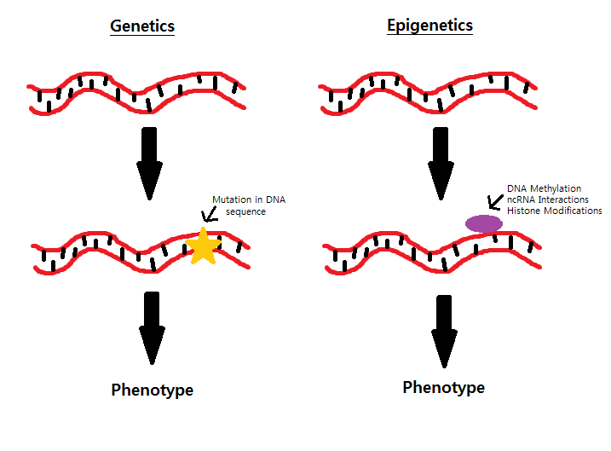
EXTRA TASK?
Review the Weaver et al. (2004) and Kaminsky et al. (2008) studies from your memos and/or from pages 105–106
  What do the studies tell you about epigenetics?
Are these needed for the revised syllabus?

Slide 10
Picture sources
Chromoseme-DNA <https://science.howstuffworks.com/life/genetic/designer-children1.htm> Accessed 10th of November 2017.
DNA <https://www.fearofflying.com/library/the-5-htt-gene/> Accessed 13th of February 2020.
Twins <http://www.redflagnews.com/headlines/identical-twin-studies-prove-homosexuality-is-not-genetic> Accessed 11th of November 2015.
Smart head/brain <https://www.quickanddirtytips.com/education/science/5-simple-ways-to-boost-our-intelligence> Accessed 13th of February.
Disgust <http://pixar.wikia.com/wiki/Disgust> Accessed 10th of October 2017.
Genetics and epigenetics <http://studentblogs.med.ed.ac.uk/reproductive-systems-group-2/introduction/> Accessed 9th of October 2018.

