Slide 1
REVIEWING THE WHOLE BIOLOGICAL APPROACH
(Dec 2019 syllabus revision)
IB Psychology LAJM

Slide 2

TASK
Read the sample responses the teacher has handed out in different parts of the classroom
  Carefully internalise the essential features of a the grade 7 responses

Slide 3
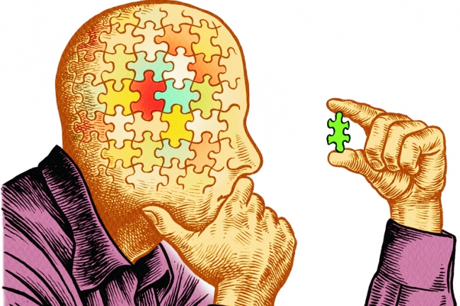
CRITICAL THINKING HUB
Review the content, theories and studies with the critical thinking in mind
  Use teacher’s materials in peda.net
See how critical thinking has been
implemented in the sample essays

Slide 4
CRITICAL THINKING HUB
The contribution of research methods used in the biological approach to understanding human behaviour
Ethical considerations in the investigation of the biological approach to understanding human behaviour
What are the key content, terms and theories related to these topics ?
What are the possible studies that could be addressed with these topics?

Slide 5
Picture sources
Memory lapse <https://www.brainhq.com/brain-resources/memory/memory-lapses/> Accessed 26th of October 2020.
Critical thinking puzzle <https://www.chronicle.com/article/Beyond-Critical-Thinking/63288> Accessed 10th of February 2019.

