Slide 1
FACTORS INFLUENCING DIAGNOSIS (18IB revision)
IB Psychology LAJM

Slide 2
TASK
”Normality versus abnormality”
Review the main contents of this topic from pages 257–261
Pay close attention to the different approaches concerning abnormality
Review at least TWO studies that can be applied with the topic

Slide 3
TASK
Read the sample response to the question ”Discuss normality and abnormality”
After reading the response, pay attention to the examiner’s comments
How could these responses be improved?
Make amendments

Slide 4
TASK
”Classification systems”
Review the main contents of this topic from pages 262–265
Focus on DSM
Review at least TWO studies that can be applied with the topic

Slide 5
TASK
Read the sample response to the question ”Evaluate the use of classification systems in the diagnosis of abnormal behaviour”
After reading the response, pay attention to the examiner’s comments
How could these responses be improved?
Make amendments

Slide 6
TASK
”The role of clinical biases in diagnosis”
Review the main contents of this topic from pages 280–287
Pay close attention to the different variables
Review at least TWO studies that can be applied with the topic

Slide 7
Past question
Discuss the role of two or more clinical biases in diagnosis (M19)
How would you answer this essay question?
Create sketch responses
Compare your ideas to the markscheme

Slide 8
TASK
Read the sample response to the question ”Discuss one or more clinical biases”
After reading the response, pay attention to the examiner’s comments
How could these responses be improved?
Make amendments

Slide 9
TASK
”Validity and reliability of diagnosis”
Review the main contents of this topic from pages 270–279
Pay close attention to the key concepts
Review at least TWO studies that can be applied with the topic

Slide 10
TASK
Read the sample response to the question ”Discuss the validity and reliability of diagnosis”
After reading the response, pay attention to the examiner’s comments
How could these responses be improved?
Make amendments

Slide 11
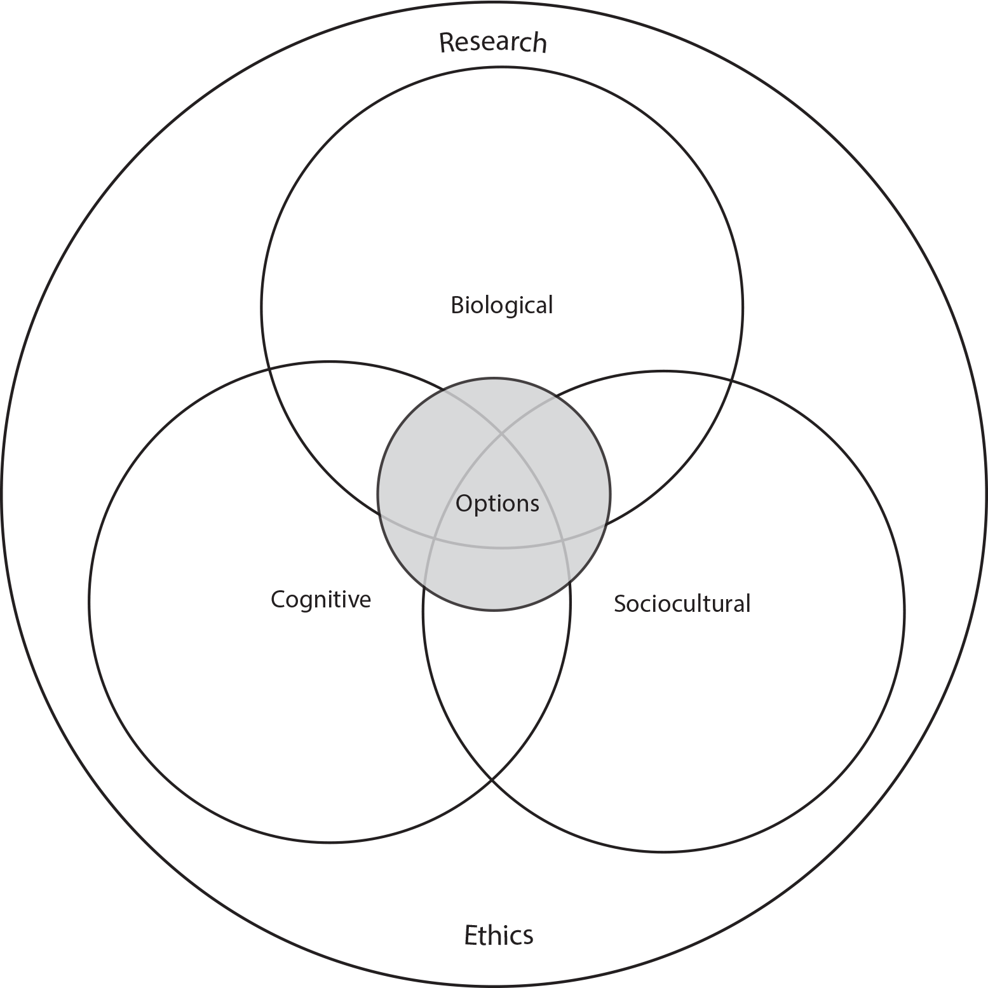
TASK
How do the different approaches of IB Psychology syllabus manifest themselves in Factors influencing diagnosis?

Slide 12
TASK
Read the sample response to the question ”Discuss a sociocultural approach to understanding factors in diagnosis”
After reading the response, pay attention to the examiner’s comments
How could these responses be improved?
Make amendments

