Slide 1
4.2 INTERPERSONAL RELATONSHIPS
IB Psyvhology LAJM

Slide 2
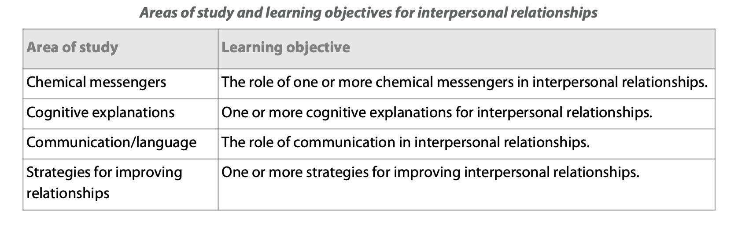
Interpersonal relationships

Slide 3

Interpersonal relationships
The role of relationships in human happiness cannot be underestimated

Slide 4

TASK
What is love?
  Try to give a definition
  What kind of components or dimension can be found in love?
  Use your personal experiences
Don’t use any assistive devices or materials!

Slide 5
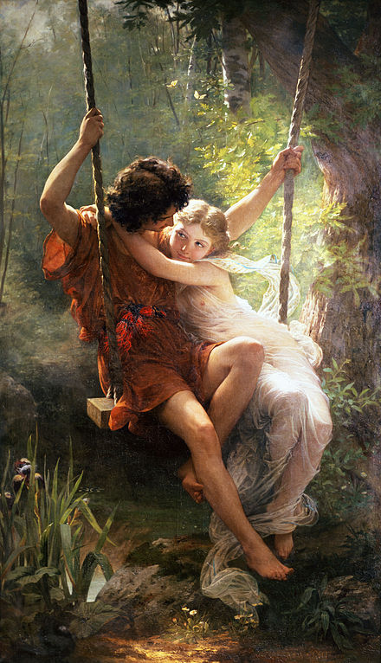
Love
Familial love (storge)
  Love between a parent and a child
Friendly love (philia)
  Love between friends
Romantic love (eros)
  Passionate love
Divine love (agape)
  Selfless love, charity

Slide 6
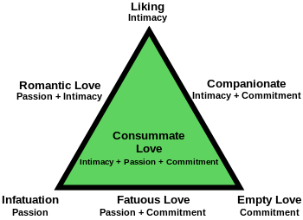
Love
Triangular theory of love (Sternberg, 1988)
  Descriptive theory of love
  Seem to be consistent with how people generally see love

Slide 7
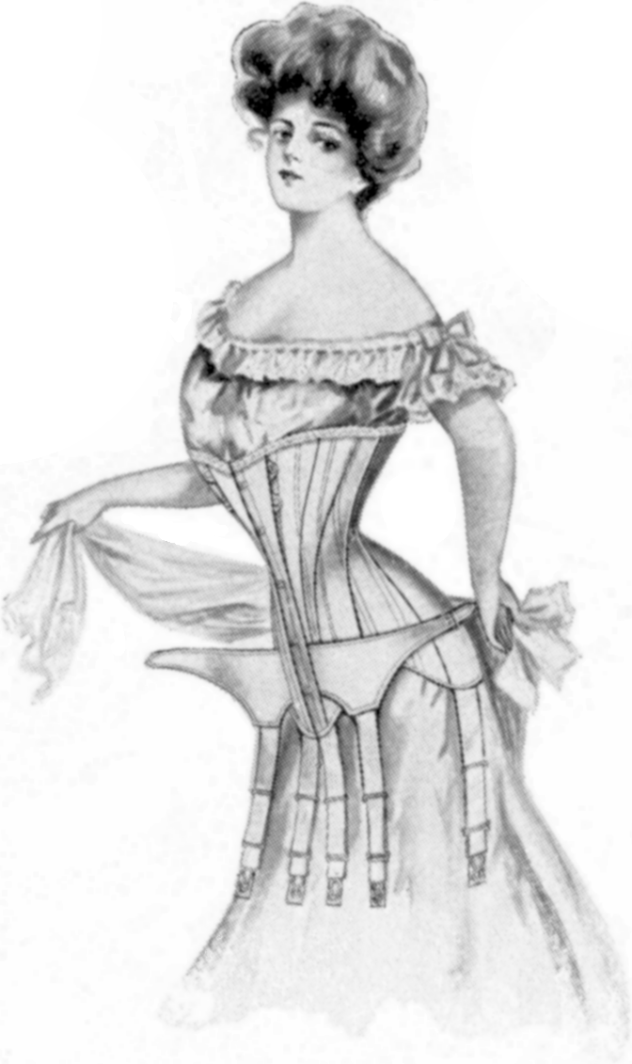
TASK
What kind of a male and female is attractive in your opinion?
  Form groups and compile a product where you present your ideals
  Are there any differences between male and female preferences?

Slide 8
Love
Buss (1989)
  Does gender play a role in the determination of desirable characteristics in a mate?
  Over 10 000 participants in 37 cultures filled out questionnaires
Female preferences:
  Financial capacity
  Ambition and industriousness
  Older male
Male preferences:
  Physical attractiveness
  Youth
SUPPORTS EVOLUTIONARY THEORY OF MATE SELECTION

Slide 9
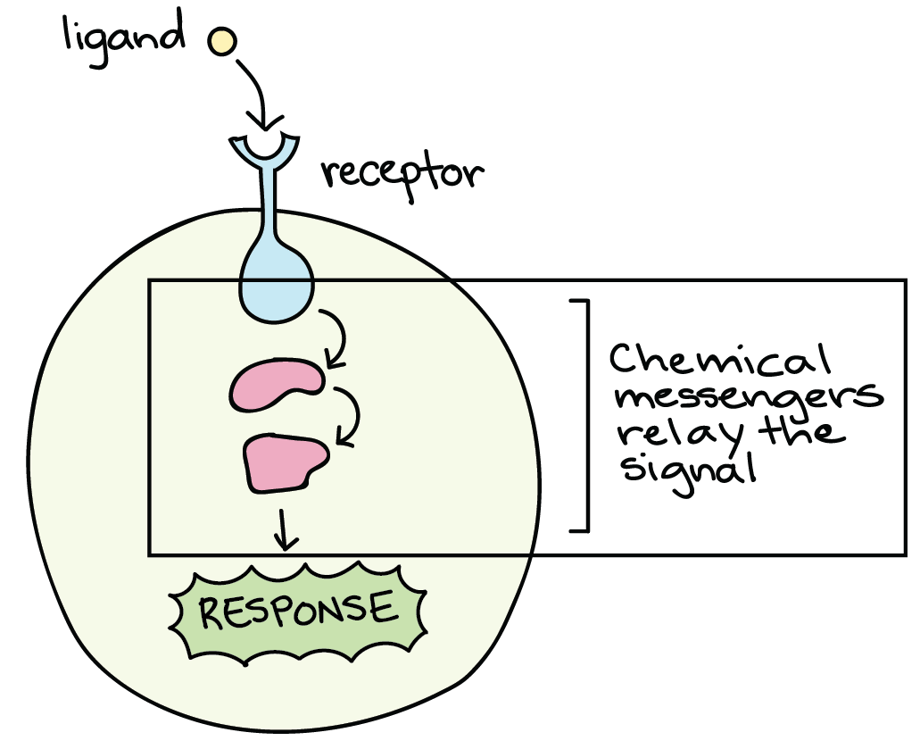
Chemical messengers
Transmit a message from one body cell to another
  Neurotransmitters
  Hormones
  (Pheromones)

Slide 10
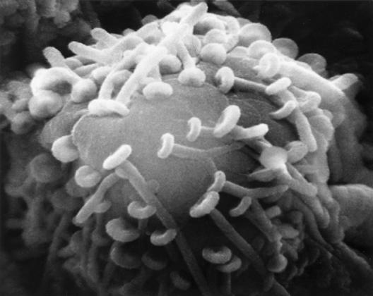
REVIEW
What was meant by neurotransmitters and neurotransmission?
Volunteers will come to the whiteboard to make a summary

Slide 11
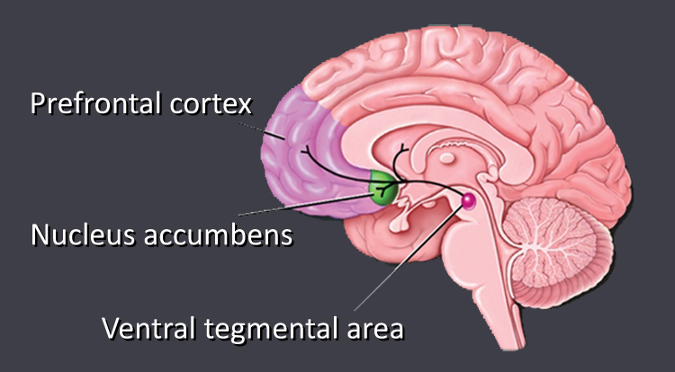
Chemical messengers
Dopamine
  A neurotransmitter (and a hormone) involved in motivational behaviour like pleasure and reward-seeking and addictive behaviour
  Released in the brain’s reward system

Slide 12
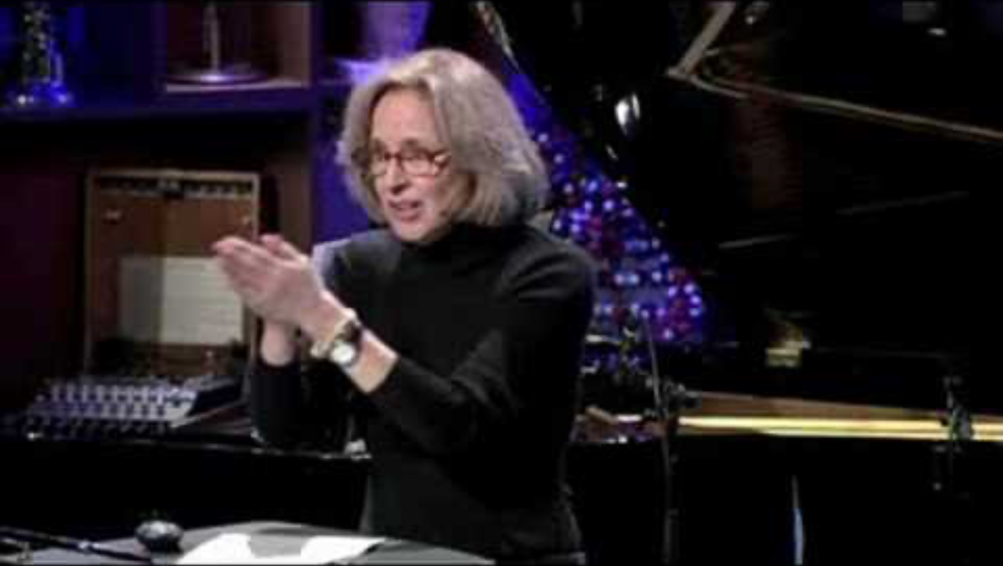
Chemical messengers

Slide 13

Chemical messengers
According to Fisher, Aron and Brown (2006), romantic love is based on three functions:
  Sex drive
  Attraction
  Partner attachment

Slide 14
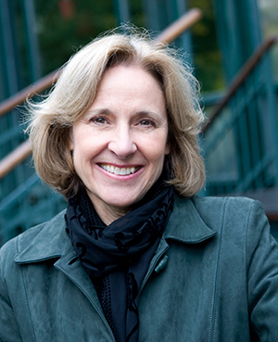
TASK
Read about the role of dopamine in attraction (romantic love) from teacher’s supplementary materials
  Make a summary of the key contents and Fisher, Aron and Brown (2005) in your own words

Slide 15
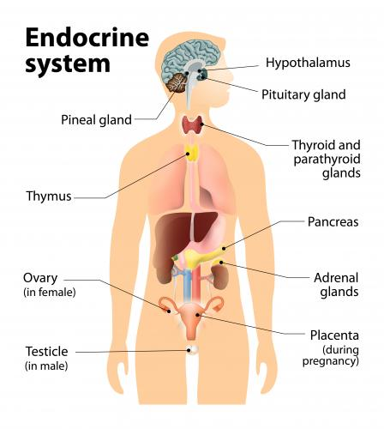
Chemical messengers
Hormones are chemicals that are produced by the glands that make up the endocrine system

Slide 16
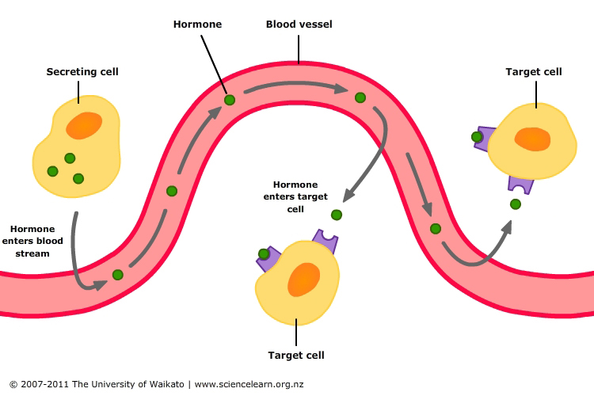
Chemical messengers
Hormones are secreted by the endocrine system into the bloodstream and carried by the blood to all parts of the body
Hormones act on specific target cells based on the lock-and-key action

Slide 17
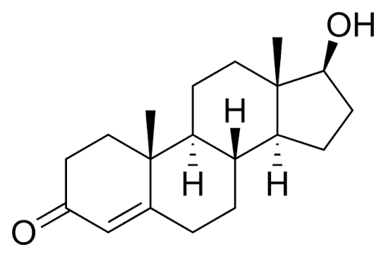
Chemical messengers
Hormones influence slower than neurotransmitters, but the effect lasts longer
Same chemical can be either a hormone or a neurotransmitter depending on where the chemical is in the body
Testosterone

Slide 18
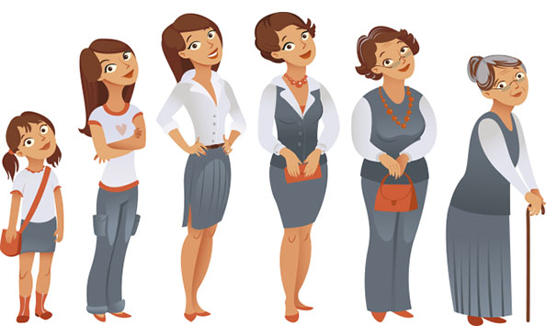
Chemical messengers
Main effects of hormones:
  Physical growth and maturation
  Metabolic processes
  Stress and activation level
  Sexual maturation and arousal

Slide 19
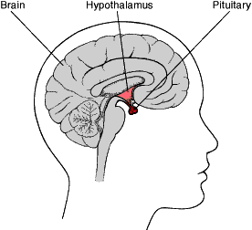
Chemical messengers
Oxytocin
  A hormone and a neurotransmitter involved in social bonding, sexual activity and childbirth
  Produced in hypothalamus and secreted by pituitary gland

Slide 20
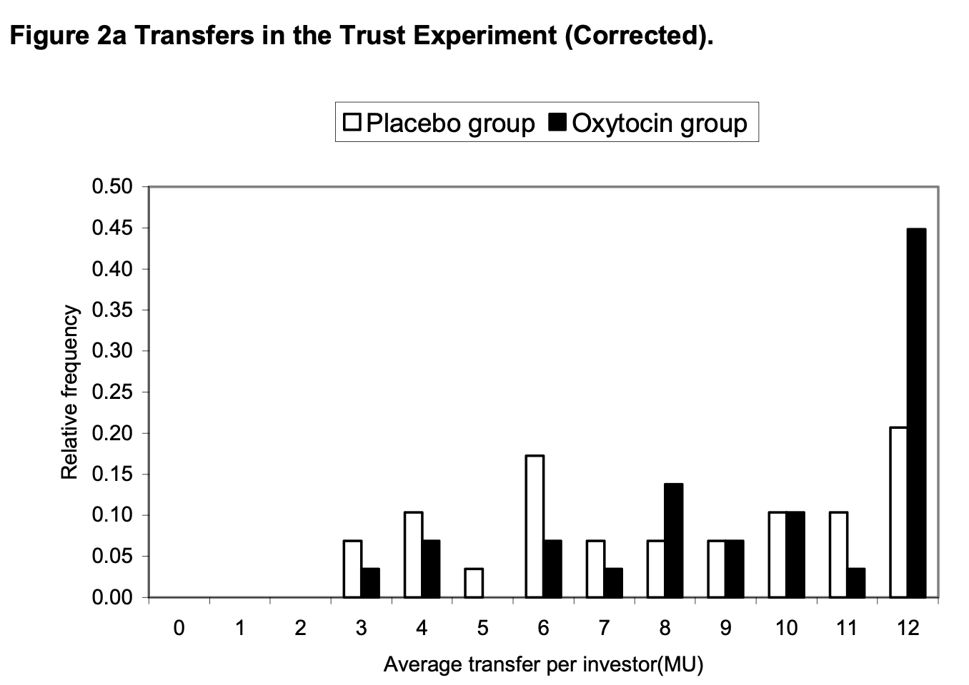
Chemical messengers
Kosfeld et al. (2005)
  True experiment with random allocation of 194 male students into either oxytocin or placebo group
  Participants played a trust game with real monetary stakes
  Oxytocin increased trust

Slide 21
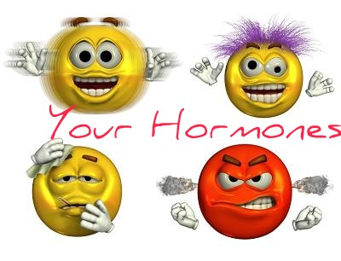
TASK
Read Baumgartner et al. (2008) and Ditzen et al. (2009) from teacher’s supplementary materials
  What do these studies tell you about the role of oxytocin in trust?

Slide 22
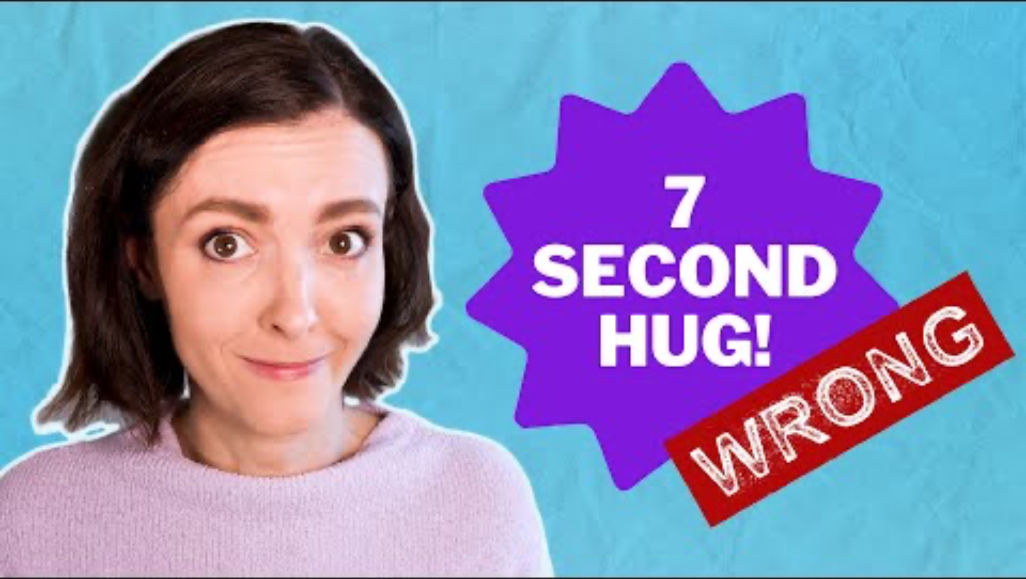
Chemical messengers

Slide 23
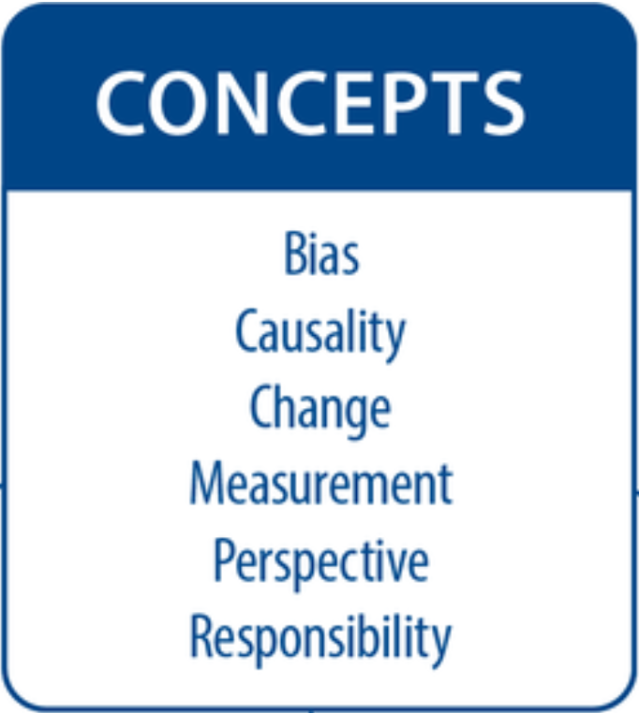
TASK
Teacher divides you into six groups
Each group revolves through six checkpoints and contributes to concept maps based on the Role of chemical messengers in interpersonal relationships

Slide 24

Cognitive explanations
Cognitive models suggest that our perceptions, judgements, and mental processes play a key role in interpersonal relationships

Slide 25

Cognitive explanations
Similarity-attraction-hypothesis (Byrne, 1971)
  People are more attracted to those who share their attitudes, values, and beliefs

Slide 26

Cognitive explanations
Why similarity increases attraction?
  Social validation
  Reduced uncertainty
  Smoother communication
  Emotional ease

Slide 27
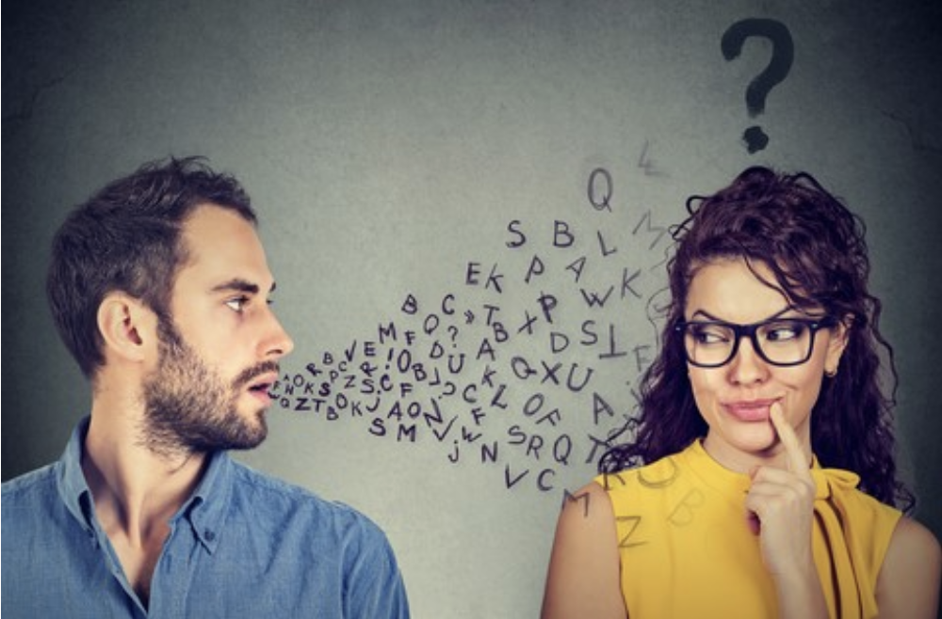
TASK
Read Markey and Markey (2007) from teacher’s supplementary materials
  Is the similarity-attraction-hypothesis supported by this study?

Slide 28
Cognitive explanations
Mere exposure effect (Zajonc, 1968)
  People tend to develop a preference for things simply because they are familiar with them
Why familiarity increases attraction?
  Familiar things are processed more fluently
  Reduction of uncertainty
  Positive cognitive associations
  Implicit memory

Slide 29
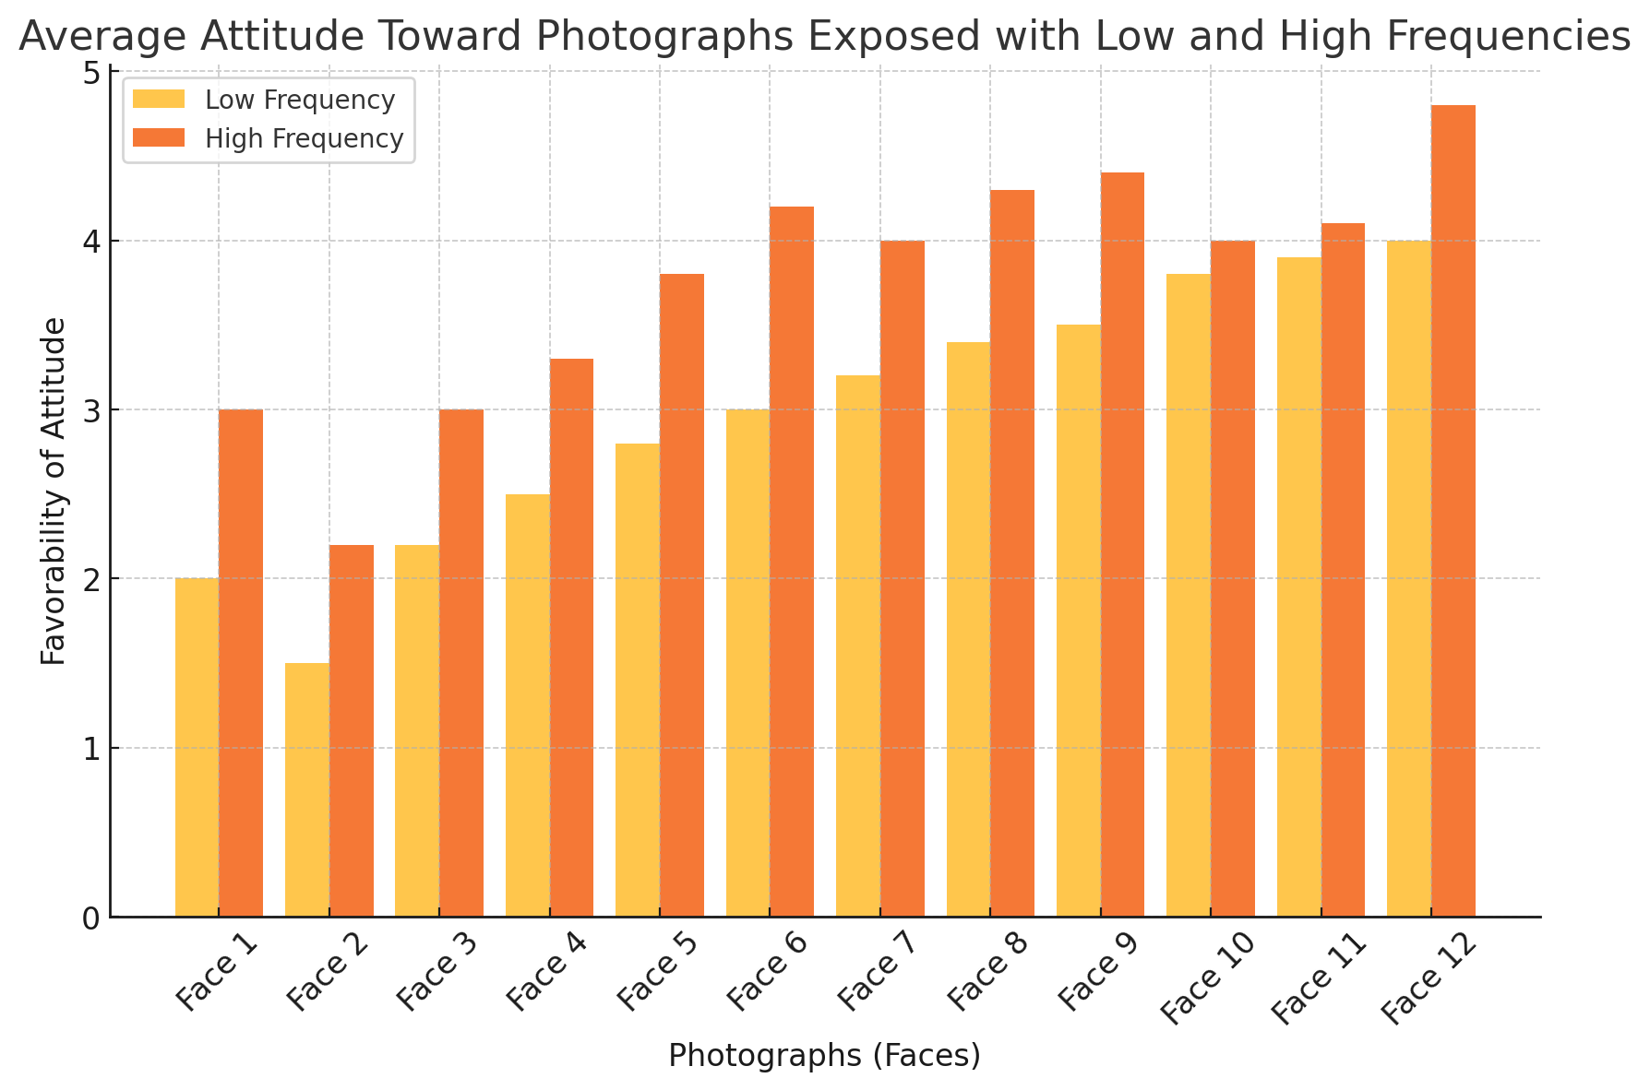
Cognitive explanations
Zajonc (1968)
  Participants were told they were taking part in a study of ”visual memory”
  Participants were shown photos of faces for two seconds per face
  Two groups had different frequencies of the photos

Slide 30

TASK
Read Moreland and Beach (1992) from teacher’s supplementary materials
  What kind of evidence does this study provide for the mere exposure effect?

Slide 31
RESEARCH: Types of experiments
Laboratory experiment
  Conducted in highly controlled, artificial conditions
Field experiment
  Conducted in real-life setting
E.g. Zajonc (1968)
E.g. Moreland and Beach (1992)

Slide 32

REVIEW
What was meant by schema theory and dual processing theory?
Volunteers will come to the whiteboard to make a summary of both theories

Slide 33

TASK
Read Kognity 4.2.1 and study how schema theory and dual processing theory can explain interpersonal conflict
  Summarize the main points in your own words

Slide 34
TASK
Teacher divides you into six groups
Each group revolves through six checkpoints and contributes to concept maps based on the Cognitive explanations

Slide 35
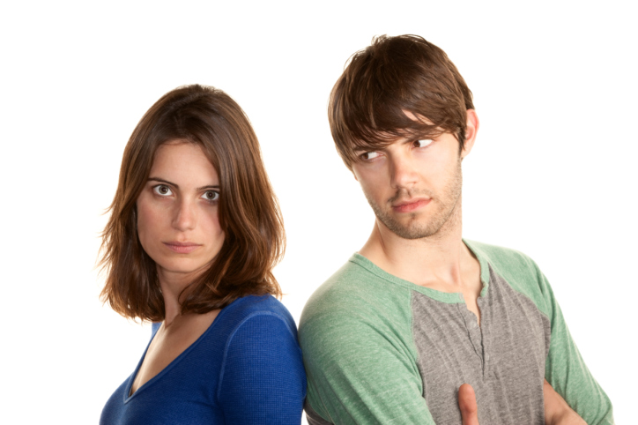
Communication and language
Communication is the foundation of all interpersonal relationships
  It is not just what we say but how we say it

Slide 36
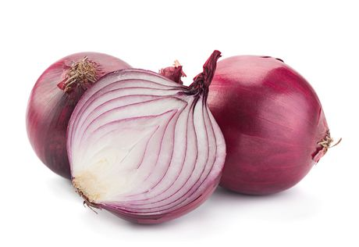
Communication and language
Social penetration theory (Altman & Taylor, 1973)
  Close relationships develop from a shallower level to more intimate level through self-disclosure

Slide 37
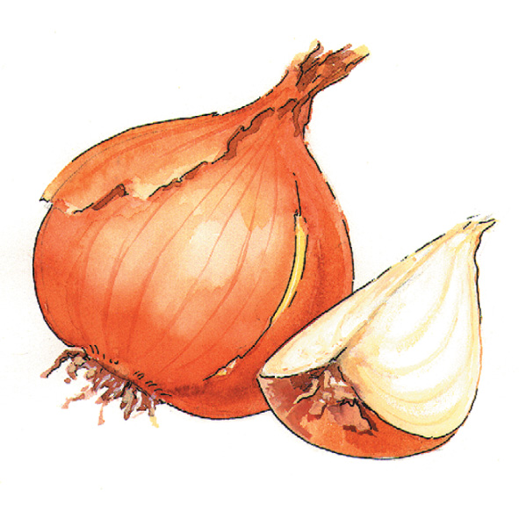
TASK
Read “How can communication reduce conflict?” from Kognity 4.2.2
  Summarise the four stages of social penetration theory in your own words

Slide 38

TASK
Read Sprecher and Hendrick (2004) from teacher’s supplementary materials
  What kind of evidence does this study provide for the social penetration theory?

Slide 39
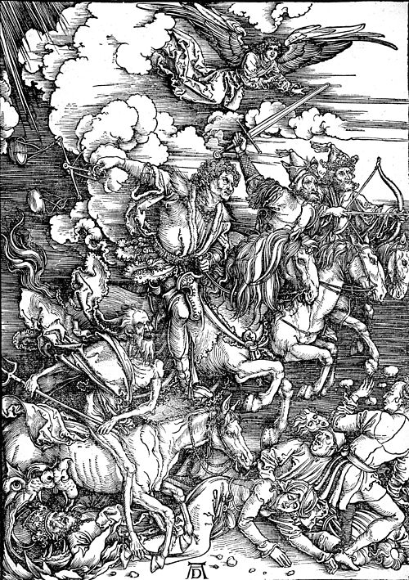
Communication and language
Four horsemen of the Apocalypse (Gottman)
  Four destructive communication patterns in interpersonal relationships
  (1) Criticism
  (2) Contempt
  (3) Defensiveness
  (4) Stonewalling

Slide 40
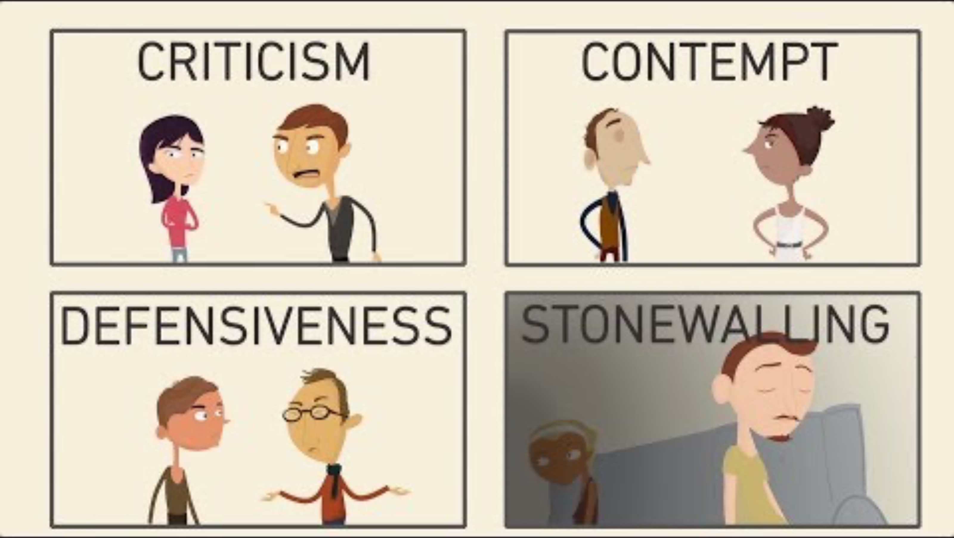
Communication and language

Slide 41
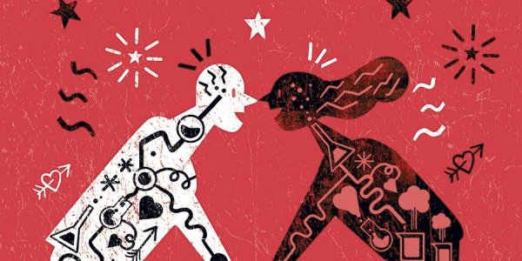
Strategies for improving relationships
Strategies for improving relationships usually overlap with communication and language in interpersonal relationships

Slide 42
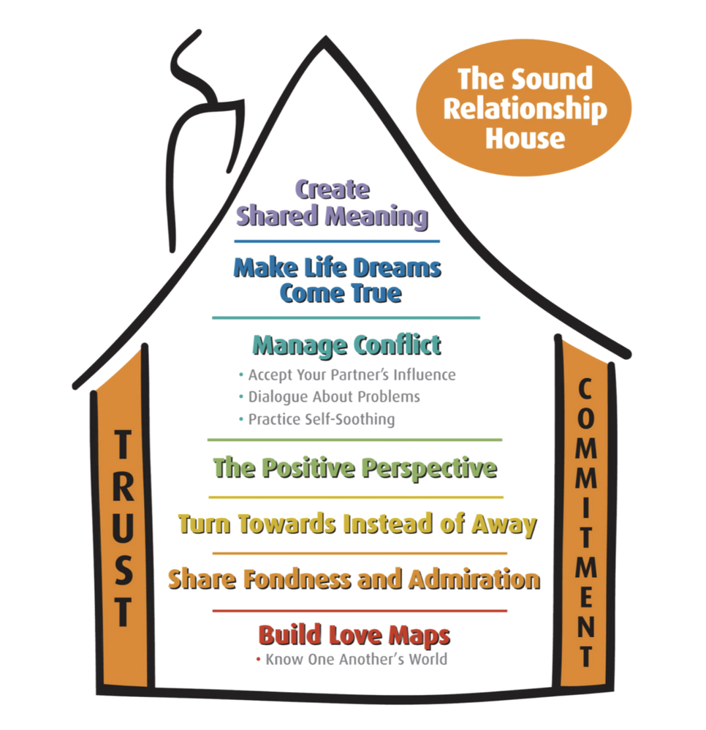
Strategies for improving relationships
Sound relationship house theory (Gottman)
  Two ”weight-bearing walls” always hold the couple together
  The seven ”floors” represent key components in a stable and strong relationship

Slide 43

Strategies for improving relationships
Sound relationship house theory is applied in Gottman method
couples’ therapy
  YOU communication: blaming the partner
  for something
  I communication: expressing one’s own feelings

Slide 44
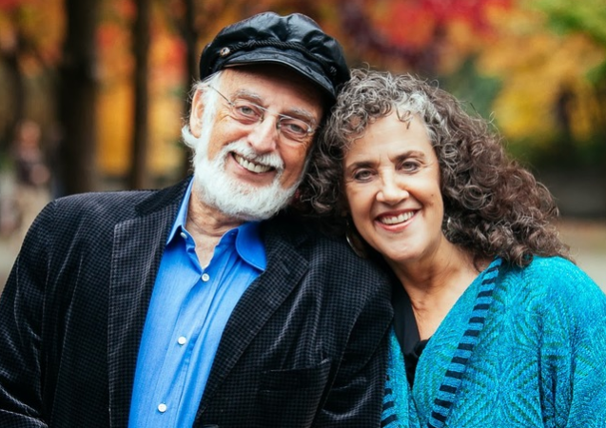
TASK
Role-play marriage counselling
Split into groups of three
  One will be a counsellor, and two other will be a married couple with a ”problem”
Apply Gottmans’ theories in your witty dialogue
  Utilise the teacher’s handout

Slide 45
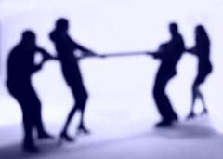
Strategies for improving relationships
Realistic group conflict theory (Cambell, 1965)
  If groups have opposite goals and compete for limited resources, inter-group conflict arises

Slide 46

TASK
Read Kognity 4.2.2 and read more about realistic group conflict theory and Sherif’s Robber’s Cave studies (1954/61)
  How do the studies support realistic group conflict theory?

Slide 47
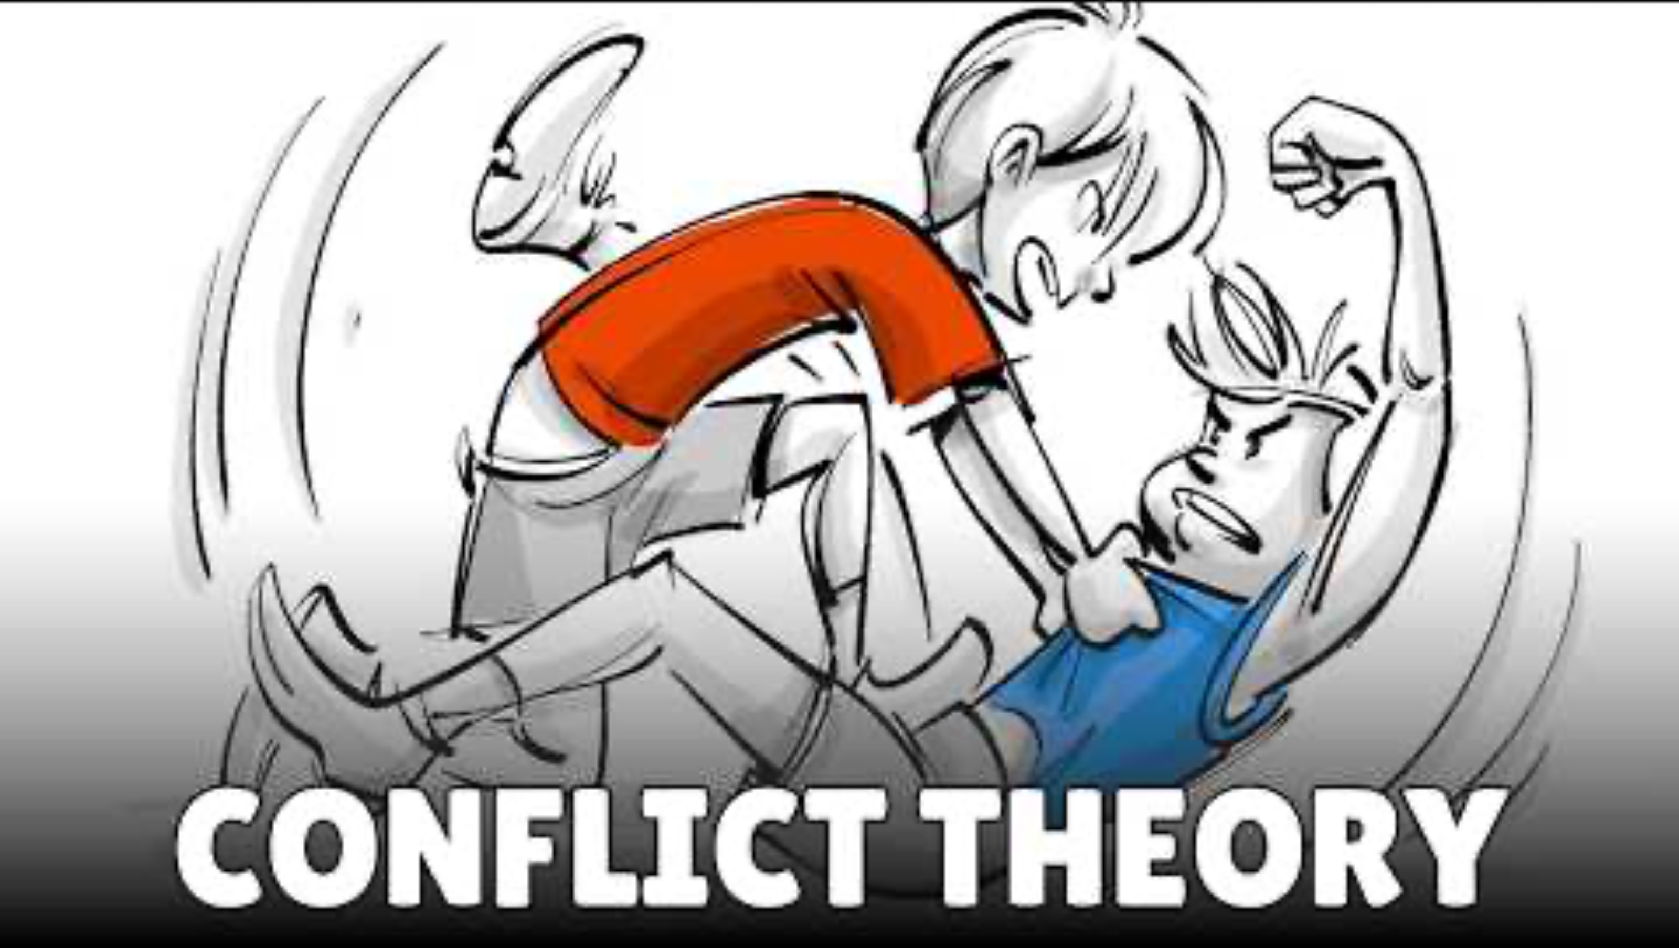
Strategies for improving relationships
How can subordinate goals resolve conflict?

Slide 48
REVIEW
What was meant by social identity theory (SIT)?
Volunteers will come to the whiteboard to make a summary of the theory

Slide 49
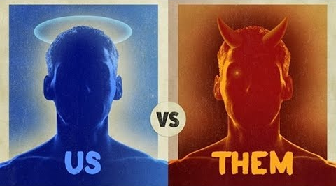
TASK
Review social identity theory (SIT)
  How do the Sherif’s Robber’s Cave studies support SIT?
  What kind of alternative explanation can SIT provide in comparison to realistic group conflict theory?

Slide 50

Strategies for improving relationships
Sabido method
  Using means of mass media to promote prosocial behaviour
  Based on SLT

Slide 51
TASK
Teacher divides you into six groups
Each group revolves through six checkpoints and contributes to concept maps based on the Communication and language and Strategies for improving relationships

Slide 52
Picture sources
Couple cooking <https://pixabay.com/fi/nainen-keittiö-mies-1979272/> Accessed 13th of November 2017.
Love character <http://weclipart.com/japanese+love+clipart> Accessed 13th of November 2017.
Spring <https://en.wikipedia.org/wiki/Eros_(concept)> Accessed 17th of April 2018.
Trianglar theory of love <https://en.wikipedia.org/wiki/Triangular_theory_of_love> Accessed 13th of November 2017.
Woman in corset <https://commons.wikimedia.org/wiki/File:CorsetStyles1909-1910p06A.png> Accessed 16th of April 2018.
Chemical messenger <https://organismalbio.biosci.gatech.edu/chemical-and-electrical-signals/intro-to-chemical-signaling-and-signal-transduction/> Accessed 15th of August 2026.
Synapse <http://163.178.103.176/CasosBerne/1aFCelular/Caso4-2/HTMLC/CasosB2/Receptor/Ch6.html> Accessed 30th of August 2017.
Brain’s reward system <https://knowingneurons.com/2012/10/31/the-reward-pathway-reinforces-behavior/> Accessed 16th of September 2020.
Helen Fisher <http://www.greatthoughtstreasury.com/author/helen-fisher> Accessed 16th of April 2018.
Helen Fisher 2 <https://seniorplanet.org/planet-talk-love-chemistry-expert-helen-fisher/senior-planet-helen-fisher/> Accessed 18th of April 2018.
Endoctrine system <https://www.thinglink.com/scene/855137537176371200> Accessed 9th of November 2017.
Brain with pituitary gland <http://www.cushings-help.com/pituitary.htm> Accessed 2nd of December 2015.
Hormones in bloodstream <https://www.sciencelearn.org.nz/resources/1836-hormonal-control-of-digestion> Accessed 9th of November 2017.
Adrenalin <https://fi.wikipedia.org/wiki/Adrenaliini> Accessed 2nd of December 2015.
Woman’s life-cycle <http://www.omaplus.fi/?s=artikkelit&p=108> Accessed 2nd of December 2015.
A couple in love <https://mielenihmeet.fi/oksitosiini-rakkauden-ja-onnellisuuden-hormoni/> Accessed 15th of August 2026.
Your hormones <http://www.aloewellnessdc.com/2014/10/16/hormone-testing-for-wellness/> Accessed 2nd of December 2015.

Slide 53
Picture sources
Similar couple <https://www.psychologytoday.com/gb/blog/the-attraction-doctor/201709/does-similarity-lead-to-attraction-and-compatibility> Accessed 19th of August
Similar friends <https://www.cocomore.com/blog/similarity-attraction-effect-why-same-wavelength-between-brand-and-customer-promises-success> Accessed 19th of August
Ideal couple <https://thinkib.net/psychology/page/52634/cognitive-theories-of-attraction> Accessed 19th of August
Zajoc (1968) <https://thinkib.net/psychology/page/52634/cognitive-theories-of-attraction> Accessed 19th of August Women at lecture <https://thinkib.net/psychology/page/52634/cognitive-theories-of-attraction> Accessed 19th of August
Be Kind – Kognity

