Slide 1
HEALTH AND WELL-BEING
HL EXTENSIONS
IB Psychology LAJM

Slide 2
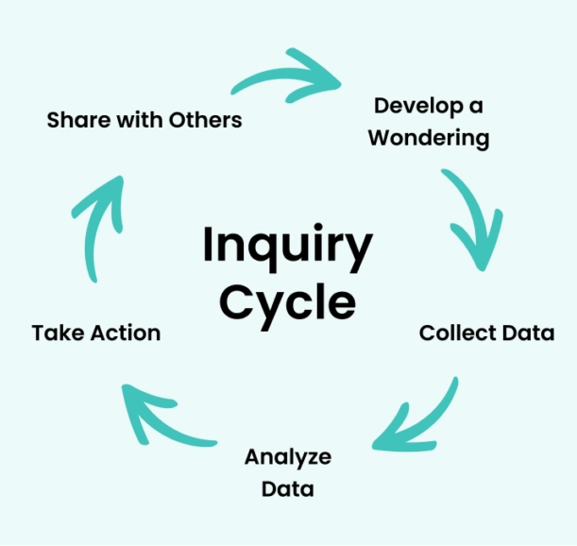
About the HL extensions
HL extensions for each context are:
  (1) Culture
  (2) Motivation
  (3) Technology
HL extensions are based on inquiry learning

Slide 3
About the HL extensions
Teacher will give prompts to encourage students to investigate a topic under each context related to culture, motivation and technology
Students will explore, investigate, reflect and finally share their findings with the
whole class
  The findings will prepare the students for Paper 3

Slide 4

About the HL extensions
Paper 3 is focused on HL extensions and
data-analysis
In Paper 3 you will have a set of stimulus materials that reflect HL extensions and where data-analysis is applied

Slide 5

HL extensions in health and well-being
Culture
  The role of culture in health and well-being
  The role of culture in diagnosing and treating mental health issues
  Cross-cultural comparisons of the prevalence of mental health issues

Slide 6
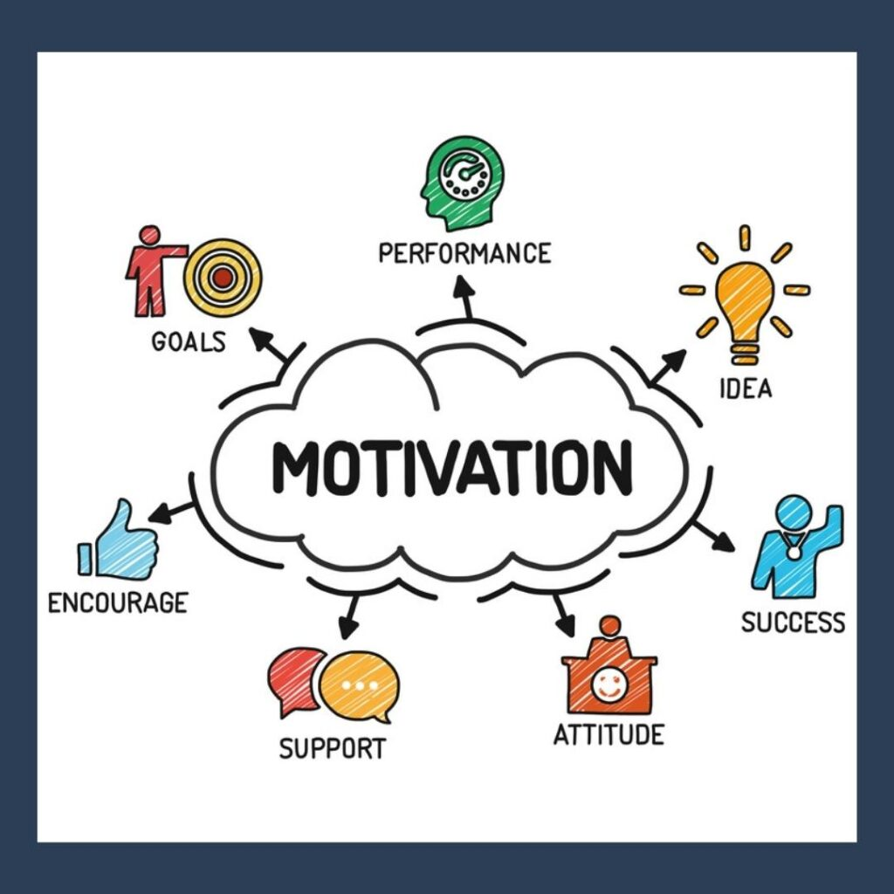
HL extensions in health and well-being
Motivation
  The different motivational theories underpinning the prevention or treatment of a health problem
  The role of motivation in changing behaviour

Slide 7

HL extensions in health and well-being
Technology
  The role of technology in assisting in the prevention or treatment of health problems.
  The role of technology on mental health problems
  The effectiveness of tele-therapy in the treatment of disorders

Slide 8
Culture in health and well-being
(1) If “healthy living” is culturally defined, are global health guidelines unintentionally promoting one culture’s values over others?
(2) If diagnostic manuals were written outside the West, how many current disorders would instantly vanish?
(3) Can we meaningfully compare mental‑health rates across cultures, or is the comparison itself a colonial act of forcing one culture’s categories onto another?
What could be your prompts?

Slide 9
Motivation in health and well-being
(4) Are motivational theories empowering tools, or pieces of fictions that preserve the illusion of rational agency?
(5) If motivation is so important, why do motivated people still fail to change? Are health professionals overemphasising motivation because it’s easier than addressing social inequalities?
What could be your prompts?

Slide 10
Technology in health and well-being
(6) Are health technologies empowering patients? Or is it quietly shifting responsibility from professionals to individuals?
(7) Is technology the new scapegoat for societal issues we refuse to address?
(8) Is tele‑therapy genuinely effective? Or are we normalizing it simply because it’s convenient and cost‑efficient?
What could be your prompts?

Slide 11
TASK
(1) Collect data/sources for each prompt
  Find both quantitative and qualitative sources
  Find examples of tables and graphs
(2) Analyse/interpret the data/sources you found relevant to the prompt
(3) What kind of arguments, counter-arguments and conclusions can you make?
(4) Prepare to share your insights with others
  Create PowerPoints with examples like in Paper 3

Slide 12
Extra tips for the inquiry
Keep the basic concepts in your mind and try to apply them to your inquiry
  Bias, causality, change, measurement, perspective and responsibility
Use the Kognity HL extension boxes as a starting point

Slide 13

Tips for culture
All inquiry questions related to culture can be linked with globalisation

Slide 14

Tips for motivation
Try to implement motivational theories
  Self-determination theory
  Maslow
  Theory of achievement motivation

Slide 15
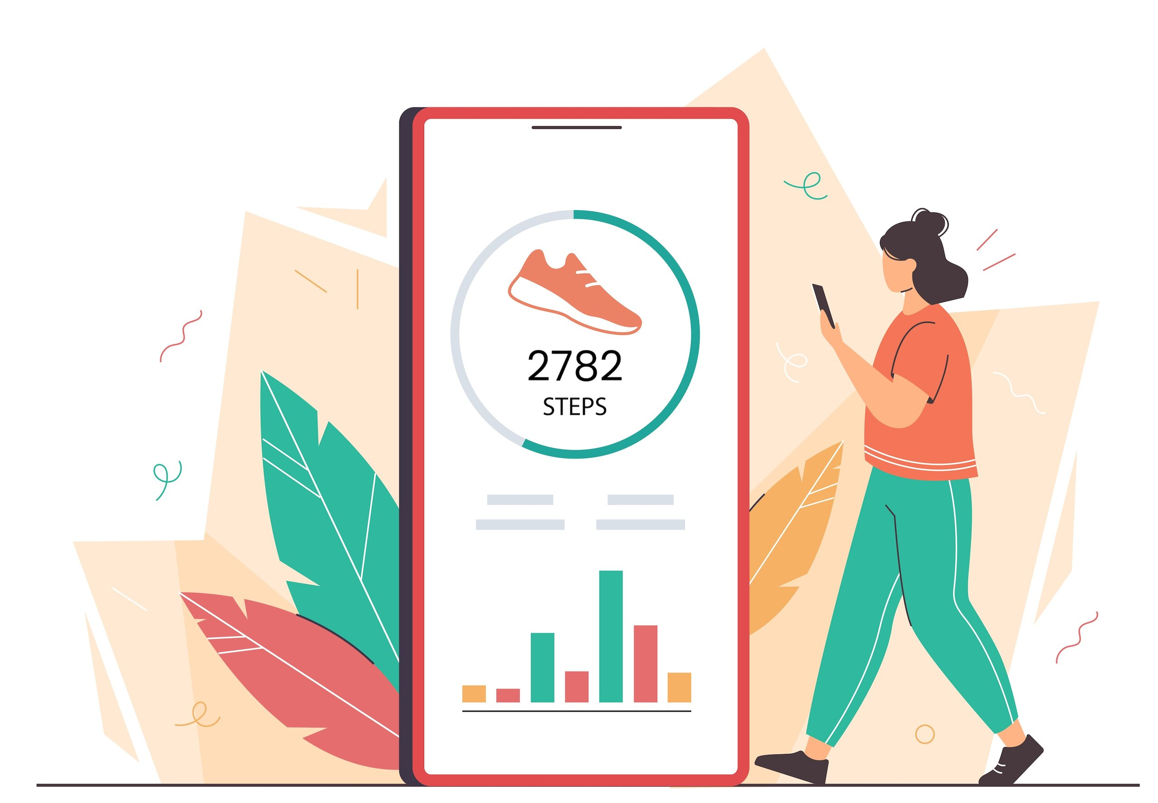
Tips for technology
Try to pinpoint specific technologies and/or applications to each inquiry question

Slide 16
Picture sources
Inquiry-based learning <https://www.clickvieweducation.com/en-au/blog/teaching-strategies/inquiry-based-learning> Accessed 2nd of October 2025.
IB logo <https://commons.wikimedia.org/wiki/File:International_Baccalaureate_Logo.svg> Accessed 2nd of October 2025.
Culture heart <https://www.linkedin.com/pulse/cultivating-work-culture-holistic-well-being-mental-health-mubaiwa> Accessed 25th of March 2026.
Motivation <https://www.protouchpro.com/guest-posts/cultivating-inner-drive-the-art-of-self-motivation/> Accessed 2nd of October 2025.
Digital learning tools <https://elearningindustry.com/the-top-benefits-of-digital-learning> Accessed 2nd of October 2025.
Globalization <http://www.mining.com/web/people-think-globalization-country/> Accessed 1st of October 2018.
Woman jumping <https://www.integrativenutrition.com/blog/2018/07/personal-independence-day> Accessed 7th of January 2026.
Step counter app <https://thinkib.net/psychology/page/60450/technology-exercise-apps> Accessed 2nd of April 2026.

