Slide 1
2.2 PREVENTION AND TREATMENT
IB Psychology LAJM

Slide 2
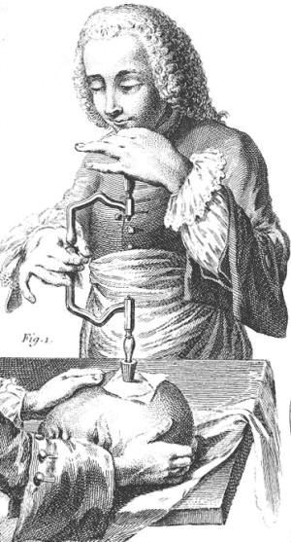
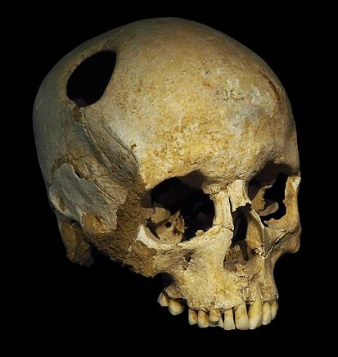
History

Slide 3
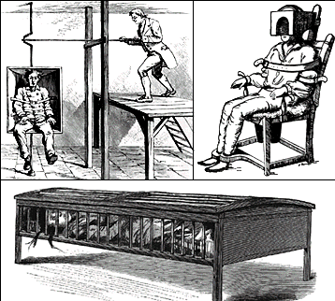
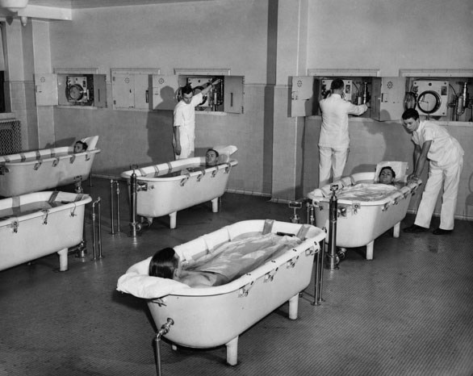
History

Slide 4
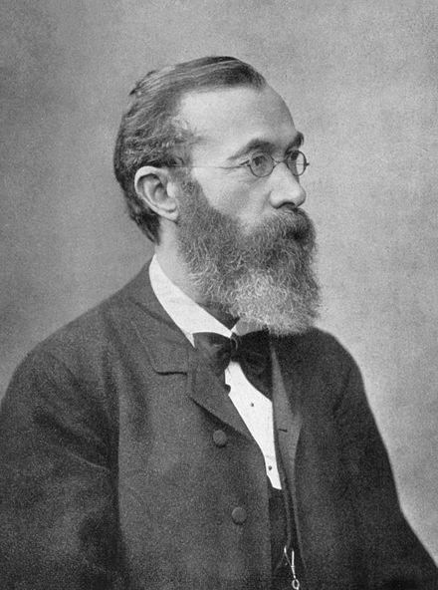
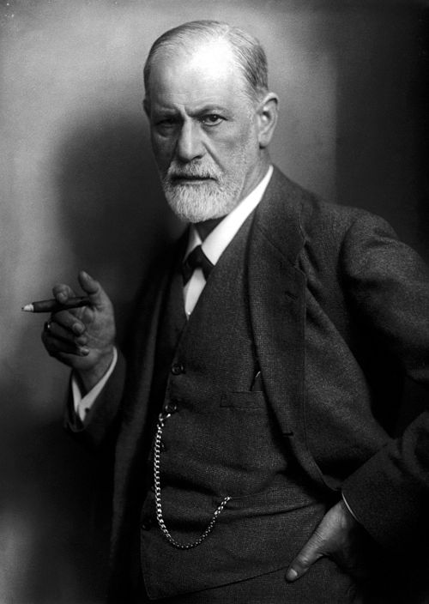
History

Slide 5
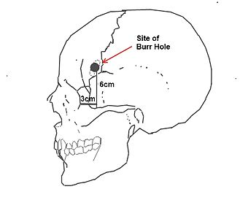
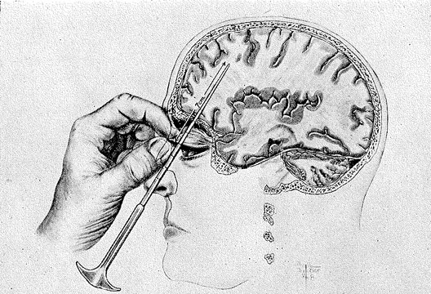
History

Slide 6
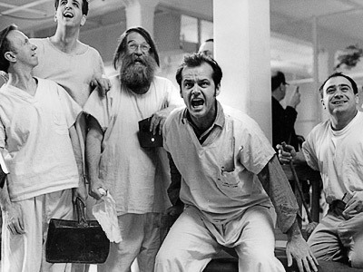
TASK
How should mentally ill be treated?
  What kind of practises and principles should be applied?

Slide 7
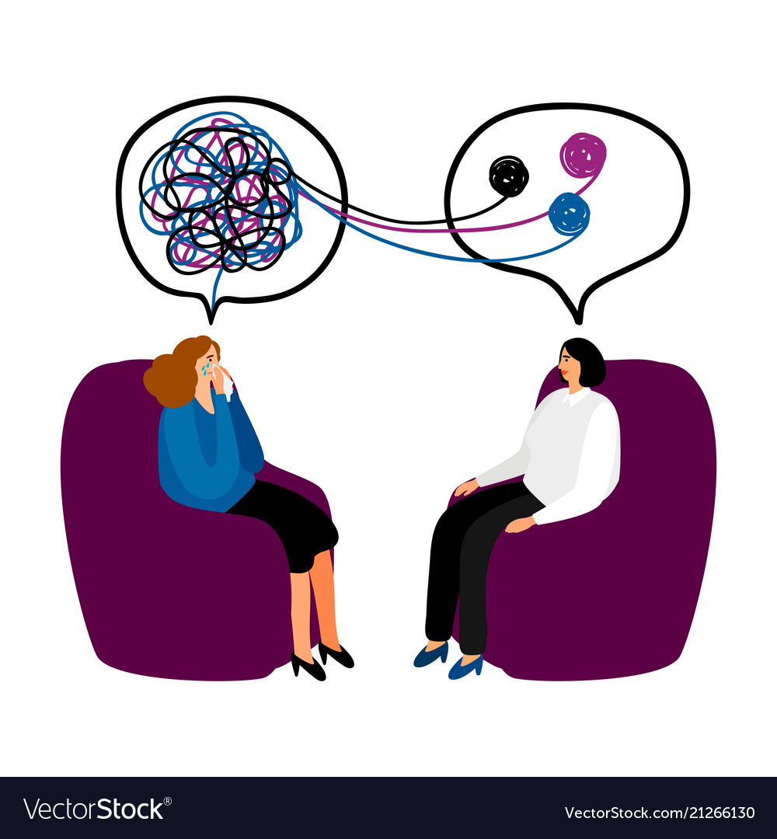
Modern treatment of disorders
Biological treatment
  Implementation of drugs and medical procedures
Psychological treatment
  Individual and group therapy

Slide 8
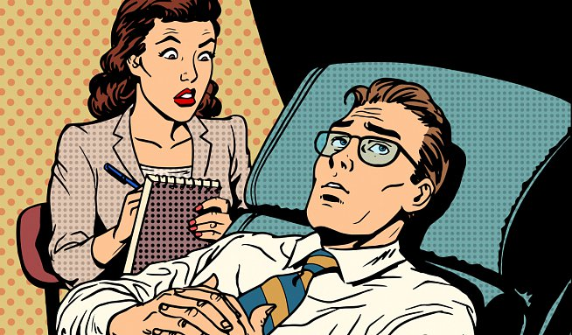
TASK
How can we assess the effectiveness of treatment?
  What kind of problems can arise?

Slide 9
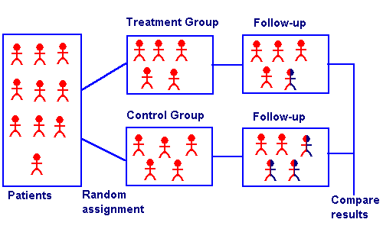
Assessing the effectiveness of treatment
Randomized
control trials
  Independent design experiments on the effectiveness of drugs and therapies

Slide 10
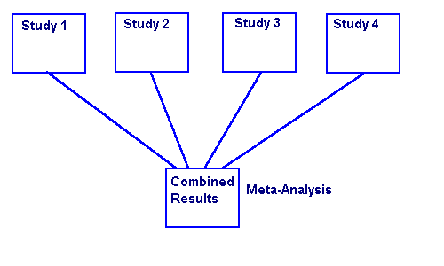
Assessing the effectiveness of treatment
Meta-analyses
  Statistical analysis of many existing studies

Slide 11

TASK
Read Kognity 2.2.1 and complement your notes on randomized control trials and meta-analyses
Moreover, study the following:
  Self-report measures
  Clinician admistered scales
  Response and remission rates

Slide 12
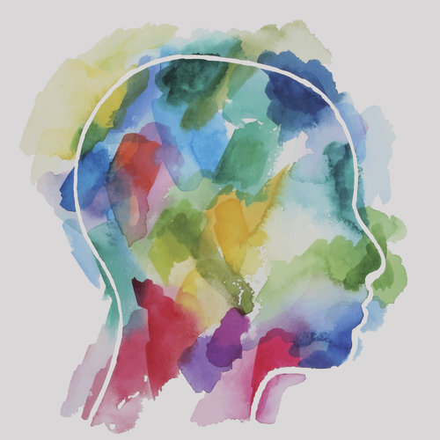
Assessing the effectiveness of treatment
Qualitative research
  Analysing the subjective experiences of the patients undergoing treatment

Slide 13

Social connection and depression
Social connection is one of the strongest protective factors against depression

Slide 14
Social connection and depression
Rosenquist, Fowler and Christakis (2011)
  Longitudinal questionnaire study
  with 12 067 participants
  Statistical analysis of the social networks of the participants
  93% more likely to be depressed if a direct friend was depressed
  43% more likely to be depressed if a friend’s friend was depressed
  37% more likely to be depressed if a friend’s friend’s friend was depressed
  Symptoms of depression may spread along social networks

Slide 15
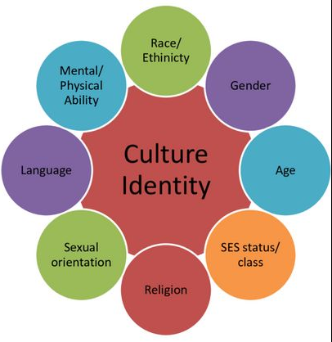
Culture and depression
Strong cultural identity may be a protective factor against depression (e.g. Brance, Chatziympyros and Bentall, 2023)

Slide 16

Culture and depression
Collectivistic culture may provide protection against depression
(e.g. Chiao and Blizinsky, 2009)
Even in individualistic cultures social support is a vital protective factor (e.g. Gariépy et al., 2018)

Slide 17
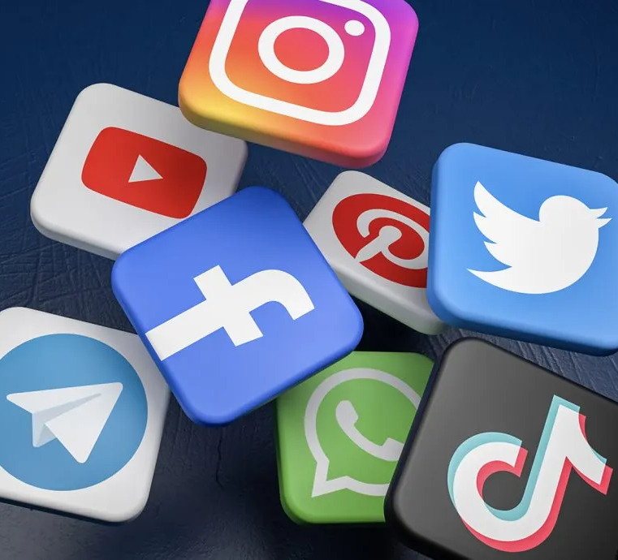
TASK
Can social media be protective factor against depression?
  Engage in conversation and try to find supporting arguments
Read ”Does social media protect against depression?” from Kognity 2.2.2 and summarize the main points in your own words

Slide 18

TASK
What kind of arguments can be presented for and against the use of antidepressants?
What kind of attitudes do you have related to antidepressants?

Slide 19
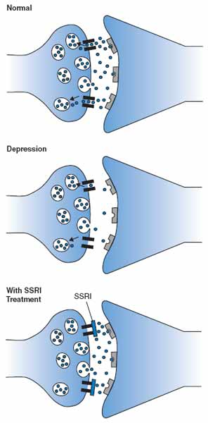
Biological treatment
Antidepressants
  Alter the number of certain neurotransmitters in the brain to restore chemical balance

Slide 20
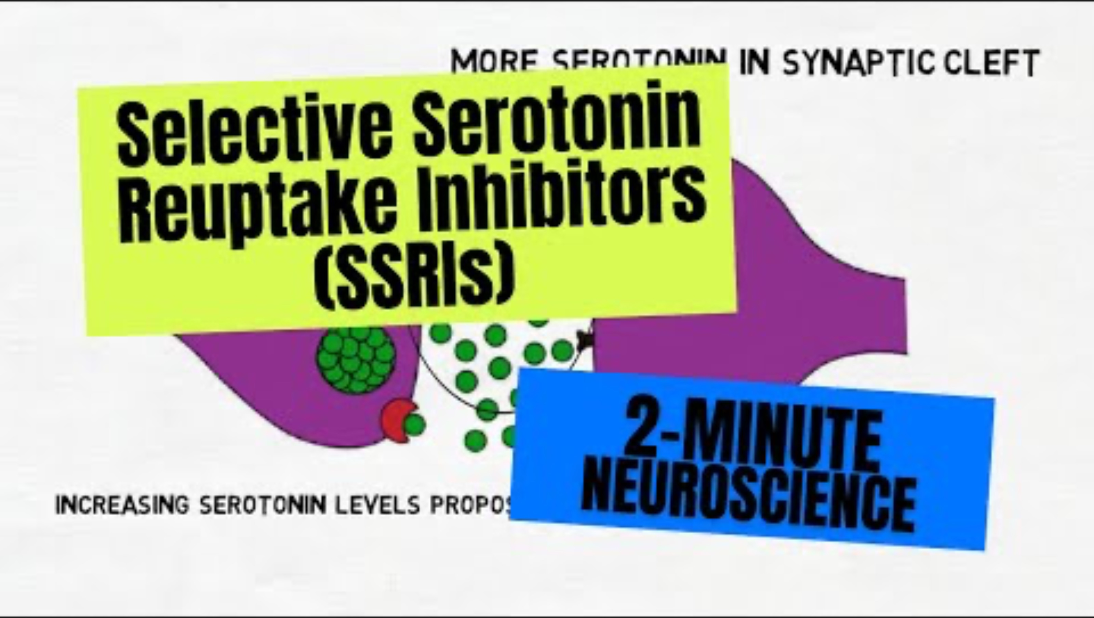
Biological treatment

Slide 21
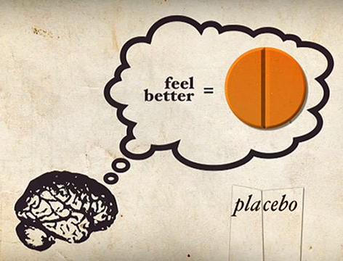
REVIEW
What was meant by placebo-effect?
  An effect based on beliefs and expectations, not caused by the actual treatment method

Slide 22
TASK
Read ”Antidepressants” from Kognity 2.2.4 and summarize the evidence in your own words
Pay attention to:
  Cipriani (2018)
  Jakobsen, Gluud and Kirsch (2020)
  Kirsch (2008)
  Reccia et al. (2022)
Did the evidence change your perspective on antidepressants?
What are the responsibilities of those who are marketing and prescribing antidepressants?

Slide 23
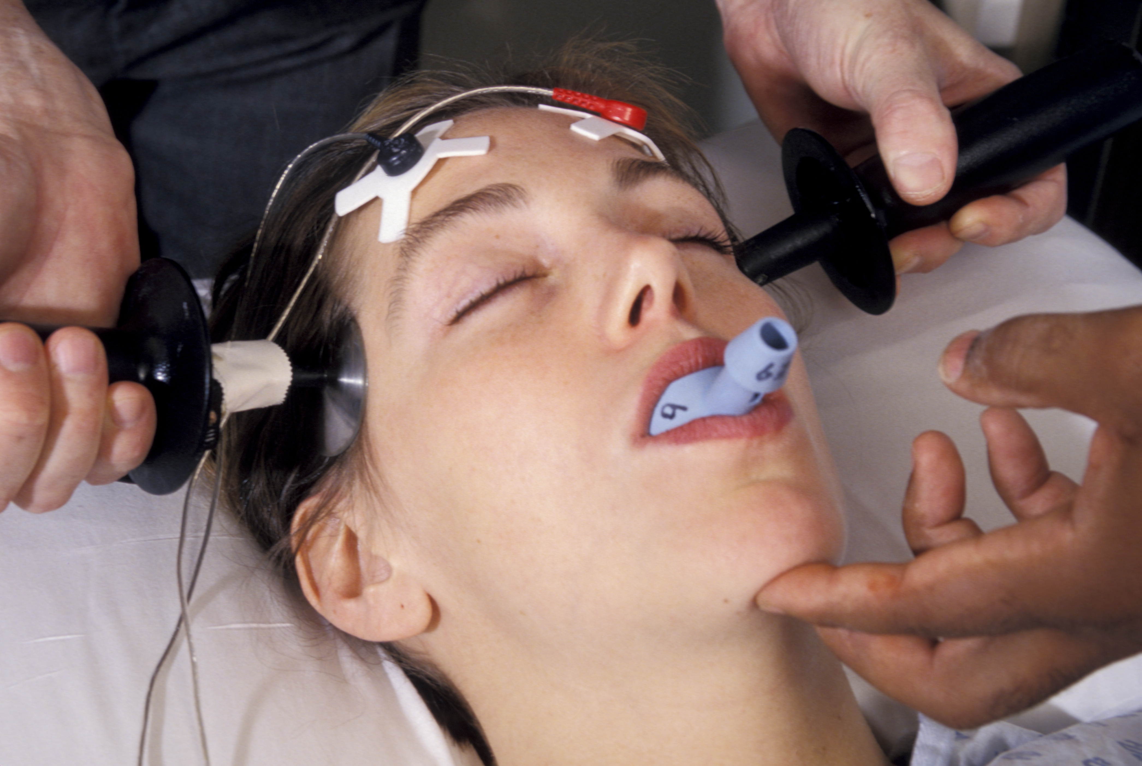
Biological treatment
Electroconvulsive therapy (ECT)
  Electrical currents are applied to trigger a brief seizure in the brain under general anesthesia

Slide 24
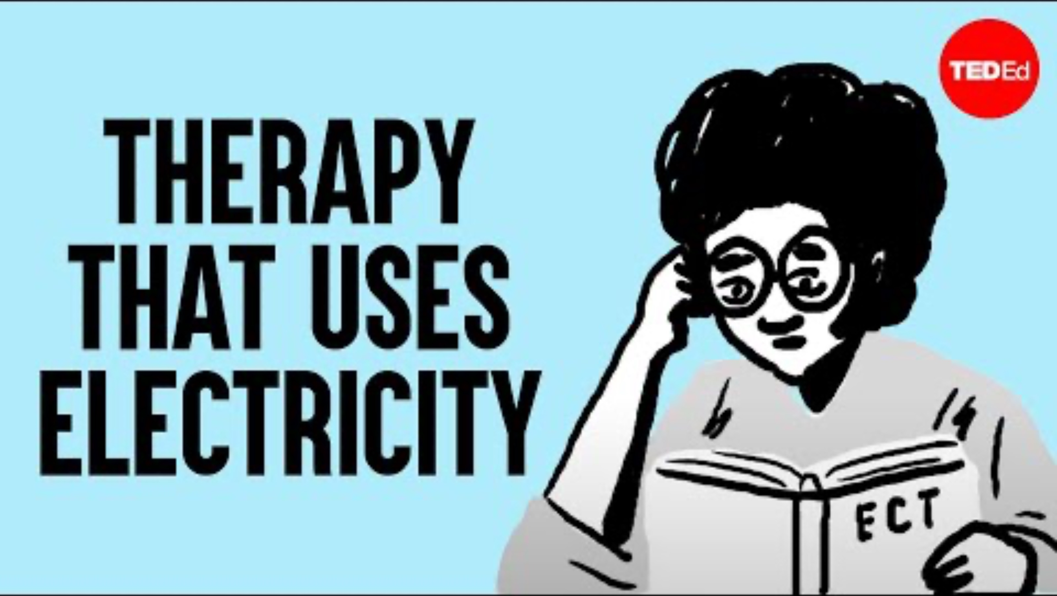
Biological treatment

Slide 25
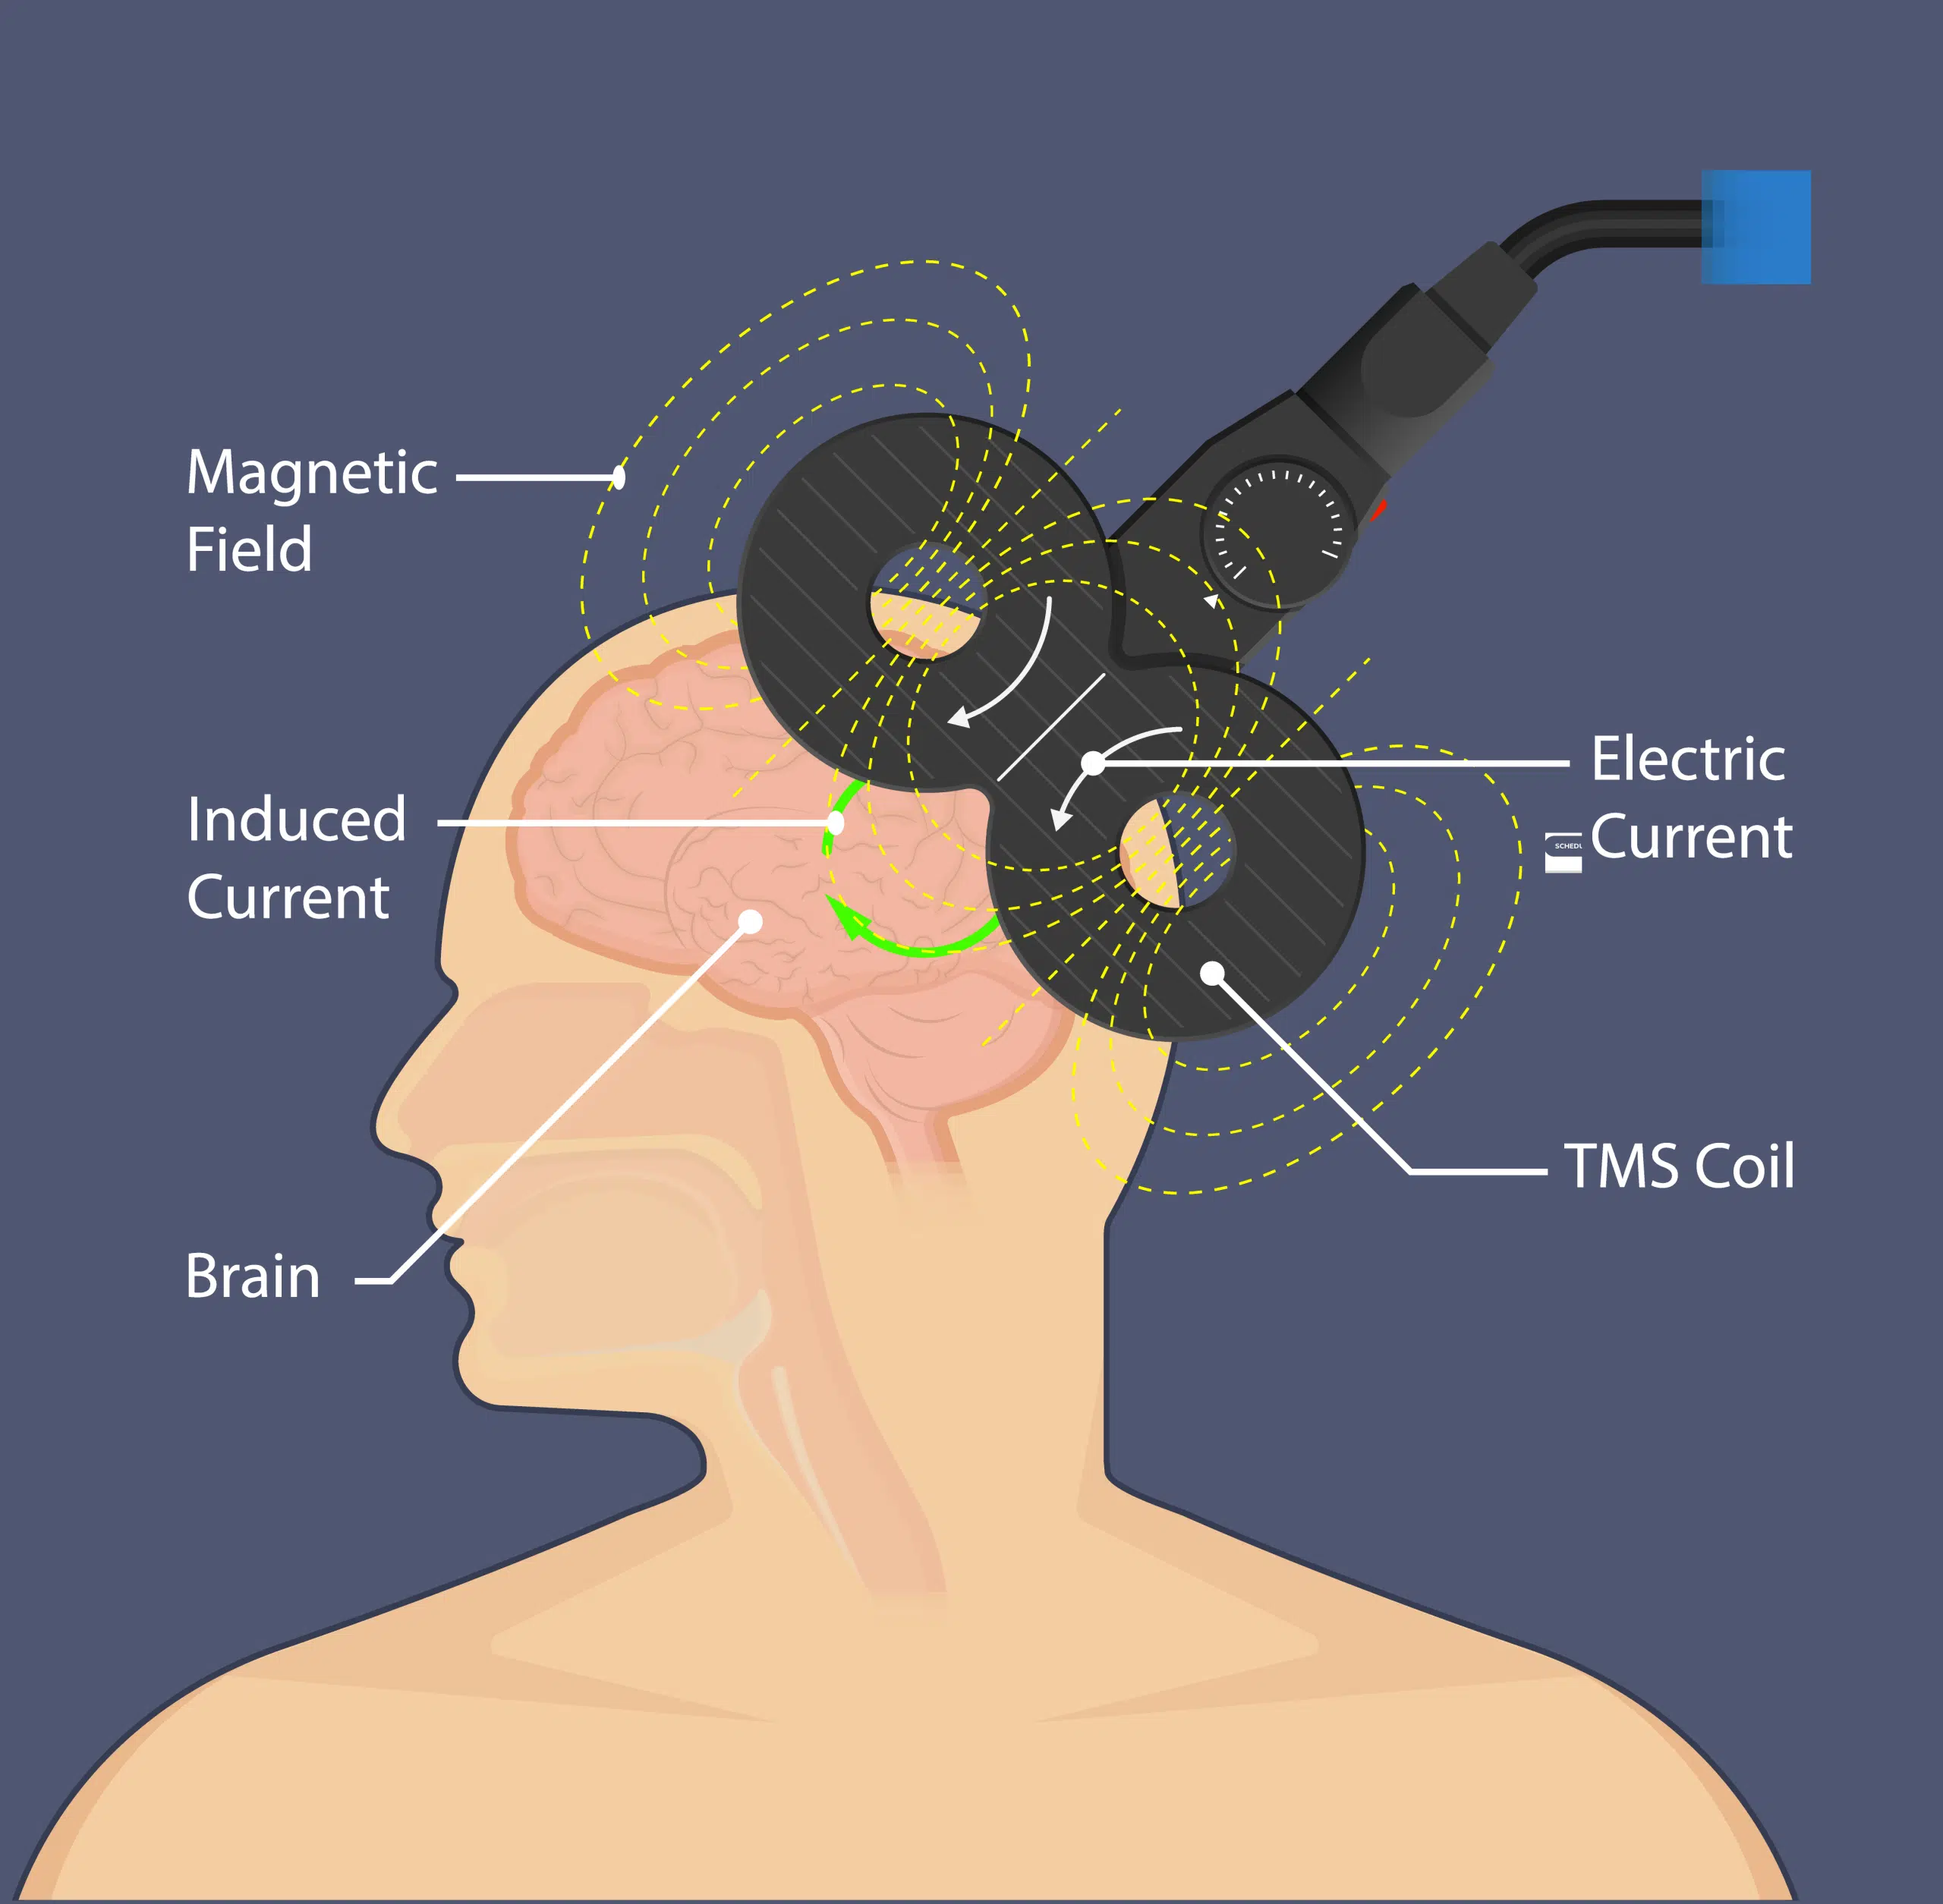
Biological treatment
Transcranial magnetic stimulation (TMS)
  Activating mood regulating parts of the brain with controlled magnetic pulses

Slide 26
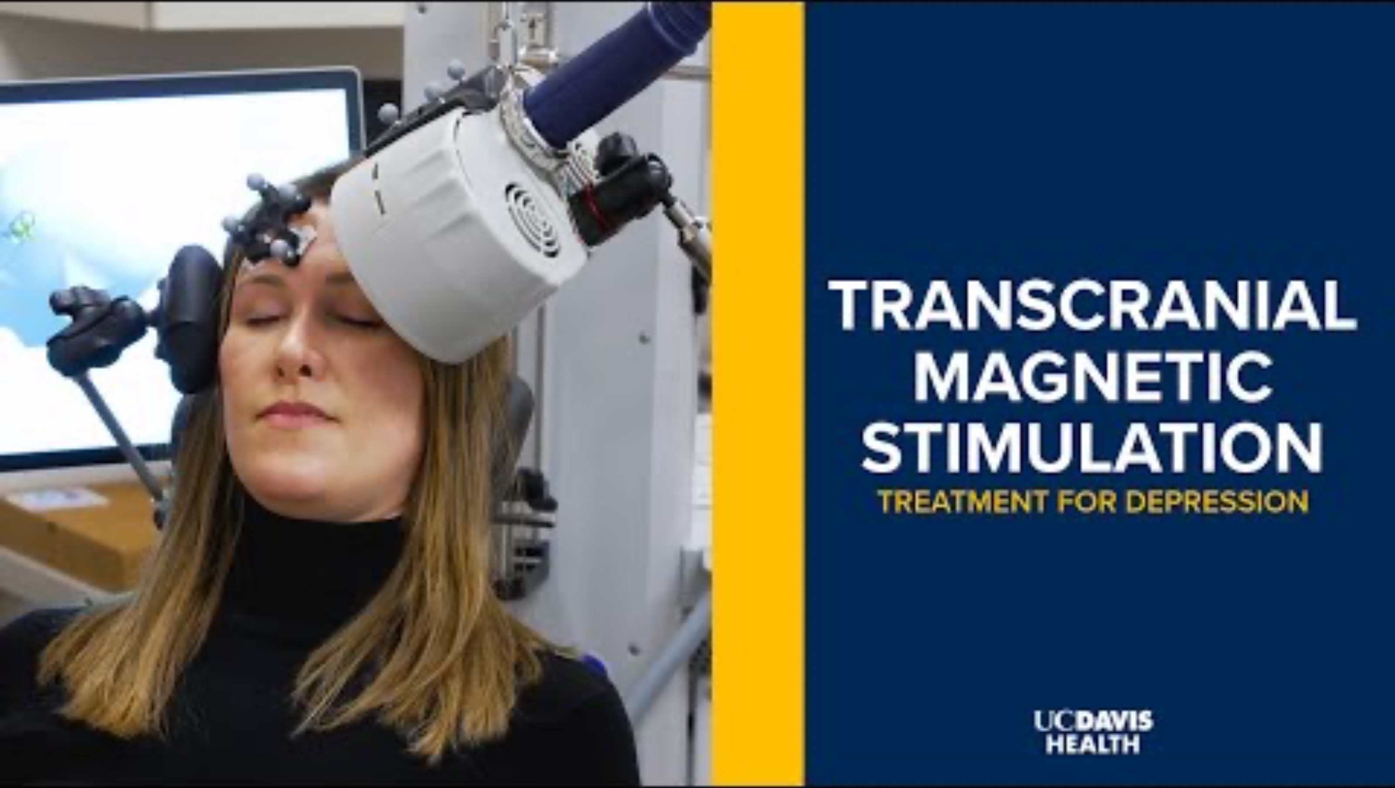
Biological treatment

Slide 27
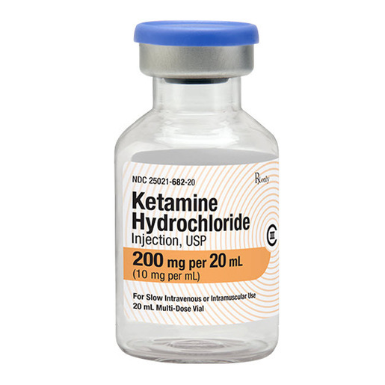
Biological treatment
Ketamine
  Anesthetic drug that stimulates glutamate production has promising prospectives (e.g. Anand et al., 2023)

Slide 28
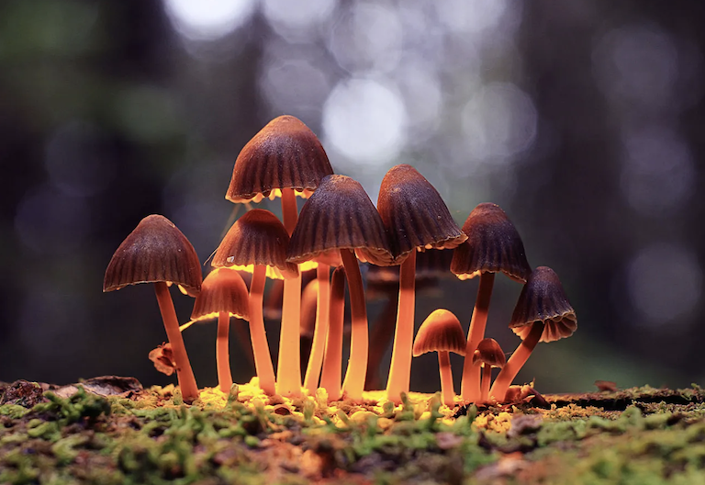
Biological treatment
Psilocybin
  ’Magic mushrooms’ that decrease the activity of amygdala and increase the resting state functionality of default mode network (DMN) have promising prospectives, too
  (e.g. Davis et al., 2020)

Slide 29

Biological treatment
Any activity that induce neuroplasticity in the brain may restore normal functioning of the default mode network (DMN)

Slide 30
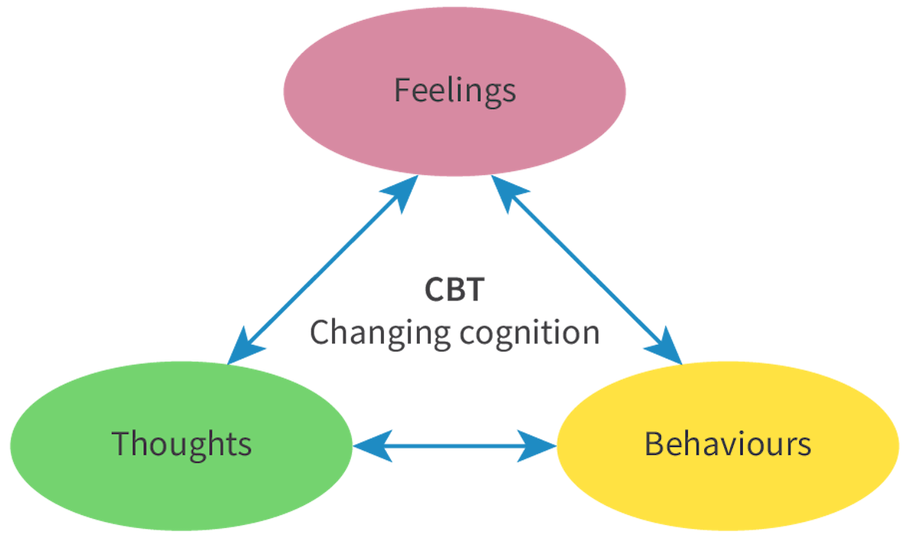
Psychological treatment
Cognitive behavioural therapy (CBT)
  Based on Aaron Beck’s theory of depression
  Key components are cognitive restructuring and behavioural activation

Slide 31
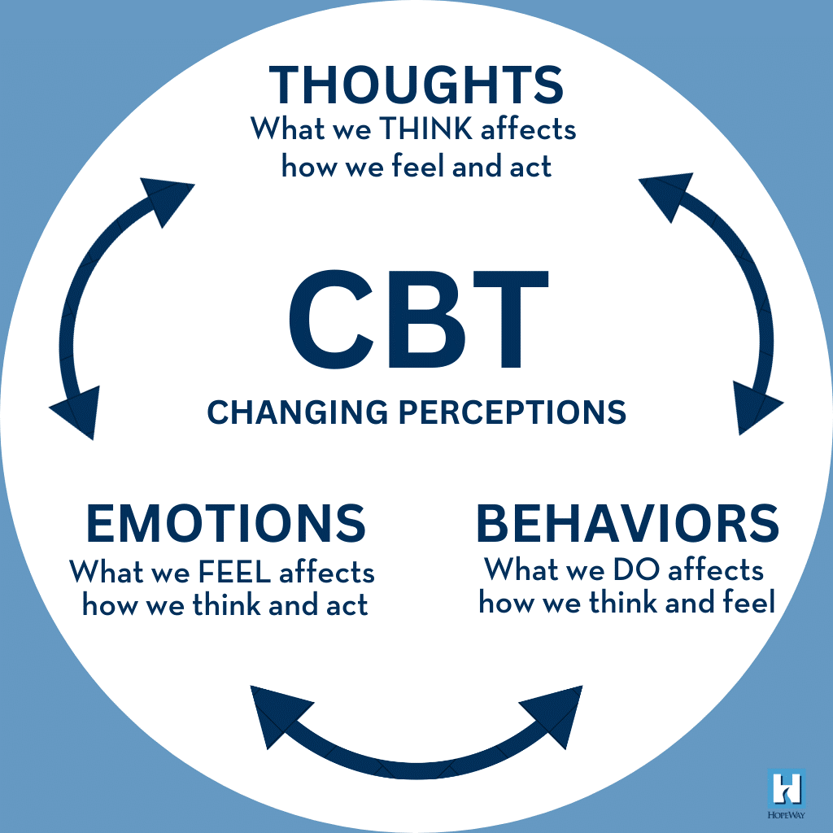
TASK
Practice cognitive restructuring and behavioural activation with the help of the teacher’s hand outs

Slide 32
TASK
Read ”Cognitive behavioural therapy” from Kognity 2.2.5 and teacher’s supplementary materials
Focus on the following:
  Riggs et al. (2007)
  Wiles et al. (2016)
  Cuijpers et al. (2023)
  Goldapple et al. (2004)
Summarise the evidence in your own words
Evaluate CBT as a treatment method for depression
  What are the strengths and the limitations of CBT?

Slide 33
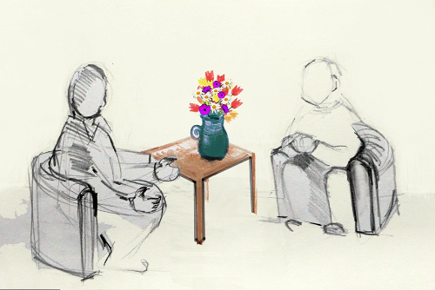
Psychological treatment
Interpersonal psychotherapy (IPT)
  Aims to improve communication skills and support networks
  IPT in combination with medication is more effective than medication alone (e.g. Cuijpers et al., 2014)

Slide 34

TASK
Close your laptops and put away all distractions
Silently engage in body scan meditation
  Systematically focus on different parts of your body to release physical tension for 3 minutes

Slide 35
Psychological treatment
Mindfulness-based cognitive therapy (MBCT)
  May reduce risk of relapse (e.g. Kuyken et al., 2015)
  May be effective and cost-effective in comparison to CBT (e.g. Strauss et al., 2023)

Slide 36

EXTRA TASK
Familiarize yourself with more approaches to psychotherapy with the help of APA webpage

Slide 37
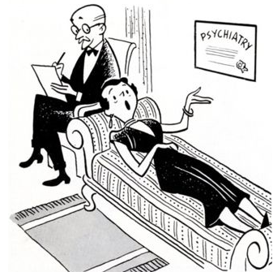
Treatment in general
Usually, the best results are achieved when different approaches are combined
  An eclectic approach
  to treatment
  Individual tailoring of different treatment methods

Slide 38
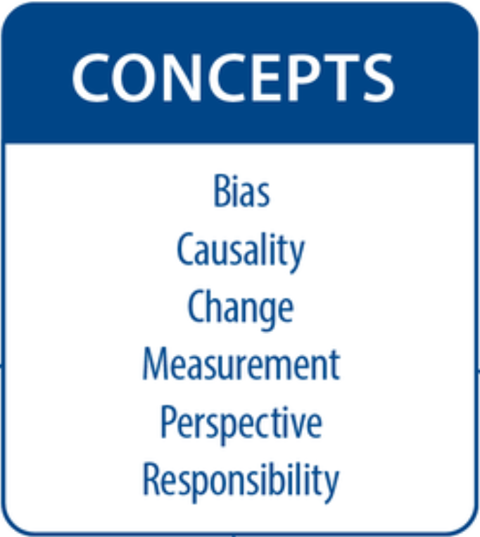
TASK
Teacher divides you into six groups and gives each group one basic concept from the syllabus
Each group makes a concept map based on the concept on prevention and treatment

Slide 39
Picture sources
Trepanation 1 and 2 <https://en.wikipedia.org/wiki/Trepanning> Accessed 15th of August 2017.
History of therapy 1 and 2 <https://www.exposingtruth.com/13-shocking-pictures-showing-how-we-used-to-treat-the-mentally-ill/> Accessed 15th of August 2017.
Wilhelm Wundt <https://en.wikipedia.org/wiki/Wilhelm_Wundt> Accessed 15th of August 2017.
Sigmund Freud <https://fi.wikipedia.org/wiki/Sigmund_Freud> Accessed 15th of August 2017.
Lobotomy 1 and 2 <https://en.wikipedia.org/wiki/Lobotomy> Accessed 15th of August 2017.
One flew over the cockoo’s nest <http://thesociallyunjust.weebly.com> Accessed 15th of August 2017.
Therapy 1 <https://www.vectorstock.com/royalty-free-vector/psychotherapy-concept-vector-21266130> Accessed 21st of August 2019.
Comic therapy <https://www.vitalia.cz/clanky/jak-zvolit-dobreho-psychologa/> Accessed 13th of August 2018.
Randomized control trials <https://www.tes.com/lessons/tQgZc4lNh9ZgSw/randomized-controlled-trial> Accessed 13th of August 2018.
Meta-analysis <http://library.downstate.edu/EBM2/2700.htm> Accessed 13th of August 2018.
Qualitative head <https://www.greenroompsychology.com/about/> Accessed 13th of August 2018.
Placebo-effect <http://www.theemotionmachine.com/how-to-create-your-own-placebo-pills> Accessed 11th of October 2015.
Social connection <https://www.counseling.org/publications/counseling-today-magazine/article-archive/article/legacy/essential-skill-development-for-meaningful-social-connection> Accessed 4th of March 2026.
Cultural identity <https://www.pechakucha.com/presentations/my-cultural-identity-in-today-s-world> Accessed 4th of Marhc 2026.
Supporting hands <https://psychology.iresearchnet.com/social-psychology/cultural-psychology/collectivistic-cultures/> Accessed 4th of March 2026.
Social media icons <https://pagecreative.co.uk/5-benefits-of-social-media-for-your-business/> Accessed 11th of February 2026.
Hot button <https://www.allbusiness.com/8-ways-discover-hot-button-content-topics-10846-1.html> Accessed 3rd of March 2026.
SSRI <https://neurosciencenews.com/neuropharmacology-decynium-22-ssri-serotonin-248/> Accessed 11th of February 2020.
ECT <https://science.howstuffworks.com/life/inside-the-mind/human-brain/electroconvulsive-therapy.htm> Accessed 3rd of March 2026.
TMS <https://www.geminitms.com/how-tms-works/the-science-behind-tms/> Accessed 5th of March 2026.
Ketamine <https://www.boundtree.com/pharmaceuticals/controlled-substances/ketamine-hcl-injection-10mg-ml-20ml-vial/p/0682-20?srsltid=AfmBOooEDq2TXrGYoLD6dFmTY8ELF8m3IeFk1hJCiHb44LhQFVE0Thdg> Accessed 4th of March 2026.
Mushrooms <https://thinkib.net/psychology/page/52589/biological-treatments-depression> Accessed 4th of March 2026.
Running woman <https://threesixtyfivecollective.com/health-wellness/the-joy-of-running/> Accessed 4th of March 2026.
CBT’s cognitive triad - Kognity
CBT’s cognitive triad with explanations <https://hopeway.org/psychotherapies/cognitive-behavioral-therapy> Accessed 6th of March 2026.
Therapy session, painted <http://mayajacobs-wallfischpsychotherapy.co.uk> Accessed 13th of August 2018.
Mindfulness kanji <https://www.gohitsushodostudio.com/make-shodo-a-mindful-practice/> Accessed 5th of March 2026.
APA logo <https://www.ariessys.com/views-press/press-releases/the-american-psychological-association-to-deploy-editorial-manager-for-70-journals/> Accessed 2nd of January 2018.
Therapy session, black and white <http://dvc.libguides.com/psychology> Accessed 21st of August 2017.

