Slide 1
2.1 MENTAL HEALTH DISORDERS
IB Psychology LAJM

Slide 2
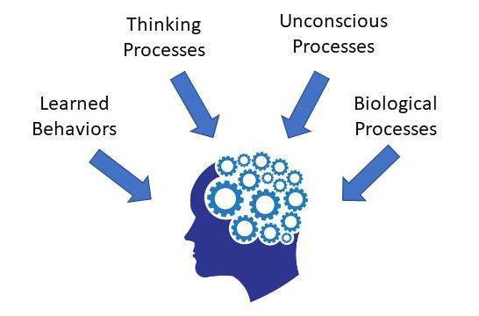
What is abnormal psychology?
Abnormal psychology studies unusual patterns of behaviour, mental disorders

Slide 3
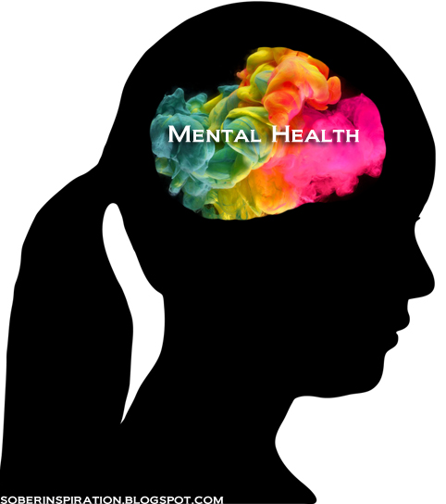
TASK
What is abnormality?
How can you differentiate normal from abnormal?
How can you tell the difference between sane and insane people?

Slide 4
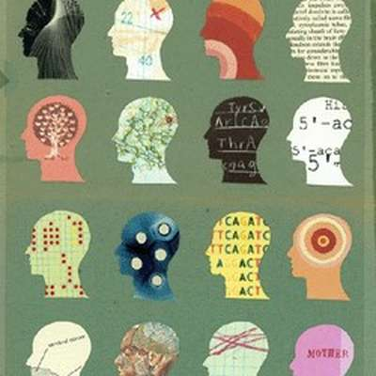
The medical model of abnormality
Psychological disorders are seen as illness in the psyche, psychopathology
Each disorder is defined based on its symptoms

Slide 5
The medical model of abnormality
Signs
Indicators of illness that can be detected by e.g. blood tests, brain scans and X-rays
Symptoms
What the patient reports to the doctor
What the doctor observes in a patient
Most psychological disorders don’t have signs equivalent to physical illnesses
Causes of psychological disorders must be inferred from symptoms

Slide 6
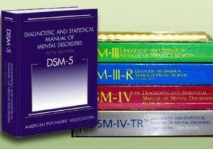
The medical model of abnormality
Classification systems are based on symptoms
There is a pattern of recognizable behaviour in every disorder
Enables diagnosis of mental disorders

Slide 7
TASK
Read “Diagnostic methodologies” from Kognity 2.1.2 and familiarize yourself with the most widely used classification systems
Pay close attention to the challenges of the classification systems
Study more about the ICD-11
Link is in Kognity
Expand drop-down menu 6 on the left navigation panel
Select and explore at least three different disorders, read through the diagnostic statements

Slide 8

What is diagnosis?
Diagnosis
”Differentiating knowledge”
Relating a pattern of behaviour to a certain category

Slide 9

REVIEW
What was meant by
Psychologist?
Psychiatrist?
Psychotherapist?
Only psychiatrists can do a clinical diagnosis according to official classification systems

Slide 10
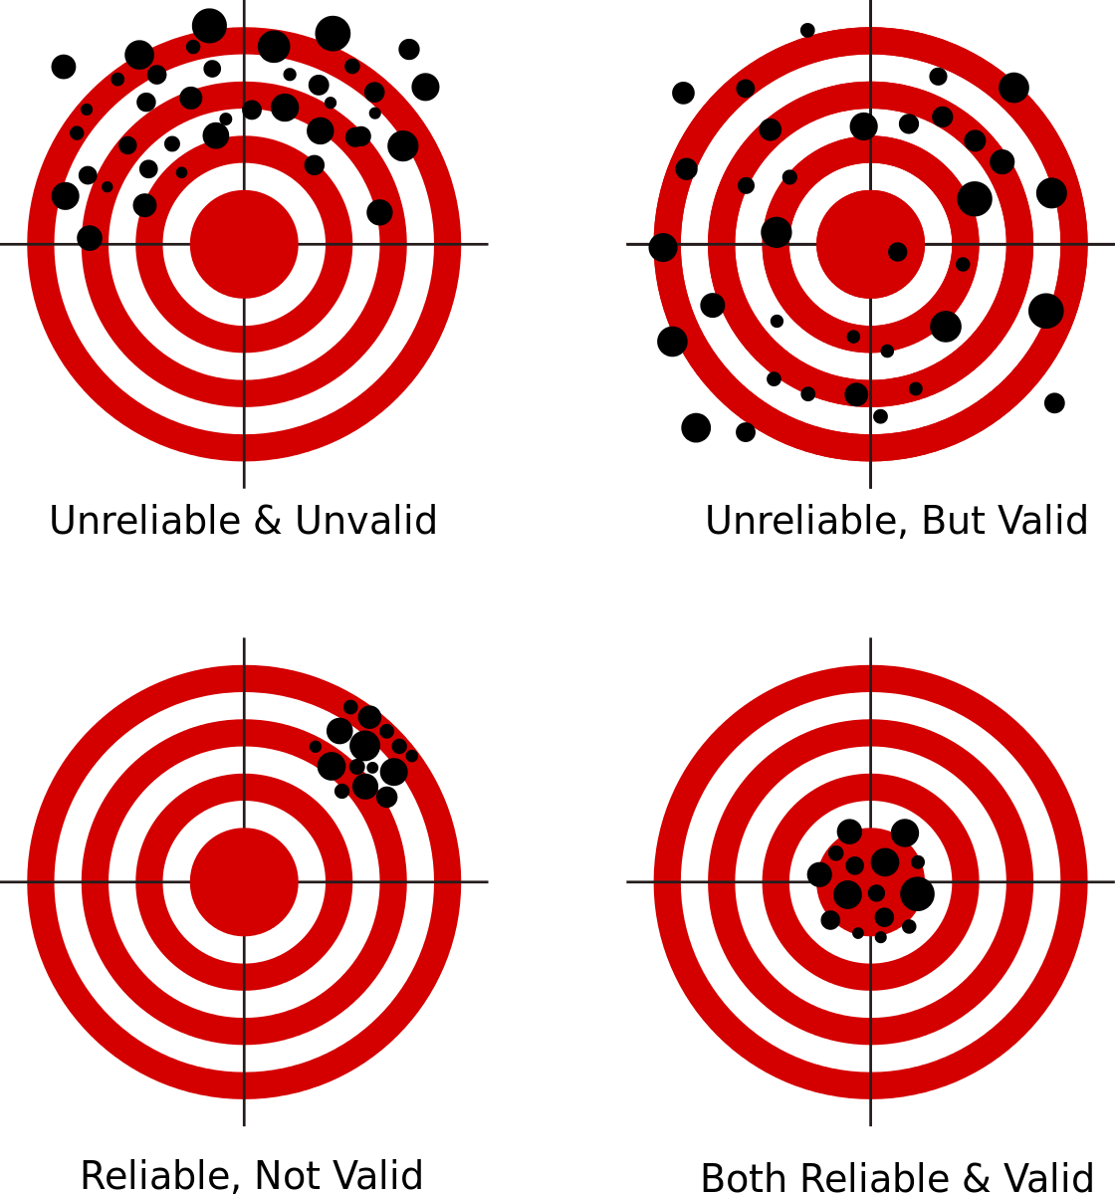
REVIEW
What was meant by reliability and validity?
Reliability: is the research repeatable?
Validity: does the research measure what it is supposed to measure?

Slide 11
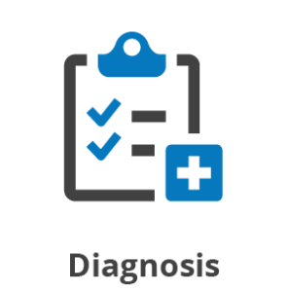
Reliability and validity of diagnosis
Reliability of diagnosis
Do different clinicians arrive at the same results with the same patients?
Interrater reliability
Validity of diagnosis
Is the diagnosis accurate?
Does the patient receive a correct diagnosis?

Slide 12
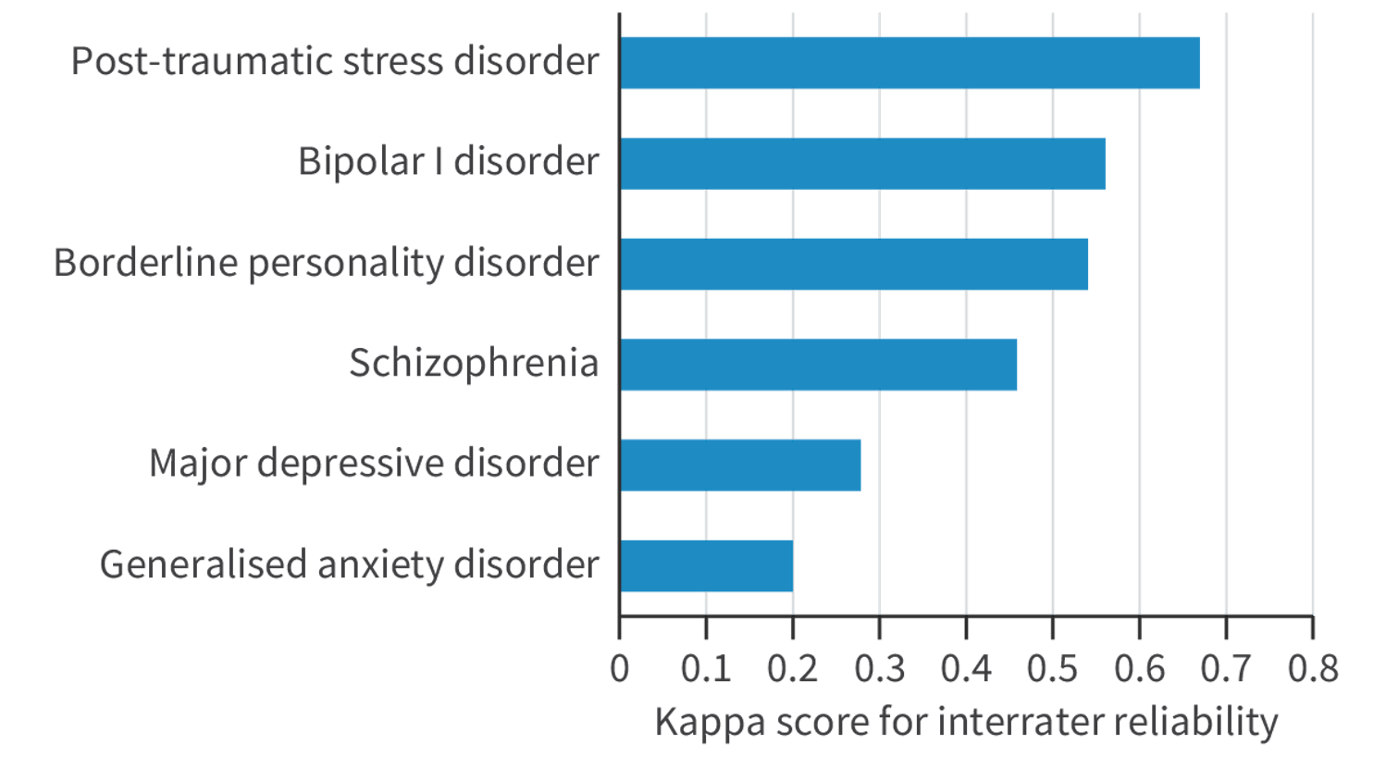
Reliability and validity of diagnosis
Regier et al. (2013)

Slide 13

Reliability and validity of diagnosis
There is an inverse relationship between validity and reliability of diagnosis
As reliability increases, validity tends to decrease, and vice versa

Slide 14

Reliability and validity of diagnosis
Kendell and Jablensky (2003)
Despite problems with reliability and validity, diagnosis can still be useful – diagnosis can have utility

Slide 15

TASK
Read ”Culture, prevalance and validity” from Kognity 2.1.1 and summarize the main ideas in your own words
Pay attention to
Eack et al. (2012)
Eaton et al. (2012)
Parker et al. (2001)
Abbreviations in Kognity 2.1.13
How do clinicians have to take culture into consideration in diagnosis?
Bias
Responsibility
Measurement
Why is depression more prevalent in women than in men?

Slide 16

Reliability and validity of diagnosis
Kendler et al. (2006)
Heritability of depression is higher in women (42%) than in men (29%)
Silberg et al. (1999)
Stressful life events had greater impact on girls after puberty
Girls have higher genetic predisposition to depression
Lu et al. (2021)

Slide 17
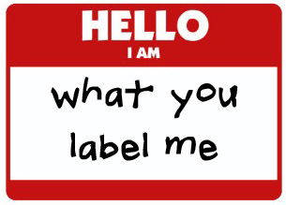
Labelling theory
Mental disorders are seen as labels that influence the self-identity and behaviour of individuals
Stigmatization
Stereotyping
Self-fulfilling prophecy

Slide 18
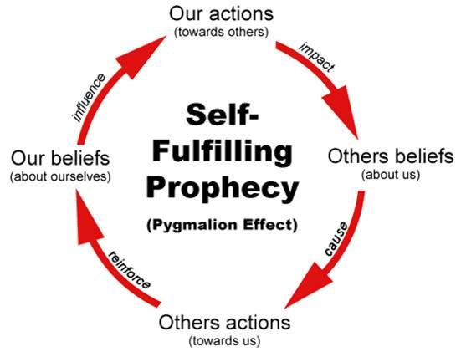
TASK
Read Kroska and Harkness (2008) from Kognity 2.1.13
Read the Passman (2011) article on labelling theory
Elaborate your notes on labelling theory

Slide 19
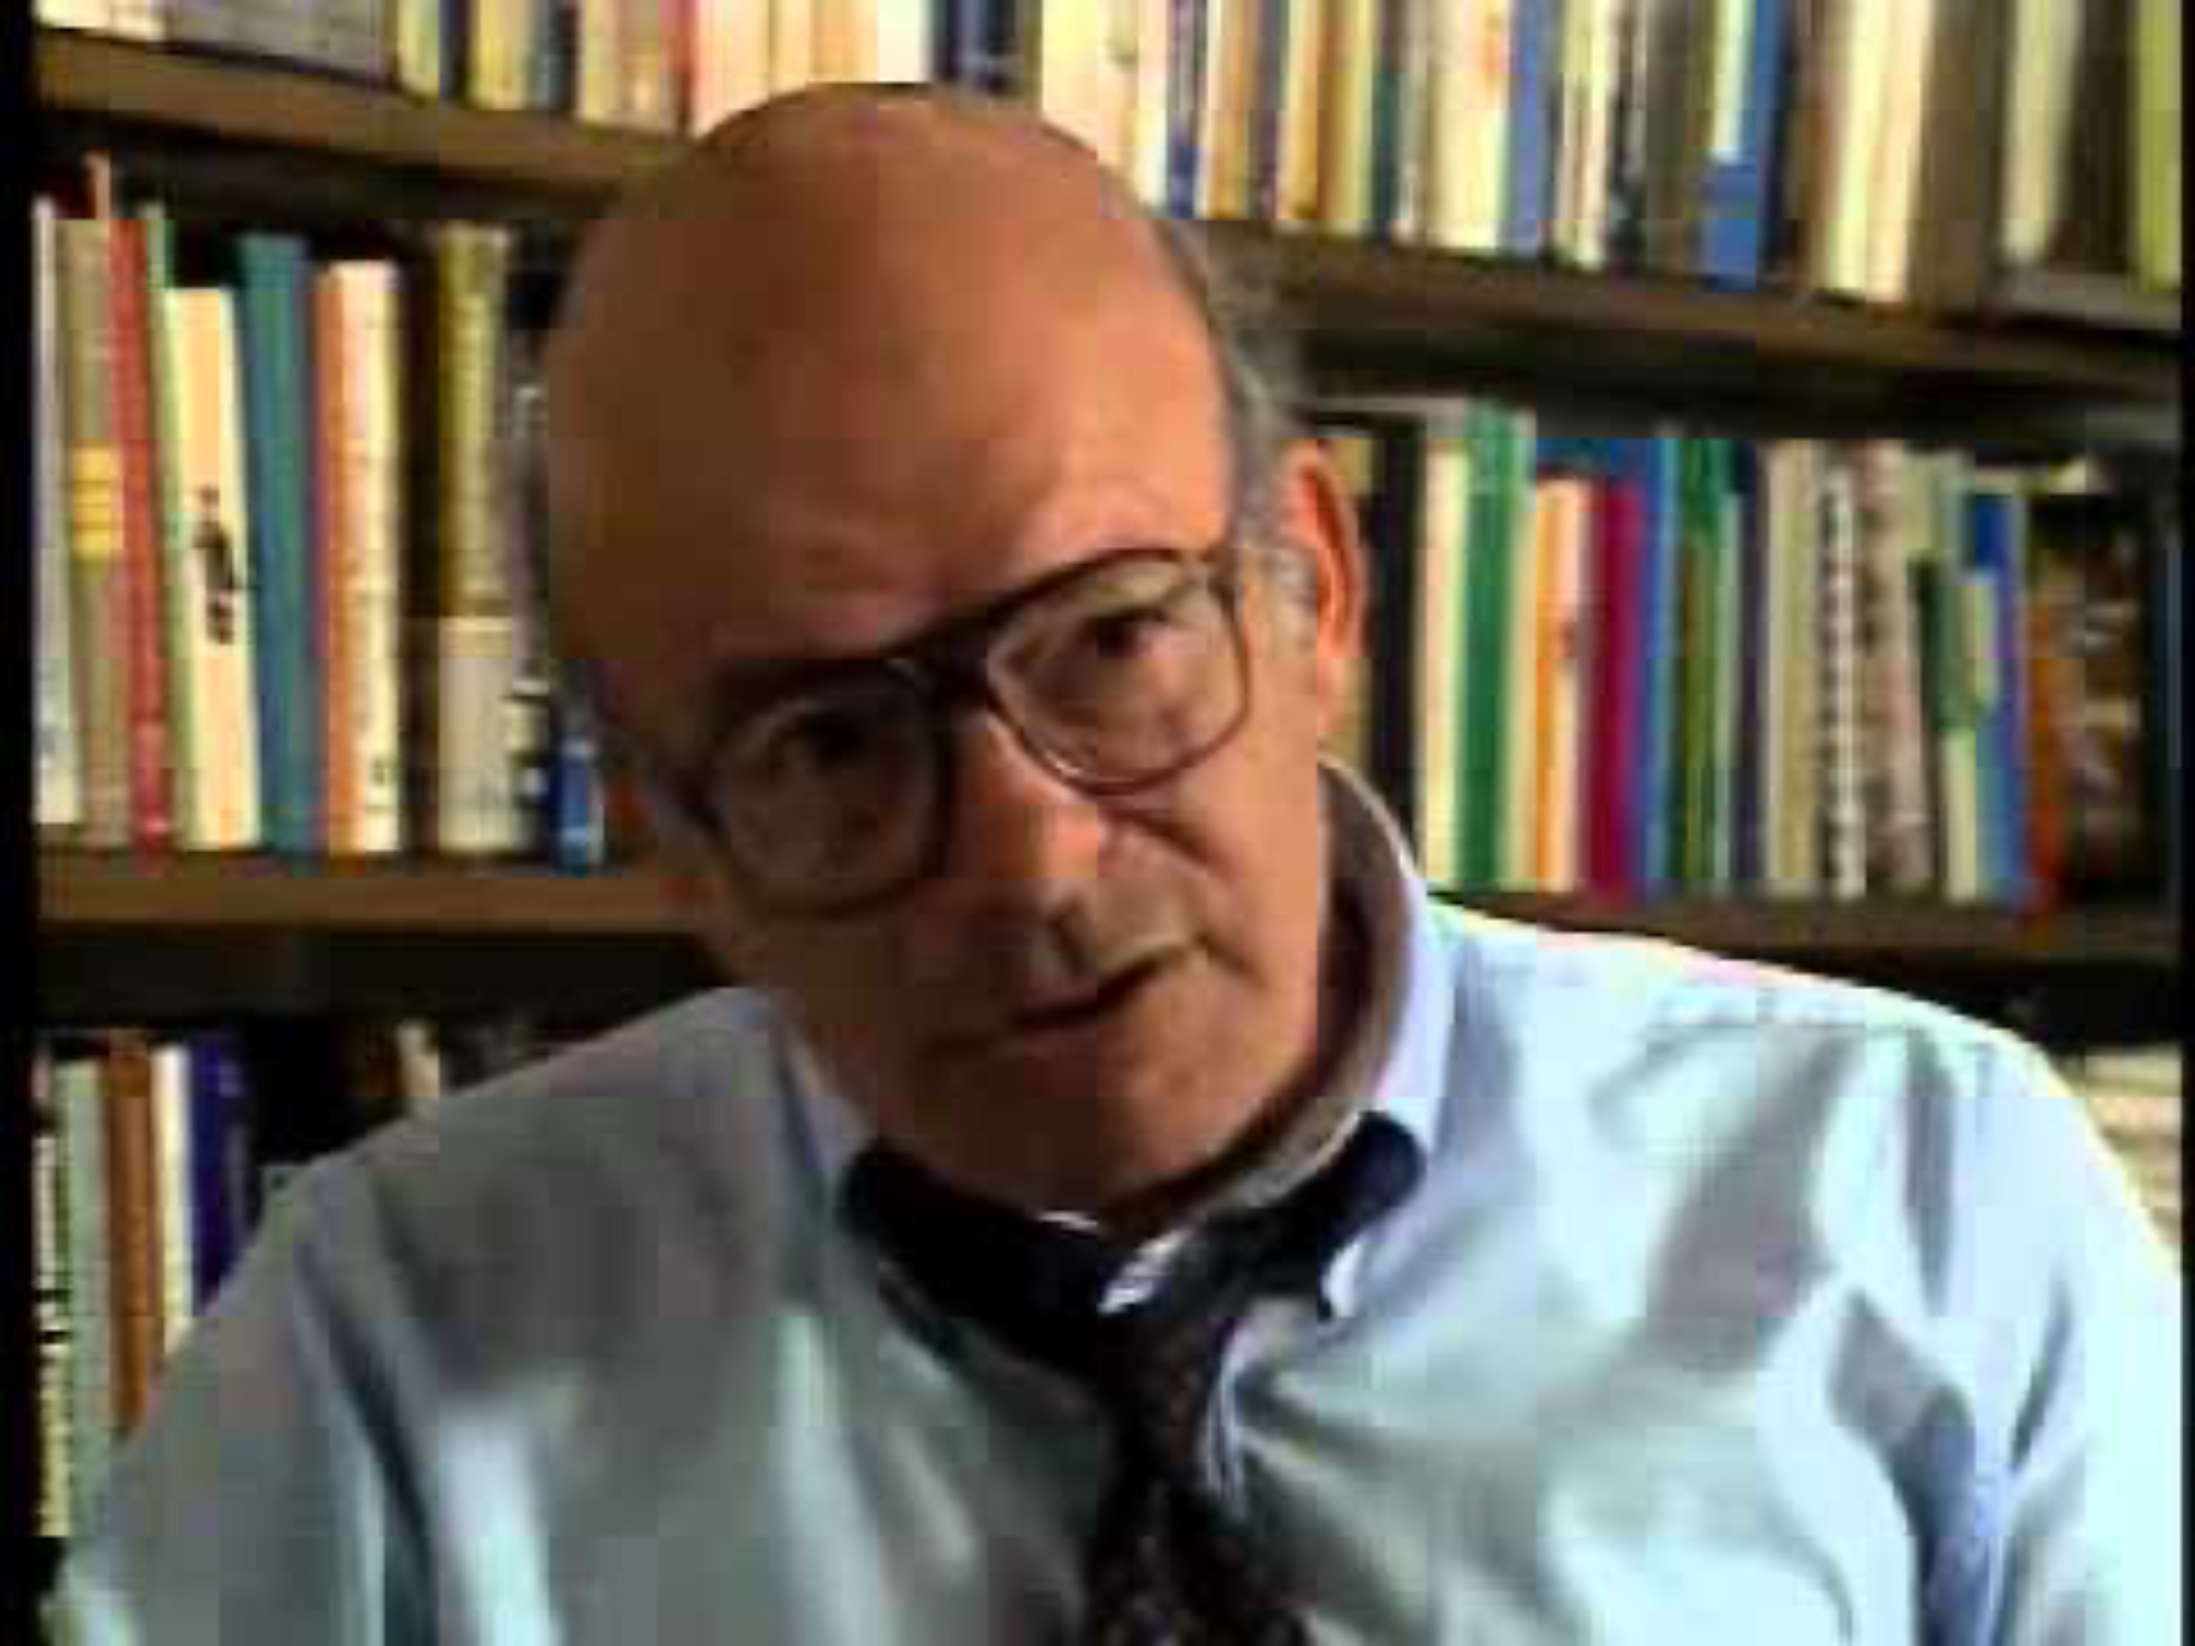
Labelling theory
After the video, do the Activity box in Kognity 2.1.1

Slide 20
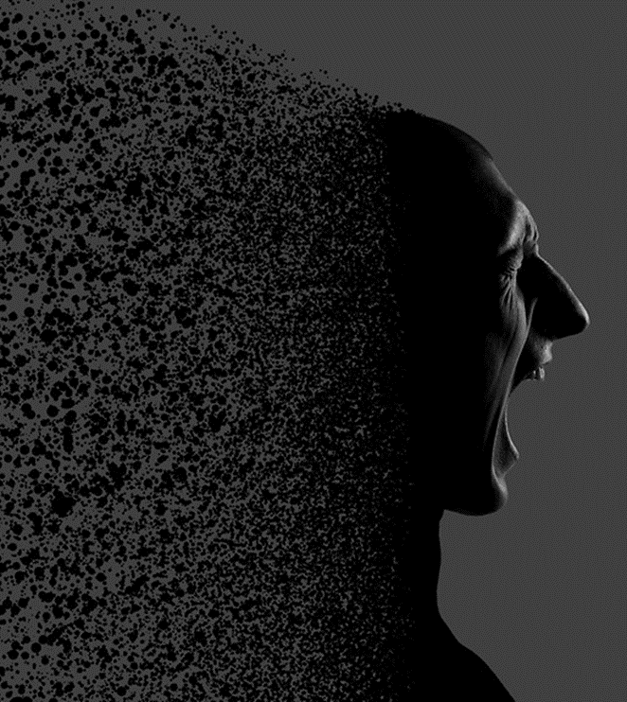
What is etiology?
Etiology
Cause of disorders
Different etiology leads to different kind of prediction and treatment of a disorder

Slide 21
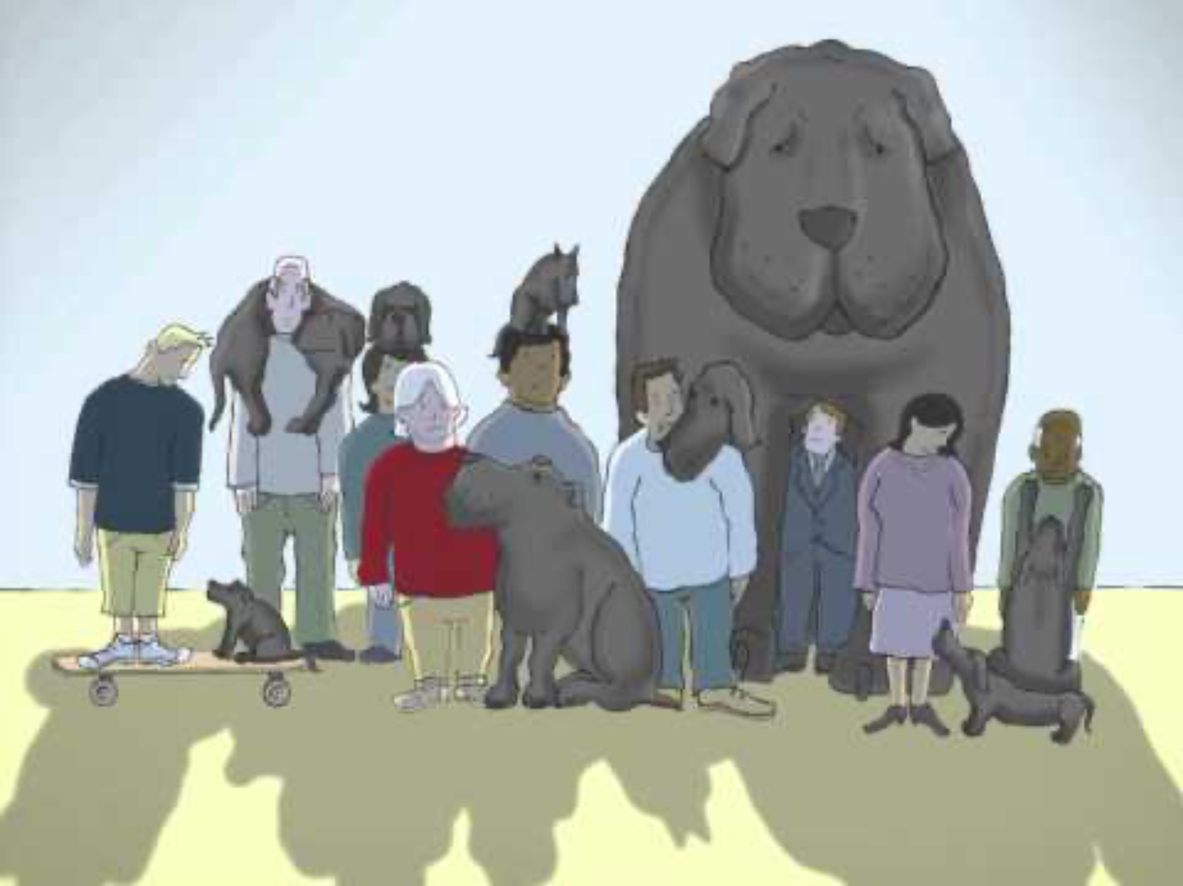

Slide 22

TASK
To what extent can environment cause depression?
What kind of environmental factors can contribute to depression?
Engage in conversation and make a mind-map

Slide 23
Sociocultural explanations for depression
Brown and Harris (1978)
Interview study of 458 women between 18 to 65 living in London
There are number of social factors or life-events that increase the likelihood of depression
(1) Three or more children under the age of 14
(2) Lack of intimate relationships
(3) Lack of employment
(4) Loss of mother before the age of 11
(5) Absence of social support
(6) History of childhood abuse

Slide 24
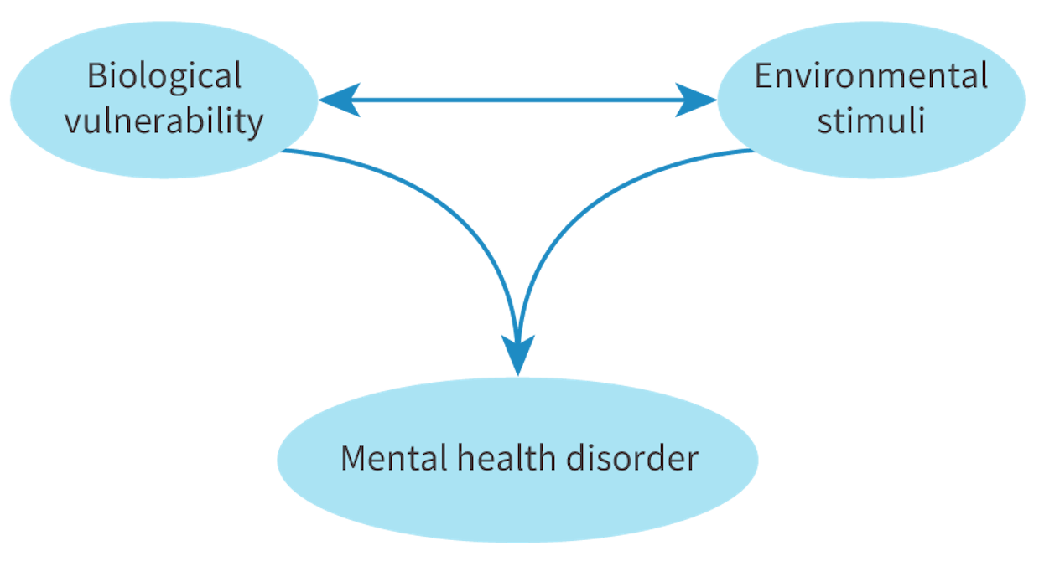
Diathesis-stress model
Psychological disorders arise from the interaction of underlying vulnerability (diathesis) and external stressor

Slide 25

Diathesis-stress model
5-HTT gene
Serotonin transporter gene
Regulates the reuptake of serotonin at brain synapses
Partially determines how strongly stressful events will influence depressive symptoms

Slide 26
TASK
Read “The 5-HTT serotonin transporter gene and depressive etiology” from Kognity 2.1.6 and study Caspi et al. (2003)
How does the 5-HTT gene influence depressive behaviour?
Read ”Culture and depression” from Kognity 2.1.3 and study Chiao and Blizinsky (2010)
How is the 5-HTT gene associated with cultural factors?
Can you separate biology and environment?

Slide 27
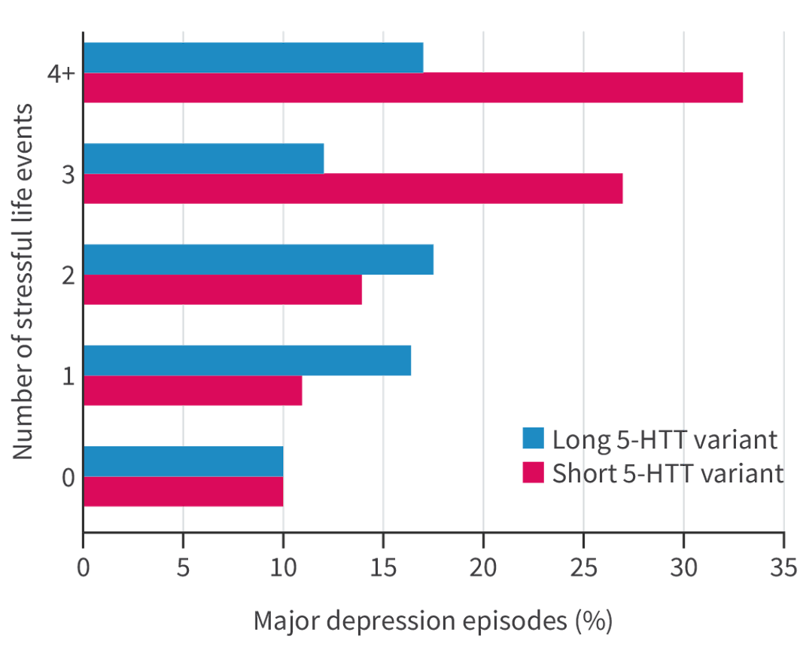
Diathesis-stress model
Neumeister et al. (2002) had similar findings as Caspi et al. (2003)
Polderman et al. (2015) found that depression is “just” 36% heritable
Caspi et al. (2003)

Slide 28
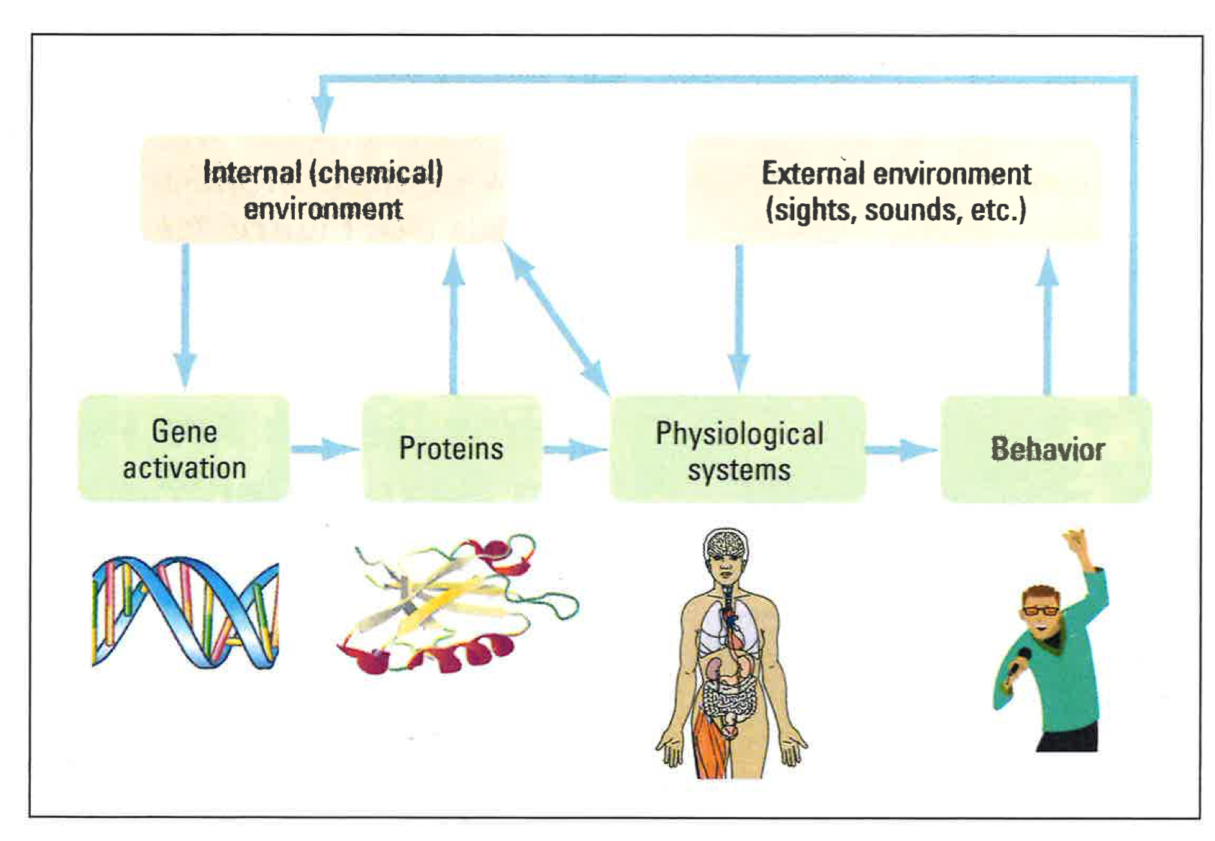
Diathesis-stress model
Interactionist approach
Genes are entwined with the environment and behaviour
Influences what genes are switched on and off (epigenetics)
Biology and environment influence each other reciprocally

Slide 29
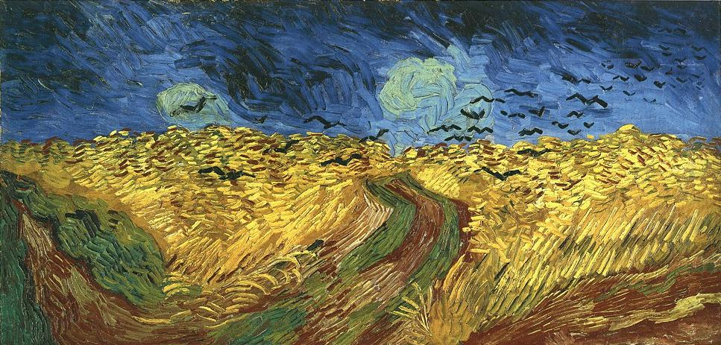
Approaches to researching culture
Etic approach
Studies universal features of all cultures
Examines cultures from an outside perspective
Emic approach
Studies culturally specific features of a culture
Understanding a culture from within
Chiao and Blizinsky (2010)

Slide 30
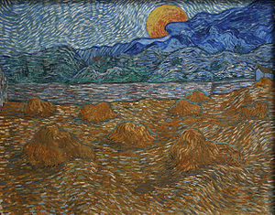
TASK
Read ”Trauma and depressions” and ”Emic Research” from Kognity 2.1.3 and focus on Kurapov et al. (2023)
What are the sociocultural factors contributing to depression in this study?
How is this study an example of an emic approach?

Slide 31
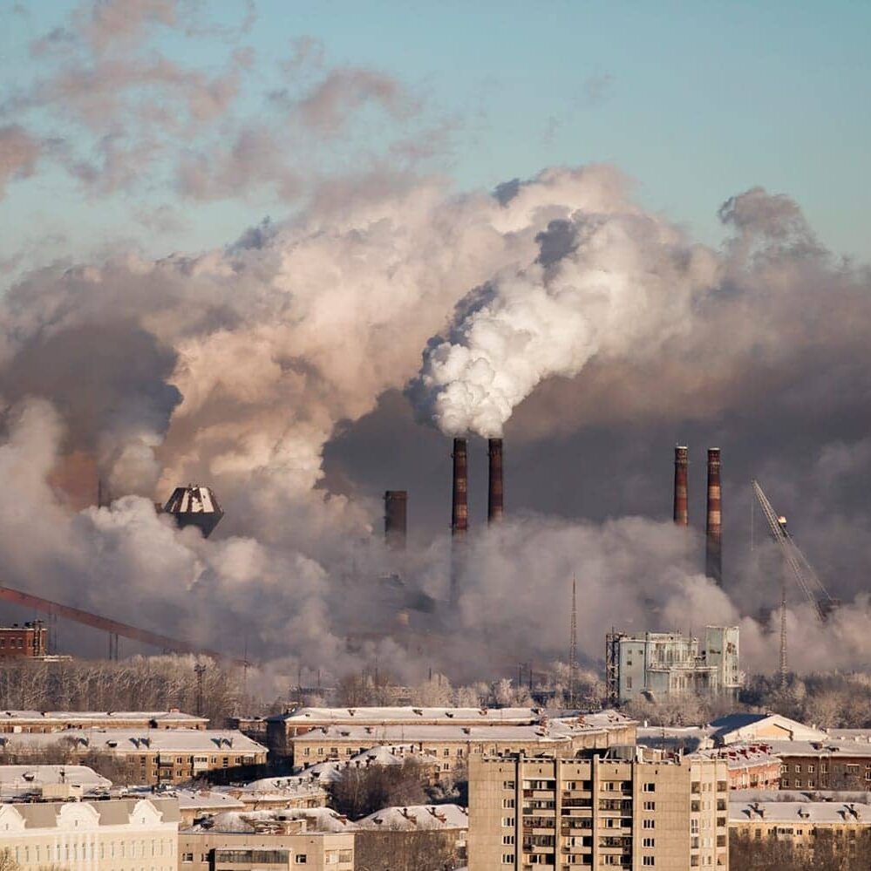
EXTRA TASK
Read ”Other environmental factors” from Kognity 2.1.3
How can air pollution contribute to depression?
Focus on Qiu et al. (2023) and Ali and Khoja (2019)

Slide 32

TASK
Reflect your use of social media
Can the use of social media contribute to depression? If so, how?
Can your own use of social media lead to depressive symptoms?

Slide 33
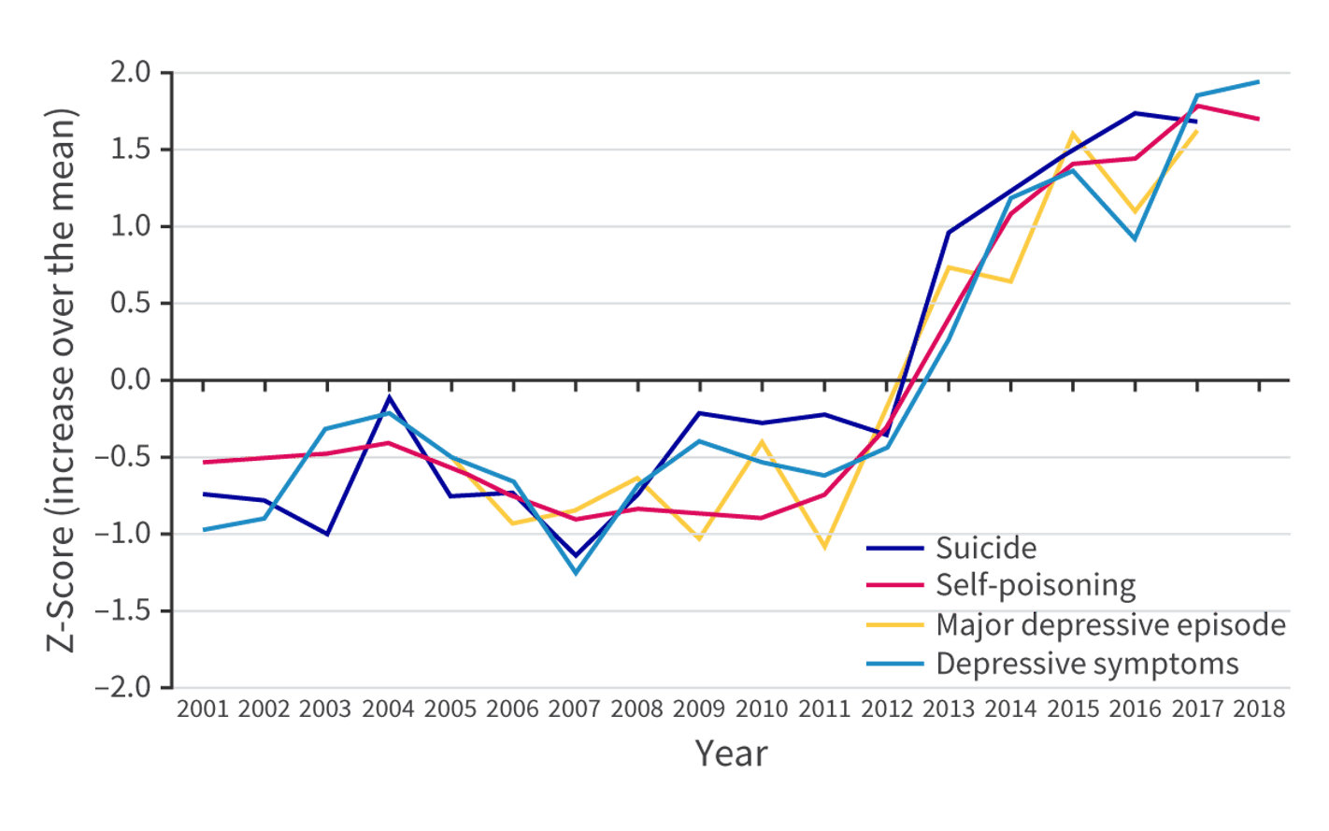
Social media and depression
Twenge (2020)

Slide 34
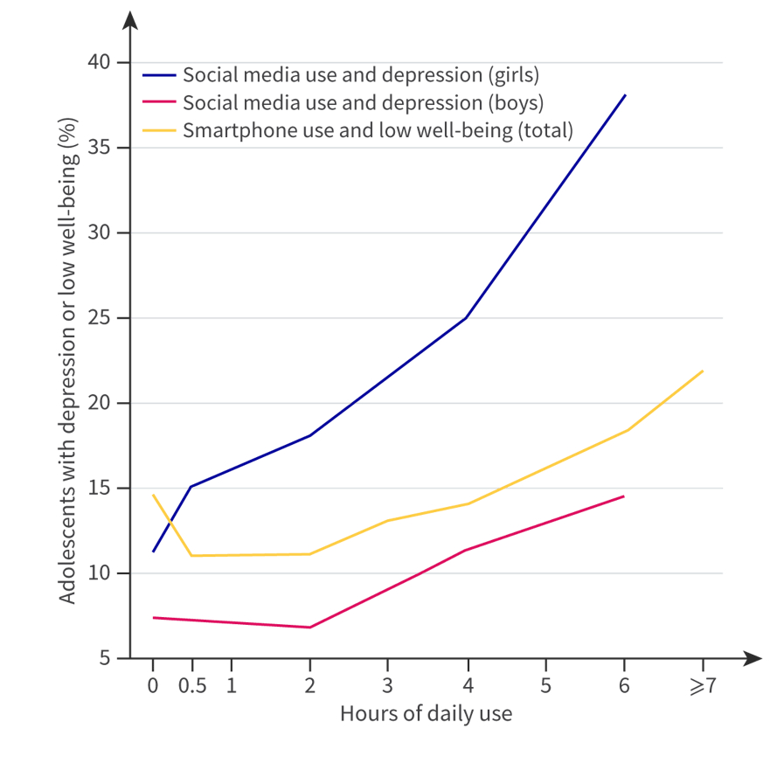
Social media and depression
Twenge (2020) suggests a strong correlation between social media and depression
Haidt, Rausch and Twenge (ongoing) imply that social media is a causal factor in depression
Twenge (2020)

Slide 35
TASK
Read ”Why would social media usage reduce psychological well-being?” and ”Negative cognitive effects” from Kognity 2.1.4
Take notes on the main points in your own words
Focus on Samra et al. (2022) and González-Nuevo et al. (2023) on upward social comparison and Elhai et al. (2020) and Einstein et al. (2023) on FOMO
Abbreviations in Kognity 2.1.13

Slide 36

TASK
Do you believe that governments have a responsibility to restrict and limit access to social media for individuals under the age of 18?
What kind of limits would you endorse?

Slide 37
REVIEW + TASK
What was meant by dual process model?
Volunteers will come to the whiteboard to make a summary of the model
How can dual process model be used to explain how social media can contribute to depression?

Slide 38

TASK
To what extent can thinking cause depression?
What kind of thinking can contribute to depression?
Engage in conversation and make a mind-map

Slide 39

TASK
What kind of thoughts concerning yourself and your actions went through your mind in the past five minutes?
What kind of thinking patterns were you able to observe?
Were you in control of all these thinking patterns?

Slide 40
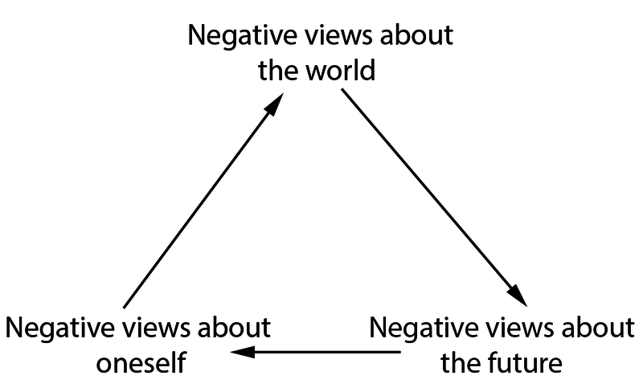
Cognitive explanations for depression
Aaron Beck’s cognitive theory of depression (1967)
Rumination on the negative appraisals of events contributes to depression
Automatic thoughts: the semi-conscious sub-vocal narrative that naturally occurs in people’s daily activities

Slide 41
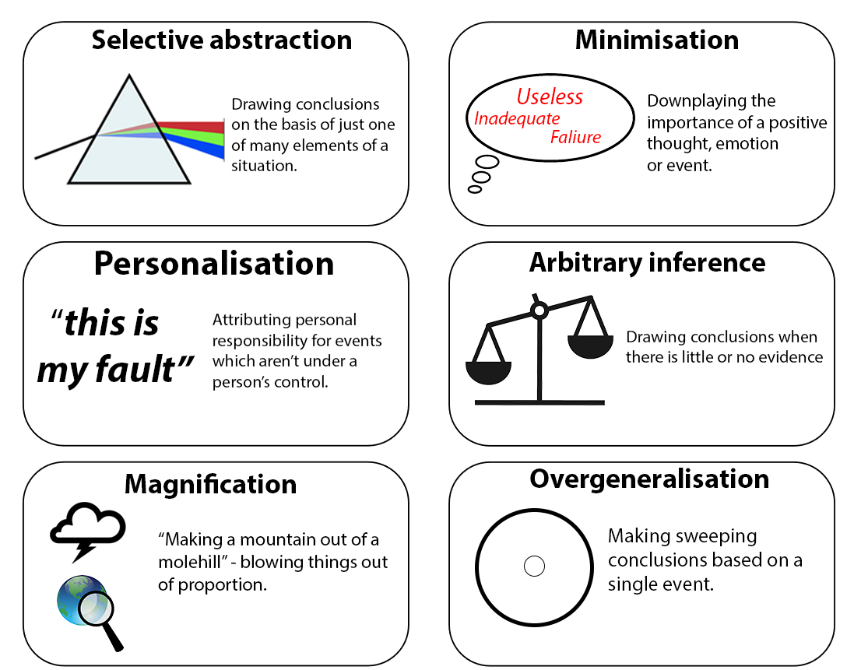
Cognitive explanations for depression

Slide 42

Cognitive explanations for depression
This doesn’t relate directly to depression, but to Beck’s theory, yes

Slide 43
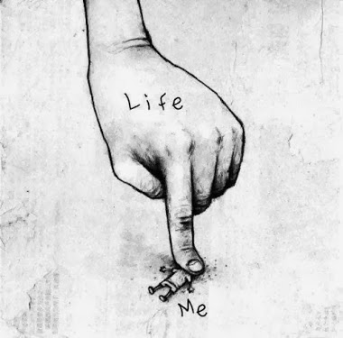
TASK
What can you do change your thinking patterns for better mental health?
How can you prevent negative views about the world, the future and yourself?

Slide 44
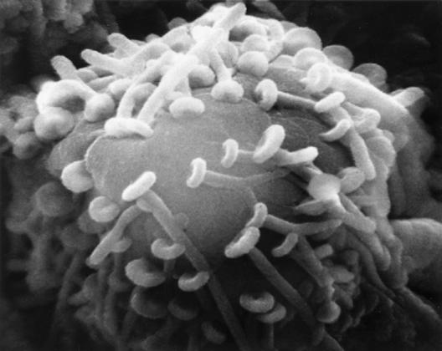
REVIEW
What was meant by neurotransmitters and synaptic transmission?
Volunteer will come to the whiteboard to make an outline

Slide 45
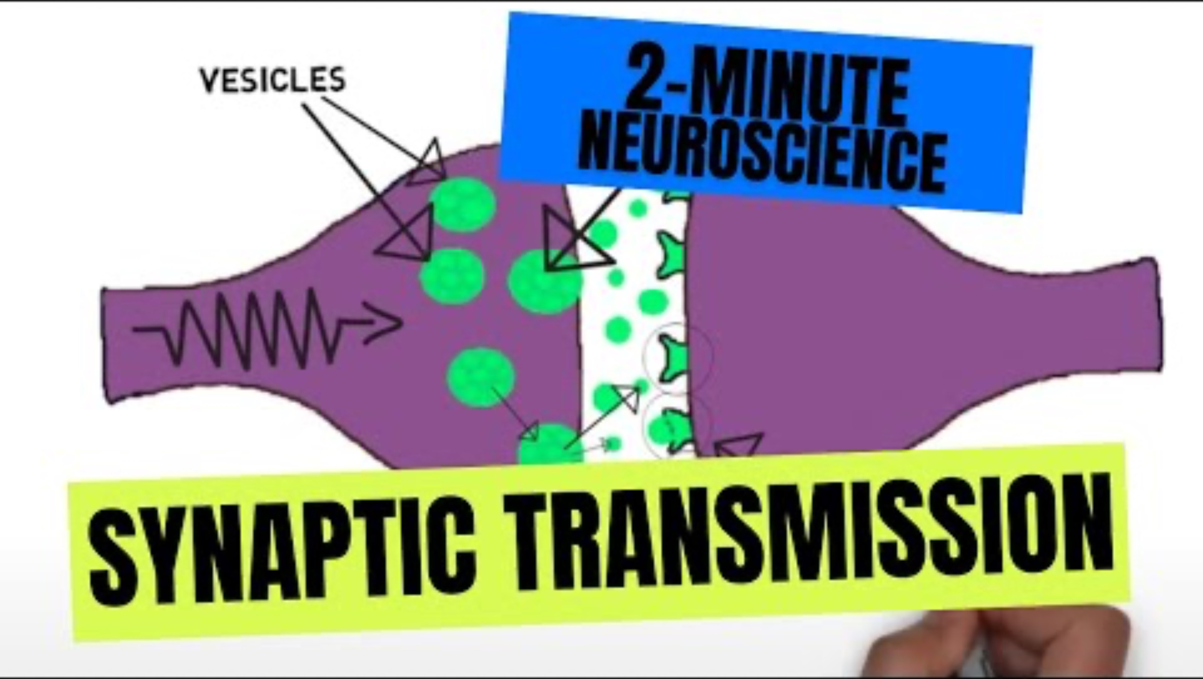
REVIEW

Slide 46
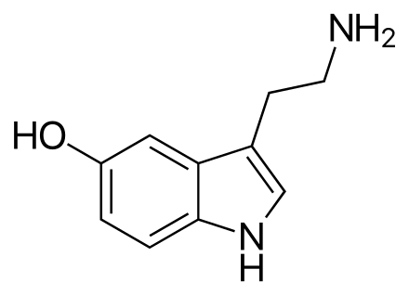
Biological explanations for depression
Serotonin hypothesis of depression
Low levels of serotonin in the brain causes depression
Modern evidence has questioned this hypothesis

Slide 47
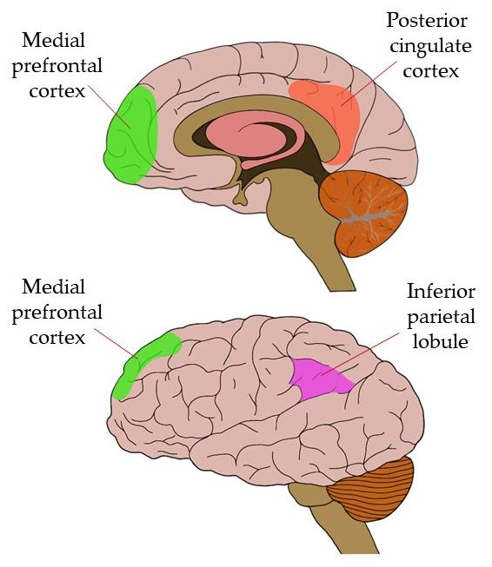
Biological explanations for depression
Neural network dysfunction
Malfunctioning neural networks, especially default mode network (DMN) contributes to rumination and therefore depression

Slide 48
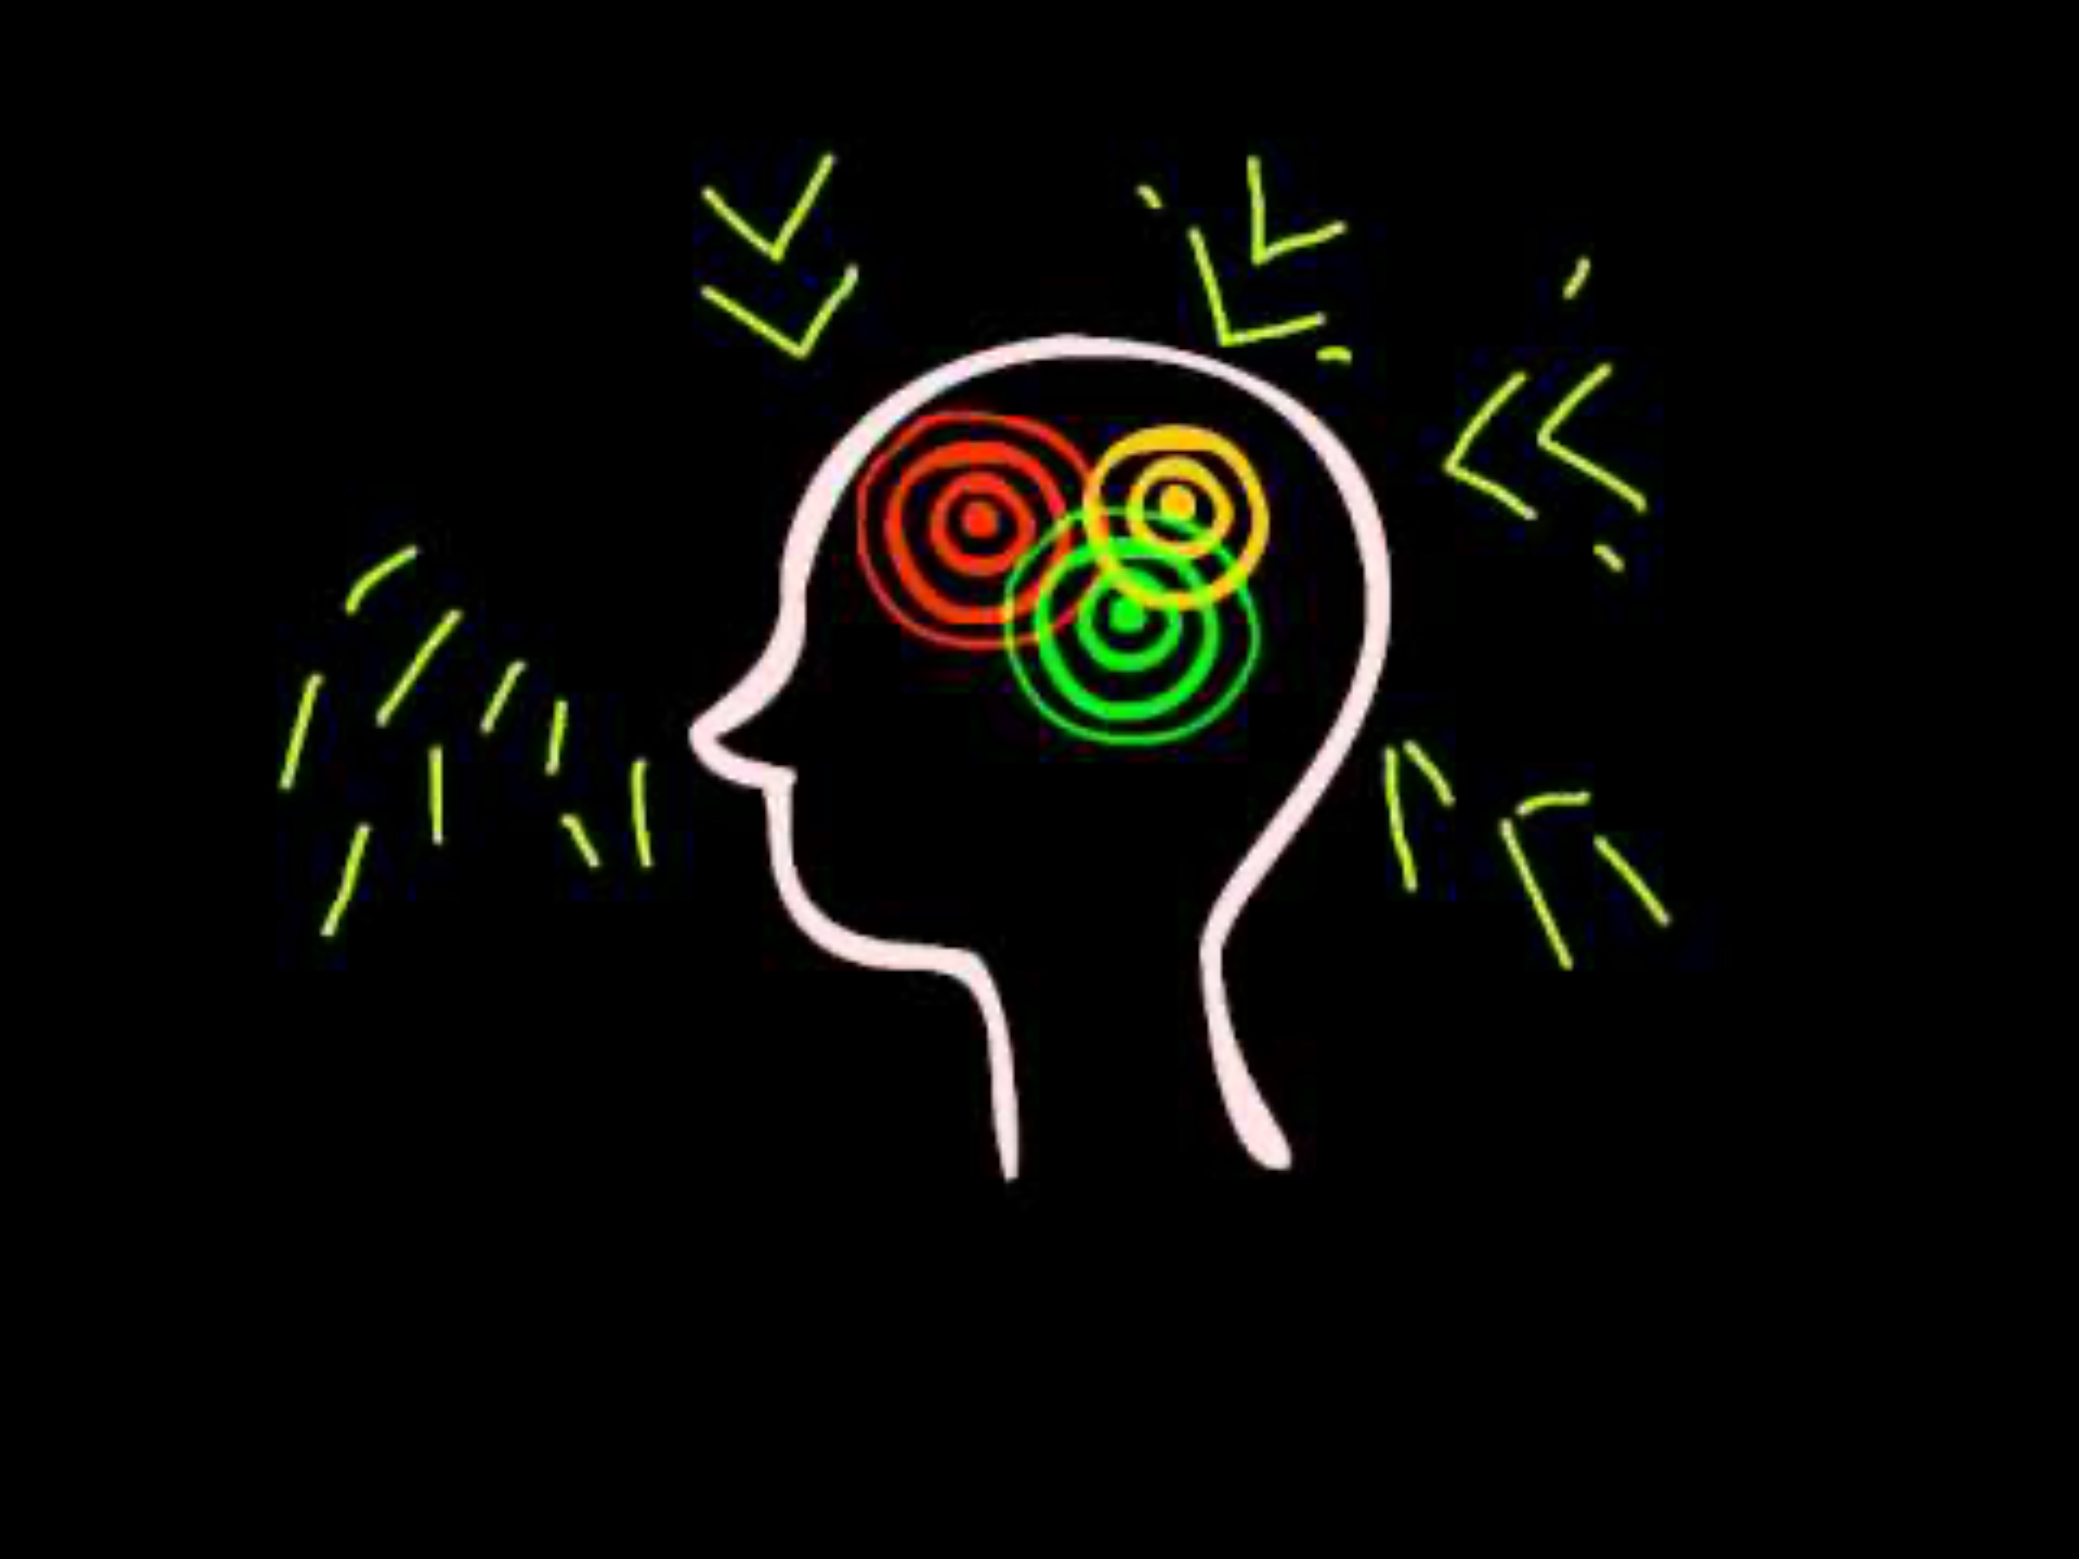
Biological explanations for depression

Slide 49
TASK
Read ”The serotonin hypothesis” and ”Neural network dysfunction” in Kognity 2.1.5 and amend your notes
What is the modern evidence against serotonin hypothesis?
What evidence do we have to support neural network dysfunction?

Slide 50
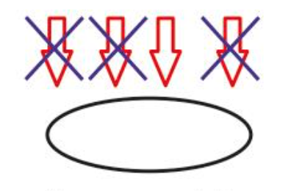
TASK
How far can we apply reductionist approach in explaining the causes of mental disorders?
Are all mental health disorders brain disorders?

Slide 51
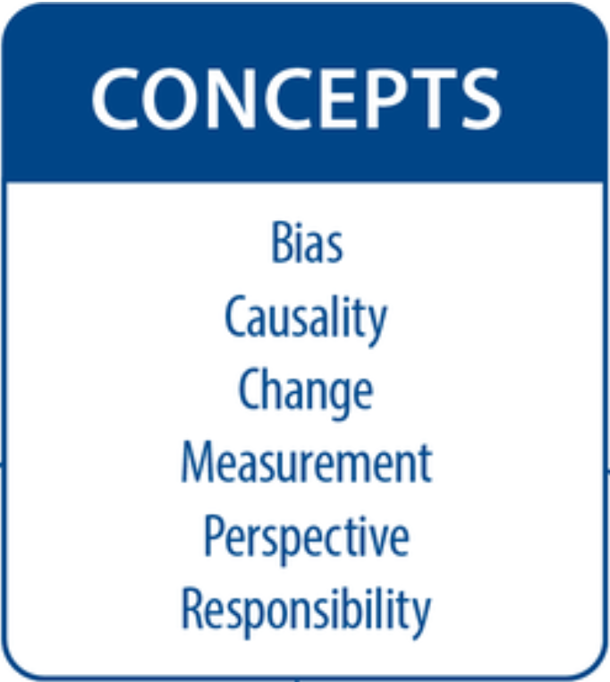
TASK
Teacher divides you into six groups and gives each group one basic concept from the syllabus
Each group makes a concept map based on the concept on mental health disorders

Slide 52
Picture sources
Perspectives in abnormal psychology <https://www.simplypsychology.org/abnormal-psychology.html> Accessed 12th of March 2018.
Mental health <http://wellbody.net/2013/04/07/what-people-should-ask-a-mental-health-expert/> Accessed 11th of August 2016.
DSMs 1 <https://www.brainscape.com/blog/2015/06/dsm-5-changes-affect-gre-psychology-exam/> Accessed 15th of March 2018.
Diagnosis 1 <http://www.alcoholicsoccermom.com/should-i-get-a-second-opinion-on-my-mental-health-diagnosis> Accessed 23rd of March 2018.
Reliability and validity <https://commons.wikimedia.org/wiki/File:Reliability_and_validity.svg> Accessed 17th of August 2017.
Diagnosis 2 <http://adadfirst.com/2016/07/the-diagnosis-is/diagnosis/> Accessed 19th of March 2018.
Kappa scores for interrater reliability – Kognity
Diagnosis 3 <https://www.eftx.org/things-to-expect-after-you-receive-an-epilepsy-diagnosis/> Accessed 11th of February 2026.
Improvement <https://ergoweb.com/continuous-improvement-ergonomics-sustainable-by-design/> Accessed 19th of March 2018.
MDD Chinese <https://www.rosehillcenter.org/mental-health-blog/am-i-depressed/> Accessed 6th of March 2023.
Label <https://fi.pinterest.com/pin/55239532912887581/> Accessed 15th of March 2018.
Self-fulfilling prophecy <stereotypic schemas influence our behaviour in a way that makes the stereotype true > Accessed 27th of August 2018.

Slide 53
Picture sources
Black anxiety <http://www.mtv.fi/lifestyle/tunteet/artikkeli/lukupiiri-matka-hyytavan-vaaristyneeseen-pahaan-mieleen/5038120> Accessed 11th of August 2016.
Environment <https://developmentalpsychiatry.com/how-environmental-factors-influence-your-mental-health/> Accessed 11th of February 2026.
Diathesis-stress model – Kognity
DNA <https://www.fearofflying.com/library/the-5-htt-gene/> Accessed 13th of February 2020.
Wheat field with crows – van Gogh <http://www.vggallery.com/painting/p_0779.ht> Accessed 6th of September 2017.
Wheat fields – van Gogh <https://en.wikipedia.org/wiki/Wheat_Fields_(Van_Gogh_series)> Accessed 6th of September 2017.
Air pollution <https://respiratory-therapy.com/disorders-diseases/chronic-pulmonary-disorders/copd/air-pollution-increases-copd-risk-speeds-aging-process/> Accessed 11th of February 2026.
Social media icons <https://pagecreative.co.uk/5-benefits-of-social-media-for-your-business/> Accessed 11th of February 2026.
Social media and depression – Kognity
Social Media Ban <https://retailpharmacymagazine.com.au/expert-reaction-to-the-social-media-ban/> Accessed 11th of February 2026.

Slide 54
Picture sources
Thinking machinery <https://www.mindtools.com/a4dzgwa/critical-thinking-video/> Accessed 11th of February 2026.
Five minutes <https://www.iconfinder.com/icons/2900587/5_min_clock_five_five_minutes_minute_timer_icon> Accessed 20th of August 2019.
Beck’s cognitive triad and faulty thinking patterns <https://en.wikipedia.org/wiki/Beck%27s_cognitive_triad> Accessed 20th of August 2019.
Depressing finger <https://yeswearestars.gr/en/depression-what-it-is-what-it-isnt/> Accessed 15th of August 2019.
Synapse <http://163.178.103.176/CasosBerne/1aFCelular/Caso4-2/HTMLC/CasosB2/Receptor/Ch6.html> Accessed 30th of August 2017.
Serotonin <https://en.wikipedia.org/wiki/Serotonin> Accessed 19th of August 2019.
Default mode network < https://neuroscientificallychallenged.com/posts/know-your-brain-default-mode-network > Accessed 11th of February 2026.

