Slide 1
3.1 MODELS OF DEVELOPMENT
IB Psychology LAJM

Slide 2
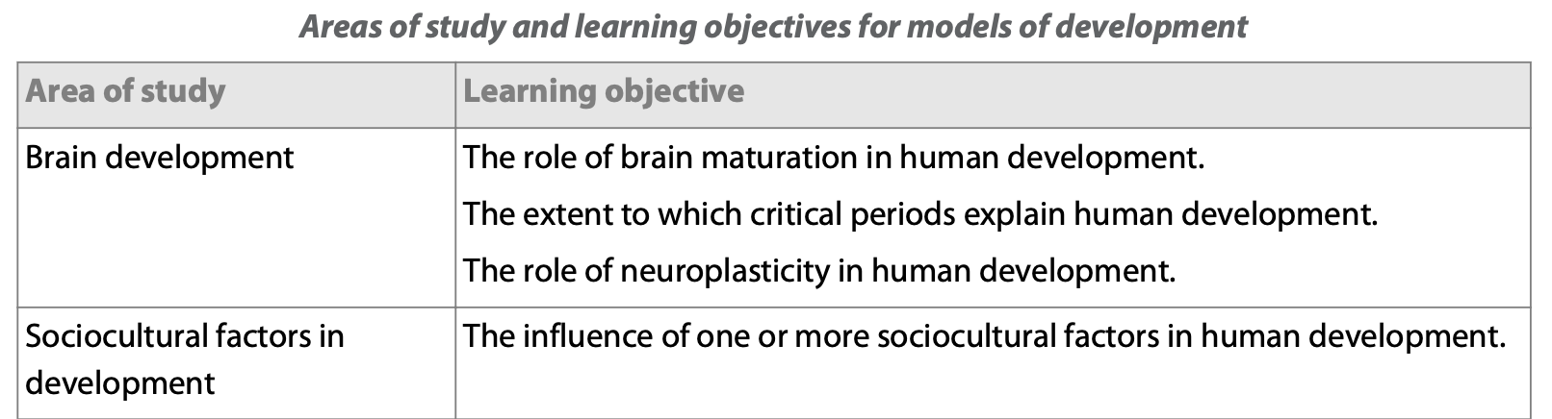
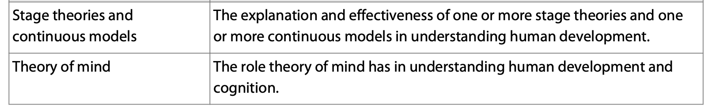
Models of development

Slide 3
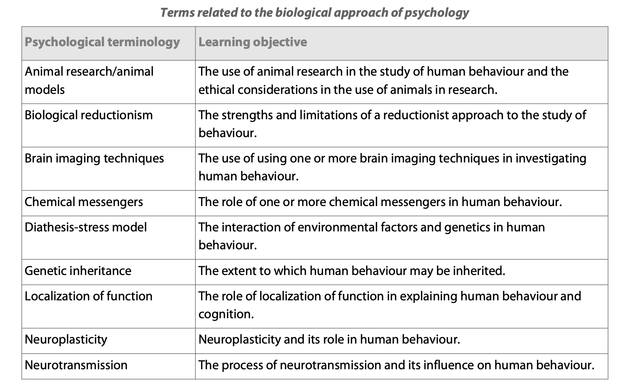
Models of development

Slide 4
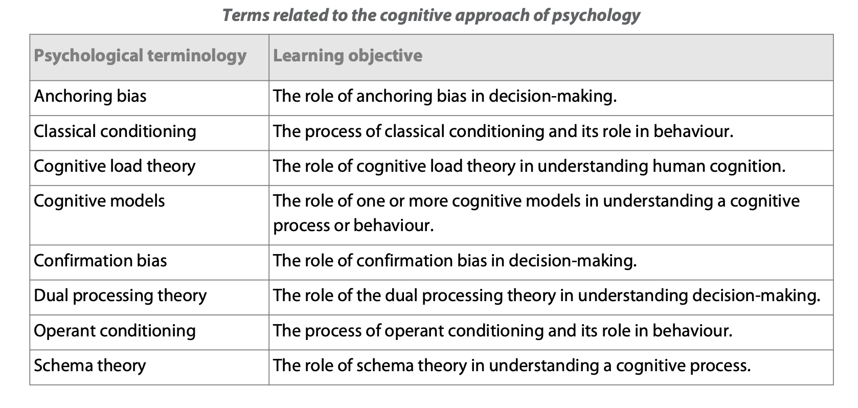
Models of development

Slide 5

Developmental psychology
The study of how and why people’s behaviour and cognition changes over time

Slide 6

Developmental psychology

Slide 7
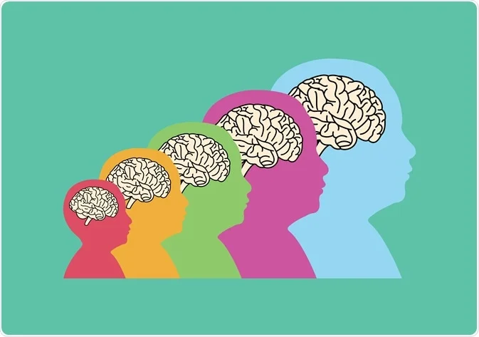
TASK
What is the role of biology in human development?
  When is your brain fully developed?
  What kind environmental factors affect the development of your brain?
Write down your hypotheses

Slide 8
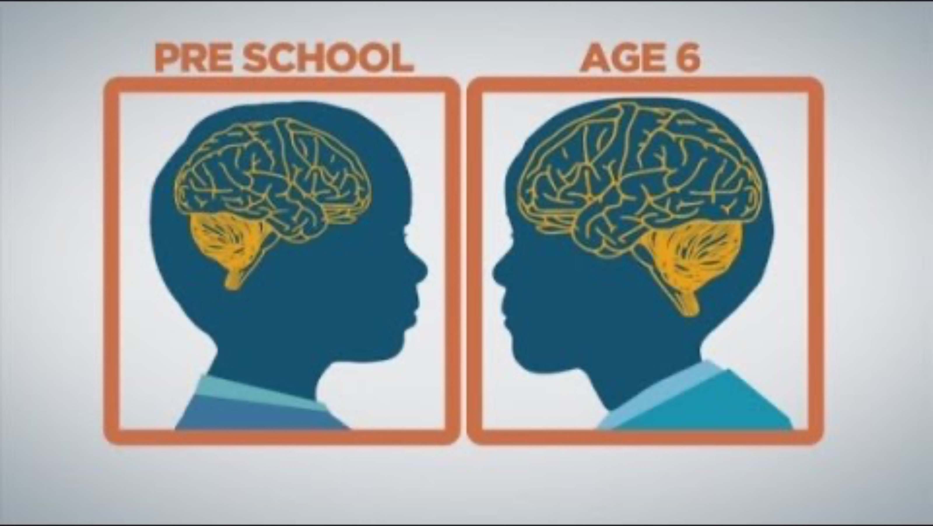
3.1.1 Maturation of the brain
Fill out the teacher’s handout

Slide 9

3.1.1 Maturation of the brain
Fill out the teacher’s handout

Slide 10
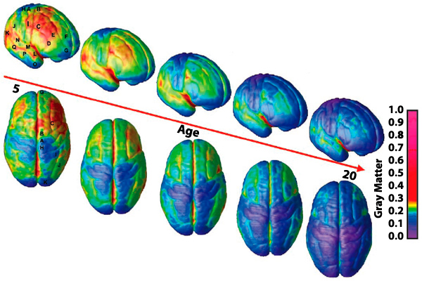
TASK
Summarise the main points of ”Maturation of the brain” in your own words from Kognity 3.1.1
  Focus on the main text, table 1 and Chugani (1991) (abbreviation in Kognity 3.1.10)

Slide 11
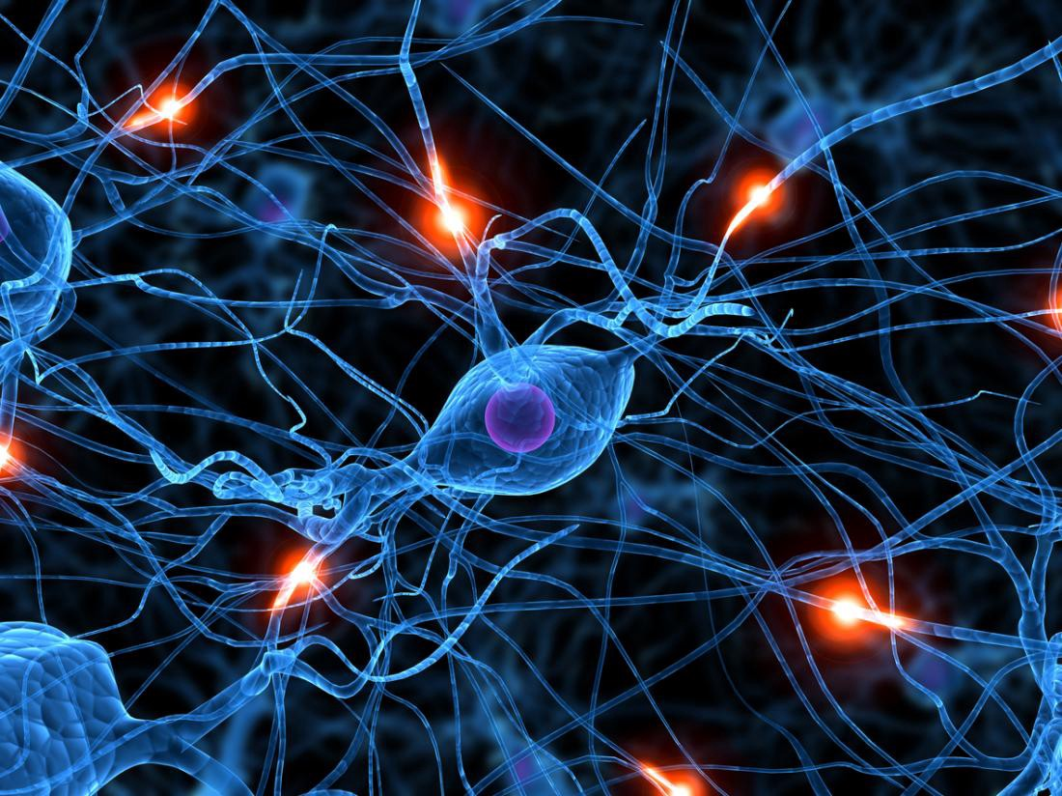
REVIEW
What was meant by neuroplasticity?
  Changes in neural networks, making and braking of neural connections

Slide 12
3.1.1 Neuroplasticity
Neurogenesis
  Process of forming new neurons in the brain
Synaptic genesis
  Formation of new connection between neurons (synaptogenesis)
Neural pruning
  Process where unnecessary synapses and neurons are eliminated
Synaptic pruning
  ”Death” of the synapses
  Can lead to the death of the neurons

Slide 13
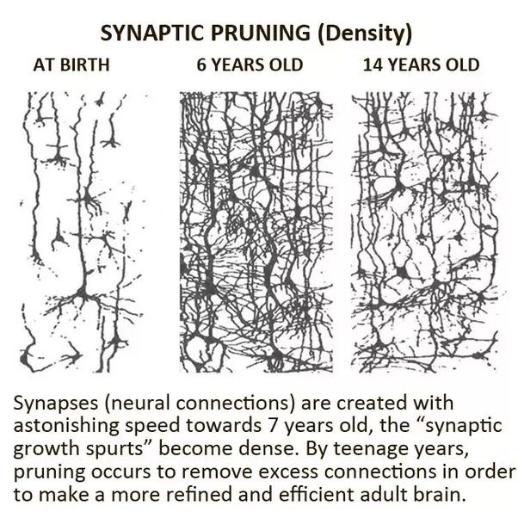
3.1.1 Neuroplasticity
From birth to 2 years rapid formation of synapses occurs
Around 2 to 5 years neural pruning is at its peak
From 6 years onwards pruning slows down, but continues till mid 20s

Slide 14
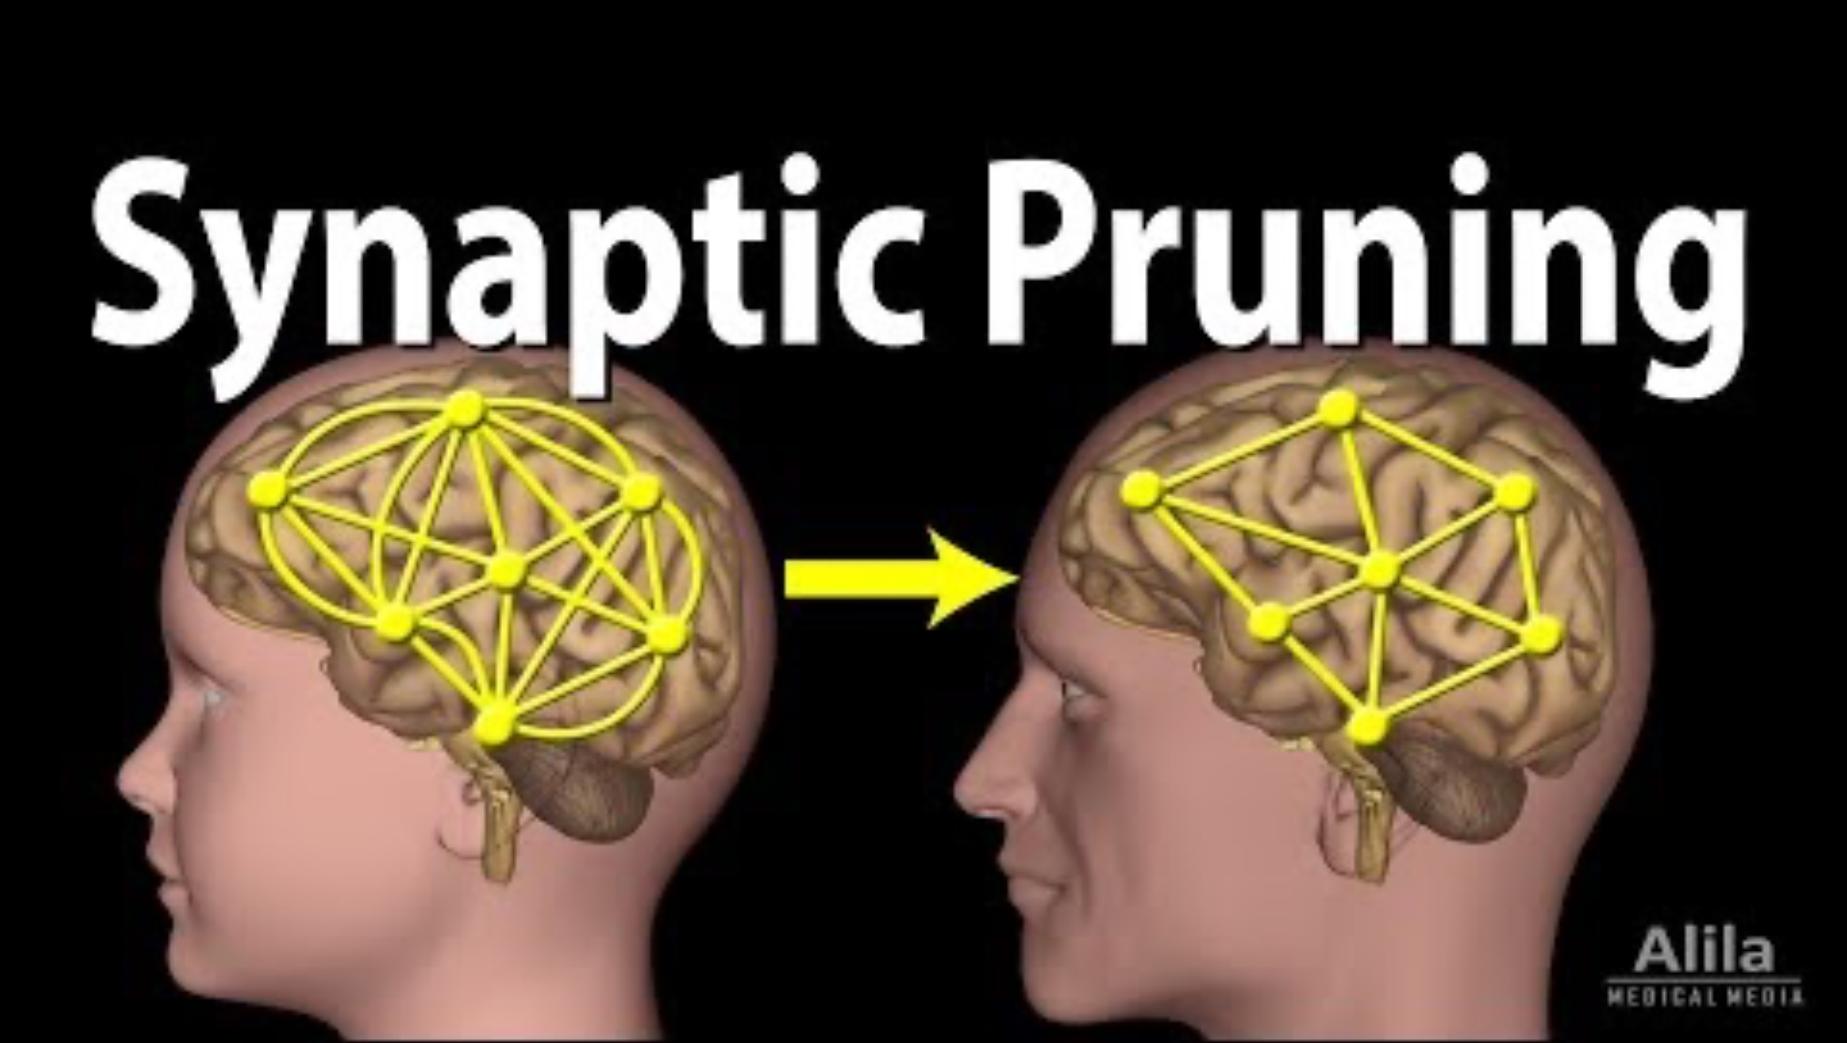
3.1.1 Neuroplasticity

Slide 15
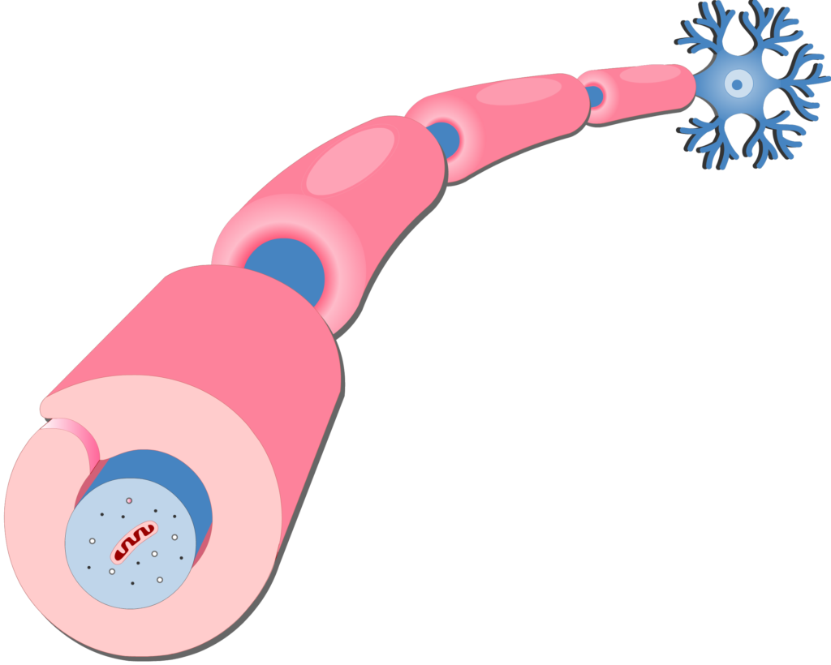
3.1.1 Neuroplasticity
Myelination
  Formation of fatty myelin sheath around the axons
  Produced by glia cells or support cells in the body
  Peaks from 0 to 2 years but continues to mid 20s

Slide 16
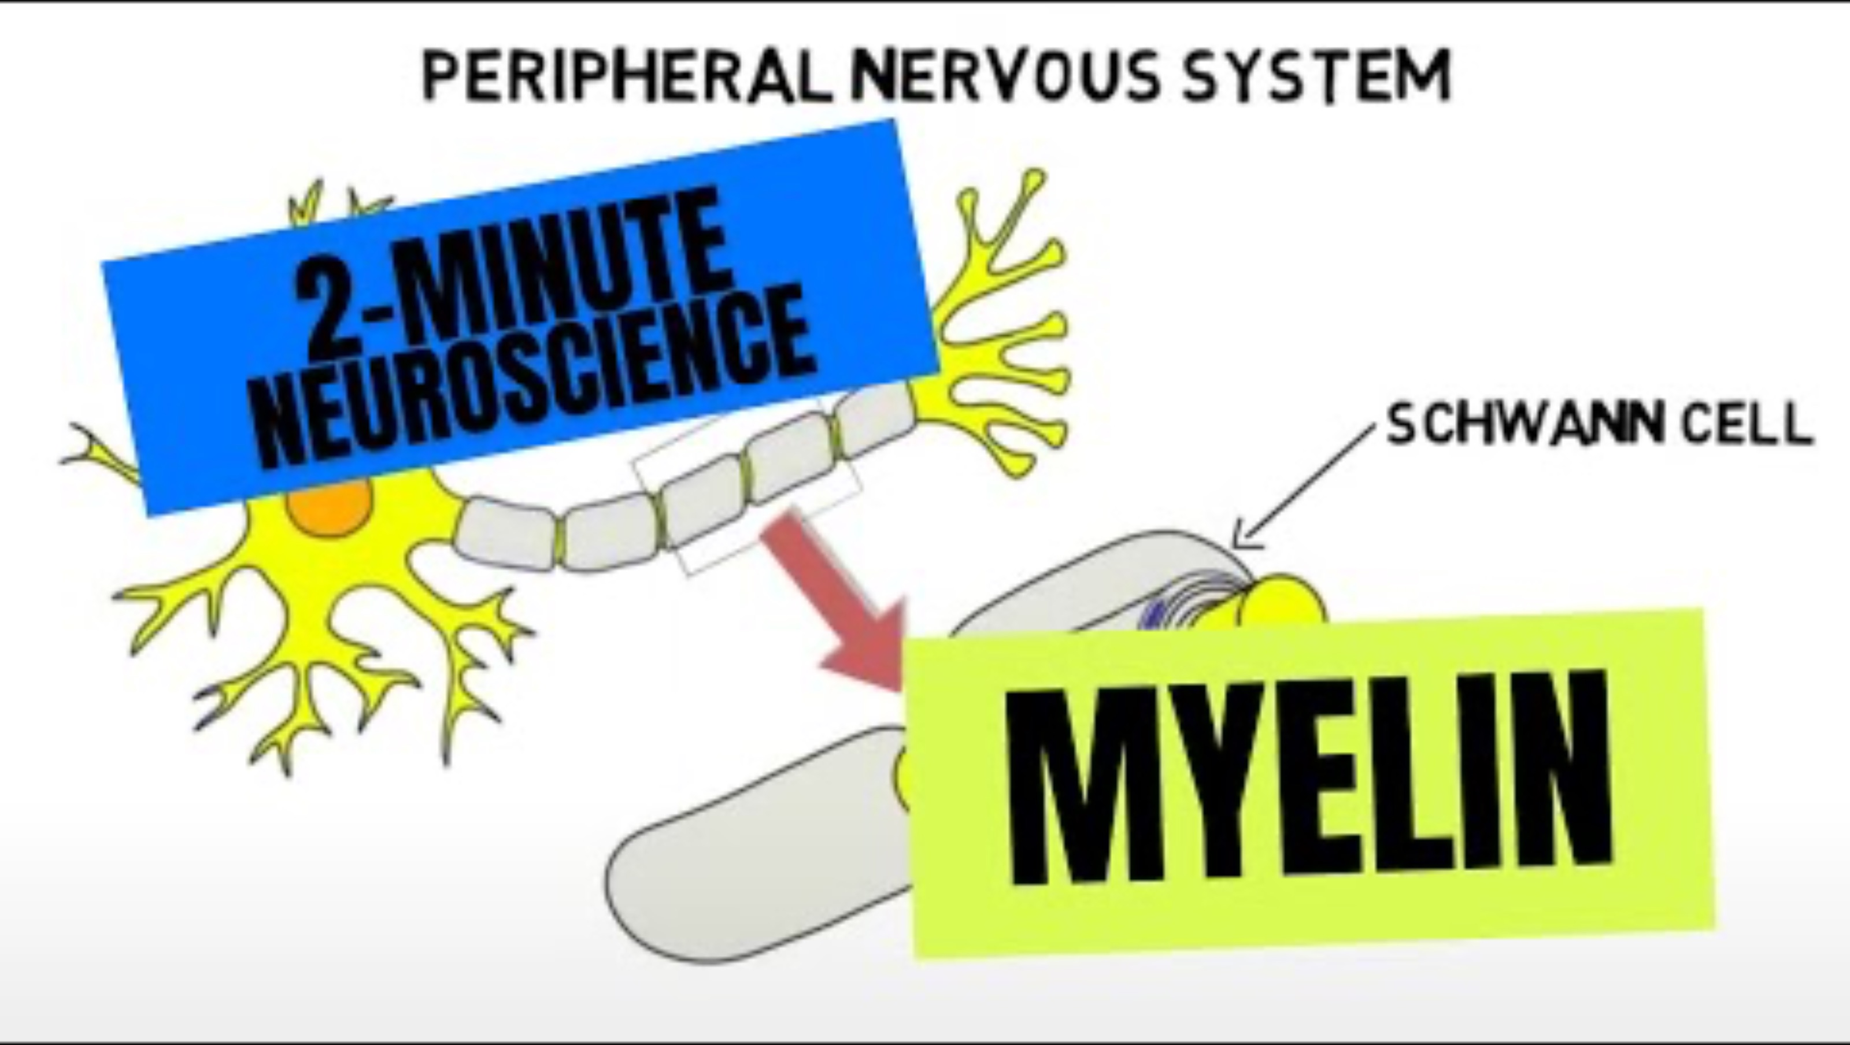
3.1.1 Neuroplasticity

Slide 17
TASK
Read ”Role of environment on neuroplasticity” and “Critical periods” from Kognity 3.1.1
  Summarize the gist of the main text with simple keywords or concept maps
  Find out the gist of Rosenzweig, Bennett and Diamond (1972) and Rutter et al. (2007) (abbreviations in 3.1.10)
  Focus on the table 2, table 3 and the concepts of critical period and sensitive period

Slide 18

3.1.1 Neuroplasticity

Slide 19
TASK
Did the video on Romanian orphanages give you new insights into the role of environment on neuroplasticity and critical / sensitive periods?
What kind of ethical considerations should researchers apply when studying these kind of children?

Slide 20
TASK
How well did your hypotheses about the role of biology in human development correspond with the things you learned?

Slide 21
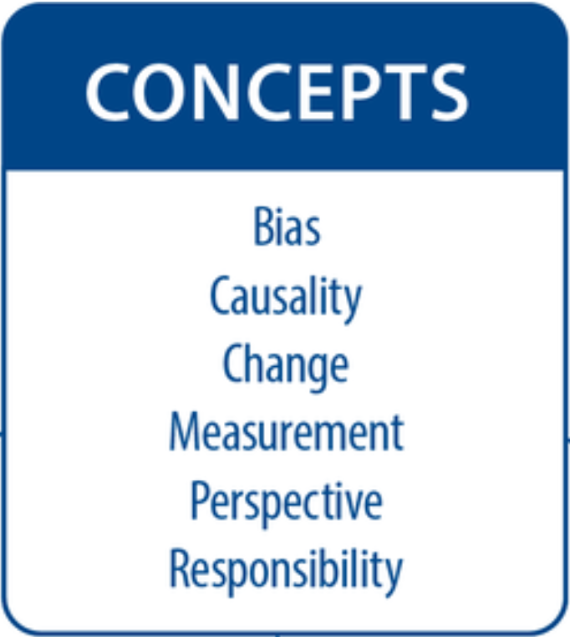
TASK
Teacher divides you into six groups
Each group revolves through six checkpoints and contributes to concept maps based on the Brain development

Slide 22

3.1.2 Stage theories
Stage theories of development argue that cognitive development proceeds in stages from childhood to adulthood

Slide 23
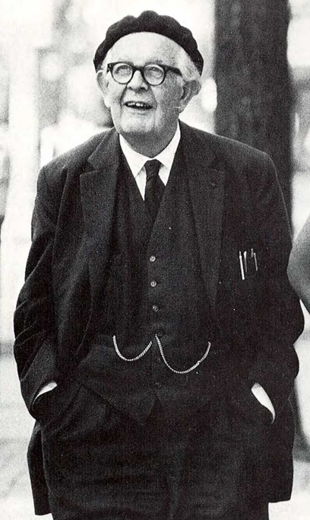
3.1.2 Stage theories
Piaget’s theory of cognitive development is based on biological maturation

Slide 24
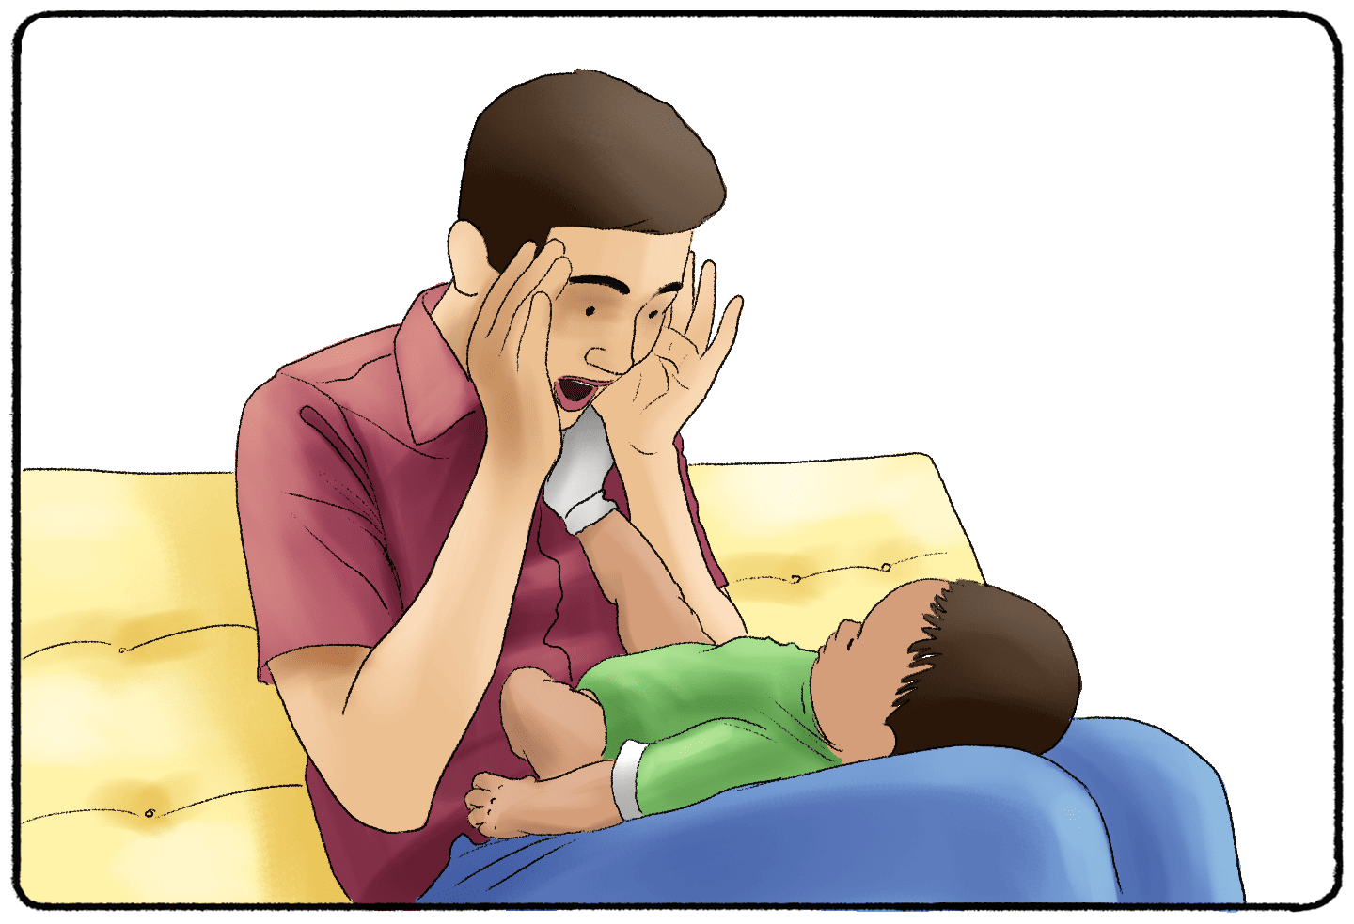
3.1.2 Stage theories
(1) Sensorimotor stage (0 to 2 years)
  Gathering information via senses and movement
  Object permanence

Slide 25
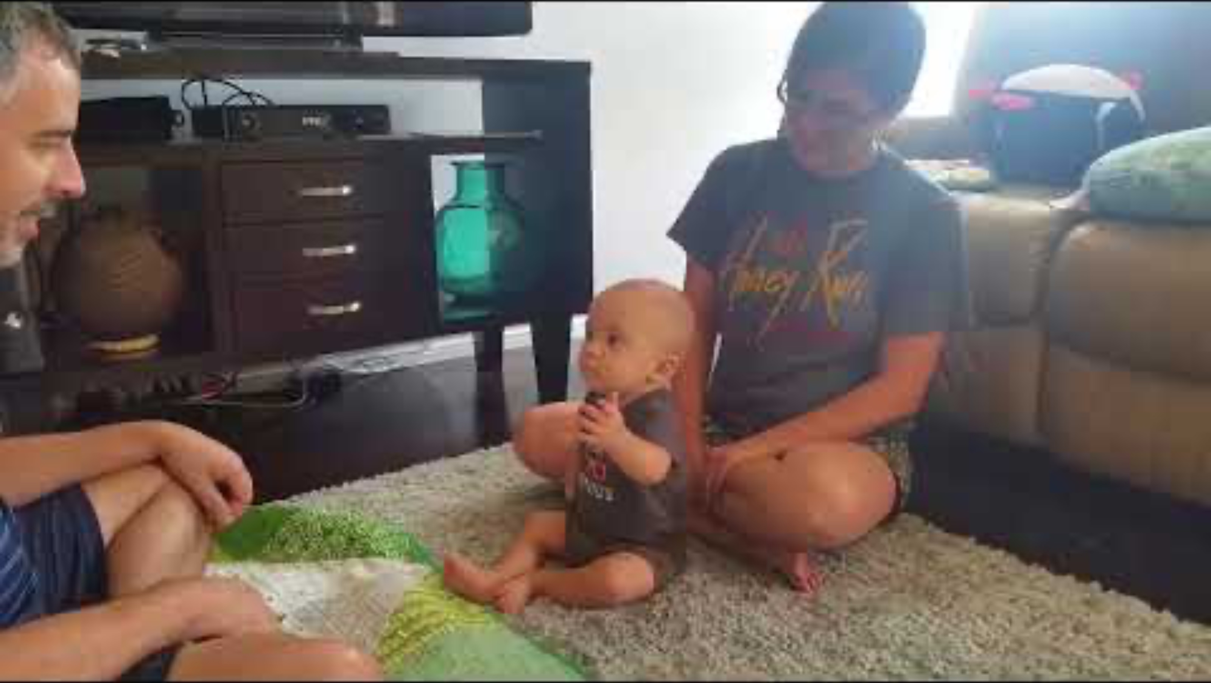
3.1.2 Stage theories
Example of object permanence

Slide 26
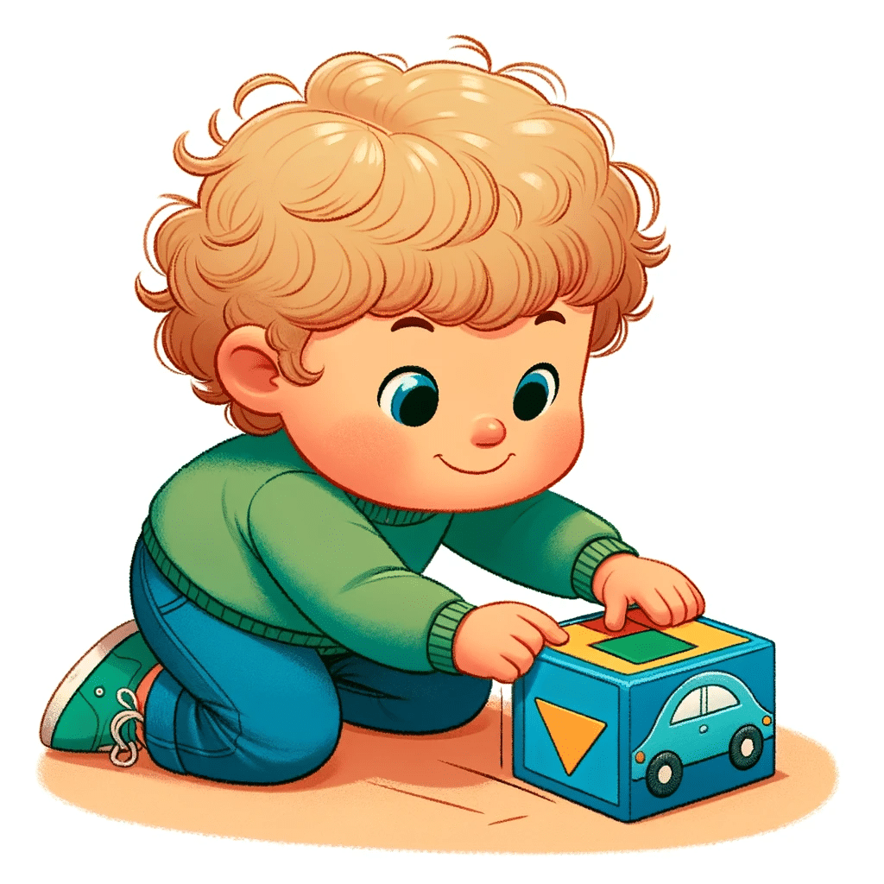
3.1.2 Stage theories
(2) Preoperational stage (2-7 years)
  Symbolic thinking is enabled
  No understanding of conservation
  Egocentrism

Slide 27
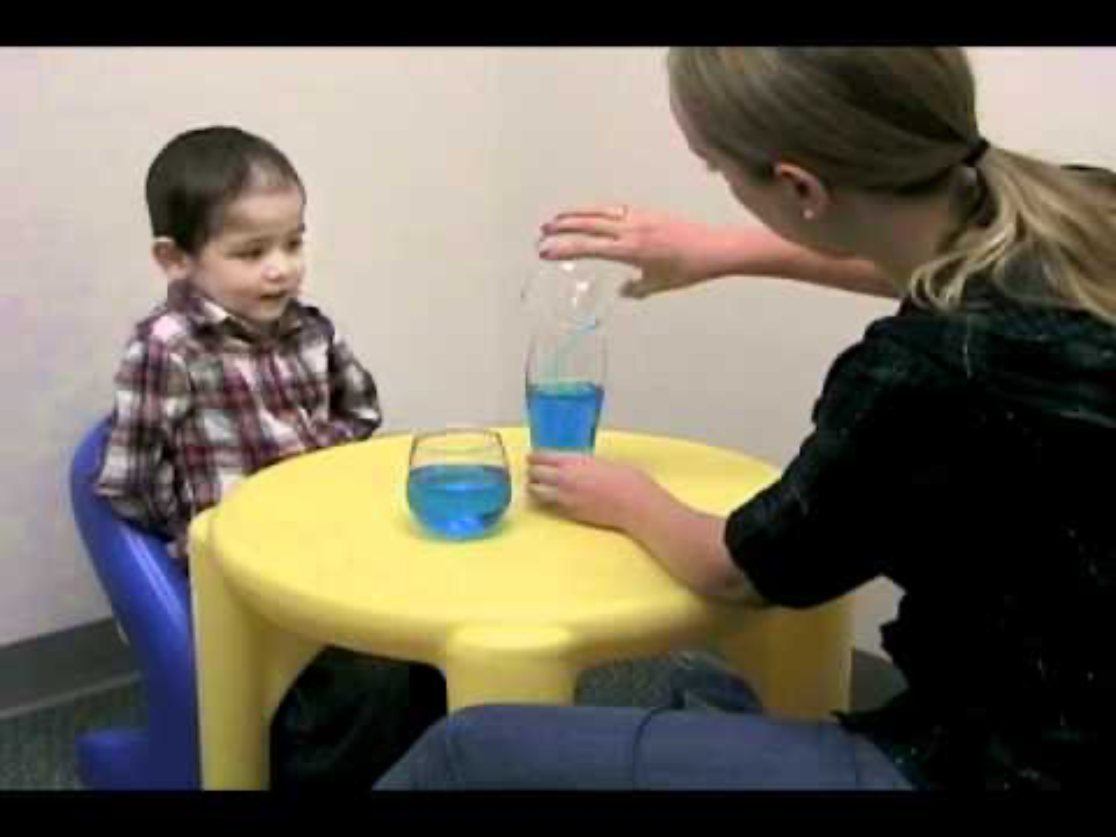
3.1.2 Stage theories
Example of Piaget’s conservation task

Slide 28
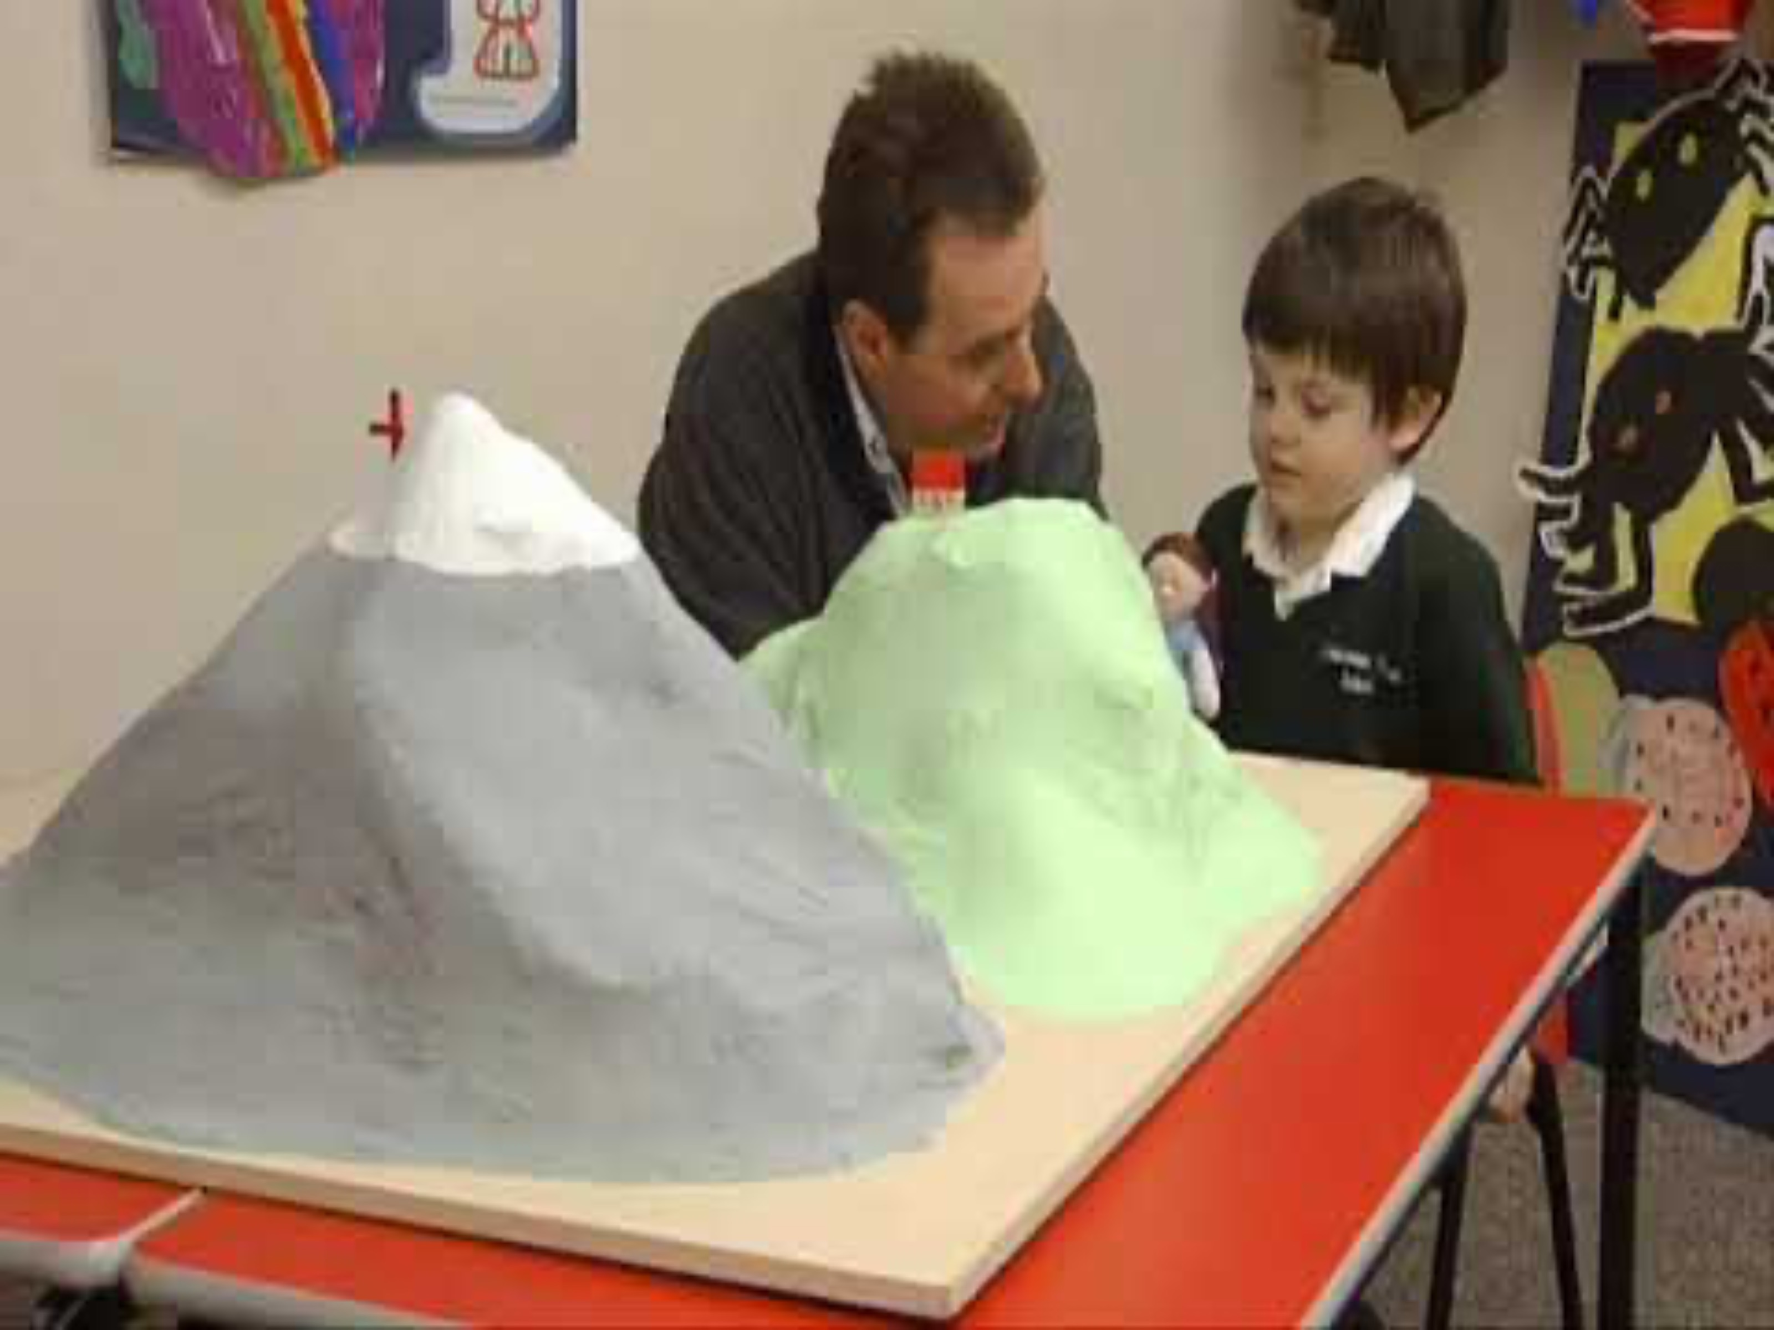
3.1.2 Stage theories
Example of egocentric thinking

Slide 29

3.1.2 Stage theories
(3) Concrete operational stage (7-11 years)
  Ability to understand conservation
  No understanding of abstract thinking
  Can perform reverse operations
  No longer egocentric (Theory of Mind)

Slide 30

3.1.2 Stage theories
(4) Formal operational stage (12+ years)
  Abstract thinking enabled
  Complex schemas that enable application of knowledge

Slide 31

3.1.2 Stage theories
(5) Postformal operational stage (adulthood)
  Critical thinking
  Ability to accept conflicts and withstand uncertainty
Not part of Piaget’s
original theory

Slide 32
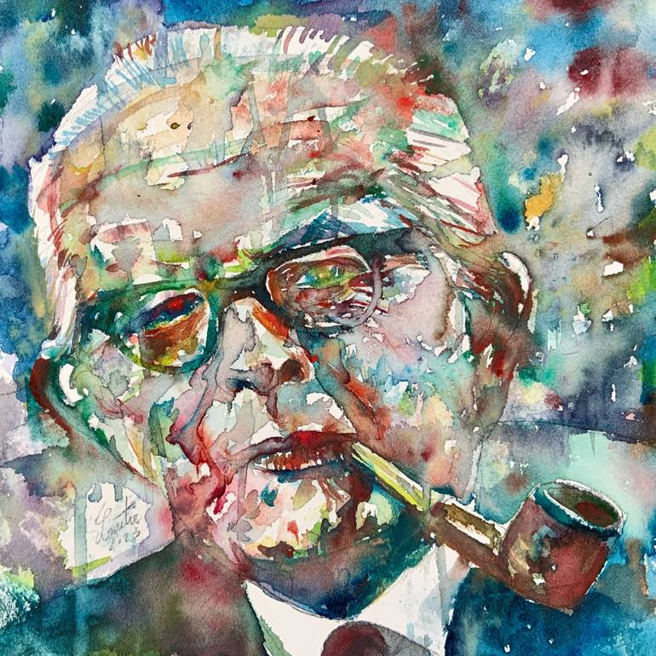
REVIEW
Read ”Piaget’s stages of cognitive development” from Kognity 3.1.2
  Review Piaget’s schema theory
  Review Piaget’s stage theory
  Amend your memos

Slide 33
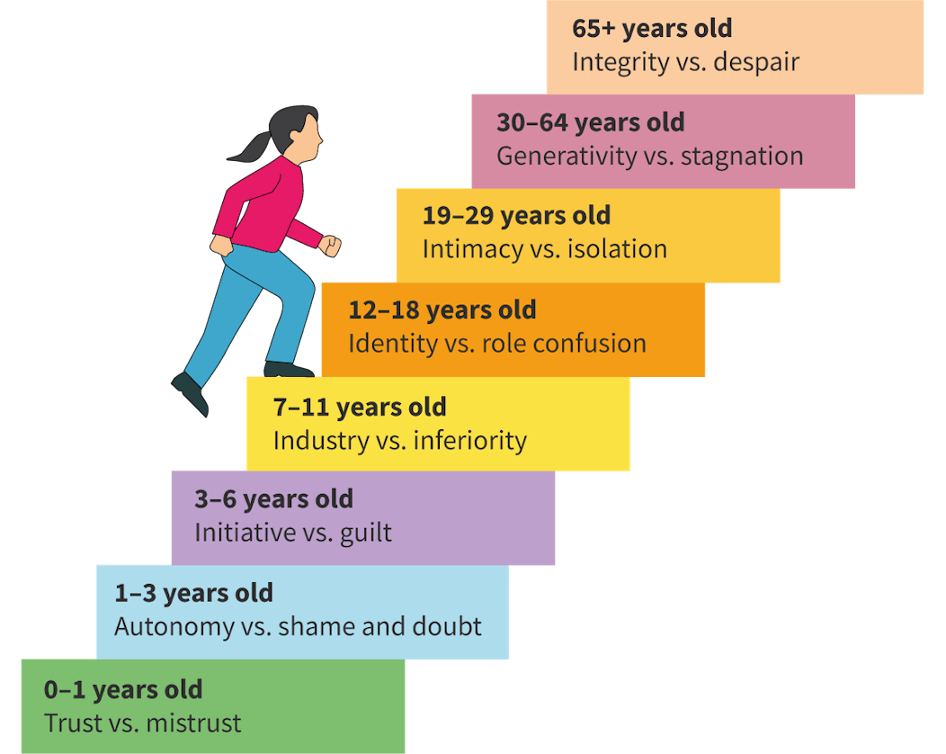
TASK
Read ”Erik Erikson’s stages of psychosocial development” from Kognity 3.1.2
  Summarize the main idea of Erikson’s theory in your own words
  Do NOT cover the stages

Slide 34
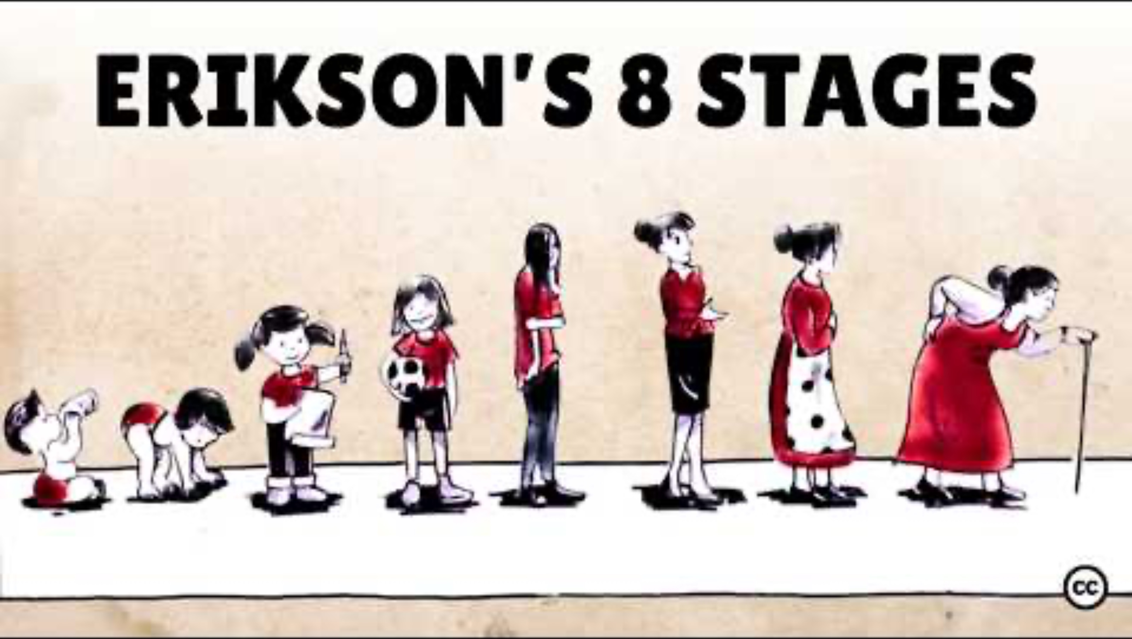
3.1.2 Stage theories
Summarize Erikson’s stages

Slide 35
TASK
Evaluate stage theories of development through the six basic concepts
  What are the strengths and limitations of stage theories?
  Use the table 2 from Kognity 3.1.2
  Write your ideas on the whiteboard

Slide 36

3.1.2 Theory of Mind (ToM)
Ability to think that others have beliefs and desires different from one’s own perspective

Slide 37
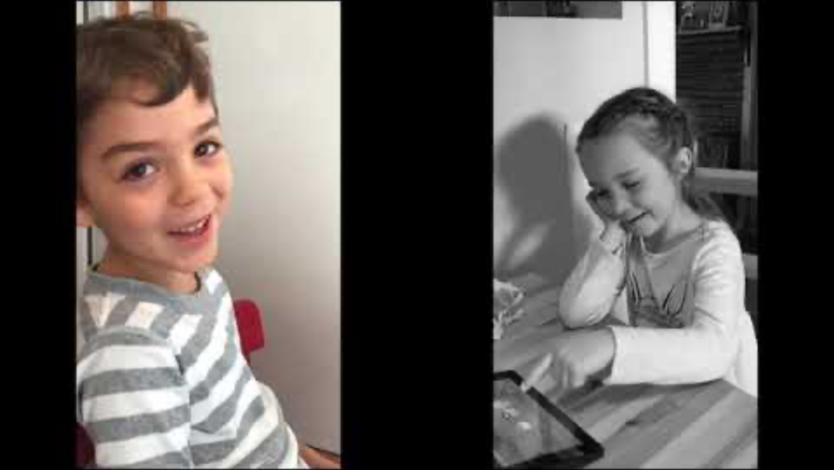
3.1.2 Theory of Mind (ToM)

Slide 38
3.1.2 Theory of Mind (ToM)
Barron-Cohen’s (1996) stage theory of mind
  (1) Pre theory of mind (1st year): gaze following
  (2) Desire stage (1-2 years): others have desires
  (3) Belief-desire stage (3 years): others can have desires and beliefs different from my own
  (4) Representational stage (4 years onwards): others’ beliefs can be false

Slide 39
3.1.2 Theory of Mind (ToM)
Development of ToM later in life
  Middle childhood (6–12): Children become less egocentric and more logical
  Adolescence (12–18): Cognitive empathy that supports complex relationships
  Adulthood and later life: More nuanced ToM with elaborate communication and social navigation

Slide 40
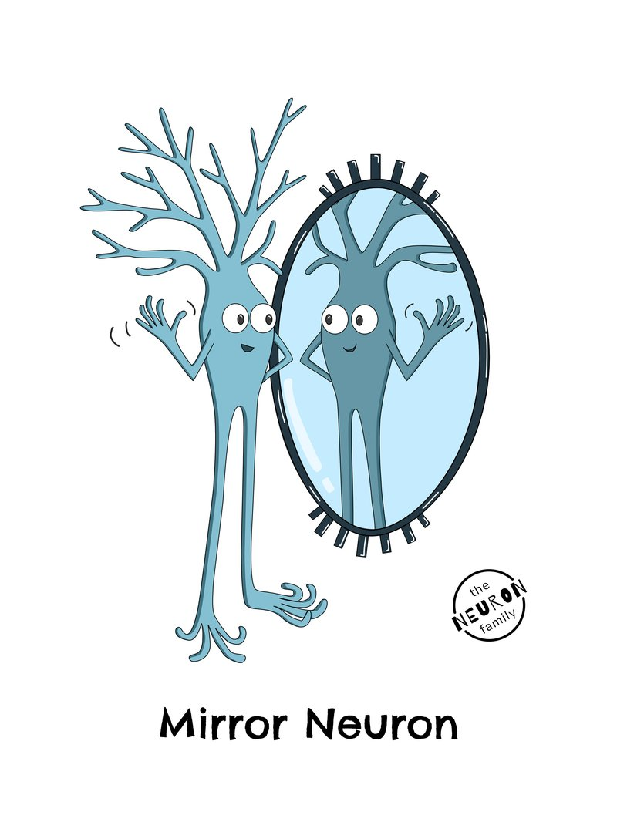
TASK
Read Carr et al. (2003) from teacher’s supplementary materials
  What role do mirror neurons play in Theory of Mind (ToM)?

Slide 41
TASK
Evaluate theory of mind through the six basic concepts
  What are the strengths and limitations of theory of mind?
  Write your ideas on the whiteboard

Slide 42

3.1.3 Continuous theories
Continuous theories of human development argue that development is a gradual, incremental process

Slide 43

TASK
How similar are you with people from other cultures?
Have you all gone through similar stages of development to become who you are?

Slide 44
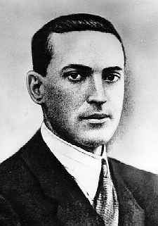
3.1.3 Continuous theories
Vygotsky’s sociocultural theory (1934)
  Child’s development is based on interactions with others in a certain social and cultural context
  Learning precedes development

Slide 45
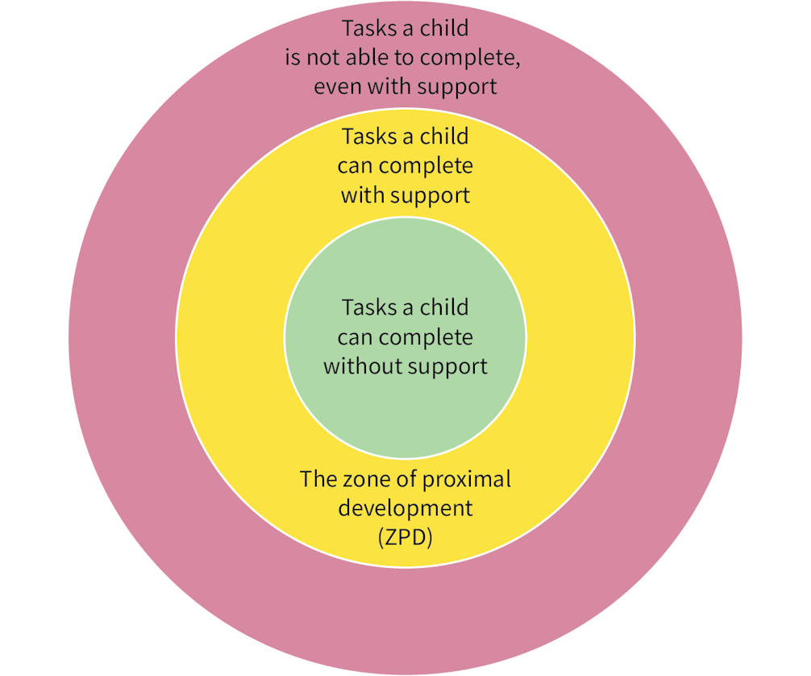
TASK
Read ”Vygotsky’s theory” from Kognity 3.1.3
  Complete the
  teacher’s handout

Slide 46
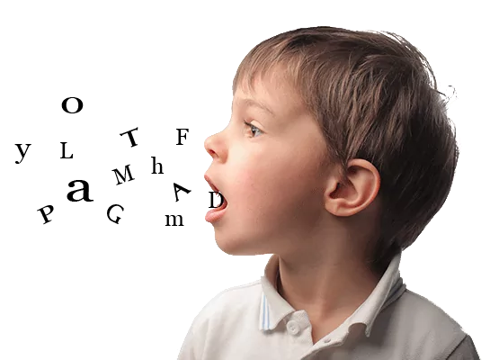
3.1.3 Continuous theories
Vygotsky’s language theory
  Private speech: children talk aloud to themselves
  Egocentric speech: children’s monologue to guide their actions
  Inner speech: children speak to themselves silently in their minds
Internalised language leads to
independent thinking

Slide 47
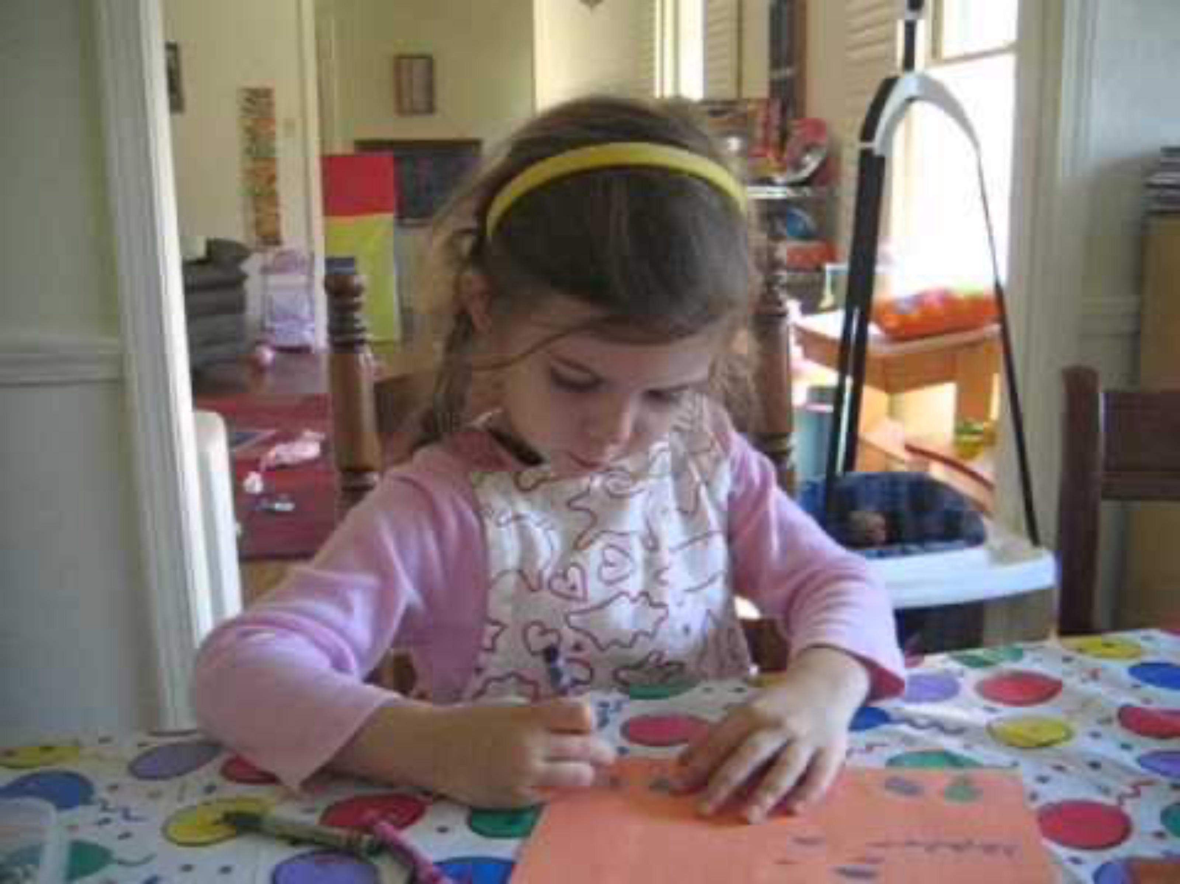
3.1.3 Continuous theories
Example of private speech

Slide 48
TASK
Evaluate continuous theories of development through the six basic concepts
  What are the strengths and limitations of continuous theories?
  Write your ideas on the whiteboard

Slide 49
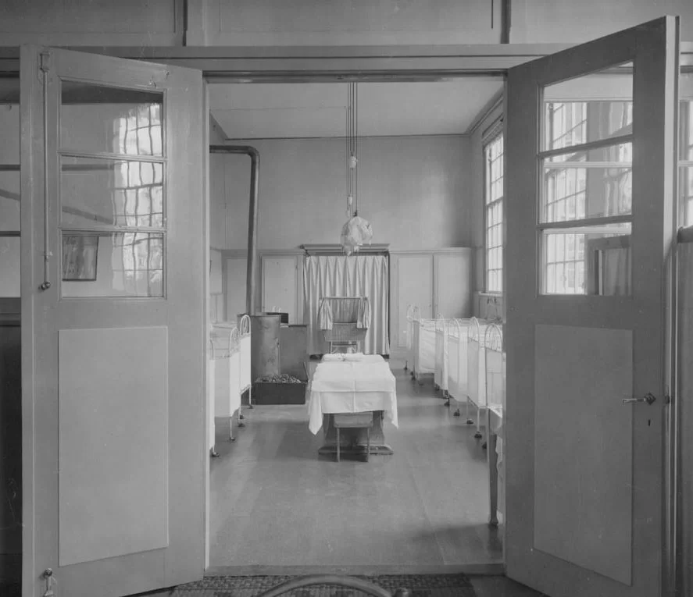
TASK/REVIEW
Read ”Deprivation and privation” from
Kognity 3.1.3
  What is meant by institutionalisation, deprivation and privation?
  How do they connect with Romanian orphanages and Rutter et al. (2007)?

Slide 50

TASK
Read Arranbarri et al. (2023) from teacher’s supplementary materials
What role does socioeconomic status play in human development?

Slide 51
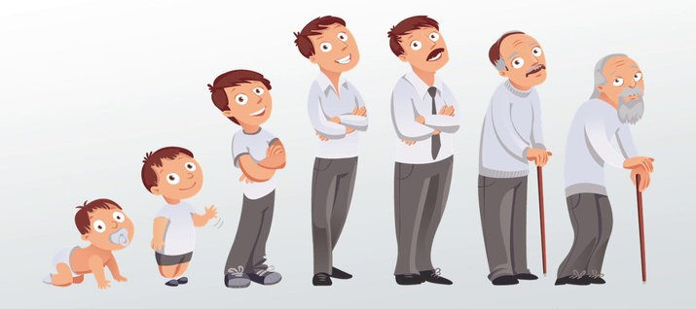
TASK
To what extent is human development universal?
  Try provide arguments and counter arguments based on what you have learned

Slide 52
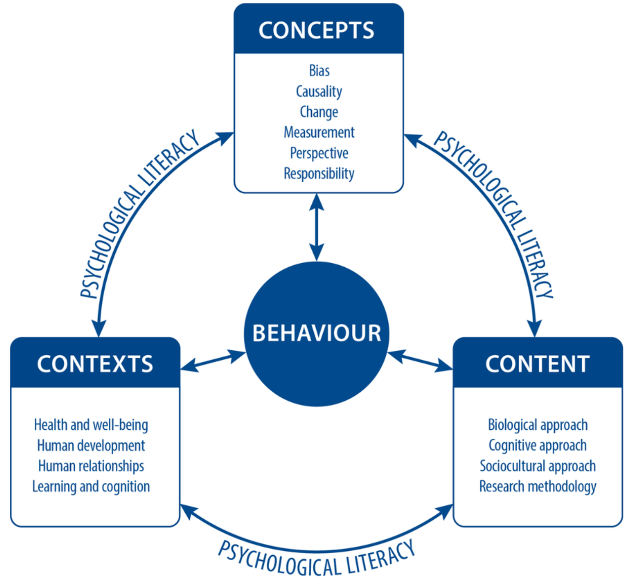
TASK
Teacher divides you into six groups and gives each group a topic from models of development
Each group makes a concept map based on the syllabus

Slide 53
Picture sources
Woman’s life-cycle <http://www.omaplus.fi/?s=artikkelit&p=108> Accessed 2nd of December 2015.
Brain development <https://www.news-medical.net/health/An-Overview-of-Brain-Development.aspx> Accessed 20th of October 2025.
Brain maturation <https://sites.duke.edu/apep/module-3-alcohol-cell-suicide-and-the-adolescent-brain/science-content/brain-maturation-is-complete-at-about-24-years-of-age/> Accessed 22nd of October 2025.
Blue brain cells <https://medium.com/predict/artificial-neural-networks-mapping-the-human-brain-2e0bd4a93160> Accessed 10th of February 2020.
Synaptic pruning<https://www.quora.com/How-much-can-our-brains-be-altered-after-we-enter-adulthood> Accessed 10th of February 2020.
Myelin sheath <https://www.getbodysmart.com/neuron-support-cells/schwann-cells/> Accessed 22nd of October 2025.
Stages <https://www.grahamfoster.co.uk/stages-of-a-branding-project/> Accessed 22nd of October 2025.
Jean Piaget <https://fi.wikipedia.org/wiki/Jean_Piaget> Accessed 22nd of October 2025.
Playing parent and child <https://practicalpie.com/object-permanence/> Accessed 22nd of October 2025.
Child playing <https://helpfulprofessor.com/preoperational-stage-examples/> Accessed 22nd of October 2025.
Experimenting child <https://www.fidmz.online/?ggcid=4746609> Accessed 22nd of October 2025.

Slide 54
Picture sources
Group of youngsters <https://www.britannica.com/science/formal-operational-stage> Accessed 22nd of October 2025.
Thinking woman <https://www.freepik.com/premium-photo/middle-age-woman-thinking-feeling-doubtful-confused-with-different-options-wondering-which-decision-make_22042990.htm> Accessed 22nd of October 2025.
Piaget painting <https://www.saatchiart.com/en-fi/print/Painting-JEAN-PIAGET/73588/11849799/view?srsltid=AfmBOorLQWNDuBs9lcVOLw4eylZA2eBEC22vLKRae-dWI5iLq1AWc4tA> Accessed 22nd of October 2025.
Erikson’s stages – Kognity
Strenghts and weaknesses <https://silviapencak.com/strengths-and-weaknesses/> Accessed 22nd of October 2025.
Theory of mind <https://embrace-autism.com/autism-and-theory-of-mind-whats-new/> Accessed 22nd of October 2025.
Mirror neuron <https://theneuronfamily.com/meet-the-neuron-family/mirror-neuron/> Accessed 23rd of October 2025.
Continuum <https://www.absolutestl.com/understanding-it/understanding-business-continuity> Accessed 23rd of October 2025.
Lev Vygotsky <https://fi.wikipedia.org/wiki/Lev_Vygotski> Accessed 23rd of October 2025.

Slide 55
Picture sources
Flaghand <https://psychology.iresearchnet.com/social-psychology/cultural-psychology/culture/> Accessed 11th of October 2017.
Zone of proximal development – Kognity
Talking child < https://thestaracademy.co.za/keep-talking-to-your-kid-to-develop-speech/ > Accessed 23rd of October 2025.
Orphanage <https://livada.org/romanian-orphanages-and-the-rise-of-alternative-care-for-romanian-orphans/> Accessed 23rd of October 2025.
Wealth <https://www.freepik.com/icon/wealth_10983133> Accessed 23rd of October 2025.
Man’s life-cycle <https://study.com/academy/lesson/human-development-stages-from-infancy-to-late-adulthood.html> Accessed 23rd of October 2025.

