Slide 1
3.2 DEVELOPMENT OF SELF
IB Psychology LAJM

Slide 2

TASK
What makes you, you?
  Write a short description
What factors influence your identity?
  Compile a short list or a mind-map
Don’t use any assistive devices!

Slide 3

TASK
Read Kognity 3.2.0
What is meant by
self-identity?
Amend your notes from the previous task

Slide 4

3.2.1 Enculturation of social norms
Social norms
  Sets of rules based on socially and culturally shared beliefs on how we should behave
  Mutually accepted standards of behaviour in a certain group

Slide 5
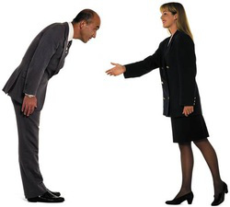
TASK
What kind of social norms do you have in your life?
How have you internalised the norms?
What kind of differences in norms have you encountered?

Slide 6
3.2.1 Enculturation of social norms
ENCULTURATION
ACCULTURATION
The process by which people internalise the surrounding culture to fully function within it
Internalising one’s own culture
The process of psychological and cultural change resulting from interacting with another culture
Adapting to another culture

Slide 7
TASK
Read the light green ”Perspective lens” box in Kognity 3.2.1
  What parts of your enculturation has been conscious and unconscious
  Make amendments to your notes

Slide 8
3.2.1 Enculturation of social norms
Enculturation can occur in:
  (1) Direct education
  (2) Participatory learning
  (3) Observational learning
Socialisation can be used as synonym to enculturation
Cultural transmission is accomplished through enculturation

Slide 9
TASK
Read the summary of Fagot (1979) from Kognity 3.2.9
  How does this study resonate with how you have learned your gender roles?
Read Smith and Lloyd (1978) from the teacher’s supplementary materials
  Are we biased with our conceptions of gender roles?

Slide 10
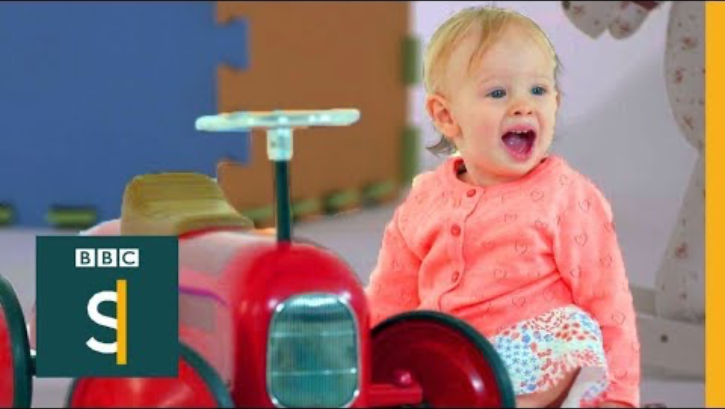
3.2.1 Enculturation of social norms
What does this video tell you about enculturation and gender roles?

Slide 11

3.2.1 Enculturation of social norms
Read Odden and Rochat (2004) from teacher’s supplementary materials
  What does this study tell you about the role of observational learning in enculturation?

Slide 12
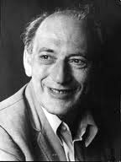
3.2.1 Social identity theory (SIT)
Developed by Tajfel and Turner (1979) for the analysis of intergroup relationships and identity development

Slide 13

3.2.1 Social identity theory (SIT)
Personal identity
  Who am I?
Social identity
  Where do I belong?
We can have several social
selves corresponding to
group memberships

Slide 14


3.2.1 Social identity theory (SIT)
SOCIAL CATEGORIZATION
+ SOCIAL IDENTIFICATION
SOCIAL COMPARISON
In-group: US
Out-group, THEM
Positive distinctiveness
and in-group favouritism:
WE are better than THEM
Intergroup discrimination

Slide 15
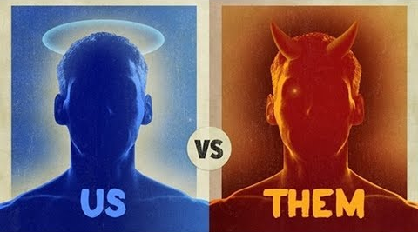
3.2.1 Social identity theory (SIT)
We exaggerate the virtues of our in-group to maintain or enhance positive self-image

Slide 16
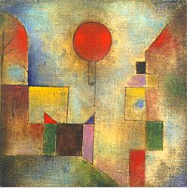
TASK
Read the summary of Tajfel et al. (1971) from Kognity 4.1.10
  How is the minimal group paradigm manifested in this study?
  What are the implications of this study for the development of identity?

Slide 17
TASK
Which groups do you belong to?
How have your group memberships developed your self-identity?
What is the role of groups in developing self-identity?

Slide 18
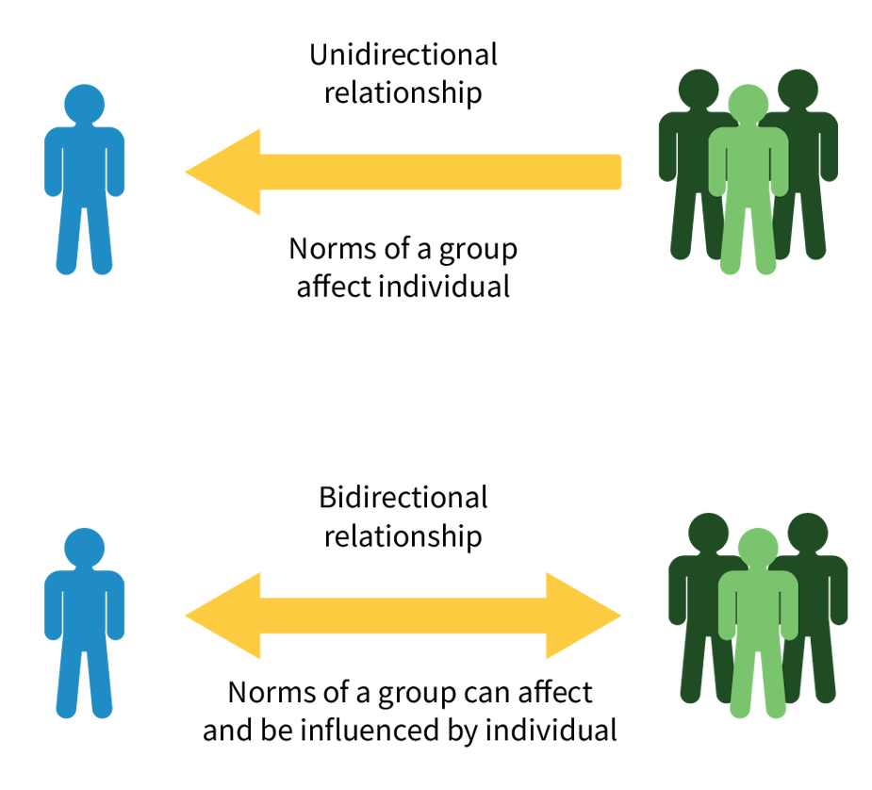
TASK
Read ”Application of social identity theory” from Kognity 3.2.1 and Howarth (2002) from Kognity 3.2.9
  How can SIT be used to explain the development of self-identity?

Slide 19
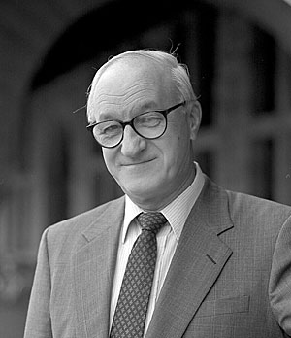
3.2.1 Social learning theory (SLT)
We learn behaviour through observational learning
  We watch models and imitate their behaviour

Slide 20
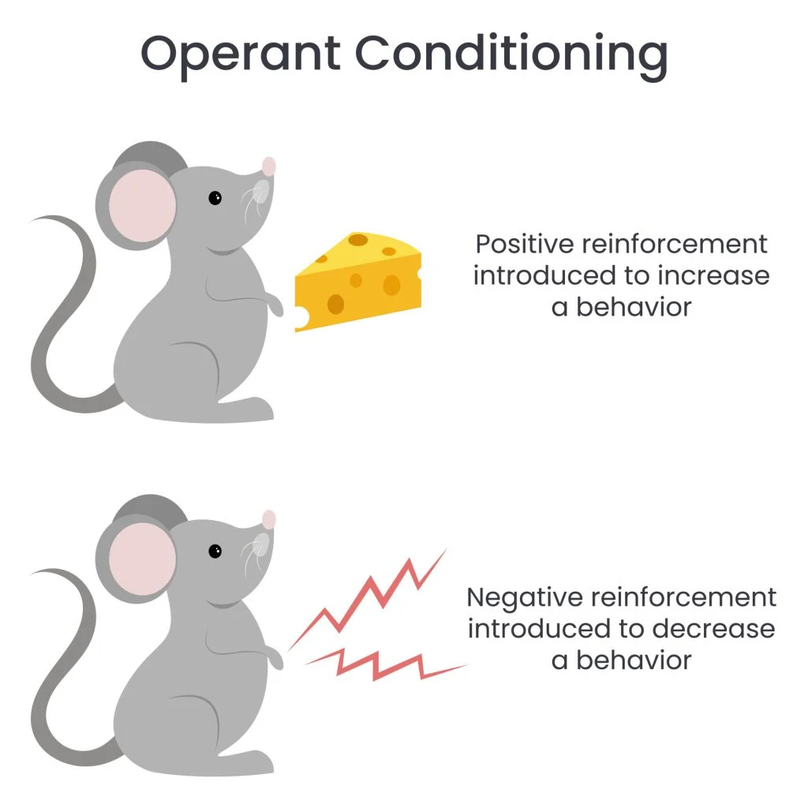
REVIEW
What was meant by operant conditioning?
What was meant by reinforcement in operant conditioning?

Slide 21

3.2.1 Social learning theory (SLT)
Vicarious learning
  Learning from the success and mistakes from others
Vicarious reinforcement
  Reinforcement of the model’s behaviour through rewards and punishments reinforces the imitator’s behaviour as well

Slide 22
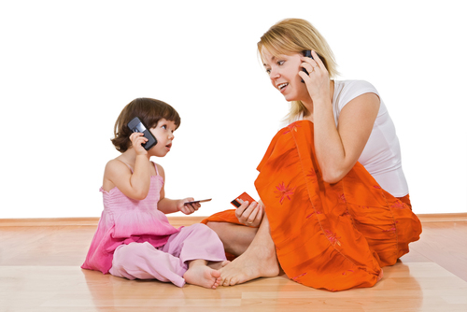
TASK
Find examples of observational learning and vicarious reinforcement from your own life

Slide 23
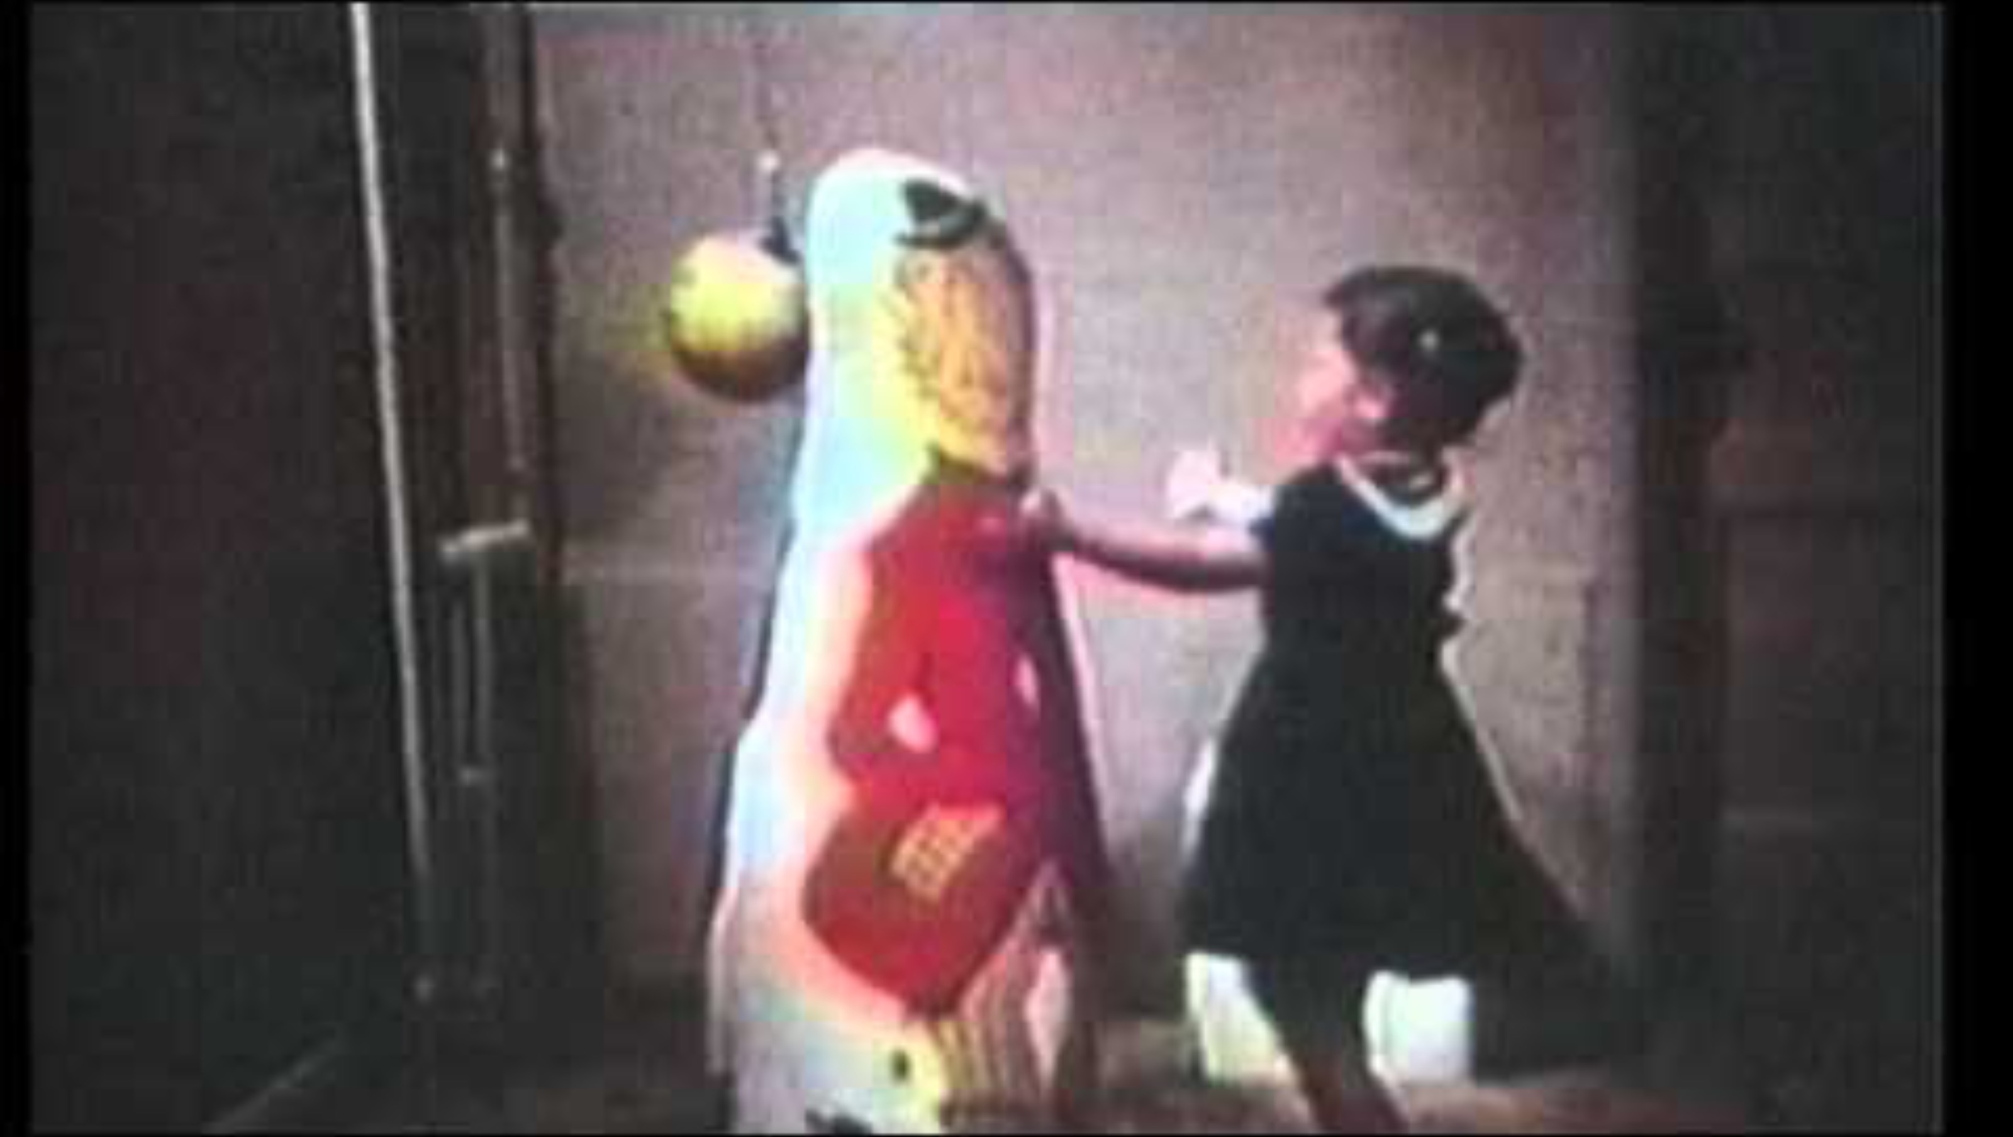
3.2.1 Social learning theory (SLT)
Summary of SLT and Bandura, Ross and Ross (1961)

Slide 24
TASK
Read ”Social learning theory” from Kognity 4.1.1 and find out what the following components of SLT mean
  (1) Attention with Identification and modelling
  (2) Retention
  (3) Reproduction with self-efficacy
  (4) Motivation with expectations
Apply these components to an example from your own life

Slide 25
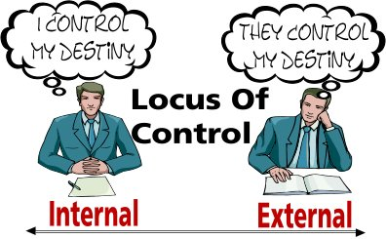
3.2.1 Social learning theory (SLT)
Self-efficacy
  Beliefs in our ability to carry out actions towards a goal
Learned helplessness
  Belief that our own efforts do not make
  any difference in pursuing a goal
High
self-efficacy
Low
self-efficacy

Slide 26
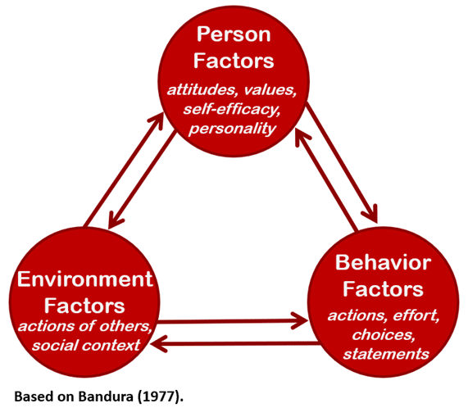
3.2.1 Social learning theory (SLT)
Reciprocal determinism
  We are influenced by our environment, but we also influence the environment
  Bidirectional relationship
Find and/or create and application of
reciprocal determinism from your own life

Slide 27
TASK
Return to ”Enculturation” in Kognity 3.2.1
  Reflect your cultural identity and how it develops your self-identity
  Use everything you have learned from enculturation, SIT
  and SLT

Slide 28

3.2.1 Peer influence
Peers play a crucial role in our development, especially during childhood and adolescence

Slide 29
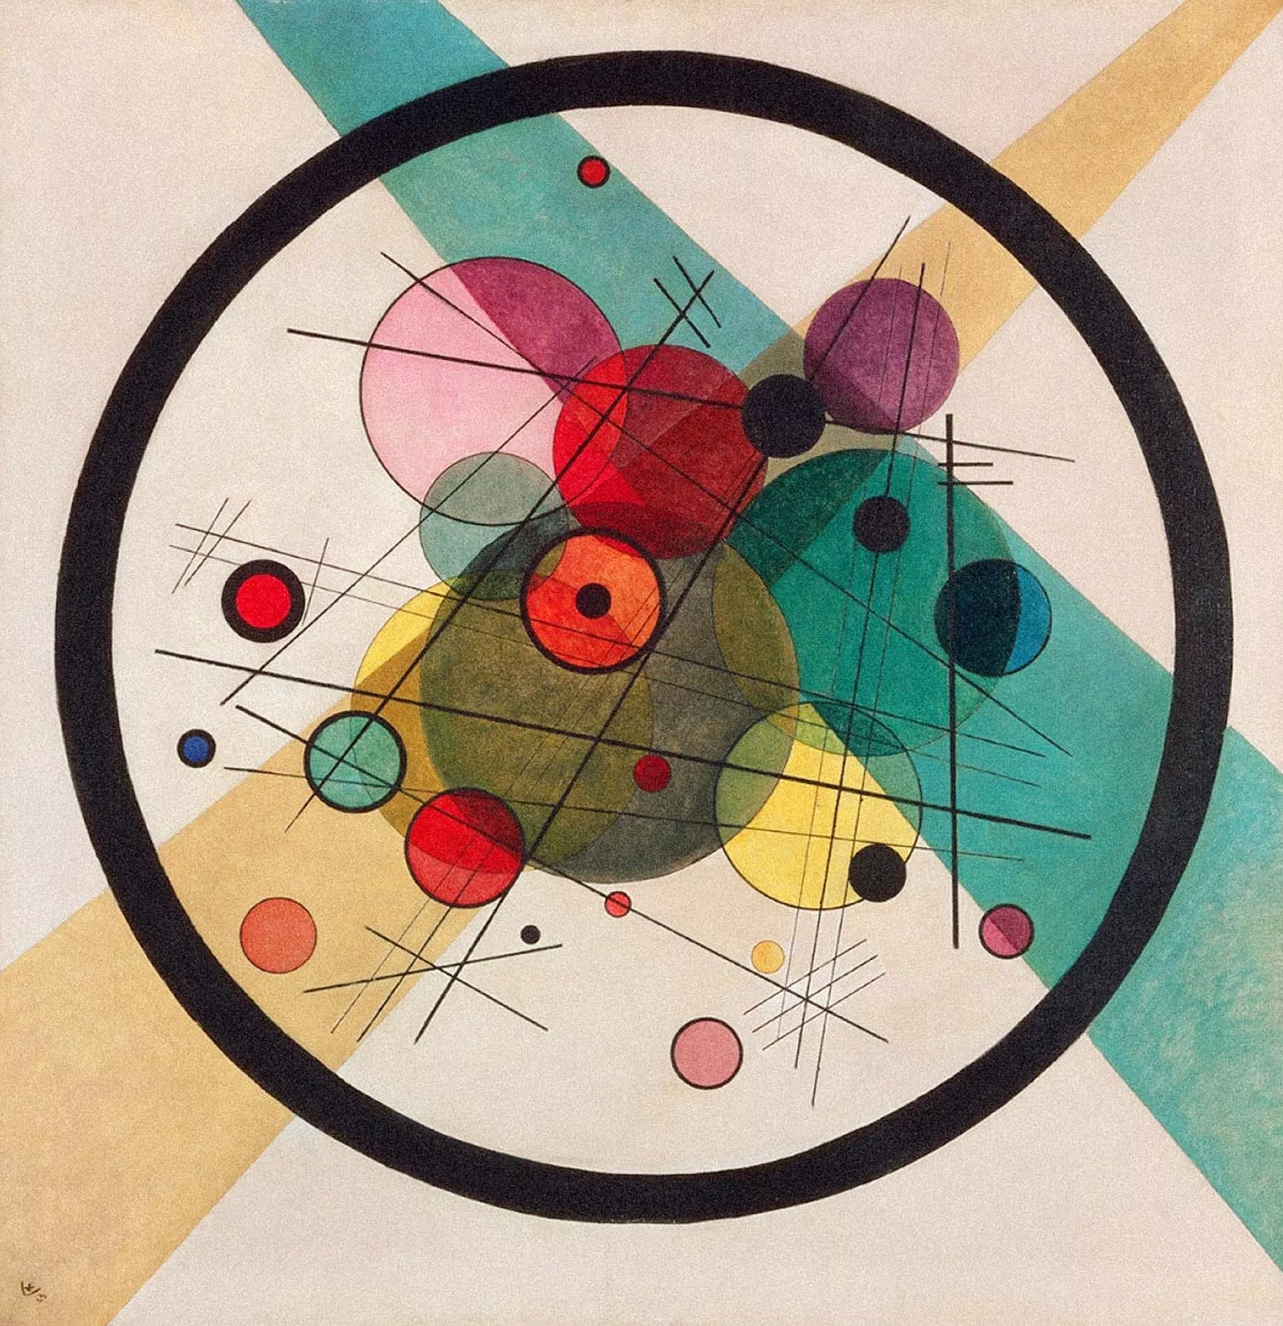
TASK
How can social identity theory (SIT) be applied to explain peer influence?
  Engage in conversation
  Write your ideas on the whiteboard
Read the summary of Jan, Soomro and Ahmad (2017) from Kognity 3.2.9
  What role does social comparison play in self-esteem?

Slide 30
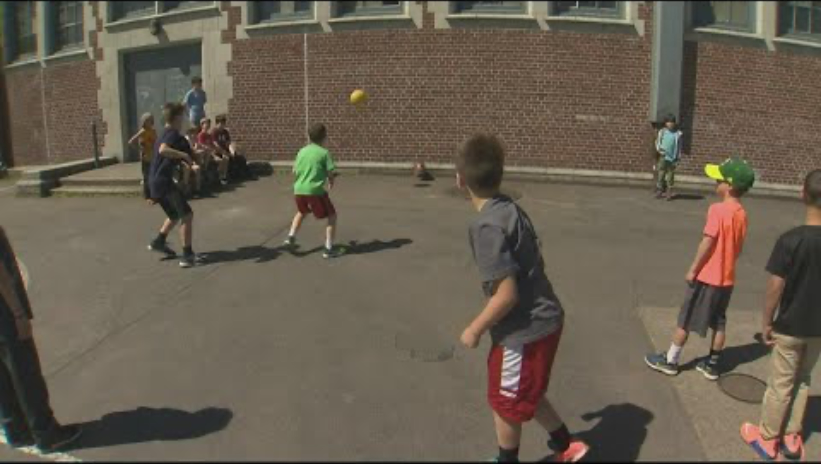
3.2.1 Peer influence
What this video tell you about the importance of peers?

Slide 31
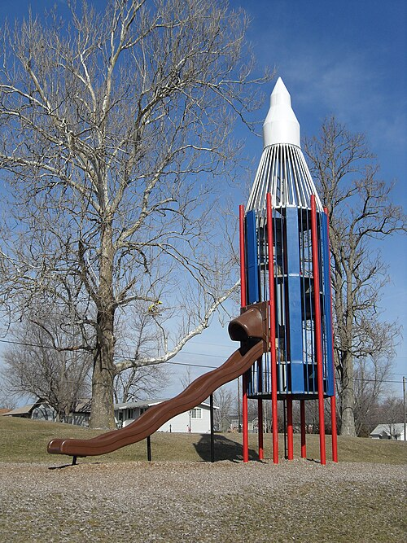
TASK
Form groups
Create a plan for an ideal playground that encourages peer interaction and play
  What would it look like?
  Prepare to present your output to others

Slide 32
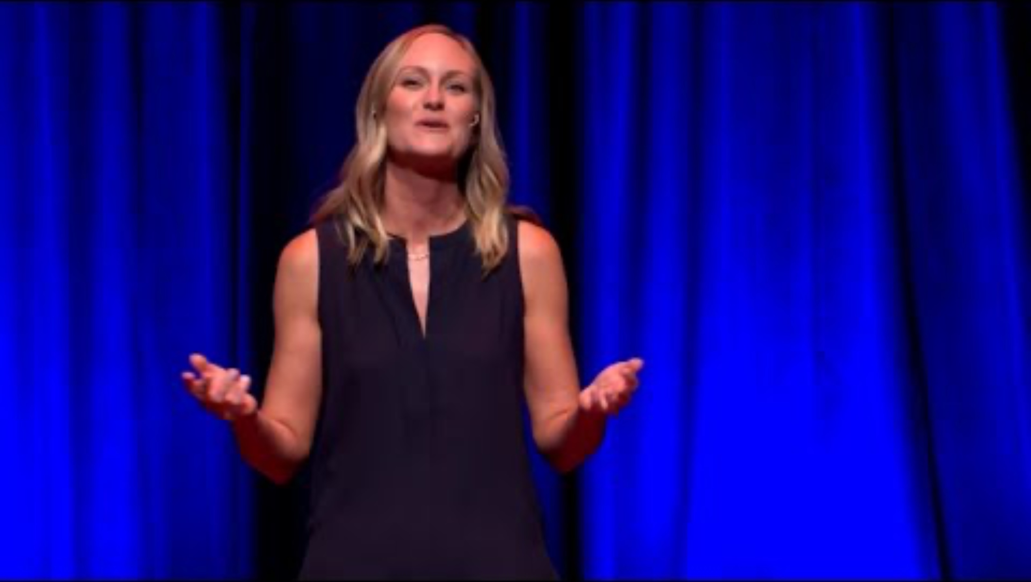
3.2.1 Peer influence
How did your ideas compare to this video?

Slide 33

3.2.1 Peer influence
Conformity
  An act to align one’s attitudes, feelings or behaviour to group norms without any request

Slide 34
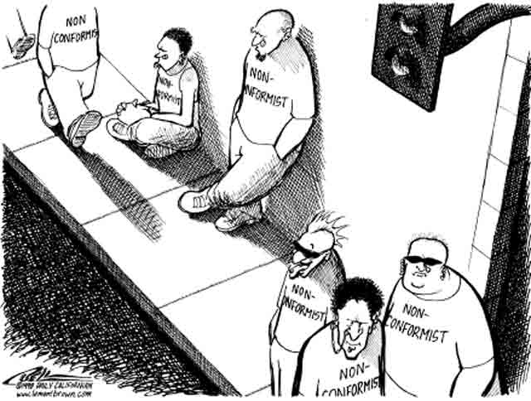
TASK
Discuss about situations where you have encountered conformity
  When have you conformed to group norms?
  Have you ever been able to resist conformity?

Slide 35
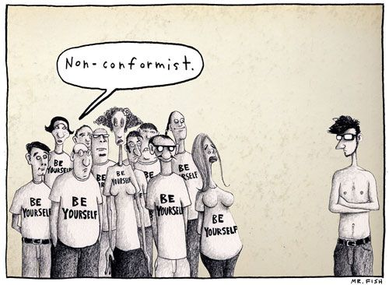
3.2.1 Peer influence
Informative conformity
  The group genuinely effects the individual’s attitudes
Normative conformity
  Individual conforms, because he or she doesn’t want to break the group norm or to be left out

Slide 36
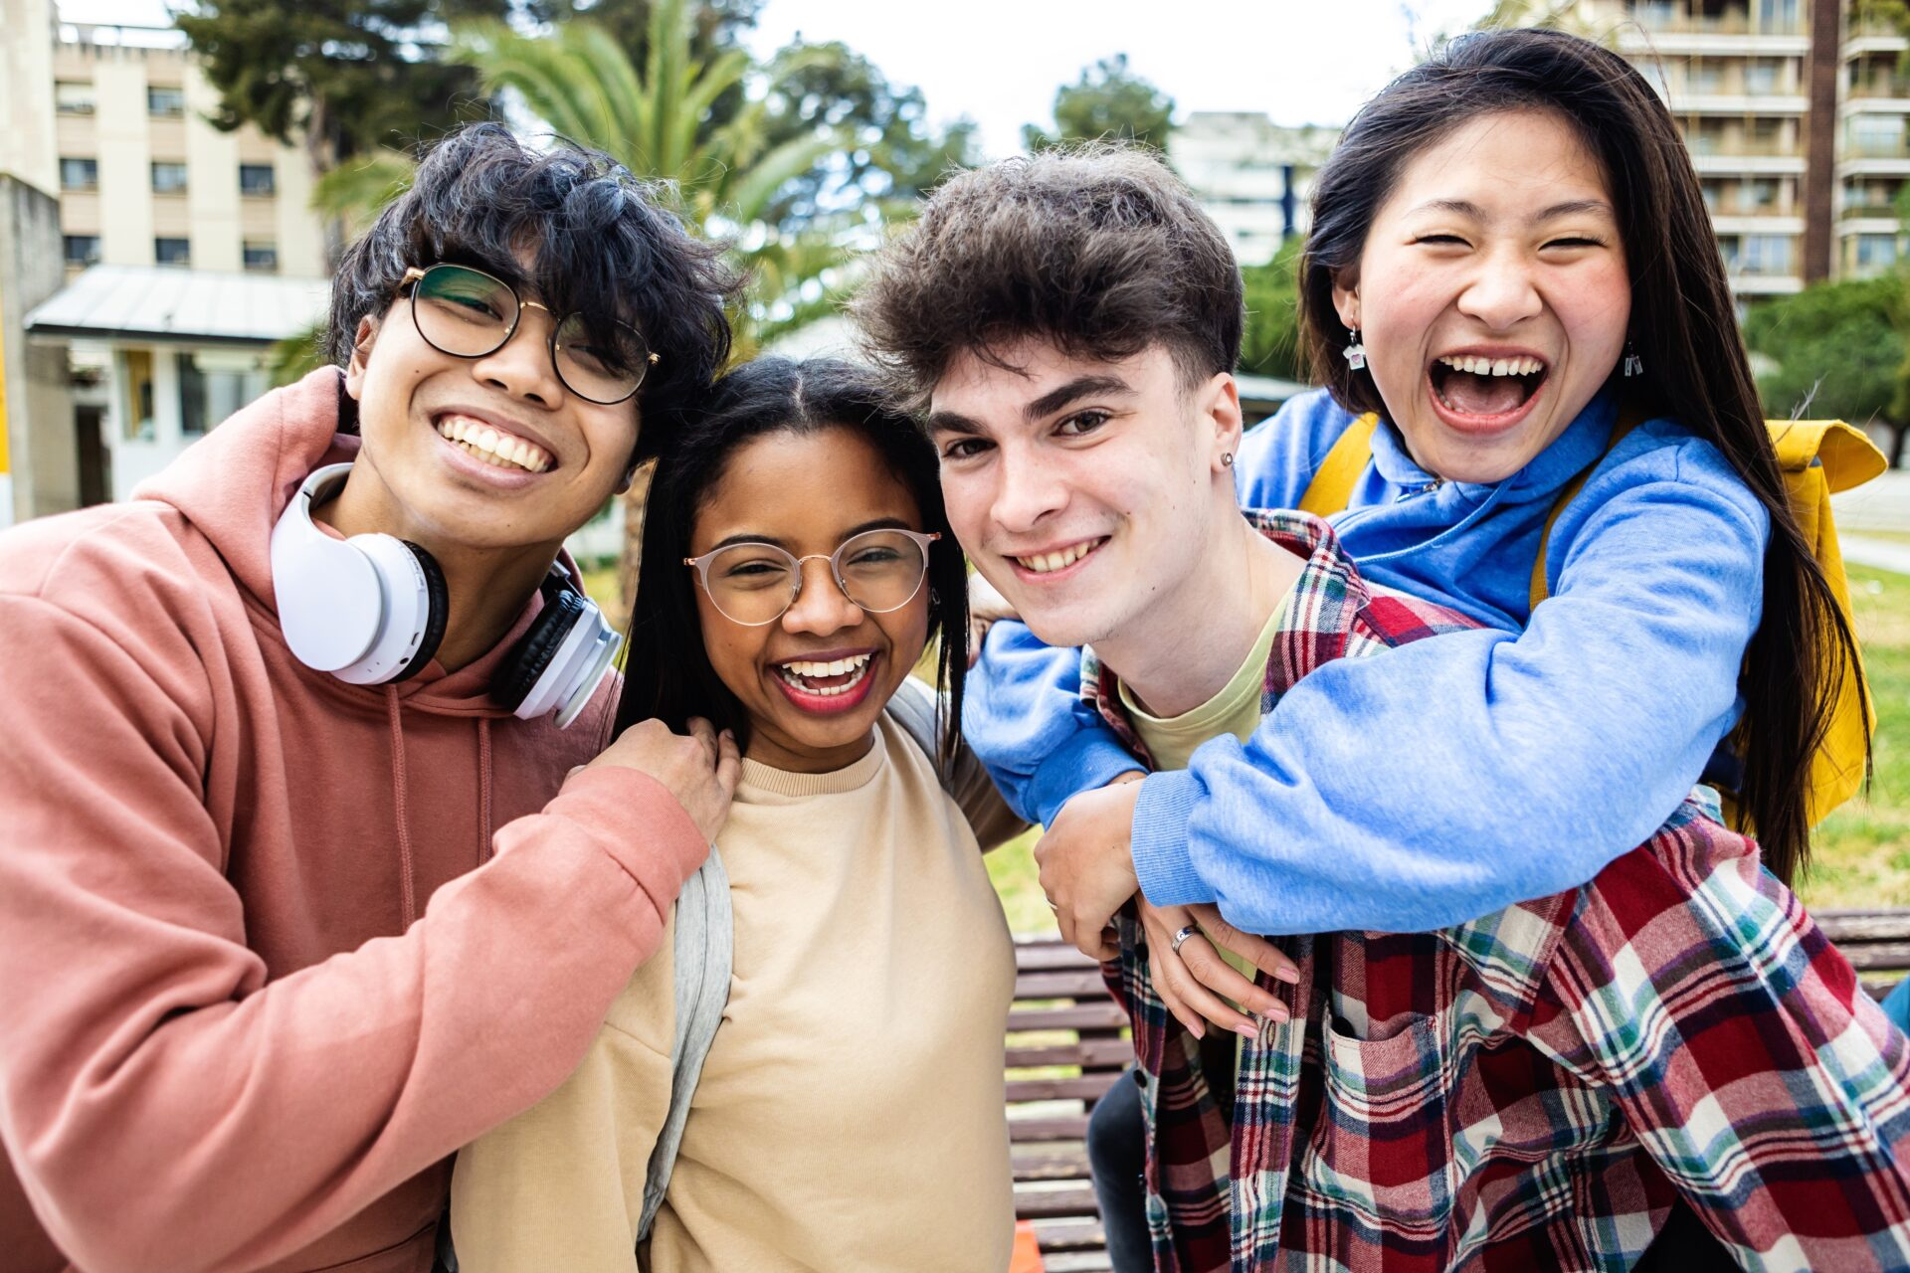
TASK
You are adolescents
Reflect your susceptibility to peer pressure, conformity and risk-taking
Can you see a difference compared to your childhood?

Slide 37

3.2.1 Peer influence
What are the implications and applications?

Slide 38
TASK
Read ”Peer influence and conformity” in Kognity 3.2.1
  Summarize the main point in your own words
  Connect these contents to the things you have already learned on peer influence
  Do the tasks in purple boxes

Slide 39
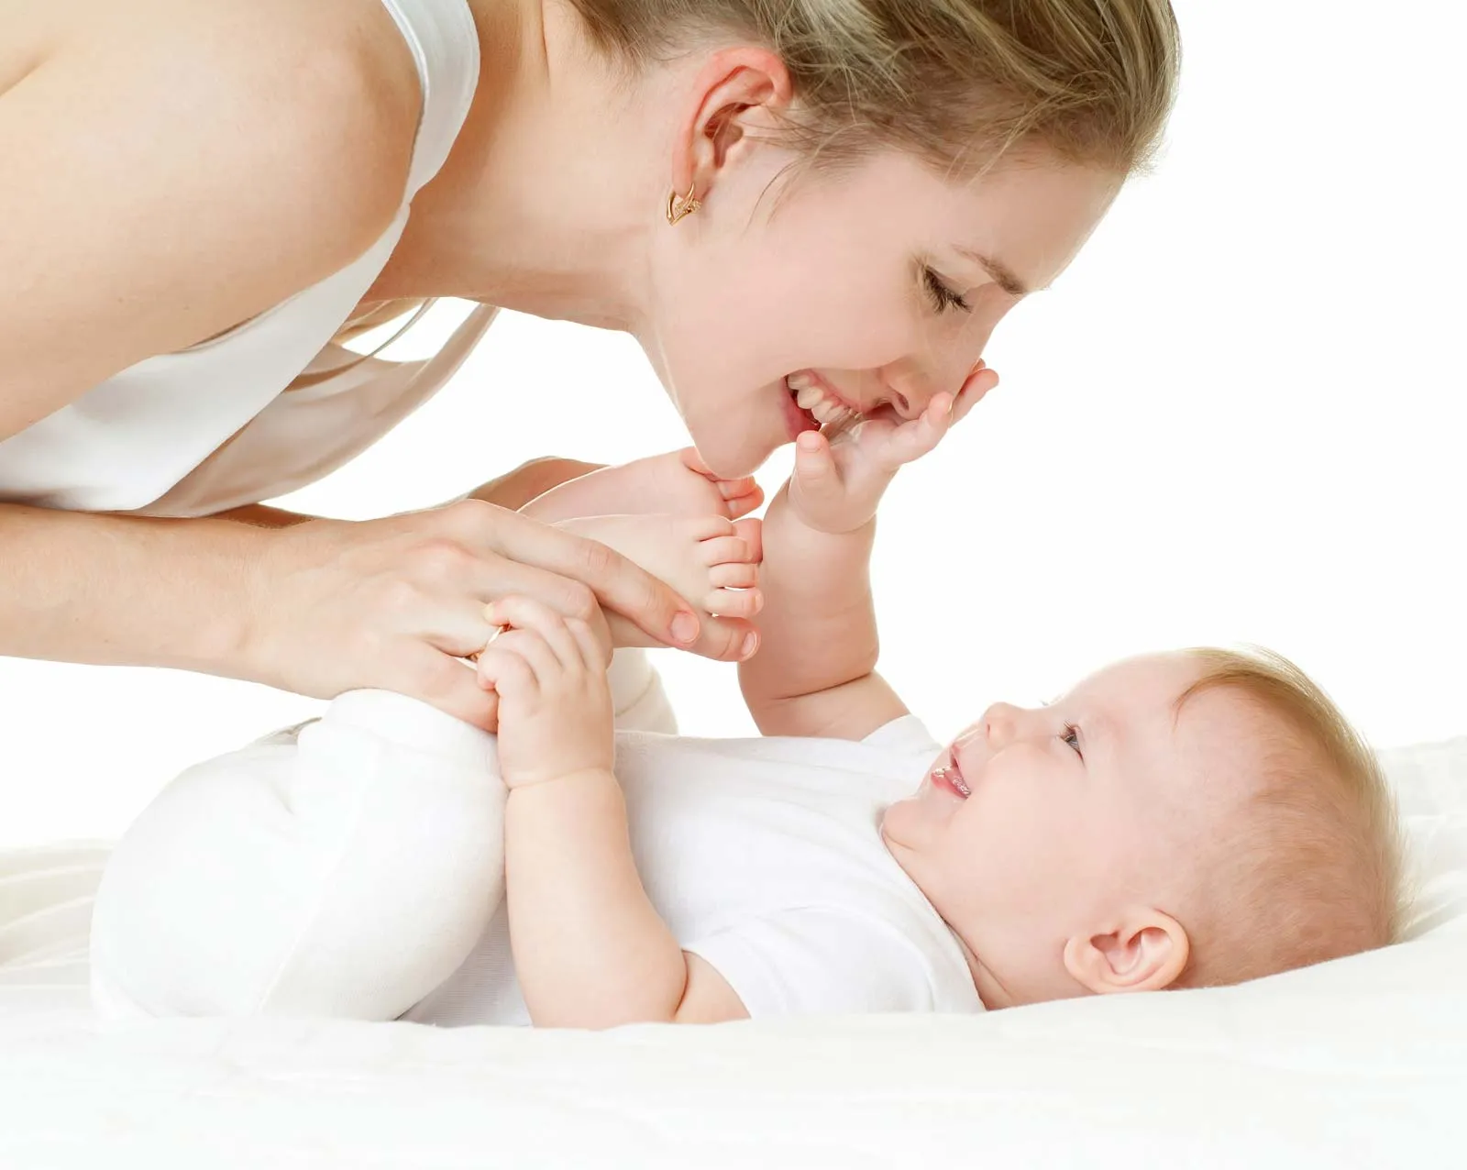
3.2.2 Attachment
Attachment is the development of mutual and intense relationship between and infant and its caregivers

Slide 40
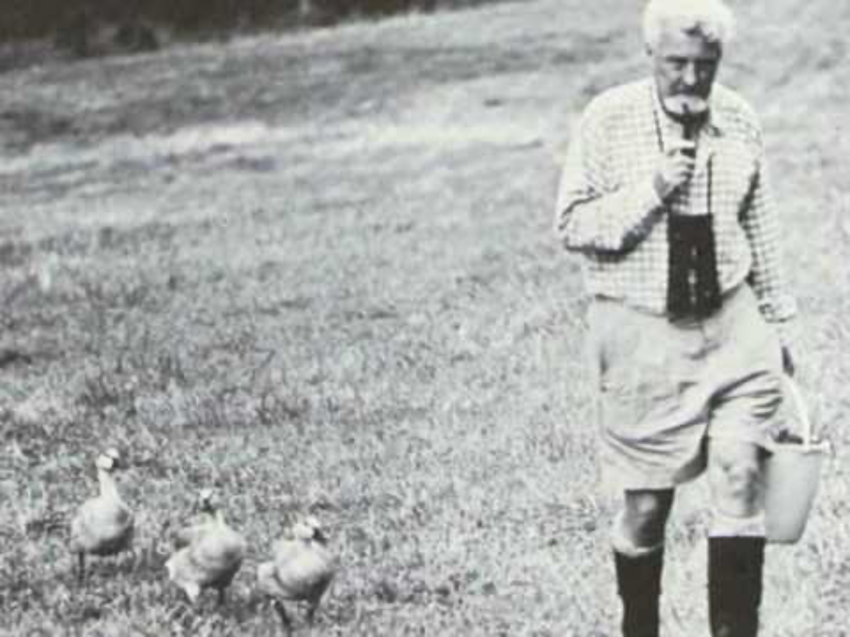
3.2.2 Attachment
Konrad Lorenz and imprinting

Slide 41
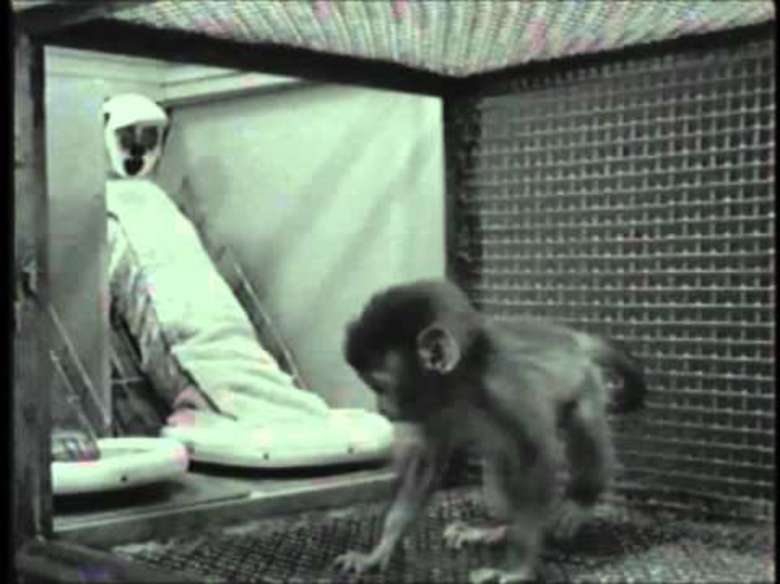
3.2.2 Attachment
Harry Harlow and attachment in monkeys

Slide 42
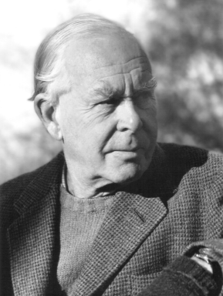
3.2.2 Attachment
John Bowlby (1907–1990)
  Attachment is an innate need in humans
Internal working model (IWM, 1973)
  Internal representations of experiences with the attachment figures
  Framework that explains how attachment shapes individuals

Slide 43
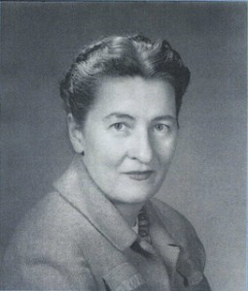
3.2.2 Attachment
Mary Ainsworth
(1913-1999)
  Developed the strange situation paradigm to test and evaluate the internal working model

Slide 44

3.2.2 Attachment
What is the role of causality in attachment?

Slide 45
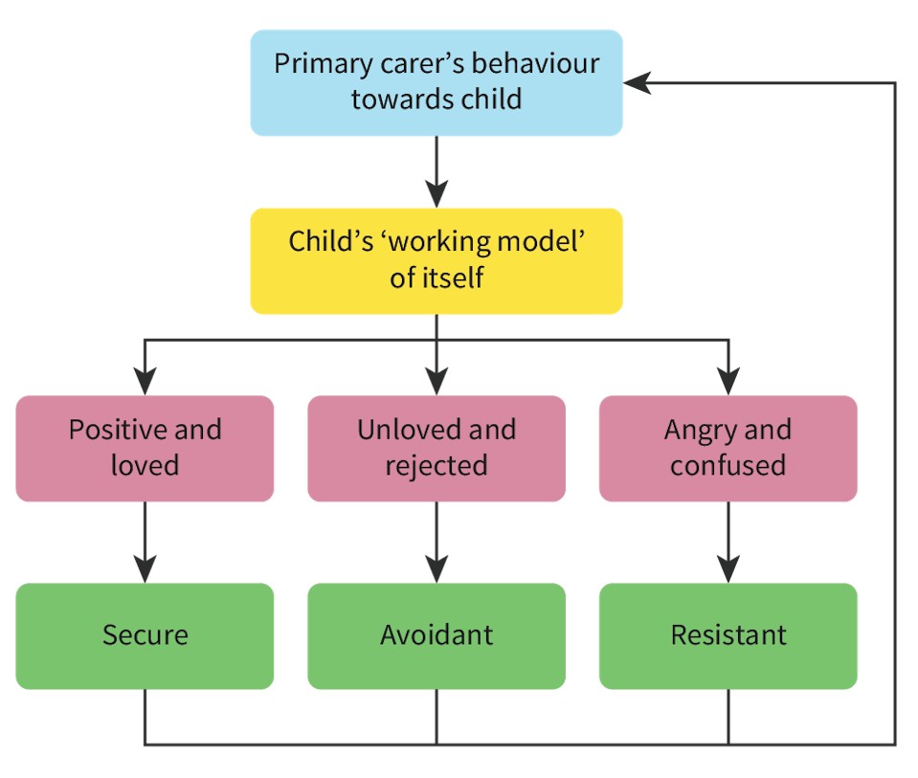
3.2.2 Attachment
Ainsworth suggested maternal sensitivity hypothesis
  Mother’s responsiveness to the child’s needs influences the child’s attachment style

Slide 46

3.2.2 Attachment
Read the summary of Hazan and Shaver (1987) from Kognity 3.2.9
  How do early attachment styles influence relationships in adulthood?
What is the role of causality
in attachment?

Slide 47
TASK
Read Kognity 3.2.2
  Amend your memos on attachment
  Try to evaluate attachment research with the help of Kognity and the six basic concepts

Slide 48
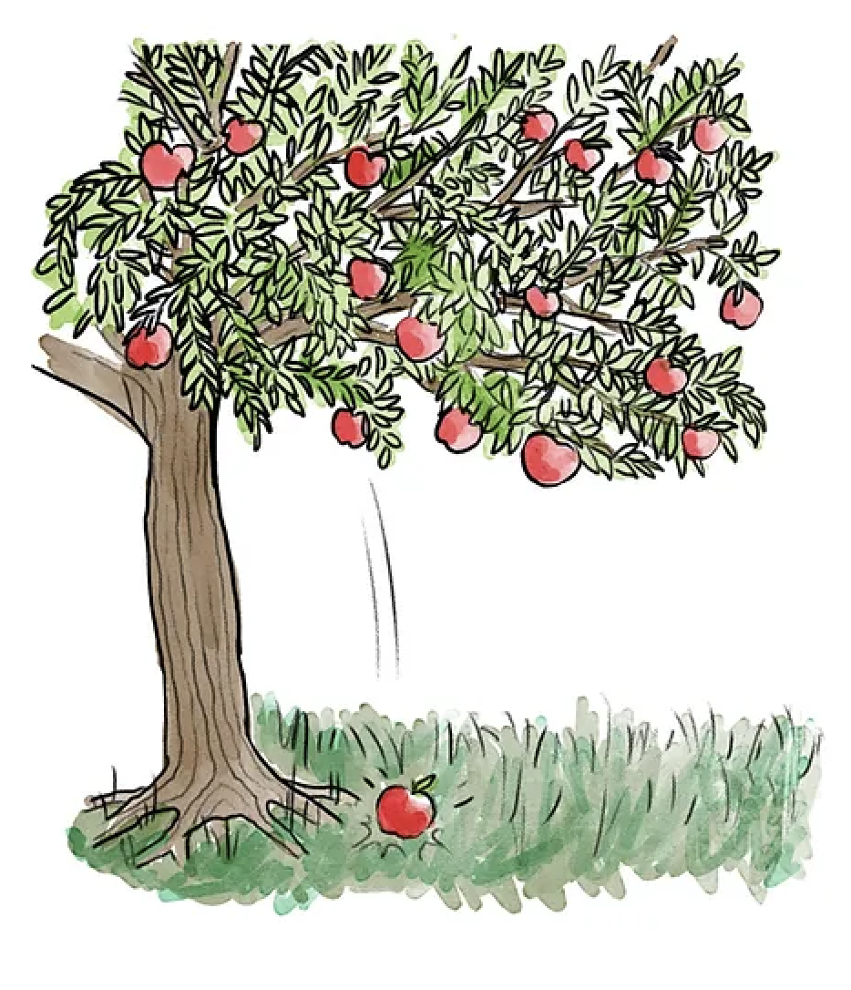
TASK
The apple doesn’t fall far from the tree
  Is it so that we cannot escape our upbringing?
  Do we need to adopt a deterministic perspective with the matter?
Provide arguments and
counter arguments

Slide 49

3.2.2 Role of childhood experiences
Childhood experiences can provide risk factors and protective factors for the development of the self

Slide 50
TASK
Do the Interactive 1 in Kognity 3.2.2
  What other things could be risk factors and protective factors in human development?
  Write to the whiteboard

Slide 51
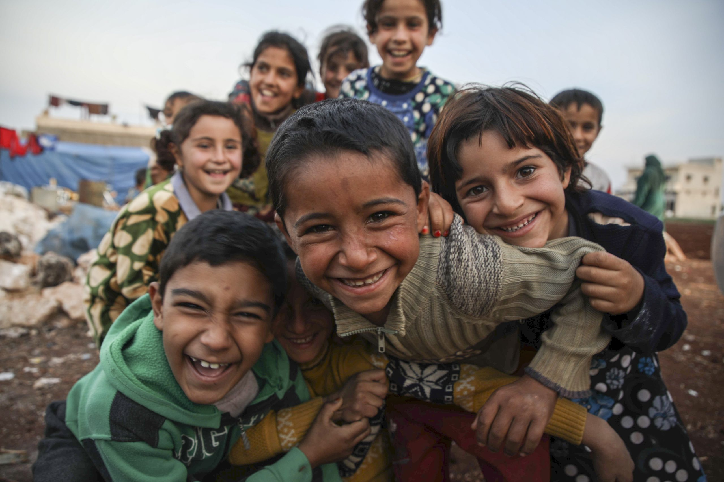
TASK
CASE: POVERTY
  What are the risk factors for children and adolescent living in poverty?
  What are the consequences of these risk factors?
Write your ideas on the whiteboard

Slide 52

3.2.2 Role of childhood experiences
How did your ideas resonate with this video?

Slide 53
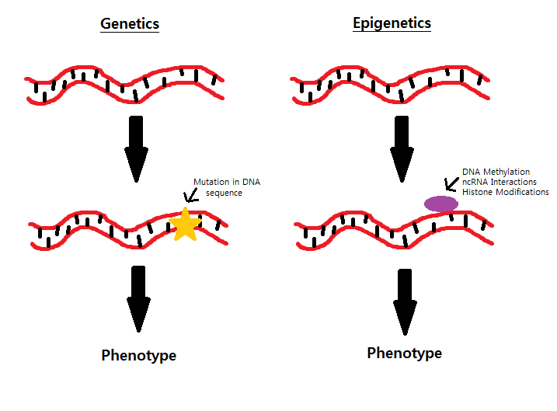
3.2.2 Role of childhood experiences
Epigenetics refers to changes in gene functions that do not change the actual DNA structure
Methylation
  The process where chemicals bind to the DNA molecule to suppress it

Slide 54
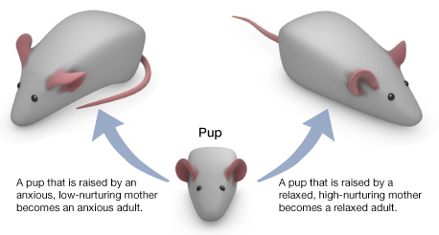
3.2.2 Role of childhood experiences
Weaver et al. (2004)

Slide 55
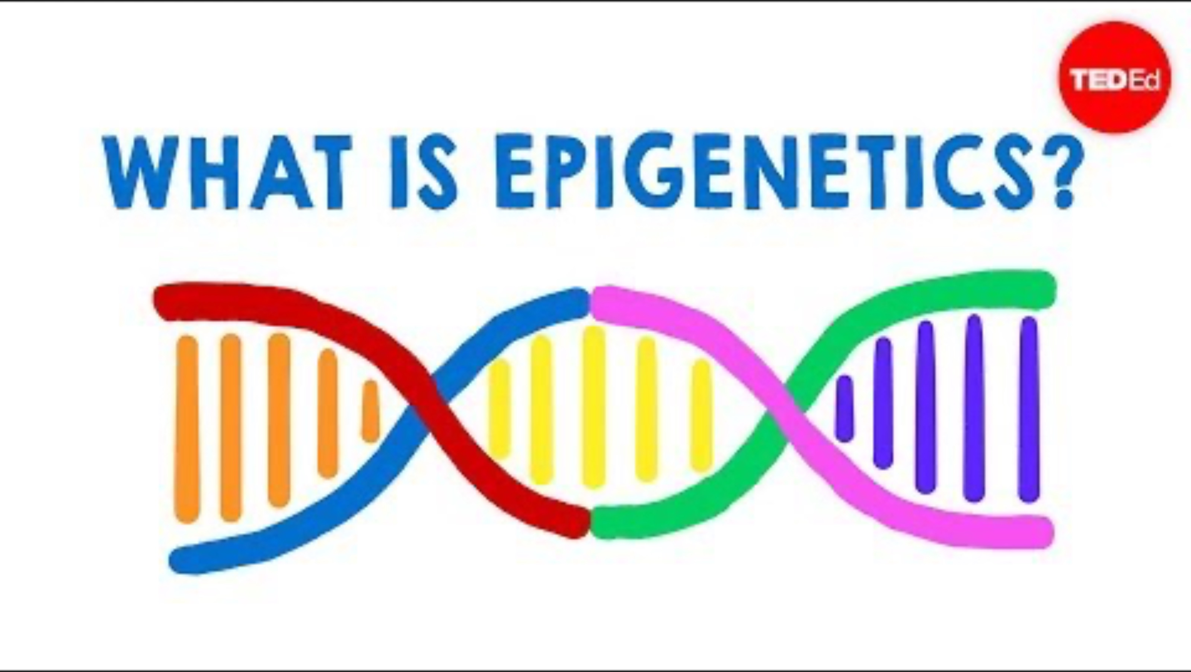
3.2.2 Role of childhood experiences
How can childhood experiences and epigenetics be related?

Slide 56
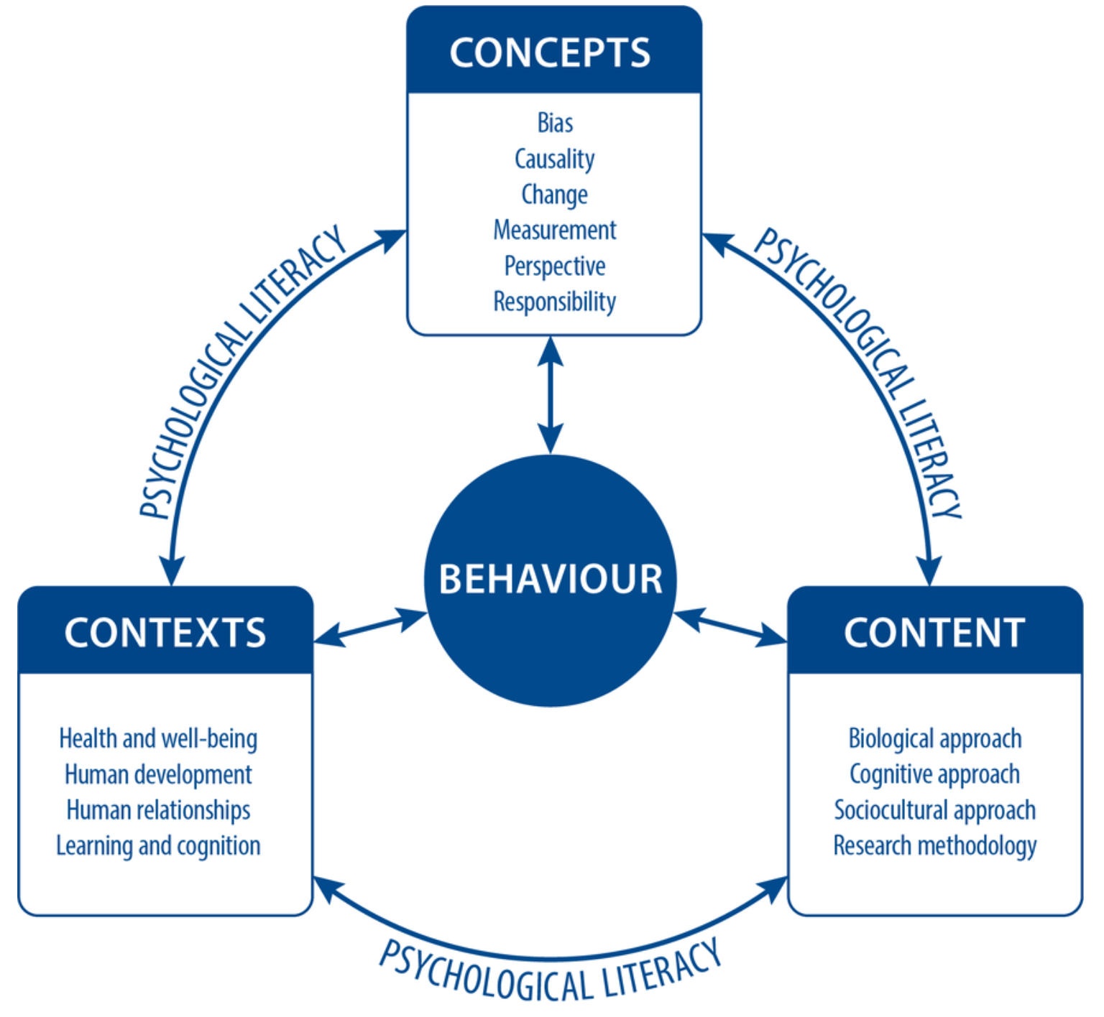
TASK
Teacher divides you into four groups and gives each group a topic from development of self
Each group makes a concept map based on the syllabus

Slide 57
Picture sources
Identity <https://www.kmuw.org/onwords/2018-05-29/onwords-identity> Accessed 4th of November 2025.
Kognity logo – Kognity
Woman eating with chopsticks <http://www.travelbeijing.com/beijing-china-travel-tips/beijing-social-and-cultural-customs.html> Accessed 6th of September 2017.
Social norm difference <https://emusocialmedia2016.wordpress.com/2016/02/11/racism-social-norms/> 29th of August 2017.
Samoa <https://americanfieldtrip.com/blog/2018/05/21/a-complete-guide-to-visiting-american-samoa/> Accessed 5th of November 2025.
Henri Tajfel <https://en.wikipedia.org/wiki/Henri_Tajfel> Accessed 21st of August 2017.
John Turner <https://mavorlab.wp.st-andrews.ac.uk/2013/04/turner_symposium/> Accessed 3rd of September 2018.
Devil <http://www.how-to-draw-cartoons-online.com/cartoon-devil.html> Accessed 21st of August 2017.
Us vs. them <https://wn.com/American_Psychology_Group> Accessed 21st of August 2017.
Paul Klee <http://www.holah.karoo.net/tajfestudy.htm> Accessed 21st of August 2017.
Unidirectional and bidirectional relationships – Kognity
Albert Bandura <https://stanford.edu/dept/psychology/bandura/bandura-bio-pajares/Albert%20_Bandura%20_Biographical_Sketch.html> Accessed 29th of August 2017.
Mouse and operant conditioning <https://www.simplypsychology.org/operant-conditioning.html> Accessed 7th of November 2025.

Slide 58
Picture sources
Lauri Markkanen <https://www.iltalehti.fi/koripallo/a/361e2ba8-8eed-41fe-b536-2a9fdfecf1e9> Accessed 22nd of April 2024.
Observational learning <http://oscareducation.blogspot.com/2013/01/observational-learning-or-learning-by.html> Accessed 20th of August 2018.
Locus of control <https://www.linkedin.com/pulse/20140718204225-176668982-the-internal-locus-of-control-taking-back-control-of-your-company-s-technology> Accessed 18th of August 2017.
Reciprocal determinism <https://helpfulprofessor.com/reciprocal-determinism-examples/> Accessed 7th of November 2025.
Peers <https://tiescenter.org/resource/the-power-of-peers-peer-engagement-implementation-guides> Accessed 7th of November 2025.
Wassily Kandinsky <https://www.wassilykandinsky.net/work-247.php> Accessed 16th of April 2026.
Playground <https://en.wikipedia.org/wiki/Cold_War_playground_equipment> Accessed 7th of November 2025.
Conformity <http://schoolsucksproject.com/podcast-342-conformity-vs-the-six-pillars-of-self-esteem-with-jake-desyllas/> Accessed 30th of August 2017.
A group of non-conformists <https://taivara.com/enemies-innovation-1-conformity/> Accessed 14th of August 2015.
A non-conformist <https://www.pinterest.com/pin/199073246001153980/> Accessed 14th of August 2015.
Adolescents <https://www.mentalhealth.com/library/education-development> Accessed 7th of November 2025.

Slide 59
Picture sources
Caregiver and an infant <https://www.britannica.com/science/attachment-theory> Accessed 3rd of December 2025.
John Bowlby <http://thebowlbycentre.org.uk/about-the-bowlby-centre/> Accessed 15th of September 2016.
Mary Ainsworth <http://www.feministvoices.com/mary-ainsworth/> Accessed 15th of September 2016.
Diagram on attachment styles – Kognity
Couple <http://www.vaestoliitto.fi/parisuhde/?x17665=4569394> Accessed 15th of September 2017.
Apple tree <https://thinkib.net/psychology/page/52642/attachment> Accessed 3rd of December 2025.
Childhood <https://viewthroughmywindow.com/back-to-childhood/> Accessed 3rd of December 2025.
Children refugees <https://thinkib.net/psychology/page/52646/childhood-experiences> Accessed 3rd of December 2025.
Genetics and epigenetics <http://studentblogs.med.ed.ac.uk/reproductive-systems-group-2/introduction/> Accessed 9th of October 2018.
Weaver rats <http://sites.bu.edu/ombs/2010/11/11/licking-rat-pups-the-genetics-of-nurture/> Accessed 5th of January 2018

