Slide 1
HUMAN DEVELOPMENT
HL EXTENSIONS
IB Psychology LAJM

Slide 2
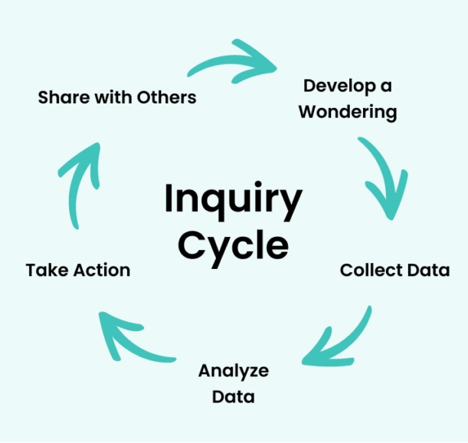
About the HL extensions
HL extensions for each context are:
  (1) Culture
  (2) Motivation
  (3) Technology
HL extensions are based on inquiry learning

Slide 3
About the HL extensions
Teacher will give prompts to encourage students to investigate a topic under each context related to culture, motivation and technology
Students will explore, investigate, reflect and finally share their findings with the
whole class
  The findings will prepare the students for Paper 3

Slide 4

About the HL extensions
Paper 3 is focused on HL extensions and
data-analysis
In Paper 3 you will have a set of stimulus materials that reflect HL extensions and where data-analysis is applied

Slide 5
HL extensions in human development
Culture
  The role of cultural dimensions in understanding the social and cognitive development of children
  The extent Western models of development can be applied to explain child development in Indigenous cultures – or vice versa
  The role of culture in developing the self

Slide 6

HL extensions in human development
Motivation
  The different motivational theories important in human development
  The role of extrinsic motivators in the social development of a child

Slide 7

HL extensions in human development
Technology
  The role of technology on the development of self
  The role of artificial intelligence to test models of human development
  The effect of technology on attachment

Slide 8
Culture in human development
(1) Are global theories of child development fundamentally flawed because they ignore cultural dimensions?
(2) Is Western developmental psychology a form of cultural imperialism? Should Indigenous models replace it?
(3) Is there a ’self’ outside culture? Or are we all products of cultural construction?
What could be your prompts?

Slide 9
Motivation in human development
(4) Do motivational theories merely explain human development, or do they actively shape it? If so, are we guiding growth based on evidence or on assumptions?
(5) Does reward-driven socialization create children who act kind without truly feeling empathy?
What could be your prompts?

Slide 10
Technology in human development
(6) Has technology enhanced the development of identity? Or annihilated it by turning us into algorithmic products?
(7) If AI can model human development, does that mean humanity is predictable?
(8) Has technoference fundamentally damaged human attachment, or is it simply reshaping how we connect?
What could be your prompts?

Slide 11
TASK
(1) Collect data/sources for each prompt
  What kind of studies and theories can you find?
  Try to find studies with tables and graphs
(2) Analyse/interpret the data/sources you found relevant to the prompt
(3) What kind of arguments, counter-arguments and conclusions can you make?
(4) Prepare to share your insights with others
  Create PowerPoints with examples like in Paper 3

Slide 12
Extra tips for the inquiry
Keep the basic concepts in your mind and try to apply them to your inquiry
  Bias, causality, change, measurement, perspective and responsibility
Use the Kognity HL extension boxes as a starting point

Slide 13
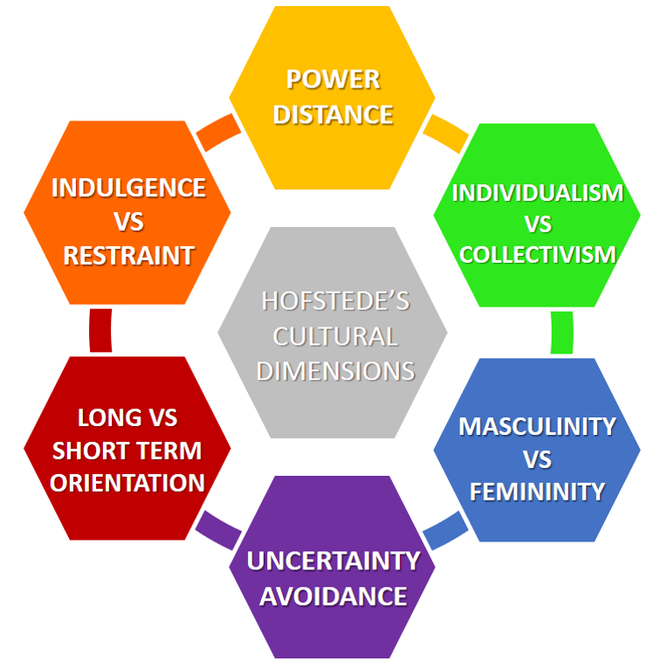
Cultural dimensions
Geert Hofstede’s model of cultural dimensions studies universal features of all cultures

Slide 14
Indigenous models of development
The indigenous Connectedness Framework (Ullrich, 2019)
  Indigenous child development is fostered by a network of relational bonds that span multiple generations, the broader community, spirituality and the land/place
  Challenges the Western perspective that attachment is a result of caregiver-child dyad

Slide 15
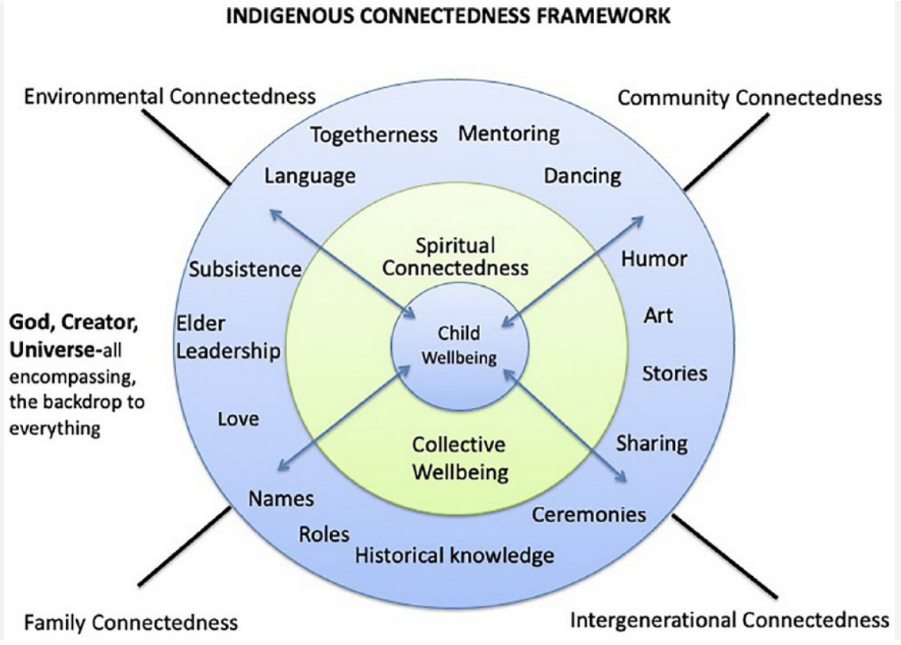
Indigenous models of development

Slide 16
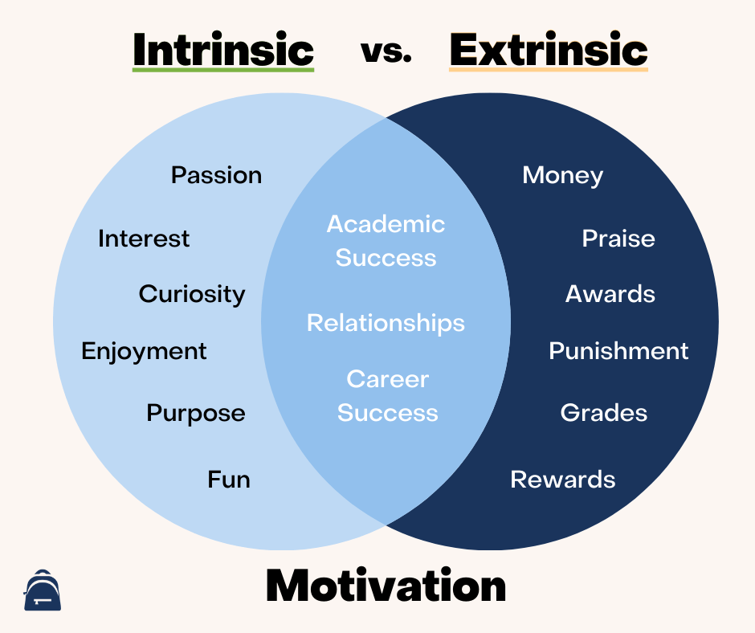
Extrinsic and intrinsic motivation
Extrinsic motivation
  Performing an activity to earn a reward or avoid a punishment
Intrinsic motivation
  Performing an activity for its own sake or for personal satisfaction

Slide 17

Self-determination theory
(Deci and Ryan, 1985)
Self-determination refers to a person’s own ability to manage themselves independently
Theoretical assumptions
  The need for growth drives behaviour
  Autonomous, intrinsic motivation is important

Slide 18
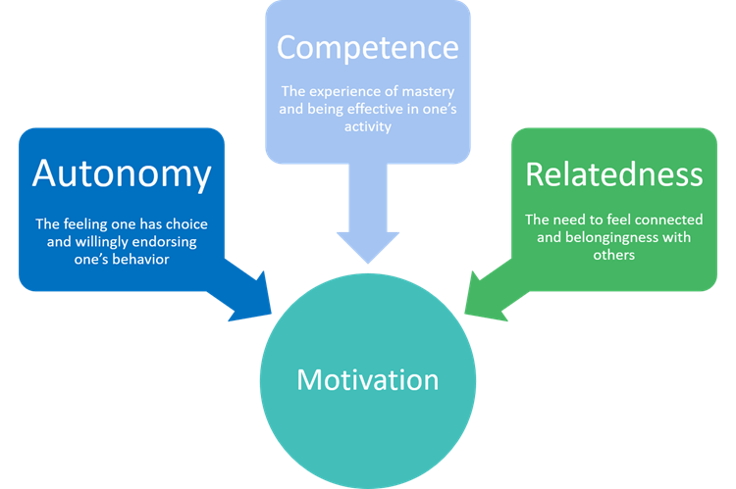
Self-determination theory
(Deci and Ryan, 1985)

Slide 19
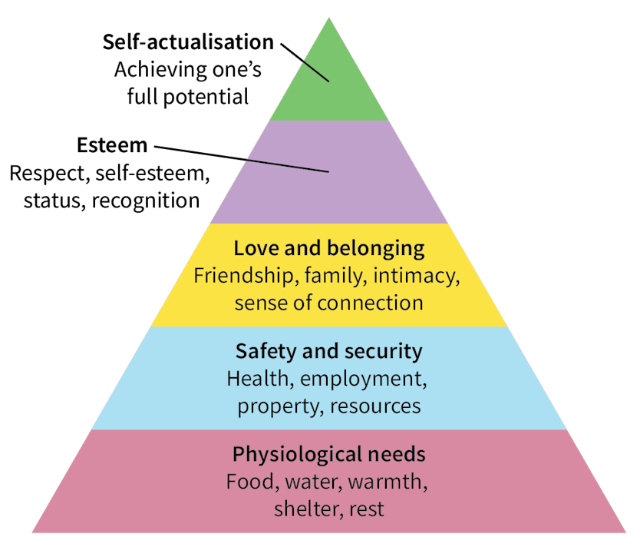
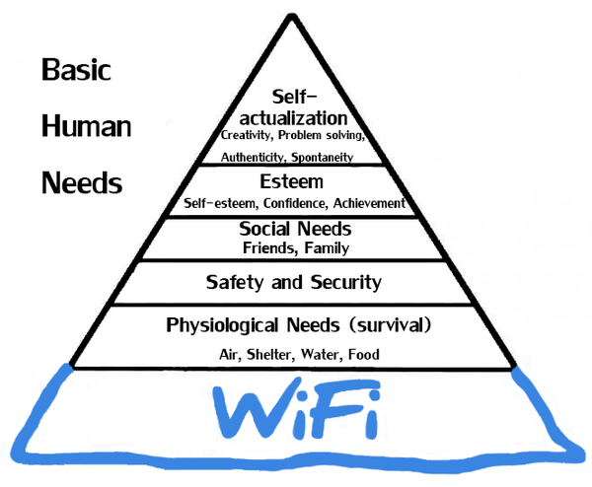
Maslow’s hierarchy of needs

Slide 20
Theory of achievement motivation (McClelland, 1961)
Focuses on three fundamental psychological needs influencing motivation in children
  (1) Achievement – setting goals
  (2) Affiliation – building friendships
  (3) Power – take leadership or seek control
McClelland proposed that these needs are learned, not innate

Slide 21
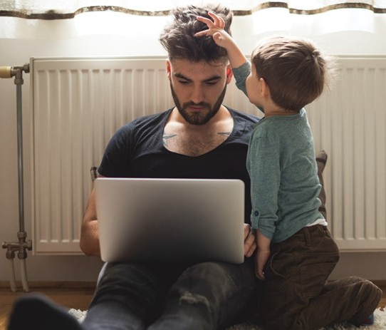
Technoference
Interruptions in personal relationships due to technology
  Disruptions of parent-child interactions caused by caregiver’s use of digital devices

Slide 22
Picture sources
Inquiry-based learning <https://www.clickvieweducation.com/en-au/blog/teaching-strategies/inquiry-based-learning> Accessed 2nd of October 2025.
IB logo <https://commons.wikimedia.org/wiki/File:International_Baccalaureate_Logo.svg> Accessed 2nd of October 2025.
Motivation <https://www.protouchpro.com/guest-posts/cultivating-inner-drive-the-art-of-self-motivation/> Accessed 2nd of October 2025.
Digital learning tools <https://elearningindustry.com/the-top-benefits-of-digital-learning> Accessed 2nd of October 2025.
Hofstede’s cultural dimensions <https://www.business-to-you.com/hofstedes-cultural-dimensions/> Accessed 12th of September 2018.
Indigenous connectedness framework <https://thinkib.net/psychology/page/60453/culture-attachment> Accessed 7th of January 2026.
Intrinsic and extrinsic motivation <https://www.structural-learning.com/post/intrinsic-motivation> Accessed 7th of January 2026.
Woman jumping <https://www.integrativenutrition.com/blog/2018/07/personal-independence-day> Accessed 7th of January 2026.
Self-determination theory <https://www.tuni.fi/playlab/self-determination-theory-in-game-based-learning/> Accessed 7th of January 2026.
Maslow - Kognity
Maslow WiFi <https://x.com/Smartlyte/status/1265708220087181319> Accessed 7th of January 2026.
Technoference <https://www.ohbaby.co.nz/parenting/parenting-tools-your-style-and-what-your-child-needs/technoference-do-we-need-to-disconnect-to-reconnect> Accessed 7th of January 2026.

