Slide 1
5.1 THINKING AND LEARNING
IB Psychology LAJM

Slide 2
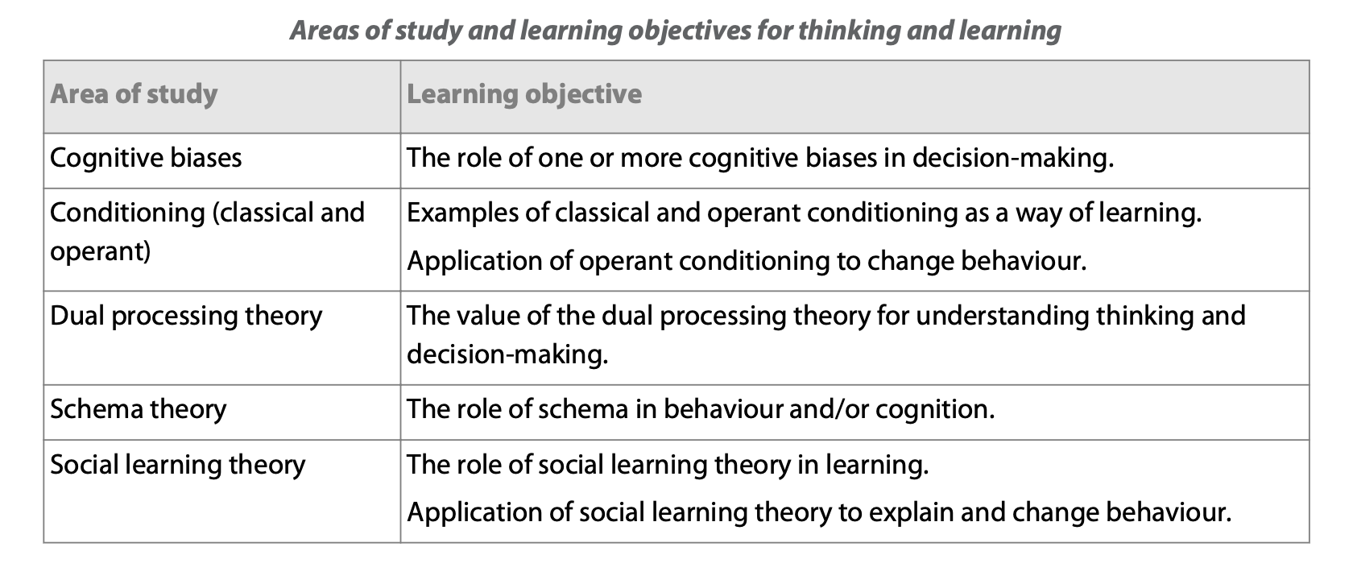
Thinking and learning
Social learning theory (SLT) will be covered under the
Human development context

Slide 3
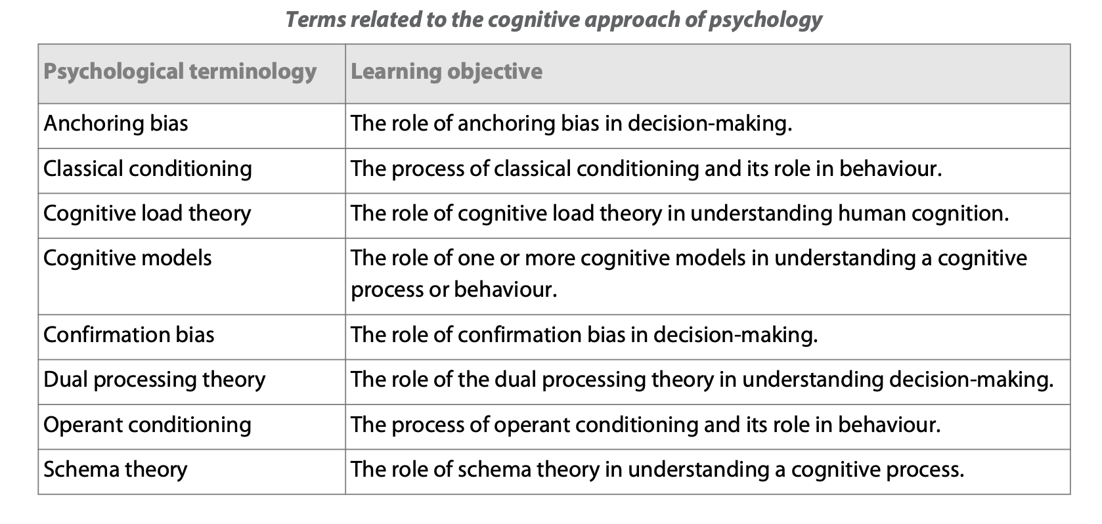
Thinking and learning
Cognitive load theory and Cognitive models will be covered
under the Cognitive processes topic

Slide 4
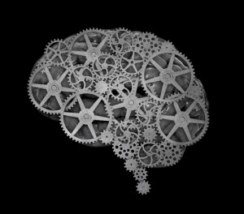
Cognitive approach
Researches human information processing
Cognition
  ”All the processes by which the sensory input is transformed, reduced, elaborated, stored, recovered and used” (Ulric Neisser, 1967)

Slide 5

TASK
A bat and ball cost $1.10
The bat costs one dollar more than the ball
How much does the ball cost?

Slide 6

TASK
S O _ P

Slide 7
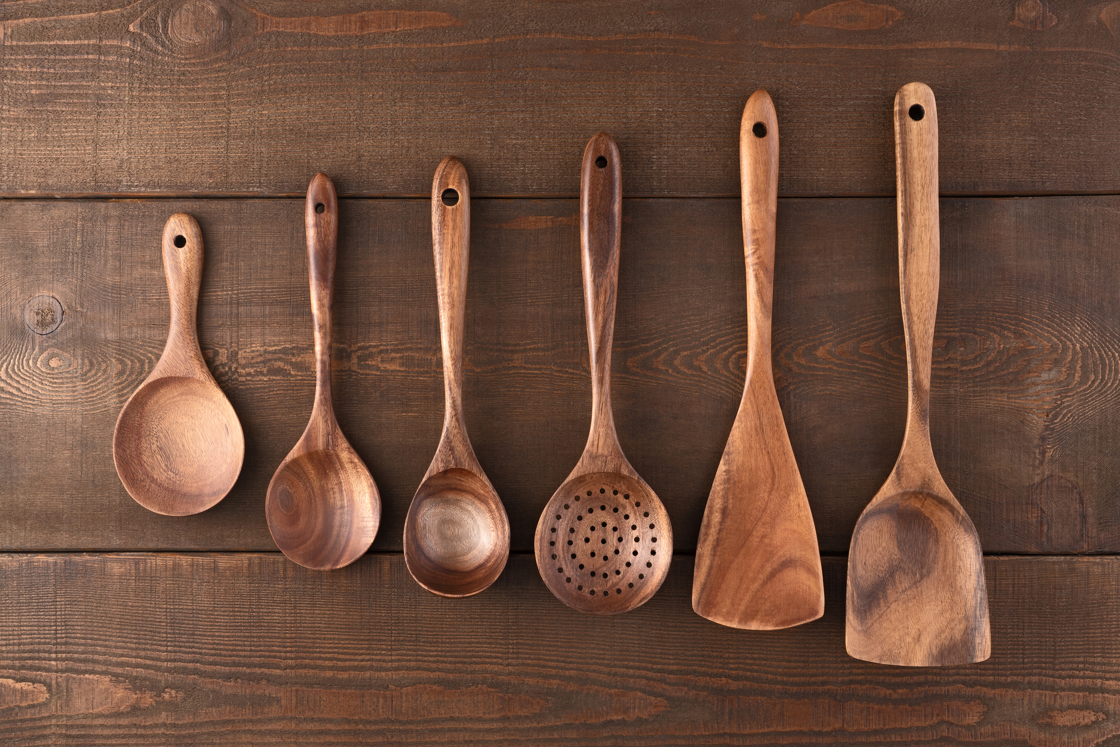
TASK
S O _ P

Slide 8
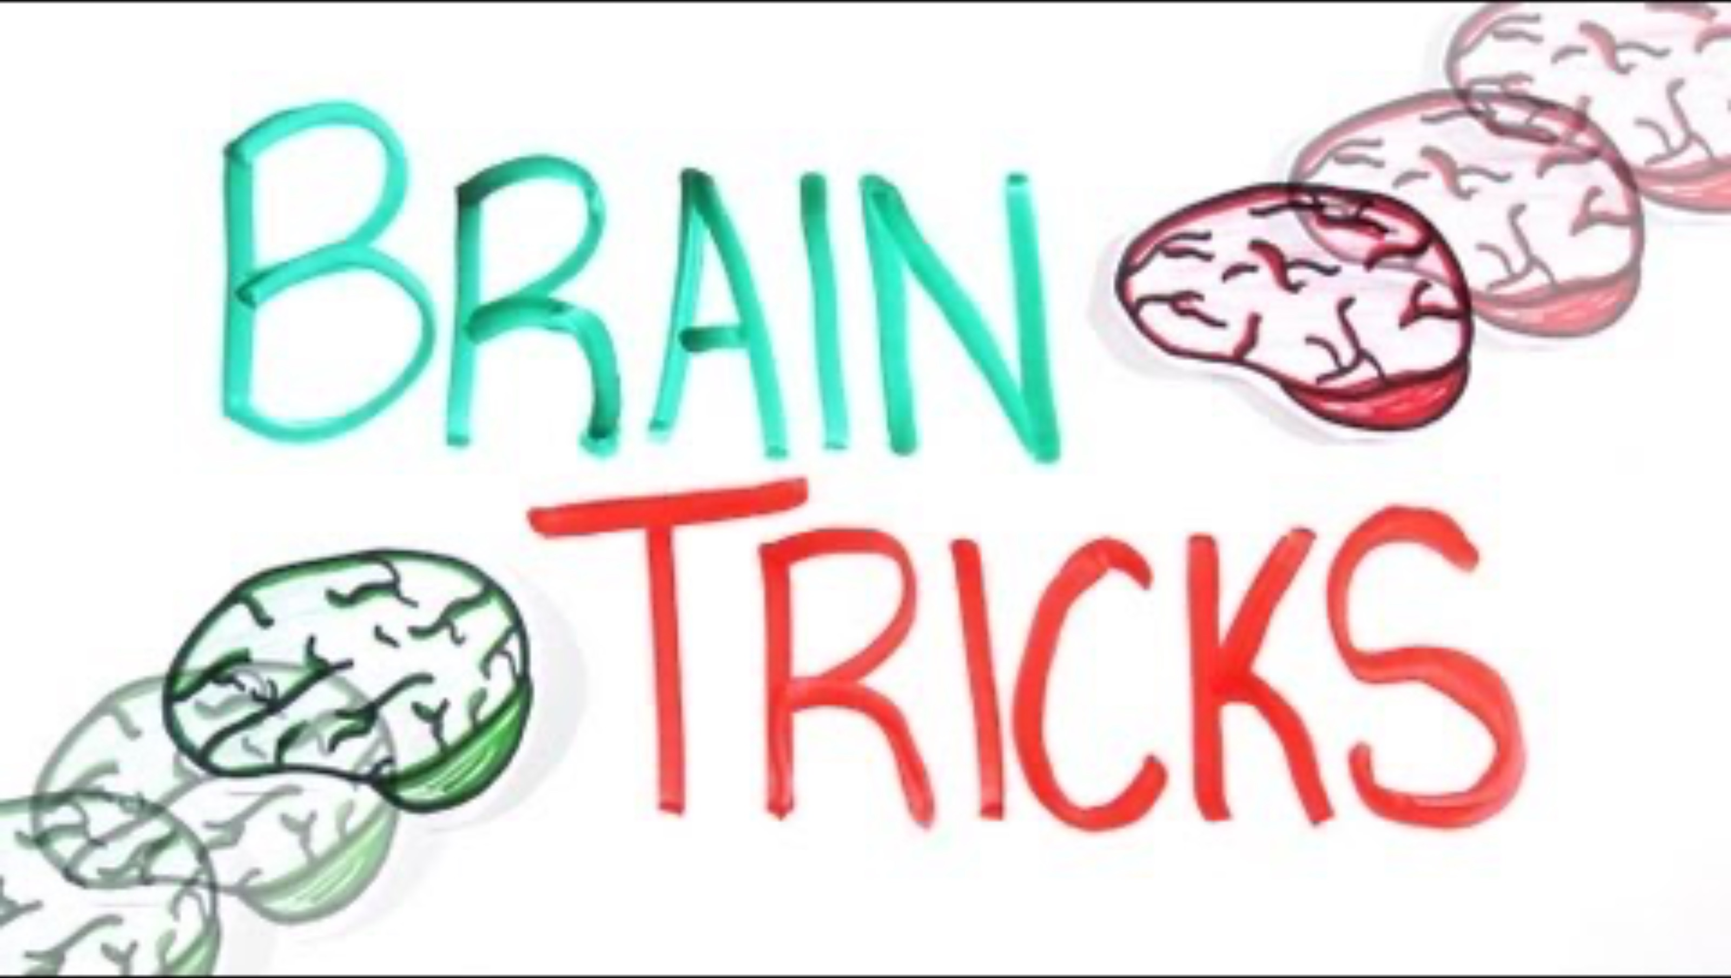
TASK
Summarize the gist of the video in your own words

Slide 9
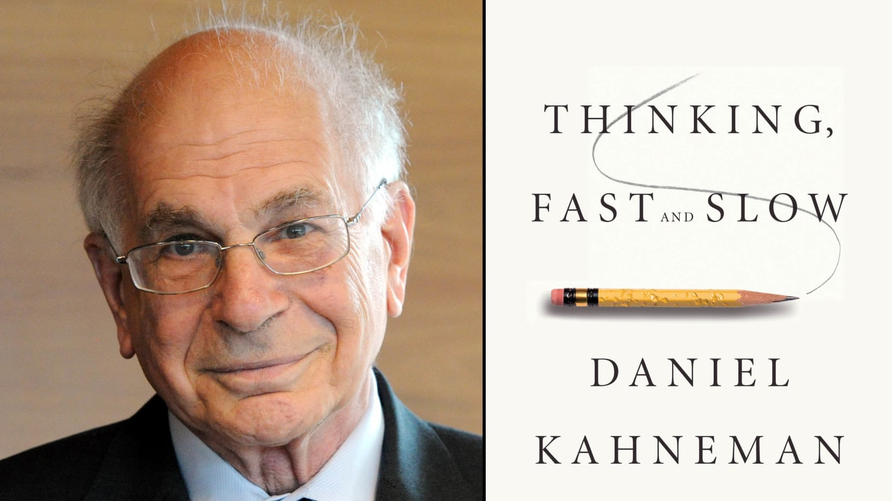
Dual processing theory
Humans have two distinct cognitive systems of thinking and decision-making
  System 1
  System 2
  Dual processing theory
Kahneman, Daniel (2011):
Thinking, Fast And Slow

Slide 10
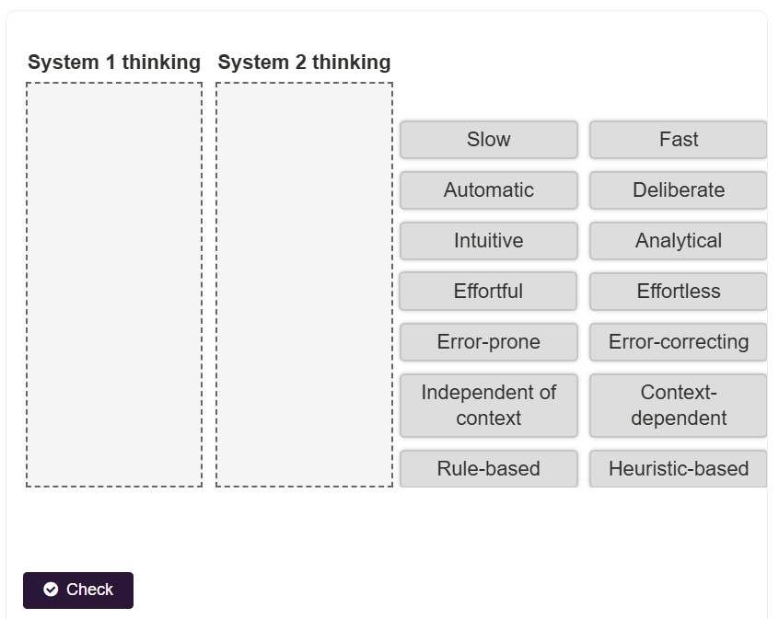
TASK
Read ”Dual process model” with subheadings from Kognity 5.1.1
Do the interactive 1 after reading

Slide 11
Dual processing theory
System 1
  Operates automatically and quickly, with little or no effort and no sense of voluntary control
  Thinking is fast, intuitive and unconscious
  Cognitive ease
System 2
  Allocates resources to the effortful mental activities that demand concentration
  Thinking is slow, analytical and conscious
  Cognitive strain

Slide 12

Dual processing theory
Systems 1 and 2 are not independent of each other but interact dynamically in human cognition
We need both systems to balance efficiency and accuracy in our thinking
Grocery store designers understand how
System 1 thinking works. How does this show
in the way products are arranged?

Slide 13
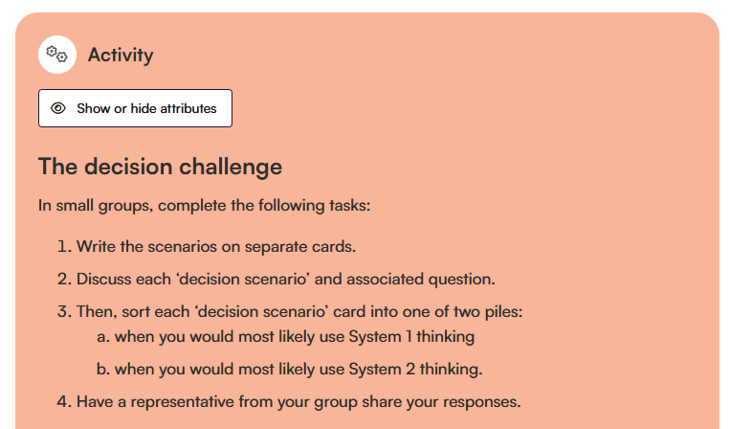
TASK
Do the activity box in Kognity 5.1.1

Slide 14
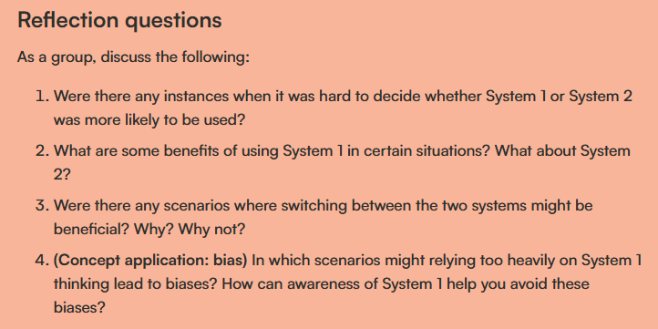
TASK

Slide 15
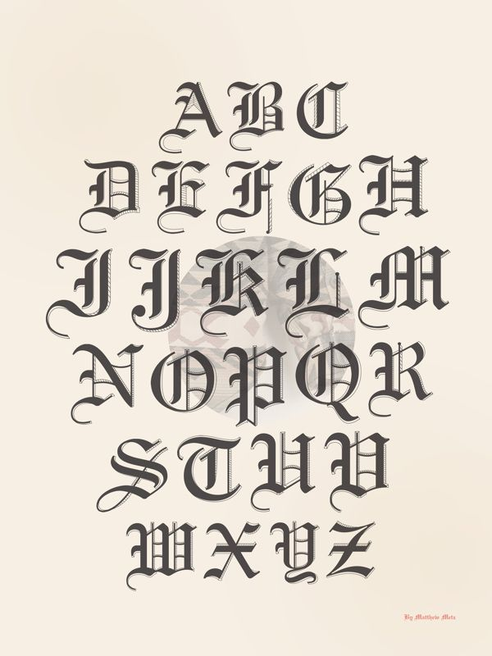
TASK
Read Diemand-Yauman, Oppenheimer and Vaughan (2011) from Kognity 5.1.1 and/or Kognity 5.1.10
  Summarize the gist of the study in your own words
  How does this study exemplify dual processing theory?

Slide 16
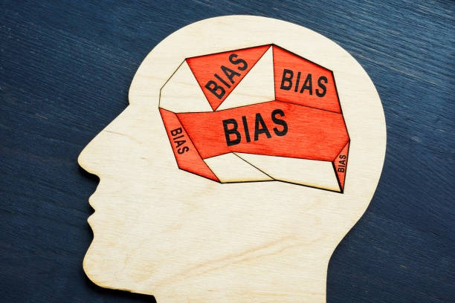
Cognitive biases
Systematic errors in our thinking that often result in flawed or irrational decisions
Biased thinking is a result of System 1 thinking and the use of heuristics

Slide 17
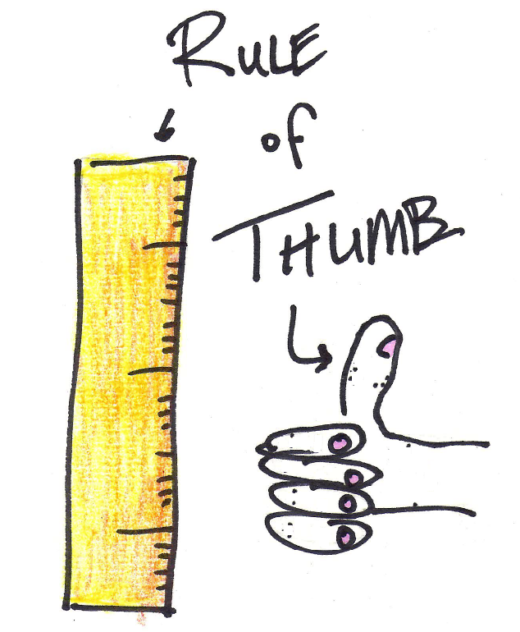
Cognitive biases
Heuristics
  Shortcuts in thinking and decision-making that people take when there is no time or resources to analyse the situation thoroughly

Slide 18
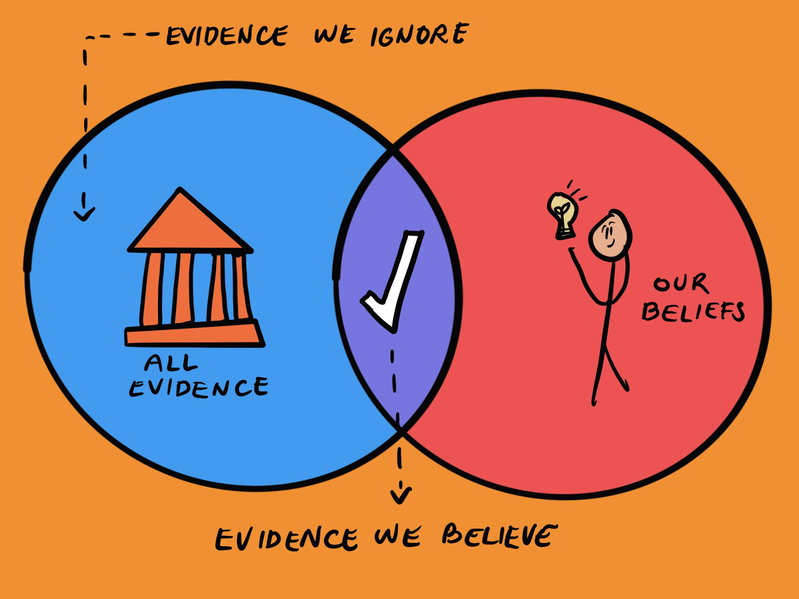
Cognitive biases
Confirmation bias
  Tendency to notice, focus on, and give greater credence to evidence that fits with our pre-existing beliefs and opinions
  Tendency to disregard information that contradicts our pre-existing beliefs and opinions

Slide 19
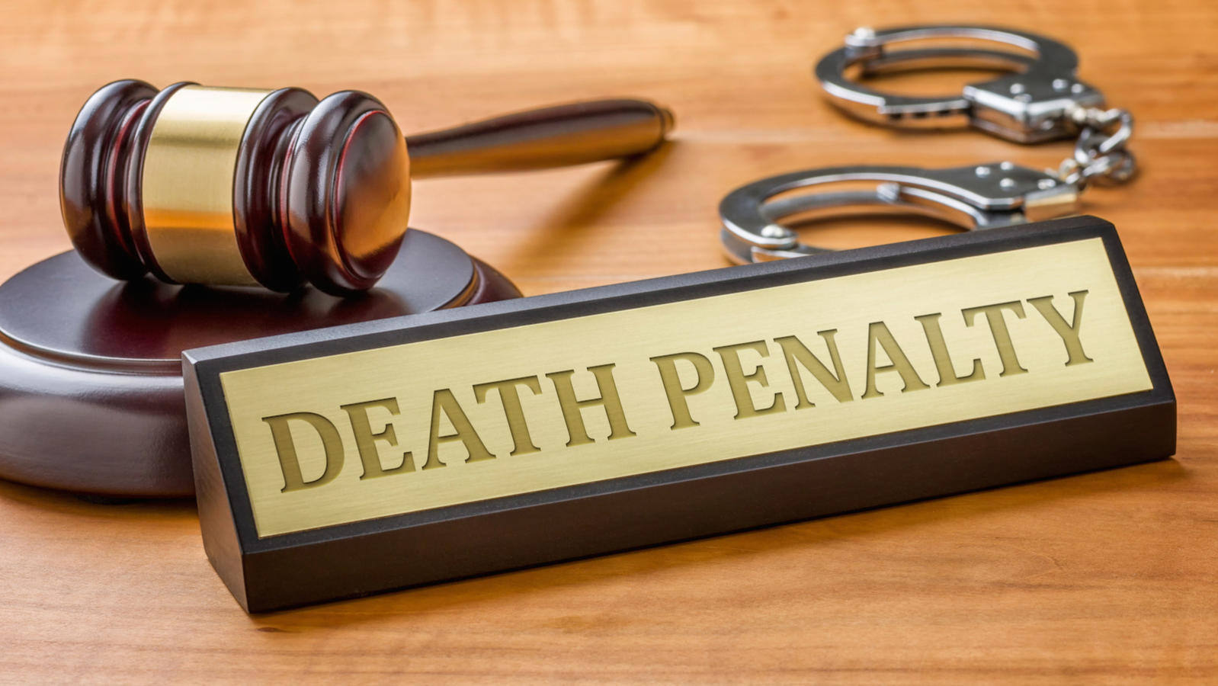
TASK
Read Lord et al. (1979) from teacher’s supplementary materials
  What does this study tell you about the power of confirmation bias?

Slide 20

TASK
Read Piksa et al. (2024) from Kognity 5.1.2 and/or Kognity 5.1.10
  What does this study tell you about the power of confirmation bias?

Slide 21
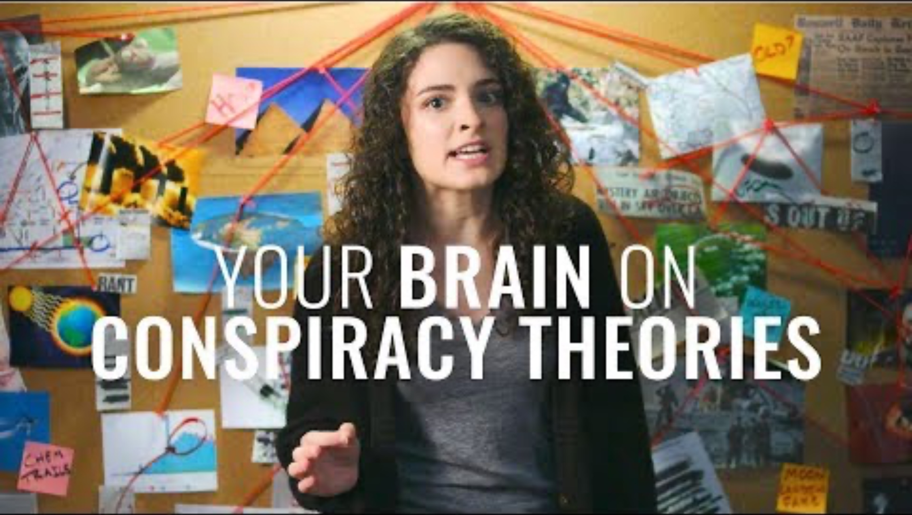
Cognitive biases
Write down the things that are new to you

Slide 22

TASK
You must bid for the house of your dreams on the right
The selling price is
300 000€
Write your bidding price on a piece of paper!

Slide 23
TASK
You must bid for the house of your dreams on the right
The selling price is
900 000€
Write your bidding price on a piece of paper!

Slide 24
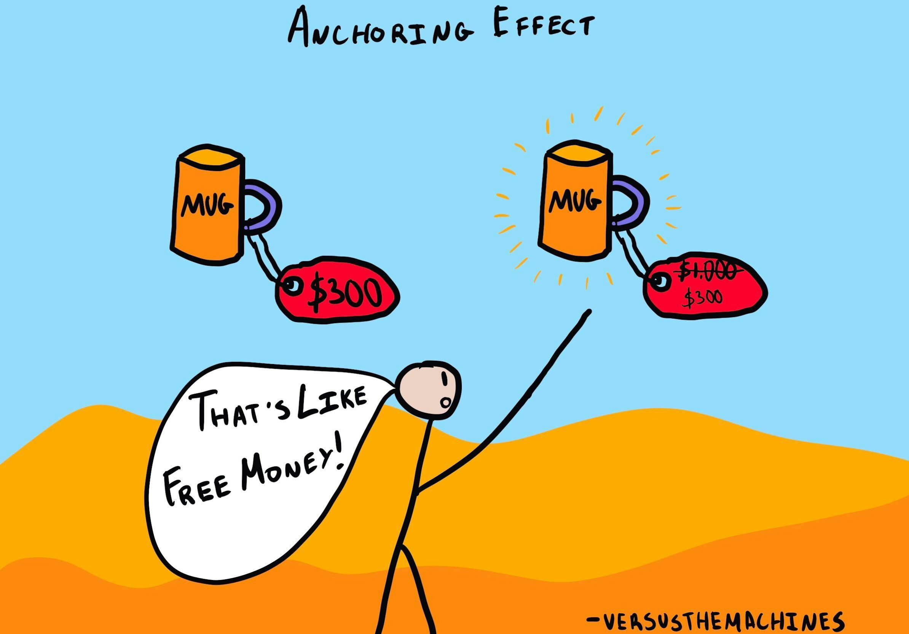
Cognitive biases
Anchoring bias
  Tendency to anchor our thinking and decision-making to the information we initially get

Slide 25
Cognitive biases
Englich and Mussweiller (2001)
  What role does anchoring play in determining sentences in courtrooms?
  44 German senior law students were given a scenario of a rape case with either a 34-month sentence (condition 1) or a 2-month sentence (condition 2)
  Participants in the condition 1 recommended on average eight months longer in prison than in condition 2 – for the same crime

Slide 26

TASK
Read Ly et al. (2023) from Kognity 5.1.2 and/or Kognity 5.1.10
  Summarize the gist of the study in your own words
  How does this study exemplify anchoring bias?

Slide 27
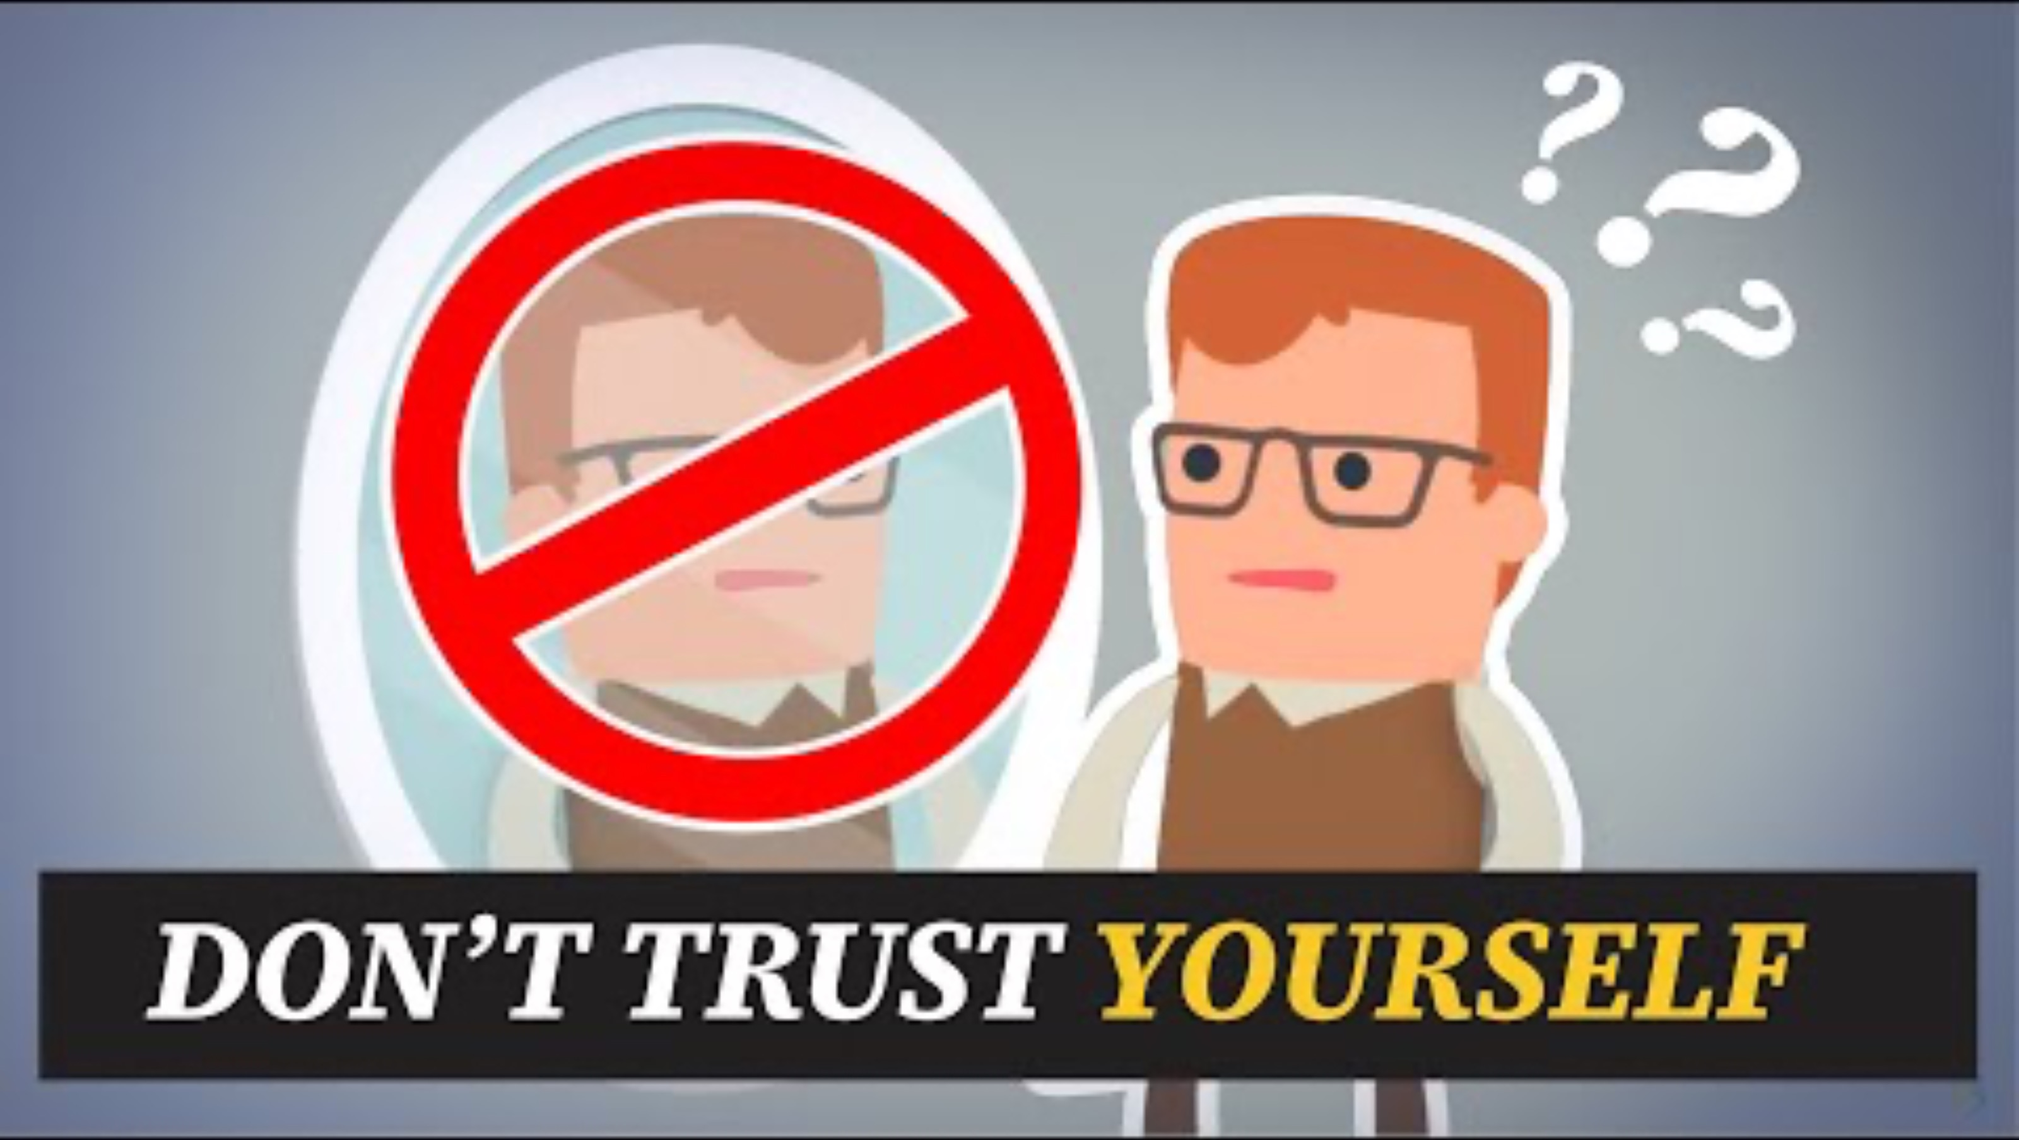
Cognitive biases
Write down the things that are new to you

Slide 28

TASK
Read ”Strategies for improving cognition” in Kognity 5.1.2
  How can we avoid confirmation bias and anchoring bias?
  What other strategies can you think of than the ones mentioned in Kognity?

Slide 29

Cognitive biases
Debiasing strategies
  Motivational: holding people accountable of their decisions
  Cognitive: prescribed rules that are designed to overcome heuristics
  Technological: using external tools to avoid biased thinking

Slide 30
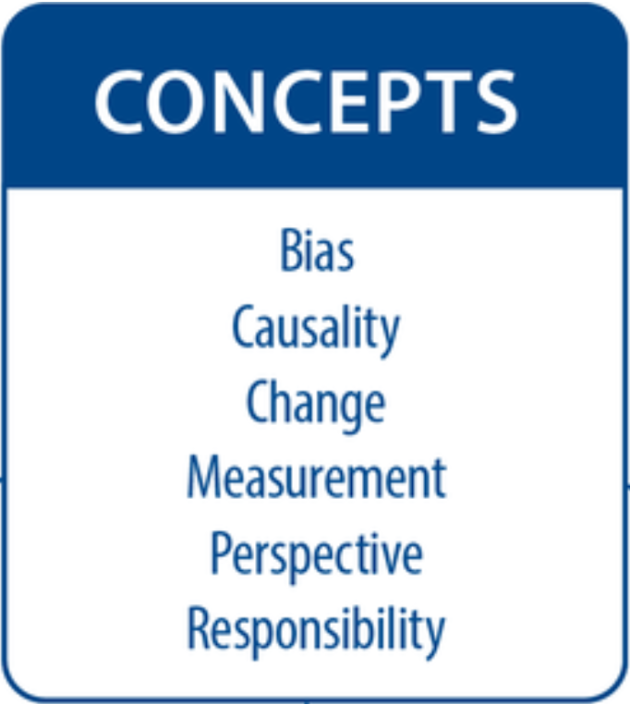
TASK
Teacher divides you into six groups
Each group revolves through six checkpoints and contributes to concept maps based on the Dual processing theory and Cognitive biases

Slide 31
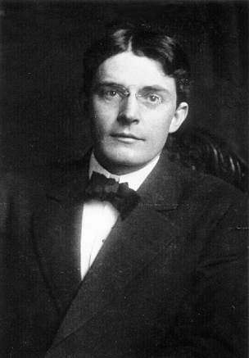
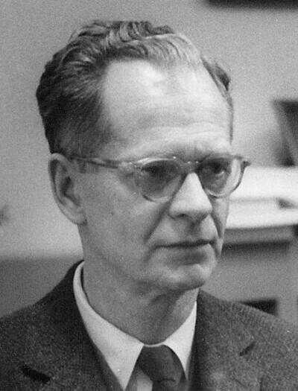
Classical and operant conditioning
Behaviourism
  A psychological perspective founded by John Watson and further developed by B. F. Skinner in the early 1900’s
  According to behaviourism human behaviour is largely controlled by our environment, rather than internal processes or our free will

Slide 32
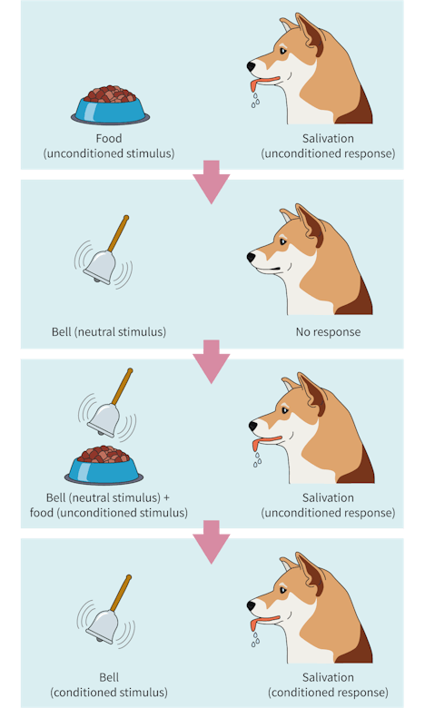
Classical and operant conditioning
Classical conditioning
  A learning process in which one develops involuntary responses to stimuli through conditioning

Slide 33
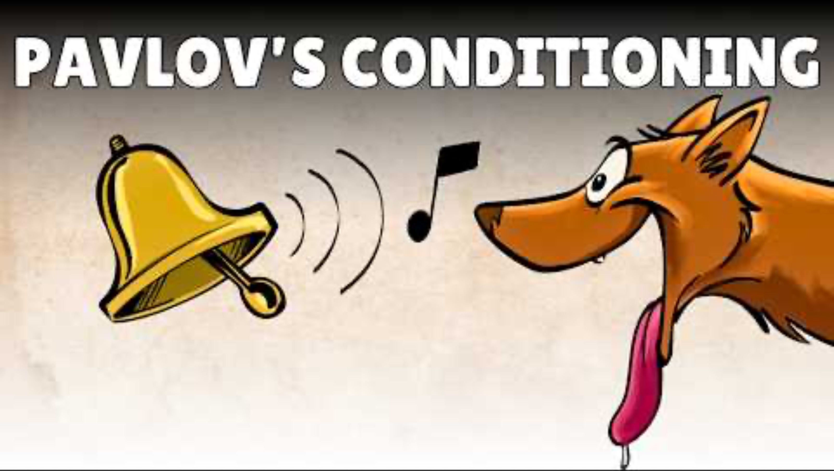
Classical and operant conditioning
Summarize Pavlov’s original study

Slide 34
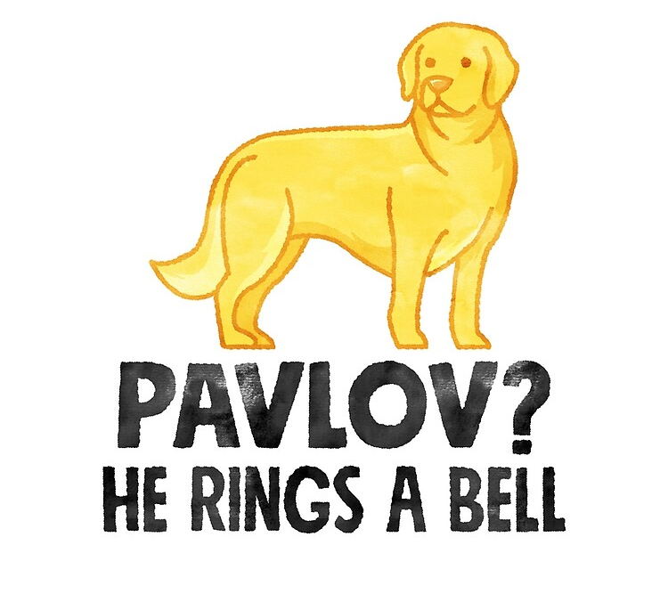
TASK
Read ”Classical conditioning” from Kognity 5.1.3
Explain the terms below in your own words and provide and example of each:
  Acquisition
  Extinction
  Spontaneous recovery
  Generalisation

Slide 35

TASK
What makes smartphone apps such as games and social media apps so addictive?
What kind of rewards do we get from these apps?

Slide 36
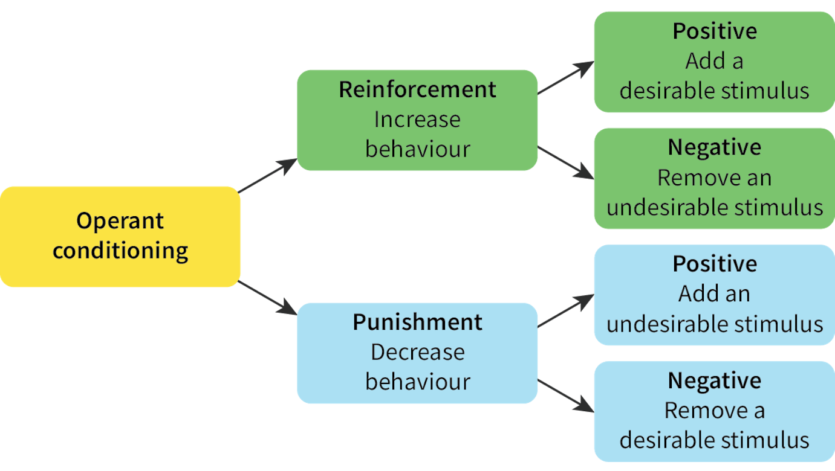
Classical and operant conditioning
Operant conditioning
  A learning process that changes behaviour using reinforcers and punishments

Slide 37
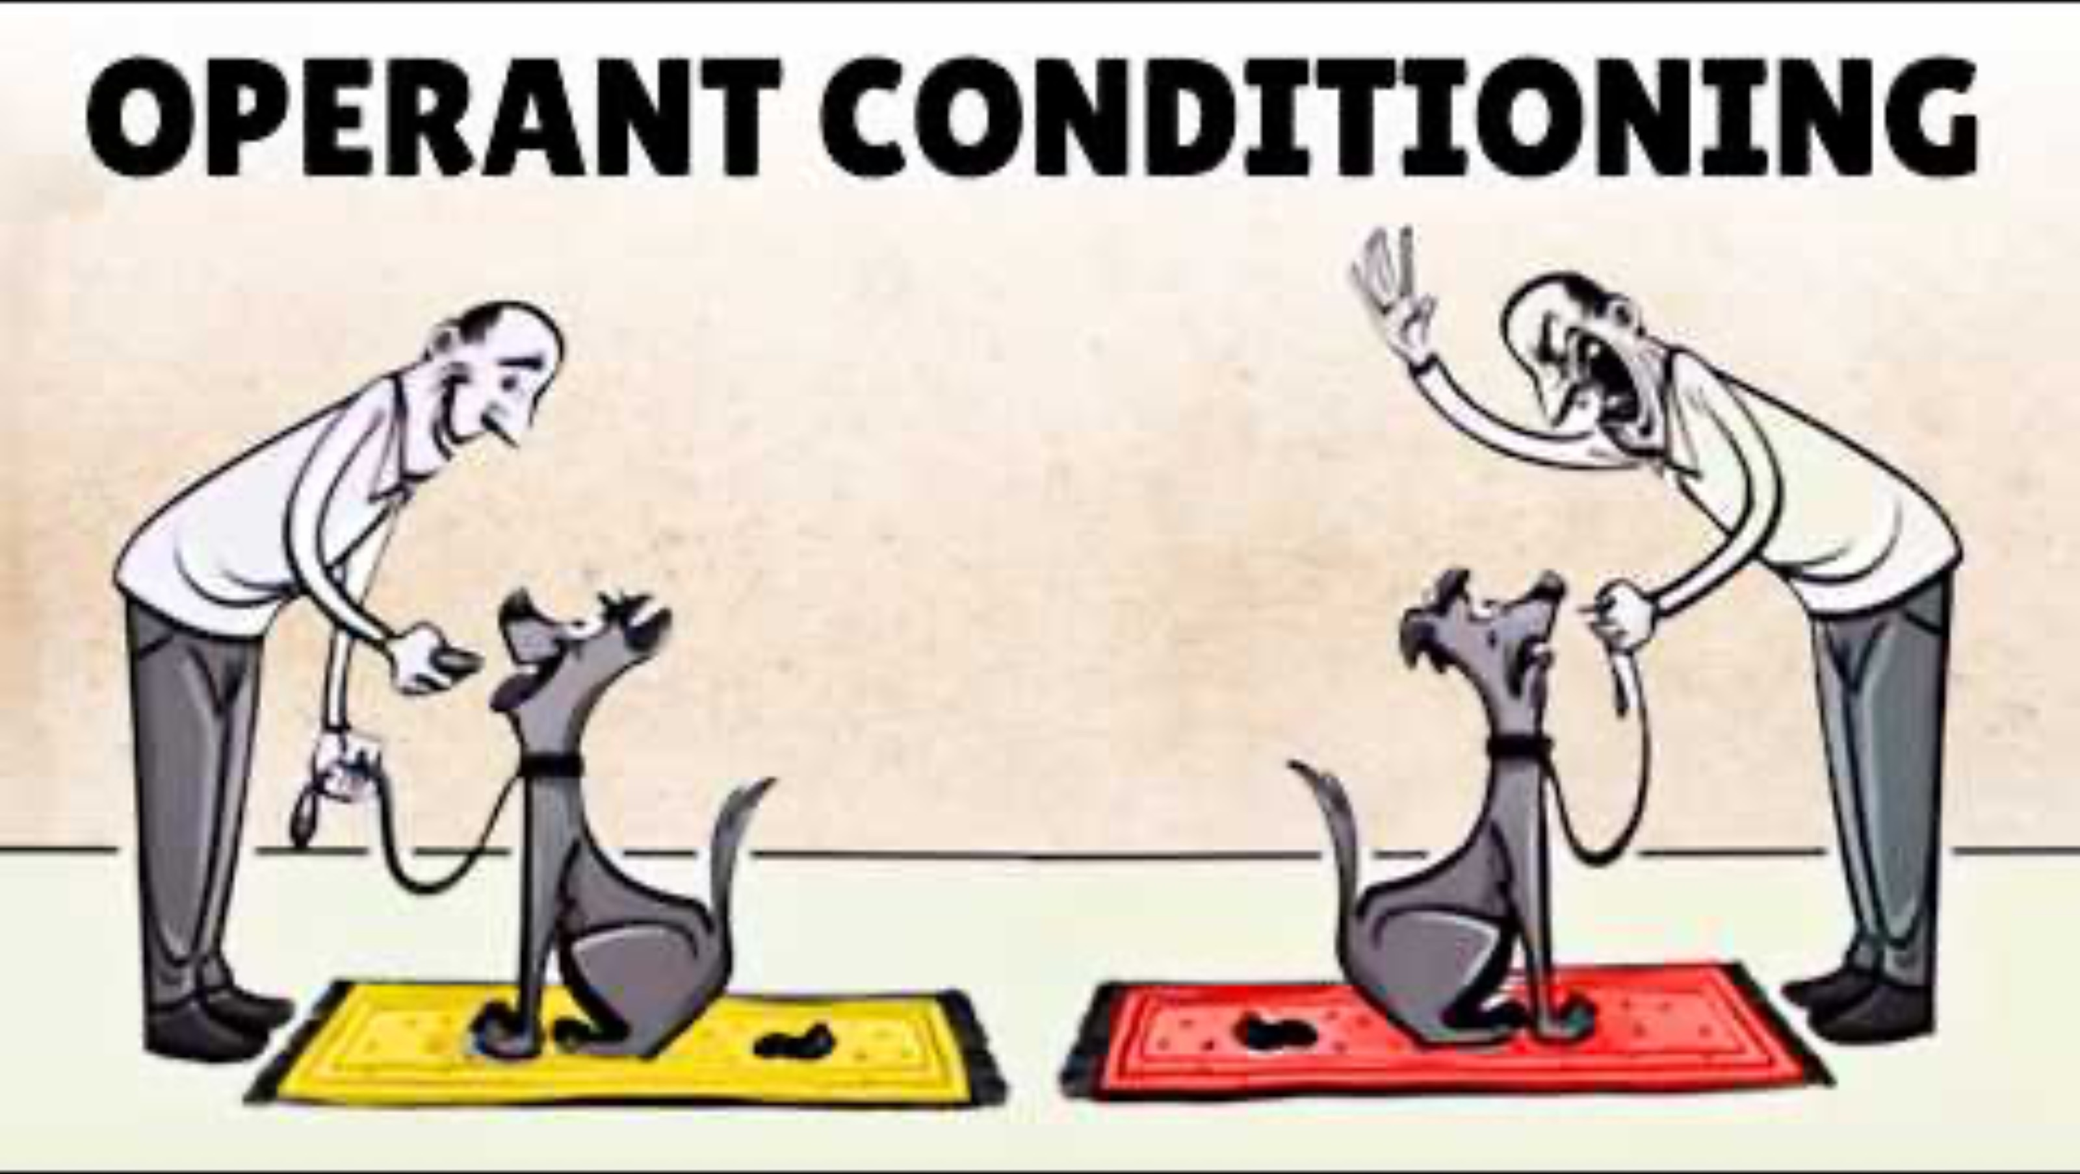
Classical and operant conditioning
Elaborate your memos with the help of this video

Slide 38

TASK
Read ”Operant conditioning” from Kognity 5.1.3
How would you encourage a child to read more books using:
  Positive reinforcement
  Negative reinforcement
  Positive punishment
  Negative punishment

Slide 39
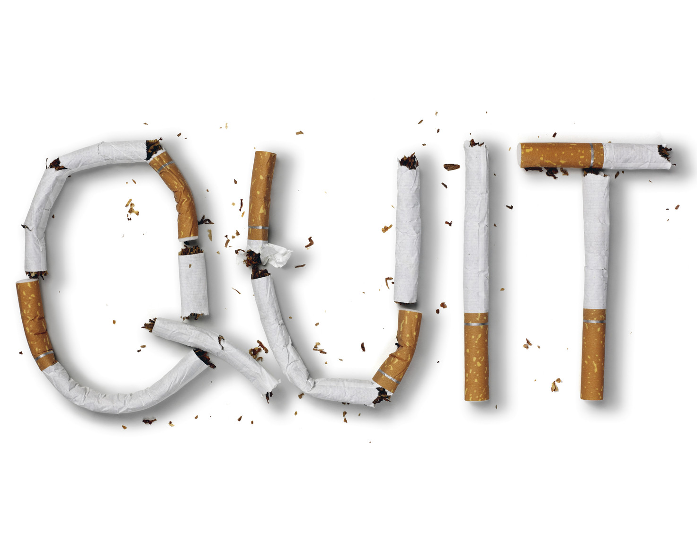
TASK
Read Dallery et al. (2017) from Kognity 5.1.3 and/or Kognity 5.1.10
  How was reinforcement used to shape behaviour to stop smoking?

Slide 40
TASK
Evaluate behaviourism through the six basic concepts
  What are the strengths and limitations of explaining learned behaviour in terms of operant and classical conditioning?

Slide 41
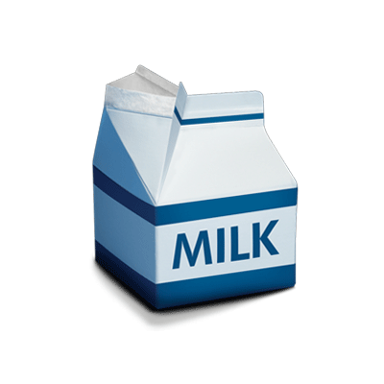
REVIEW
What were meant by schemas?
What could be examples of different schemas?
How do schemas influence our behaviour?

Slide 42
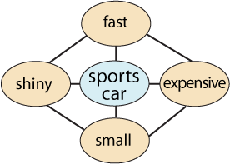
Schema theory
Cognitive schemas
  Mental representations
  Patterns of knowledge

Slide 43
Schema theory
ENVIRONMENT
CYCLE OF
PERCEPTION
SELECTS
TARGETS
CHANGES
SCHEMA
PERCEPTION
DIRECTS

Slide 44
Schema theory
THREE MAIN STAGES IN MEMORY PROCESSES
ENCODING
STORAGE
RETRIEVAL
SCHEMA PROCESSING CAN INFLUENCE
MEMORY AT ALL STAGES

Slide 45
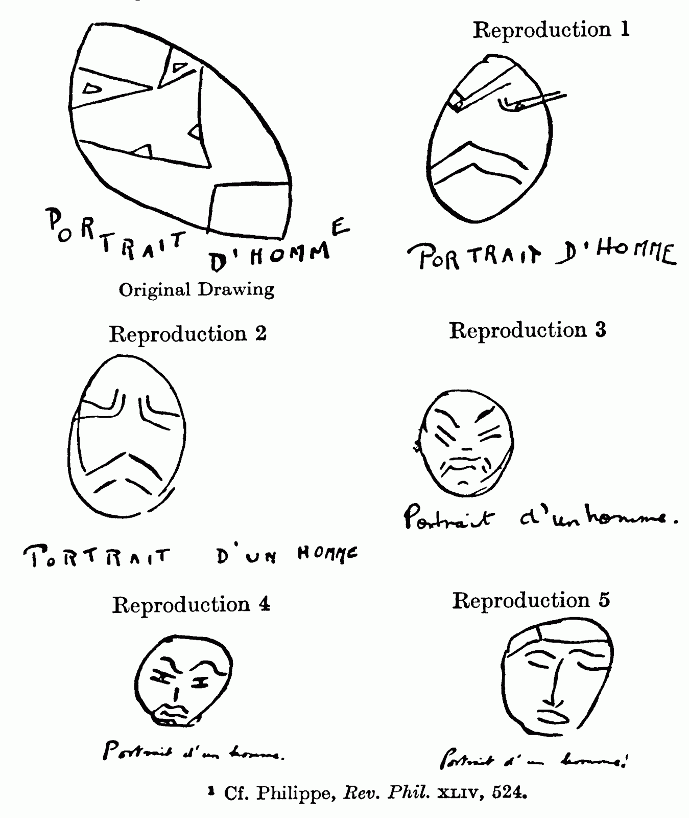
Schema theory
Bartlett (1932)
  Studied the reliability of memory with serial reproduction of Native American legend “The War of Ghosts”

Slide 46
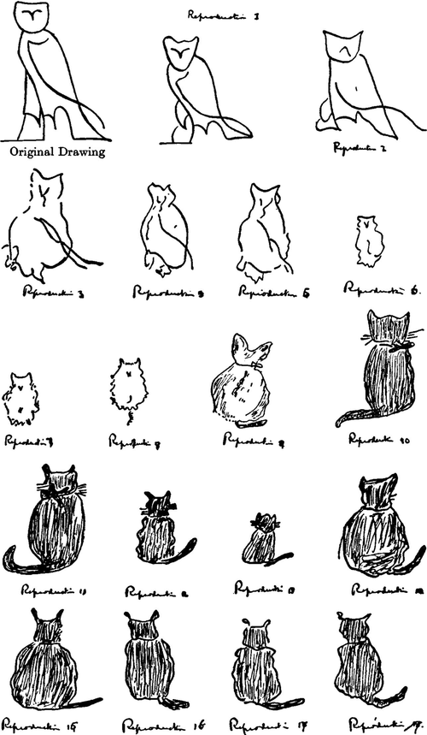
Schema theory
Effort after meaning
  Attempt to match unfamiliar ideas into a familiar framework

Slide 47
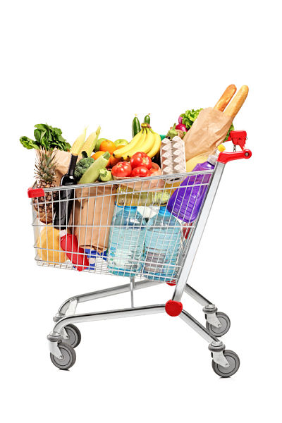
Schema theory
Social schemas
  Schemas about groups of people
  E.g. stereotypes
Scripts
  Schemas about sequences or events
  E.g. grocery shopping

Slide 48
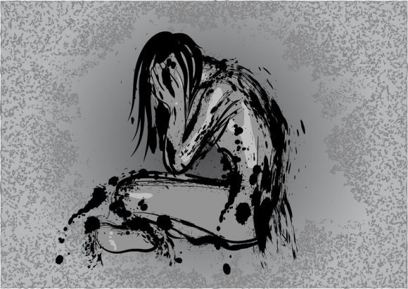
Schema theory
Self-schemas
  Schemas about ourselves
  ”I wish I was different”
  ”People don’t notice me”
  ”No matter how hard I try I will fail for sure”

Slide 49
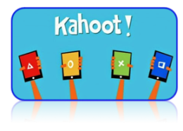
TASK
Teacher will divide the class in two groups
Both groups will given a stimulus material
Both groups will do a Kahoot! separately

Slide 50
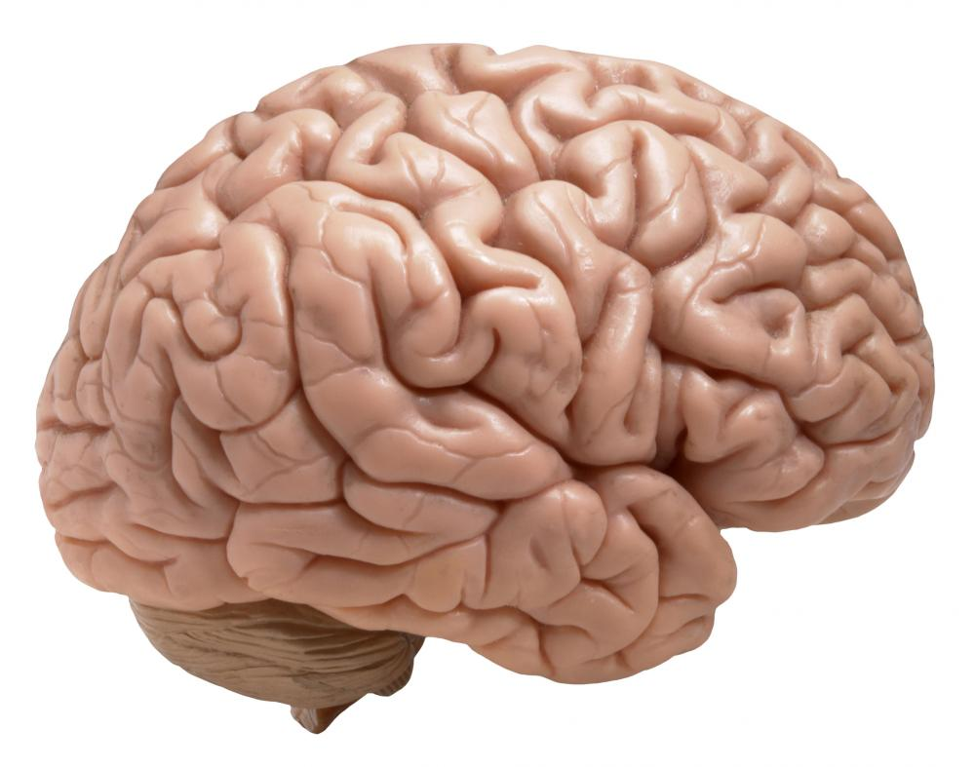

Schema theory
TOP-DOWN
PROCESSING
BOTTOM-UP
PROCESSING

Slide 51

Schema theory
Pattern recognition
  Matching the current sensory input to schemas in memory

Slide 52
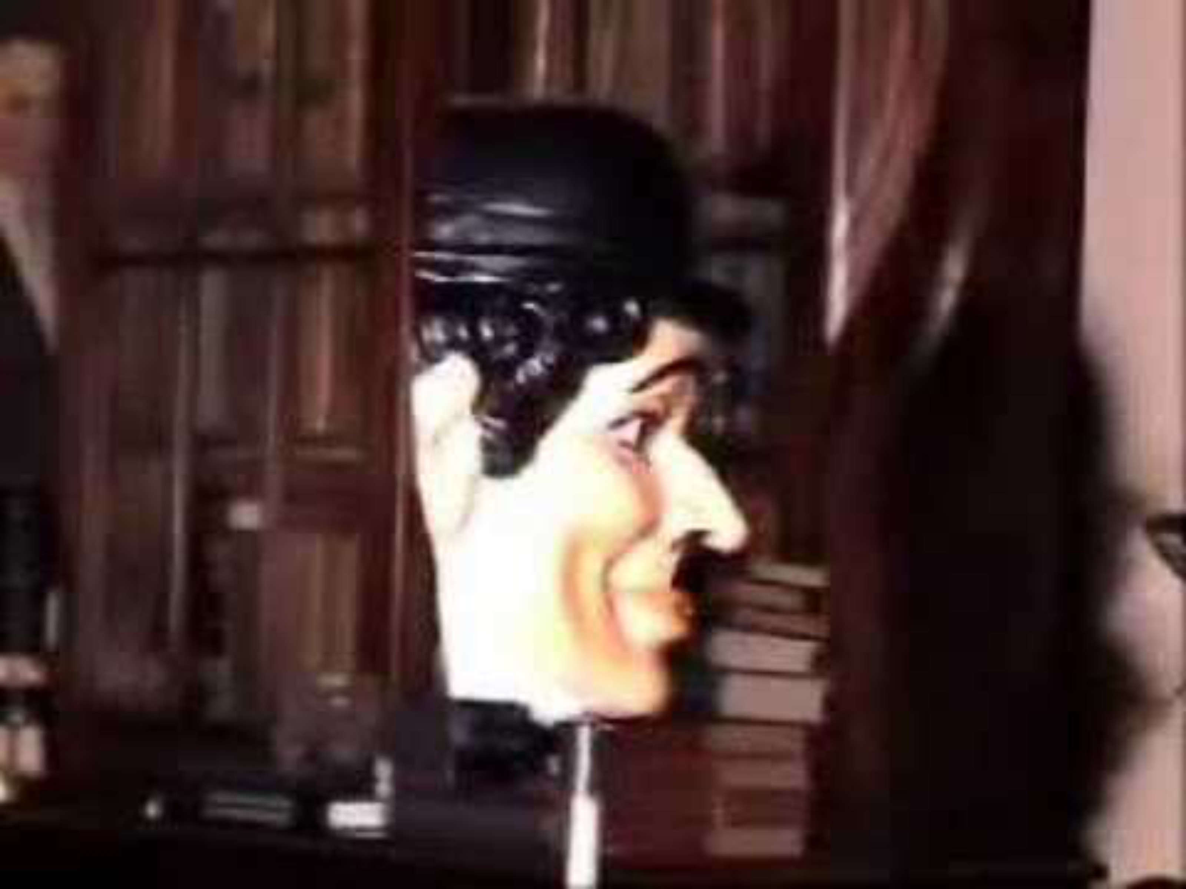
Schema theory
Pattern recognition in action

Slide 53
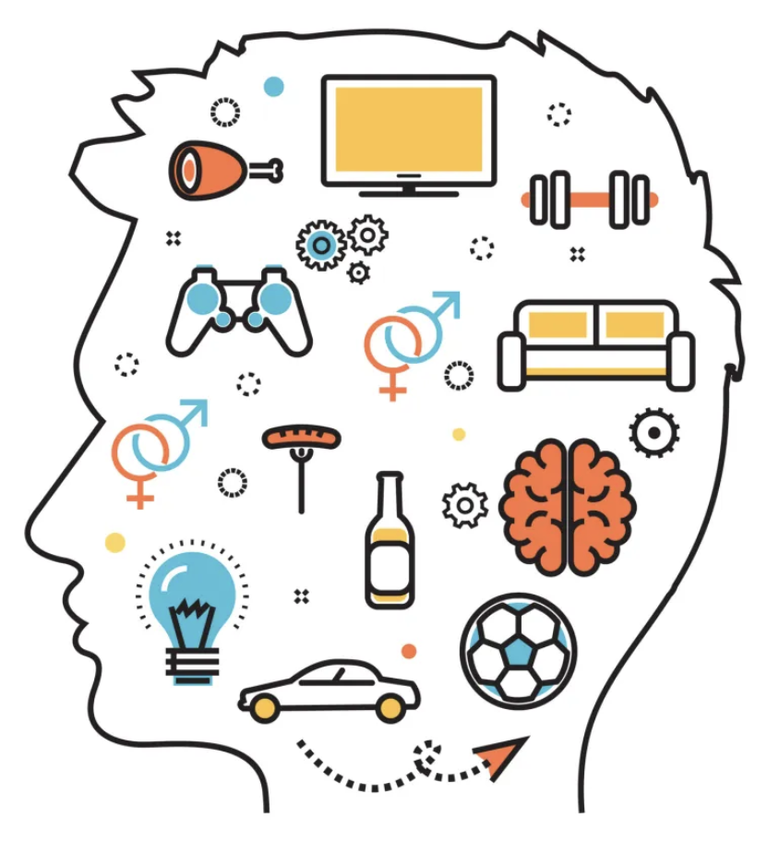
TASK
Read the Extra material on schema theory from teacher’s supplementary materials
  Make short notes and amend the ones you already have on schema theory
  What new did you learn from the material?

Slide 54
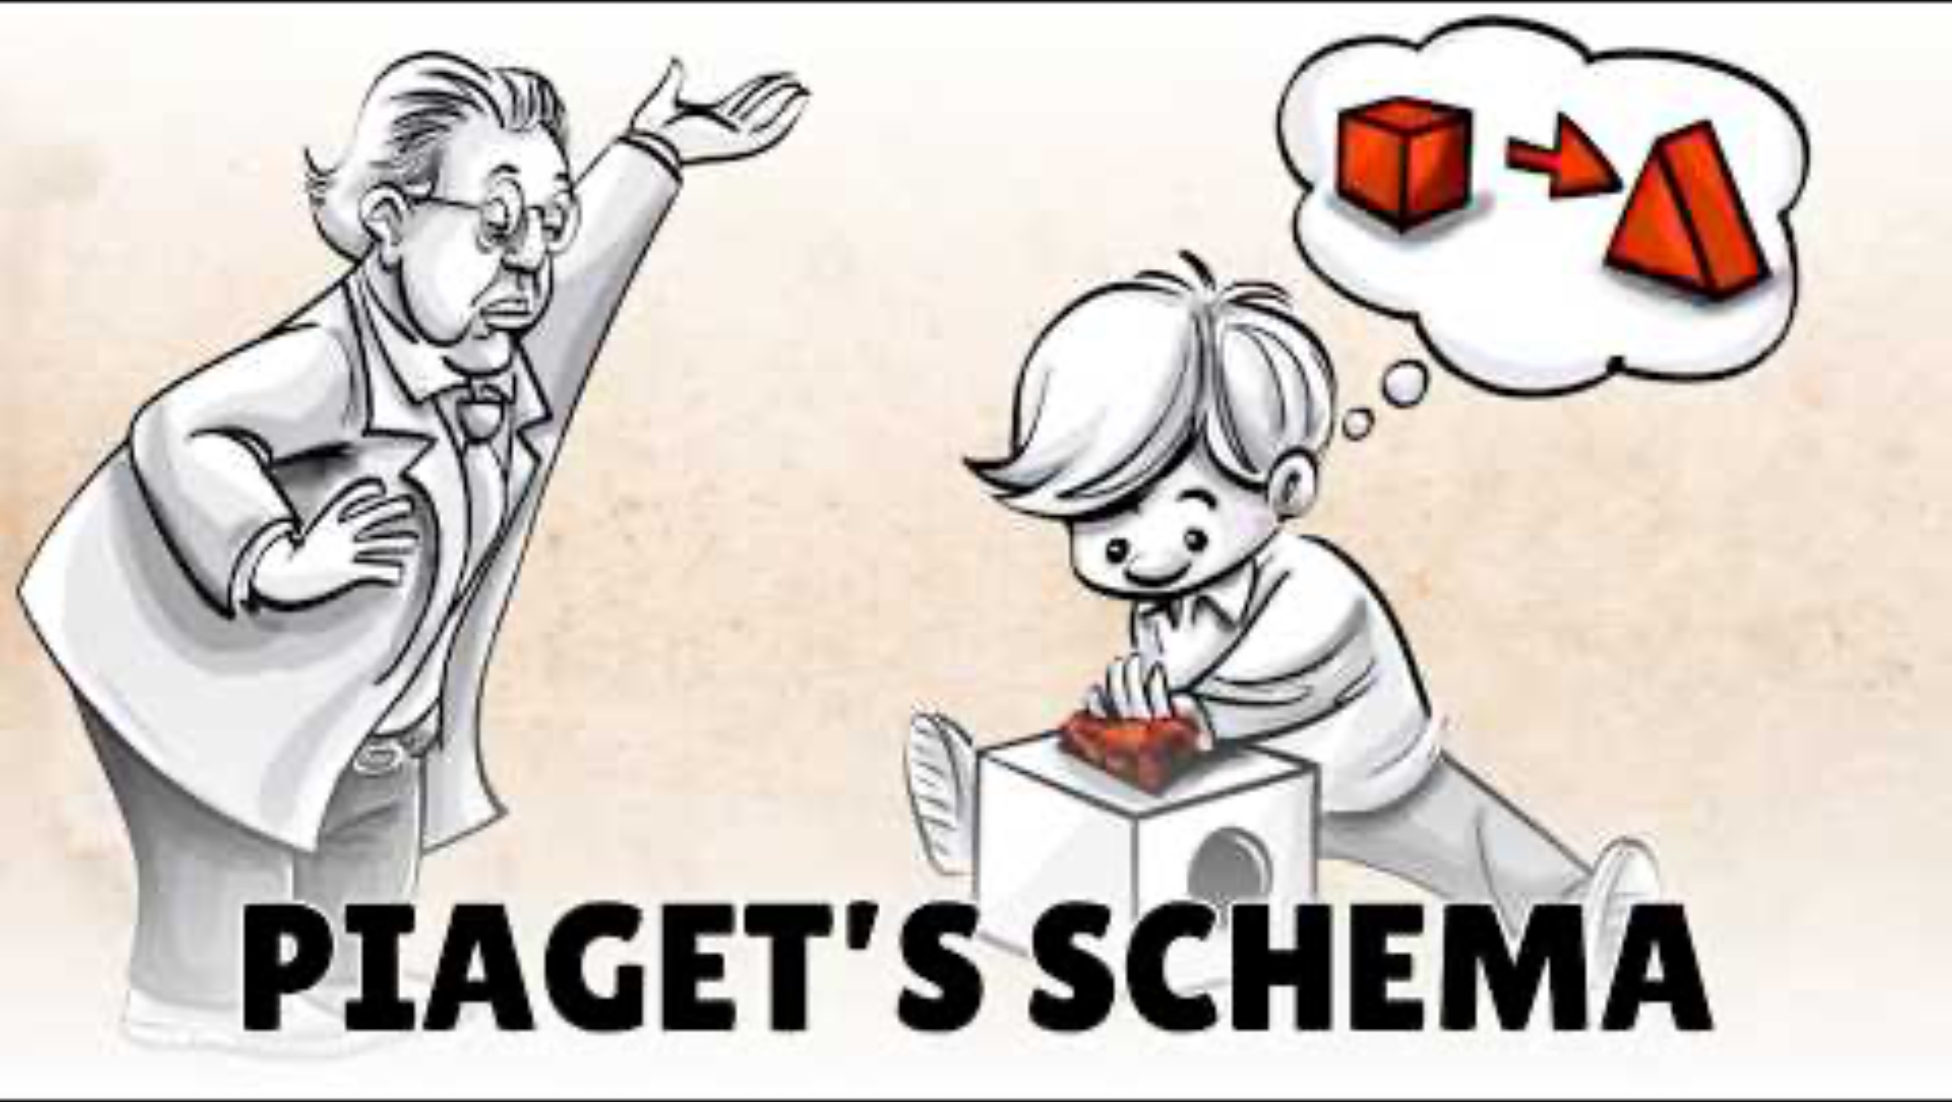
Schema Theory
Write down the things that are new to you

Slide 55
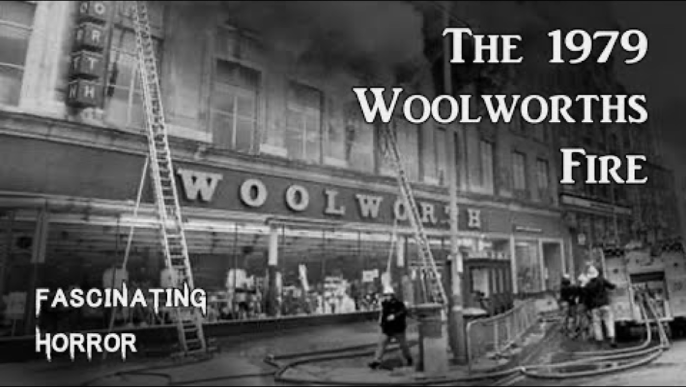
Schema theory
How can you apply schema theory here?

Slide 56

Schema theory
Theory of reconstructive memory
  Memory is an active process
  Memory is NOT exact, it is distorted by existing schemas

Slide 57
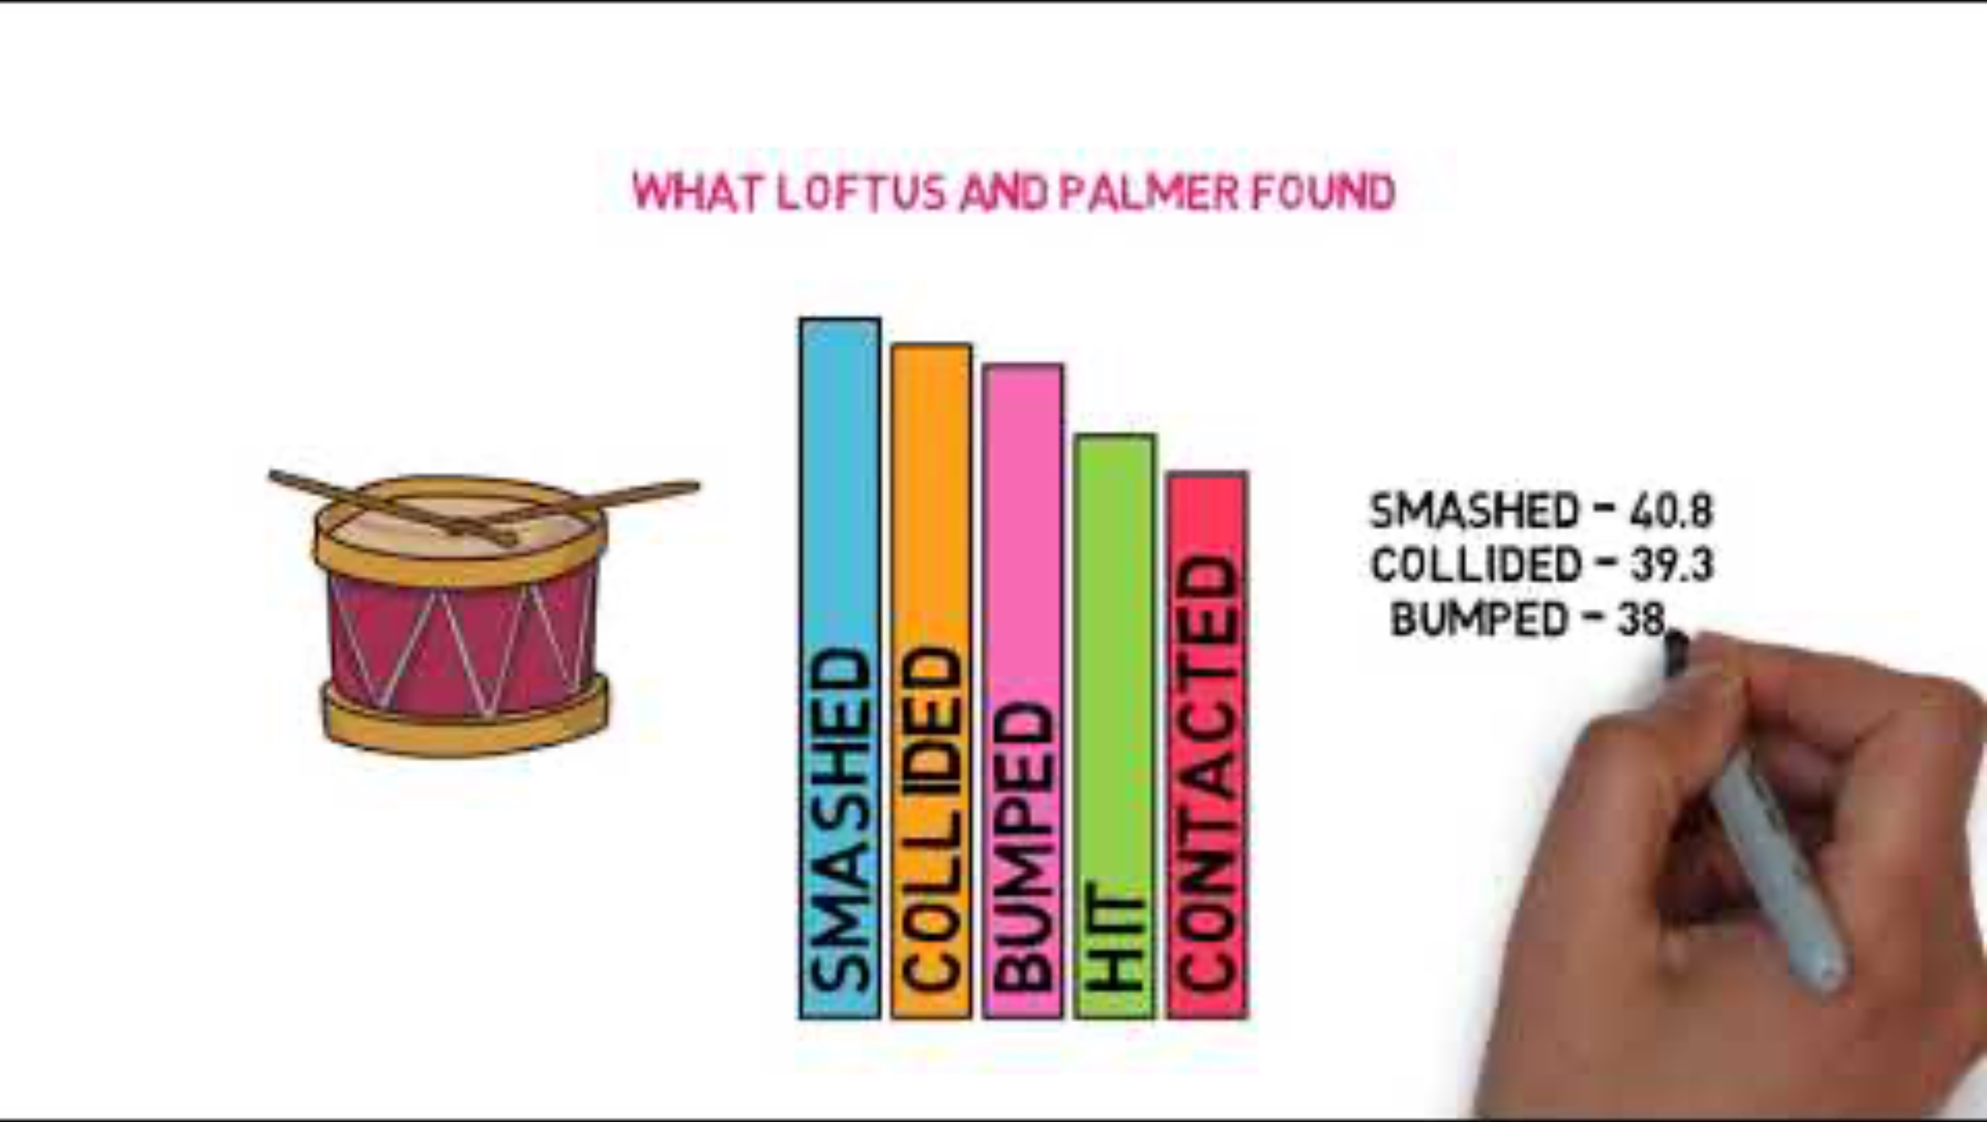
Schema theory
Study the gist of Loftus and Palmer (1974) with this video

Slide 58
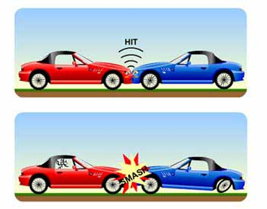
Schema theory
Loftus and Palmer suggested that the findings could be interpreted in two ways
  Response bias: the verb biases the response to a higher estimate
  Memory change: the verb causes an actual change in the memory

Slide 59
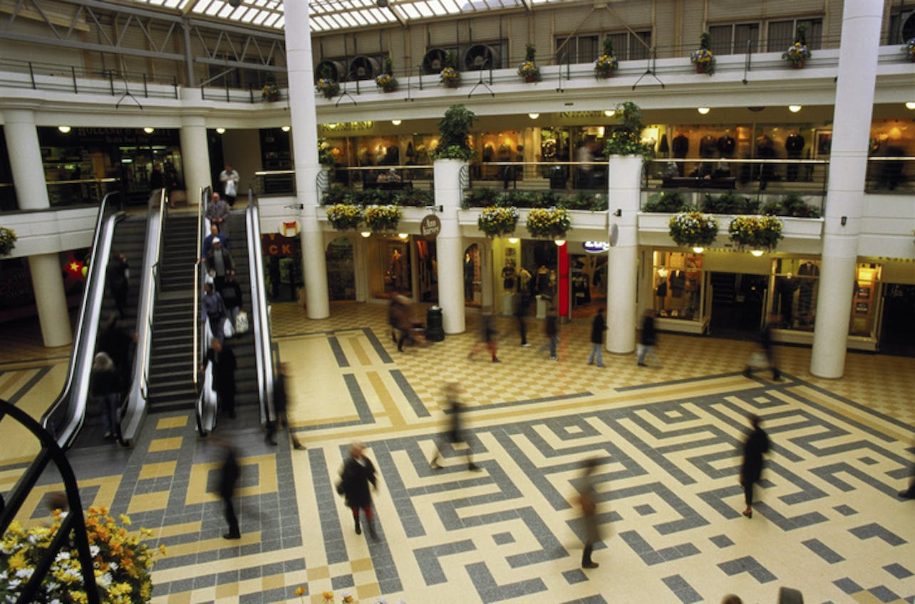
TASK
Read ”Memories and external factors” from Kognity 5.2.2 and Loftus and Palmer (1974), Paterson and Kemp (2006) and Loftus and Pickrell (1995) from Kognity 5.2.11
  How do external factors influence our memories?

Slide 60
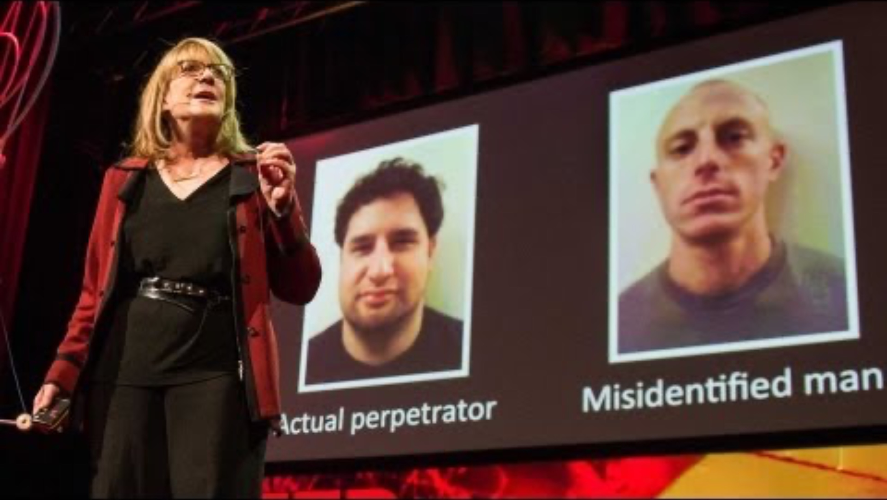
Schema Theory
How reliable is your memory?

Slide 61
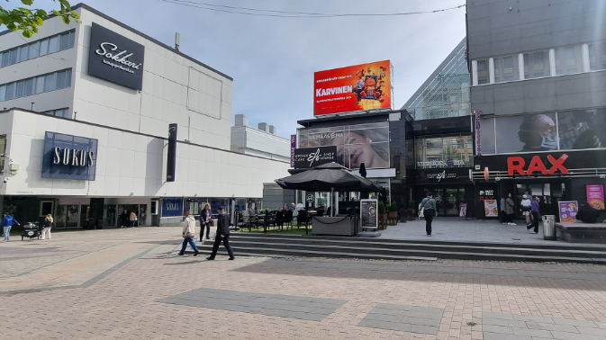
TASK
Read A Crime Drama from the teacher’s handout
  Do task in small groups

Slide 62
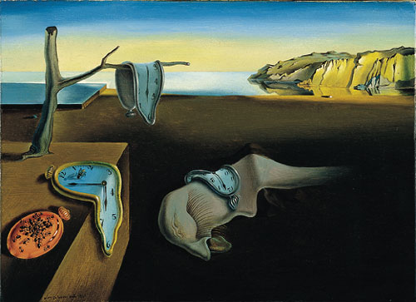
TASK
Is human memory reliable?
  On what basis it is?
  On what basis it is not?
  Can you trust your memory?

Slide 63
TASK
Evaluate schemas and schema theory through the six basic concepts
  What are the pros and the cons of schemas?
  What are the strengths and limitations of schema theory?

Slide 64
Picture sources
Wheel brain <http://careersinpsychology.org/becoming-a-cognitive-psychologist/> Accessed 11th of November 2015.
Bat and ball <https://www.stickpng.com/img/sports/baseball/gear/baseball-bat--ball> Accessed 30th of August 2019.
Shower <https://www.grohe-mena.com/en_cy/bathroom-collection/shower-systems.html> Accessed 24th of August 2026.
Kitchenware <https://www.etsy.com/nz/listing/834702239/wooden-soup-spoon-6-inches-soup-spoon> Accessed 24th of August 2026.
Daniel Kahneman <https://www.thedailybeast.com/daniel-kahnemans-gripe-with-behavioral-economics> Accessed 19th of February 2018.
Shopping <https://www.diabetescarecommunity.ca/diet-and-fitness-articles/diabetes-diet-articles/navigating-the-grocery-store-for-vegetables/> Accessed 24th of August 2026.
Old font <https://fi.pinterest.com/tuhuyat/old-english/> Accessed 26th of August 2026.
Bias <https://www.linkedin.com/pulse/changing-your-mind-how-become-more-aware-bias-work-julie> Accessed 24th of August 2026.
Rule of thumb <http://daysgoneby.me/dyk-rule-thumb/> Accessed 19th of February 2018.
Confirmation bias <https://thedecisionlab.com/biases/confirmation-bias> Accessed 24th of August 2026.
Death penalty <https://thinkib.net/psychology/page/50732/cognitive-biases> Accessed 24th of August 2026.
Vaccine <https://emhealth.org/2020/12/17/covid-19-vaccines-faq/> Accessed 26th of August 2026.
Dream house <https://www.archdaily.com/217544/travertine-dream-house-wallflower-architecture-design> Accessed 10th of November 2020.
Doctor <https://stmacorpuschristi.com/what-does-an-internal-medicine-doctor-treat/> Accessed 26th of August 2026

Slide 65
Picture sources
Anchoring bias <https://thedecisionlab.com/biases/anchoring-bias> Accessed 24th of August 2026.
Debiased head <https://psychology.iresearchnet.com/social-psychology/social-influence/debiasing/> Accessed 24th of August 2026.
Addictive phone <https://www.linkedin.com/pulse/phone-addiction-new-drug-killing-us-softly-juan-sanchez-bonet> Accessed 24th of August 2026.
John Watson <https://fi.wikipedia.org/wiki/John_Broadus_Watson> Accessed 24th of August 2026.
B. F. Skinner <https://en.wikipedia.org/wiki/B._F._Skinner> Accessed 24th of August 2026.
Classical condioning – Kognity
Pavlov rings a bell <https://www.redbubble.com/i/poster/Pavlov-That-Rings-A-Bell-Pun-Joke-by-sharedipmemes/57835796/flk2> Accessed 24th of August 2026.
Types of operant conditioning – Kognity.
A child reading <https://www.vecteezy.com/free-photos/boy-reading-book> Accessed 24th of August 2026.
Quit smoking <https://www.health.harvard.edu/blog/whats-best-way-quit-smoking-201607089935> Accessed 1st of September 2026.
Milk carton <http://www.smallworlds.com/forum/archive/index.php/t-1274171.html> Accessed 23rd of November 2017.
Schema of sport cars <http://mercercognitivepsychology.pbworks.com/w/page/61207282/Schemas> Accessed 11th of November 2015.
Bartlett serial reproduction figures 1 <http://www.psychsummaries.com/2011/11/bartlett-1932-and-war-of-ghosts.html> Accessed 27th of November 2017.
Bartlett serial reproduction figures 2 <http://psycnet.apa.org/fulltext/2014-16777-001.html> Accessed 27th of November 2017.
Groceries <https://www.groceryshoppingbusiness.com/hello-world/> Accessed 6th of November 2018.

Slide 66
Picture sources
Depression <https://www.docsopinion.com/2018/02/25/depression-symptoms/> Accessed 6th of November 2018.
Kahoot! <http://www.psi-solutions.org/kahoot-it/> Accessed 24th of January 2016.
Brain <http://cliparting.com/free-brain-clipart-4926/> Accessed 23rd of November 2017.
Eye drawing <http://www.clipartpanda.com/clipart_images/blue-eye-clip-art-image-1399516> Accessed 23rd of November 2017.
Face in trees <https://8tracks.com/theperksofbeingme/confusing-thoughts-on-a-chilly-afternoon> Accessed 27th of November 2017.
Schema head < https://www.themantic-education.com/ibpsych/2017/11/29/schema-theory-a-summary/ > Accessed 24th of August 2026.
Memory wheel head <http://exclusive.multibriefs.com/content/working-memory-in-english-language-development> Accessed 24th of November 2015.
Loftus & Palmer <https://www.simplypsychology.org/loftus-palmer.html> Accessed 27th of November 2017.
Mall picture from Kognity 5.2.2
Jyväskylän kompassi © Milla Jurva
Dali <https://fi.wikipedia.org/wiki/Muiston_pysyvyys> Accessed 25th of November 2015.

