Slide 1
LEARNING AND COGNITION
HL EXTENSIONS
IB Psychology LAJM

Slide 2
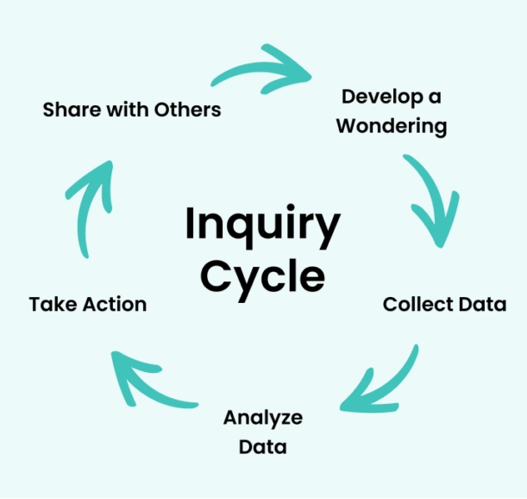
About the HL extensions
HL extensions for each context are:
  (1) Culture
  (2) Motivation
  (3) Technology
HL extensions are based on inquiry learning

Slide 3
About the HL extensions
Teacher will give prompts to encourage students to investigate a topic under each context related to culture, motivation and technology
Students will explore, investigate, reflect and finally share their findings with the
whole class
  The findings will prepare the students for Paper 3

Slide 4

About the HL extensions
Paper 3 is focused on HL extensions and
data-analysis
In Paper 3 you will have a set of stimulus materials that reflect HL extensions and where data-analysis is applied

Slide 5
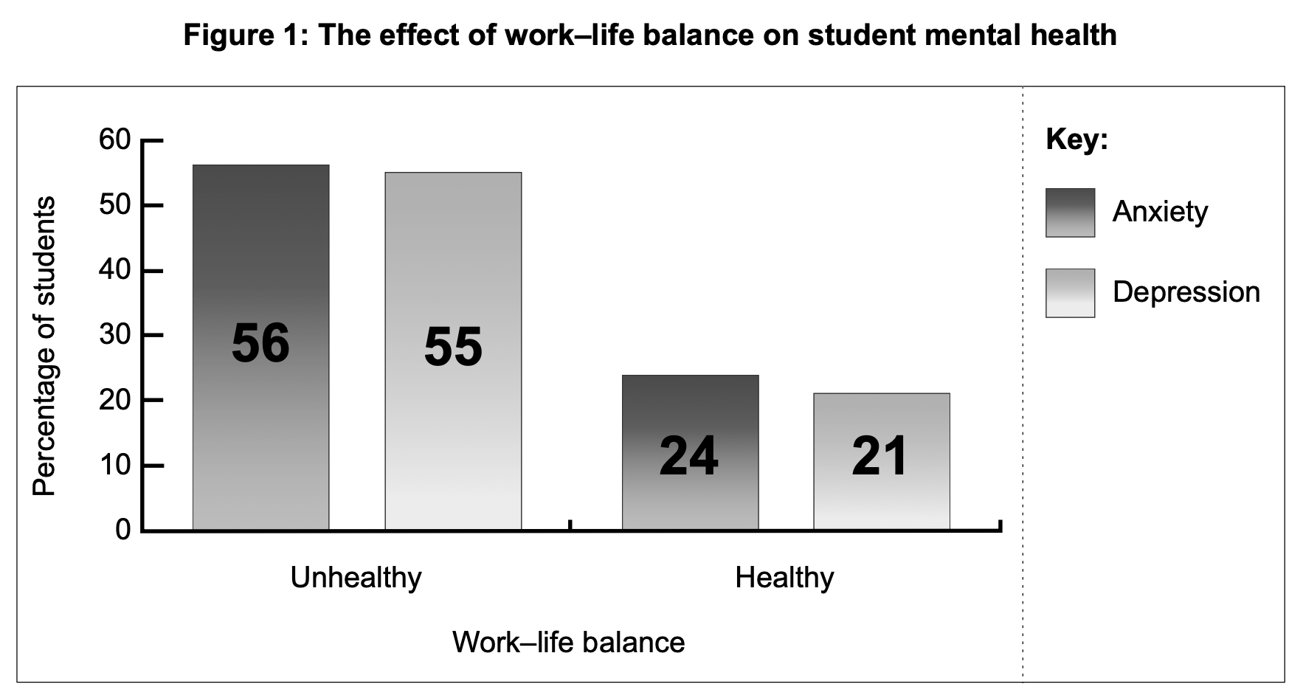
TASK
Familiarize yourself with the sample Paper 3
You should look for similar kind of sets of data as in the sample paper and work with the inquiry question

Slide 6

HL extensions in learning and cognition
Culture
  The role of culture on learning and cognition
  The role of bilingualism on other cognitive processes
  The extent to which learning and cognition across cultures are similar and different

Slide 7

HL extensions in learning and cognition
Motivation
  The role of motivation in enhancing one cognitive process
  The strategies to motivate students to becoming independent learners
  The extent motivation can be assessed

Slide 8

HL extensions in learning and cognition
Technology
  The role of technology in learning
  The effect of technology on cognition

Slide 9
Culture in learning and cognition
(1) To what extent does culture influence the way people learn, and can learning processes ever be considered universal?
(2) Is monolingualism a greater cognitive disadvantage than is commonly acknowledged, and why might this issue receive limited attention?
(3) Can intelligence be meaningfully compared across cultures, or are cultural conceptions of intelligence fundamentally incommensurable?
What could be your prompts?

Slide 10
Motivation in learning and cognition
(4) To what extent is motivation more important than intelligence in determining learning and achievement?
(5) Does increasing external motivation make students more dependent on rewards and encouragement, rather than fostering independence?
(6) To what extent can motivation be measured scientifically, and what are the limitations of attempting to quantify it?
What could be your prompts?

Slide 11
Technology in learning and cognition
(7) Has technology truly revolutionized learning, or has it primarily increased opportunities for distraction?
(8) How does reliance on technology affect memory, critical thinking, and other cognitive processes?
(9) To what extent has technology encouraged people to become cognitive misers, relying on external tools rather than their own mental resources?
What could be your prompts?

Slide 12
TASK
(1) Collect data/sources for each prompt
  What kind of studies and theories can you find?
  Try to find studies with tables and graphs
(2) Analyse/interpret the data/sources you found relevant to the prompt
(3) What kind of arguments, counter-arguments and conclusions can you make?
(4) Prepare to share your insights with others
  Create PowerPoints with examples like in Paper 3

Slide 13
Extra tips for the inquiry
Keep the basic concepts in your mind and try to apply them to your inquiry
  Bias, causality, change, measurement, perspective and responsibility
Use the Kognity HL extension boxes as a starting point

Slide 14
Picture sources
Inquiry-based learning <https://www.clickvieweducation.com/en-au/blog/teaching-strategies/inquiry-based-learning> Accessed 2nd of October 2025.
IB logo <https://commons.wikimedia.org/wiki/File:International_Baccalaureate_Logo.svg> Accessed 2nd of October 2025.
Learning culture lamp <https://sloanreview.mit.edu/article/three-steps-to-building-a-learning-culture-that-delivers-innovation/> Accessed 2nd of October 2025.
Motivation <https://www.protouchpro.com/guest-posts/cultivating-inner-drive-the-art-of-self-motivation/> Accessed 2nd of October 2025.
Digital learning tools <https://elearningindustry.com/the-top-benefits-of-digital-learning> Accessed 2nd of October 2025.

