Slide 1
LEARNING AND COGNITION
HL EXTENSIONS
IB Psychology LAJM

Slide 2
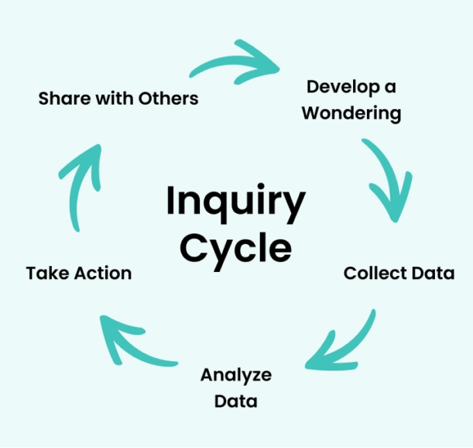
About the HL extensions
HL extensions for each context are:
  (1) Culture
  (2) Motivation
  (3) Technology
HL extensions are based on inquiry learning

Slide 3
About the HL extensions
Teacher will give prompts to encourage students to investigate a topic under each context related to culture, motivation and technology
Students will explore, investigate, reflect and finally share their findings with the
whole class
  The findings will prepare the students for Paper 3

Slide 4

About the HL extensions
Paper 3 is focused on HL extensions and
data-analysis
In Paper 3 you will have a set of stimulus materials that reflect HL extensions and where data-analysis is applied

Slide 5

HL extensions in learning and cognition
Culture
  The role of culture on learning and cognition
  The role of bilingualism on other cognitive processes
  The extent to which learning and cognition across cultures are similar and different

Slide 6

HL extensions in learning and cognition
Motivation
  The role of motivation in enhancing one cognitive process
  The strategies to motivate students to becoming independent learners
  The extent motivation can be assessed

Slide 7

HL extensions in learning and cognition
Technology
  The role of technology in learning
  The effect of technology on cognition

Slide 8
Culture in learning and cognition
Learning is the same in every culture because culture doesn’t have any impact on learning
Monolingualism is the real cognitive disadvantage – but we just don't talk about it
Comparing intelligence across cultures is like comparing apples to algorithms – they are incommensurable
What could be your prompts?

Slide 9
Motivation in learning and cognition
Motivation matters more than intelligence – because without it, even the smartest minds stagnate
The more we try to motivate students, the more dependent they become
Trying to measure motivation is like trying to weigh curiosity – it is pseudoscience
What could be your prompts?

Slide 10
Technology in learning and cognition
Technology hasn’t revolutionized learning – it has just made distraction more efficient
The more we rely on technology, the less we remember – and the less we think
Technology has made us cognitive misers
What could be your prompts?

Slide 11
TASK
(1) Collect data/sources for each prompt
  What kind of studies and theories can you find?
  Try to find studies with tables and graphs
(2) Analyse/interpret the data/sources you found relevant to the prompt
(3) What kind of arguments, counter-arguments and conclusions can you make?
(4) Prepare to share your insights with others
  Create PowerPoints with examples

Slide 12
Picture sources
Inquiry-based learning <https://www.clickvieweducation.com/en-au/blog/teaching-strategies/inquiry-based-learning> Accessed 2nd of October 2025.
IB logo <https://commons.wikimedia.org/wiki/File:International_Baccalaureate_Logo.svg> Accessed 2nd of October 2025.
Learning culture lamp <https://sloanreview.mit.edu/article/three-steps-to-building-a-learning-culture-that-delivers-innovation/> Accessed 2nd of October 2025.
Motivation <https://www.protouchpro.com/guest-posts/cultivating-inner-drive-the-art-of-self-motivation/> Accessed 2nd of October 2025.
Digital learning tools <https://elearningindustry.com/the-top-benefits-of-digital-learning> Accessed 2nd of October 2025.

