Slide 1
5.2 COGNITIVE PROCESSES
IB Psychology LAJM

Slide 2
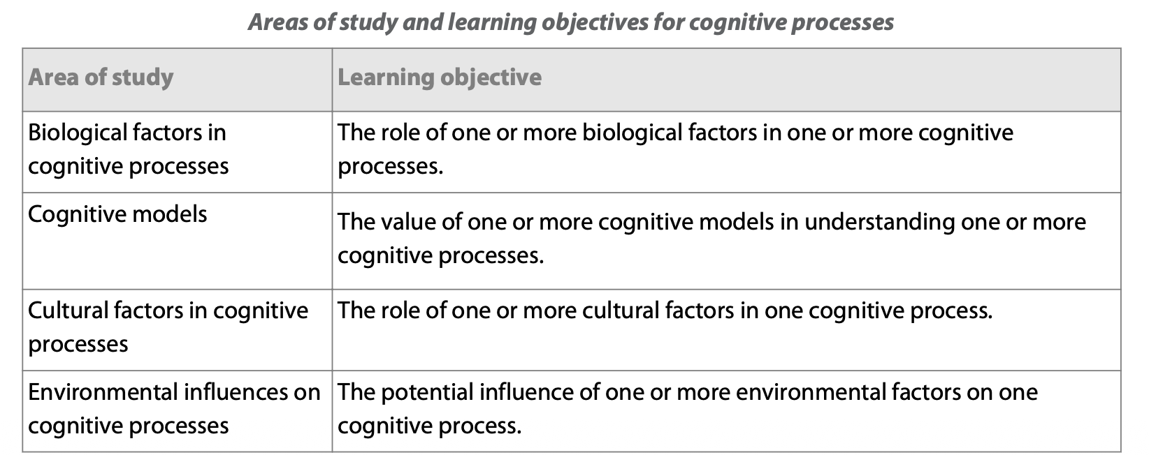
Cognitive processes

Slide 3
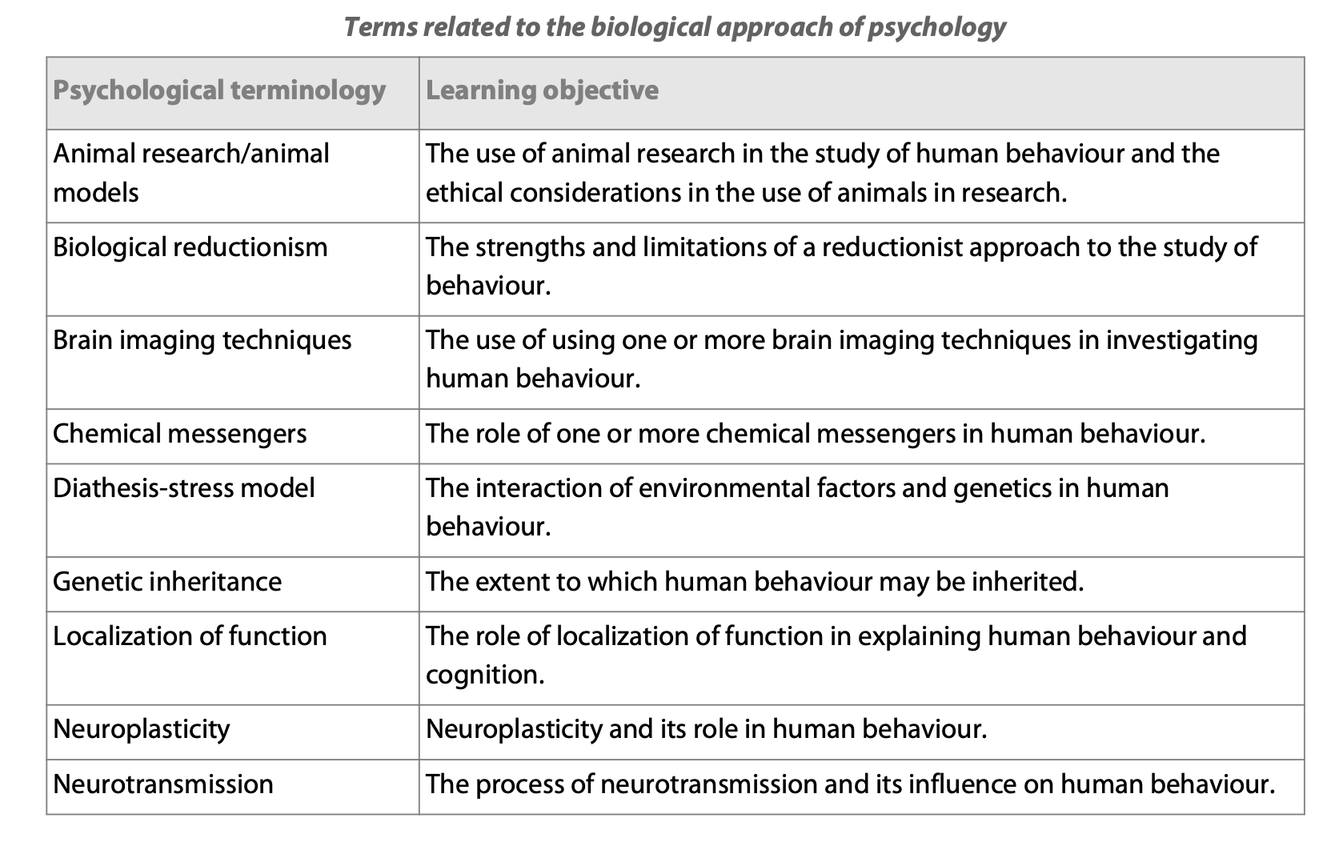
Cognitive processes

Slide 4
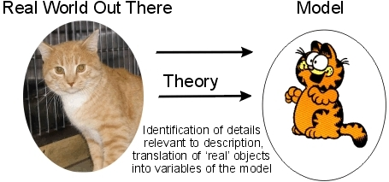
Cognitive models
What is a model?
  Physical representation what a psychological phenomenon could
  look like
  Hypothetical construct

Slide 5
Cognitive models
Behaviourism: Only observable behaviour (response to stimulus) can be scientifically studied
Cognitive psychology: What happens between the stimulus and response?
  To help explain complex processes like memory, cognitive psychologists have developed cognitive models
STIMULUS
RESPONSE

Slide 6

Models of memory
Why does our memory work like this?

Slide 7
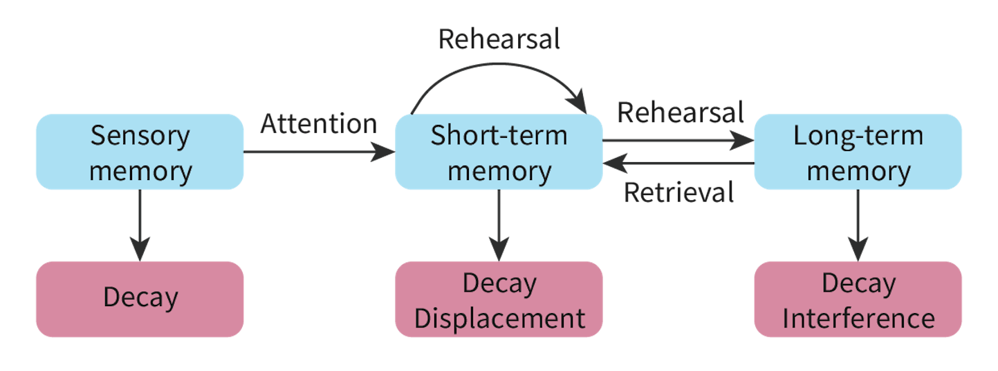
Models of memory
Multi-store model of memory (Atkinson & Shiffrin, 1968)
Aims to explain how humans encode, store and retrieve
information between three distinct stores

Slide 8
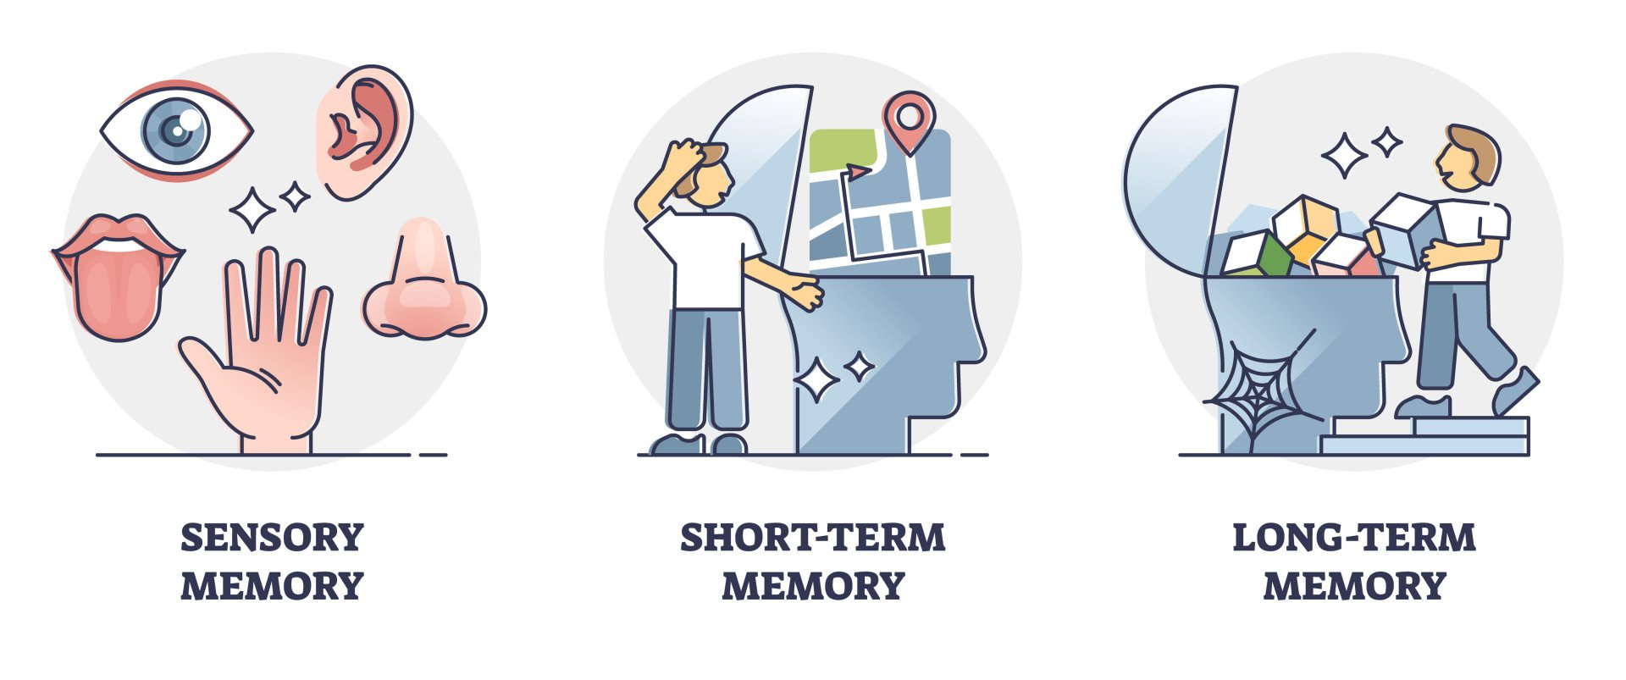
TASK
Read “Multi-store model of memory (MSM)” from Kognity 5.2.1 and complete the teacher’s handout
  How does encoding, capacity and duration differ in each store?

Slide 9
TASK
Prepare yourself for Sperling’s test (1960)!
  Teacher will show you a 4x3 grid of characters for an extremely brief moment of time
  After showing the grid, the teacher will say ”top”, ”middle” or ”bottom” indicating the line of the grid
  Your job is to remember as many characters from that line as possible

Slide 10
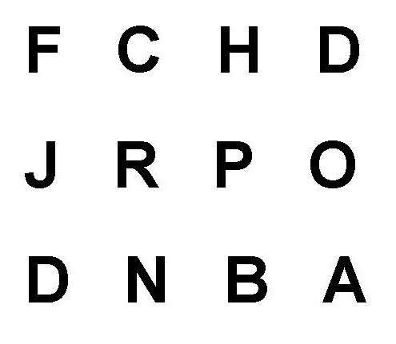

Slide 11
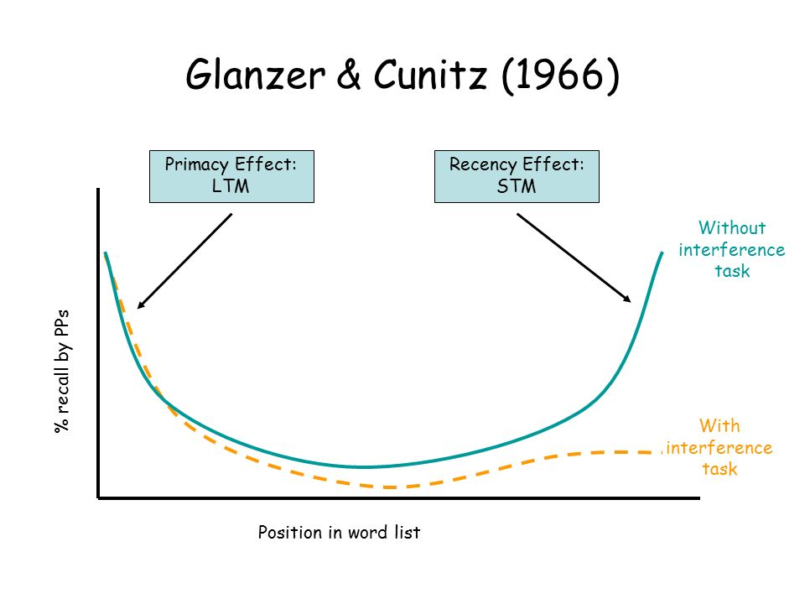
TASK
Read Glanzer and Cunitz (1966) from teacher’s supplementary materials?
  What kind of evidence does serial position effect provide for the multi-store model of memory?

Slide 12
RESEARCH: Types of experiments
Independent measures design
  Participants are randomly allocated into separate groups, usually experimental and control groups
Repeated measures design
  Participants experience all the conditions of the experiment

Slide 13
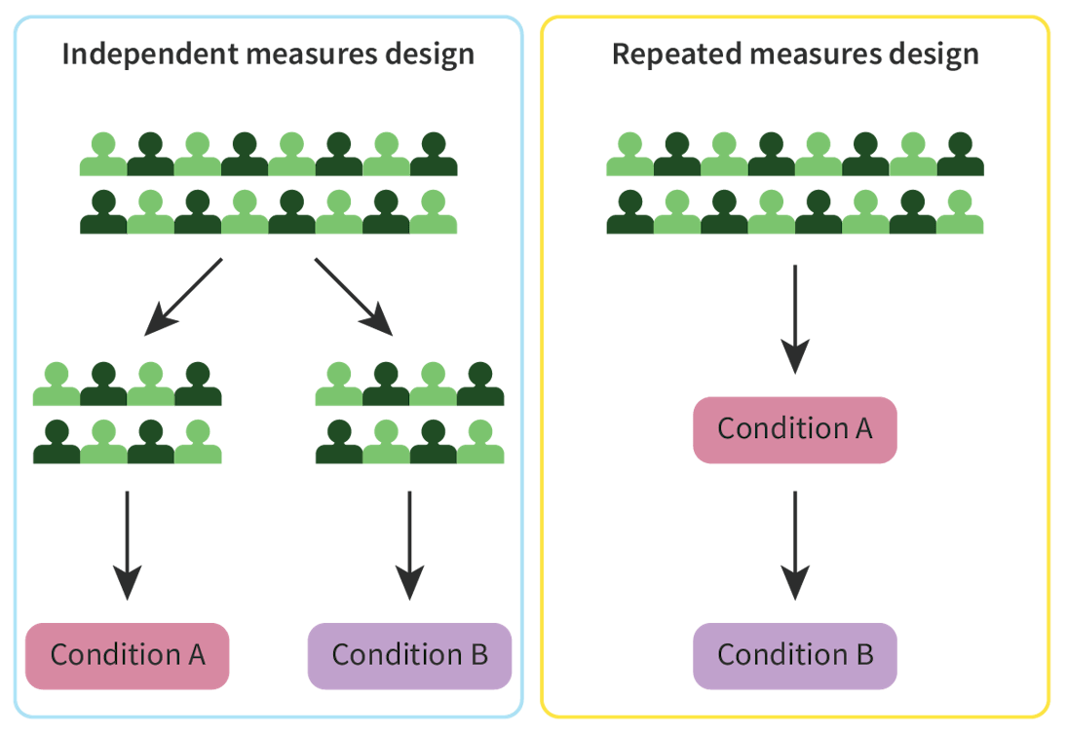
RESEARCH: Types of experiments

Slide 14
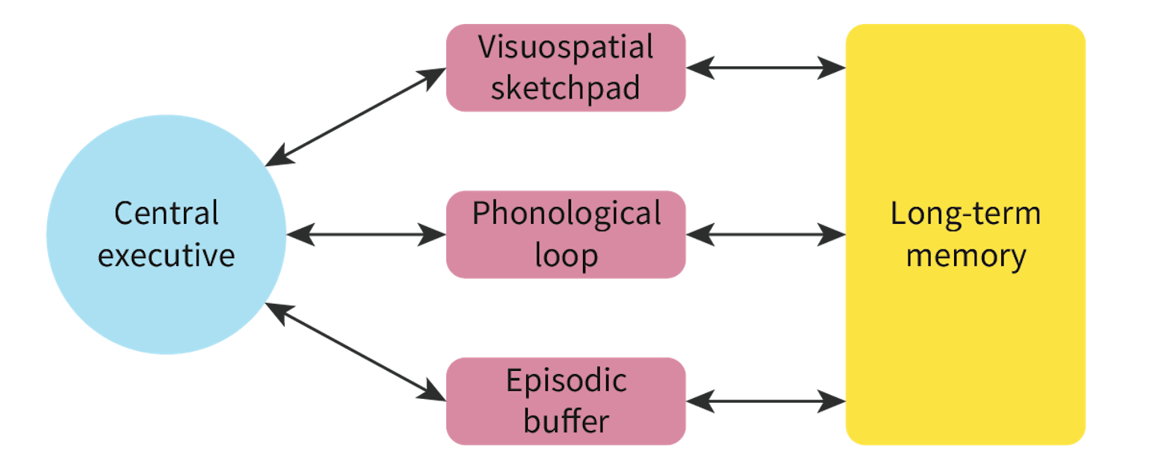
Models of memory
Working memory model (Baddeley and Hitch, 1974)

Slide 15
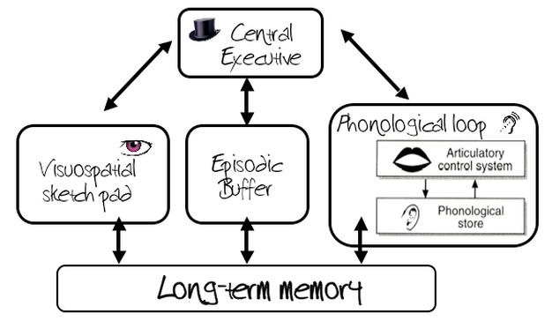
TASK
Read “Working Memory Model (WMM)” from Kognity 5.2.1 and summarize the main functions of the parts in the working memory model in your own words

Slide 16

TASK
Read the summary of Landry and Bartling (2011) from Kognity 5.2.11
  What kind of evidence does it provide for working memory model?

Slide 17
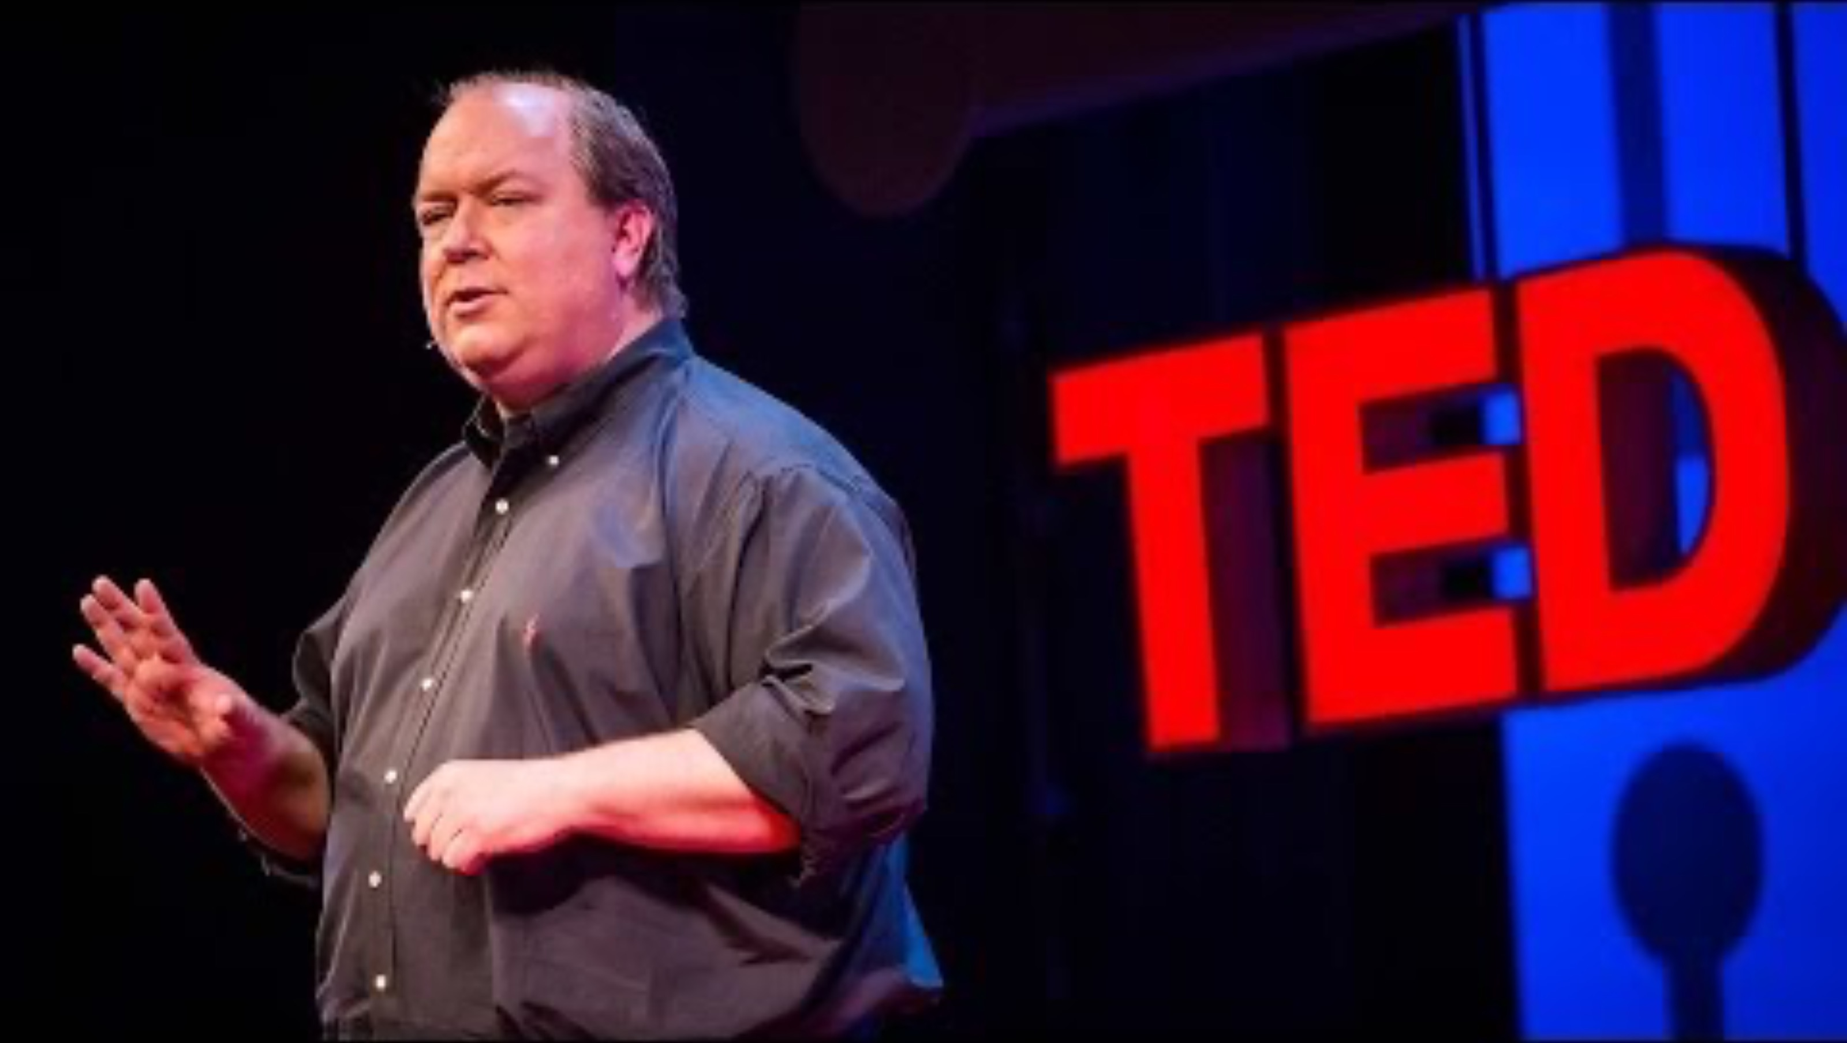
Models of memory
Write down the things that are new to you

Slide 18

Cognitive load theory
Postulates that humans have limited working memory capacity
Information overload occurs when we are presented with information that exceeds our working memory capacity

Slide 19
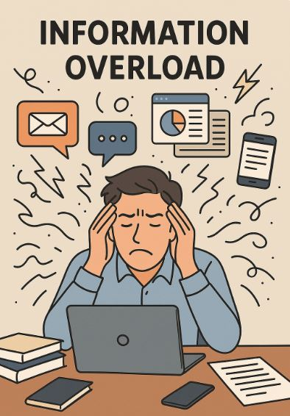
Cognitive load theory
Three types of cognitive load
  (1) Intrinsic: how difficult is the task per se?
  (2) Extraneous: how easy or difficult it is to learn in the environment?
  (3) Germane: how well can I fit the material into schemas?

Slide 20
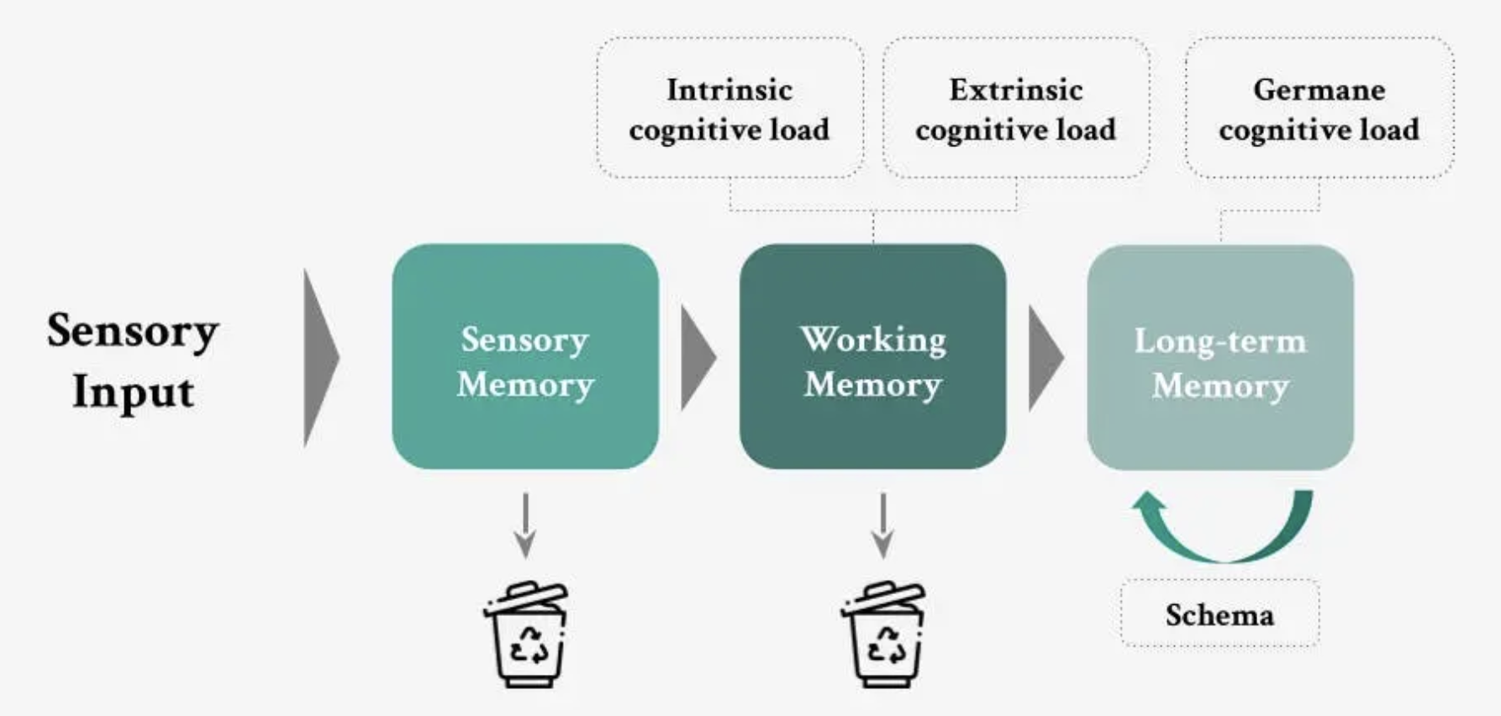
Cognitive load theory

Slide 21
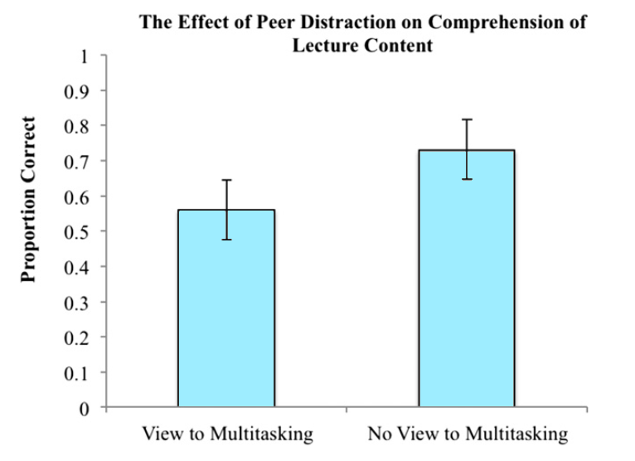
Cognitive load theory
Sana et al. (2013)
  Does viewing multitasking compromise student performance?
  44 undergraduate psychology students listened to a PowerPoint presentation on meteorology
  Half of them had a view to multitasking

Slide 22

TASK
Read Mani et al. (2013) from teacher’s supplementary materials
  How can a poverty cause a context for cognitive load?

Slide 23
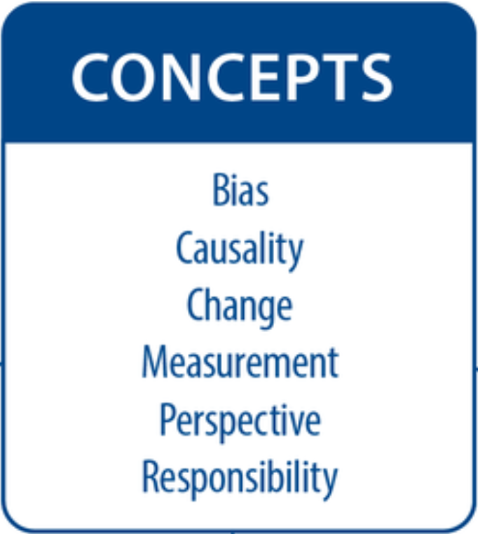
TASK
Evaluate models of memory and cognitive load theory through the six basic concepts
  What are the strengths and limitations of memory models and the cognitive load theory?

Slide 24
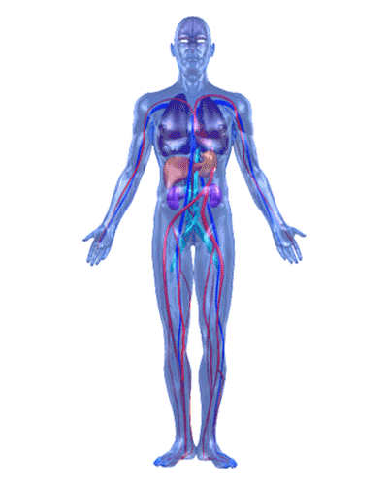
Biological approach
Researches how physiology impacts
our behaviour
  The relationship between biological factors and behaviour is bidirectional

Slide 25
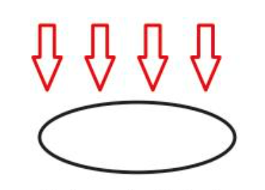
RESEARCH: Holism
An attempt to explain human behaviour in all its complexity
  All factors need to be taken into consideration
WHAT PROBLEMS ARISE?

Slide 26
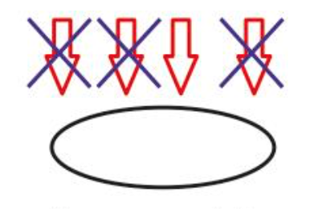
RESEARCH: Reductionism
(1) An attempt to reduce the factors influencing human behaviour
(2) An attempt to reduce complex higher-level phenomena into simpler lower-level phenomena
WHAT PROBLEMS ARISE?

Slide 27
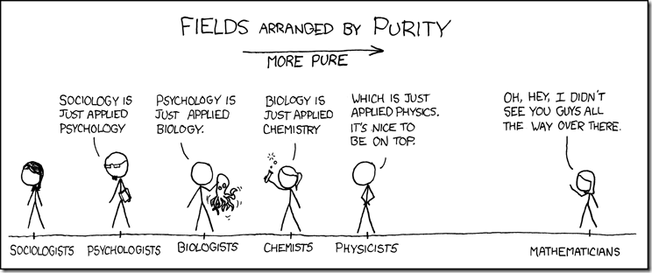
RESEARCH: Reductionism
IS EVERYTHING JUST APPLIED PHYSICS?
OR SOMETHING ELSE?

Slide 28

RESEARCH: Reductionism
Biological reductionism
  Psychological phenomena can be explained with breaking them down into biological components such as genes, neurons and neurotransmitters

Slide 29
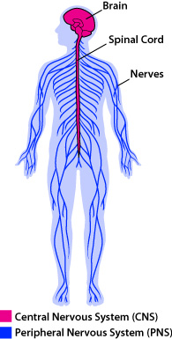
Neuron
Neuron = nerve cell
Neuron ≠ nerve
Our nervous system consists of circa 86 billion neurons

Slide 30

TASK
Draw a neuron with the help of the teacher

Slide 31
TASK
Read the teacher’s handout
What are the functions of neuron’s parts?
Write the functions down on your drawing of a neuron
Find out what sensory neurons, motor neurons and interneurons are
What are the main functions of these types of neurons?
Where can we find these neurons?

Slide 32
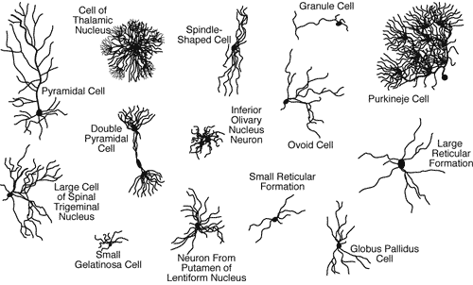
Neuron

Slide 33
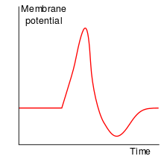
Action Potential
Nerve impulse, a function unique to nerve cells
Information within a neuron is conveyed electrically in the form of action potentials

Slide 34
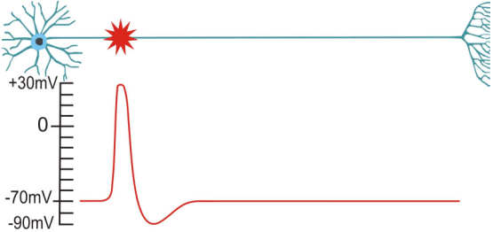
Action Potential

Slide 35
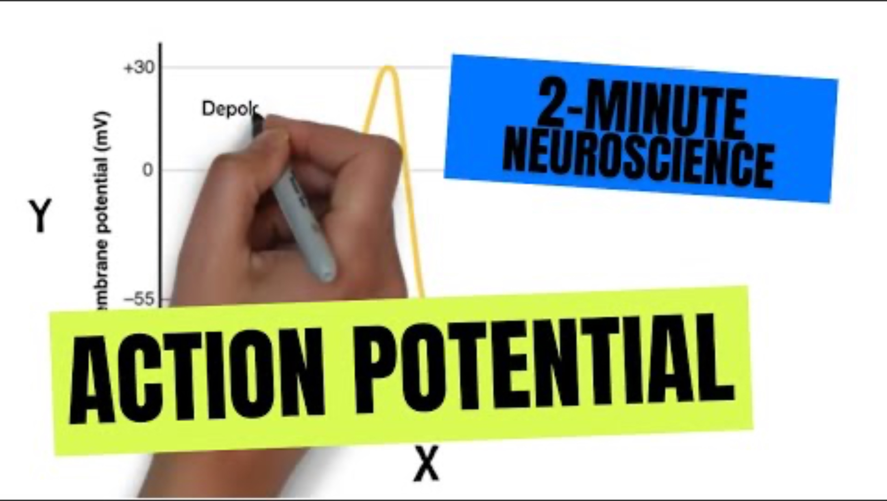
Action Potential

Slide 36
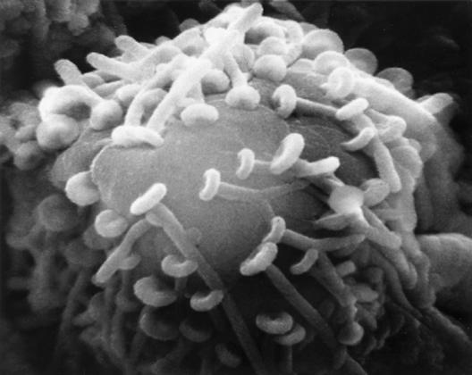
Neurotransmission
Synapse is a junction between the axon terminal and the receiving neuron
Information between neurons is conveyed chemically through synapses

Slide 37
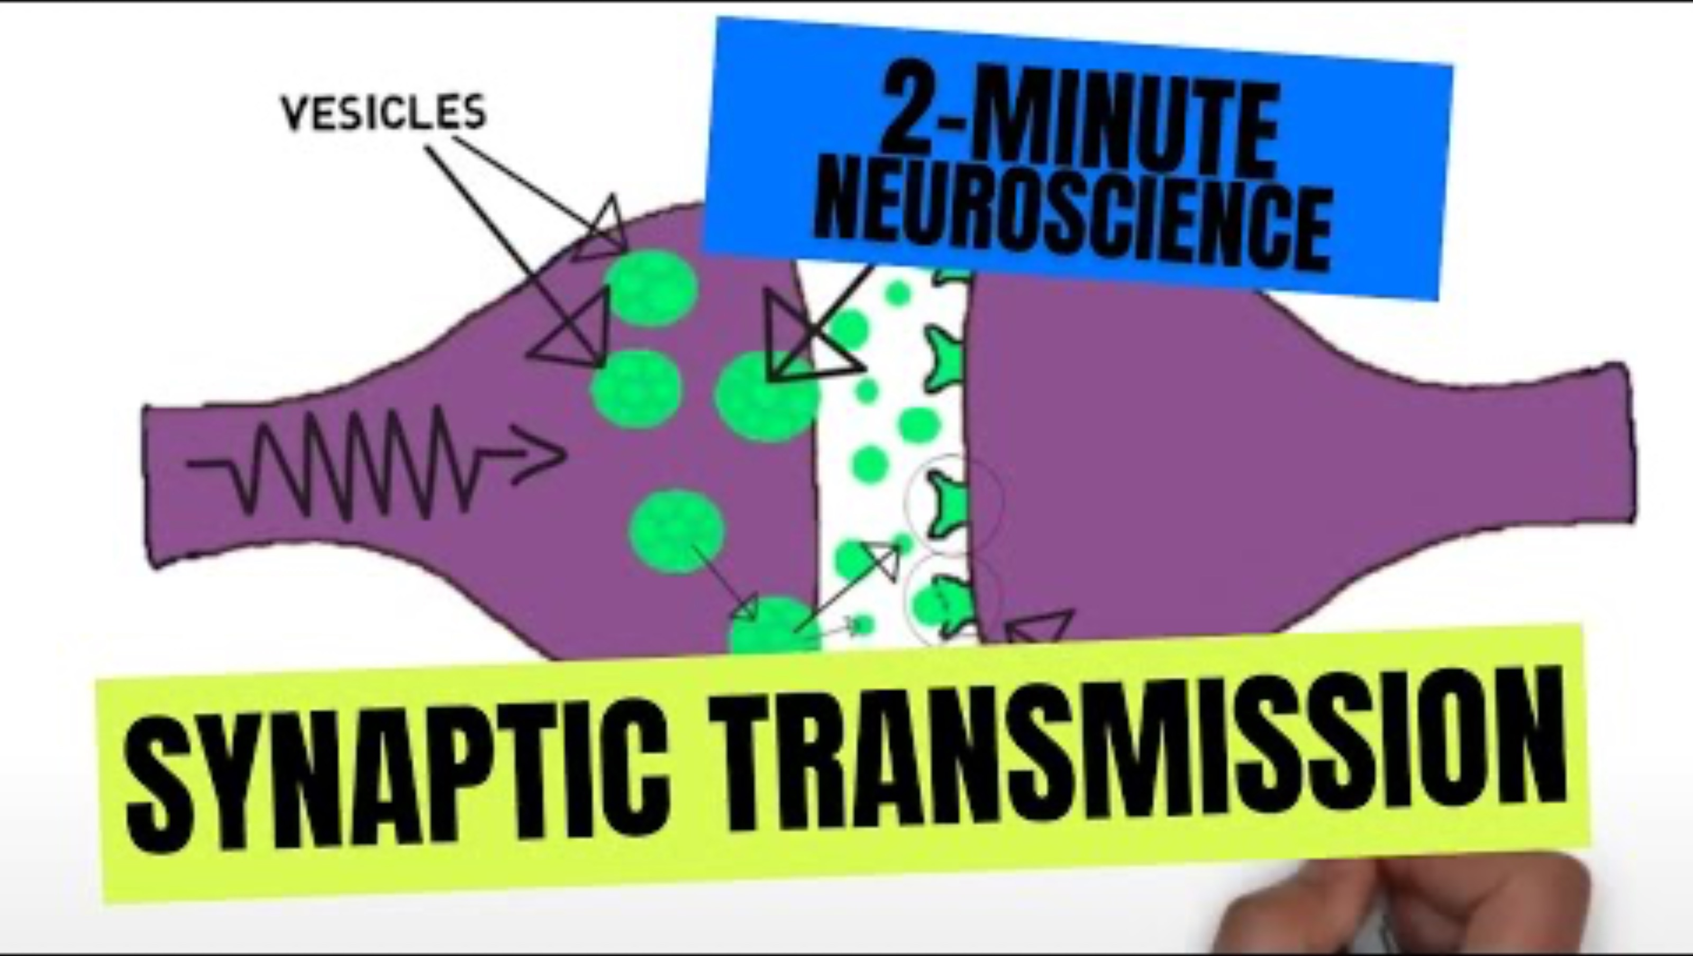
Neurotransmission

Slide 38
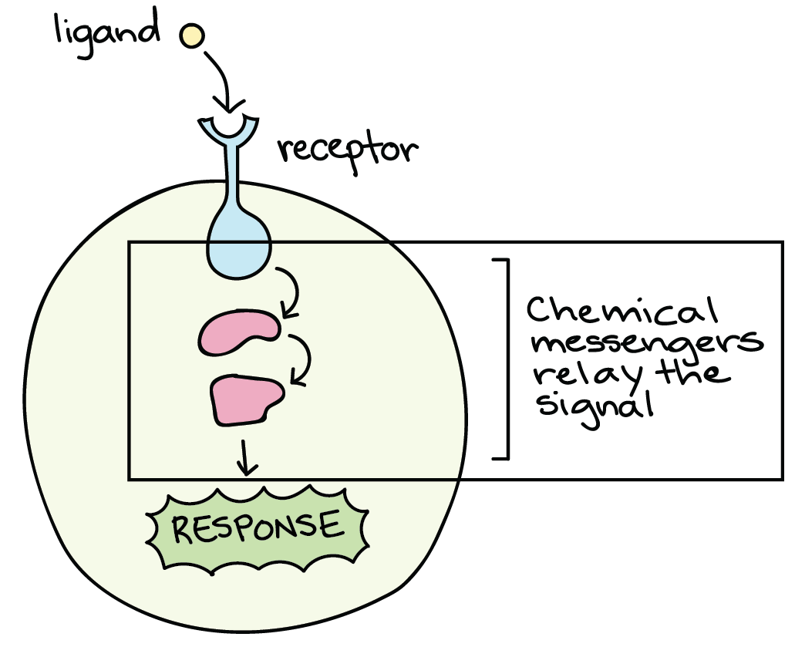
Chemical messengers
Transmit a message from one body cell to another
  Neurotransmitters convey messages from one neuron to another
  Hormones convey messages to the whole body via bloodstream

Slide 39
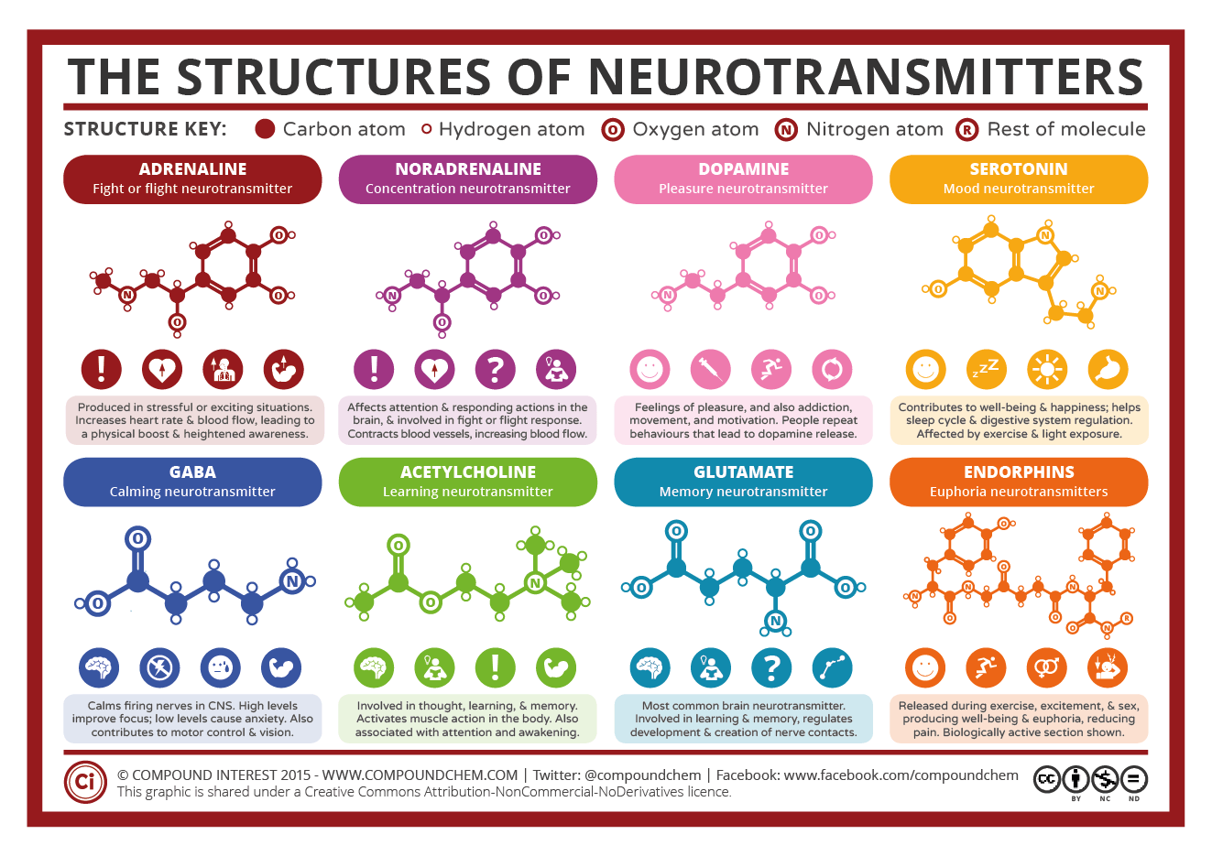

Slide 40
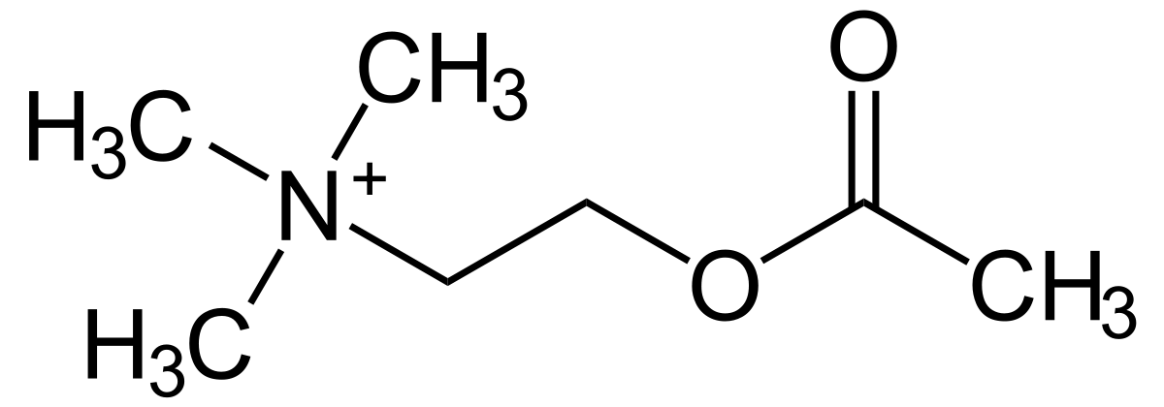
Chemical messengers
Acetylcholine
  A neurotransmitter involved in learning, memory, attention and muscle action
  One of the most abundant neurotransmitters within the body

Slide 41
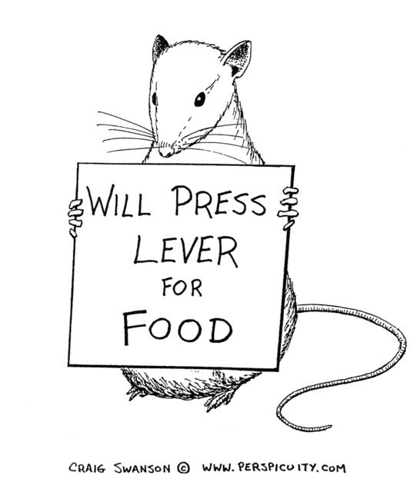
TASK
Read Rogers and Kesner (2003) from teacher’s supplementary materials
  What kind of evidence does it provide for the role of neurotransmission and chemical messengers in memory functions?

Slide 42
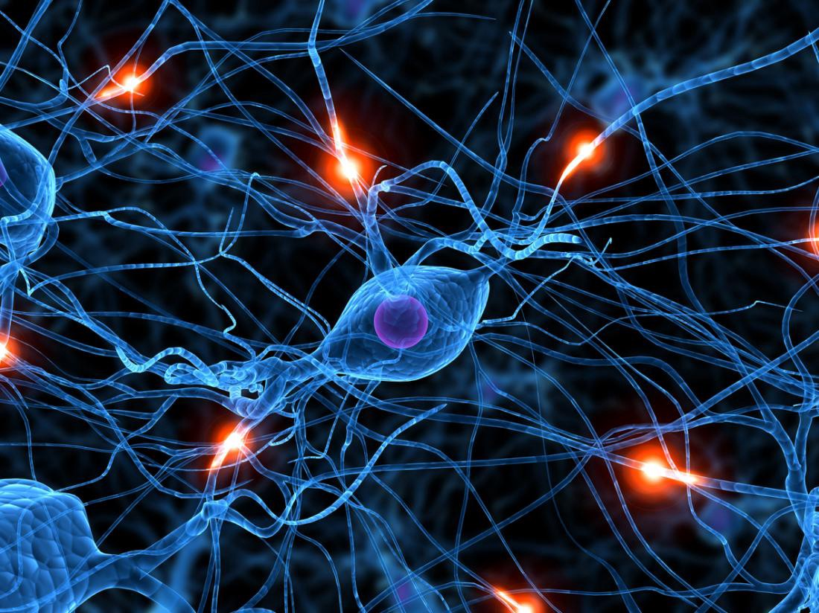
Neuroplasticity
Synaptic connections between neurons form neural networks
Changes in neural networks is termed neuroplasticity

Slide 43

Neuroplasticity

Slide 44
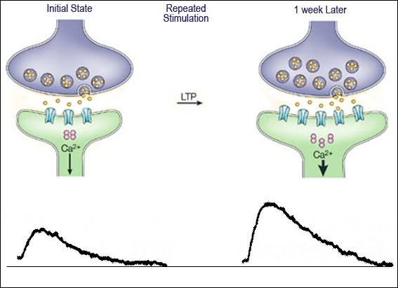
Neuroplasticity
Long-term potentiation
  Strengthening of synapses based on frequent activation
  Produces a long-lasting increase in information transmission between neurons

Slide 45
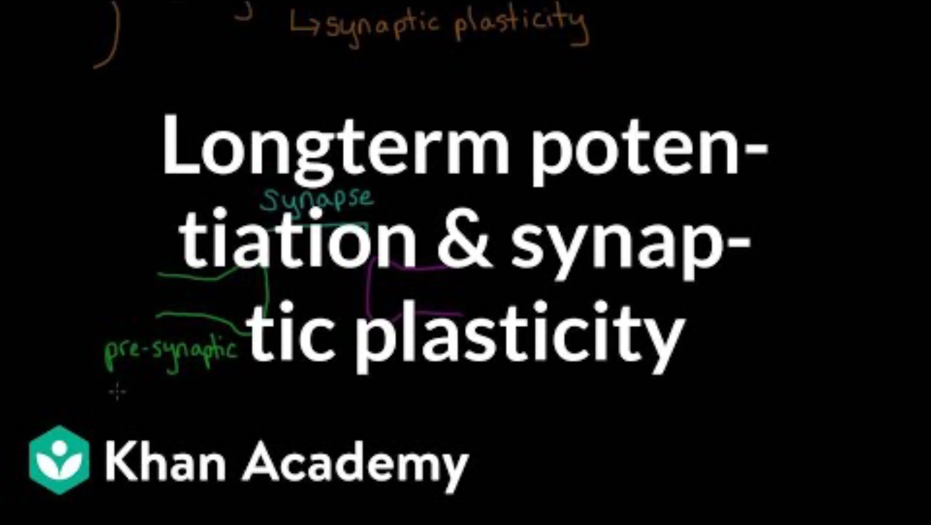
Neuroplasticity

Slide 46
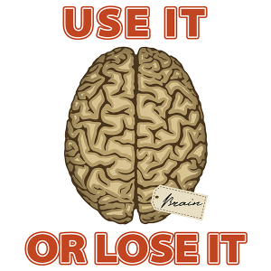
Neuroplasticity
Long-term potentiation leads to dendritic branching
When a synapse is not used, it may undergo synaptic pruning

Slide 47

TASK
Read Draganski et al. (2004) from teacher’s supplementary materials
  What kind of evidence does it provide for neuroplasticity?

Slide 48
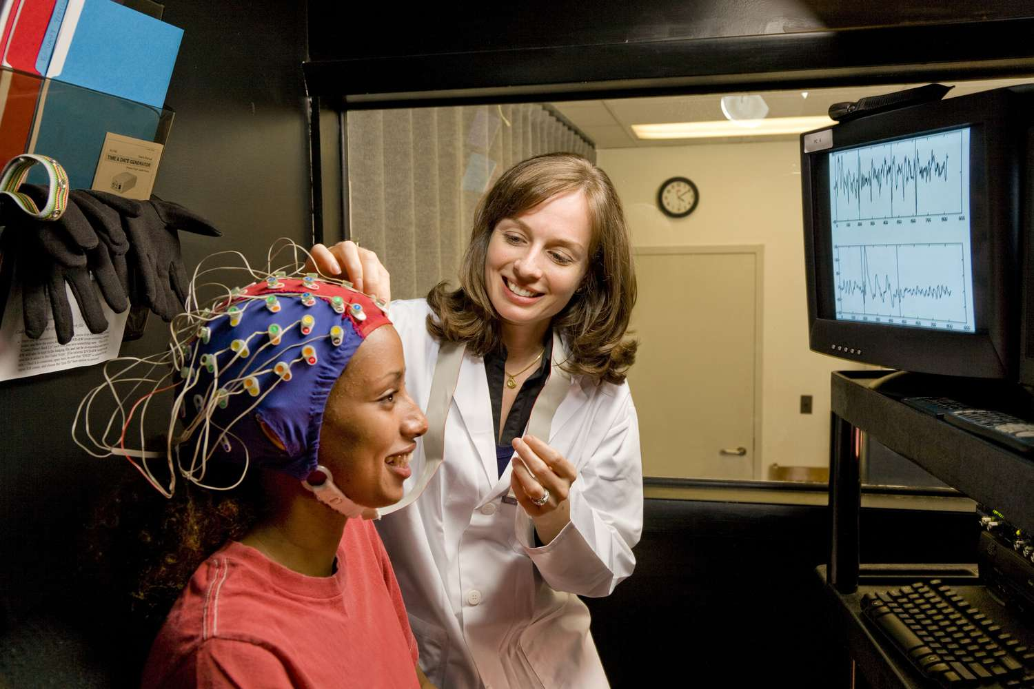
RESEARCH: Types of experiments
True experiment
  Allocation into experimental and control groups is done randomly
  Researchers manipulate the IV
  Cause-effect inferences can be made

Slide 49
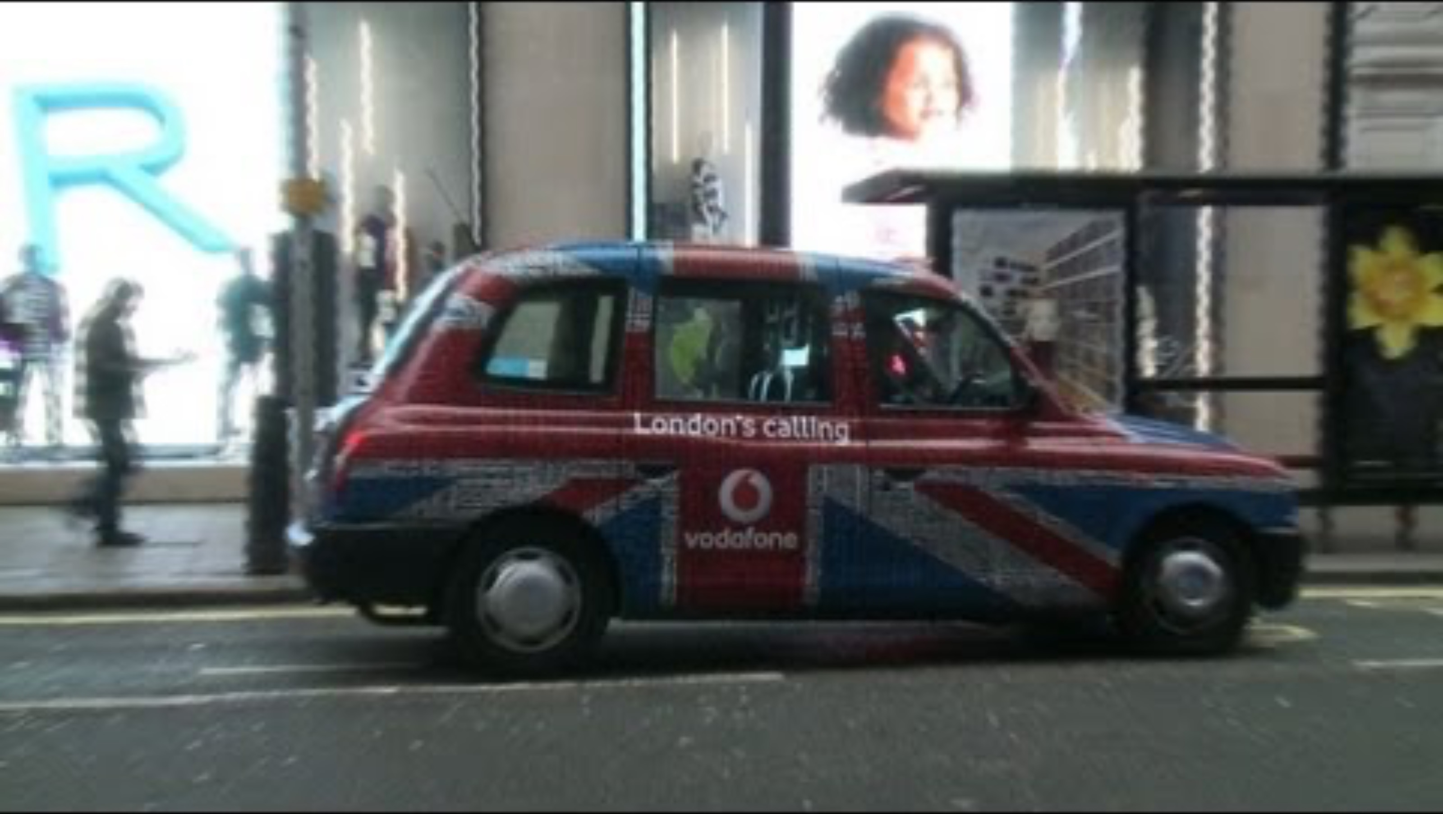
Neuroplasticity

Slide 50
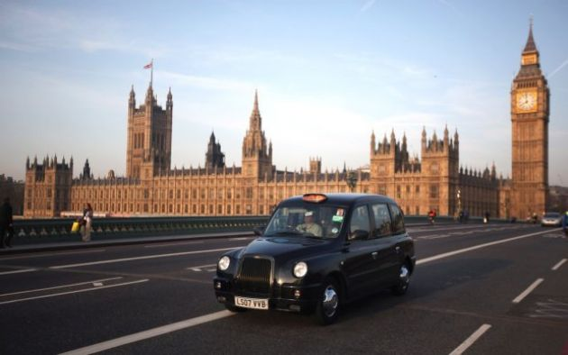
TASK
Read Maguire et al. (2000) from Kognity 5.2.3 and/or Kognity 5.2.11
  What kind of evidence does it provide for neuroplasticity?
  How is Maguire et al. (2000) different from Draganski et al. (2004)?

Slide 51
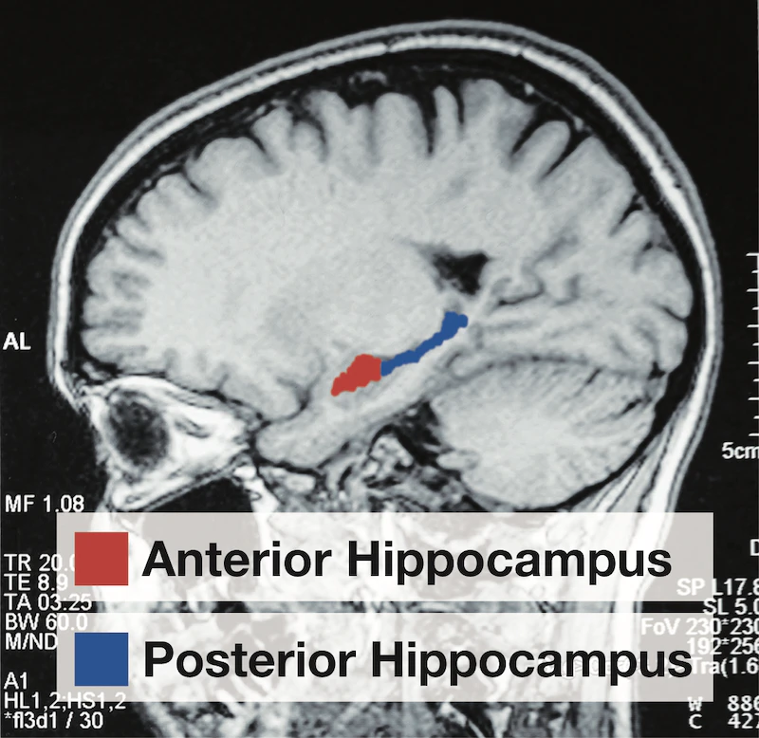
RESEARCH: Types of Experiments
Quasi-experiment
  Allocation into groups is done based on pre-existing differences
  Researchers do NOT manipulate the IV
  Weak cause-effect inferences can be made
True experiment
  Allocation into experimental and control groups is done randomly
  Researchers manipulate the IV
  Strong cause-effect inferences can be made
HOW IS QUASI-EXPERIMENT
DIFFERENT FROM
TRUE-EXPERIMENT?

Slide 52
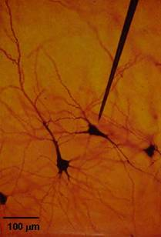
Brain imaging techniques
Specific techniques and technologies to measure brain activity

Slide 53
Brain imaging techniques
Temporal resolution
  How precise is the technology with respect to time?
Spatial resolution
  How accurately the technology maps the brain?
Invasiveness
  To what extent does the technology affect the normal functioning of the body?
Immerse yourself with the most
common brain imaging techniques
in the teacher’s handout

Slide 54
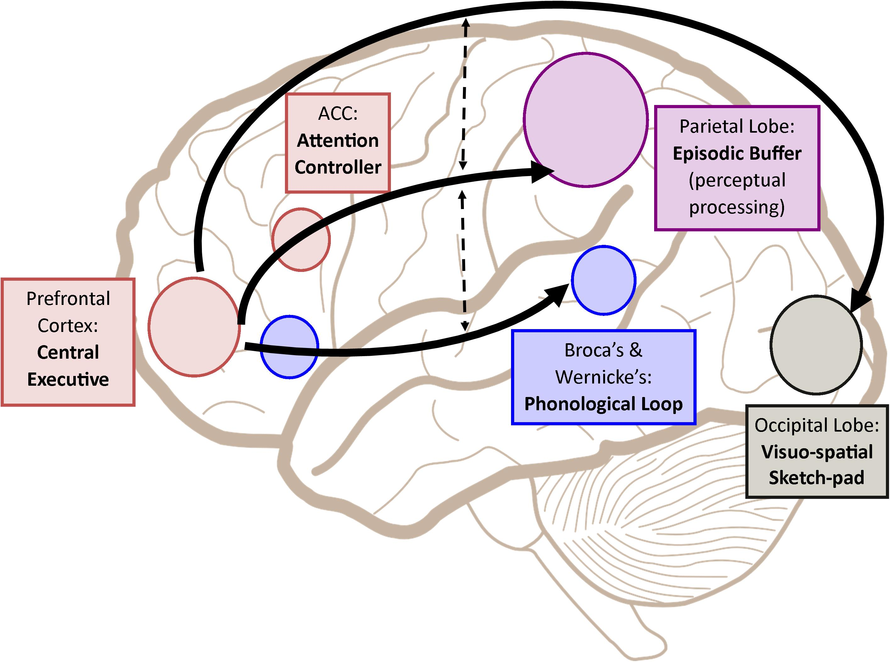
Localization of Functions
Specific parts of the brain are responsible for specific behaviour or cognitive process

Slide 55
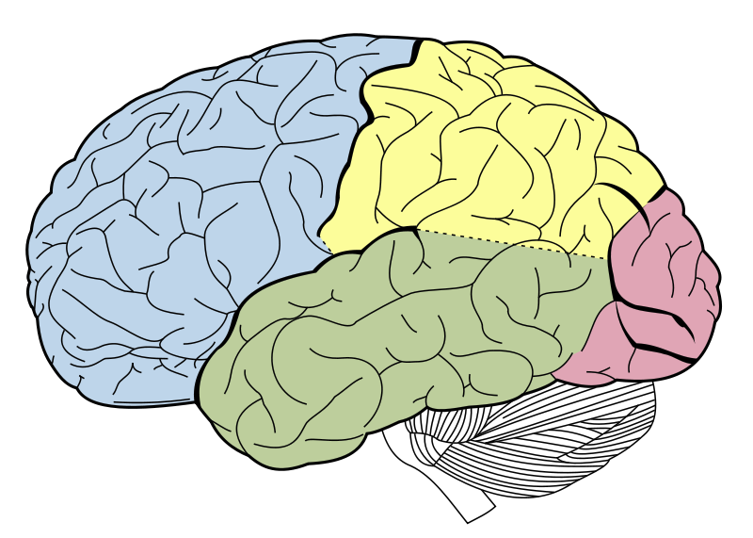
TASK
Complete the teacher’s handout on certain brain parts and their functions
  Use Kognity 5.2.3 as a starting point

Slide 56
EXTRA TASK
Do the ”Activity sheet: To what extent is memory a valid source of knowledge?” in Kognity 5.2.5
Do the ”Key terms” task in Kognity 5.2.9

Slide 57
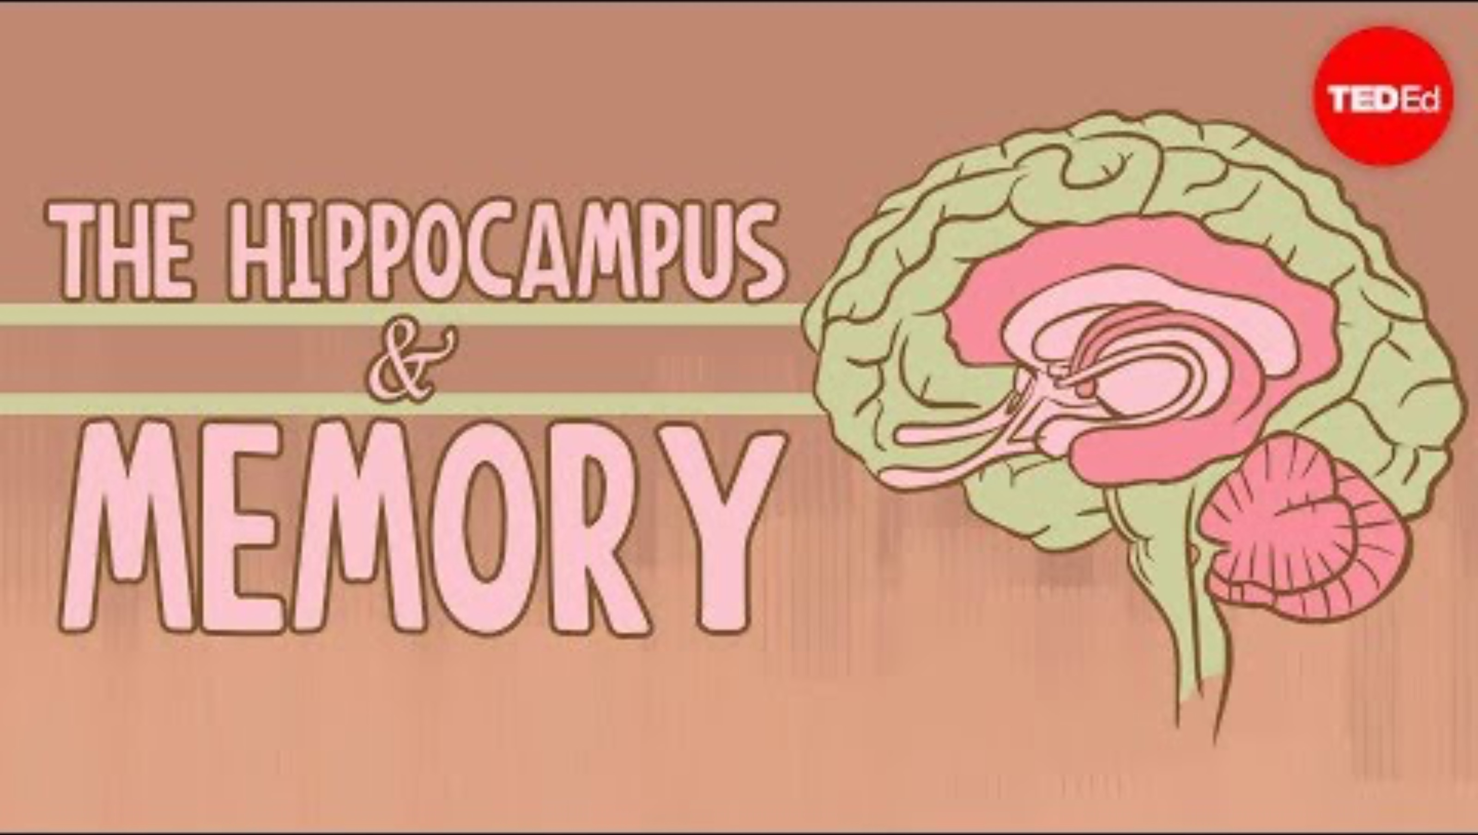
Localization of Functions
How are case studies utilised with localization?

Slide 58
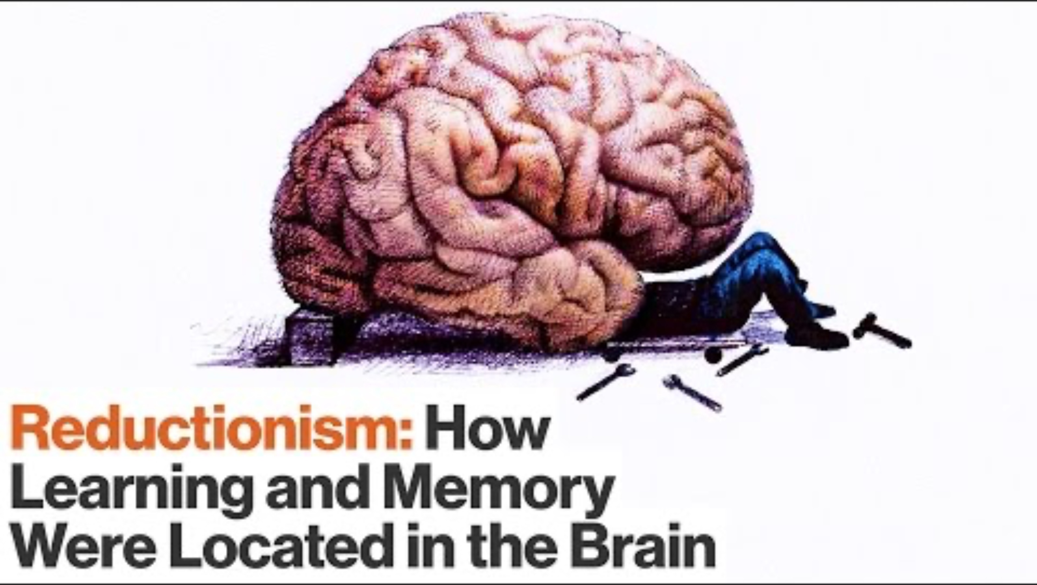
RESEARCH: Reductionism
How has reductionism helped with localising brain functions?

Slide 59
TASK
Evaluate biological approach through the six basic concepts
  What are the strengths and limitations of biological approach related to human memory functions?

Slide 60
Picture sources
Garfield model <http://backreaction.blogspot.com/2008/04/emergence-and-reductionism.html> Accessed 26th of October 2020.
MSM diagram – Kognity
MSM picture <https://www.simplypsychology.org/multi-store.html> Accessed 27th of August 2026.
Glanzer and Cunitz (1966) <https://slideplayer.com/slide/7812447/> Accessed 26th of October 2020.
Types of experiments – Kognity
WMM 1 – Kognity
WMM 2 <http://aspsychologyblackpoolsixth.weebly.com/working-memory-model.html> Accessed 28th of October 2020.
Information overload 1 <https://www.linkedin.com/pulse/i-information-overload-vicki-vanderent> Accessed 31st of August 2026.
Information overload 2 <https://www.lisedunetwork.com/information-overload-causes-effects-and-solutions/> Accessed 31st of August 2026.
Cognitive load theory and MSM <https://thedecisionlab.com/reference-guide/psychology/cognitive-load-theory> Accessed 31st of August 2026.
Sani et al. (2013) diagram and financial stress <https://thinkib.net/psychology/page/52682/cognitive-load-theory> Accessed 31st of August 2026.
Financial anxiety <https://thinkib.net/psychology/page/52682/cognitive-load-theory> Accessed 8th of September 2026.
Rotating body <https://www.collegedrinkingprevention.gov/specialfeatures/interactivebody.aspx> Accessed 26th of August 2017.

Slide 61
Picture sources
Purity of sciences <https://www.millennialstar.org/what-is-science-is-science-about-reductionism-or-holism-2/> Accessed 4th of Augusto 2018.
DNA <https://www.fearofflying.com/library/the-5-htt-gene/> Accessed 13th of February 2020.
Central and peripheral nervous systems <https://askabiologist.asu.edu/parts-nervous-system> Accessed 29th of August 2017.
Drawing a tree < http://www.wikihow.com/Draw > Accessed 29th of August 2017.
Types of neurons <http://www.mind.ilstu.edu/curriculum/neurons_intro/neurons_intro.php> Accessed 29th of August 2017.
Action potential 1 <http://www.apstherapy.co.nz/action%20potentials.html> Accessed 26th of October 2015.
Action potential 2 <http://www.apstherapy.co.nz/action%20potentials.html> Accessed 26th of October 2015.
Synapse <http://163.178.103.176/CasosBerne/1aFCelular/Caso4-2/HTMLC/CasosB2/Receptor/Ch6.html> Accessed 30th of August 2017.
Chemical messenger <https://organismalbio.biosci.gatech.edu/chemical-and-electrical-signals/intro-to-chemical-signaling-and-signal-transduction/> Accessed 15th of August 2026.
Structures of neurotransmitters <http://www.compoundchem.com/2015/07/30/neurotransmitters/> Accessed 31st of August 2017.
Acetylcholine <https://en.wikipedia.org/wiki/Acetylcholine> Accessed 15th of August 2021.

Slide 62
Picture sources
Test rat <http://www.fanpop.com/clubs/psychology/images/1361799/title/skinner-rat-fanart> Accessed 5th of January 2018.
Blue brain cells 1 <https://medium.com/predict/artificial-neural-networks-mapping-the-human-brain-2e0bd4a93160> Accessed 10th of February 2020.
LTP <https://sites.google.com/site/mcauliffeneur493/home/synaptic-plasticity> Accessed 23rd of November 2017.
Use it or lose it <https://languageattrition.org/use-or-lose/> Accessed 23rd of November 2017.
Juggler <https://joehart.com.au/blog/2019/04/14/are-you-a-master-juggler-or-do-you-keep-dropping-the-ball> Accessed 10th of August 2025.
EEG experiment <https://www.verywellmind.com/how-to-conduct-a-psychology-experiment-2795792> Accessed 11th of August 2023.
London taxi <http://www.cityam.com/blog/1402483881/which-londons-taxi-app-offers-best-fares> Accessed 30th of November 2017.
Single cell register <http://hirnforschung.kyb.mpg.de/en/methods/electrophysiology.html> Accessed 3rd of September 2017.
Anterior and posterior hippocampus <https://www.tutor2u.net/psychology/reference/maguire-2000> Accessed 11th of August 2023.
STM brain structures <https://www.frontiersin.org/articles/10.3389/fpsyg.2018.00401/full> Accessed 28th of October 2020.
Lobes of the brain <http://rantsite.net/2011/03/tyhmentaako-hakukoneiden-kaytto-ihmisia/> Accessed 15 of November 2017.

