Slide 1
INTRODUCTION TO
IB PSYCHOLOGY
IB Psychology LAJM

Slide 2
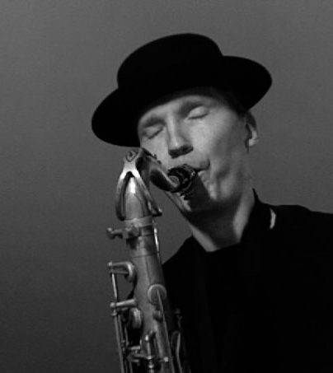
Who is the teacher?
Markus Lajunen (LAJM)
  Teacher of IB TOK and
  IB Psychology + philosophy and psychology
  Worked previously in Konnevesi, Joensuu and of course Jyväskylä
  Part-time musician

Slide 3
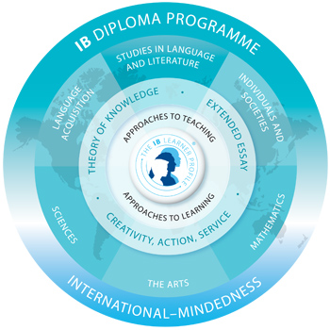
Psychology in the IB
Diploma Programme
IB psychology is part of the group 3, individuals and societies
Psychology draws on concepts, methods and understandings from several different disciplines

Slide 4
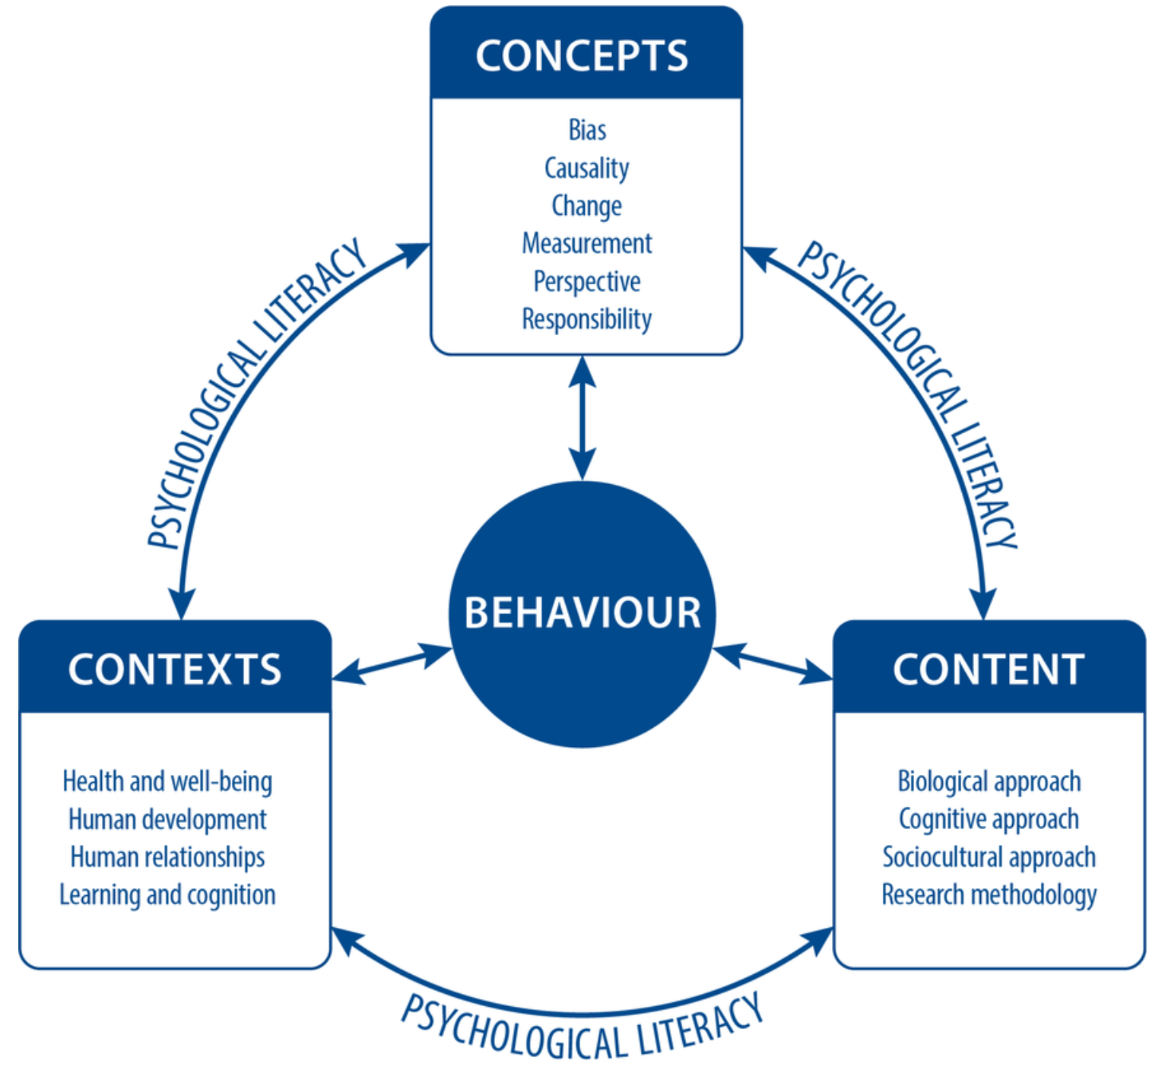
IB Psychology syllabus

Slide 5
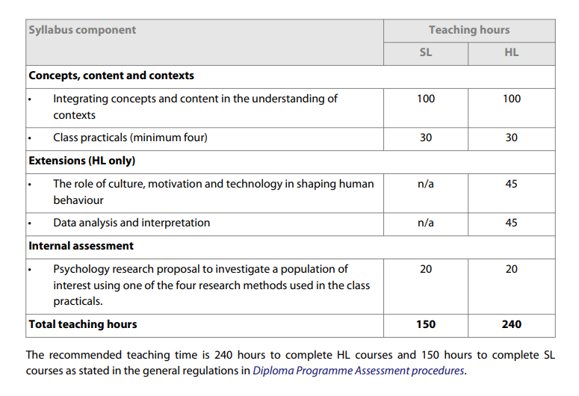
SL and HL in IB Psychology

Slide 6
SL and HL in IB Psychology
Regardless of the level (SL or HL) of your studies, you will be attending psychology classes the whole IB Diploma Programme
Some lessons will be for HL only and SL students will be informed about these lessons

Slide 7
Assessment in IB Psychology
Finals
  P1: 4 SAQs and 1 ERQ (90 mins for both HL and SL) on contents, contexts and concepts
  P2: 4 SAQs and 1 ERQ (90 mins for both HL and SL) on class practicals and concepts
  P3: 3 SAQs and 1 ERQ (1h 45mins HL only) on
  HL extensions and data-analysis
Internal Assessment (IA)
  Research proposal based on the class practicals

Slide 8
Assessment in IB Psychology
After each term, you will get a grade (1–7)
Grades will be based on mock exams that mimic the Final exams
Internal Assessment (IA) is done during IB2 year term 2
  The whole term is dedicated to the task

Slide 9

IB Psychology materials
We use Kognity online learning platform as our primary textbook
IB Psychology guide and teacher’s peda.net should be used extensively, too
ManageBac is used to upload student work
Wilma is used for communication

Slide 10
IB Psychology schedules
Year | Term | Syllabus components
IB1 | 1 | Review: Psychological research from pre-IB psychology course Concepts: Introduction to the six concepts in IB Psychology Content: Biological, Cognitive and Sociocultural approach and Research methodology with Concepts in the Context of Learning and cognition Assessment: Paper 1 Section A + Section B HL/SL
 | 2 | Class practical: Experiment + individual research report HL Extension: The role of culture, motivation and technology in Learning and cognition + data-analysis for Paper 3 Content: Biological, Cognitive and Sociocultural approach and Research methodology with Concepts in the in the Context of Human development (Models of development) Assessment: Paper 1 Section C HL/SL
 | 3 | Content: Biological, Cognitive and Sociocultural approach and Research methodology with Concepts in the Context of Human development (Development of self) HL Extension: The role of culture, motivation and technology in Human development + data-analysis for Paper 3 Class practical: Observation + individual research report Assessment: Paper 2 section A based on experiment and observation HL/SL
 | 4 | Content: Biological, Cognitive and Sociocultural approach and Research methodology with Concepts in the Context of Health and well-being Assessment: Full Paper 1 based on the Human development (Development of self) and Health and well-being
 | 5 | Class Practical: Interview + individual research report HL Extension: The role of culture, motivation and technology in Health and well-being + data-analysis for Paper 3 Content: Biological, Cognitive and Sociocultural approach and Research methodology with Concepts in the Context of Human relationships (Group behaviour) Assessment: Paper 2 Section B HL/SL

Slide 11
IB Psychology schedules
Year | Term | Syllabus components
IB2 | 1 | Content: Biological, Cognitive and Sociocultural approach and Research methodology with Concepts in the Context of Human relationships (Interpersonal relationships) HL Extension: The role of culture, motivation and technology in Human relationships + data-analysis for Paper 3 Class Practical: Survey + individual research report Assessment: Full Paper 1 (Human relationships) and full Paper 2 (all class practicals) HL/SL
 | 2 | Internal Assessment HL Extension: Data Analysis Assessment: Predicted grade of the Internal Assessment work
 | 3 | HL Extension: Data Analysis Assessment: Paper 3 Mock HL
 | 4 | Review of the whole IB Psychology syllabus Assessment: Final Mocks (all Papers at least once)

Slide 12
What are we studying for?
The goal of IB Psychology is to promote psychological literacy
  Conceptual understanding of psychology
  Critical thinking and scientific reasoning
  Application to real-world contexts
  Ethical and social responsibility
  Self-awareness and reflective thinking
  Communication skills

Slide 13

TASK
What are your goals in IB psychology?
  Write down your expectations and aims
  What would you like to learn in IB psychology?
  Engage in conversation

Slide 14
Picture Sources
Markus Lajunen playing the saxophone. Copyright Markus Lajunen.
IB Diploma Programme <http://www.yis.ac.jp/page.cfm?p=763> Accessed 10th of August 2017.
Writing hand drawing <https://www.comlib.org/event/ymca-creative-writing-workshop/> Accessed 16th of May 2018.

