Slide 1
CONCEPTS AND RESEARCH METHODOLOGY
IB Psychology LAJM

Slide 2

REVIEW
Review essential contents from pre-IB psychology course concerning psychological research with the help of the teacher’s handouts and pre-IB peda.net webpage
YOUR UNDERSTANDING
WILL DEEPEN THROUGHOUT
THE IB PSYCHOLOGY COURSE

Slide 3
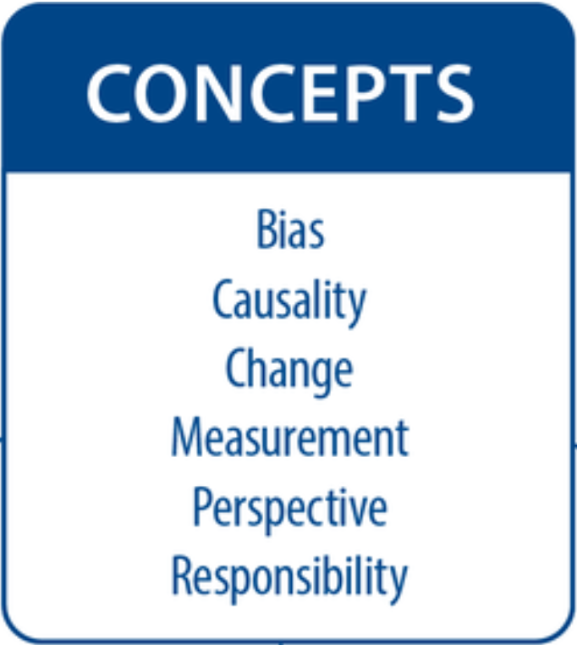
Concepts in IB Psychology
Broad and generic ideas that find manifestations in specific contexts and contents
With these concepts we can discuss and evaluate psychological research and claims
The concepts may also offer insight to human behaviour itself

Slide 4
TASK
Teacher divides you into six groups
Each group is given one of the six basic concepts in IB Psychology
Each group must create an easy-to-understand poster that can be read immediately
  What does the concept mean?
  How can you exemplify it?
Utilise the teacher’s handouts as a source

Slide 5

TASK
Put your posters on display
Revolve around the posters and try to absorb essential information

Slide 6
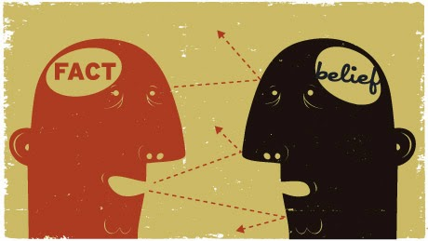
Concepts in IB Psychology
Bias is a limitation in objective thinking that might skew psychological research and our cognition
  It is important to become aware of different biases and minimize their impact

Slide 7
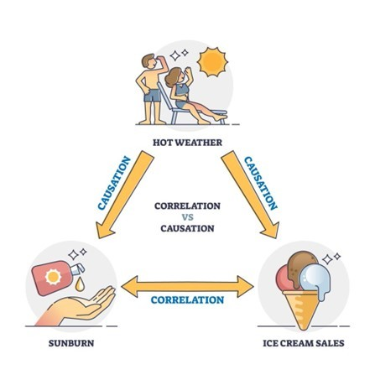
Concepts in IB Psychology
Causality is cause-and-effect relationship between variables
  Psychology tries to determine causal relationships in complex human behaviour

Slide 8

Concepts in IB Psychology
Change is constant in human behaviour
  Why does human behaviour change?
  How can we change human behaviour?

Slide 9
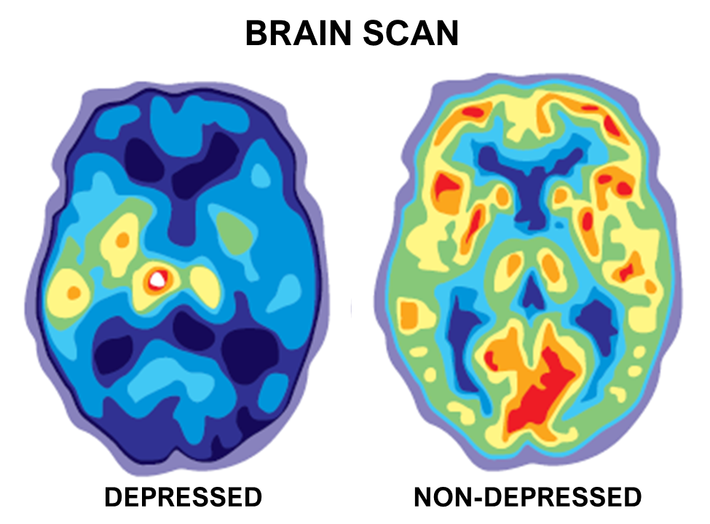
Concepts in IB Psychology
Measurement is a fundamental challenge for psychological research
  What kind of methods can psychologists utilise to objectively observe and measure complex human behaviour?

Slide 10

Concepts in IB Psychology
Perspective relates to different approaches in understanding human behaviour
  Biological
  Cognitive
  Sociocultural

Slide 11
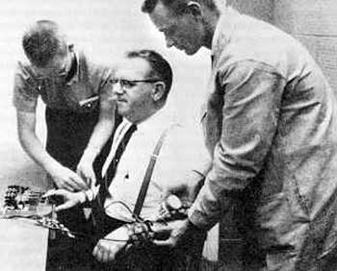
Concepts in IB Psychology
Responsibility refers to ethical principles that guide psychologists
  Understanding ethical aspects in research is vital for a psychology student

Slide 12
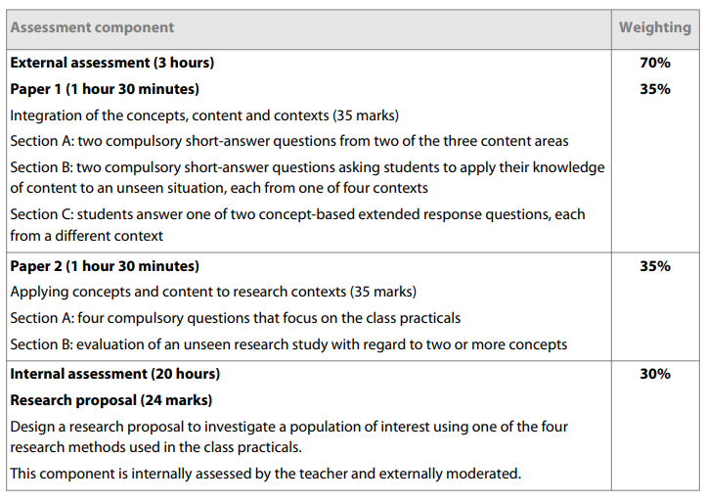
Concepts in IB Psychology
How is the understanding of the concepts assessed in SL?

Slide 13
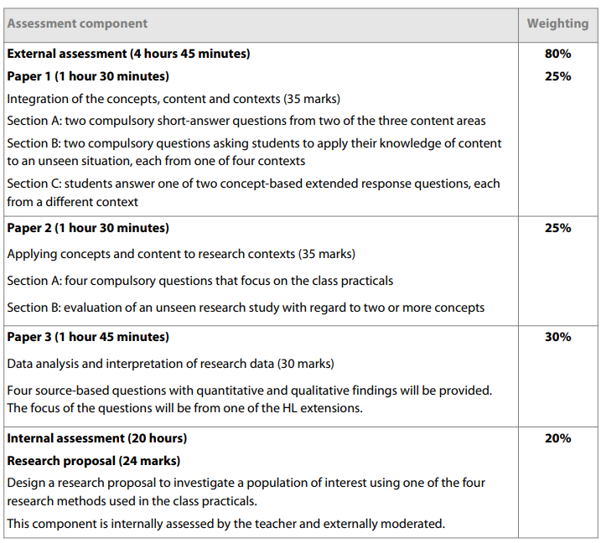
Concepts in IB Psychology
How is the understanding of the concepts assessed in HL?

Slide 14

Psychology as a science
Theories should be supported by empirical evidence
WHAT IS MEANT BY
EMPIRICAL EVIDENCE
AND HOW IS IT GAINED?

Slide 15
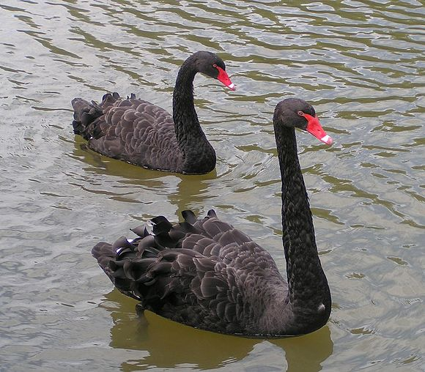
Psychology as a science
Theories and studies should be falsifiable
  It should be possible for the theory or the study to be proven wrong
HOW CAN YOU FALSIFY
A THEORY OR A STUDY?

Slide 16
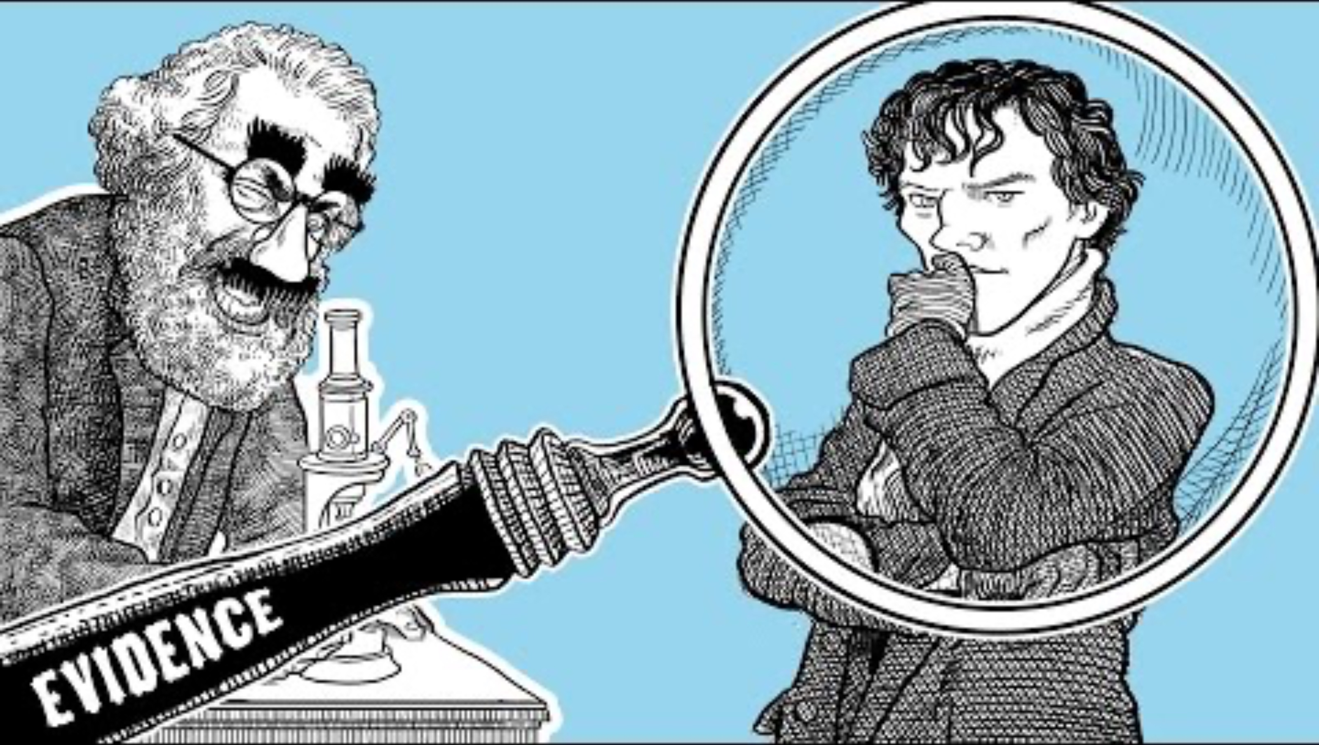
Psychology as a science

Slide 17

Psychology as a science
Theories and concepts should be testable
HOW CAN YOU TEST
A THEORY OR A CONCEPT?

Slide 18
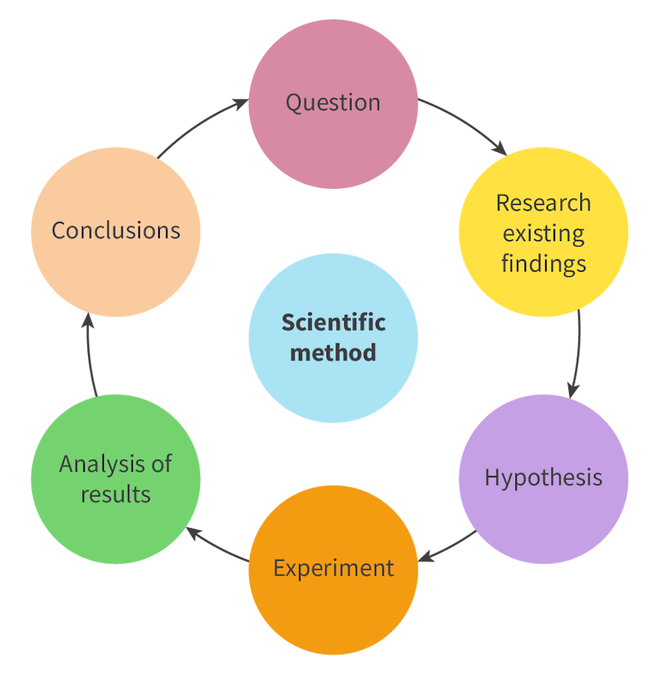
Psychology as a science
Psychology uses the scientific method to test theories and concepts
Psychological knowledge is constructed in scientific research

Slide 19

Psychology as a science
Independent research should be able to replicate studies
HOW CAN YOU REPLICATE
A STUDY AND WHY
IT IS IMPORTANT?

Slide 20
REVIEW
What was meant by quantitative and qualitative research methods in psychology?
Volunteers will come to the whiteboard to make a comparison table

Slide 21
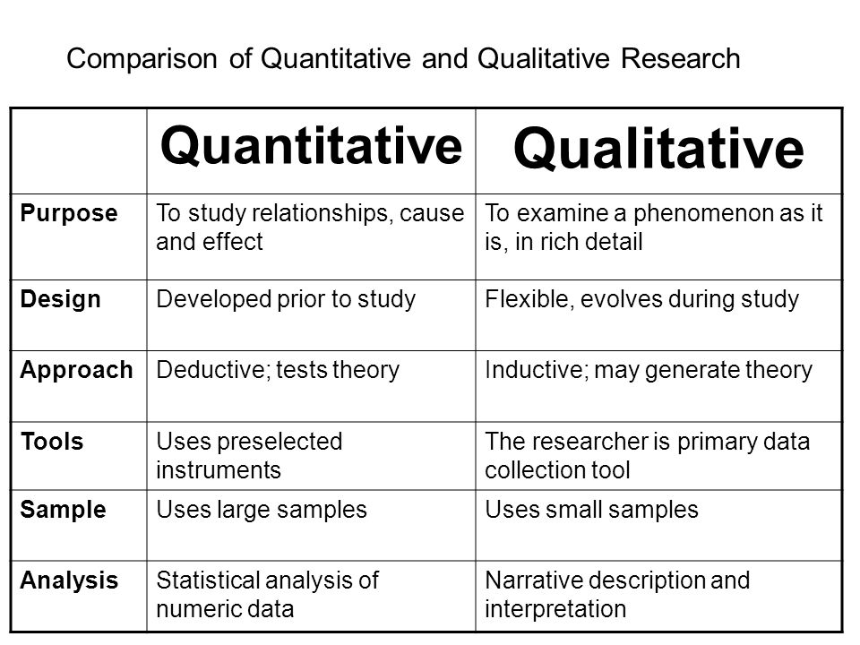

Slide 22
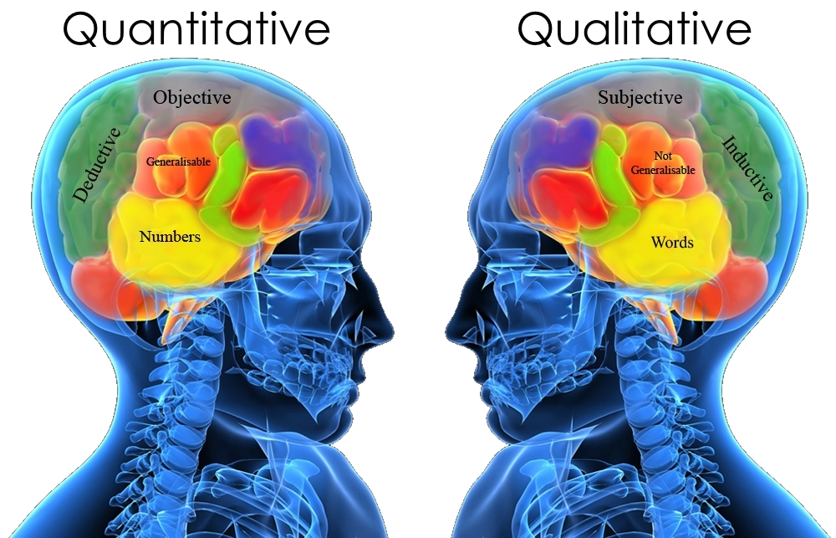
THESE TWO APPROACHES SHOULD NOT BE SEEN AS COMPETING,
BUT AS COMPLEMENTARY PERSPECTIVES TO DIFFERENT TYPES OF
RESEARCH QUESTIONS

Slide 23
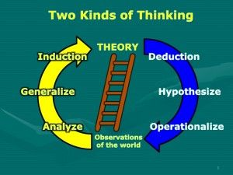

Slide 24
REVIEW
What was meant by experiments?
Volunteers will come to the whiteboard to make a summary

Slide 25
Research methods
Experiment aims to establish a cause-and-effect relationship between two variables
  Manipulation of the independent variable influences the dependant variable
True experiment
  Allocation of participants into experimental and control groups is done randomly
Quasi-experiment
  Allocation into groups is done based on pre-existing differences

Slide 26
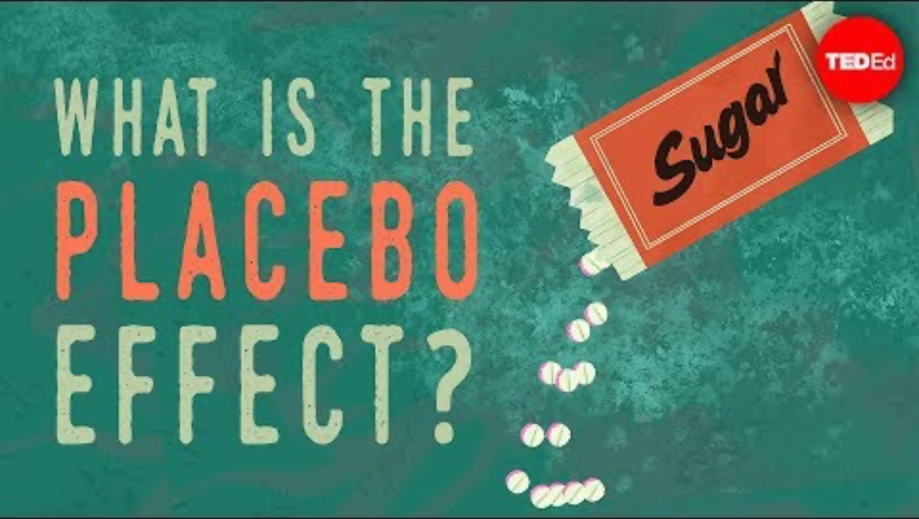
Research methods
Why is a placebo experiment needed in medical research?

Slide 27
REVIEW
What was meant by correlation?
How is correlational research different from experiments?

Slide 28
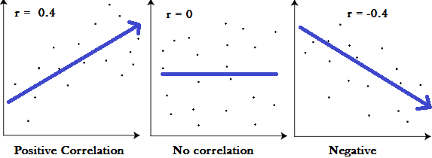
Research methods
Correlation
  Measure of linear relationship between two variables
Effect size (r)
  The value of
  correlation coefficient (from –1 to 1)

Slide 29
Research methods
Statistical significance
  Probability of the correlation effect size (r) being caused by chance alone is small
  p-value or probability value less than .05 (5%)
  => there is an over 95% change of finding a significant relationship

Slide 30
Research methods
A good correlational study has large effect size (r) and small p-value

Slide 31
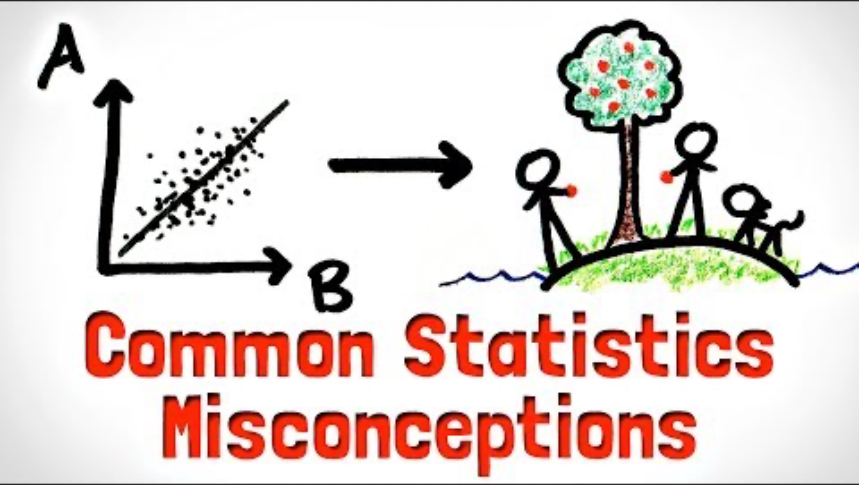
Research methods
Correlation does not imply causation, or does it?

Slide 32
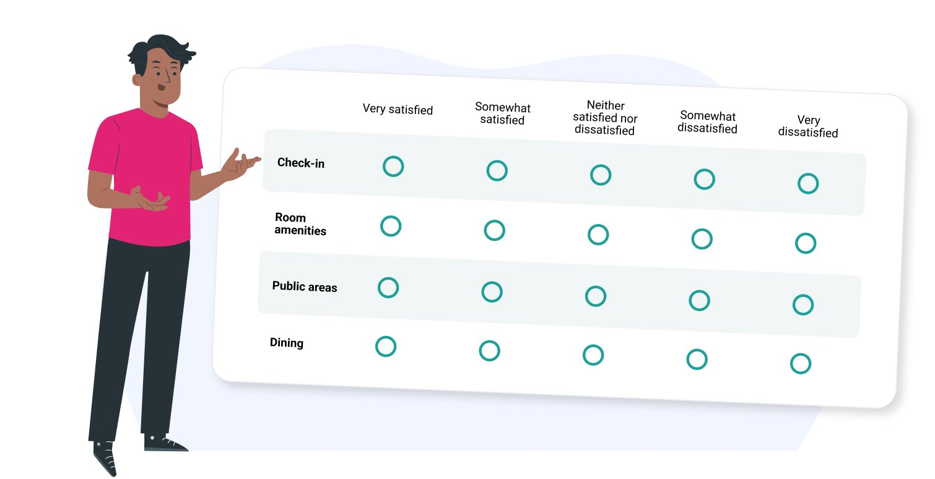
Research methods
Survey / questionnaire asks standardised set of questions from participants
  Fixed scales / narrative responses

Slide 33

Research methods
Observation
  Naturalistic / controlled
  Overt / covert
  Participant /
  non-participant

Slide 34

Research methods
Interview asks questions of participants
  Structured
  Semi-structured
  Narrative
  Focus group (group interview)

Slide 35
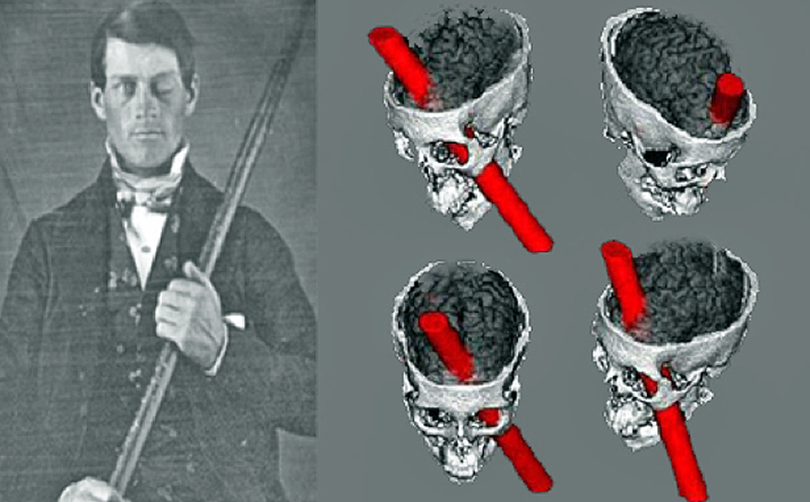
Research methods
Case study is an in-depth investigation into a single case or example
  Often focused on an individual, but can include groups and institutions

Slide 36

Research methods

Slide 37
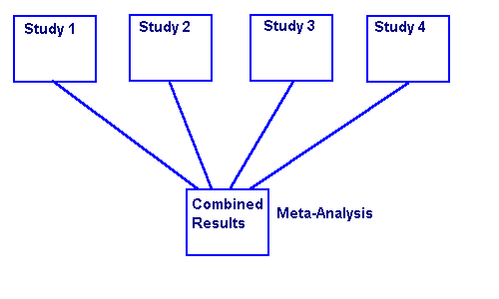
Research methods
Meta-analysis is a study of studies
  Gathers a large collection of studies with the same or very similar aim
  Aims to provide a more comprehensive insight to a topic

Slide 38
TASK
Familiarize yourself with tables 1 and 2 in Kognity 1.1.2
Which research method and why would be most useful in investigating the research questions on the right?
(1) How common are depressive symptoms among 16–18-year-old Finnish upper secondary students?
(2) Can a ”digital detox” reduce symptoms of depression?

Slide 39
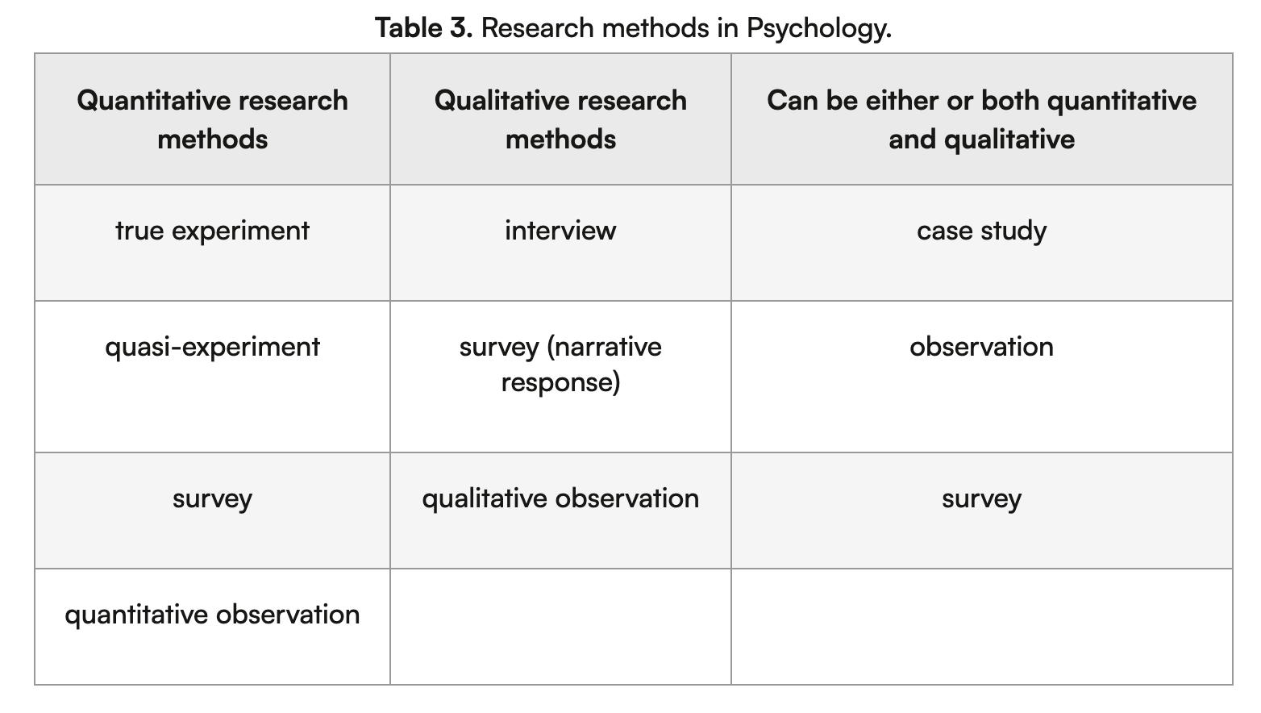
Research methods

Slide 40
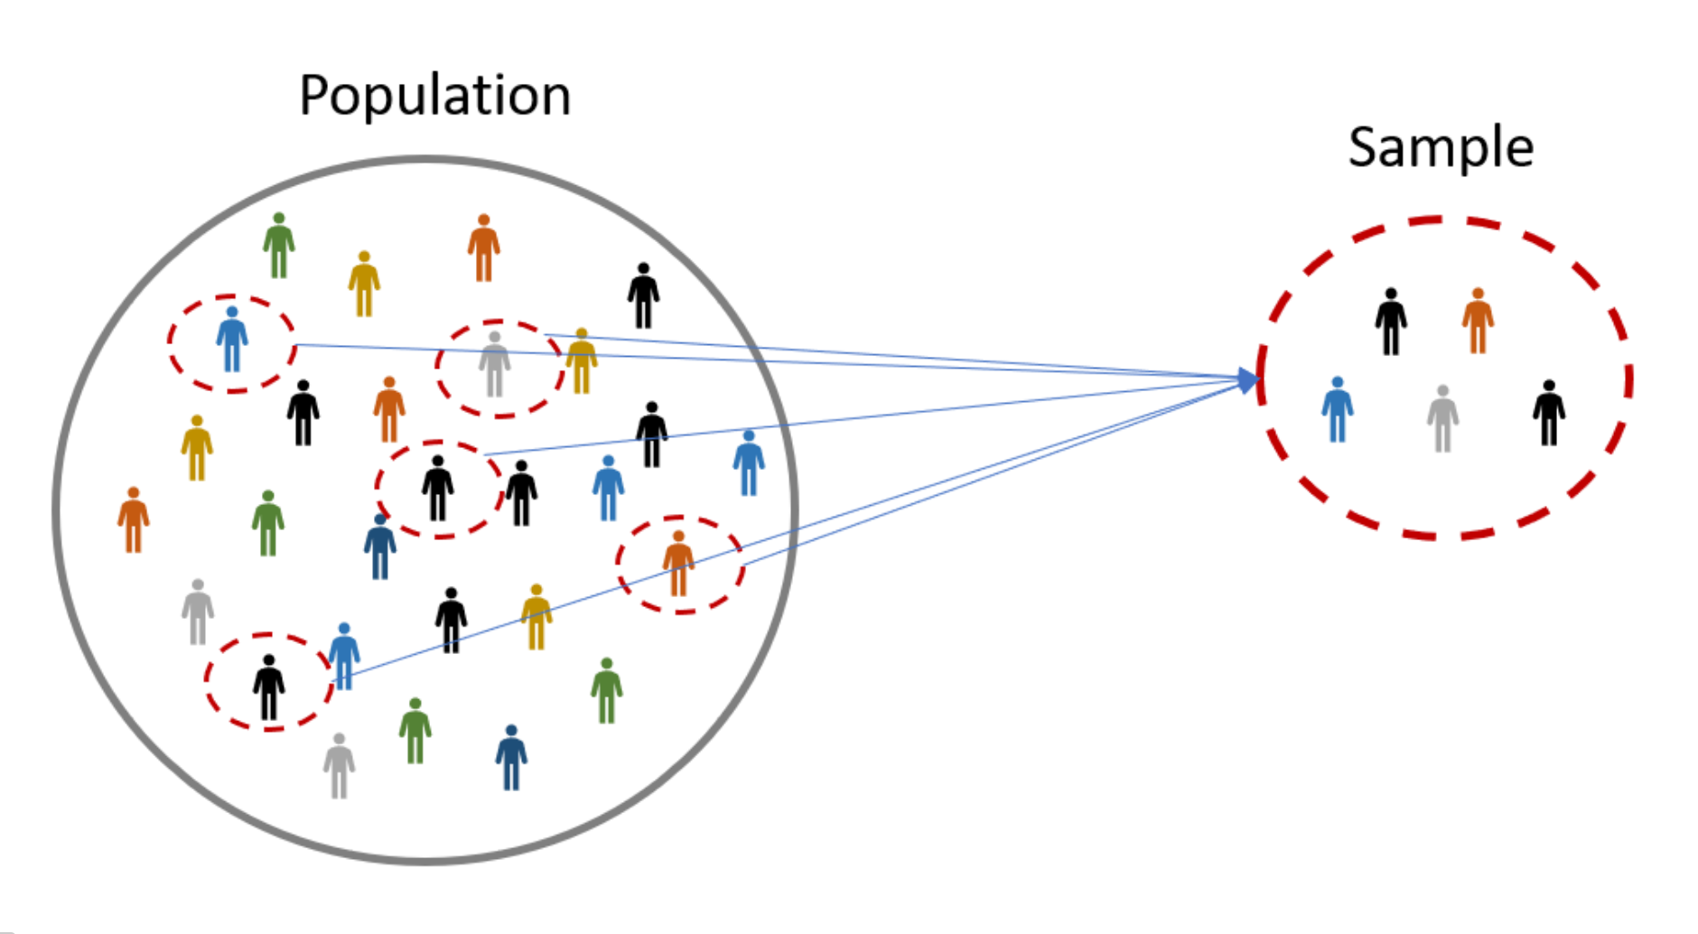
Sampling techniques
Sample
  A subset of individuals selected from a population
  A good sample represents the population and allows reliable generalizations to the population

Slide 41
TASK
Read about different sampling techniques in Kognity 1.1.8
Which sampling technique would you choose for the studies on the right and why?
  What are the strengths and the limitation of your choices?
(1) How common are depressive symptoms among 16–18-year-old Finnish upper secondary students?
(2) Can a ”digital detox” reduce symptoms of depression?

Slide 42
Sampling techniques
Random sampling
  Random sub-set of the members of the population
  Requires sufficient sample size
Stratified sampling
  Decide essential characteristics of the population
  Study the distribution of the characteristics within the target population
  Recruit participants randomly, but keep the proportions

Slide 43

Sampling techniques
Opportunity / convenience sampling
  Recruiting participants that are easily available
Self-selected sampling
  Recruiting volunteers

Slide 44

Sampling techniques
Snowball sampling
  Small number of participants are invited and asked to invite other people to the research

Slide 45
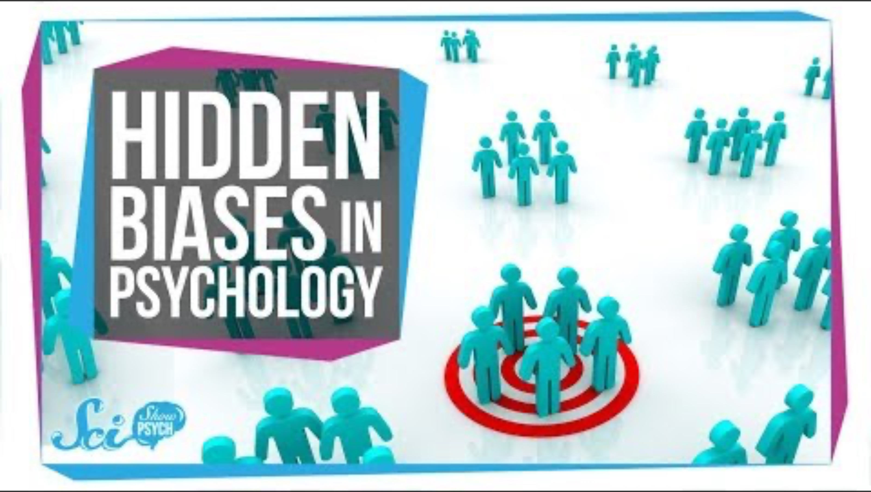
Sampling techniques
What does WEIRD stand for and why and how does it cause bias?

Slide 46
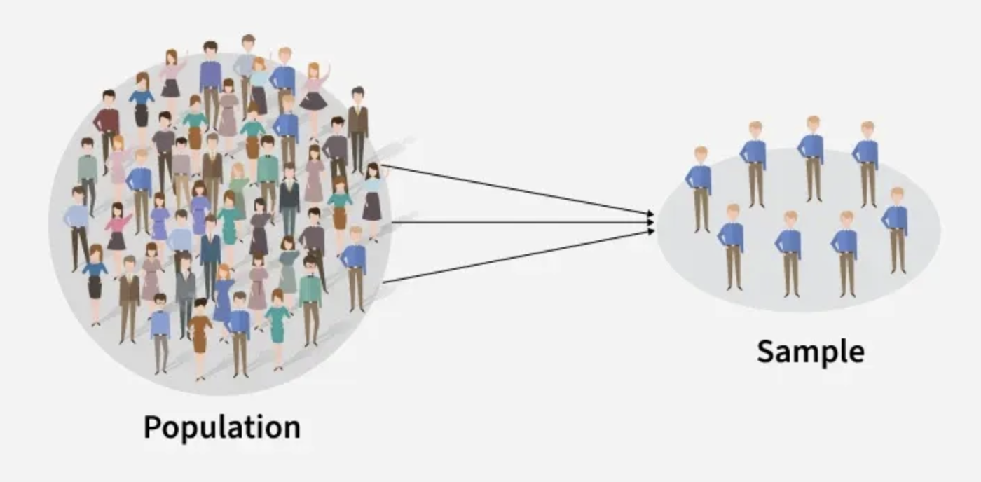
Research considerations
Sampling bias
  Sample does not represent of the population

Slide 47
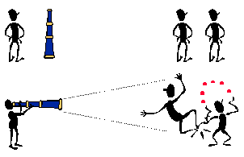
Research considerations
Participant bias
  People change their behaviour because they know they are being researched

Slide 48
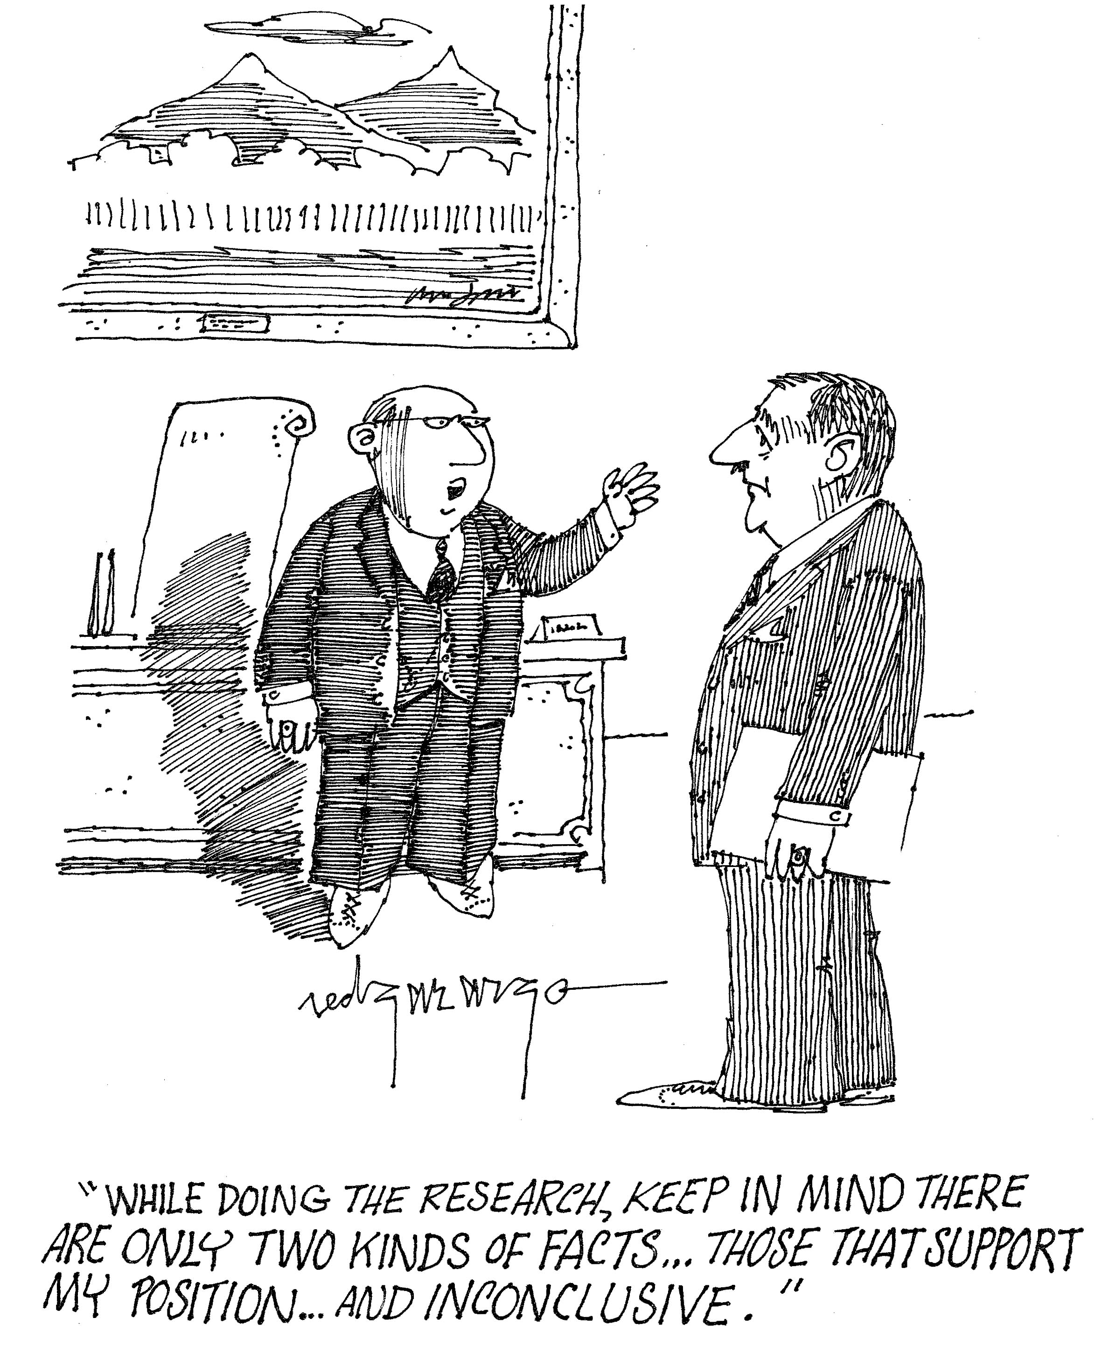
Research considerations
Researcher bias
  Ways how researcher’s beliefs, expectations, or preferences influence the research

Slide 49
Experimental research | Correlational research | Surveys / questionnaires | Qualitative research
Selection |  |  | Acquiescence bias
History |  |  | Social desirability bias
Maturation | Third variable problem | Acquiescence bias | Dominant respondent bias
Testing effect | Curvilinear relationship | Social desirability bias | Sensitivity bias
Instrumentation | Spurious correlation | Extreme responding | Confirmation bias
Regression to the mean |  |  | Leading questions bias
Experimental mortality |  |  | Question order bias
Demand characteristics |  |  | Sampling bias
Experimenter bias |  |  | Biased reporting
See the handout on these
biases in teacher’s
supplementary
materials

Slide 50
REVIEW
What was meant by operationalisation?
What could be a good example of operationalisation in psychological research?

Slide 51

Research considerations
Construct is any theoretically defined variable, a psychological phenomenon
  E.g. love, aggression
  and memory
Constructs need to be operationalized in quantitative research

Slide 52

Research considerations
Validity refers to the accuracy of the research
  Do the research methods used correspond to the phenomenon that is being researched?

Slide 53

TASK
Read “Increasing the validity of research” from Kognity 1.1.3 and find out what the following forms of validity mean:
  Internal validity
  Content validity
  Construct validity
  Face validity
  External validity

Slide 54
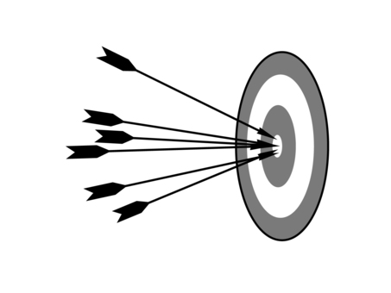
Research considerations
Face validity
  Does the research look like it is measuring what is should be measuring?
Content validity
  Do all parts of the research measure the phenomenon?

Slide 55
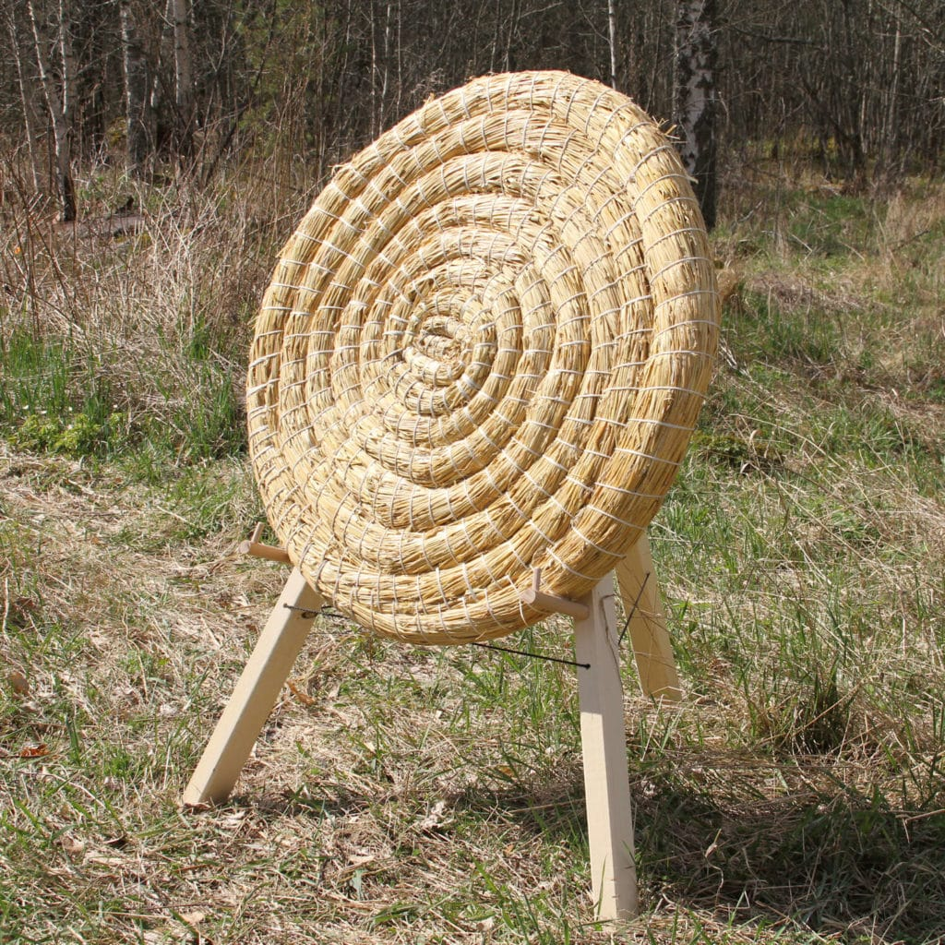
Research considerations
Construct validity
  Characterizes the quality of operationalisations
  How well does the measurement relate to the construct?

Slide 56
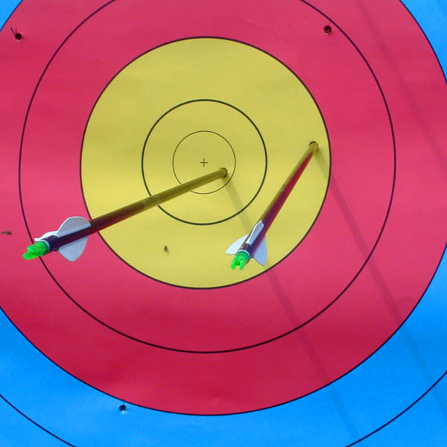
Research considerations
Internal validity
  Characterizes the methodological quality of experiments
  How well are the confounding variables controlled?

Slide 57
Research considerations
External validity
  Characterizes the generalizability of the findings
(1) Population validity
  Can the findings be generalized to wider population?
(2) Ecological validity
  Can the results be generalized to real-life setting?

Slide 58
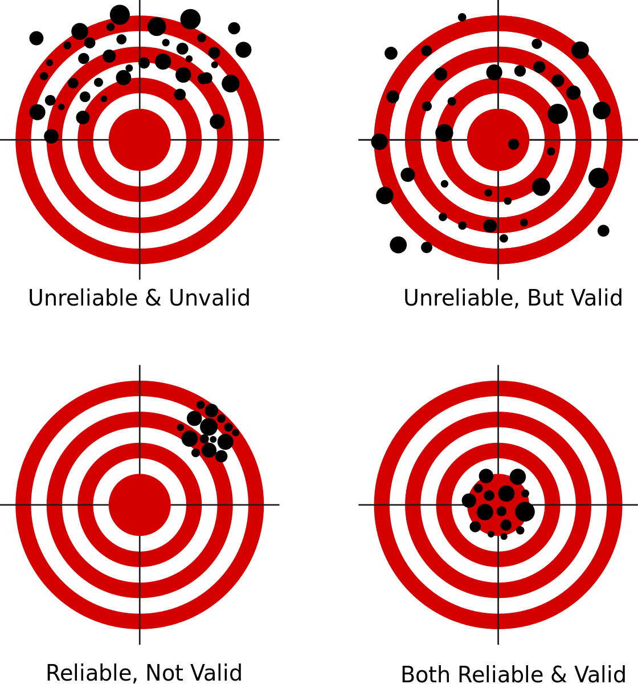
Research considerations
Reliability refers to the consistency of the research results
  Are the results of the research repeatable?

Slide 59
TASK
Read ”Establishing reliability in research” from Kognity 1.1.3 and summarise the following forms of reliability in your own words:
  Test-retest reliability
  Parallel reliability
  Interrater reliability
  Member checking
  Triangulation

Slide 60
Research considerations
Test-retest reliability
  Testing the same participants at different times
Parallel reliability
  Using different measurement tools for the same phenomena
Interrater reliability
  Two or more researchers analyse the same data
Member checking
  Sharing research findings with the participant
Triangulation
  Using multiple research methods or data sources

Slide 61

Research considerations
Credibility or trustworthiness in qualitative research is an equivalent of internal validity in the experimental studies
  Does the research represent the phenomena?

Slide 62

Research considerations
Reflexivity
  Thinking about the strength and limitations of the selected research methods and personal expectations

Slide 63
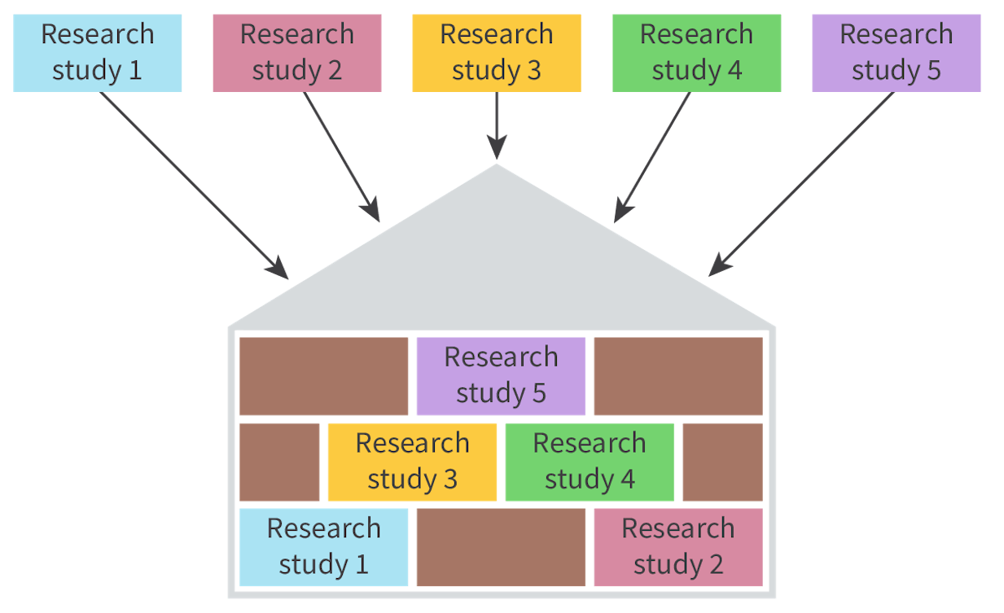
Research considerations
Triangulation refers to a combination of different approaches to collecting and interpreting data
  Method triangulation
  Data triangulation
  Research triangulation
  Theory triangulation

Slide 64
Research considerations
Types of generalizability
  Sample-to-population: generalizing from the sample to the population (quantitative)
  Theoretical: generalizing from particular data sets to a broader theory (quantitative and qualitative)
  Transferability, aka case-to-case generalizability: applying the results to a context that is close to the sample (qualitative)

Slide 65

Ethics in psychological research
Ethicality is an important prerequisite for all psychological research

Slide 66

TASK
Read “Ethical frameworks” from Kognity 1.1.9
  Summarize the main points in your own words

Slide 67

TASK
Read pages 35-36 and 54 from the IB Psychology Guide
  Are the IBO’s guidelines in line with the general ethical guidelines you have been studying?
  Can you find any similarities, differences and overlaps?

Slide 68

Ethics in psychological research

Slide 69
Picture sources
Review <http://ajslp.pubs.asha.org/article.aspx?articleid=2204333> Accessed 22nd of November 2017.
We can do it! –poster <https://en.wikipedia.org/wiki/We_Can_Do_It!> Accessed 10th of August 2026.
Bias <https://crew.co/blog/cognitive-biases-decision-making/> Accessed 22nd of August 2017
Causation vs. correlation <https://www.linkedin.com/posts/krishnakumarramanathan_correlation-vs-causality-activity-7085877470708588544-r35M> Accessed 10th of August 2026.
Woman’s life-cycle <http://www.omaplus.fi/?s=artikkelit&p=108> Accessed 2nd of December 2015.
PET brain scans <https://usabrainsciences.com/conditions/depression> Accessed 10th of August 2026.
Perspective into a mind <https://relationshipsmdd.com/lander?oref=https%3A%2F%2Fwww.google.com%2F> Accessed 10th of August 2026.
Milgram <http://listverse.com/2008/09/07/top-10-unethical-psychological-experiments/> Accessed 31st of August 2018.
Theory <https://www.irrationalchange.com/theory> Accessed 15th of August 2015.
Black swans <https://en.wikipedia.org/wiki/Black_swan> Accessed 15th of August 2015.
Black and white wheel head <https://www.magnific.com/free-photos-vectors/thinking-graphic> Accessed 15th of August 2015.
Scientific method – Kognity
Replication <https://estuary.dev/blog/types-of-data-replication/> Accessed 15th of August 2015.

Slide 70
Picture sources
Comparison of quantitative and qualitative research <https://www.google.fi/url?sa=i&rct=j&q=&esrc=s&source=images&cd=&cad=rja&uact=8&ved=0ahUKEwi79OaCp-XVAhXnQZoKHeQbAj8QjB0IBg&url=https%3A%2F%2Fueassignmentmccb.formation-conseil.info%2Fqualitative-research-case-study-approach.html&psig=AFQjCNF7xcd5d0nJibDVUc0iQ8bWo6HAsw&ust=1503300805080393> Accessed 18th of August 2017.
Quantitative and qualitative heads <http://www.cdsmr.com/newsworthy/qualitative-quantitative-research-the-cds-way> Accessed 18th of August 2017.
Two kinds of thinking <https://www.pinterest.ca/pin/395542779751940516/> Accessed 26th of November 2015.
Correlation <http://www.statisticshowto.com/probability-and-statistics/correlation-coefficient-formula/> Accessed 1st of February 2018.
Survey <https://yourcx.io/en/blog/2025/01/reasons-why-well-designed-survey-questions-matter-in-feedback-collection/> Accessed 13th of August 2025
Observation <https://westernsydney.pressbooks.pub/customerinsights/chapter/chapter-8-observational-research/> Accessed 13th of August 2025
Interview <https://blogs.oregonstate.edu/whatsinaninterview/2024/10/31/hello-world/> Accessed 13th of August 2025
Phineas Gage <http://onlinestorybank.com/2014/03/the-strange-case-of-mr-phineas-gage/> Accessed 17th of August 2017
Meta-analysis <http://library.downstate.edu/EBM2/2700.htm> Accessed 13th of August 2018.
Research methods in psychology – Kognity

Slide 71
Picture sources
Sample <https://www.simplypsychology.org/sampling.html> Accessed 17th of November 2026.
Sampling <https://www.verywellmind.com/what-is-a-representative-sample-2795798> Accessed 10th of January 2023
Snowball sampling <https://dollarcents.org/infographics/compound-interest-snowball-effect/> Accessed 7th of August 2018.
Validity target <http://www.readingeagle.com/voices/article/realism-of-archery-king-hits-a-bullseye> Accessed 6th of August 2018.
Face validity <https://blog.questionmark.com/face-validity-participants-connecting-assessments-to-constructs> Accessed 6th of August 2018.
Drawn target boards <https://en.ac-illust.com/clip-art/25041993/the-arrow-hits-the-target> Accessed 18th of August 2026.
Straw target board <https://rautaportti.fi/tuote/olkinen-jousiammuntataulu/> Accessed 18th of August 2026.
Close-up on target board <https://fi.wikipedia.org/wiki/Tiedosto:WA_archery_target_with_arrows.jpg> Accessed 18th of August 2026.

Slide 72
Picture sources
Reliability and validity <https://commons.wikimedia.org/wiki/File:Reliability_and_validity.svg> Accessed 17th of August 2017.
SciShow <https://en.wikipedia.org/wiki/SciShow> Accessed 21st of August 2018.
Experiment <http://blog.stridekick.com/matchup-experiment-what-inspires-behavior-change/> Accessed 30th of January 2018.
Minute Physics <https://www.youtube.com/channel/UCUHW94eEFW7hkUMVaZz4eDg> Accessed 25th of August 2021
Participant bias <http://psychtutor.weebly.com/research-methods.html> Accessed 22nd of August 2017.
Researcher bias <https://scalesstudy.wordpress.com/2012/03/30/bias-in-research/> Accessed 18th of August 2026.
Trust and credibility <https://www.tes.com/lessons/CN7qOjEDZ_0-Zw/credibility> Accessed 6th of August 2018.
Rainbow refelection <https://stockcake.com/i/rainbow-beach-reflection_1367973_483637> Accessed 18th of August 2026.

Slide 73
Picture sources
Code of ethics <https://www.bps.org.uk/news-and-policy/bps-code-ethics-and-conduct> Accessed 6th of August 2018.
Got Ethics? <https://sites.psu.edu/leadership/2014/10/26/should-employer-ethics-policies-extend-to-employee-personal-lives/> Accessed 24th of August 2015.
IB Diploma Programme <http://www.yis.ac.jp/page.cfm?p=763> Accessed 10th of August 2017.

