Slide 1
FUTUURI & KONDITIONAALI 1, 2
america will be great again.
america would be great again if mr. Trump had more sense.
america would have been great again if trump hadn’t ruined everything.

Slide 2
Look at these sentences! Find the conditional.
If Franz sees Gabi, he’ll tell her.
If we don’t go now, we’ll be late for the meeting.
If I went to the moon, I’d bring you back some cheese.
If Nanami went to London, she’d meet Jin.
June has a boyfriend, Robert. Mary is talking to June about Robert and says ’If I were you, I’d leave him.’
If I win the lottery, I will buy a fancy car.
If I won the lottery, I would buy a fancy car. (but I won’t!)

Slide 3
Discuss with your partner:
What would you do…
…if you won the lottery?
…if you were President?
…if you passed all your exams with top grades?
…if you became a famous Hollywood film star?
If I were… I would…
BUT: How likely is it that any of these will happen?

Slide 4
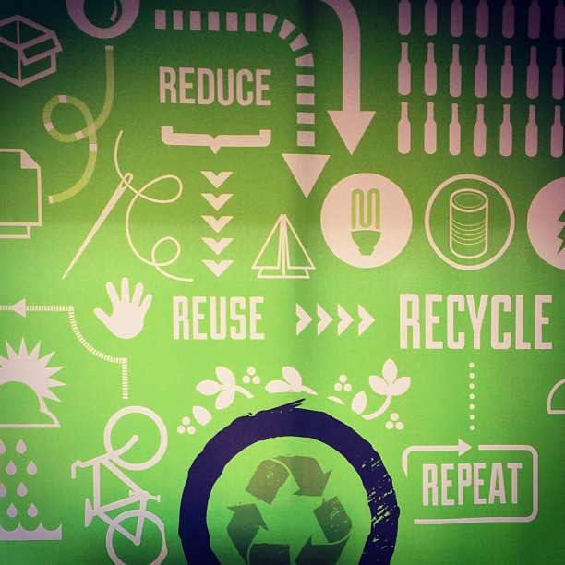
Futuurin ja konditionaalin ero
FUTUURI:
Kierrätän, jos autat minua.
I will recycle if you help me.
I’ll
KONDITIONAALI (-isi)
Kierrättäisin, jos auttaisit…
I would recycle if you helped me.
I’d
MITEN MUODOSTAN FUTUURIN JA KONDITIONAALIN? KIRJOITA SÄÄNTÖ.
Futuuri: Päälauseessa apuverbi + pääverbin muoto. IF-lauseessa...
Konditionaali: Päälausessa apuverbi + pääverbin muoto. IF-lauseessa…
FUTUURI: will/won’t + pääverbin perusmuoto. IF-lause perusmuoto (help)
1.KONDITIONAALI: would / wouldn’t + perusmuoto. IF-lause imperfekti (helped)
*konditionaalia myös could (voisi) ja should (pitäisi)
*would lyhenee myös muotoon ´d – I’d save the planet if..
Good to know:
Pilkku vain jos IF-lause aloittaa virkkeen!

Slide 5
2. konditionaali
KONDITIONAALI (-isi)
Kierrättäisin, jos auttaisit…
I would recycle if you helped me.
I’d
2. KONDITIONAALI Olisin kierrättänyt, jos olisit auttanut.
I would have recycled if you had helped me.
MUODOSTUS:
WOULD HAVE +
PÄÄVERBIN 3. MUOTO
*wouldn’t have
PLUSKVAMPERFEKTI
had + 3. muoto
1. KONDITIONAALI kertoo, mitä voisi tapahtua (tulevaa)
2. KONDITIONAALI kertoo, mitä olisi voinut tapahtua (mennyt aika)
Good to know:
Pilkku vain jos IF-lause aloittaa virkkeen!
Kirjoita yksi oma esimerkkilause itsellesi kustakin konditionaalista. Opettele lauseet, niin sinulla on aina esimerkkitapaus, jota soveltaa!
Mitä hullumpi lause, sen parempi!

Slide 6
Look at these sentences. Find 1st conditional and 2nd conditional.
If Franz had seen Gabi, he would have told her.
If we went now, we wouldn’t be late for the meeting.
If I had gone to the moon, I would have brought you back some cheese.
If Nanami went to London, she’d meet Jin.
If I had won the lottery, I would have bought a fancy car.
If I won the lottery, I would buy a fancy car. (but I won’t!)

Slide 7
Rewriting history
1. Think of some historical situations that might have changed the world. Finish the sentences with your partner.
If electricity had never been invented… (we would have lived in darkness.)
If the dinosaurs hadn’t died out…
If Trump hadn’t been elected President…
If Columbus had never discovered America…
If 50 Cent hadn’t started rapping…
If Finland hadn’t won/lost the war with Russia…
If I had been Michael Jackson…
If I had been <INSERT PERSON>…
Kirjoita lauseet suomeksi – saat harjoitusta 2. konditionaalista.

