Slide 1
Nokkisbiisejä

Slide 2
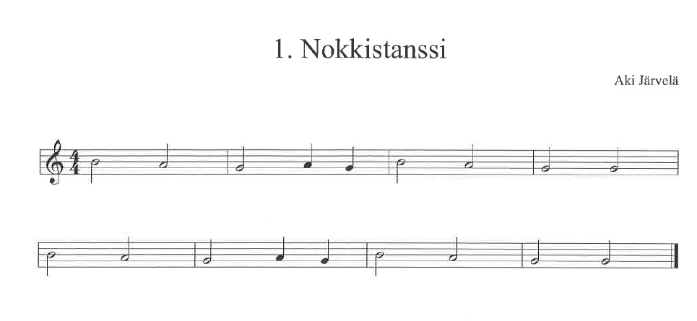


h a g a g h a g g
h a g a g h a g g

Slide 3
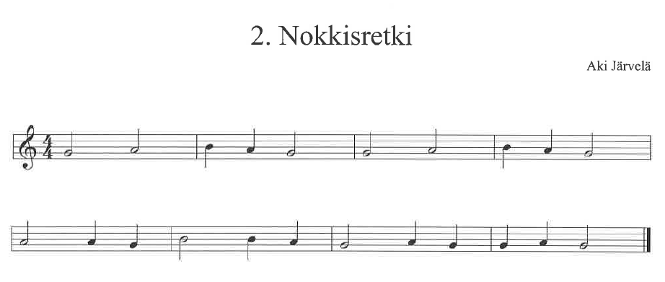
g a h a g g a h a g
a a g h h a g a g g a g

Slide 4
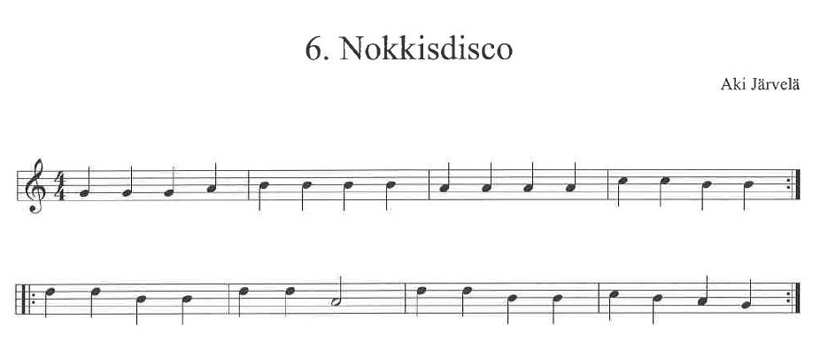

g g g a h h h h a a a a c c h h
d d h h d d a d d h h c h a g

Slide 5

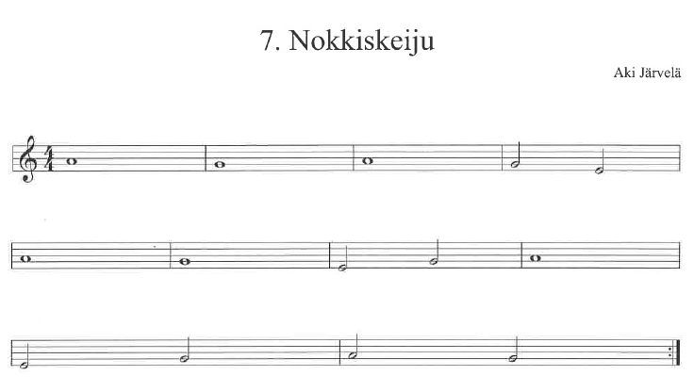
a g a g e
a g e g a
e g a g

