Slide 1
Social studies

Slide 2
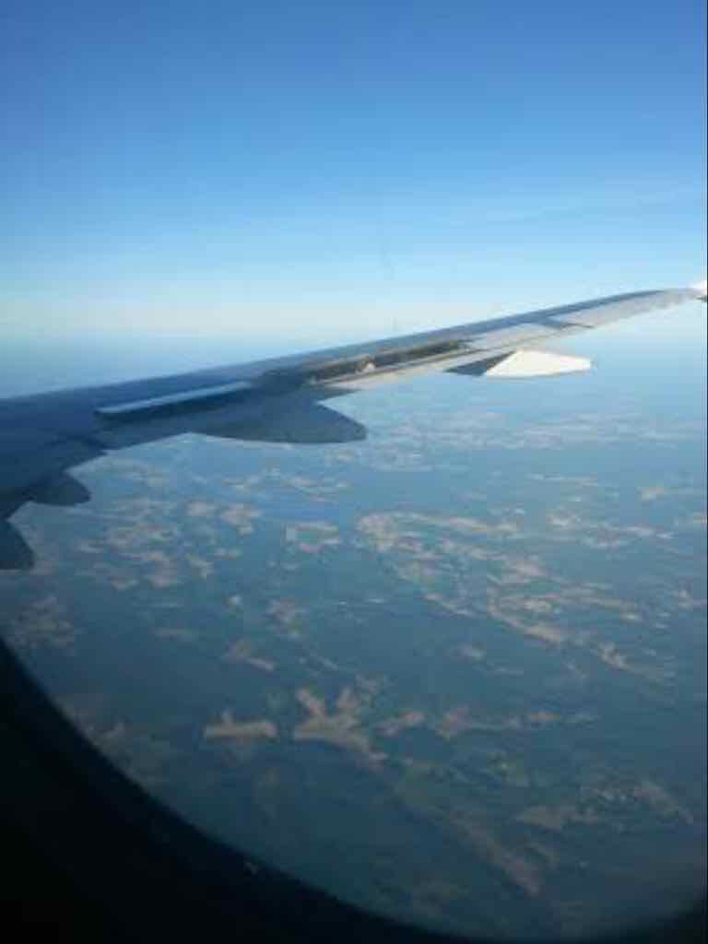
Airplane
We spilt in to groups and learned the subject by drama
We played that airplane had crushed down, we are in empty island and we need to make a society
We created the rules and thinked what the punishments will be
We learned how society works and why there are rules and it was fun

Slide 3
Influence
We split in groups of 4
We got a way to influence others decisions and made a play about it
We watched the plays and talked about the ways to influence
We learned about the power of other people and acting and the plays were fun

