Slide 1
Creative dance

Slide 2
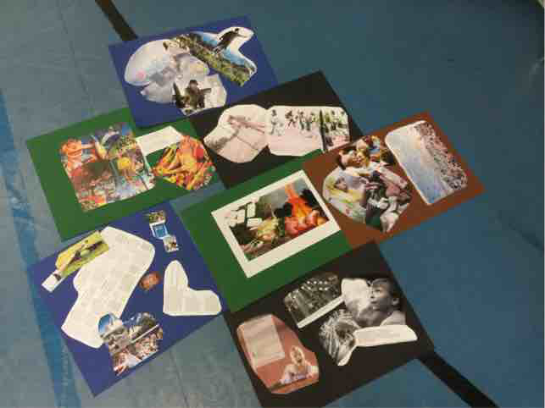
Start of the lesson
Split in to groups
Check what we were going to do
Warm-up with the groups of 6-7 people
THEME: Finland 100 years old and Finland in year 2017
Video is coming here soon!

Slide 3
Creative dance
Choose a theme for your dance performance (from Finland 100 or Finland in year 2017)
You can take tips for choosing the theme from the pictures teacher give to you
For examples equality, education, the changes in the population
3. 1 to 8 of the given moves must be in the performance
4. Add other movements between the given ones, order of the moves are free, they can be done solo, in canon or together
5. Use different speeds, directions, paterns, etc.
6. Practise your choreography so it goes fluently
7. Choose your music (Finnish)
8. Perform it to other groups at the end of the class + filming it

Slide 4
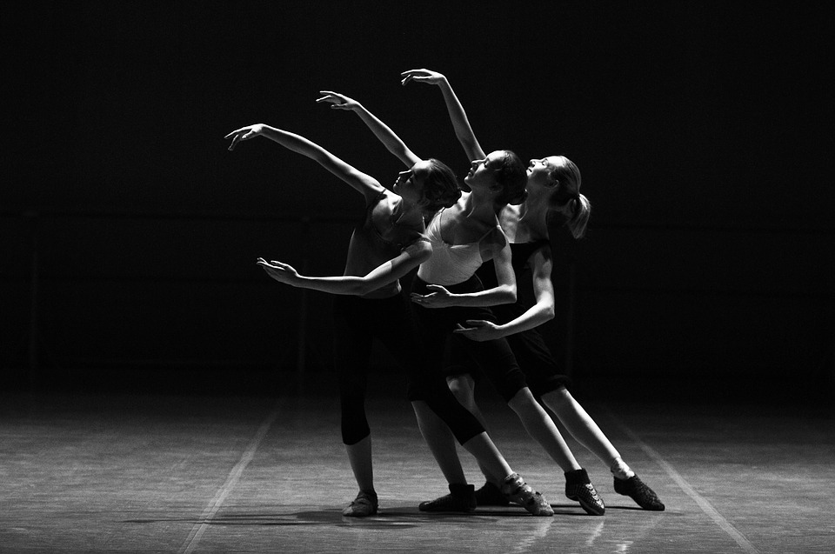
The Moves
Rolling move while standing
Jump
Balance move
Series of steps
Improvising
Move on the height of floor
Big jump
Rolling move on the height of floor

Slide 5
Results
We had only 60 minutes to plan, rehearse and perform the dances
We did everything by ourselves and from our vision
The themes were happiness, grit (determination, courage, strength, etc), sausages and midsummer party
Everybody did their best and liked to dance

