Slide 1
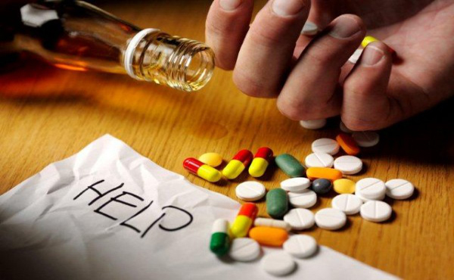
The problem of addiction
              Anselmo Gabriele
              Cascavilla Matteo
              Punzetti Matteo
              Tomasino Carlo

Slide 2
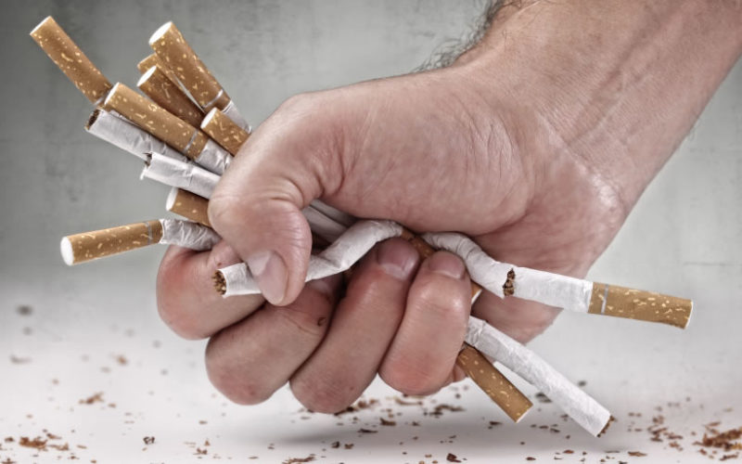
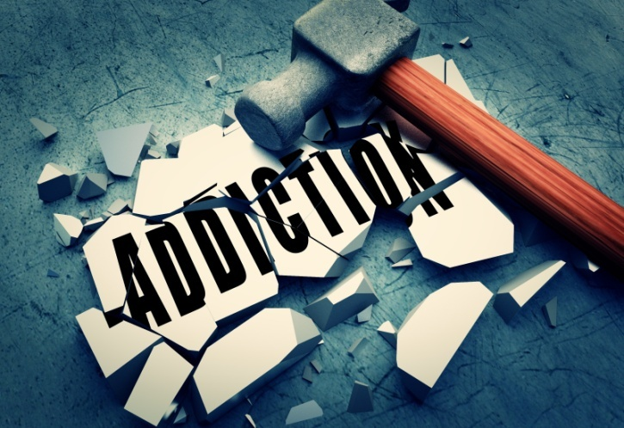
Awareness campaign regarding addiction
We think that it is very important to talk to the students about addictions because this trend is growing fast and it represents a problem for young people.

Slide 3

Learning by playing
The game that we thought represents a new way of learning: this method is simply called “learning by playing”.
With this method we hope that you can learn a lot of new information in a funny way.

Slide 4
How to play
15 cards: NAME of drugs
15 cards: HISTORY of drugs
15 cards: EFFECTS of drugs
5 cards: STORIES of the users
You have to match each drug with its history and its effects.
HISTORY
it was discovered in …
Marijuana
EFFECTS
this drug can cause …

Slide 5
Addictions
Opium
Cocaine
Heroin
Hashish
LSD
Hash oil
Ecstasy
Anphetamine
Marijuana
Gambling
Smart drugs
Mescalina
Tobacco
Methadone
Alcohol

Slide 6
Correct answers
Opium – 11 t
Cocaine – 12 x Paula
Heroin – 13 y
Hashish – 6 e
LSD – 5 n Luca
Hash oil – 7 o
Ecstasy – 8 c
Anphetamine – 15 u
Marijuana – 4 p Marco
Gambling – 3 a
Smart drugs – 14 f Jane
Mescalina – 9 b
Tobacco – 2 i
Methadone – 10 z
Alcohol – 1 g John

Slide 7
Difference between use,abuse and addiction
Use: When the drugs are occasionally used for their feelings of pleasure or euphoria.
Abuse: When the drug is taken, altrought the people who assume it know that it can be dengerous to their mental and physical health.
Addiction: when the use of the drug becomes necessary,infact people that are addicted can no longer live without it.

Slide 8
The action of drugs
The use of drugs causes alteration of the limbic system.
The drugs change the ability of people to control their emotions.
Repeated use of drugs destroys the balance of communication systems in the brain acting on neurons and internal hormonal system.

Slide 9
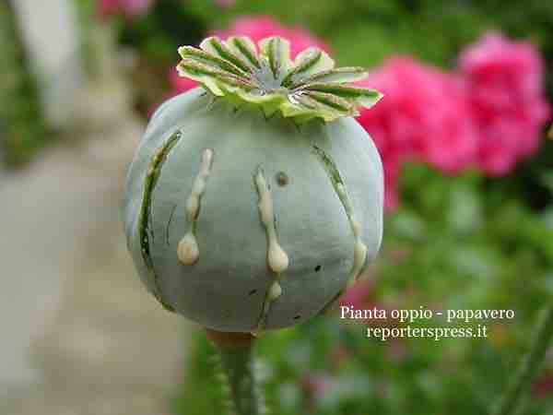
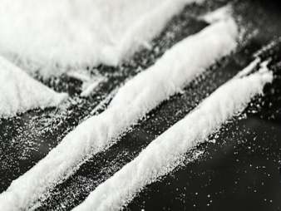
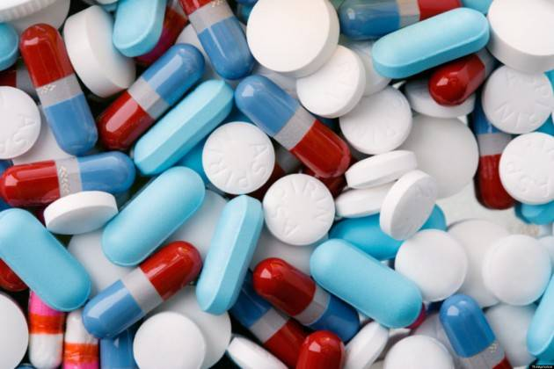
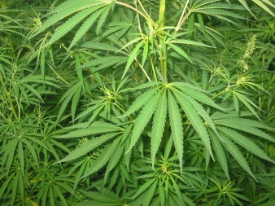
Types of drugs
The various types of drugs can be divided into different groups. We have decided to classify them according to their active substance and based on their pharmacological effects. We have find 4 groups:
Opioids
Stimulants
Hallucinogens
Cannabis and derivatives

Slide 10
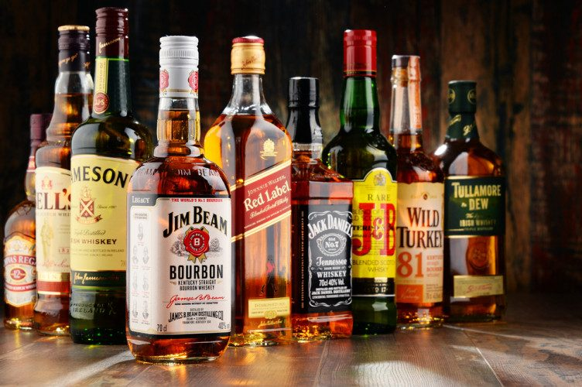
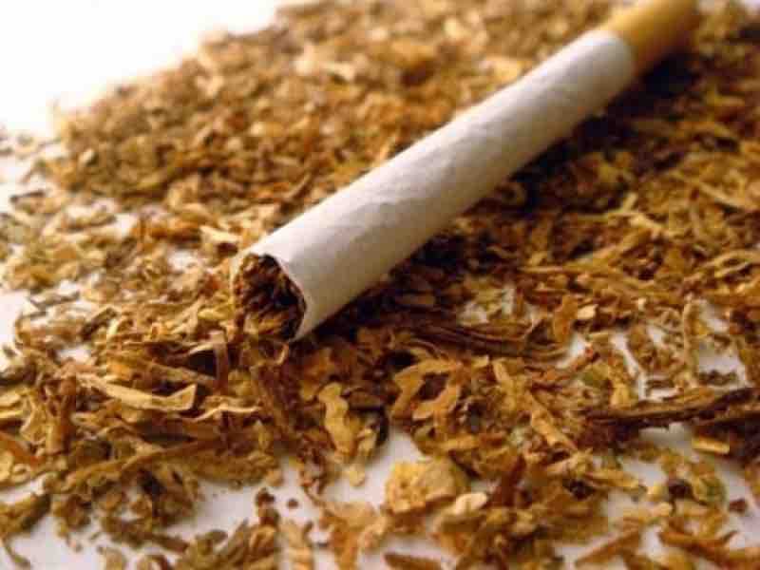
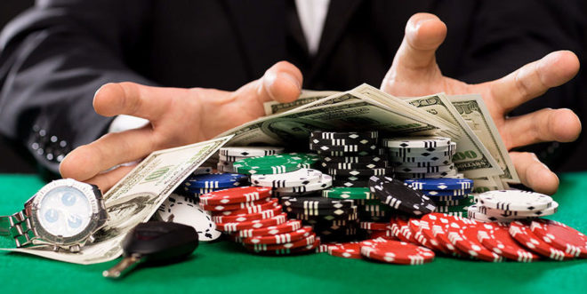
Other addictions
Alcohol:Is an intoxicating beverage containing ethanol .
Tobacco:Is any of several plants belonging to the genus nicotiana.
Gambling: staking or risking money,or anything of value, on the outcome of something involving chance.

