Slide 1
BlueLightS Funding Call Presentation
Overview of funding opportunities and project goals
Notes:
AI-generated content may be incorrect. ---

Slide 2
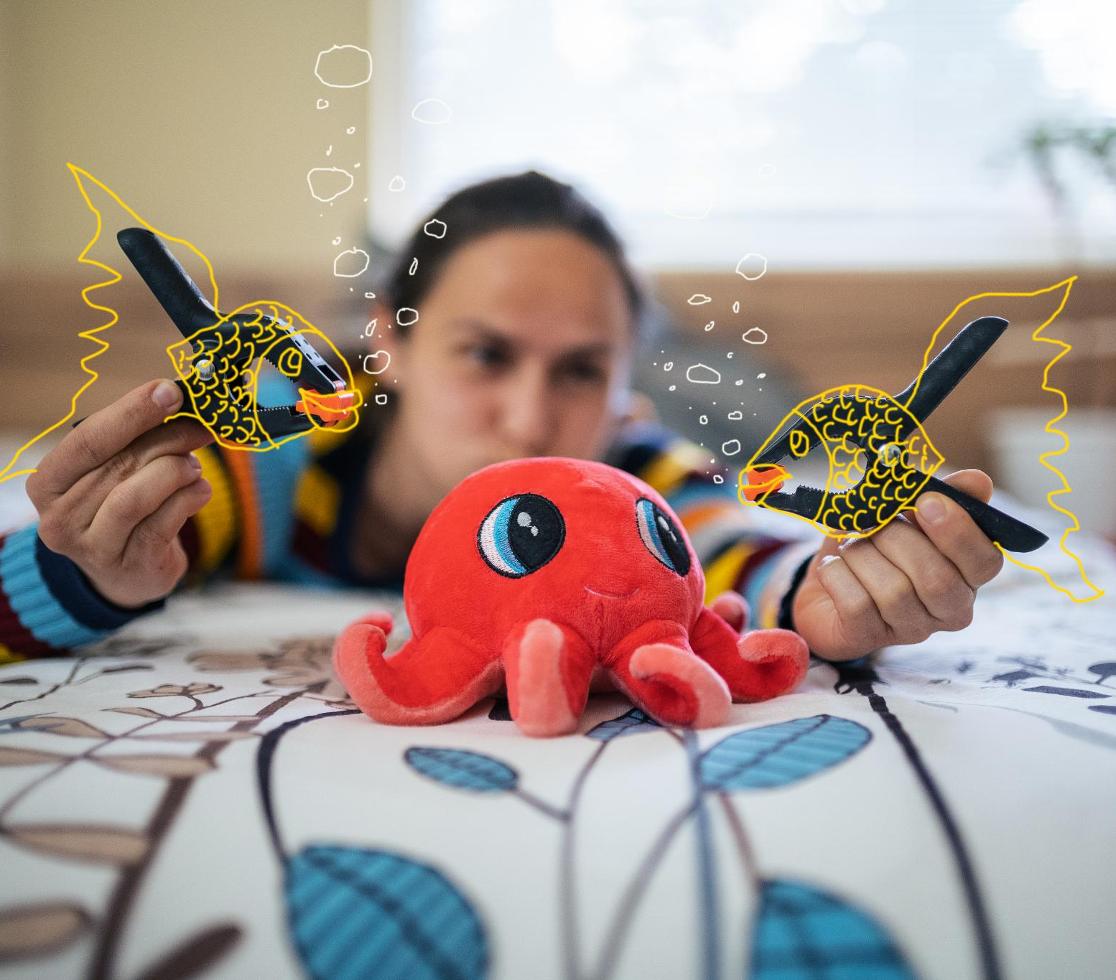
Introduction to BlueLightS
Ocean and Water Literacy
BlueLightS promotes ocean and water literacy by supporting student-led projects in schools across Europe.
EU Mission Contribution
Participating schools contribute to restoring aquatic ecosystems by 2030 through the EU Mission initiative.
Network of European Blue Schools
BlueLightS expands collaboration by fostering a network of European schools focused on sustainability education.
Notes:
--- This slide references information from the following file: https://eu-prod.asyncgw.teams.microsoft.com/v1/objects/0-weu-d5-d01d40382b354b4591918dc04ec7aa2f/views/original/BlueLightS_Funding_Call_Presentation.pptx,https://atlantic-maritime-strategy.ec.europa.eu/en/funding/calls/2nd-call-blue-challengesblue-schools-bluelights BlueLightS is an EU-funded initiative under the Horizon Europe Programme aimed at promoting ocean and water literacy in schools across Europe. The program supports creative, student-led projects that engage with aquatic environments and encourage meaningful action. By participating in BlueLightS, schools contribute to the EU Mission 'Restore our Ocean and Waters by 2030', which seeks to reverse the degradation of aquatic ecosystems caused by human activities. The initiative also helps expand the Network of European Blue Schools (NEBS), fostering collaboration and sustainability education among students and educators.

Slide 3
European Network of Blue Schools (ENBS)
Part of the EU4Ocean Coalition, supported by the European Commission
Aims to promote ocean literacy in European schools
Schools complete the “Find the Blue” challenge by creating water-related projects
Successful schools receive the European Blue School Certificate
Encourages student engagement with marine and freshwater topics
Offers access to a community of educators, resources, and events
Supports cross-border collaboration and sustainability education
Notes:
--- This slide references information from the following file: https://eu-prod.asyncgw.teams.microsoft.com/v1/objects/0-weu-d5-d01d40382b354b4591918dc04ec7aa2f/views/original/BlueLightS_Funding_Call_Presentation.pptx,https://atlantic-maritime-strategy.ec.europa.eu/en/funding/calls/2nd-call-blue-challengesblue-schools-bluelights BlueLightS is an EU-funded initiative under the Horizon Europe Programme aimed at promoting ocean and water literacy in schools across Europe. The program supports creative, student-led projects that engage with aquatic environments and encourage meaningful action. By participating in BlueLightS, schools contribute to the EU Mission 'Restore our Ocean and Waters by 2030', which seeks to reverse the degradation of aquatic ecosystems caused by human activities. The initiative also helps expand the Network of European Blue Schools (NEBS), fostering collaboration and sustainability education among students and educators.

Slide 4
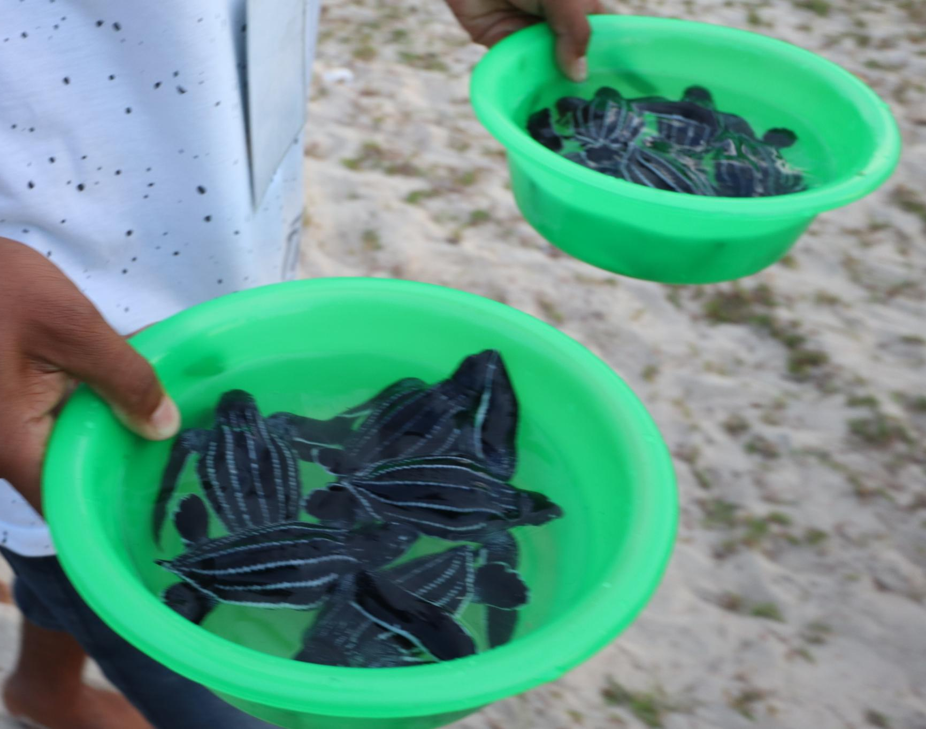
Objectives of the Funding Call
Support for Blue Projects
The funding call supports impactful blue projects in schools aligned with Mission Ocean & Waters goals.
Community Diversity
It encourages participation from diverse schools including coastal, inland, primary, secondary, and vocational institutions.
Collaborative Learning
The initiative promotes eTwinning to foster collaborative learning and environmental responsibility.
Focus on Regional Themes
Projects focus on key regional themes like Mediterranean pollution, Atlantic/Arctic conservation, and Baltic aquaculture.
Notes:
--- This slide references information from the following file: https://eu-prod.asyncgw.teams.microsoft.com/v1/objects/0-weu-d5-d01d40382b354b4591918dc04ec7aa2f/views/original/BlueLightS_Funding_Call_Presentation.pptx,https://atlantic-maritime-strategy.ec.europa.eu/en/funding/calls/2nd-call-blue-challengesblue-schools-bluelights The BlueLightS funding call aims to support impactful blue projects in schools that align with the Mission Ocean & Waters objectives. It seeks to diversify the community of participating schools, including coastal and inland institutions, as well as primary, secondary, and vocational schools. The initiative encourages collaborative learning through eTwinning and promotes environmental responsibility. Projects should be innovative and ambitious, focusing on key principles of blue education and regional lighthouse themes such as pollution in the Mediterranean, conservation in the Atlantic/Arctic, and aquaculture in the Baltic.

Slide 5

Eligibility Criteria
Eligible Schools
Primary, secondary, and vocational schools registered in EU or Horizon Europe countries are eligible to apply.
Application Requirements
Applications must be submitted by schools as legal entities, not individuals, ensuring formal representation.
Network Membership
Schools must belong to NEBS or commit to applying for Blue School label by project's end.
Funding Restrictions
Applicants should not have prior funding from ProBleu or SHORE projects to remain eligible.
Notes:
--- This slide references information from the following file: https://eu-prod.asyncgw.teams.microsoft.com/v1/objects/0-weu-d5-d01d40382b354b4591918dc04ec7aa2f/views/original/BlueLightS_Funding_Call_Presentation.pptx,https://atlantic-maritime-strategy.ec.europa.eu/en/funding/calls/2nd-call-blue-challengesblue-schools-bluelights Eligible applicants for the BlueLightS funding call include primary, secondary, and vocational schools legally registered in EU Member States or Horizon Europe associated countries. Applications must be submitted by the school as a legal entity, not by individuals. Schools must either be part of the Network of European Blue Schools (NEBS) or commit to applying for the Blue School label by the end of the project. Additionally, applicants must not have received previous funding from the ProBleu or SHORE projects. Applications can be submitted individually or as part of a consortium of eligible schools from the same country.

Slide 6
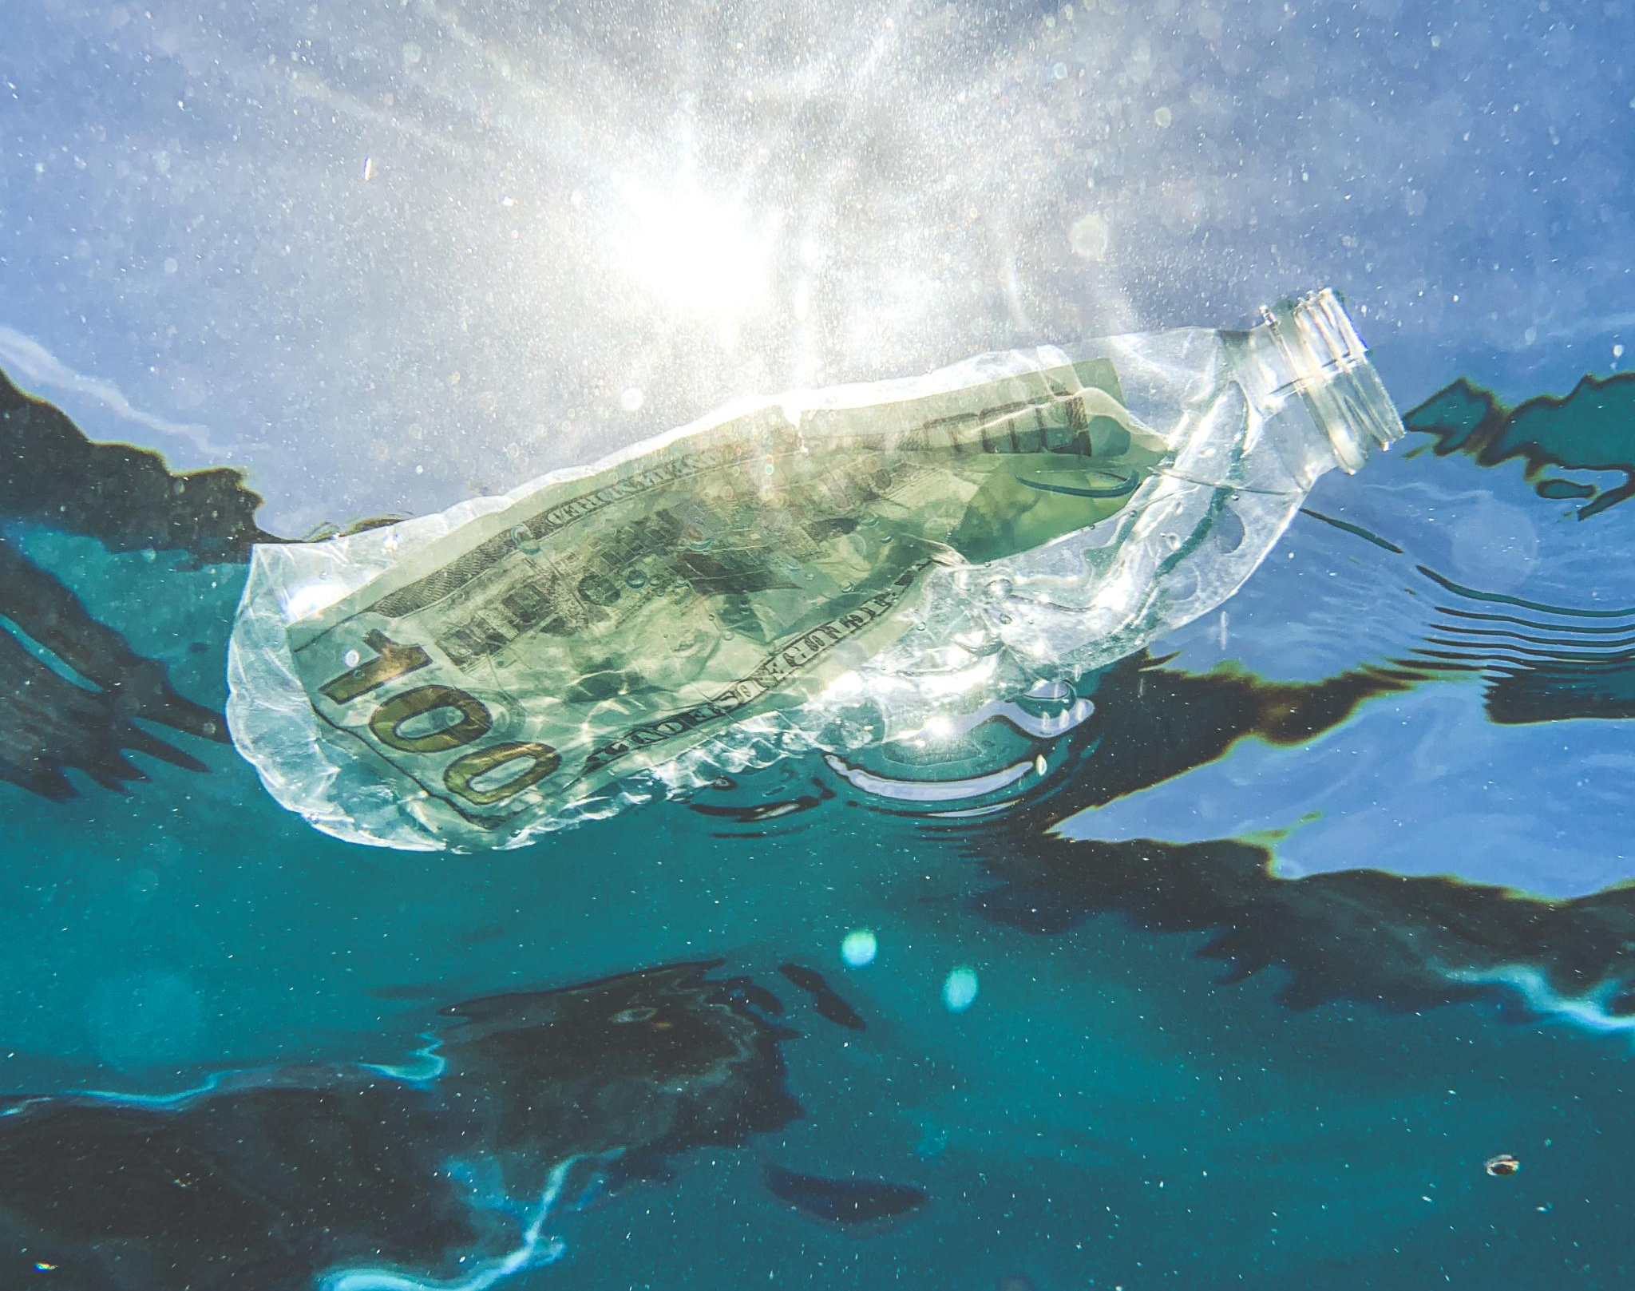
Project Themes
Pollution and Plastics
Focus on reducing pollution and addressing issues with plastics and microplastics in aquatic environments.
Ocean and Water Conservation
Promote conservation of ocean and water ecosystems to restore aquatic biodiversity and health.
Carbon Neutrality Initiatives
Support projects that drive carbon neutrality and encourage positive environmental impacts.
Sustainable Aquaculture
Encourage sustainable aquaculture practices that support environmental sustainability and ecosystem balance.
Notes:
--- This slide references information from the following file: https://eu-prod.asyncgw.teams.microsoft.com/v1/objects/0-weu-d5-d01d40382b354b4591918dc04ec7aa2f/views/original/BlueLightS_Funding_Call_Presentation.pptx,https://atlantic-maritime-strategy.ec.europa.eu/en/funding/calls/2nd-call-blue-challengesblue-schools-bluelights Projects submitted under the BlueLightS funding call should address one or more of the following themes: pollution and plastics (including microplastics), ocean and water ecosystem conservation, initiatives promoting carbon neutrality and positive environmental impact, and sustainable aquaculture. These themes are aligned with the broader goals of the EU Mission to restore aquatic ecosystems and promote environmental sustainability. Schools are encouraged to develop innovative and student-led projects that engage the school community and contribute to these thematic areas.

Slide 7
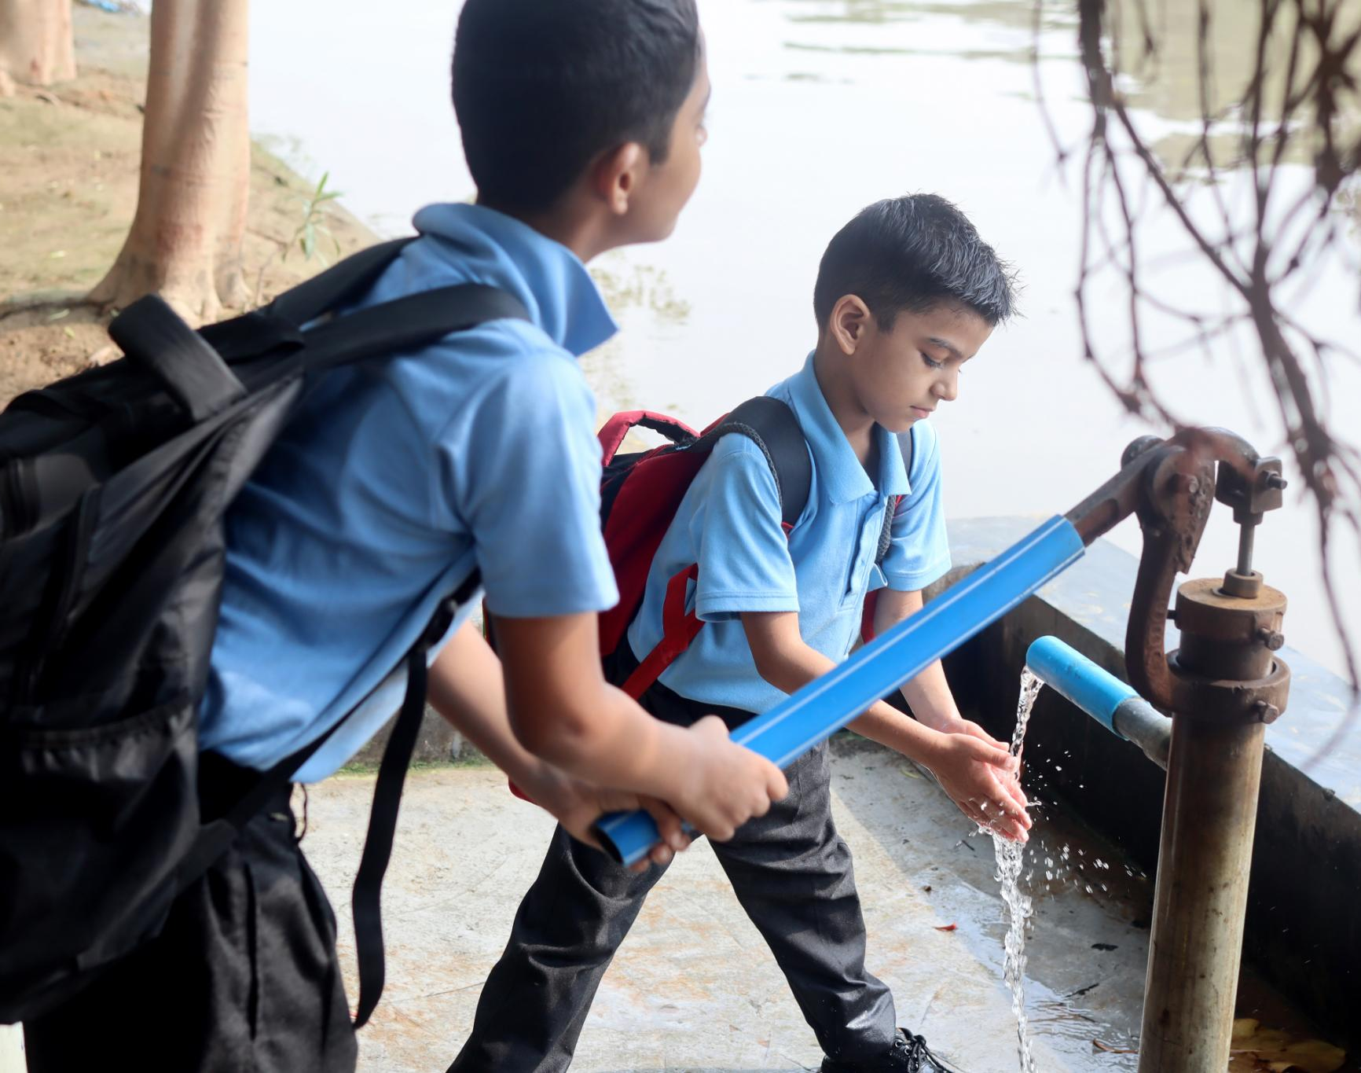
Example Projects
Student-Led Water Research
Students engage in research on local water bodies to enhance understanding of aquatic environments and ecosystems.
Plastic Reduction Campaigns
Awareness campaigns help reduce plastic usage and promote sustainable environmental practices among communities.
International Collaboration
Cross-cultural exchanges through eTwinning foster global citizenship and cooperative learning among students.
Skills Development
Hands-on activities develop critical thinking and problem-solving skills supporting sustainability goals.
Notes:
--- This slide references information from the following file: https://atlantic-maritime-strategy.ec.europa.eu/en/funding/calls/2nd-call-blue-challengesblue-schools-bluelights Example projects under the BlueLightS initiative include student-led research on local water bodies, awareness campaigns to reduce plastic usage, and international collaborations through eTwinning. These projects not only enhance students' understanding of aquatic environments but also foster a sense of environmental responsibility and global citizenship. By engaging in hands-on activities and cross-cultural exchanges, students develop critical thinking and problem-solving skills while contributing to the sustainability goals of their communities and the broader EU Mission.

Slide 8

Funding and Timeline
Grant Amounts by Country
Grants range from €3,000 to €9,000 depending on the country and membership status in Horizon Europe.
Application Deadline
Applications must be submitted by 25 September 2025 at 17:00 CEST to be considered for funding.
Project Timeline
Funded projects run from January to May 2026, aligned with the academic year for maximal engagement.
Notification Date
Successful applicants will be notified by 1 December 2025 to prepare for project start.
Notes:
--- This slide references information from the following file: https://eu-prod.asyncgw.teams.microsoft.com/v1/objects/0-weu-d5-d01d40382b354b4591918dc04ec7aa2f/views/original/BlueLightS_Funding_Call_Presentation.pptx,https://atlantic-maritime-strategy.ec.europa.eu/en/funding/calls/2nd-call-blue-challengesblue-schools-bluelights The maximum grant available per school project under the BlueLightS funding call is €3,000 for Horizon Europe associated countries and €6,000 for EU Member States. Certain countries, such as Croatia, Romania, France, and Sweden, may receive up to €9,000. The application deadline is 25 September 2025 at 17:00 CEST. Successful applicants will be notified by 1 December 2025, and funded projects are expected to run from January to May 2026. This timeline allows schools to plan and implement their projects during the academic year, ensuring maximum engagement and impact.

Slide 9
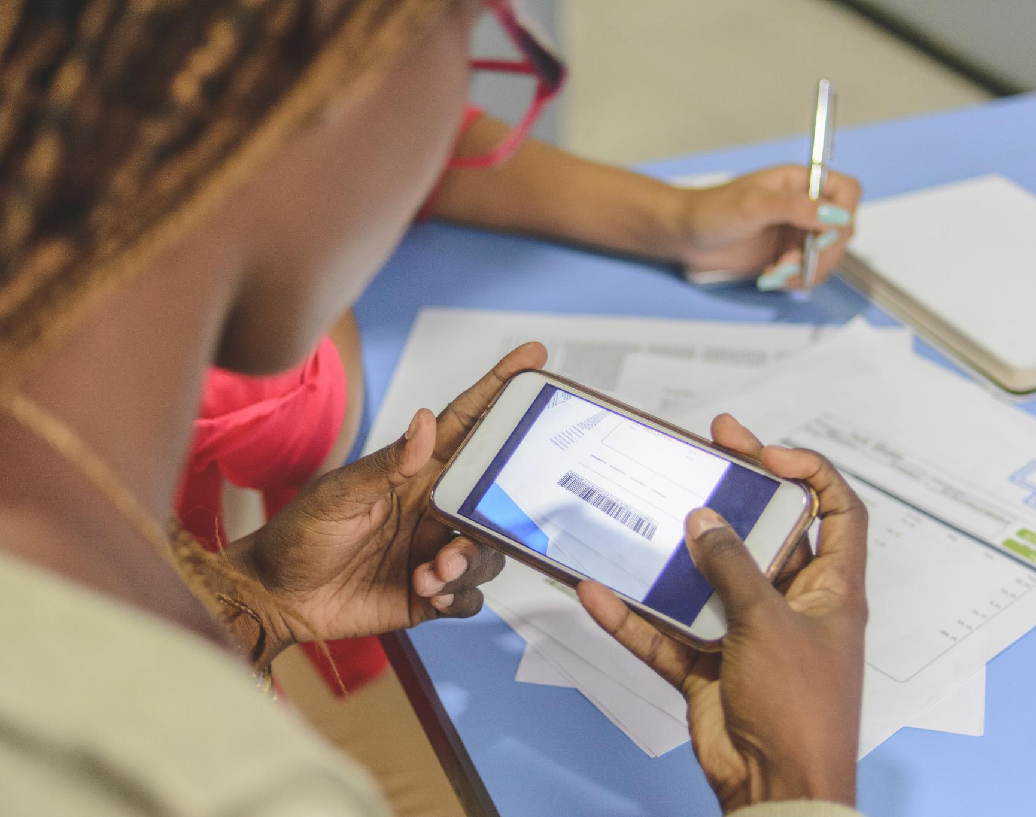
Application Process
Electronic Submission
Applications must be submitted electronically using the official BlueLightS website form.
Eligible Applicants
Applications should be completed by school staff such as teachers, principals, or project managers.
Application Requirements
Applications must outline project objectives, thematic focus, and expected outcomes clearly.
Network Commitment
Schools should show commitment to joining the Blue Schools Network and promoting sustainability education.
Notes:
--- This slide references information from the following file: https://eu-prod.asyncgw.teams.microsoft.com/v1/objects/0-weu-d5-d01d40382b354b4591918dc04ec7aa2f/views/original/BlueLightS_Funding_Call_Presentation.pptx,https://atlantic-maritime-strategy.ec.europa.eu/en/funding/calls/2nd-call-blue-challengesblue-schools-bluelights Applications for the BlueLightS funding call must be submitted electronically via the official application form on the BlueLightS website. The application should be completed by a school employee, such as a teacher, principal, or project manager. Schools can apply individually or as part of a consortium with other eligible schools from the same country. It is important that the application clearly outlines the project's objectives, thematic focus, and expected outcomes. Schools should also demonstrate their commitment to joining the Network of European Blue Schools and engaging students in meaningful sustainability education.

