Slide 1
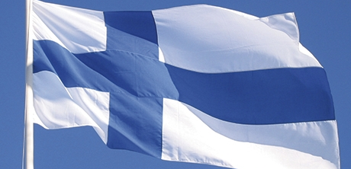
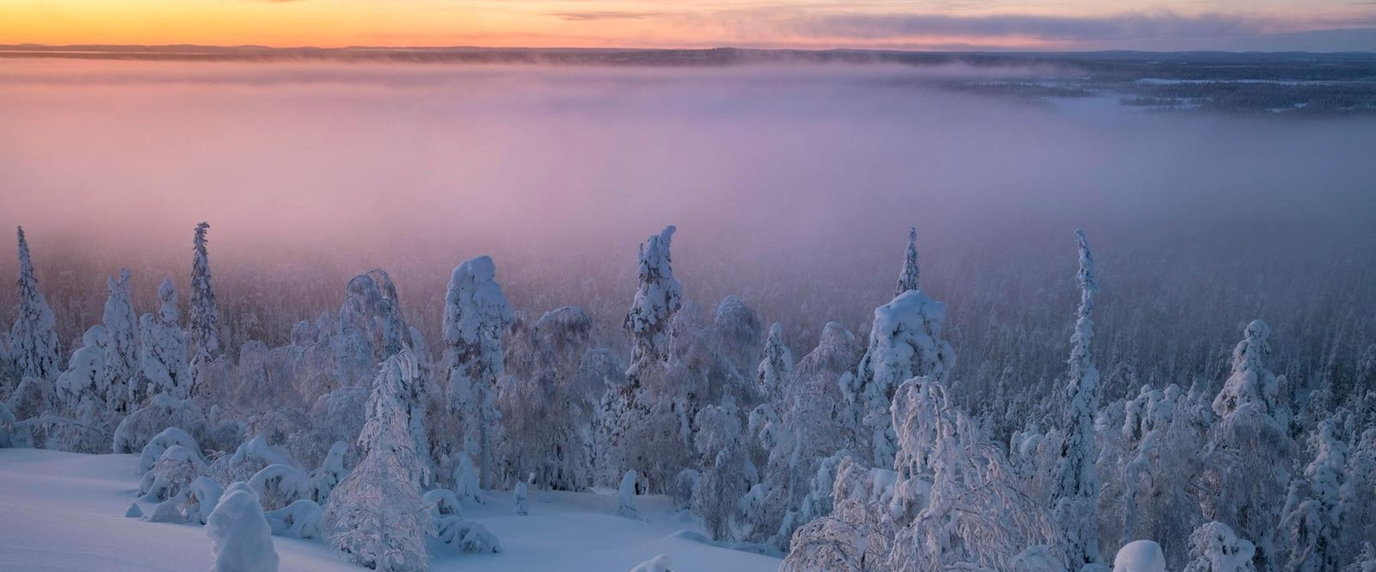
FINLAND
Suomi

Slide 2
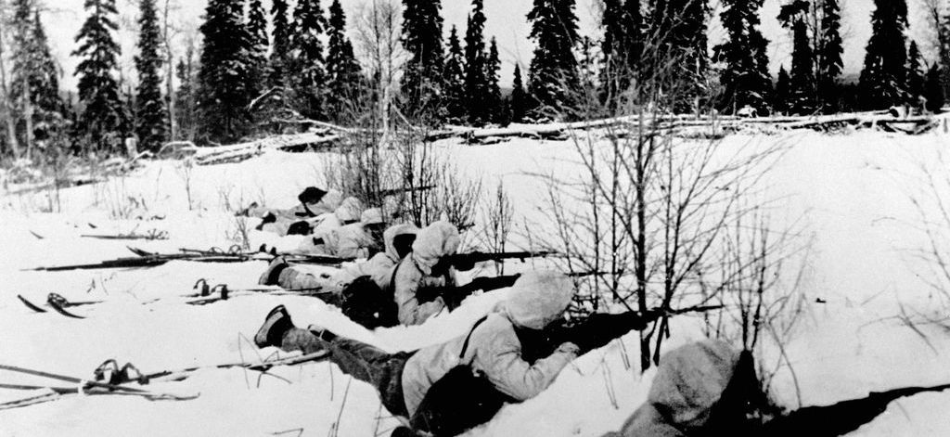
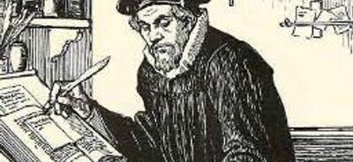
HISTORY
Finnish snipers during the Winter War
Finland declared independence on the 6th of December 1917.
Before its indepence, Finland was part of the kingdom of Sweden and, after Finland's land was conquered by it, Russia.
The first book written in the Finnish language was the ABC Book by Mikael Agricola, the founder of the Finnish language.
Mikael Agricola translating the Bible to Finnish

Slide 3
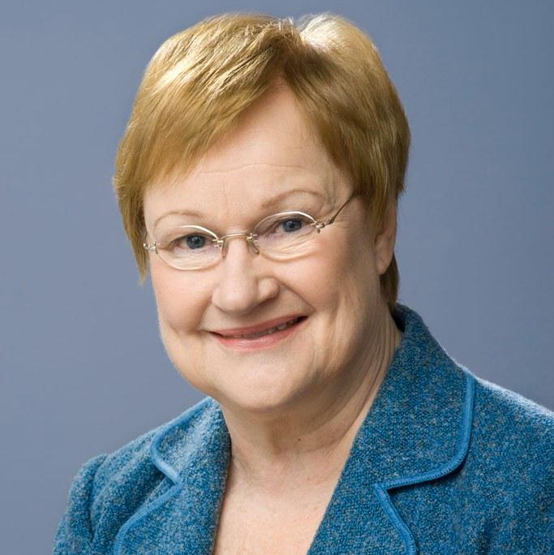
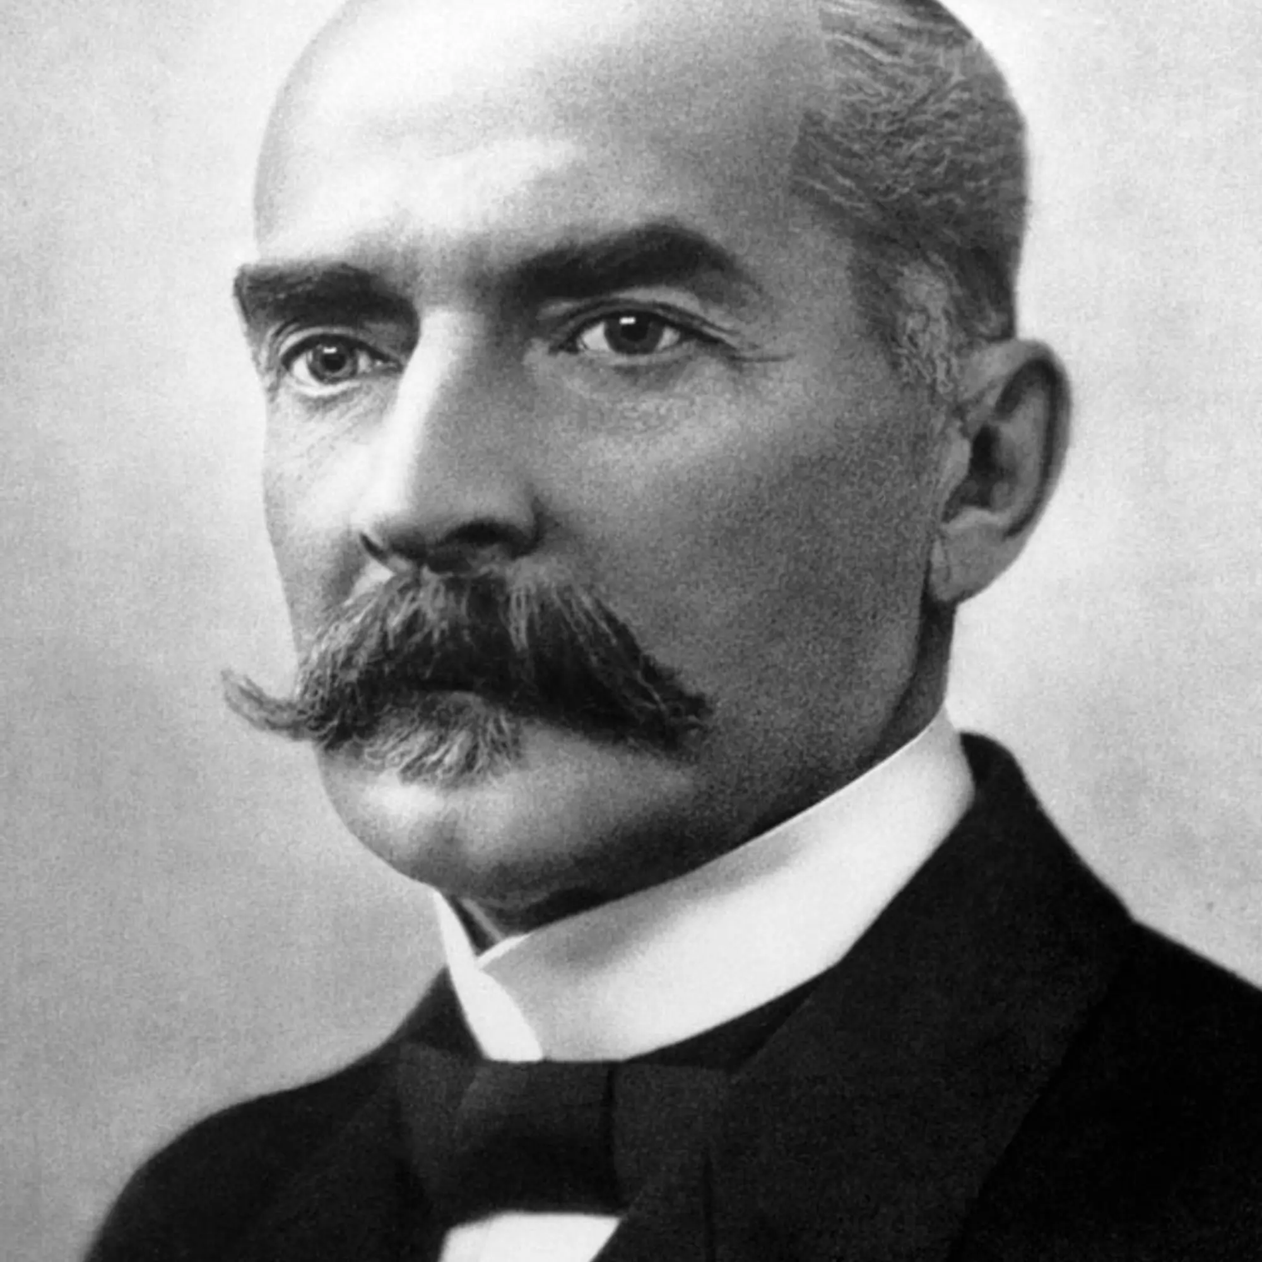
HISTORICAL FIGURES
Alexander I of Russia
The Russian Tsar who conquered Finland in 1809
Kaarlo Juho Ståhlberg
Finland's first president
Carl Gustaf Emil Mannerheim
Commander of the victorious side during the Finnish Civil War of 1918
Tarja Kaarina Halonen
Finland's first female president
Tarja Kaarina Halonen
Kaarlo Juho Ståhlberg

Slide 4
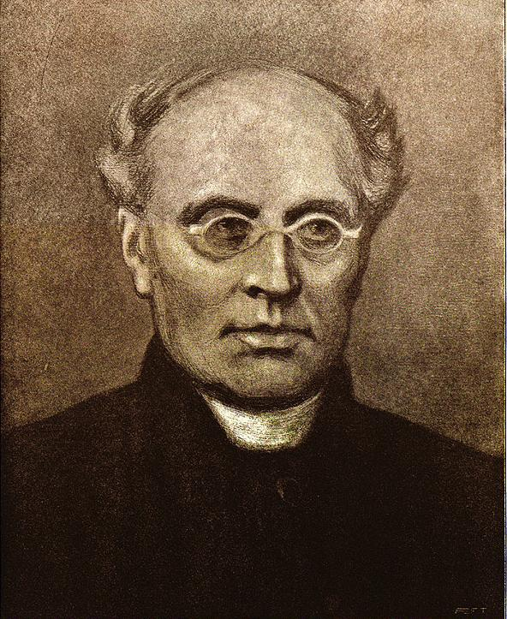
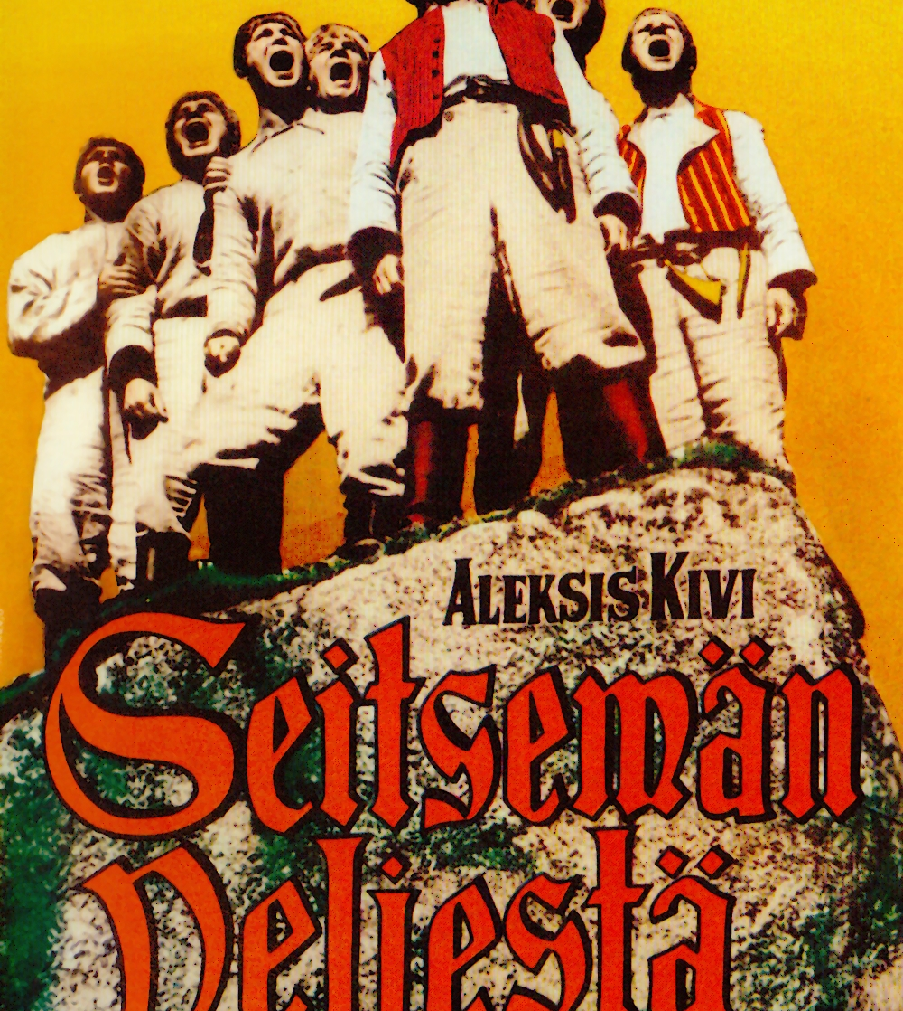
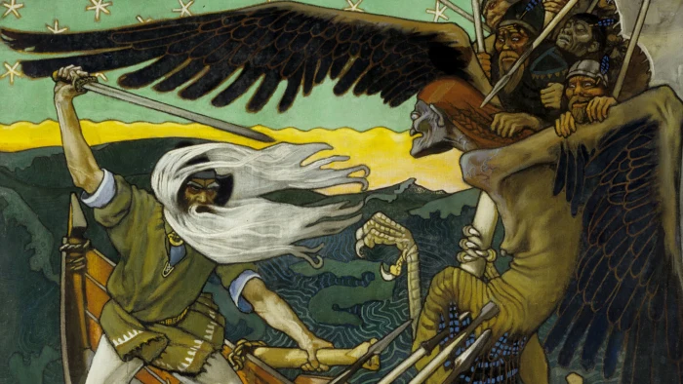
LITERATURE
Aleksis Kivi
Seven Brothers, 1870
Johan Ludvig Runeberg
Our Land, Finnish national anthem, 1848
The Tales of Ensign Stål, 1848
Elias Lönnrot
Kalevala, 1835, a collection of old folk stories that can be sang in its entirety. It is also the Finnish national epic
Portrait of Johan Ludvig Runeberg
Seven Brothers movie adaptation poster
Iconic art piece from Kalevala

Slide 5
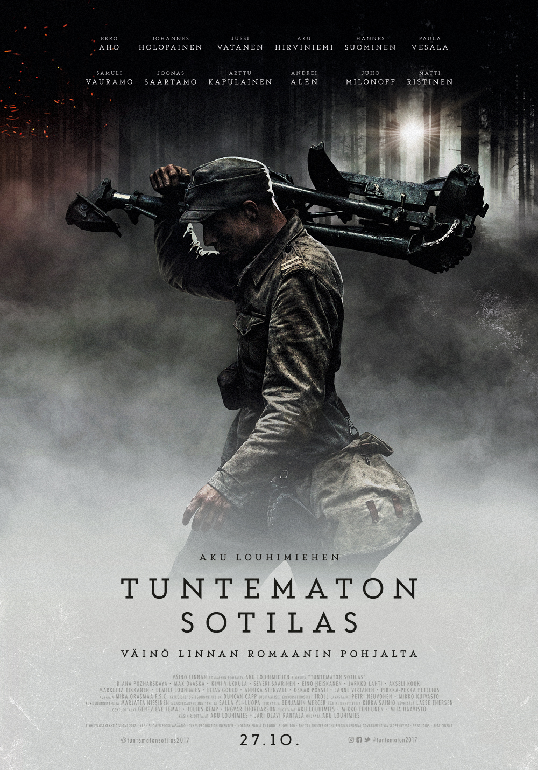
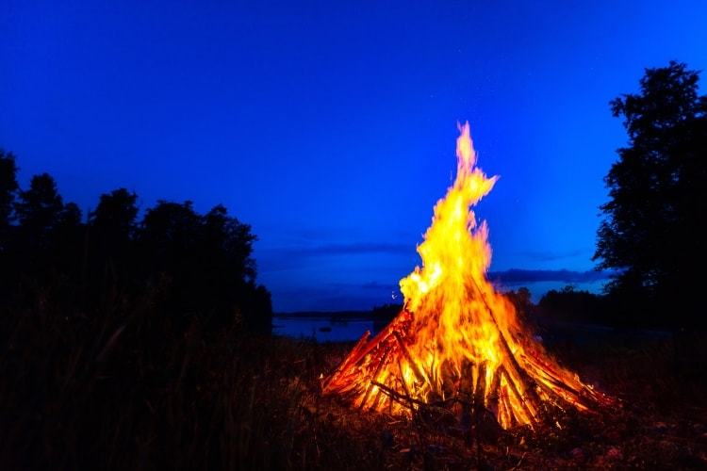
TRADITIONS
Mid Summer
Often spent at a summer cottage
Sauna and swimming
A (excessively) large fire pit is lit
Independence Day
All lights are turned off with the exception of two candles, which are lit on a window sill
Families get together to watch The Unknown Soldier, a Finnish war film depicting a group of Finnish soldiers in 1941 in the Continuation War against the Soviet Union
The Unknown Soldier 2017 movie adaptation
Mid Summer fire pit at night

Slide 6
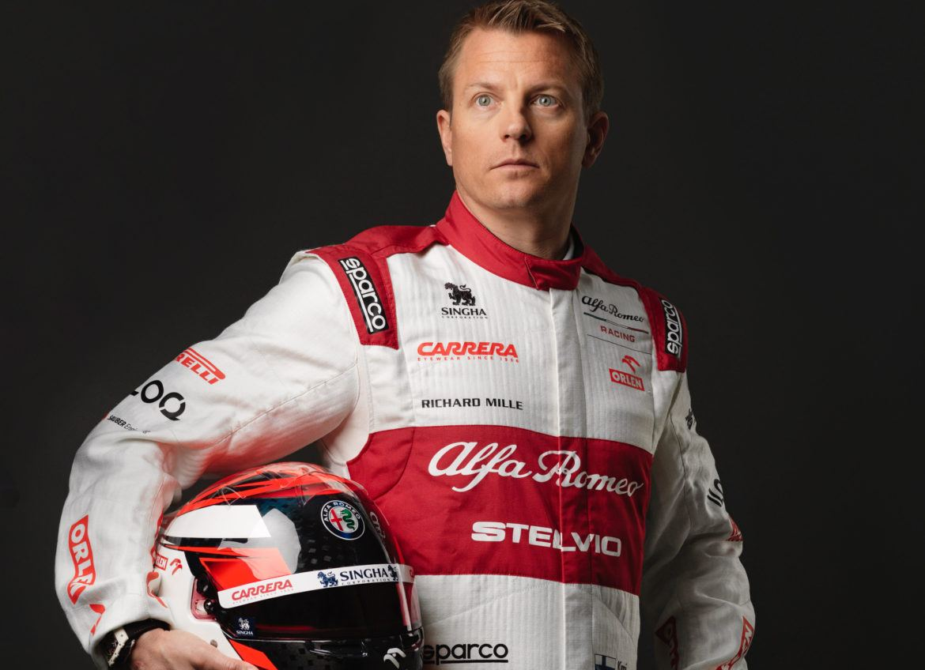
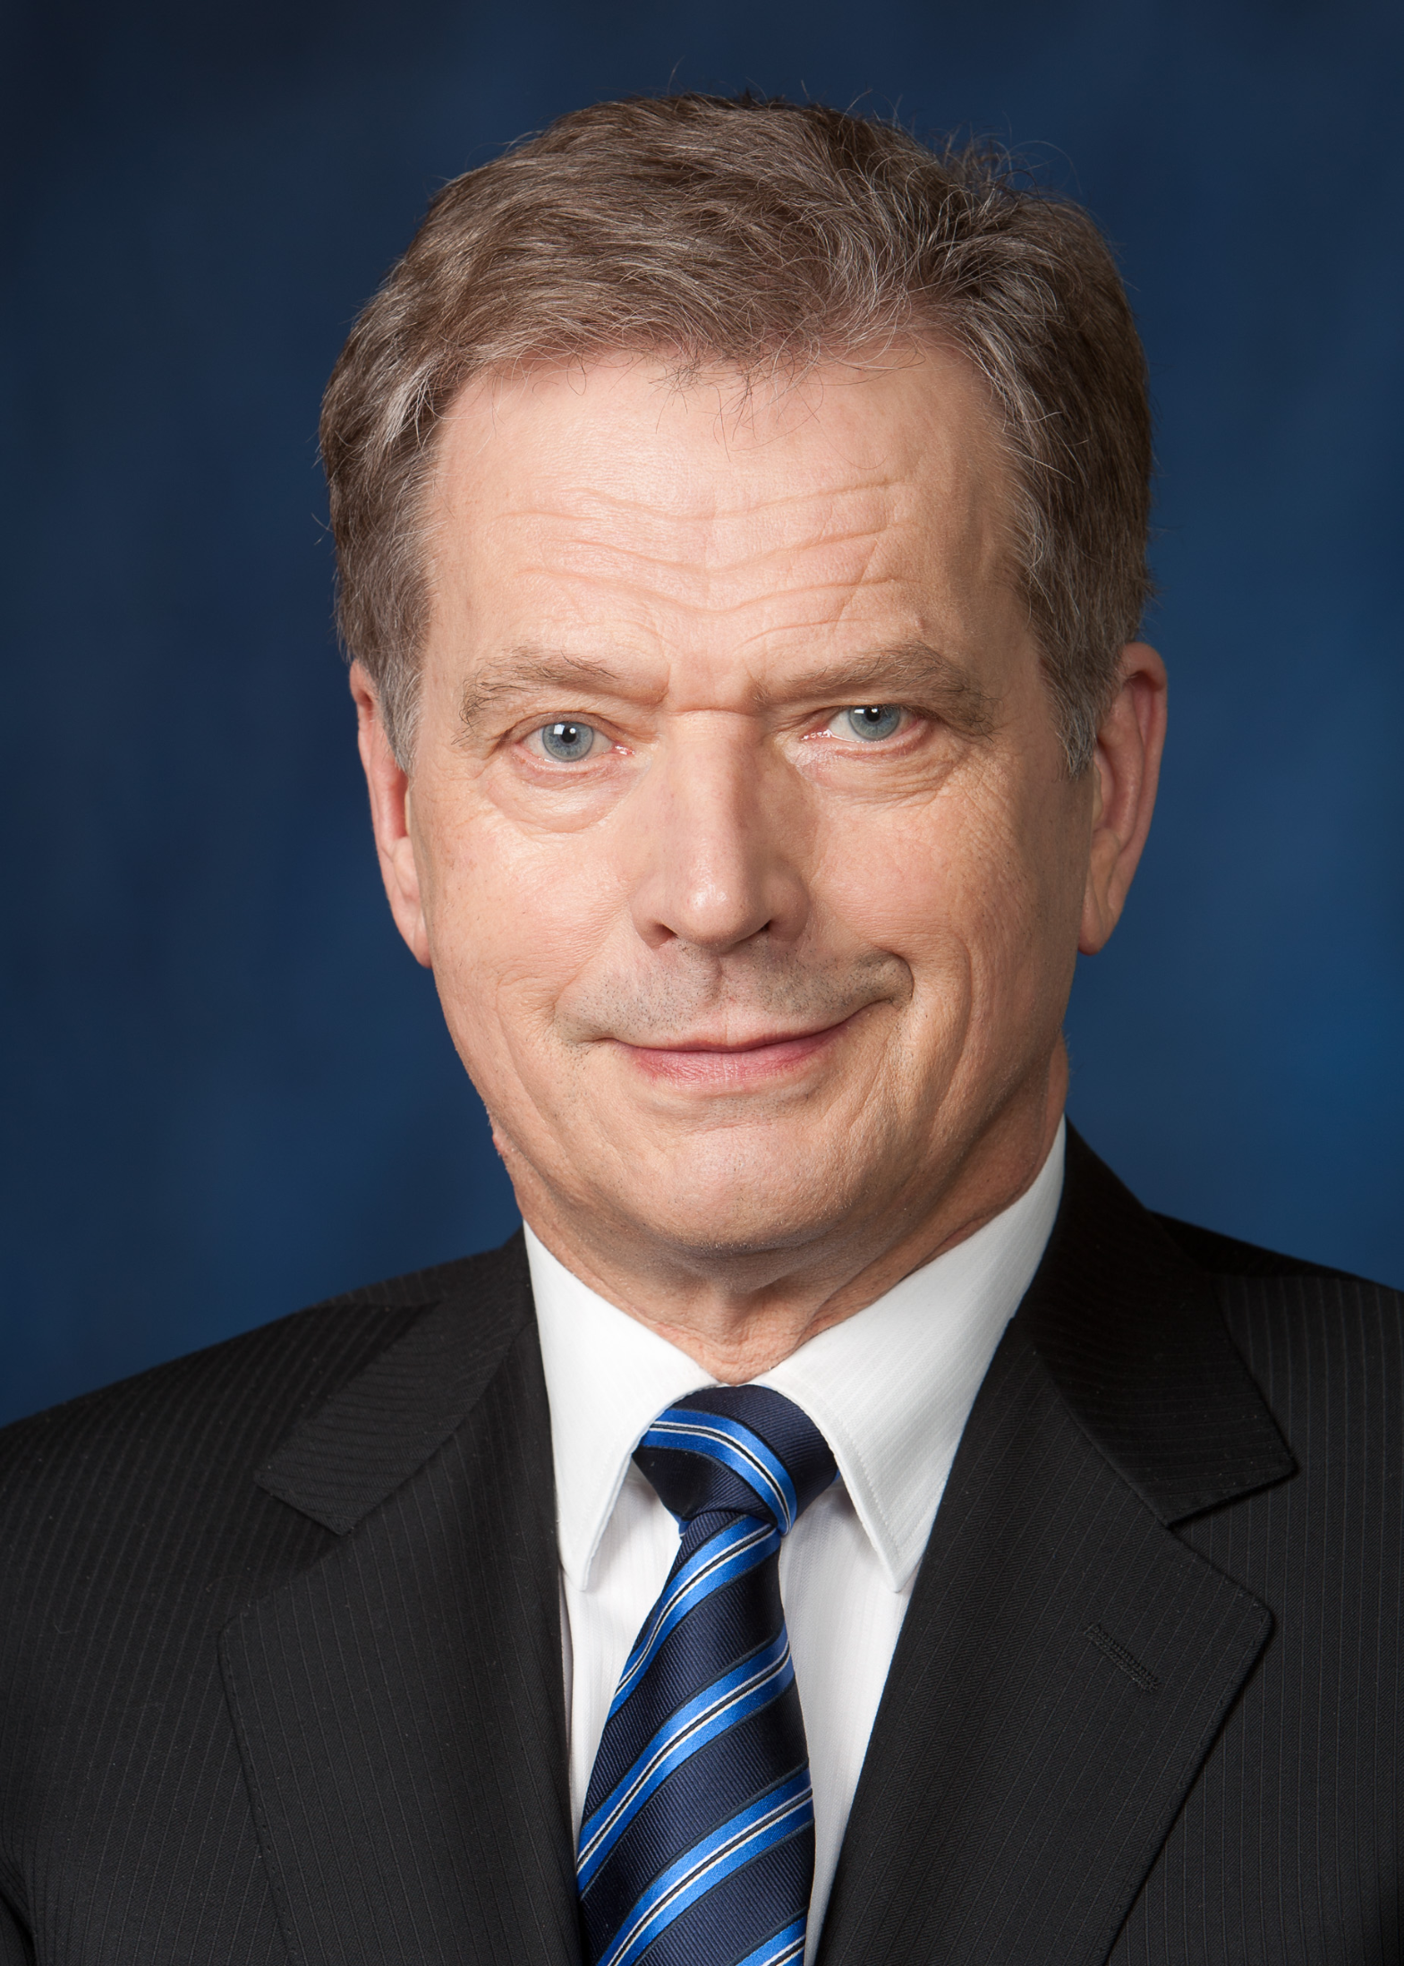
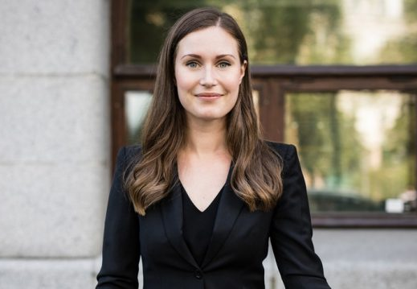
MODERN NOTABLE FIGURES
Kimi Räikkönen
Kimi Räikkönen AKA "The Iceman"
Finnish Formula One driver
Ilkka Paananen
CEO of Finnish video game company, Supercell
Antti Tuisku
Finnish pop singer
Sauli Niinistö
Finland's current president
Sanna Marin
Finland's current prime minister
Sauli Niinistö
Sanna Marin

