Slide 1
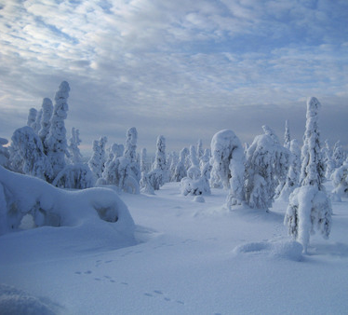
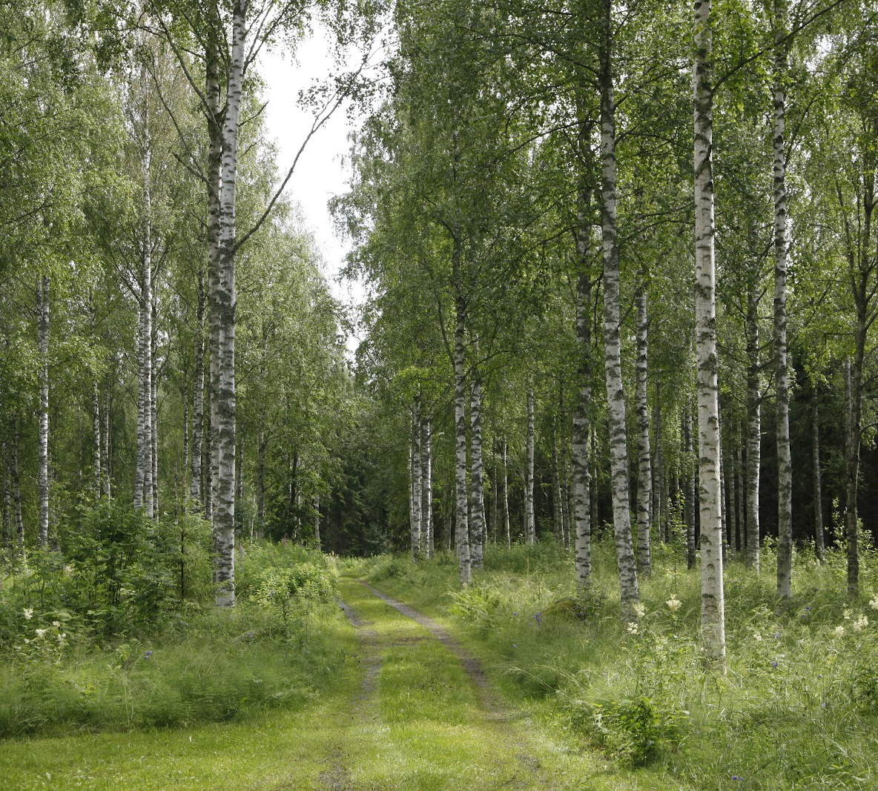
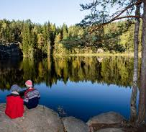
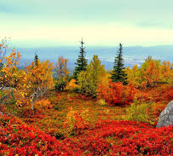
FINNISH NATURE
We have four seasons.
Winter begins in Finland in November and ends in March.
Spring begins in Finland in March or April.
Our summer months are June and July.
Autumn begins in August.

Slide 2
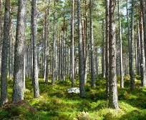
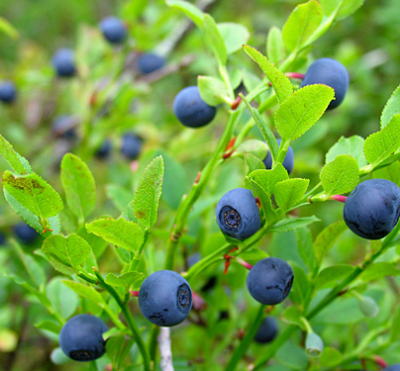
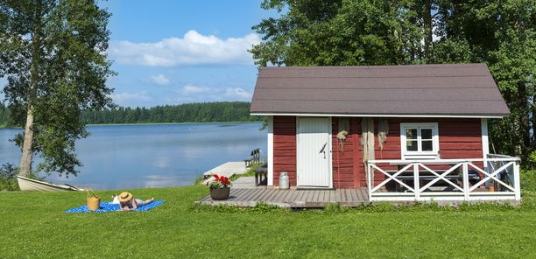
NATURE IS IMPORTANT
Finnish people love nature.
We have our summer cottages in the countryside by a lake.
The Finns relax by going for walks in the forest and picking the berries ans swamps.
In the winter we go skiing on our frozen lakes.
Staying in the nature is good for the wellbeing.

Slide 3
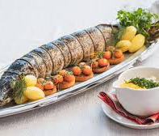
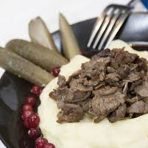
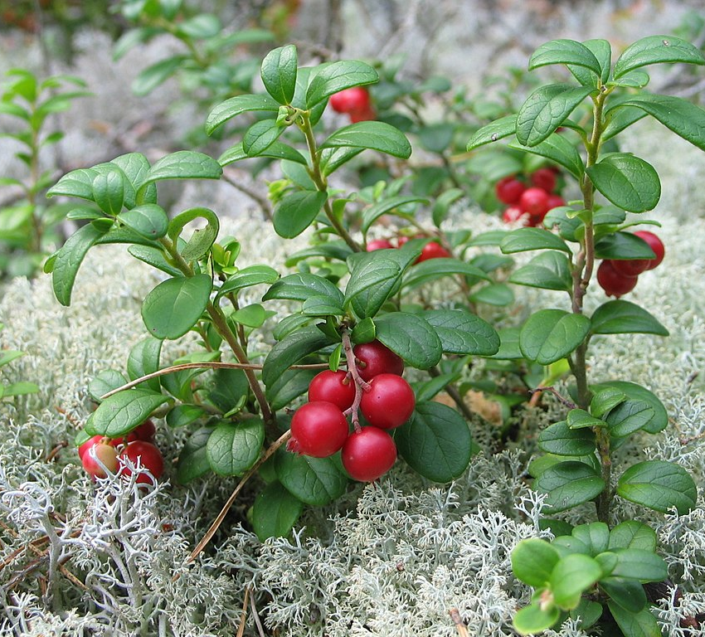
FINNISH FOOD
Food that we get from the Finnish nature:
Berries and swamps
fish
reindeer meat
moose and deer meat

