Slide 1
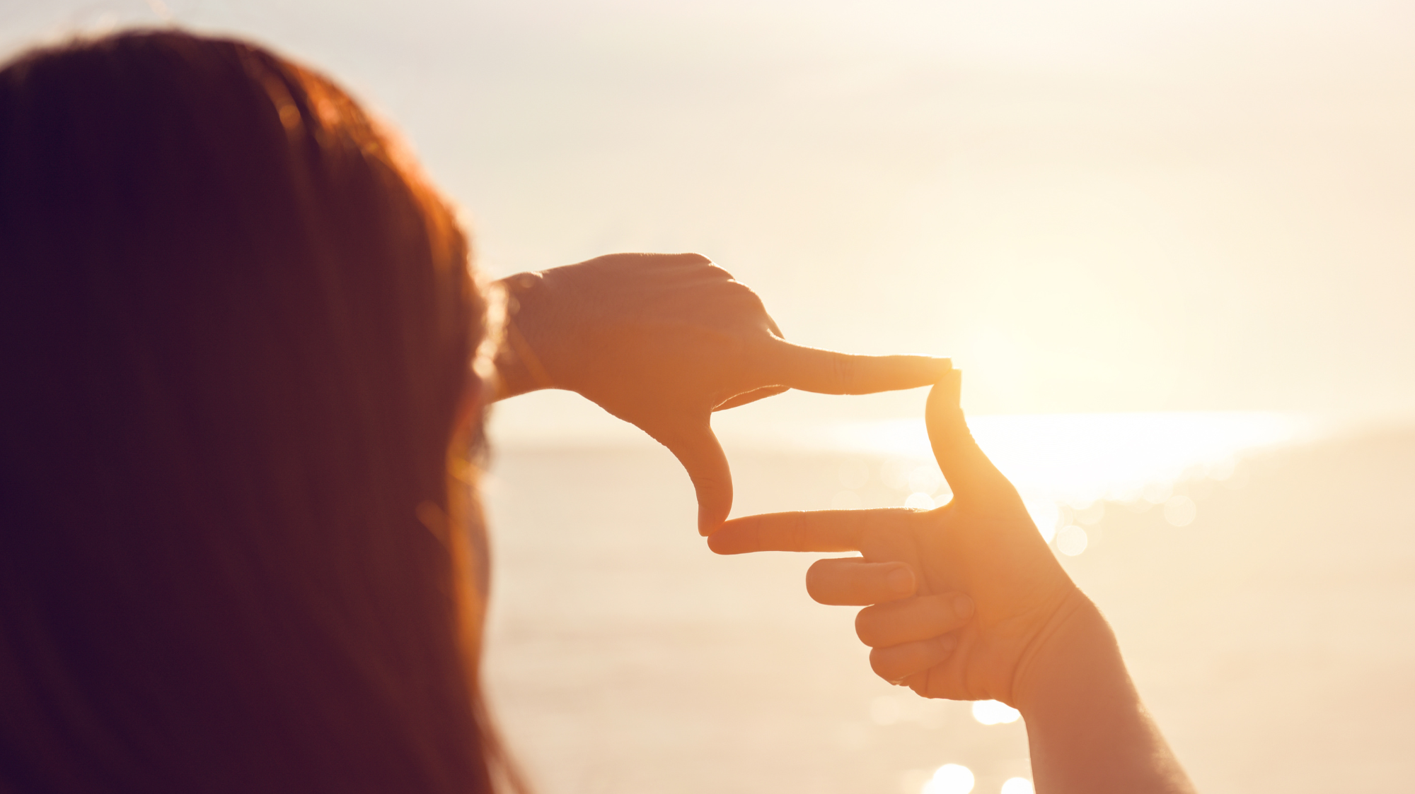
The world in 2050
22.11.2023 Jenni Decandia

Slide 3
Now and in the future

Slide 4
Now and in the future
Think about three things that are important to you and that you hope will remain in your life in the future.

Slide 5
Now and in the future
What three things would you like to change in your own life?

Slide 6
Now and in the future
What three things would you like to change in the world?

Slide 7
Statements – What do you think?

Slide 8
Statement 1
Humanity has the ability and desire to solve global problems.

Slide 9
Statement 2
Education can influence the future.

Slide 10
Statement 3
Everyone's actions and choices matter.

Slide 11
Statement 4
It is possible to achieve the Agenda 2030 goals.

Slide 12
Statement 5
The future is open and therefore it can be influenced by today's actions and choices.

