Slide 1

Good Digital Practices on Facilitating Collaborative and Self-Directed Learning
21.11.2023 Jenni Decandia

Slide 2
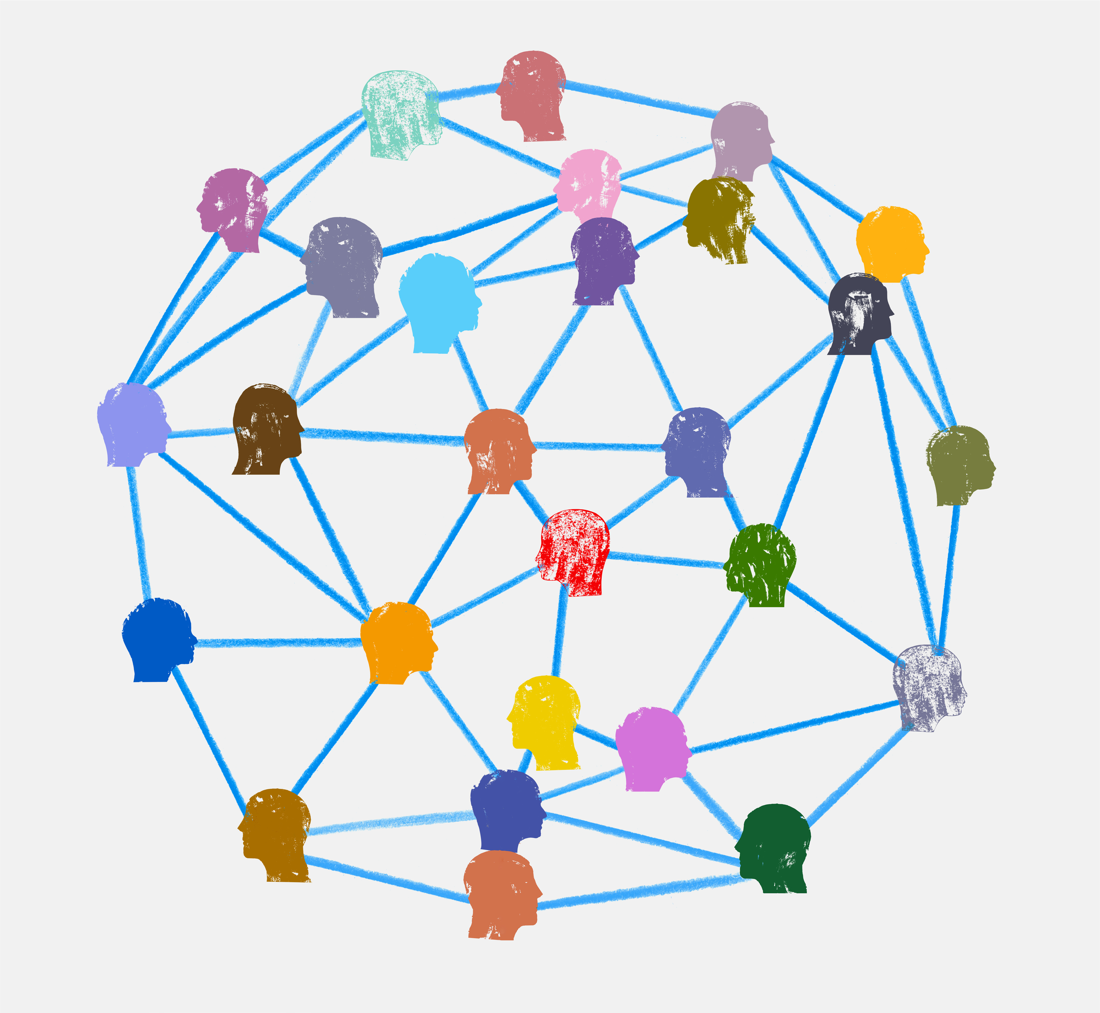
Online learning environments
effective online learning environments should foster collaboration and self-directed learning among students.
By implementing appropriate digital practices, educators can create engaging and supportive learning experiences that promote student engagement, knowledge acquisition, and skill development.

Slide 3

Collaborative learning
Collaborative learning cultivates
  Teamwork
  Communication
  problem-solving skills

Slide 4

Self-directed learning
self-directed learning fosters:
Independence
self-motivation
metacognitive abilities.
Both approaches are valuable in promoting deeper learning and preparing students for future success!

Slide 5
Creating a Supportive Digital Learning Environment
Establish clear expectations and guidelines for online interactions and collaboration.
Provide ongoing support and feedback to students as they navigate the digital learning environment.
Encourage students to engage with each other and share their knowledge and expertise.
Use digital tools to promote inclusivity and accessibility for all learners.

Slide 6
Integrating Digital Practices into Teaching and Learning
Align
Align digital practices with specific learning objectives and pedagogical approaches.
Scaffold and support
Scaffold and support students as they transition to digital learning environments.
Provide
Provide opportunities for hands-on exploration and experimentation with digital tools.
Encourage
Encourage reflection and feedback on the effectiveness of digital practices.

Slide 7

Thank you!

