Slide 1
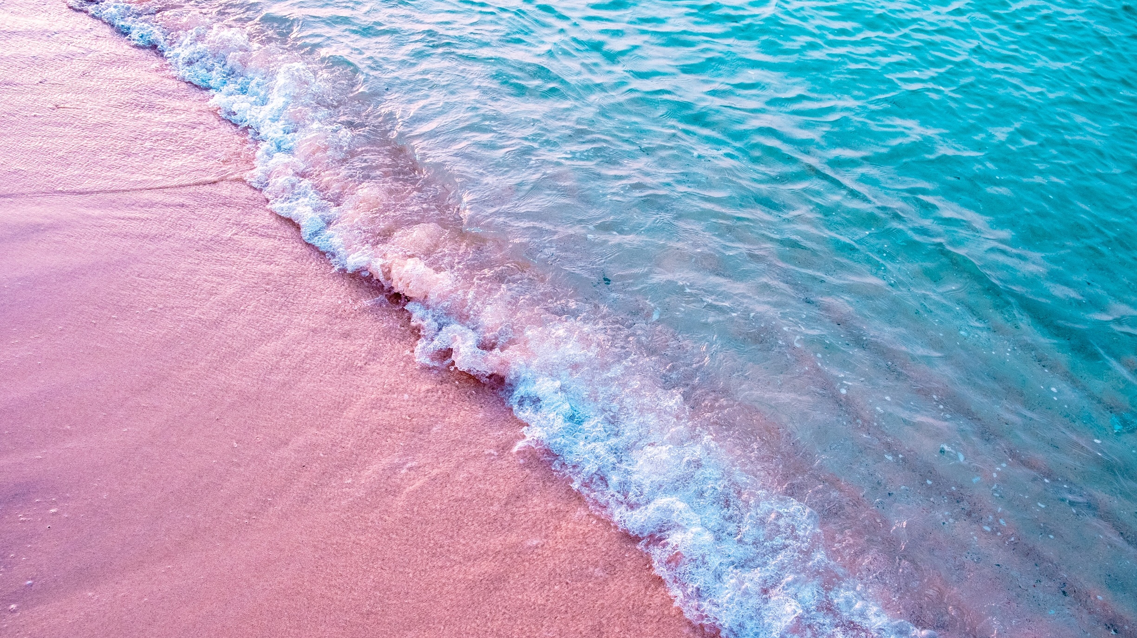
Blue Schools
20.11.2023 Jenni Decandia

Slide 2
Learning objectives
WHAT IS THE NETWORK OF EUROPEAN BLUE SCHOOLS?
WHY BECOME A EUROPEAN BLUE SCHOOL?
HOW TO DEVELOP A BLUE SCHOOL PROJECT?
BLUE SCHOOL ACTIVITIES

Slide 3
Blue Schools
How are we connected to the ocean?

Slide 4
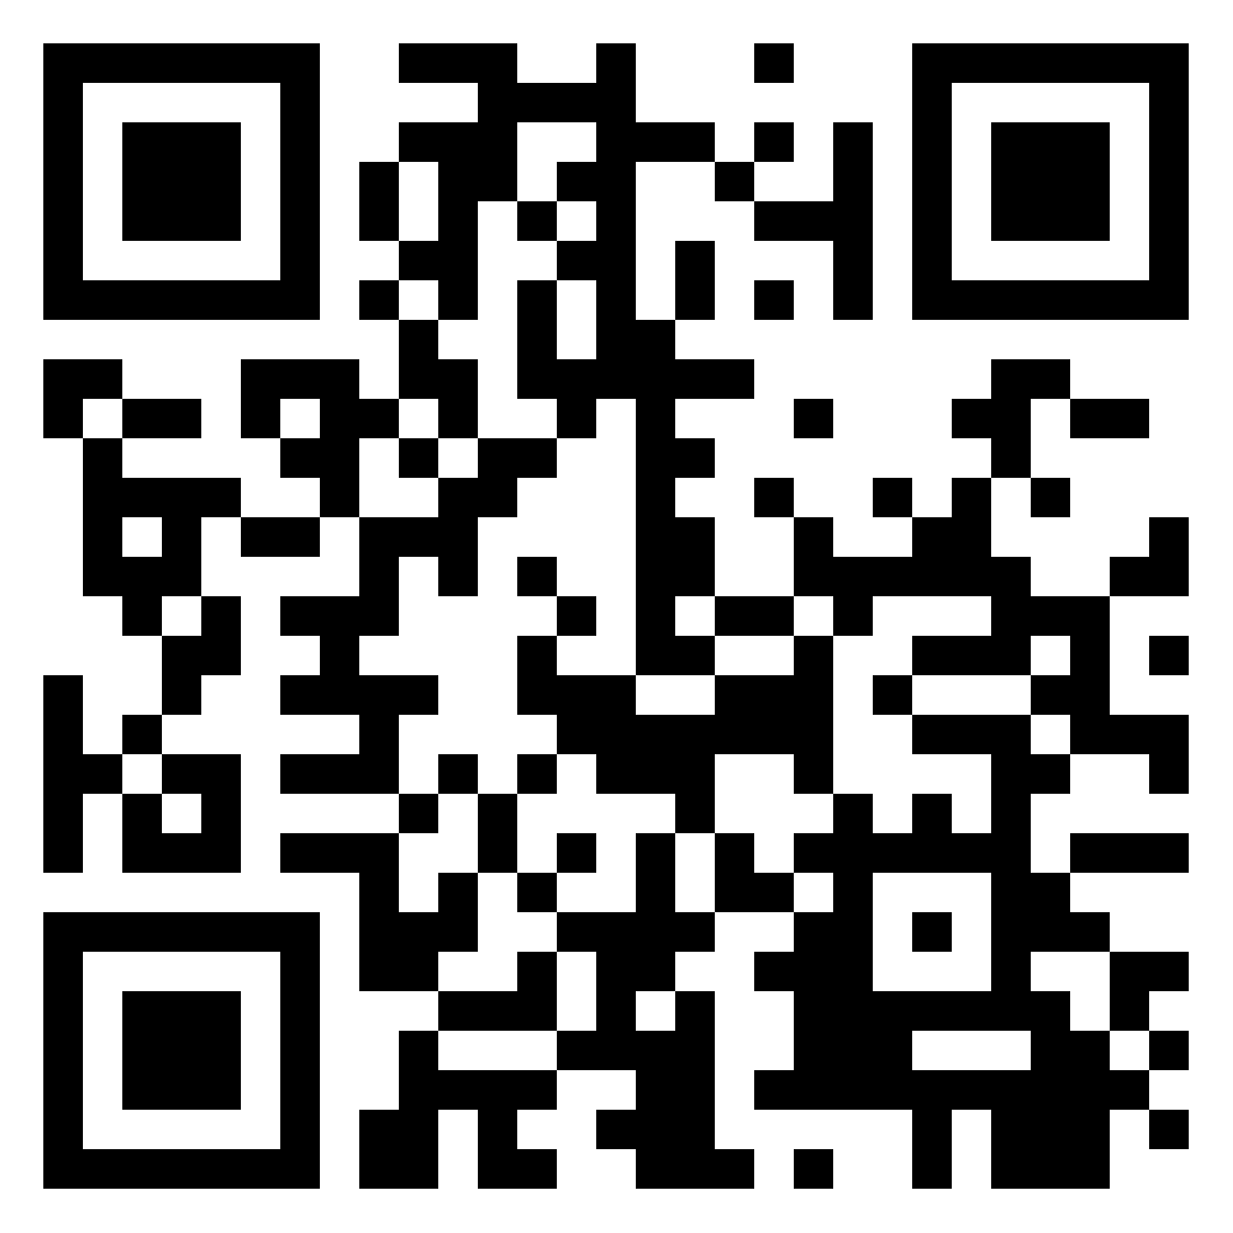
Blue Schools
How are we connected to the ocean?

Slide 5
How are we connected to the ocean?
All people on Earth are directly or indirectly connected to the ocean in a variety of ways:
We are connected to the ocean through what we eat, breathe and use, where we go on a holiday.
The ocean is our planet's life support system - and it needs our protection.

Slide 6
Blue Schools
WHAT IS THE NETWORK OF EUROPEAN BLUE SCHOOLS?
#EUBlueSchools

Slide 7
WHAT IS THE NETWORK OF EUROPEAN BLUE SCHOOLS?
European Blue Schools bring the ocean into the classroom.
On the journey to becoming a European Blue School, teachers and pupils will improve their understanding of the ocean and develop a sense of responsibility towards our shared planet.
After successfully completing a Blue school project in line with requirements, schools will receive the European Blue School certification.

Slide 8
WHAT IS THE NETWORK OF EUROPEAN BLUE SCHOOLS?
Network of European Blue Schools aims to inspire students, teacher, school director or staff of education services to challenge the students, from kindergarten, primary, lower and upper secondary, technical or vocational schools, to develop a “Find the blue” project that links them to the ocean or the sea.
By successfully completing the project and sharing its results, schools will receive the European Blue School label.

Slide 9
WHY BECOME A EUROPEAN BLUE SCHOOL?
Join the wave and spread the word!
You want to learn more about the activities of the Network of European Blue Schools and its members?
Check out the hashtag #EUBlueSchools

Slide 10
HOW TO DEVELOP A BLUE SCHOOL PROJECT?

