Slide 1
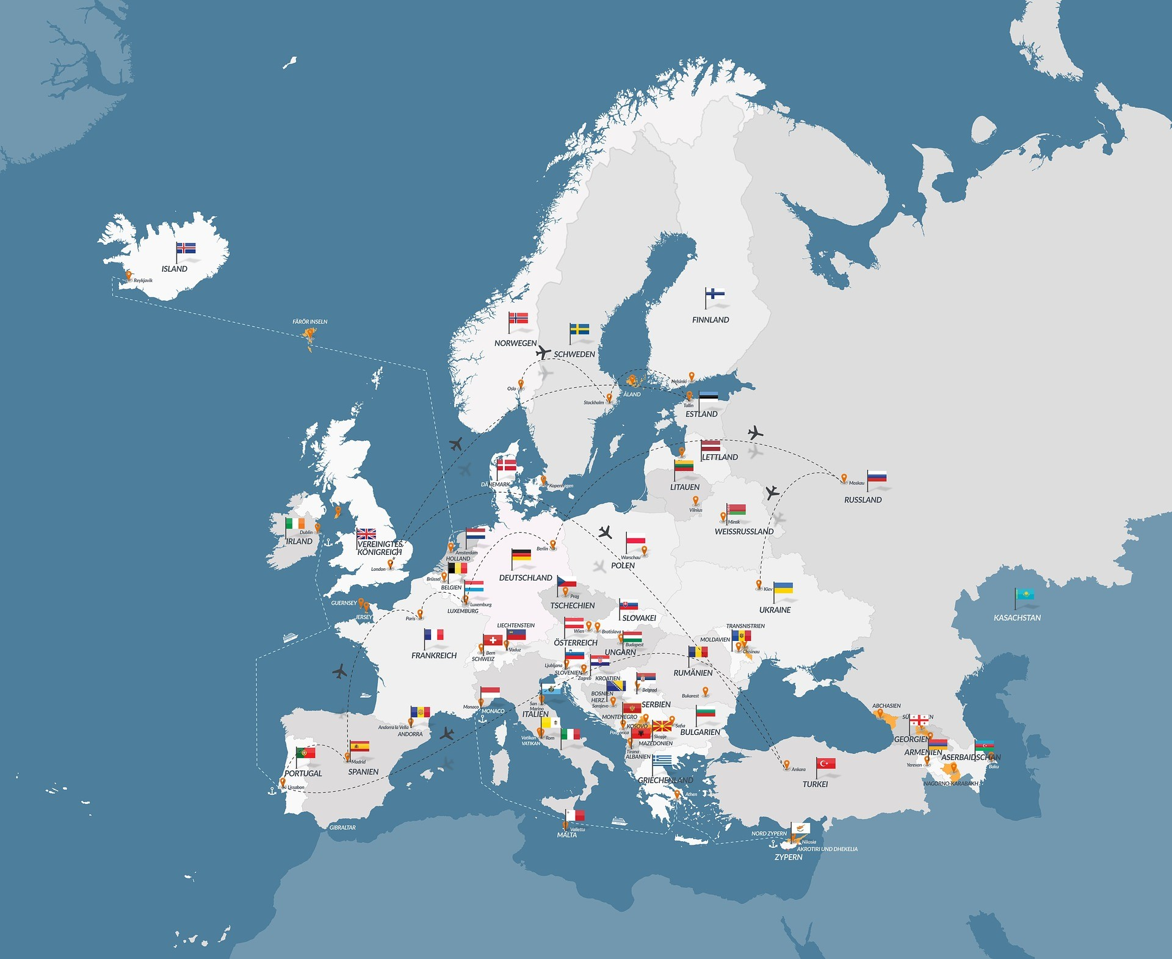
Suomi-Finland
Population: 5,6 million
(18 inhabitats per 1 km2)
-a lot of forests and lakes
-four seasons
-a lot of snow in winter (in Lapland)
-Santa Claus lives in Lapland
-a lot of mosquitoes in summer (in Lapland)
-temperature varies from +30 to -30 Celsius!

Slide 2
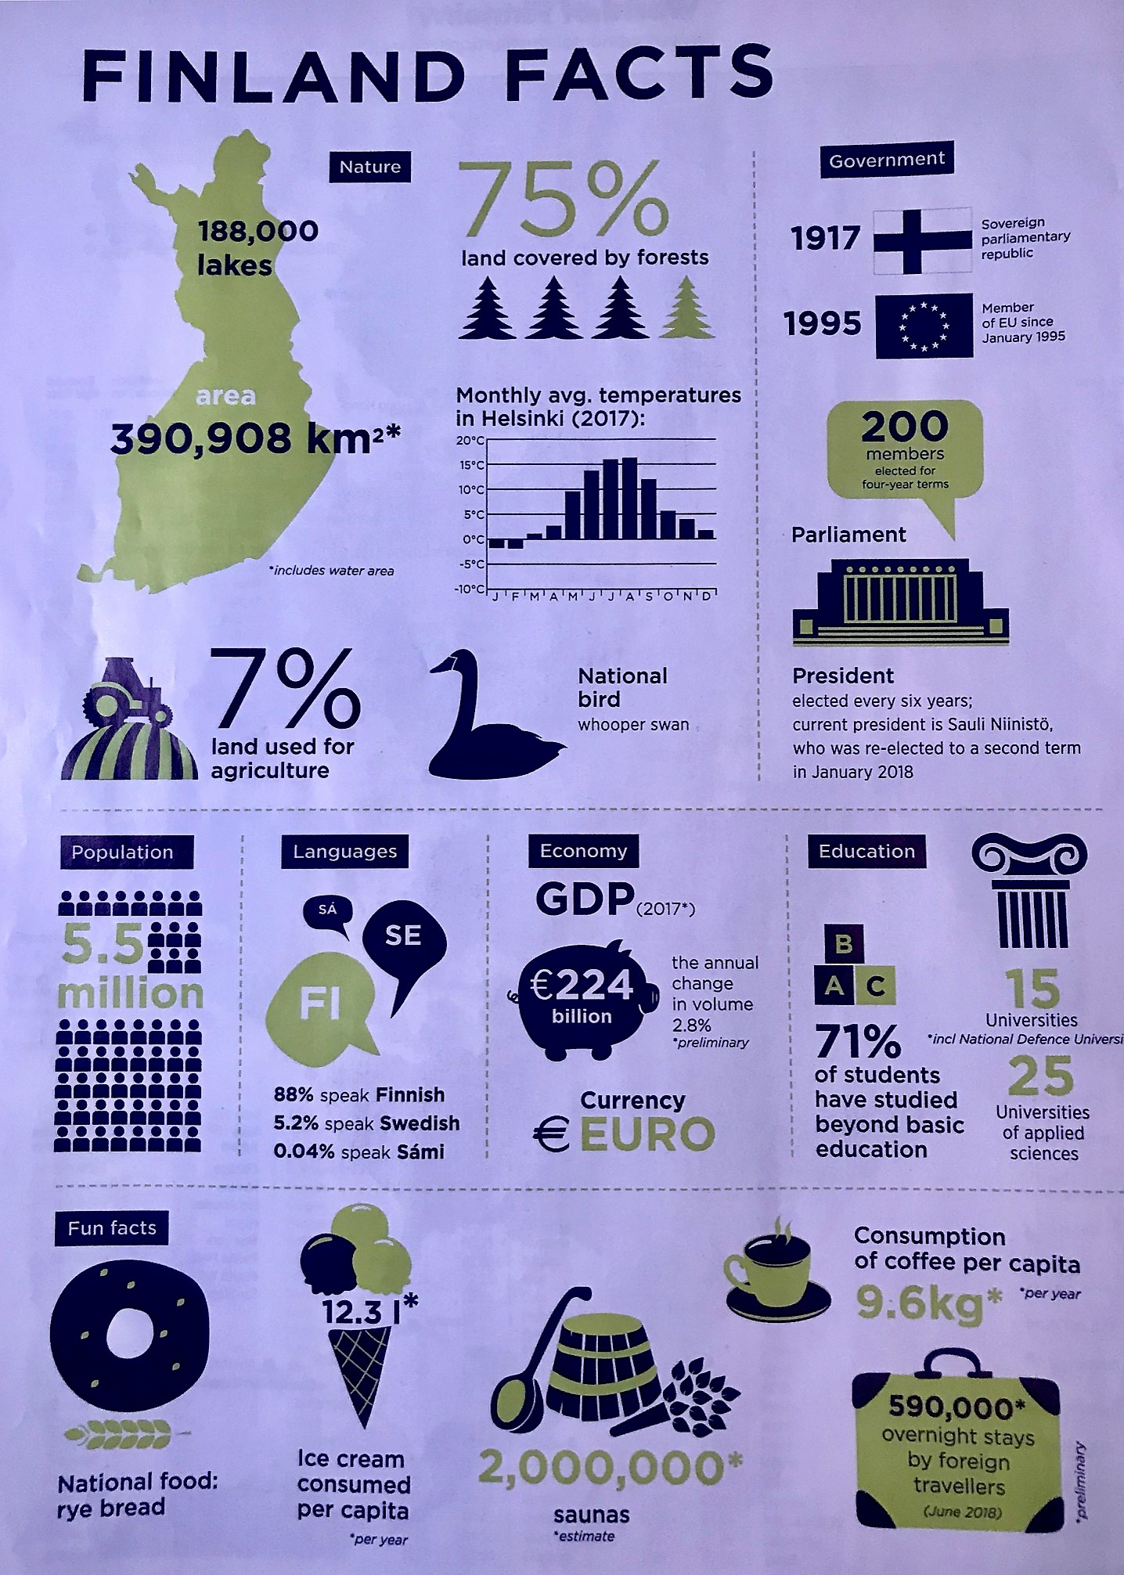
Finland Facts
We are highly educated.
We drink coffee and go to sauna
all day- all night long.
We like ice cream- a lot!

Slide 3
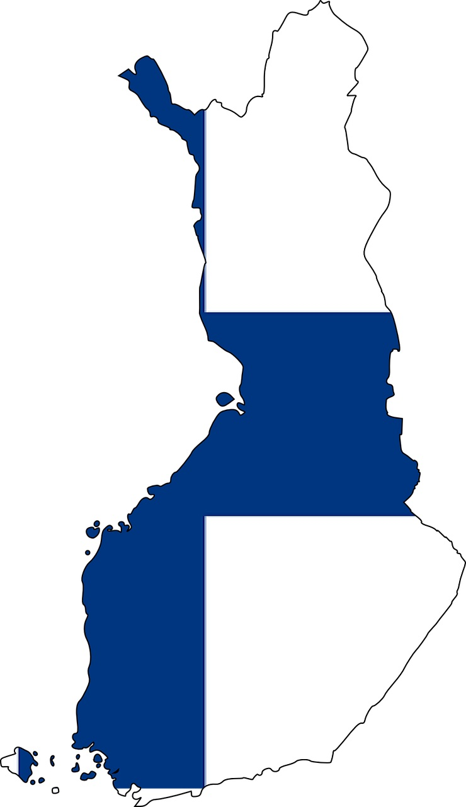
The World´s Happiest Country 2018-2023
World Happiness Report
We are so happy because we are going to live a long and healthy life.
Our GDP (gross domestic product) is high and we have social freedom, people are generous and we do not have corruption.
☺

Slide 4
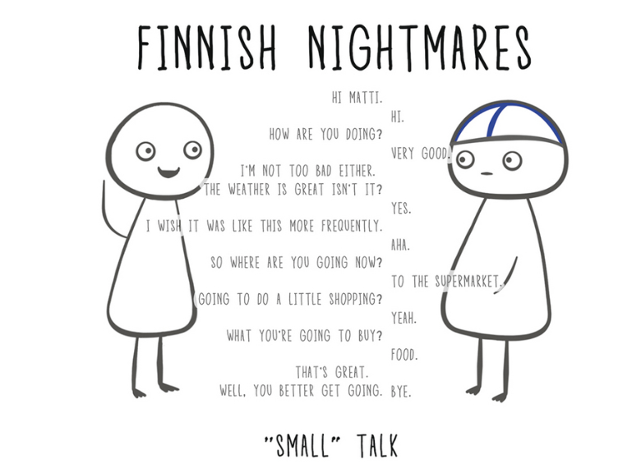
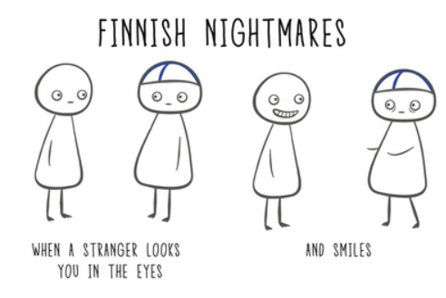
Finnish Nightmares

Slide 5
Orimattila- A Small and Vivid Town in Southern of Finland
16 000 inhabitats, 20 km from Lahti (famous for its winter sport events) and 90 km from Helsinki (the capital of Finland)

Slide 6
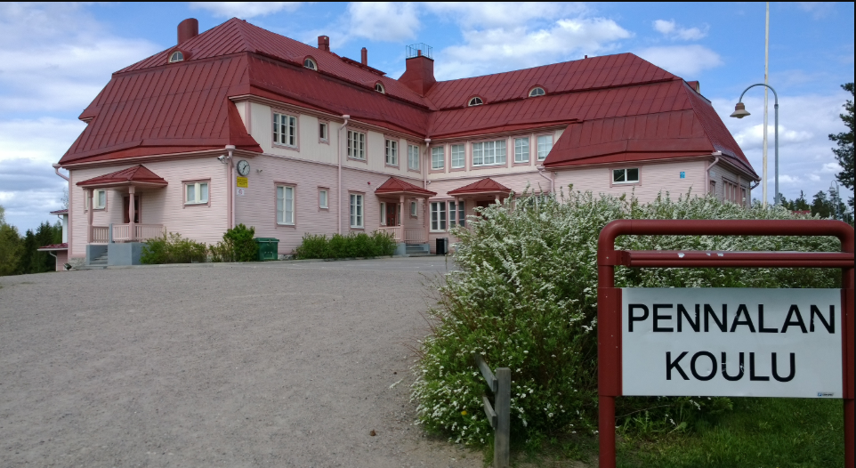
Welcome to Pennala!
”Very nice to see you. Good to have you here.
This is our pink school and it´s very dear.
I am very happy, because you are here.
Hello and Hooray, Hip-Hey please come again.”

Slide 7
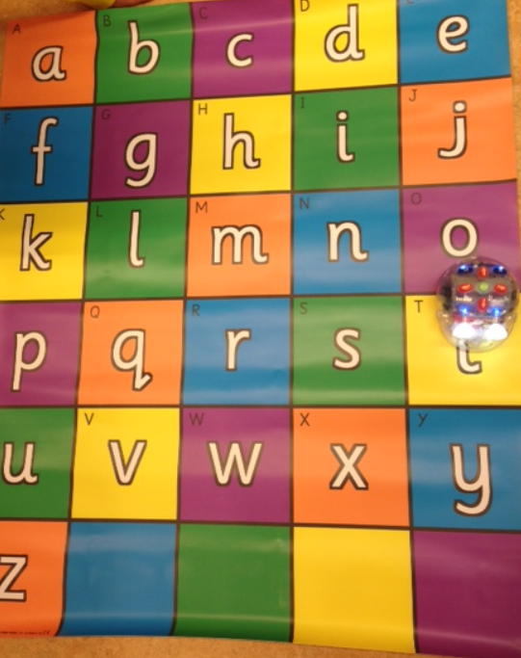
Pennala Primary School
120 pupils- grades 1st to 6th
(age from 7 to 13 years old)
7 Classroom Teachers
1 Special Needs Teachers
3 Special Needs Assistants
1 Headmaster

Slide 8
Pennala´s School
Our school´s values in educational programmes are:
-appreciate your roots, environment and all people
-be a good friend
-think positively about yourself and others
Teachers are interested and talented in many ways: music, robotics, nature and sports.

