Slide 1
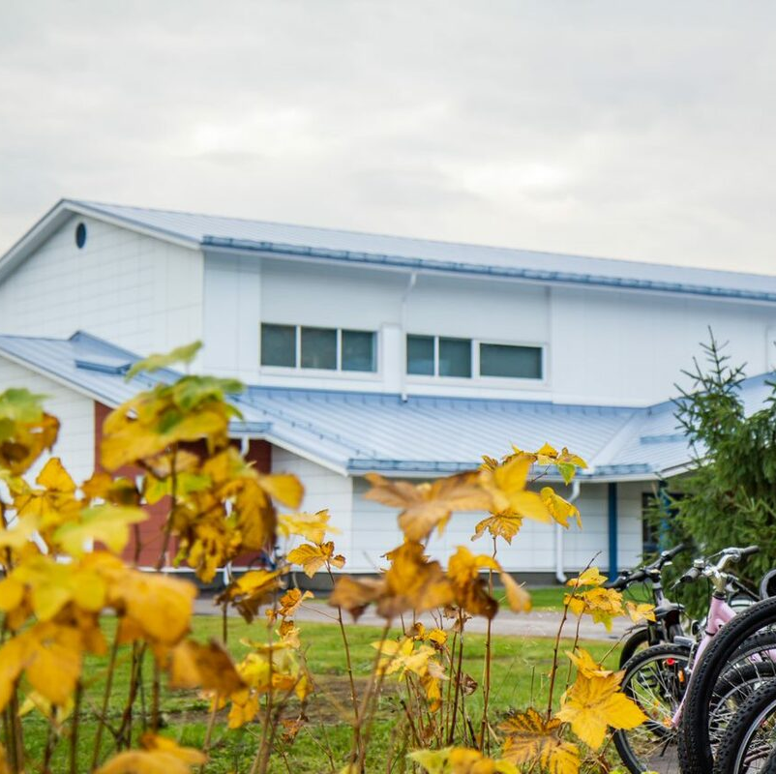
My school – Myllylä School by pupils
Written and photos by
Akseli, Jose, Siiri, Samuel, Amanda, Viivi, Rosanna, Emilija, Tinja and Alisa

Slide 2
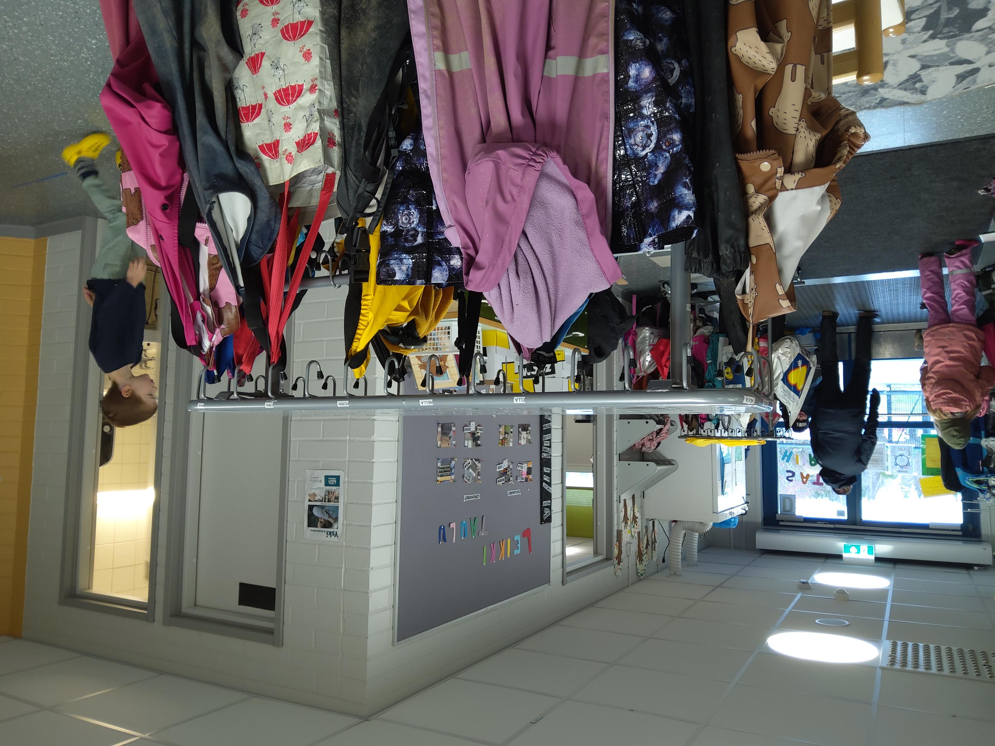
Facts about us
There are from pupils from pre-school to 6:th grade in our school.
The youngest are 5-6 years old and the oldest are 12-13 years old.
We are 300 pupils, 29 teachers, assistans, special education teachers
Our school was built in 1995, expanded in 2016 and renovated in 2021.
In our school we speak many languages:
e.g. Finnish, English, Swedish, Russian,
Arabic, Estonian,German, Turkish,
Lithuanian, Romanian, Malayalam,
Hindi, Thai etc.

Slide 3
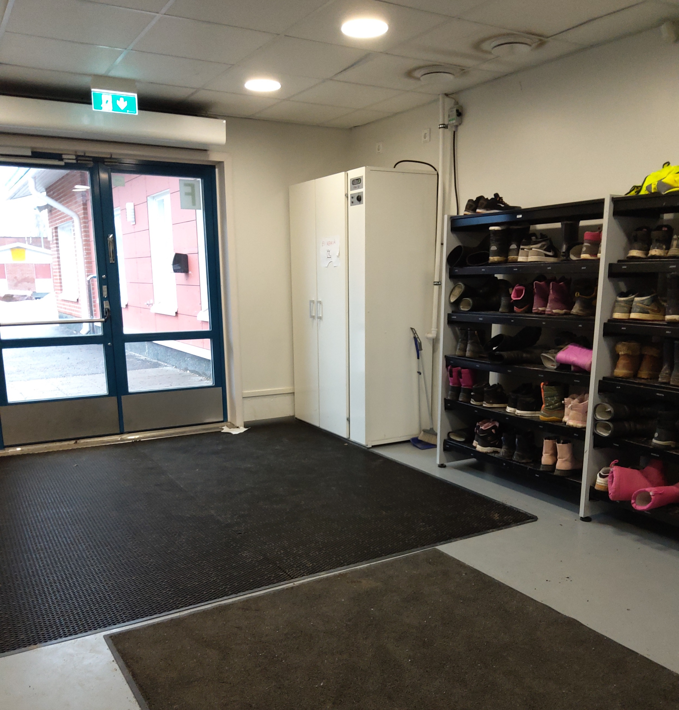
We are a ”no shoes school”
This means that we all leave our outdoor shoes to their own places near the doors.

Slide 4
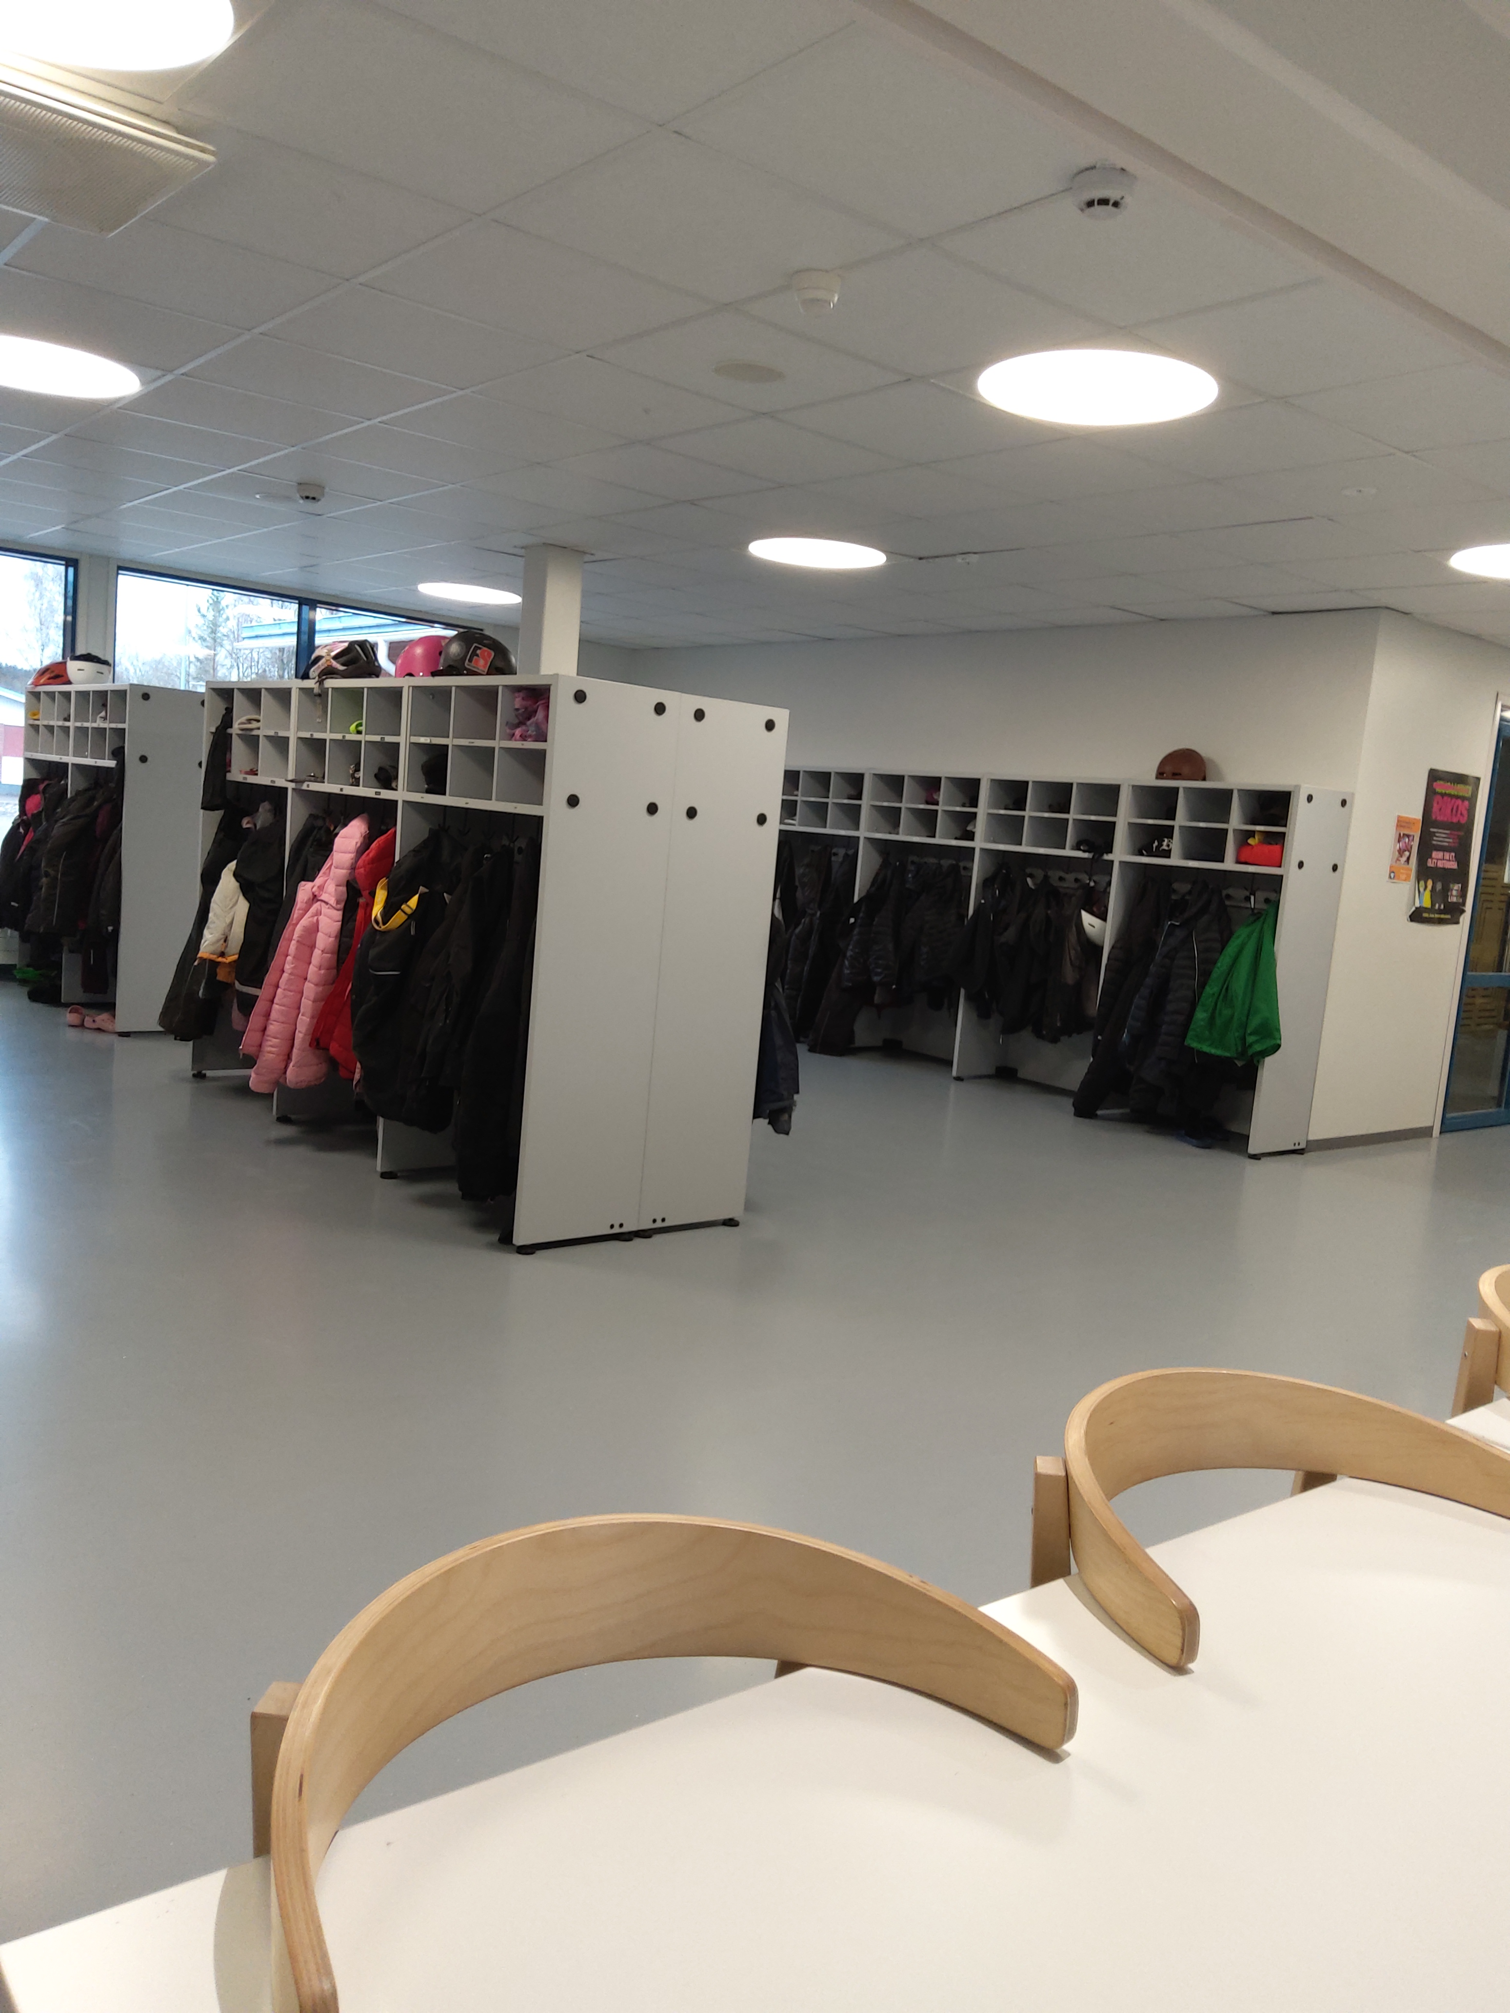
Every student puts their outside clothes like jackets and hats to the stand after recess and everyone has their own name on the stand.

Slide 5
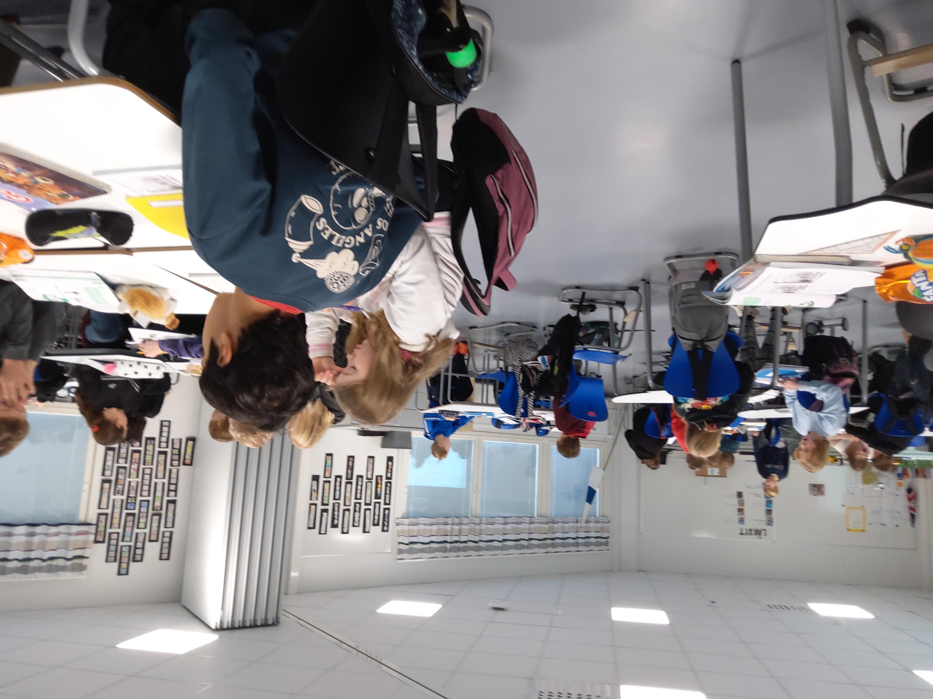
Our own classroom 5ab
We work two classes together with three teachers: Maarit, Tiina and Sari. We are 53 pupils in the class. You can sometimes hear us…

Slide 6
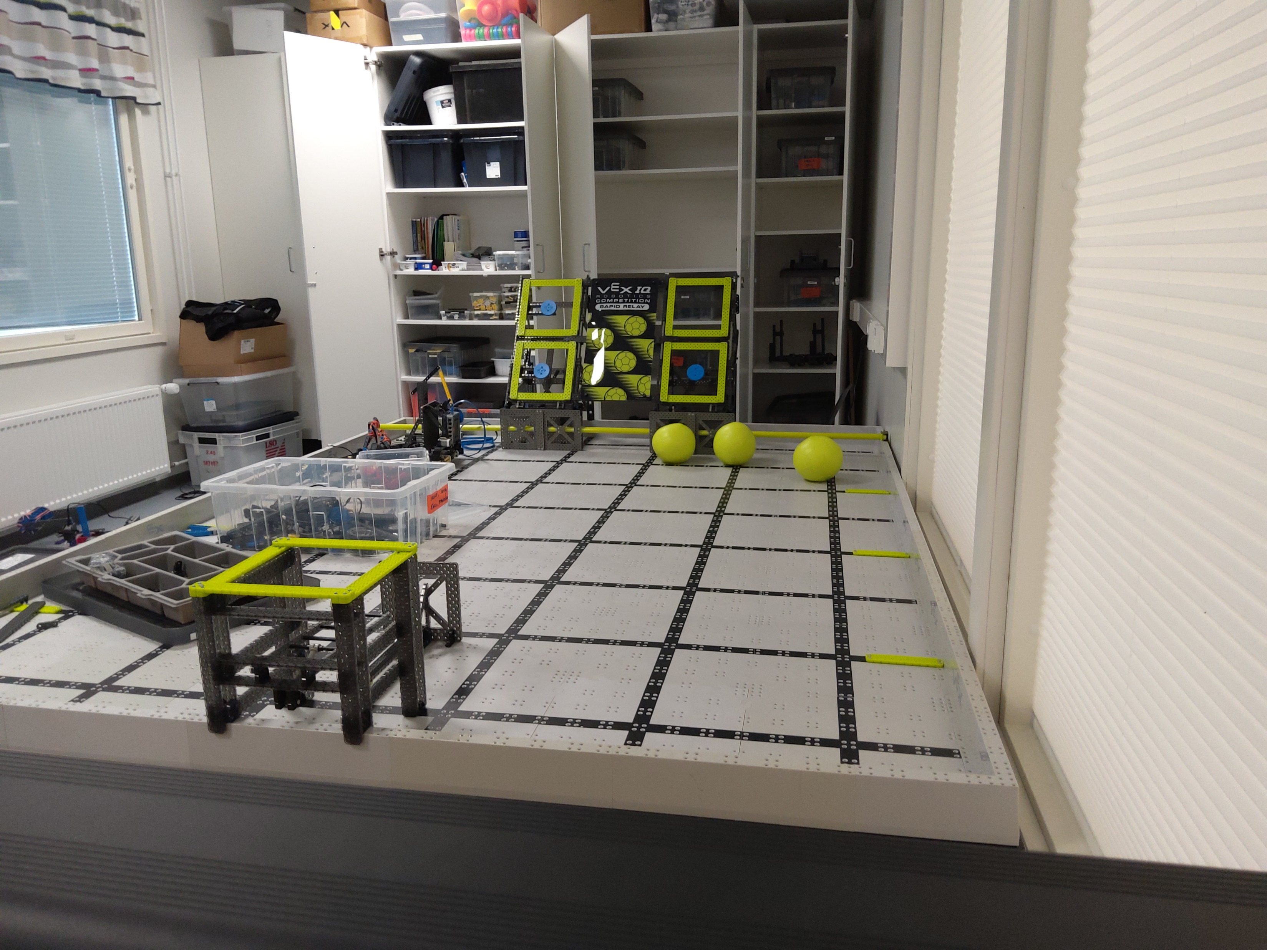
Our own classroom 5ab
We have also an area where we build our robots. We do that in crafts lessons and also in an afernoon club.
We will take part in Finnish Championship VEX-games. If we win, we might get to the USA for world championships!

Slide 7
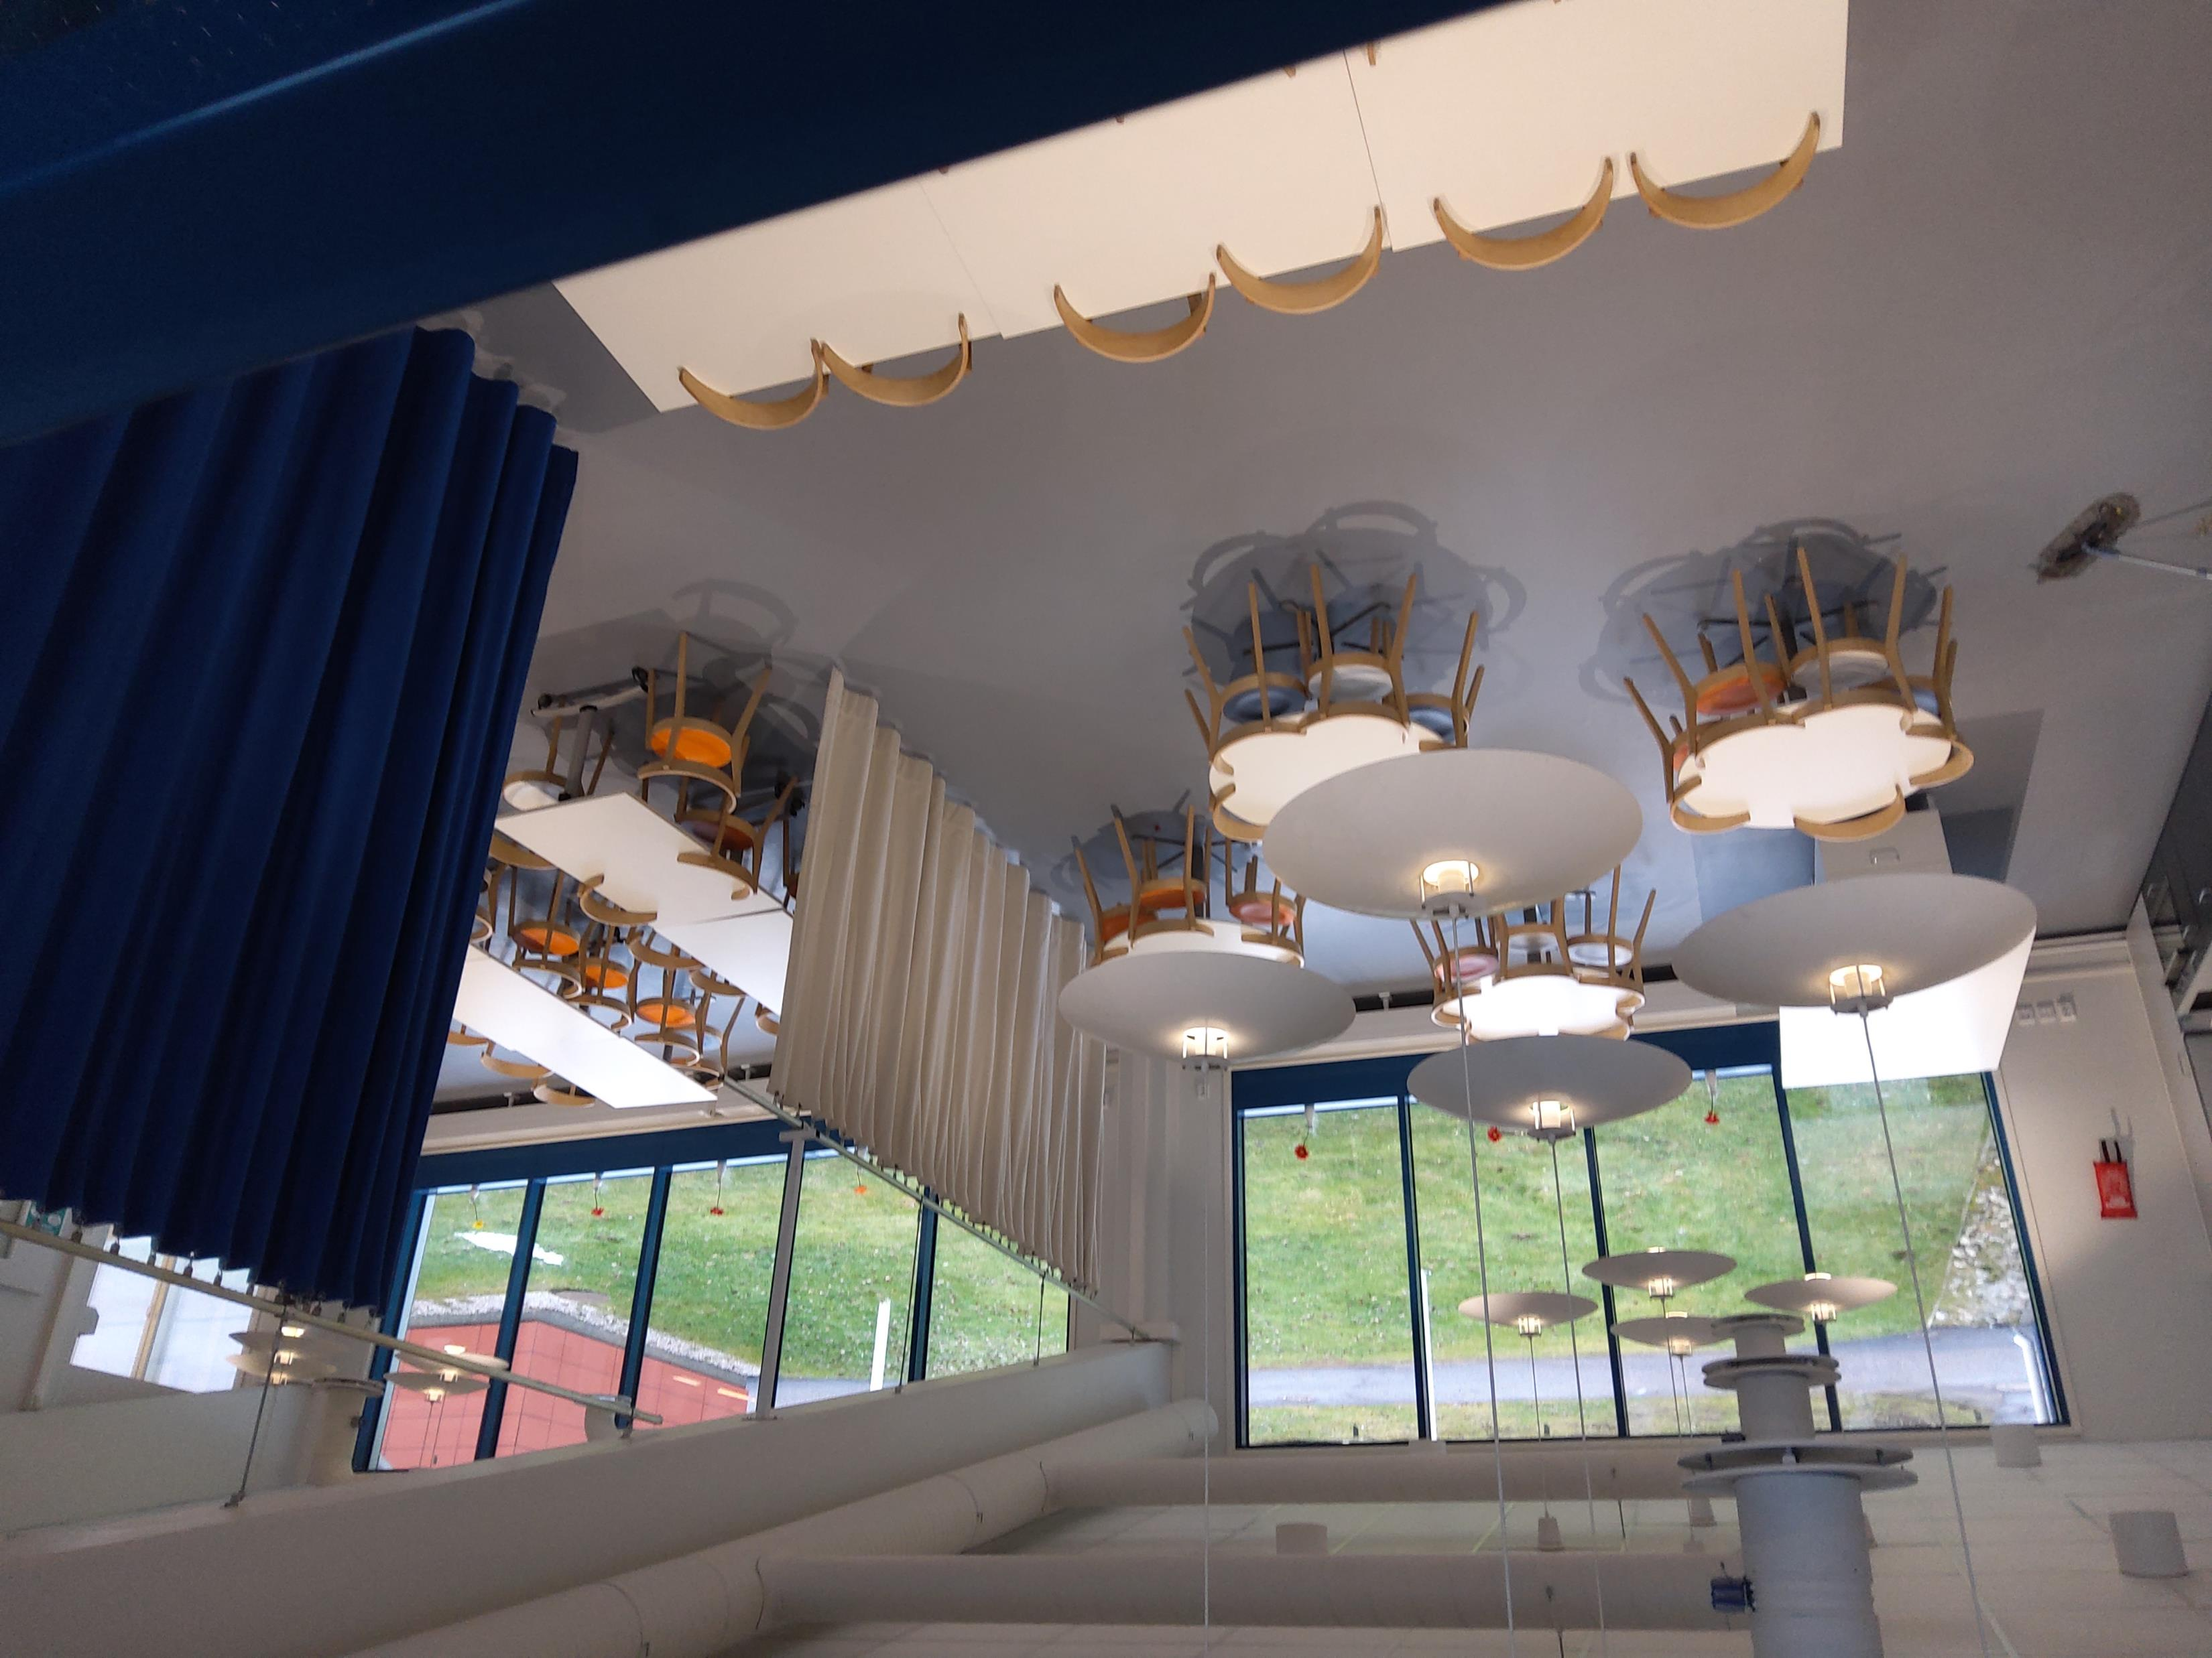
School lunch
Everyone gets a free lunch in our school canteen every day. We at 10.30-12 depending on your class level
In our school canteen there are many chairs for eating but we cannot choose where to sit because teachers choose where we sit.
You can choose a vegetarian meal or non-vegetarian meal.
Once a week we have fish.

Slide 8
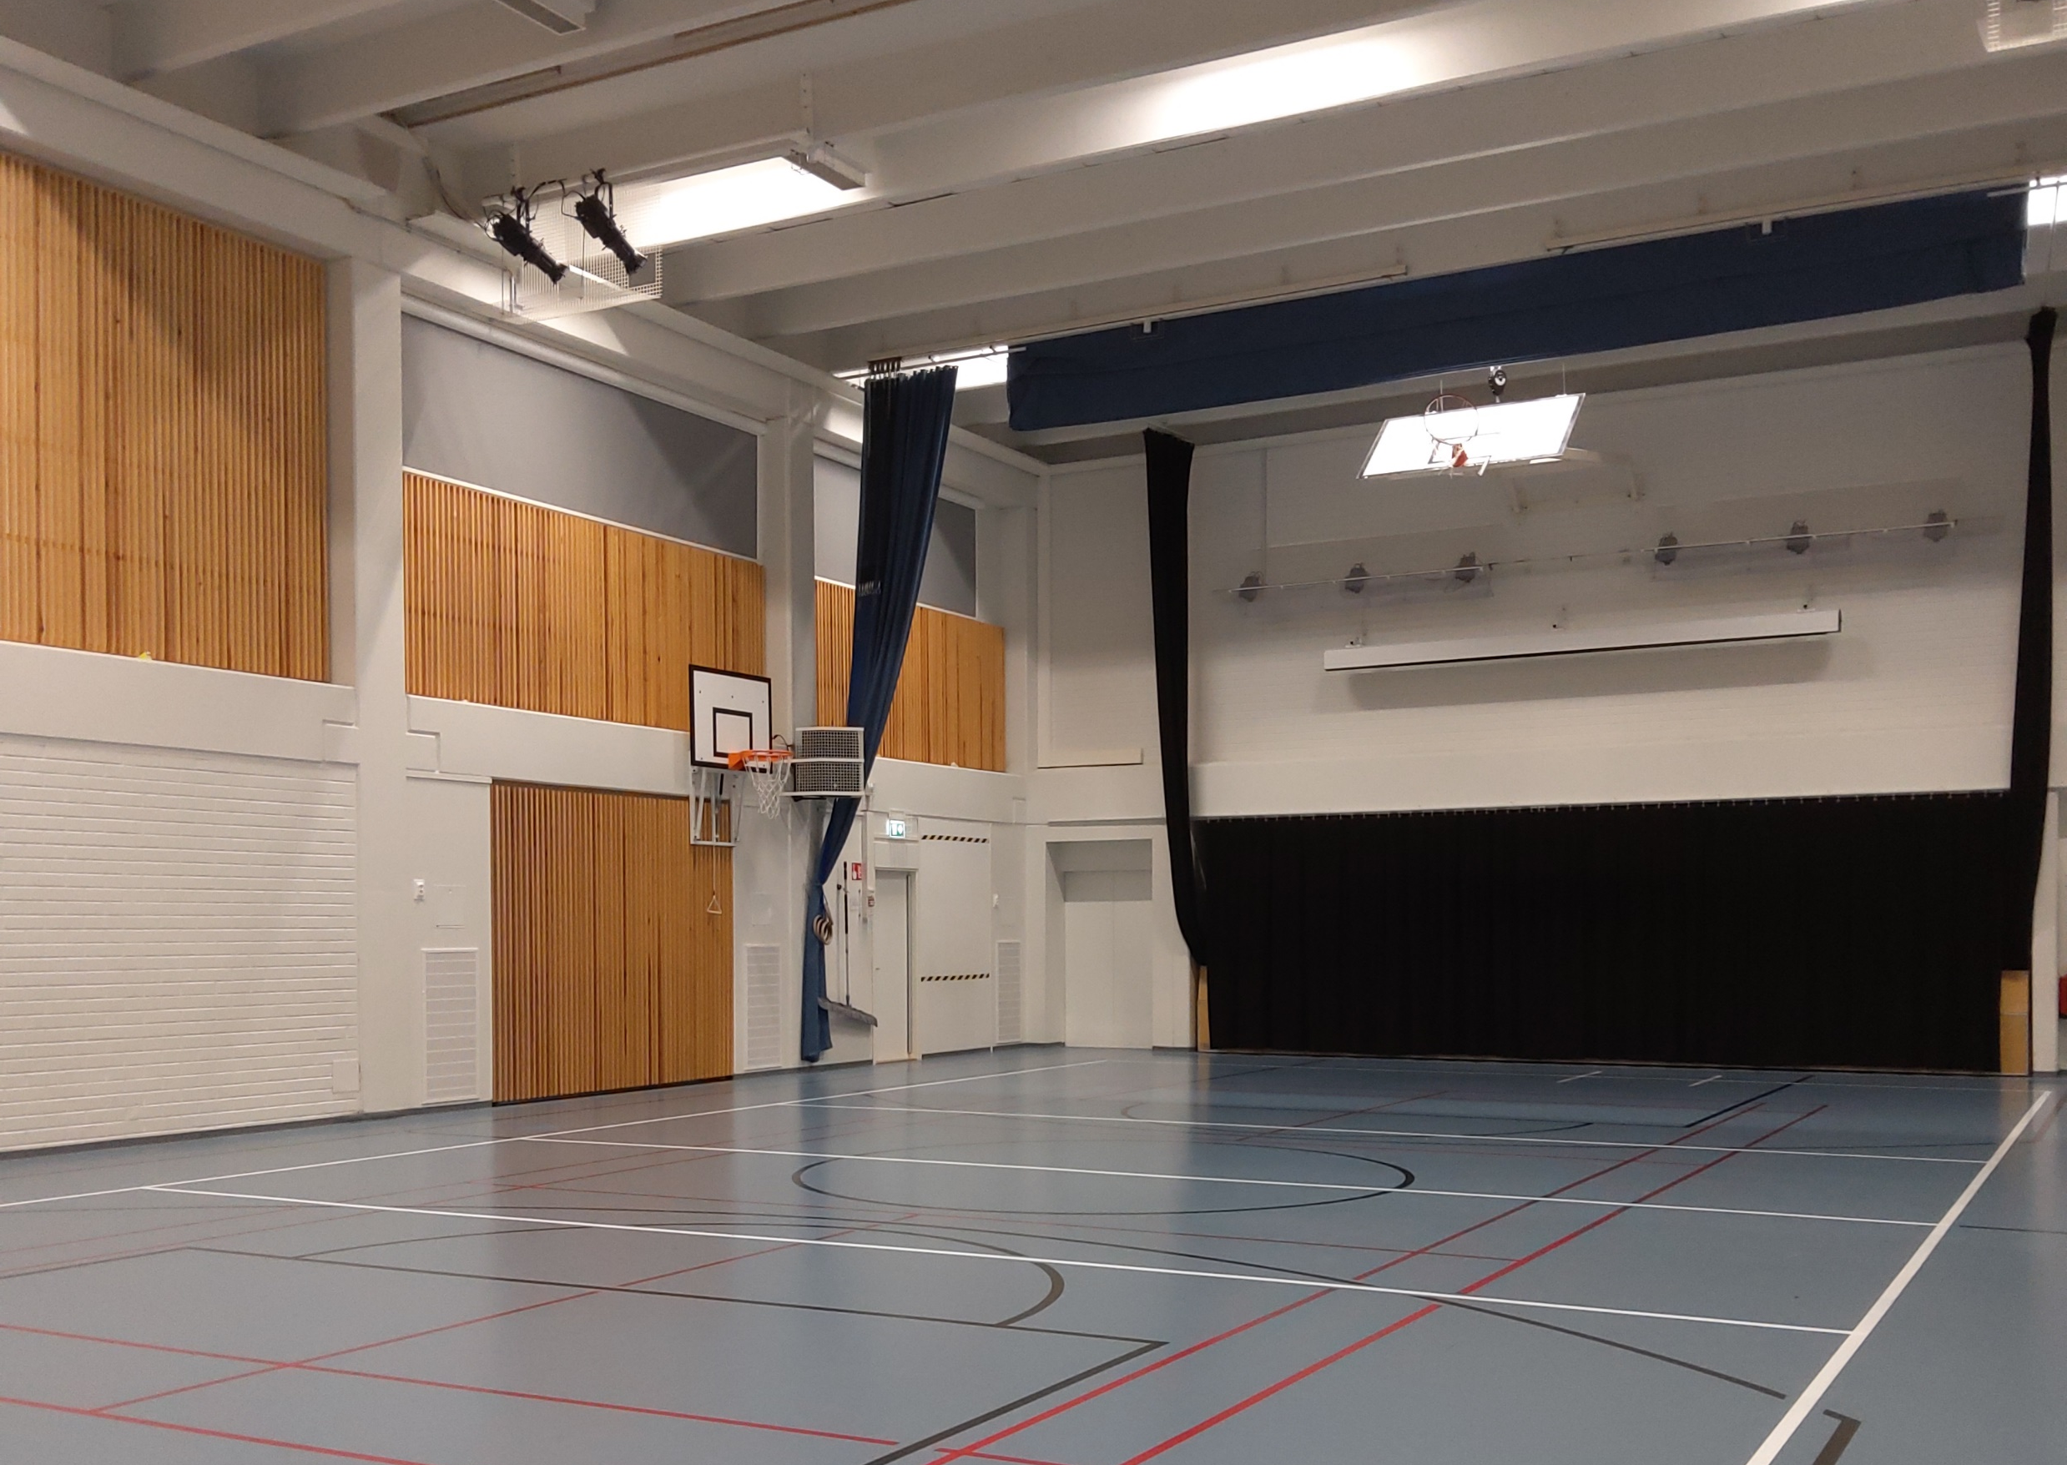
Sports or shows
In our gym we have gym lessons, assemblies or christmas shows or spring shows etc.
We have also a lot of outdoor sports. Now we’d like to have more snow for skiing and skating.

Slide 9
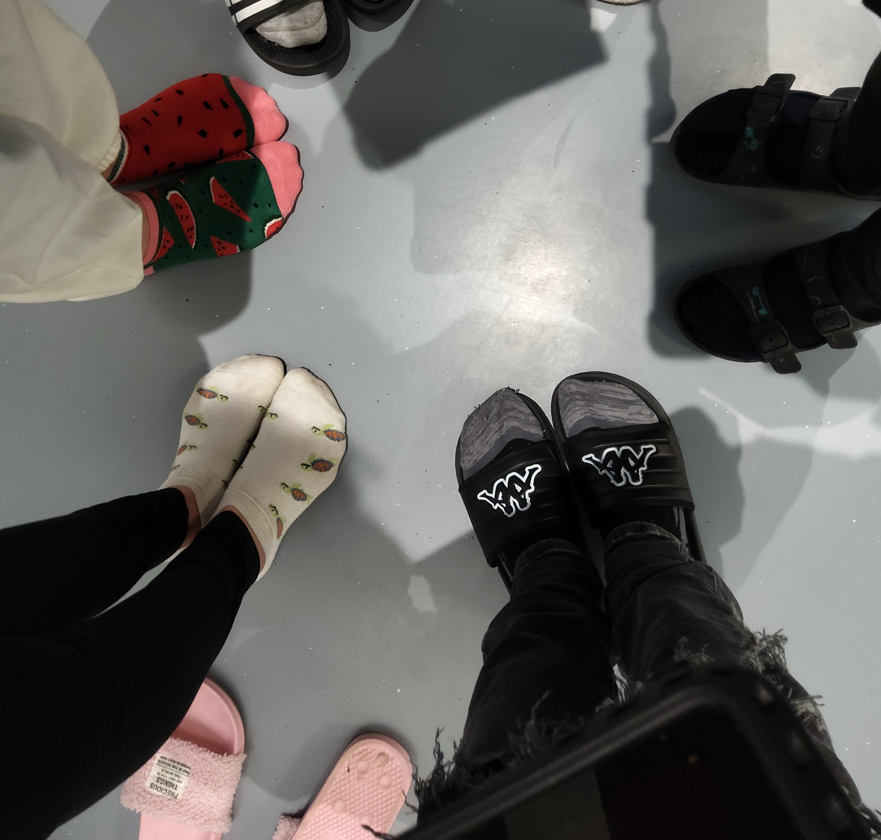
Some important rules
We have a rule of perfumes, we cannot put too much perfume because some people are allergic to perfumes.
In our school students are friends and bullying is WRONG!
We don’t use mobile phones at school.

Slide 10
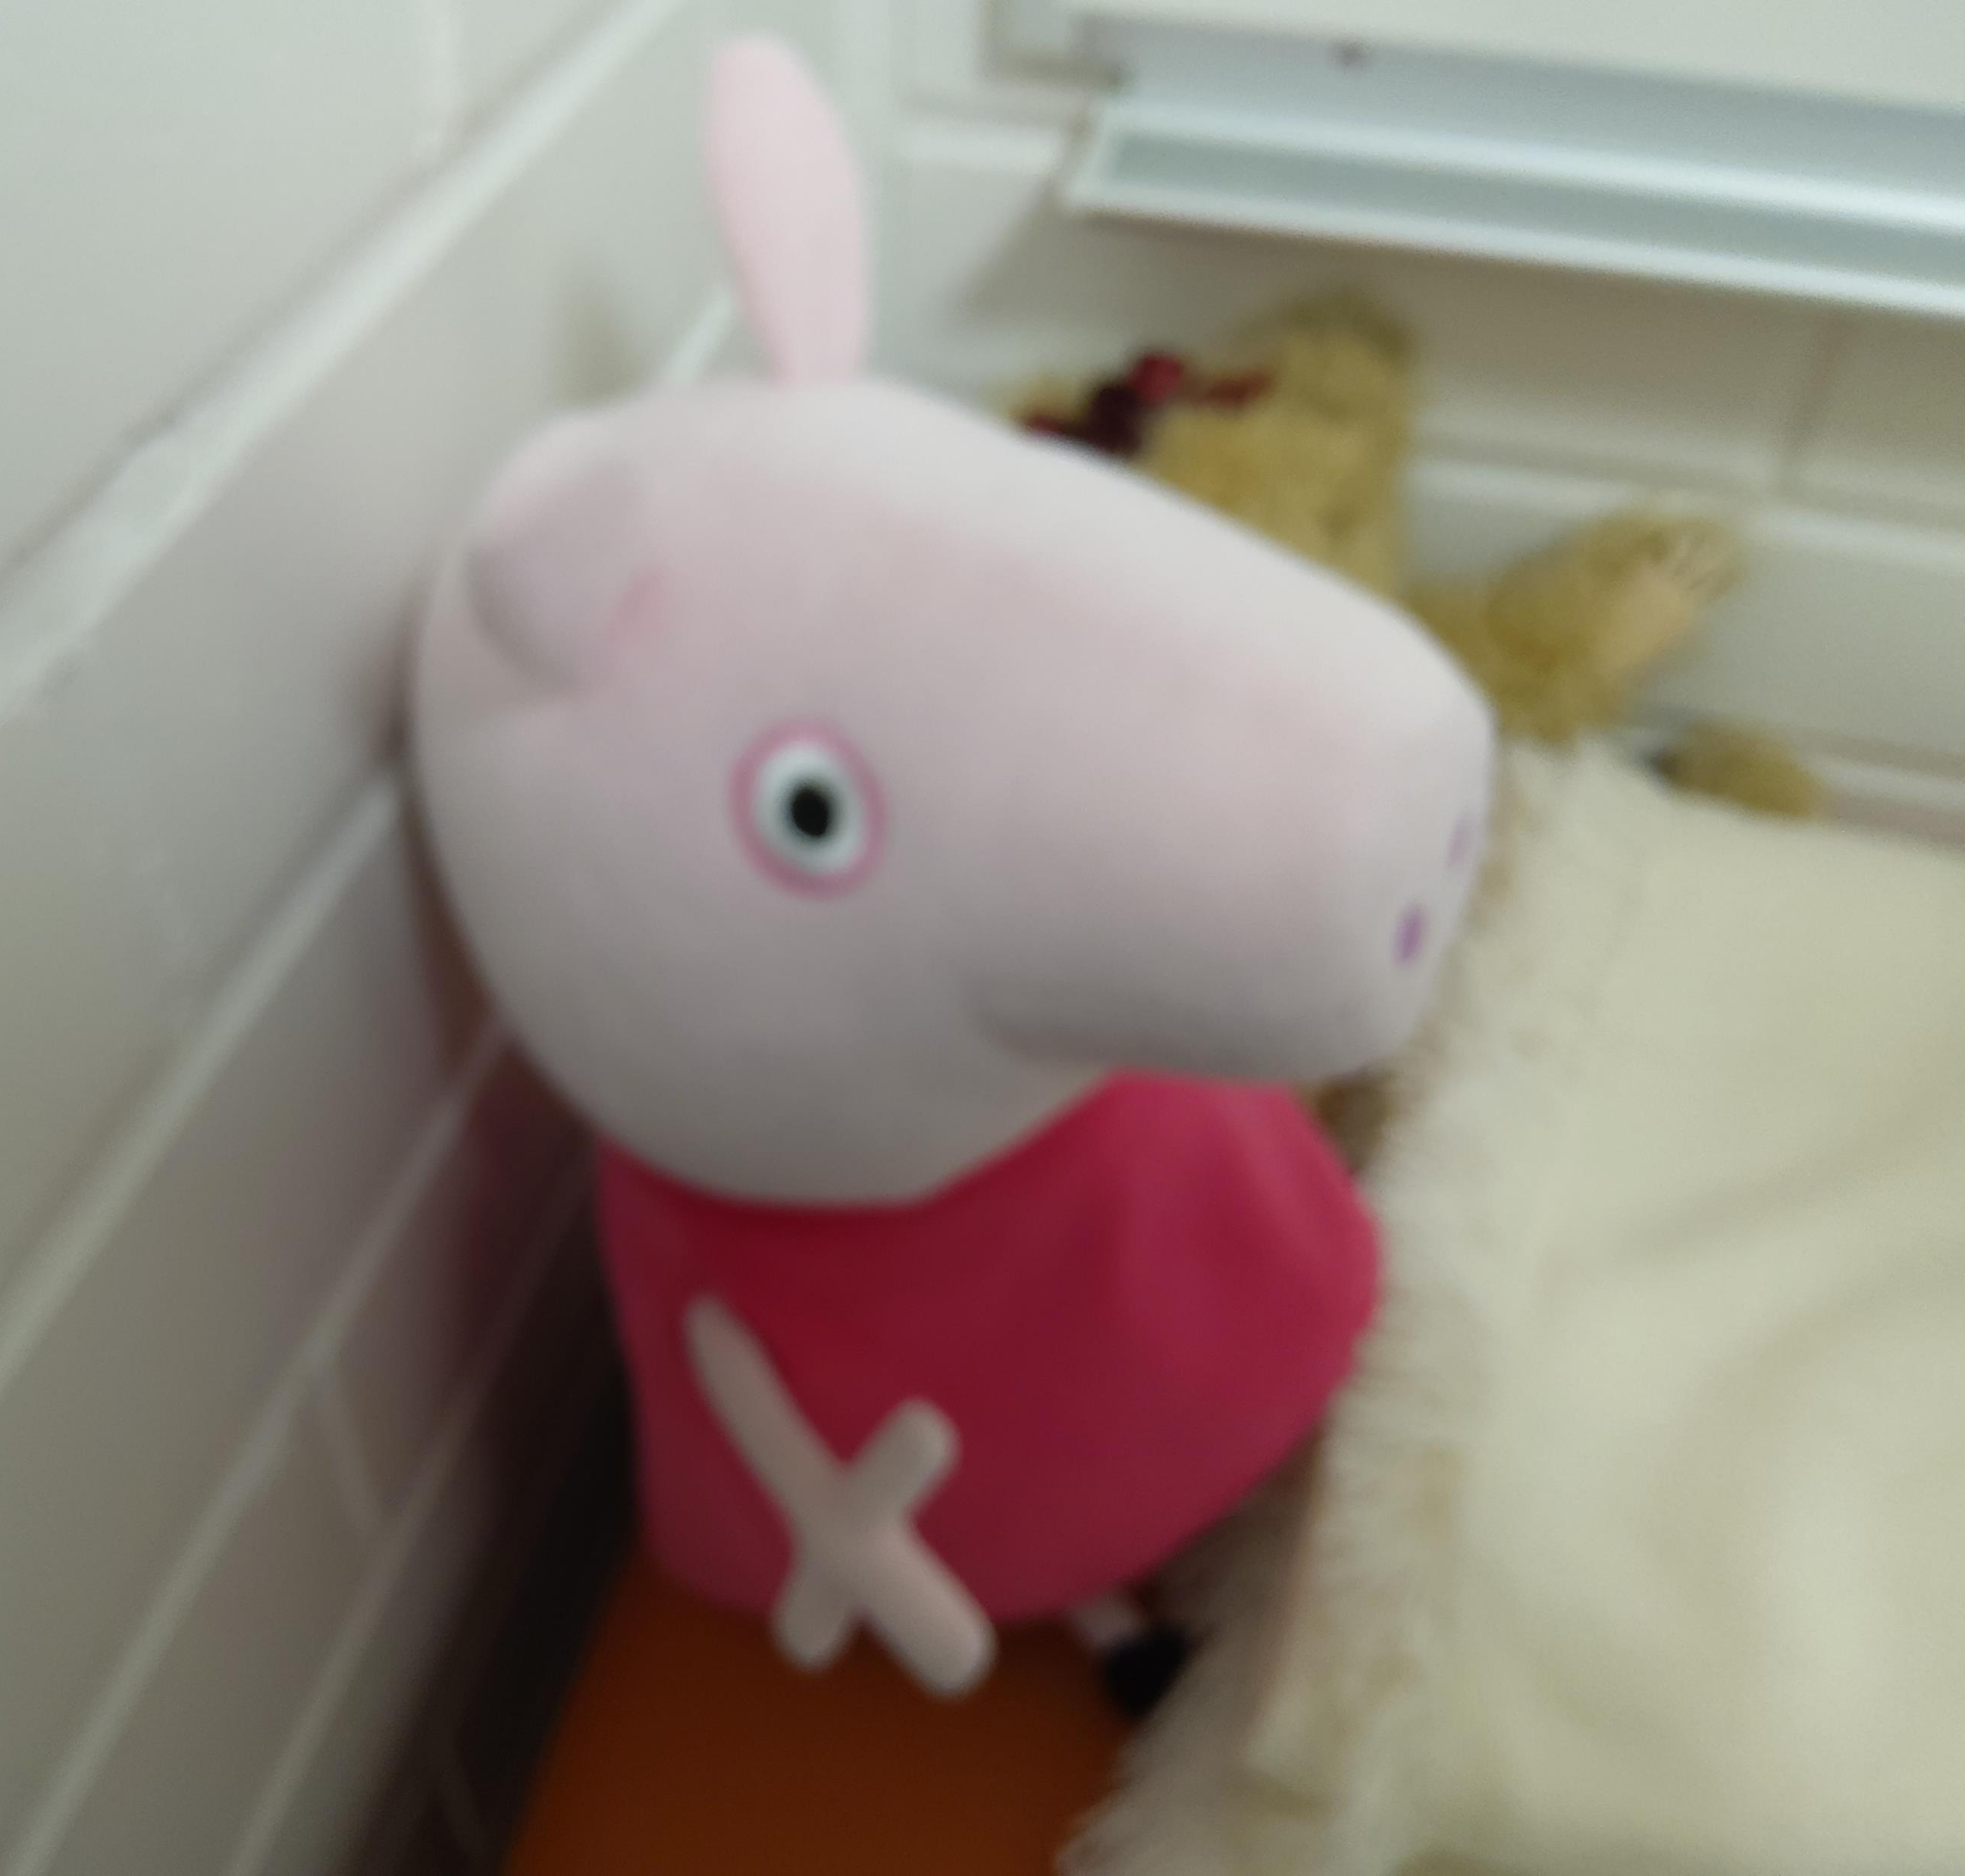
No phones!
In our class, when the day starts we almost always take away everyones phone so no one watches or plays with it during lessons or breaks.

Slide 11
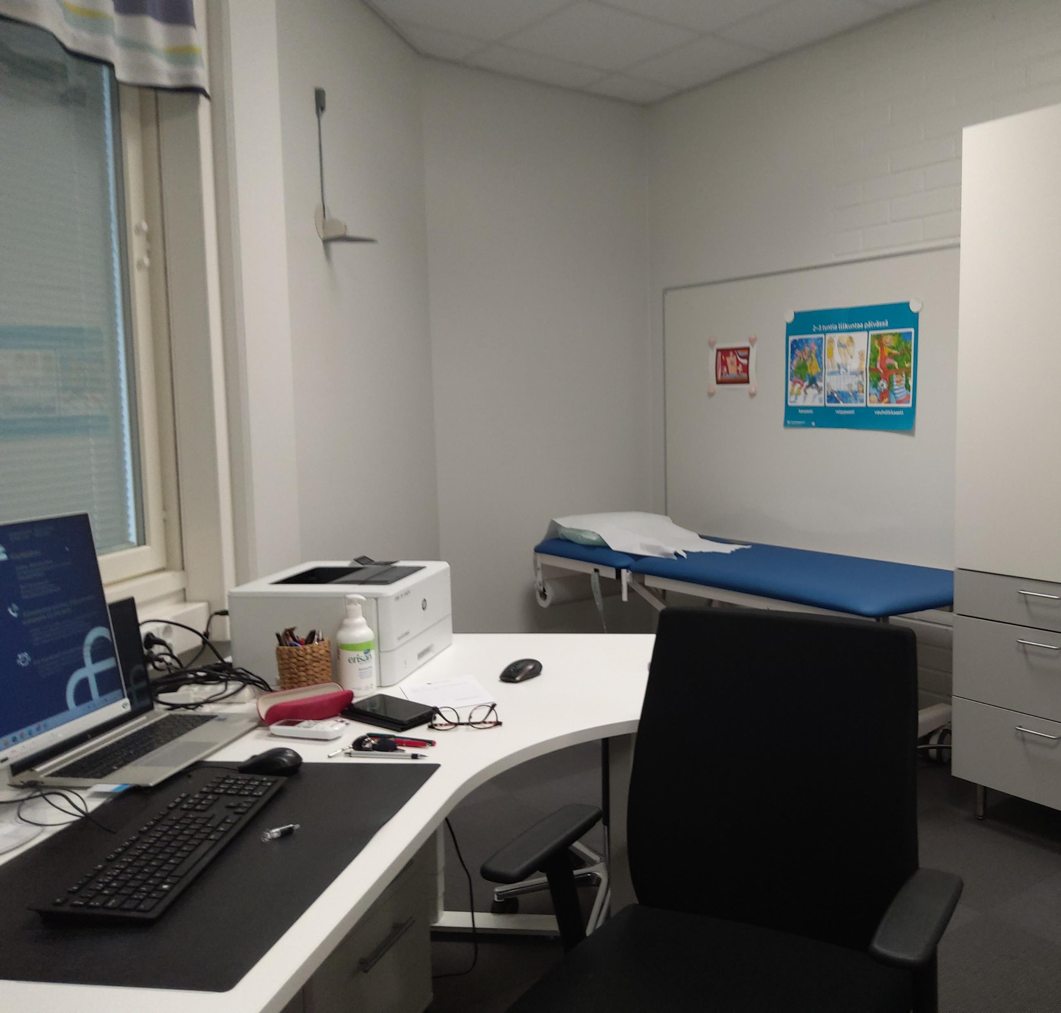
Susa is taking care of us.
We have a school nurse at school four days in a week.

Slide 12
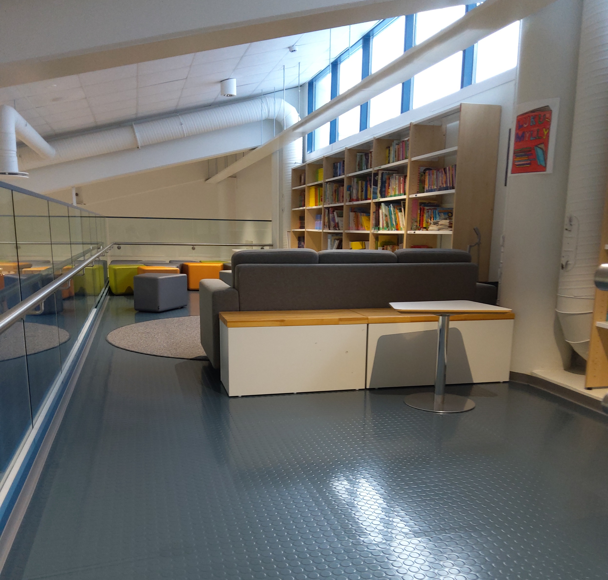
School library – school loft
This is our small library. The official library is 300 metres from school so it’s easy to visit there. The library lorry visits us once a week.
We can sometimes to come here to study.

Slide 13
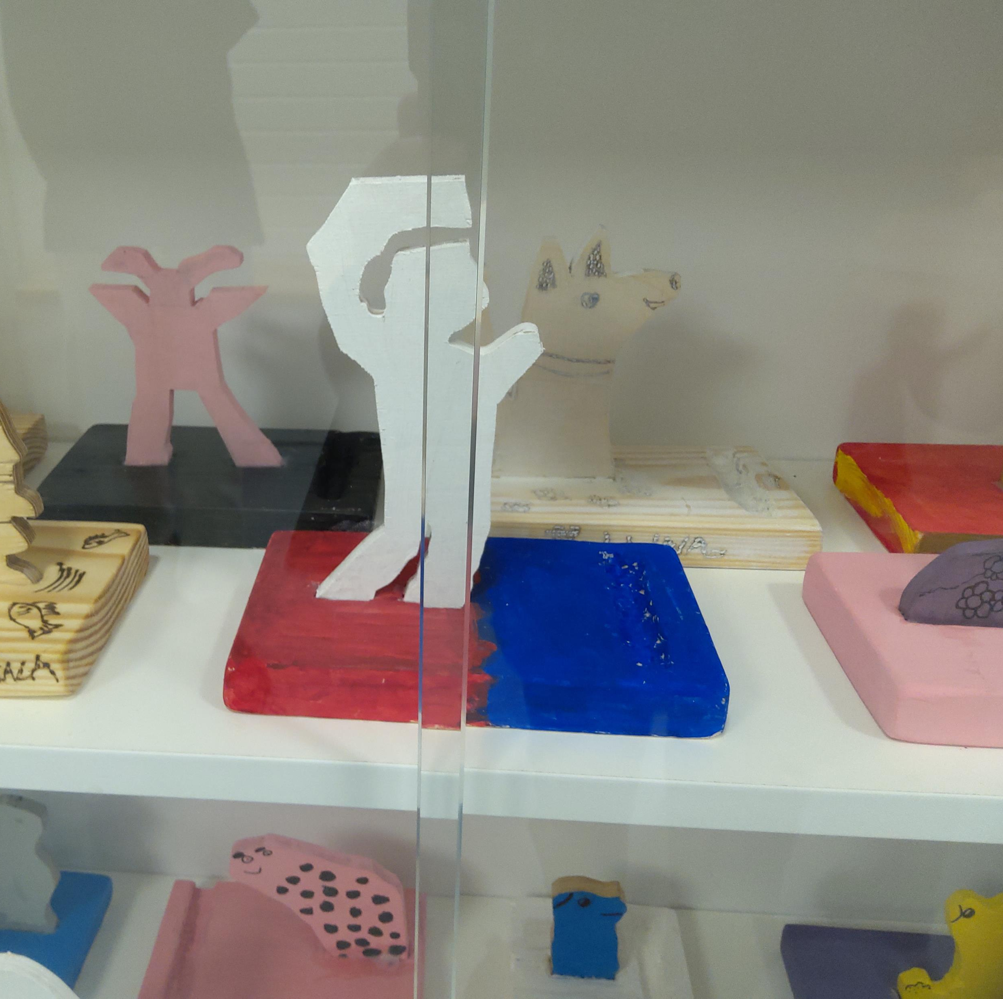
Many kind of classrooms
Our classes are pretty big and we have different classrooms. Classrooms where we sing,where we paint or draw, classrooms where we do things with wood and/or wool or fabrics.

Slide 14
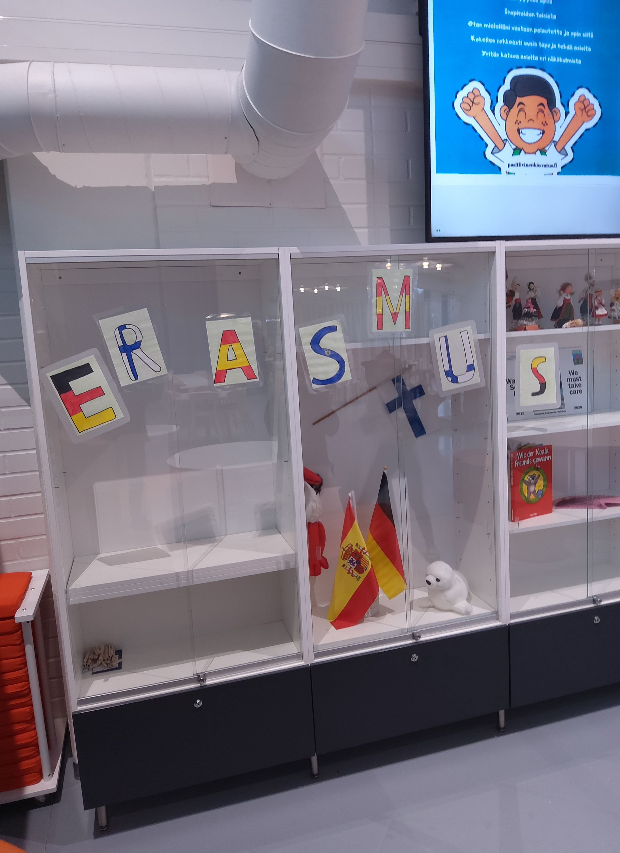
Erasmus
Erasmus is an important part of our school. Since 1997 we have had European projects. First only teachers visited and took part in courses. Nowadays we pupils travel more!

Slide 15
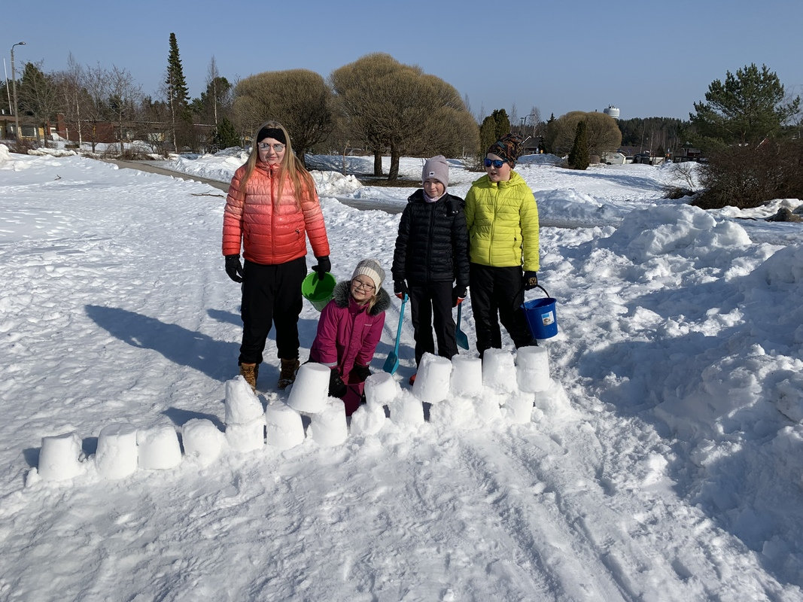
Welcome to visit us!

