Slide 1
Hydroponics

Slide 2
What is hydroponics
The process of growing plants in sand, gravel, or liquid, with added nutrients but without soil.
Hydroponics is a method of growing plants in a water based, nutrients rich solution. The basic premise behind hydroponics is to allow the plants roots to come in direct contact with the nutrient solution, while also having access to oxygen, which is essential for proper growth

Slide 3
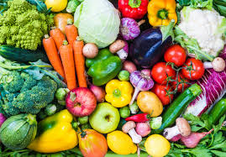
What can we grow???
Plants that are commonly grown in hydroponics include vegetables such as:
Lettuce
Cucumber
Spring onions
Peppers
Spinach
Strawberries
Blueberries
Different types of herbs

Slide 4
Benefits of a hydroponic system
You can grow all year around – both indoors and out.
Conserves water and plant nutrients are controlled.
More plants can be grown in a given area and crop flavour is enhanced.
Plants grow quicker with increased yields.
No need for weeding.
Soil borne pests are eliminated, leading to reduced needs for pesticides.

Slide 5
Problems with hydroponic systems
Putting together a hydroponic system isn't cheap.
Constant monitoring is required.
Hydroponic systems are in danger to power outages.
Micro-organisms that are water-based can creep in rather easily.
Growing a hydroponic garden demands technical expertise.
Production is limited compared to field conditions.

Slide 6
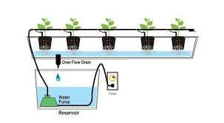
How does the system work?

Slide 7
Aquaponics

Slide 8
What is aquaponics?
Aquaponics refers to any system that combines conventional aquaculture with hydroponics in a symbiotic environment. In normal aquaculture, excretions from the animals being raised can accumulate in the water, increasing toxicity.

Slide 9
What can we grow???
You can grow the same things as in the hydroponics system. This can be plants with high nutritional demands.
Most household crops can be grown in this system.

Slide 10
Advantages of aquaponics?
Environmentally responsible with low water usage and low power usage.
The primary inputs to the system are Fish food and water.
Little to no Chemical usage.
Many of the plants that thrive in Aquaponics growing are very easy to grow.
Low susceptibility to pests and diseases.

Slide 11
Disadvantages of aquaponics
High start-up investment costs for aquaponics technology and equipment
Aquaponics systems include several places where dysfunction could lead to failure of the whole system (and loss of fish)
Several variables are involved in the configuration of aquaponics systems (construction, aquatic conditions, surrounding environmental factors, etc.), leading to difficulties in predicting ideal conditions for any given system.

Slide 12
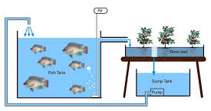
How does this system work?

Slide 13
Bioponics

Slide 14
What is Bioponics?
Bioponics is a method of hydroponic growing
Bioponics involves the use of certified- organic nutrients in a hydroponic solution along with a substrate.
Bioponics is related to hydroponics and aquaponics, but focuses on the use of completely organic nutrients.
Bioponics is always 100% organic
Bioponics is a fish optional farming technique

Slide 15
Indoor farming
Indoor farming is the future of urban farming
It allows for vertical farms that grow all crops, in any place, at any time
Advantages:
-you can control conditions
-high profits
-clean crops
-crops can grow anywhere
-no ploughing
-less staff
-larger crops
-shorter harvest time
Disadvantages:
-lots of planning needed
-expensive
-electricity and gas needed to maintain it
-alarms needed

Slide 16
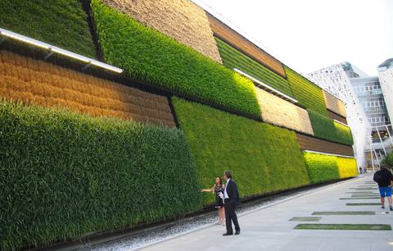
City farming and farming walls
City farming is also called urban farming. It is a combination of different efforts aimed at growing fruits and vegetables in an urban area
Green walls have become a rising new trend of built environments in recent years. Incorporating living nature into urban environments not only looks much more inviting, but also has a number of other benefits and purposes
Advantages:
Can make us happier and more productive reduce stress and fatigue improve air quality

Slide 17
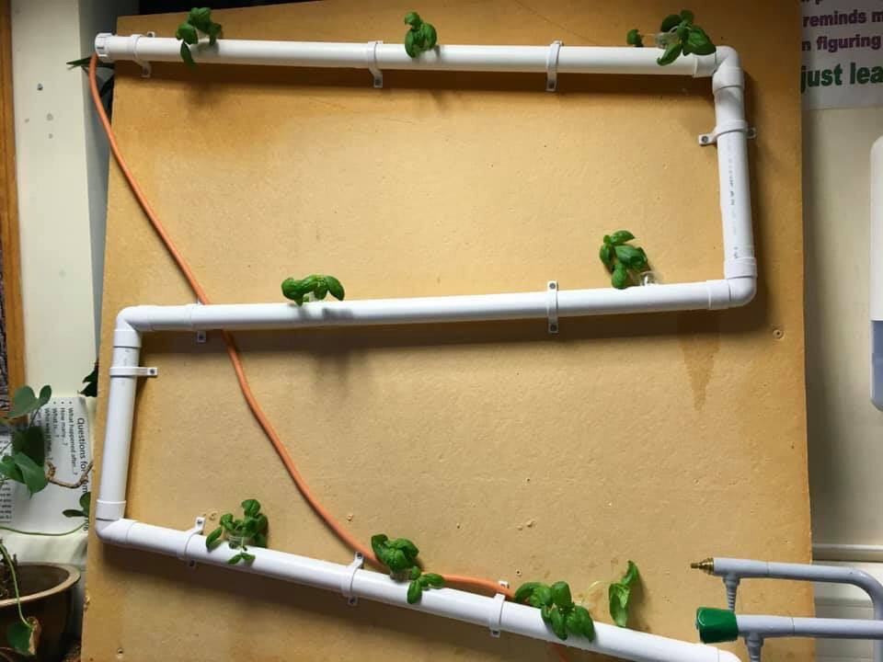
Our project

Slide 18
What was our aim?
To create a hydroponics system
learn more about hydroponics
Work as a team to create a sustainable solution for growing plants without wasting water

Slide 19
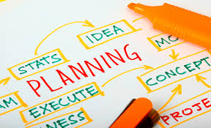
Planning
As a team we:
Researched into hydroponics- how the systems work
Researched what a plant needs to grow
Decided on an idea as a team- first idea
Idea development- changes we made to the original design

Slide 20
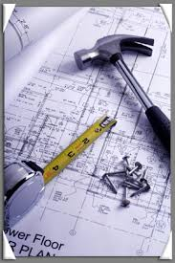
Making
Using the recourses provided we placed
equipment where we thought it should go
Measuring
cutting
assembling
changes
Securing to the bored
Trial
made changes that were needed

Slide 21
Thank you for listening!

