Slide 1
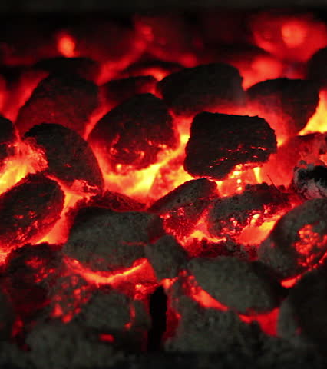
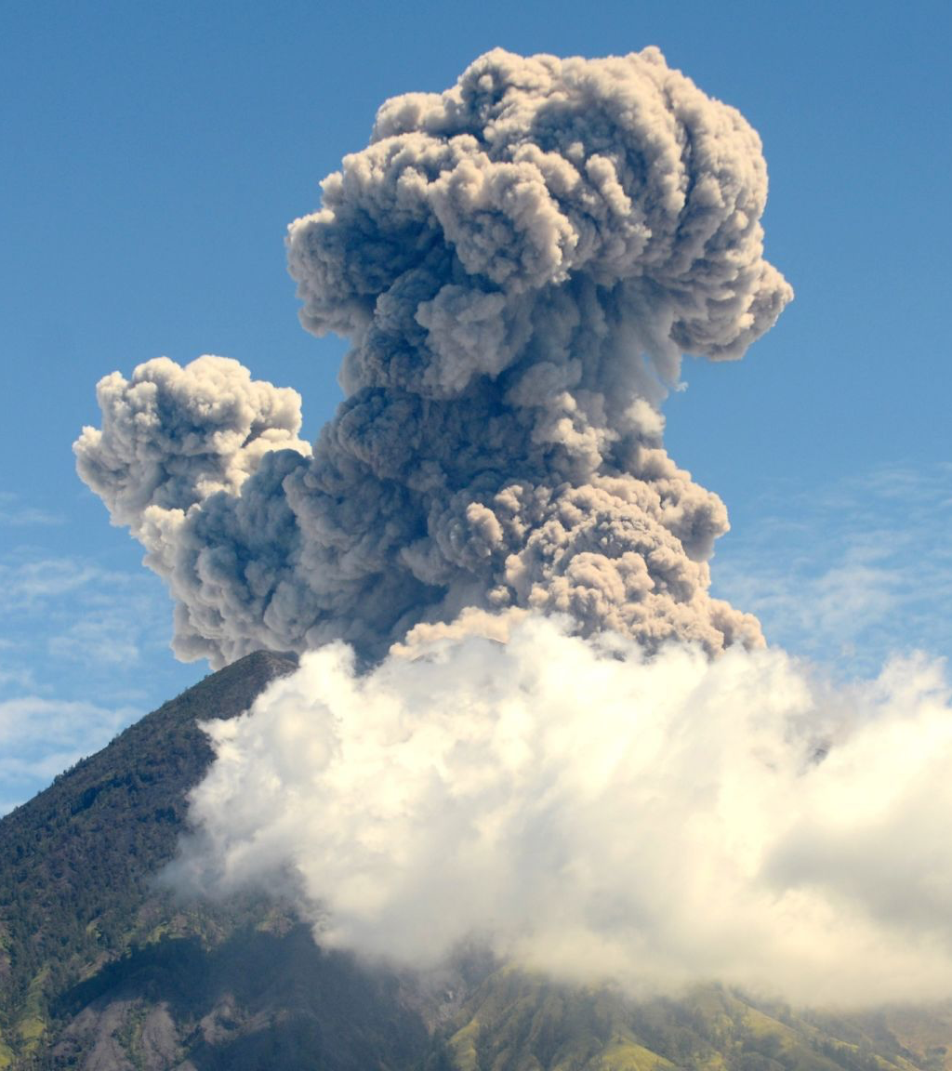
CO2 causes
They are divided into two groups
Human causes
Natural causes

Slide 2

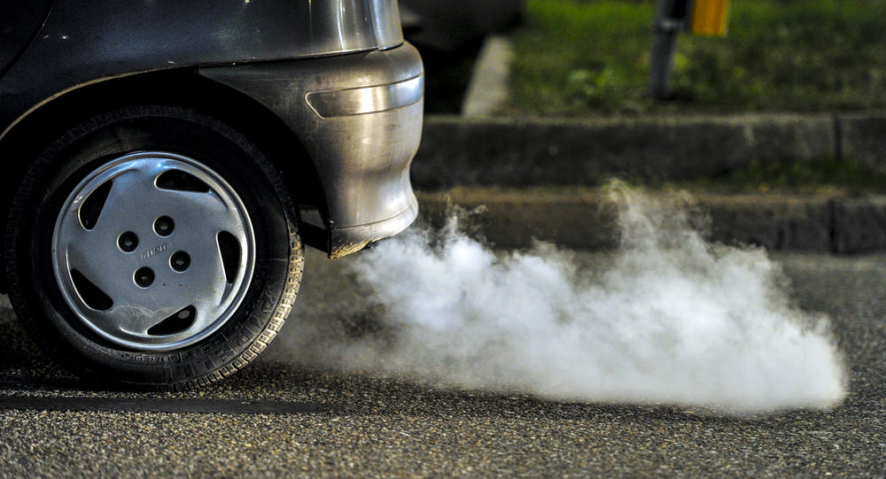
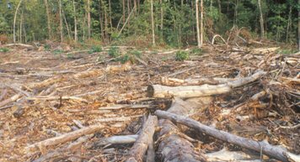
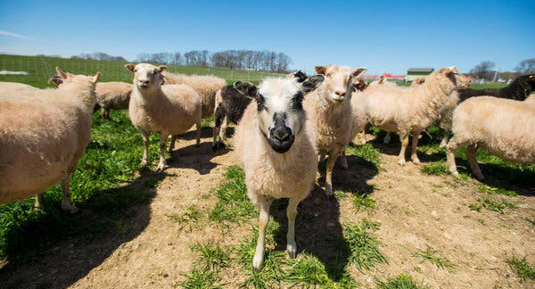
Human causes
Burning coal, oil and gas produces CO2 and nitrous oxide
Cutting down forest(deforestation). Trees help to regulate the climate by absorbing CO2 from the atmosphere so when they are cut down, that beneficial effect is lost and the carbon stored in the trees is released into the atmosphere, adding to the greenhouse effect
Increasing livestock farming. Cows and sheep produce large amounts of methane when they digest their food

Slide 3
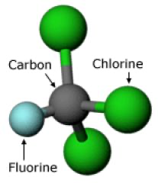
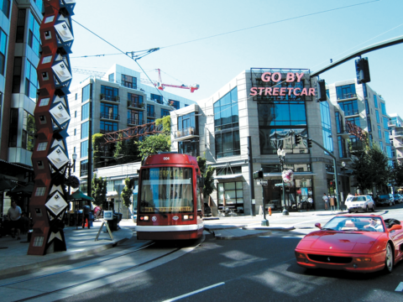
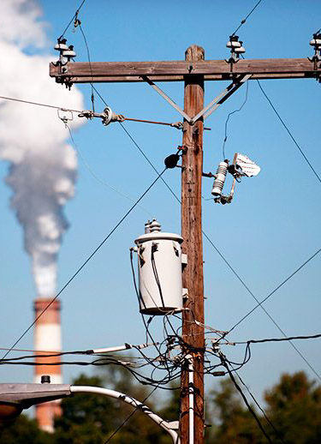
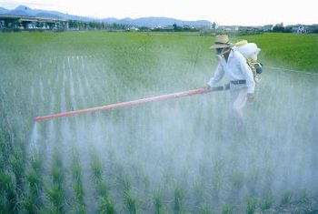
Fertilisers containing nitrogen produce nitrous oxide emissions
Fluorinated gases produce a very strong warming effect, up to 23,000 times greater than CO2.
Consuming electricity
Transportation
Building

Slide 4
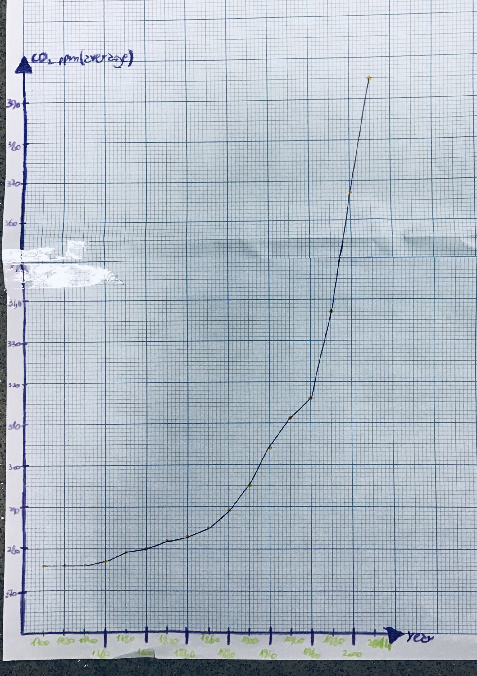

CO2 emissions from 1700 to 2014
CO2 ppm (average) | Year
276 | 1700
276 | 1720
276 | 1740
277 | 1760
279 | 1780
280 | 1800
282 | 1820
283 | 1840
285 | 1860
289 | 1880
295 | 1900
304 | 1920
311 | 1940
316 | 1960
337 | 1980
367 | 2000
395 | 2014

Slide 5
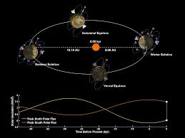
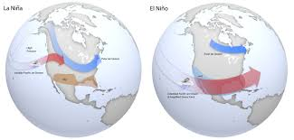
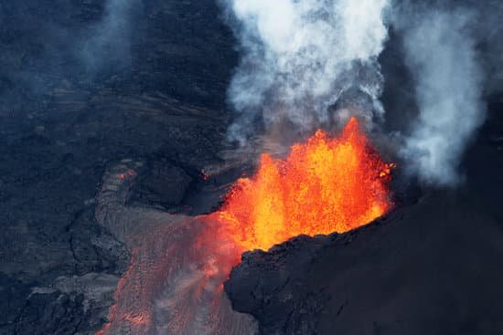
Natural causes
El Niño and La Niña
Volcanic eruptions
Milankovitch cycles
El Nino and La Nina.docx

Slide 6
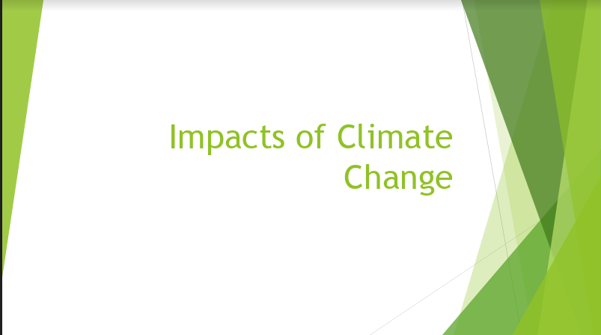

Slide 7
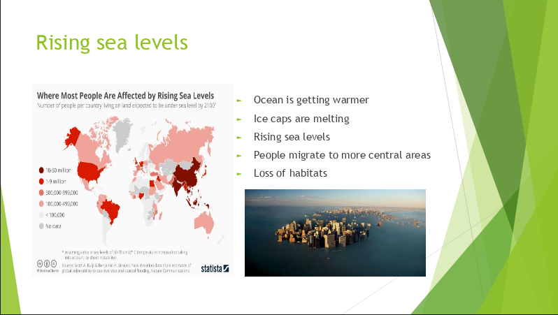

Slide 8
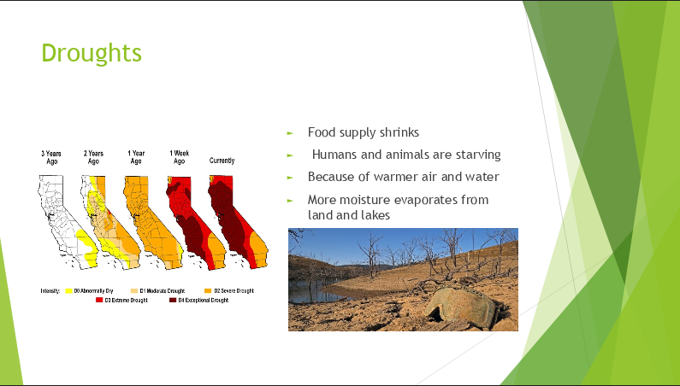

Slide 9
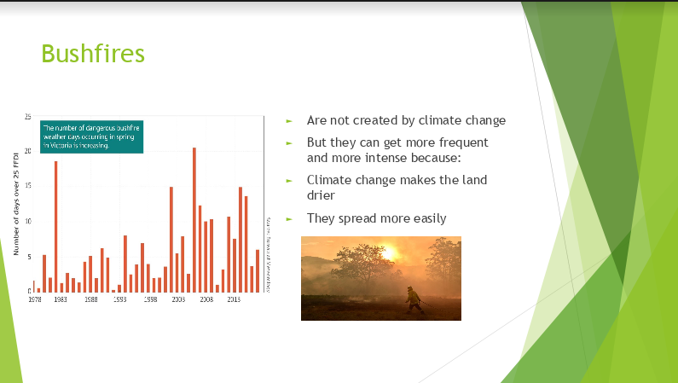

Slide 10
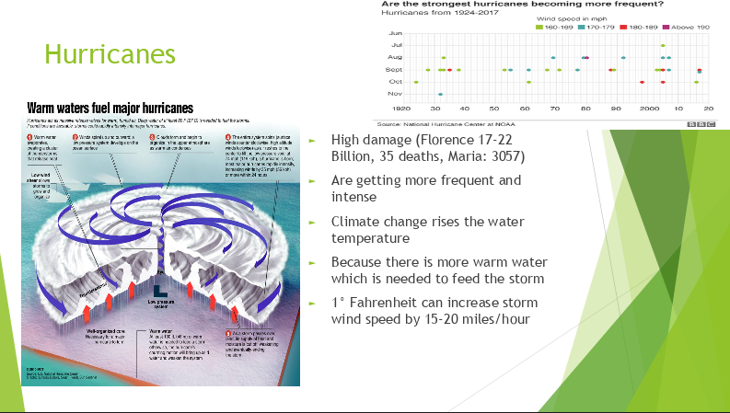

Slide 11
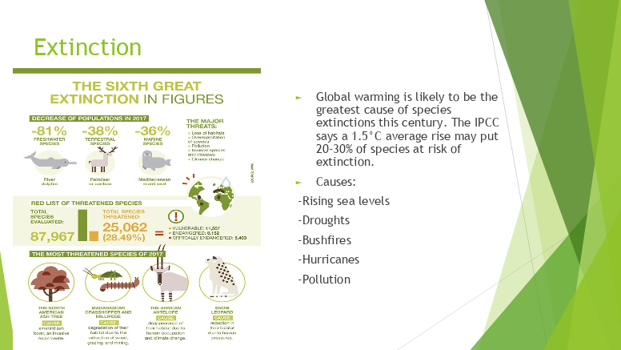

Slide 12
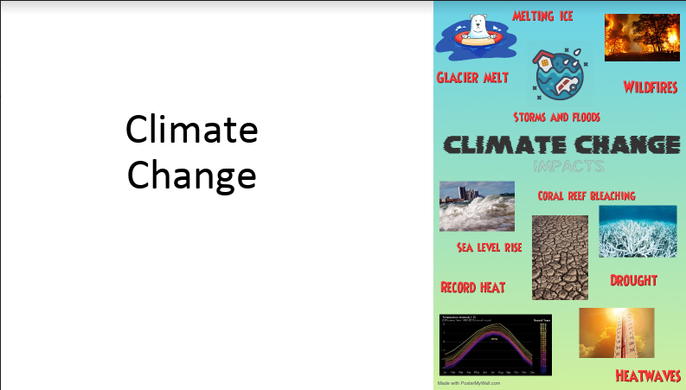

Slide 13
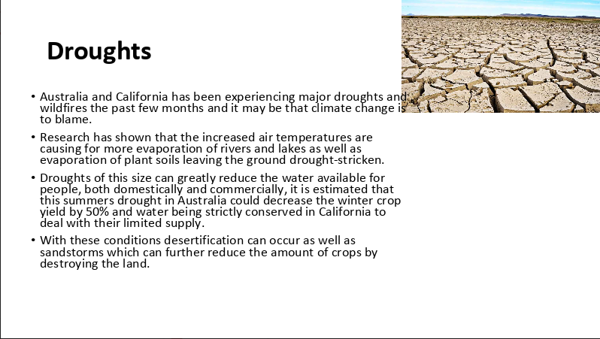

Slide 14
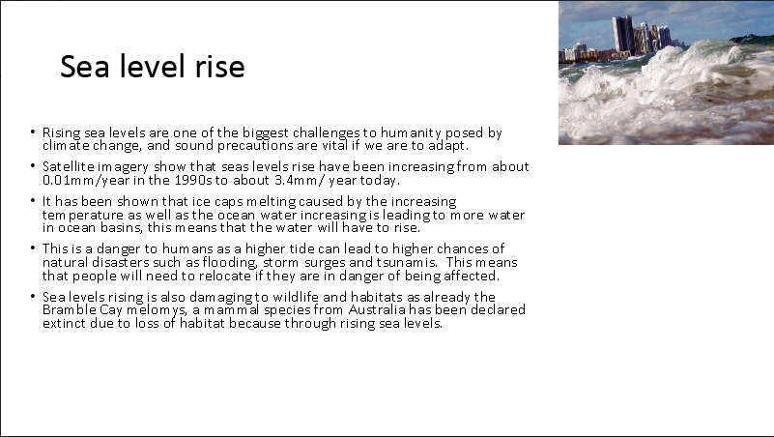

Slide 15
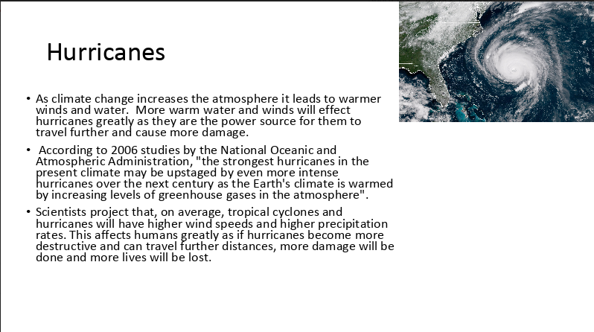

Slide 16
