Slide 1
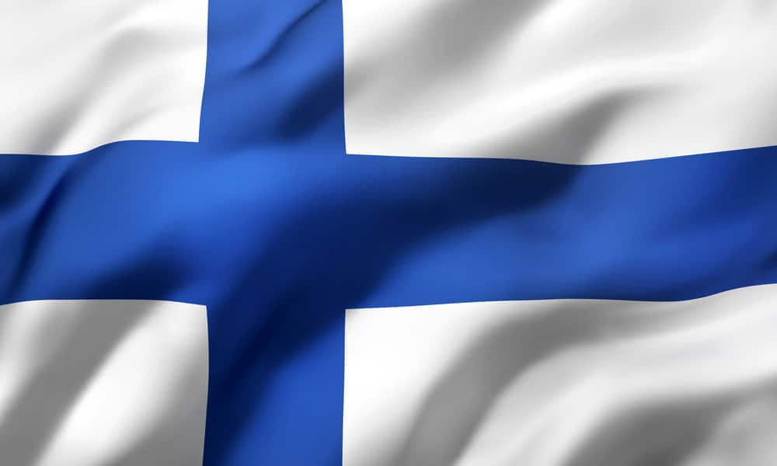

FINLAND

Slide 2
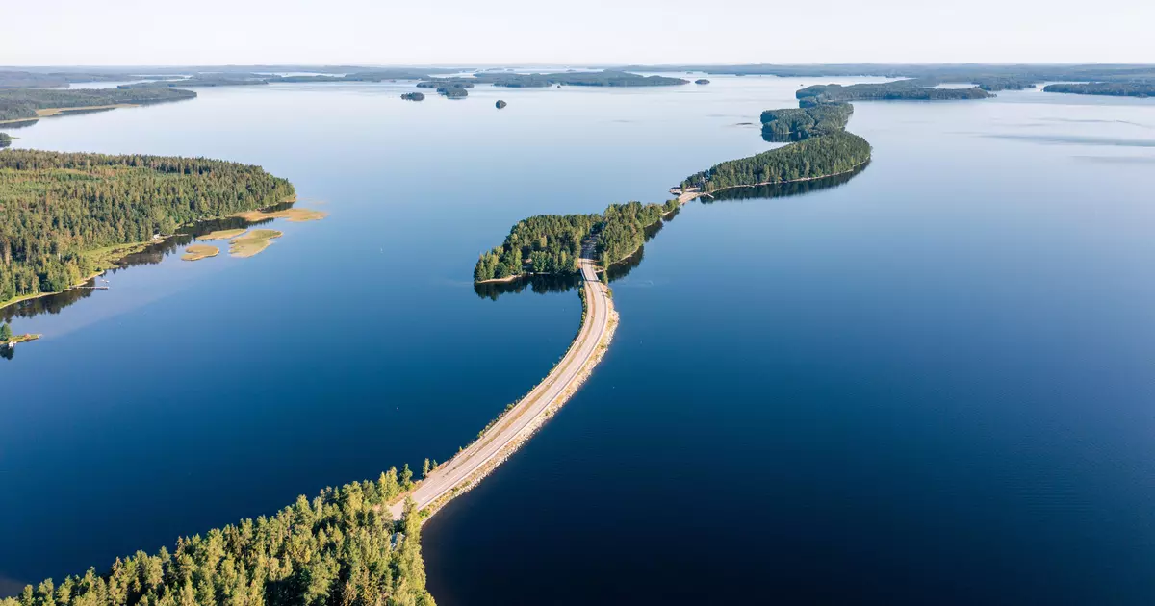
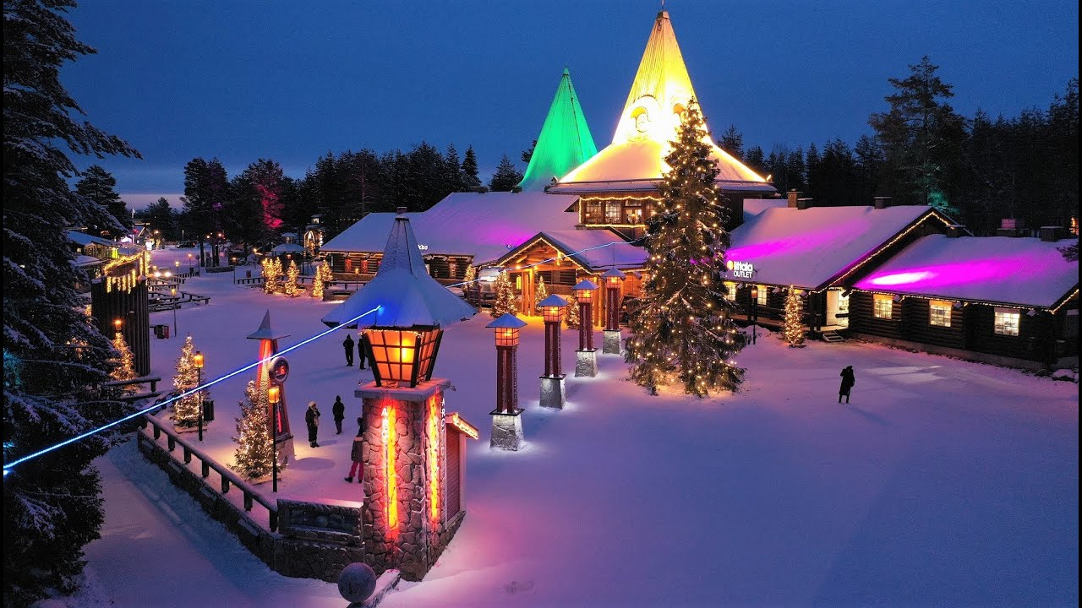
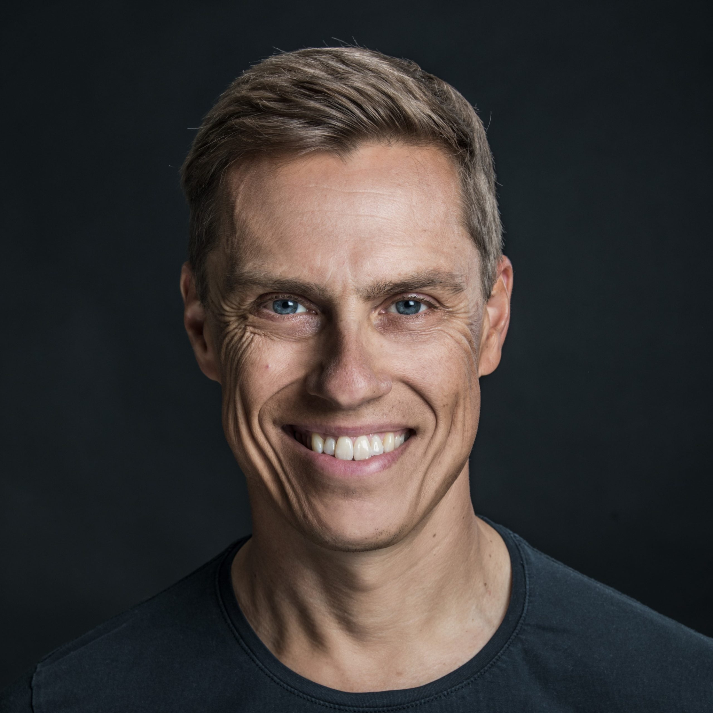
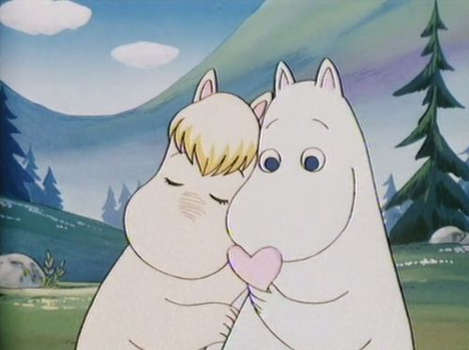
Facts about Finland
-Finland is the land of thousand lakes.
-Finland is about 338 472 km²
-Finland uses euros as their currency.
-Alexander Stubb is the president of Finland.
-Finlands population is about 5.5 million people.

Slide 3
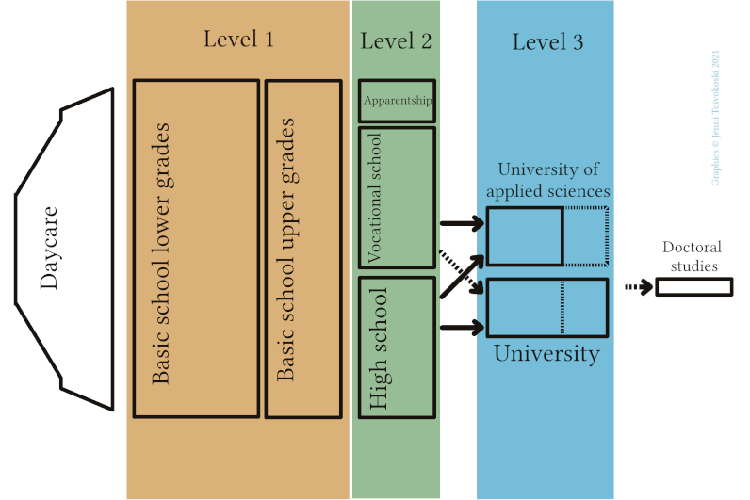
The Finnish school system

Slide 4

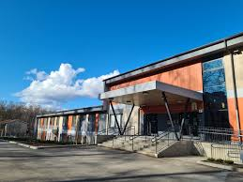
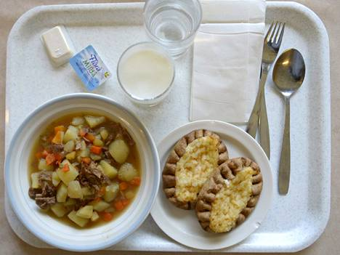
Our school: Ojamonharjun yhtenäiskoulu
We have about 660 pupils in the grades 1- 9. There are about 80 teachers and assistants.
The school food is free in Finland.
Compulsory subjects are Mathematics, History, Biology, English, Swedish, Sports etc.
In the 8th you can choose subjects like Home economics, Textile work, Art, Sport, German and Spanish.

Slide 5
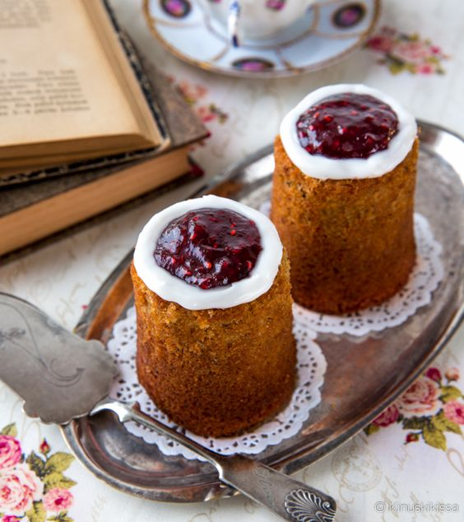
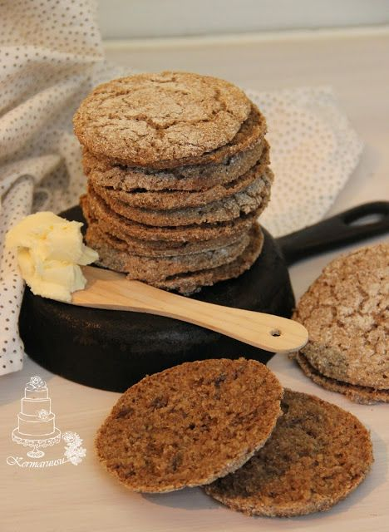
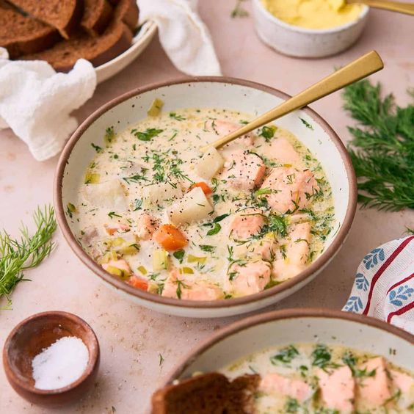
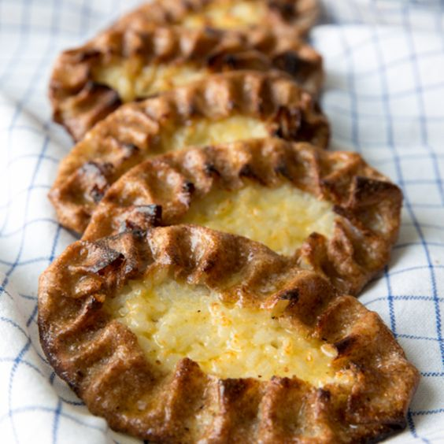
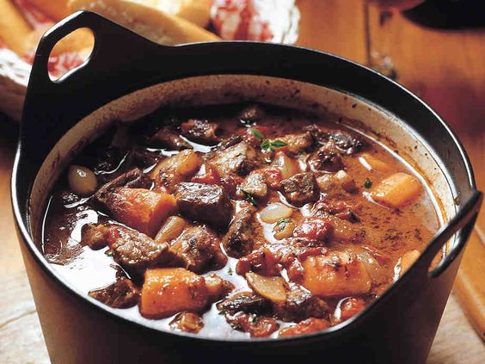
Traditional and typical food
Finnish food culture values simple and local ingredients, featuring dishes like rye bread (ruisleipä), salmon soup (kalakeitto), and reindeer (poronkäristys).

Slide 6
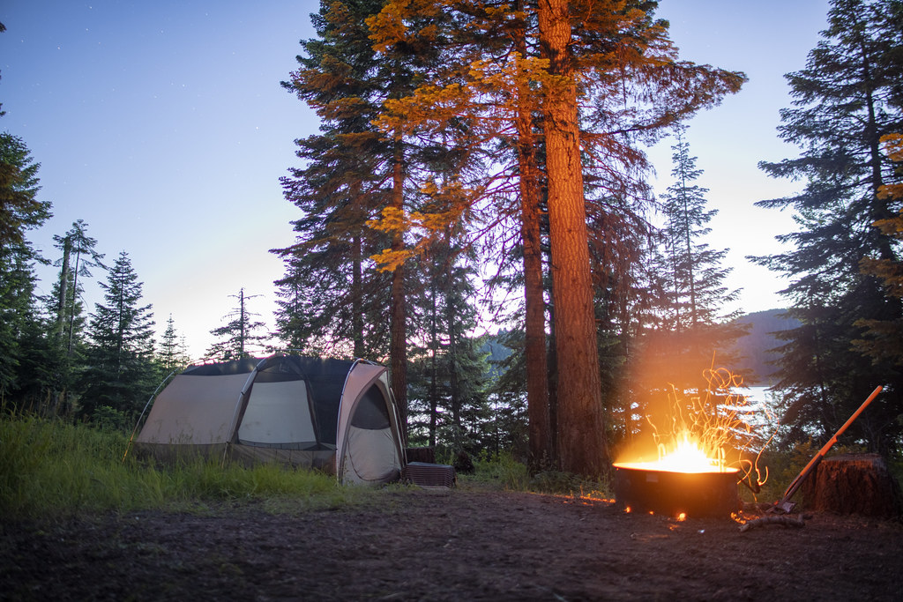
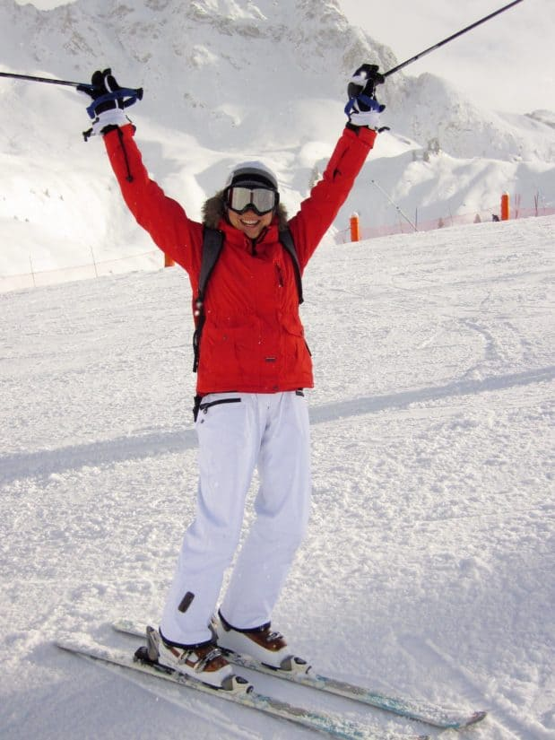
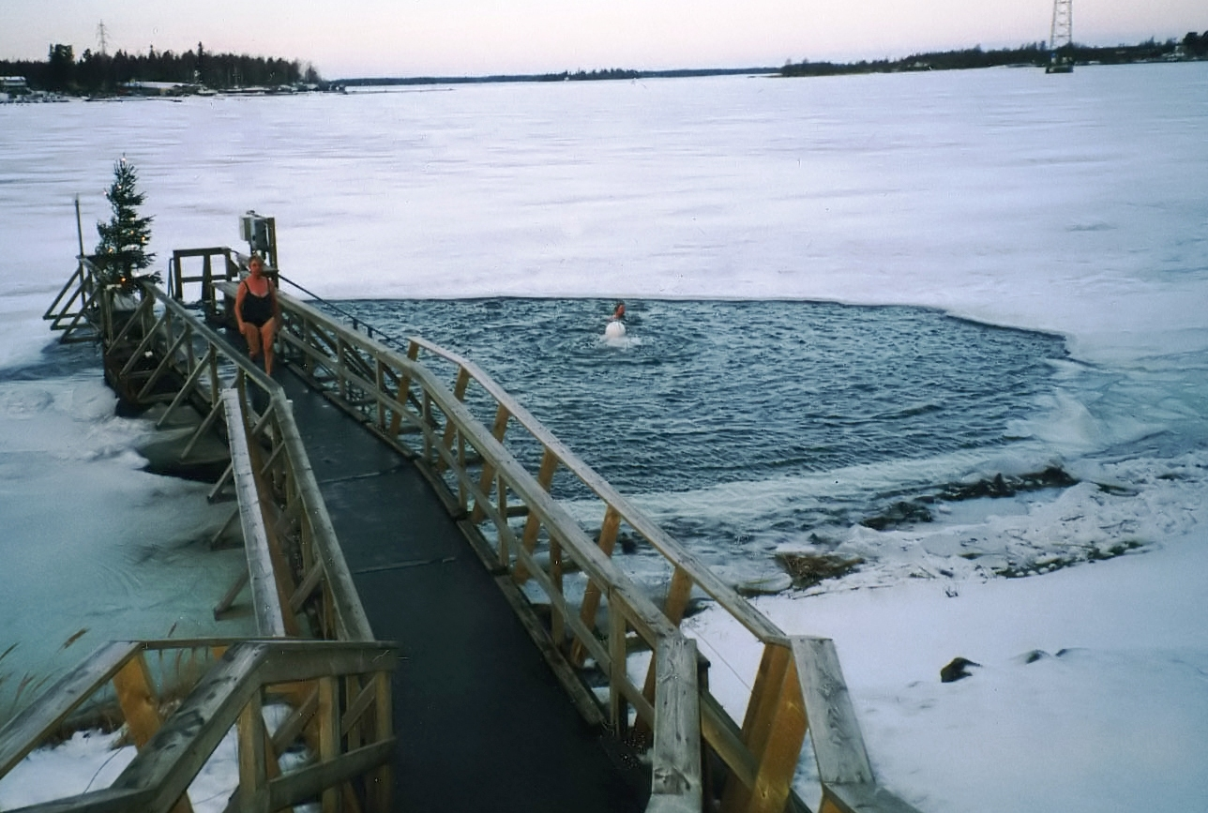
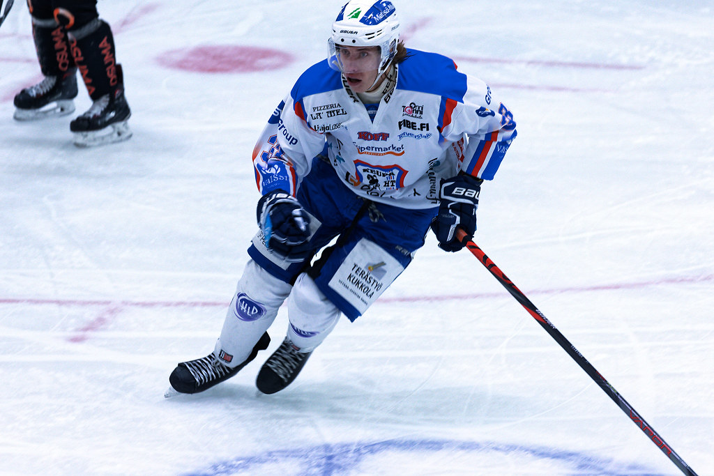
Freetime and sport
we do sports for example
camping, skiing, ice swimming
and ice hockey

Slide 7
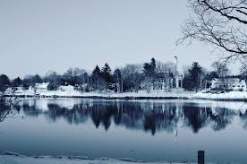
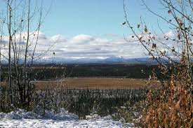
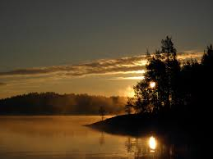
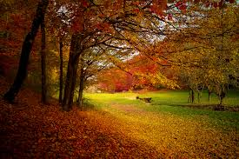
Nature and climate
Finland has four seasons: winter, spring, summer and autumn.
Finnish nature consist mostly of forests, lakes, swamps and fields.

Slide 8
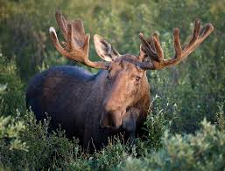
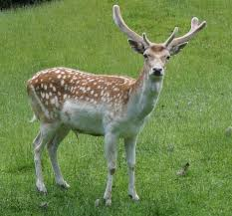
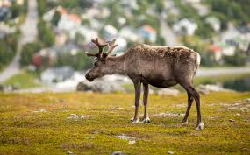
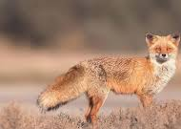
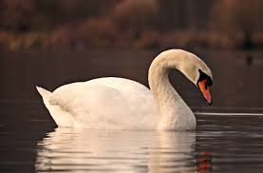
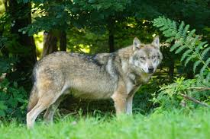
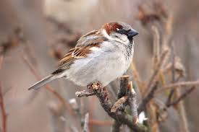
Finnish animals
Commonly seen animals are moose, deers, wolves, reindeer, foxes, sparrows and swans.

Slide 9
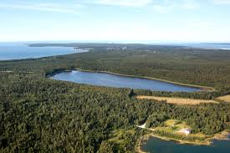
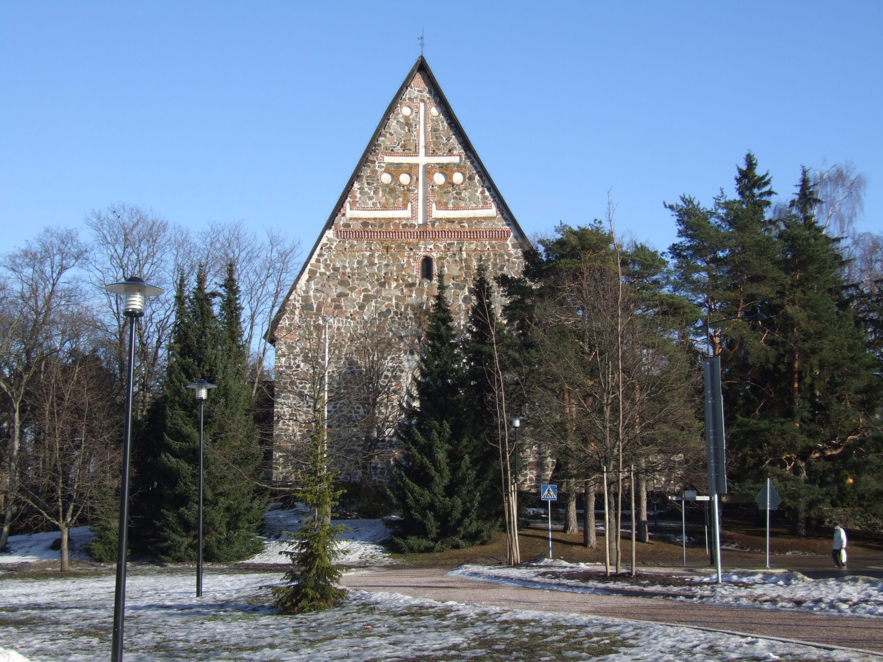
Main sights in Lohja
Church of St. Lauri in Lohja (Lohjan Pyhän laurin kirkko)
Lake Lohja (Lohjanjärvi)

Slide 10
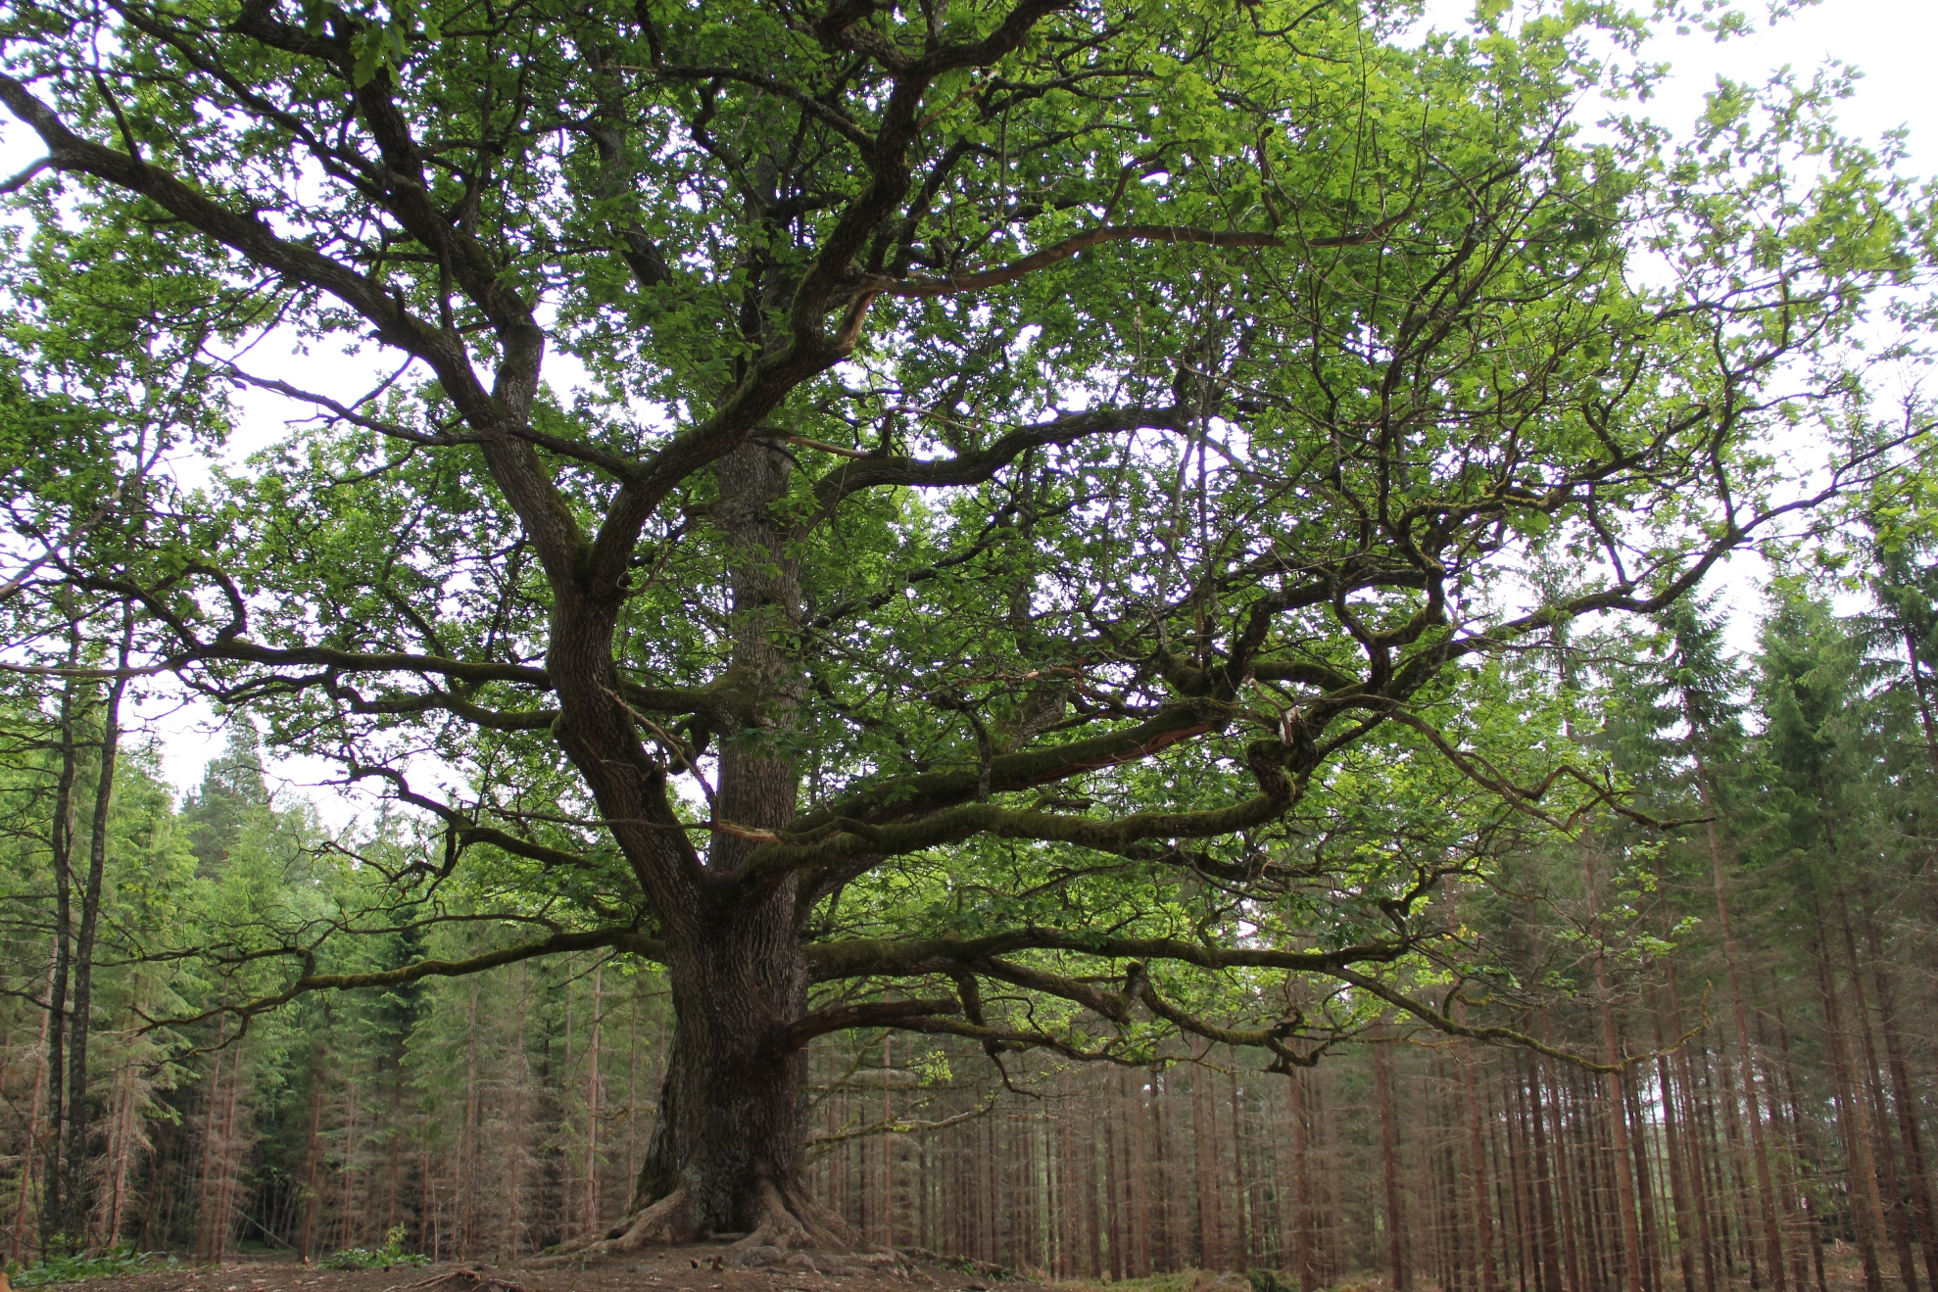
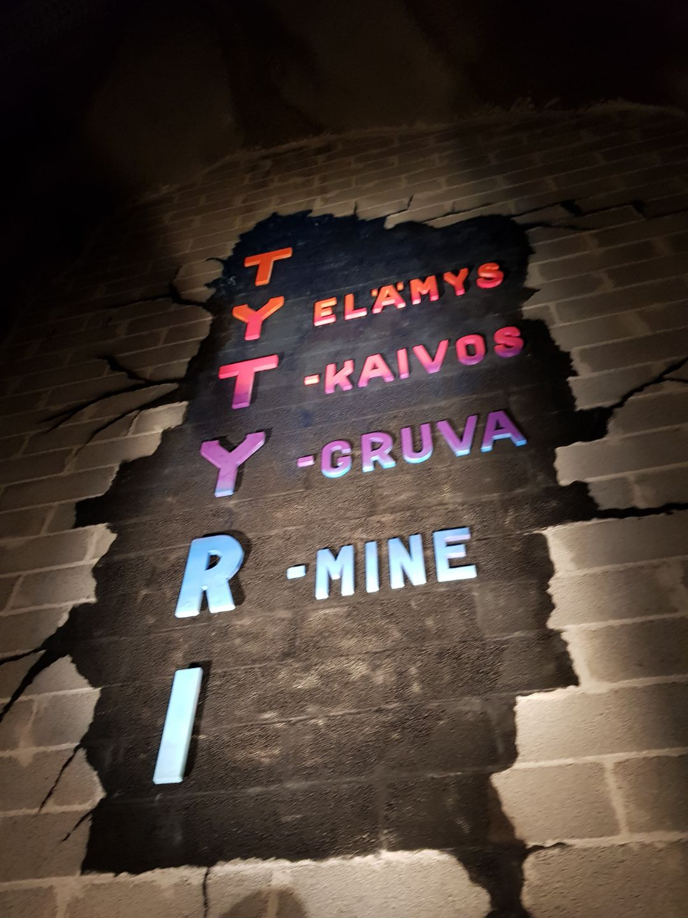
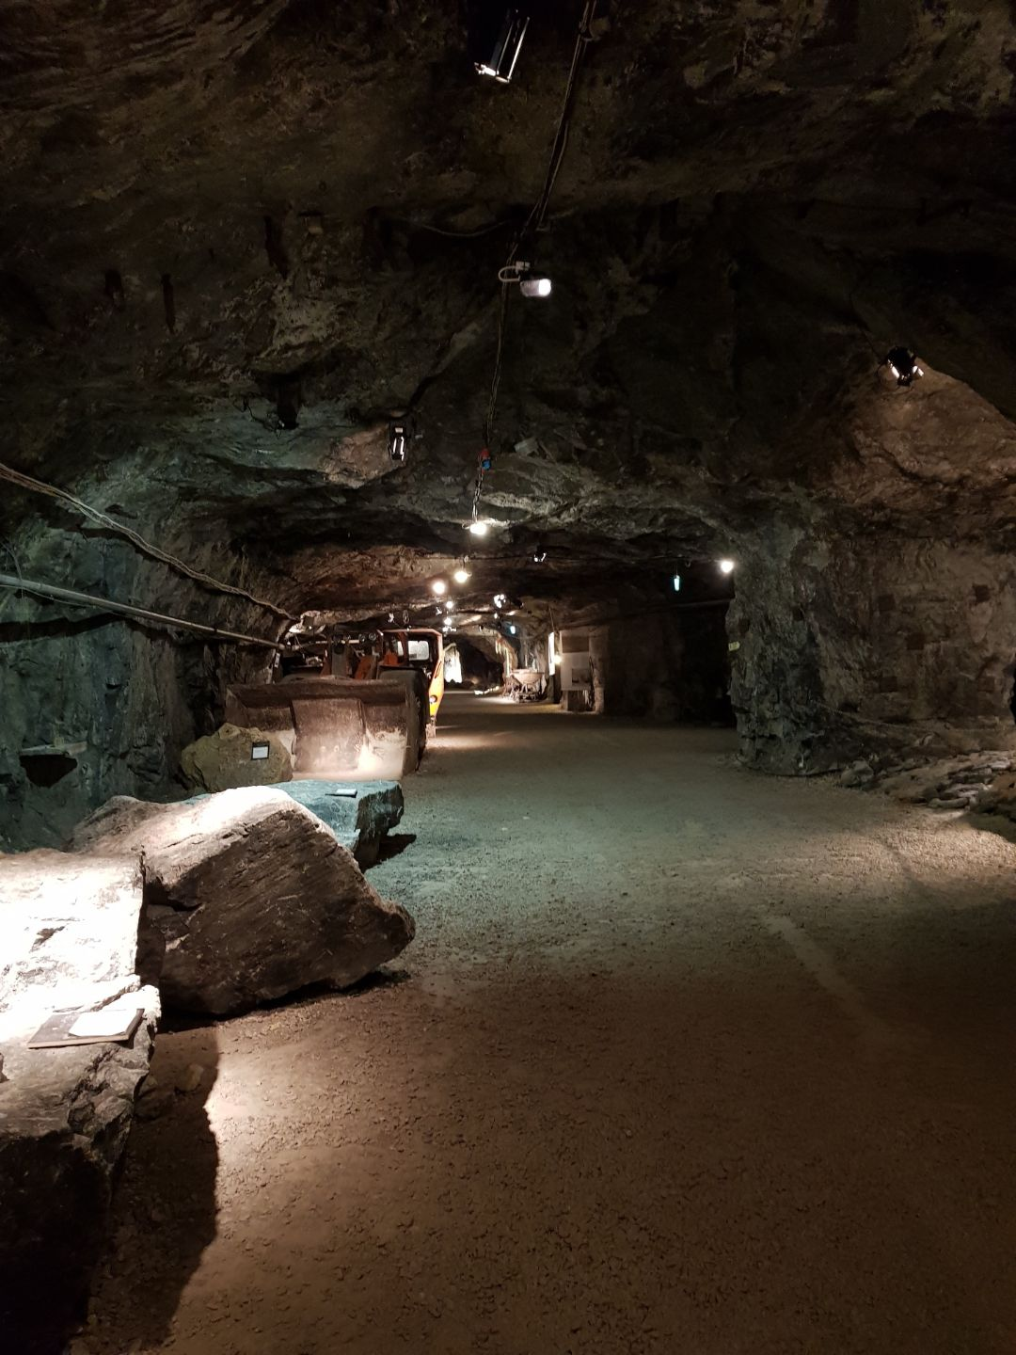
Main sights in Lohja
Paavola’s Oak (Paavolan tammi) Tytyri’s mine(Tytyrin kaivos)

Slide 11
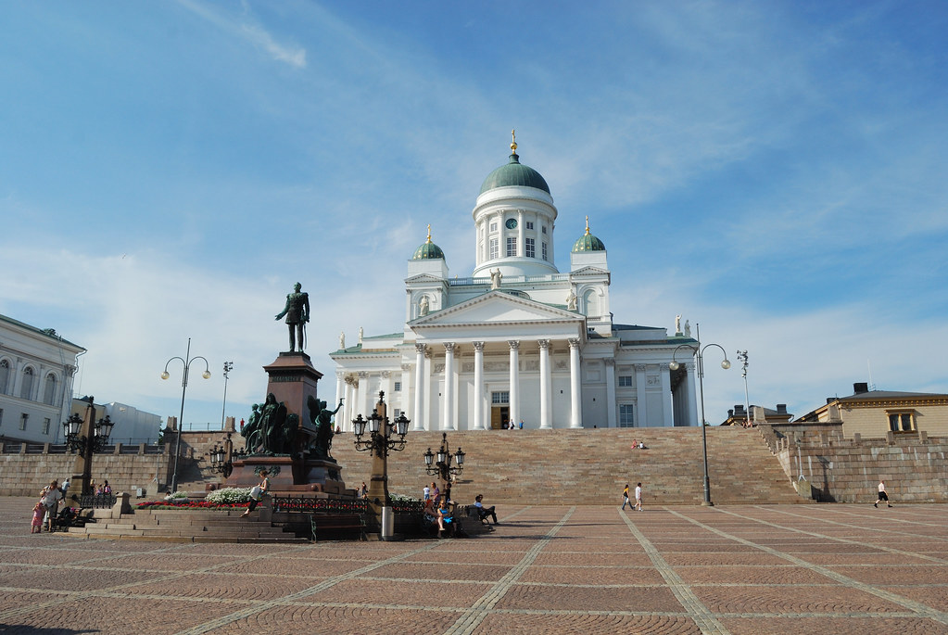
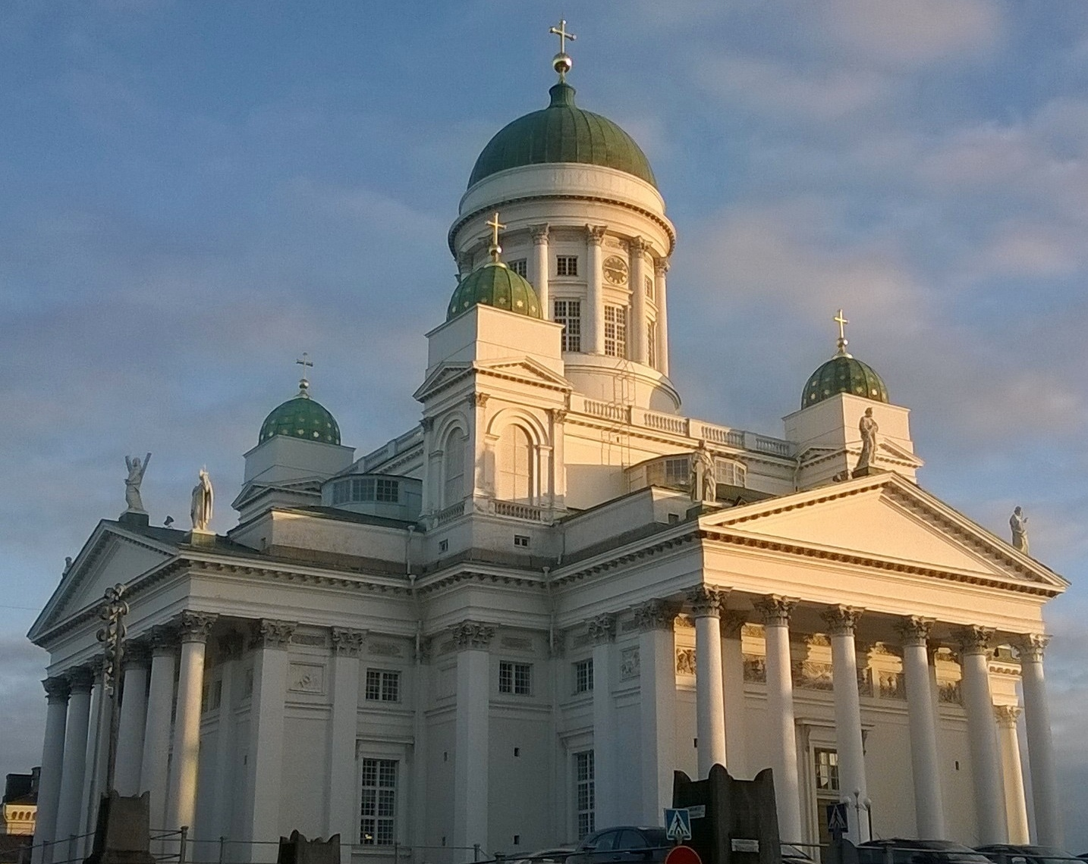
Main sights in Finland, Senate square
One beautiful sight is in a centre of Helsinki, Senate square.

Slide 12
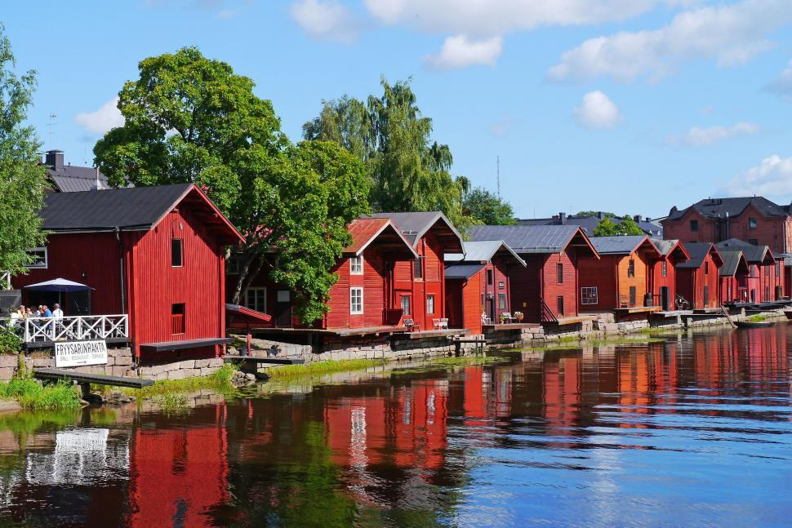
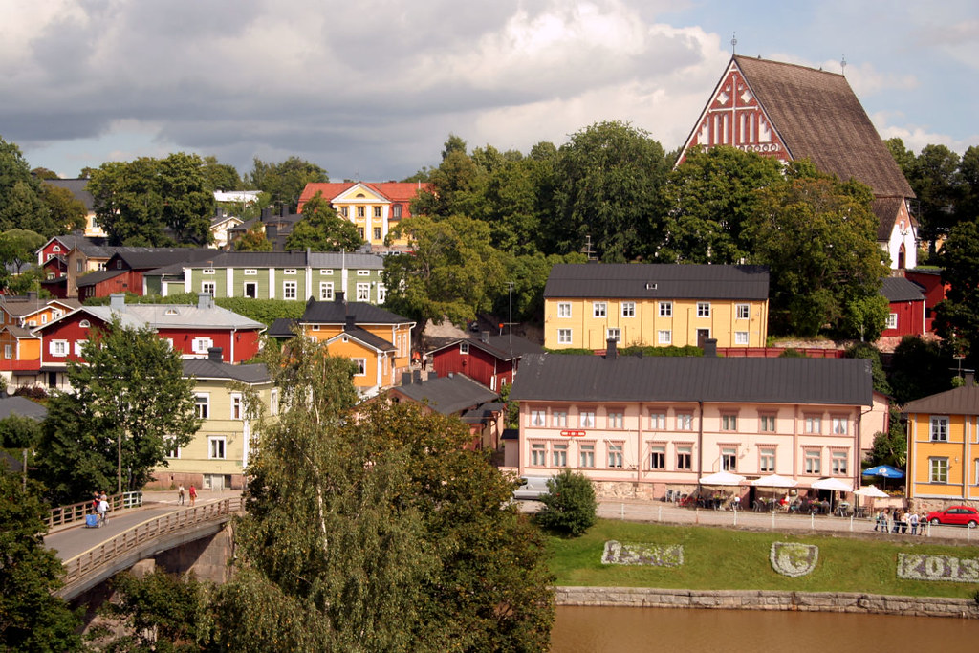
Porvoo
Porvoo is a city in Finland. You can especially go to see the older part of Porvoo.

Slide 13
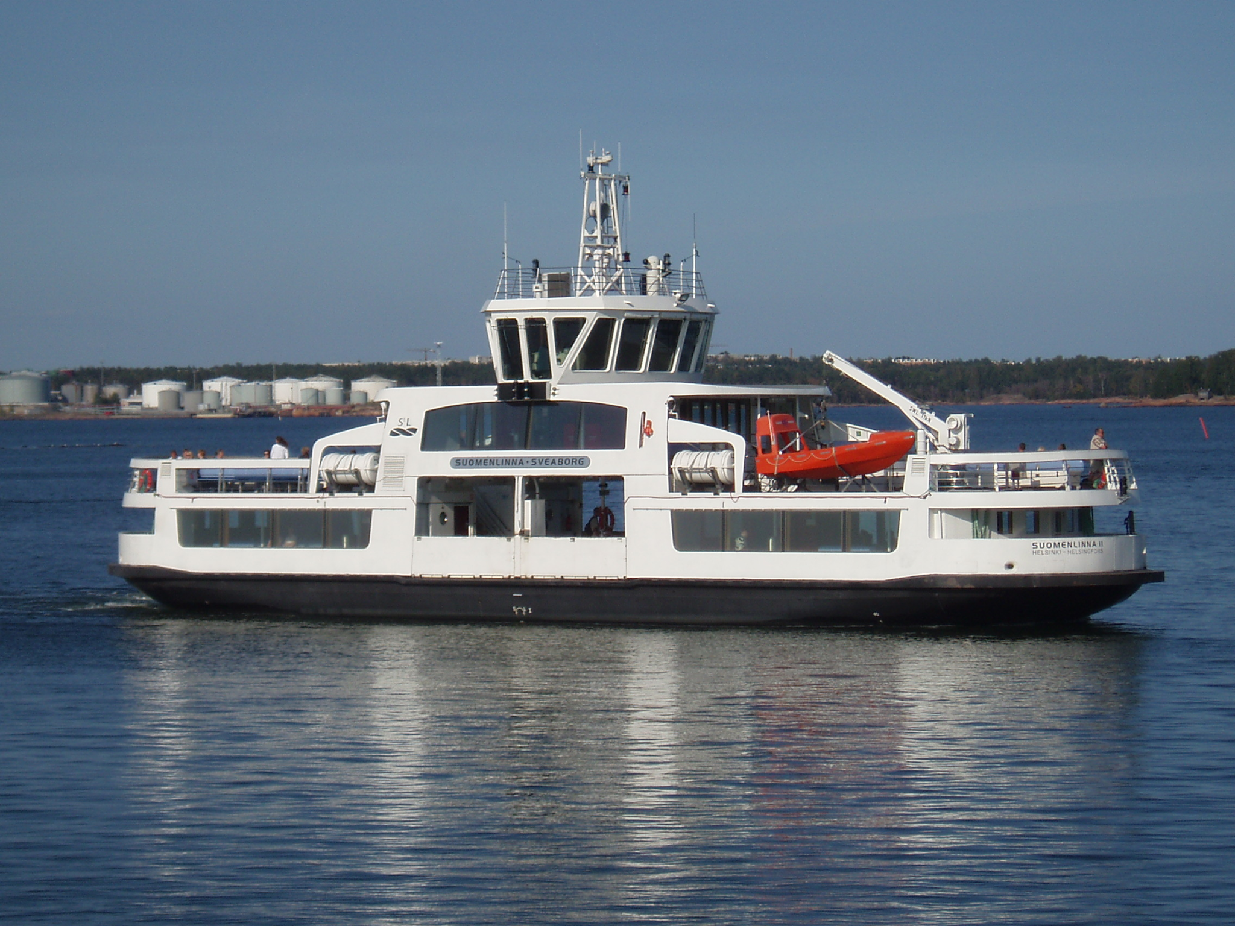
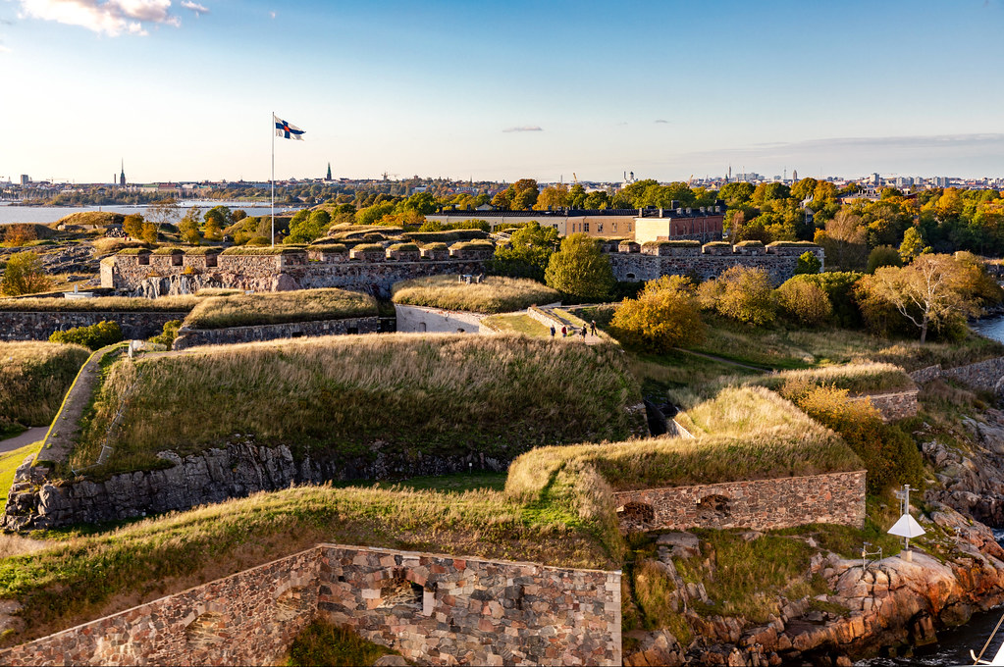
Sea Fortress
A historical place where you can go only by ferry.
This is a example of ferry

Slide 14

Thank you for watching!
https://www.youtube.com/watch?v=b3iA8VDpnrg

