Slide 1
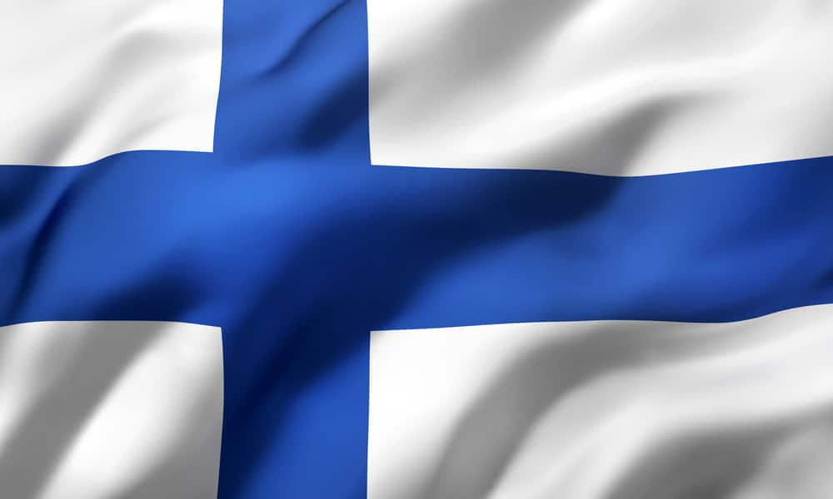

FINLAND

Slide 2
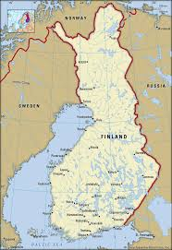
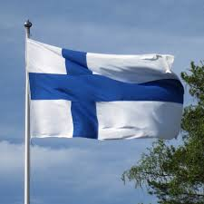
Facts about Finland
Finland is known for being voted the happiest country in the world for 7 years in a row!
Finland is often thought as being an Scandinavian country but actually finland is an Nordic country and not a Scandinavian country like Norway, Sweden and Denmark.
Finland has the most lakes in Europe in total 188,000.
Finland has invented stuff like Supercell, Angry birds, Moomins and the famous Nokia phones.
Capital: Helsinki.
Population: 5,556 million people.
Area: 338 426 km2
Official languages: Finnish and Swedish.

Slide 3
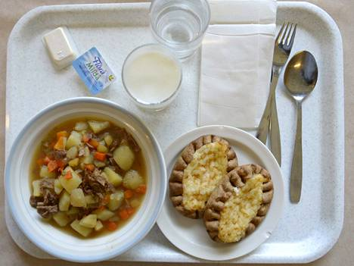
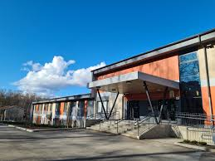
The Finnish School
The school food is free in Finland, most of students think that school food is bad.
Finland have 190 school days in year. Our school day starts 8.10, 9.00 or at 10.00. The school ends at 13.10, 14.10 or at 15.00.
Compulsory subjects are Mathematics, History, Biology, English, Swedish, Sports etc.
In the 8th you can choose subjects like Home economics, Textile work, Art, Sport, German and Spanish.
Our school is a comprehensive school with grades from 1st grade to the 9th grade. After basic education you go to the vocational school or upper secondary school.

Slide 4
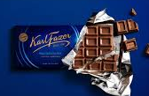
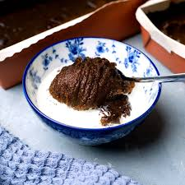
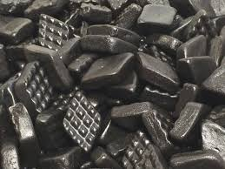
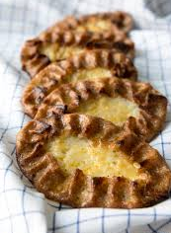
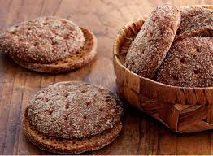
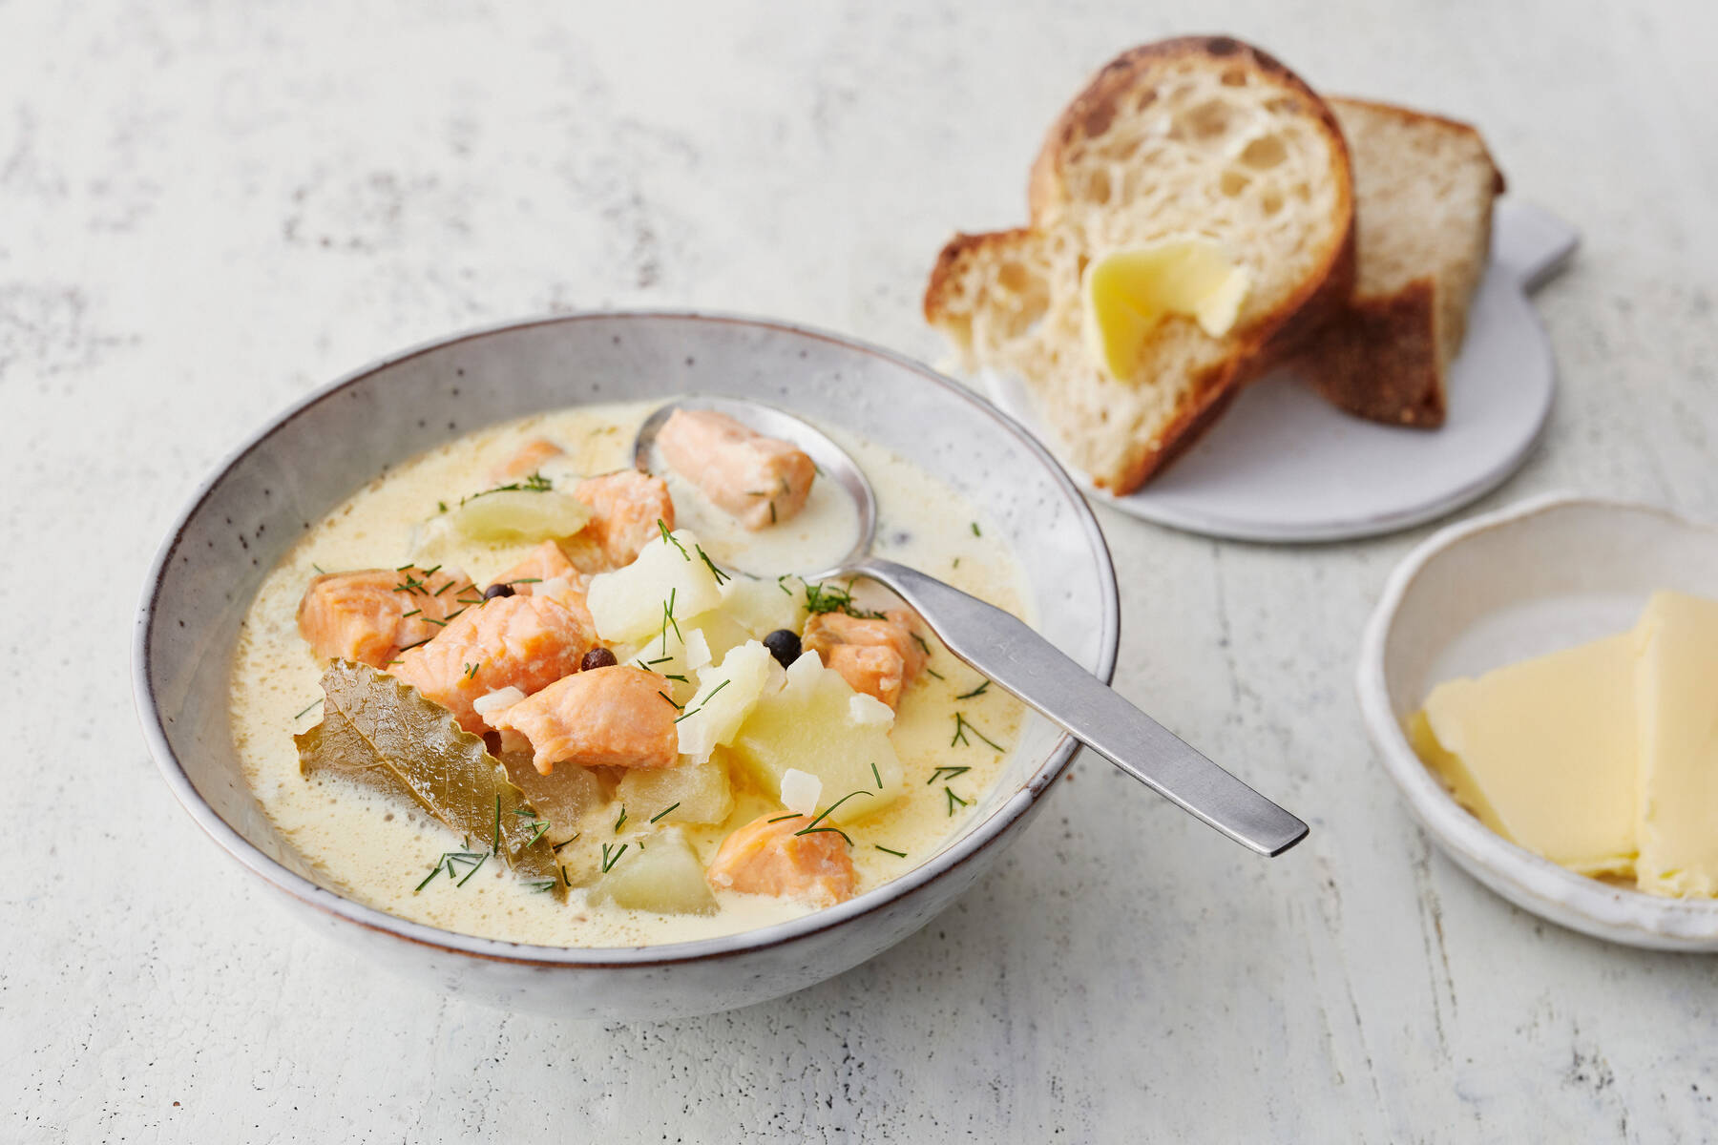
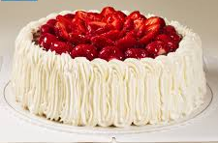
Typical Finnish Food
”Mämmi” traditional
Easter pudding (made of rye and malt)
Salty liquorice
Fazer’s blue chocolate
Karelian pie
Strawberry cream cake
Rye bread
Salmon soup

Slide 5
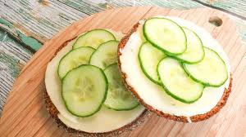
Typical breakfast: bread with cheese, cucumber/tomato, yoghurt. Many Finns also eat porridge (older people).
We eat breakfast at 7.00-7.30 o’clock before the school. There are many pupils who don’t eat at all.
We eat lunch at school 11.45.
After school we eat snack like bread again.
Some Finns eat dinner at about 17 o’clock.
And before going to sleep we eat something: fruit, cornflakes, bread….

Slide 6
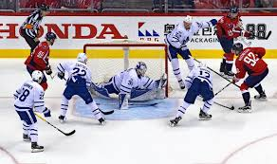
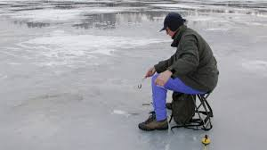
Freetime and Sport
Finnish people like ice hockey a lot and a lot of the people watch it.
Some people also like Finnish baseball, boating or go fishing in the summer or in the winter it’s called ice fishing.
Some people also like to watch football but it isn’t so popular in Finland.
Ice swimming is also also popular, a lot of the teens in Finland also like floorball.

Slide 7
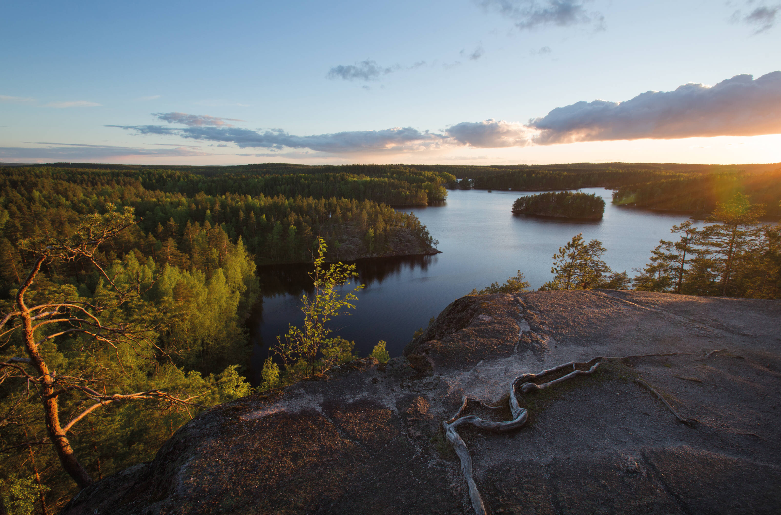
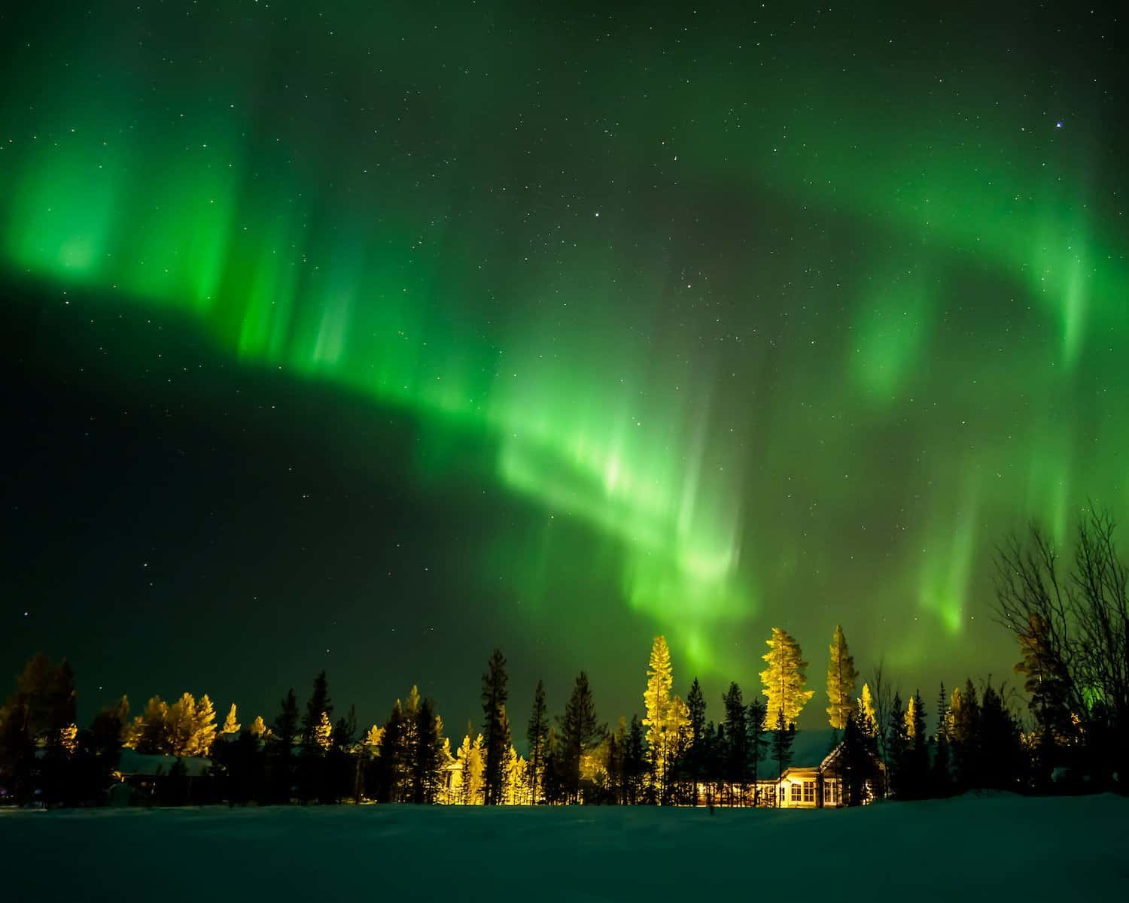
Nature and Climate
Southern Finland during summer:
Finland is a country of trees and lakes. Finland has around 188,000 lakes and most of the country is covered in trees. In Finland, summers are very short, warm and bright and winters are long, cold and dark.
The average summer temperature is around +20°C but in southern and central parts of the country, it can get much warmer than that. The average temperature during winter is anything below zero degree Celsius to minus 20 degree Celsius.
Northern Finland during winter:

Slide 8
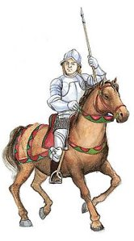
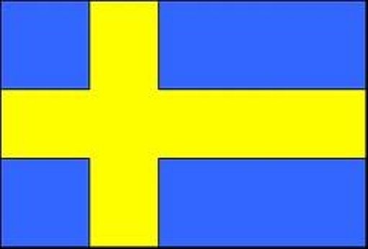
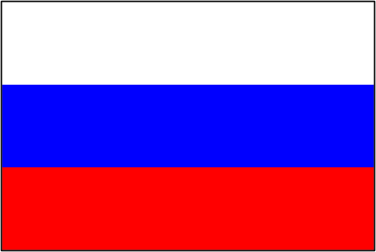
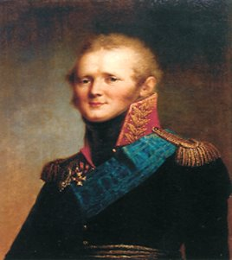
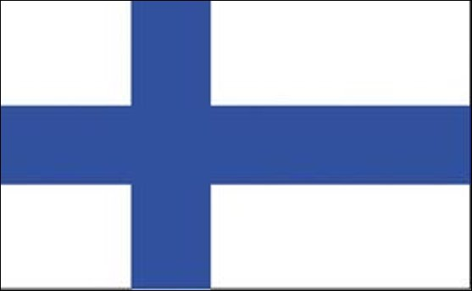
History of Finland
Finland was part of the Swedish kingdom 1155-1809.
The Finns were converted to Christianity during the years 1000-1200.
During the Napoleonic wars Finland was conquered (1808-1809) by Alexander I, emperor of Russia. Finland became a Grand Duchy. Finland was part of Russian empire during 1809-1917.
Finland became
independent 6.12.1917.

Slide 9
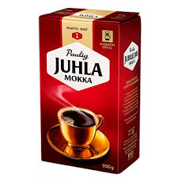
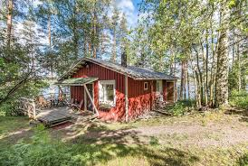
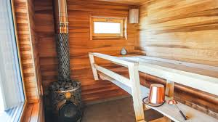
Traditions
We like to go in saunas, and it's a big part of the culture.
Finnish people don't like talk to people or ask out.
In the summer a lot of Finnish people like to in cottages and spend their summer there with friends and family.
In Finland we celebrate christmas, easter and mid summer, they are the main holidays.
A lot of Finnish people like to drink coffee in the morning.

Slide 10
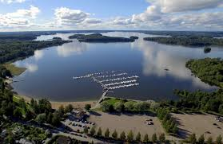
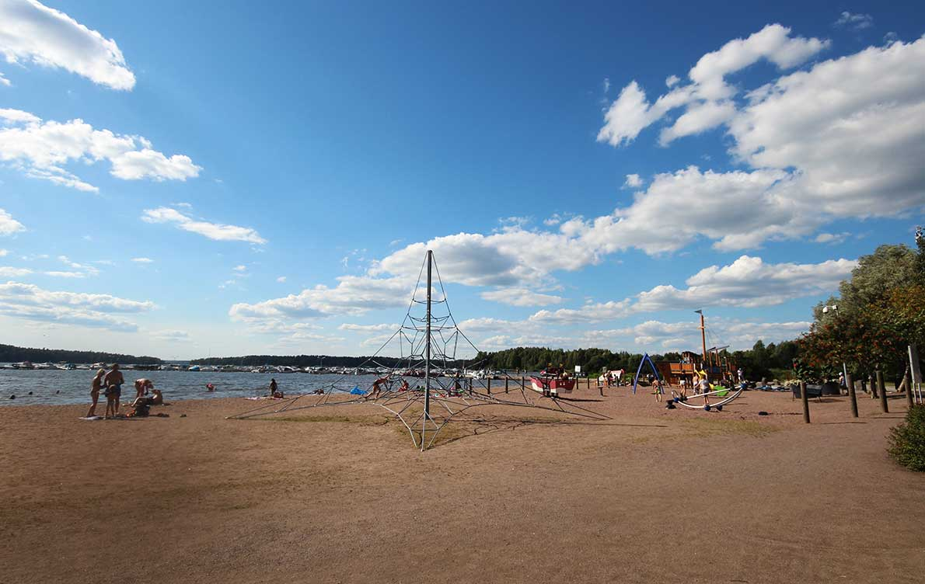
Main sights in Lohja
Aurlahti
Aurlahti is a beach that is really nice.
There are many events like rantajamit
In aurlahti is biggest harbor in lohja 400 place
You can buy food there

Slide 11
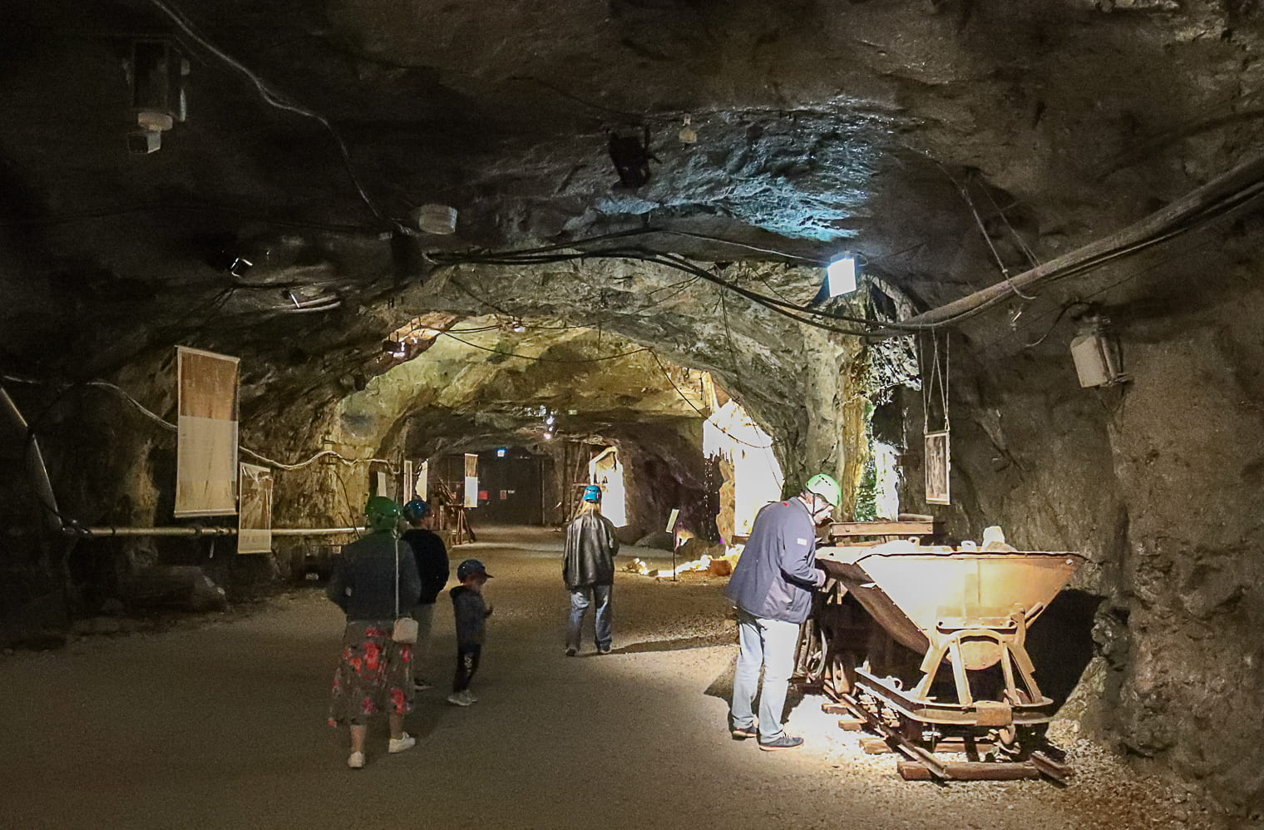
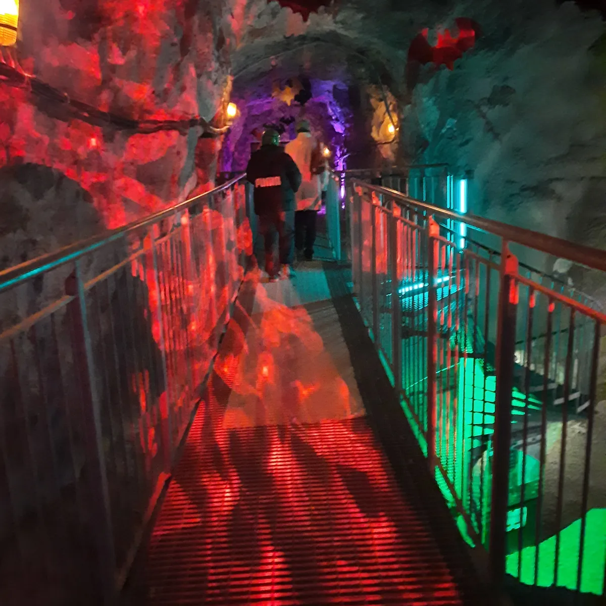
Main sights in Lohja
Tytyrin Kaivos is a mine under 100 meters. The mine is 100 years old.
During your visit, you can get to know the geological and mining history. There's also themed cave you can see there.
You may also see some characters there,
like troll, witch or Santa Claus.

Slide 12
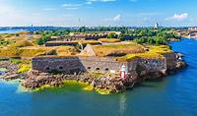
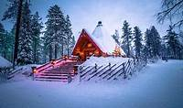
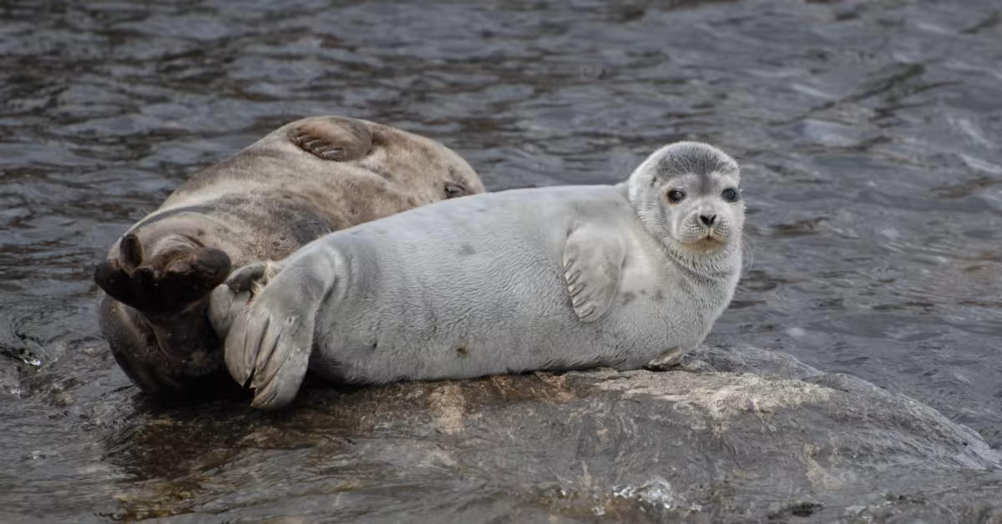
Main sights in Finland
Suomenlinna: One of the world’s largest sea fortresses, Suomenlinna is an 18th-century fort located on an island just a 15-minute ferry ride from Helsinki’s Market Square.
Rovaniemi and the Arctic: Visit Rovaniemi, the official hometown of Santa Claus, and experience the magic of Lapland. Don’t miss the chance to see the Northern Lights and explore the Arctic wilderness.
Saimaa: The biggest lake in Finland. It is about 1377 km2. Here you can find the Saimaannorppa (Saimaa ringed seal).

Slide 13
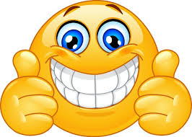
THANKS!
BY:veeti and jEmIl NyKuLla :-)
Finland- beautiful country (2:34min)
https://www.youtube.com/watch?v=b3iA8VDpnrg
Jean Sibelius Finlandia
https://www.youtube.com/watch?v=F5zg_af9b8c&t=317s

