Slide 1



FINLAND
MALAGA, SPAIN 10.-16.11.

Slide 2
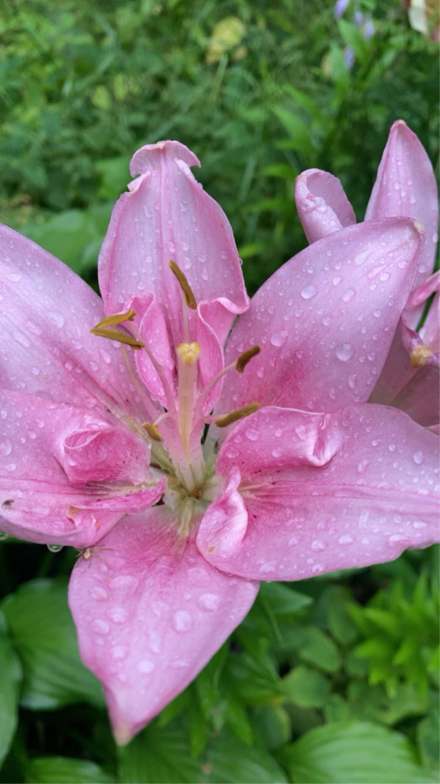
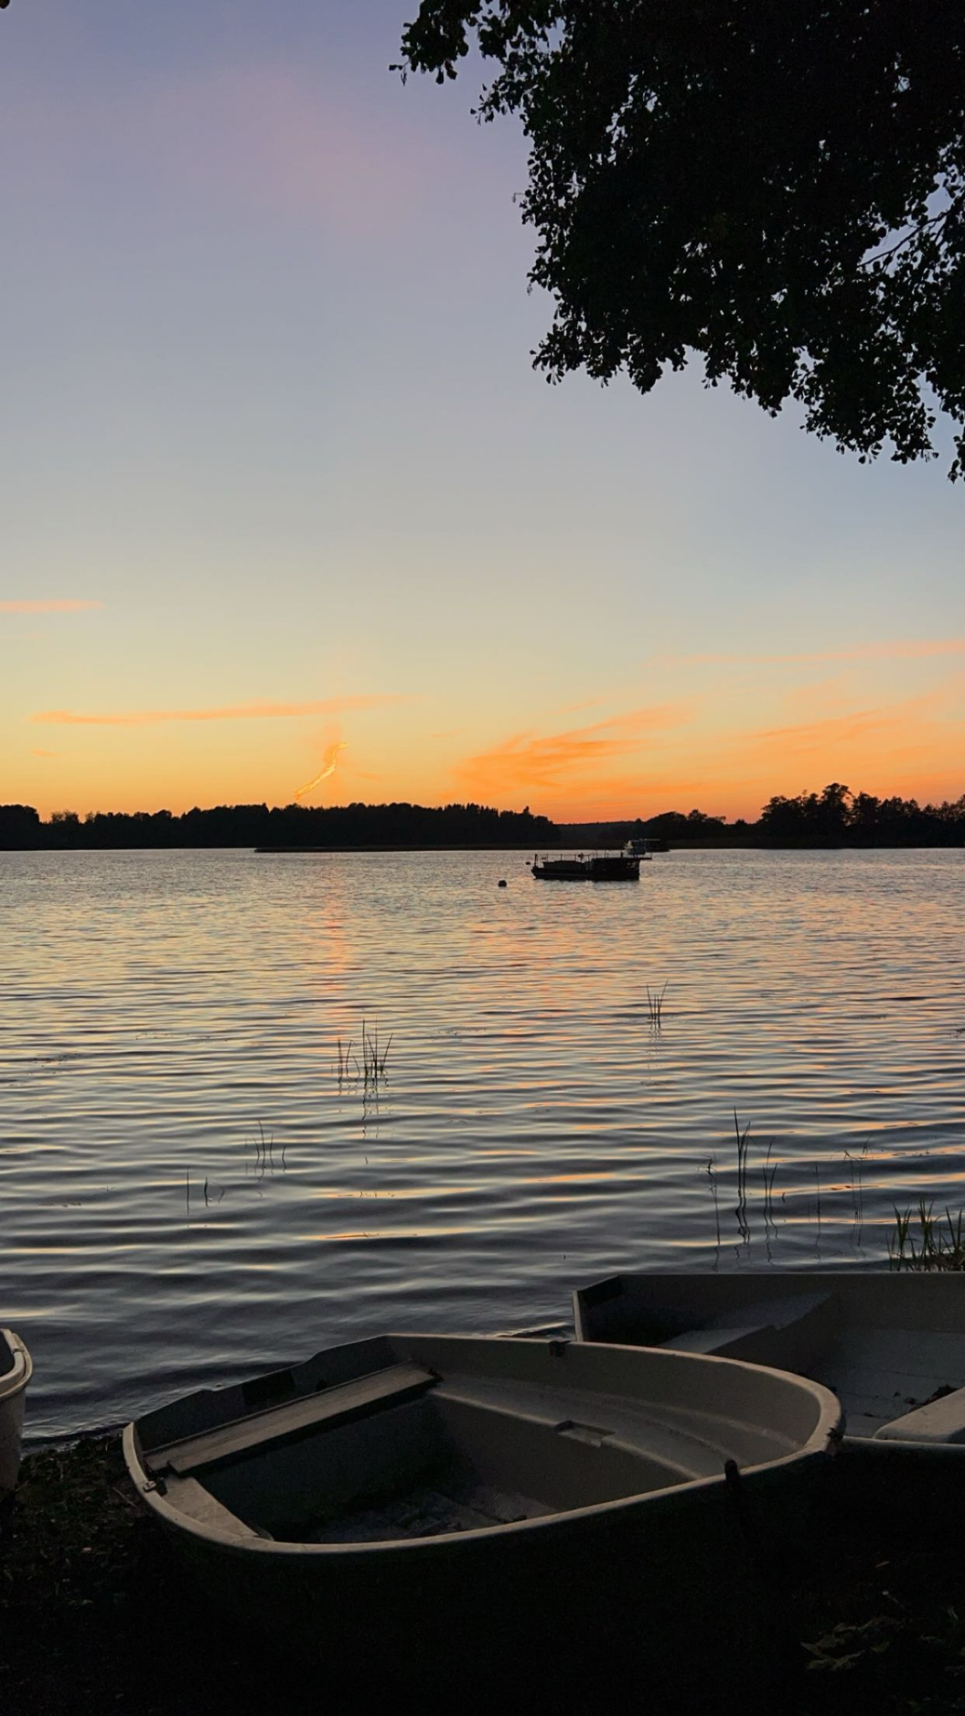
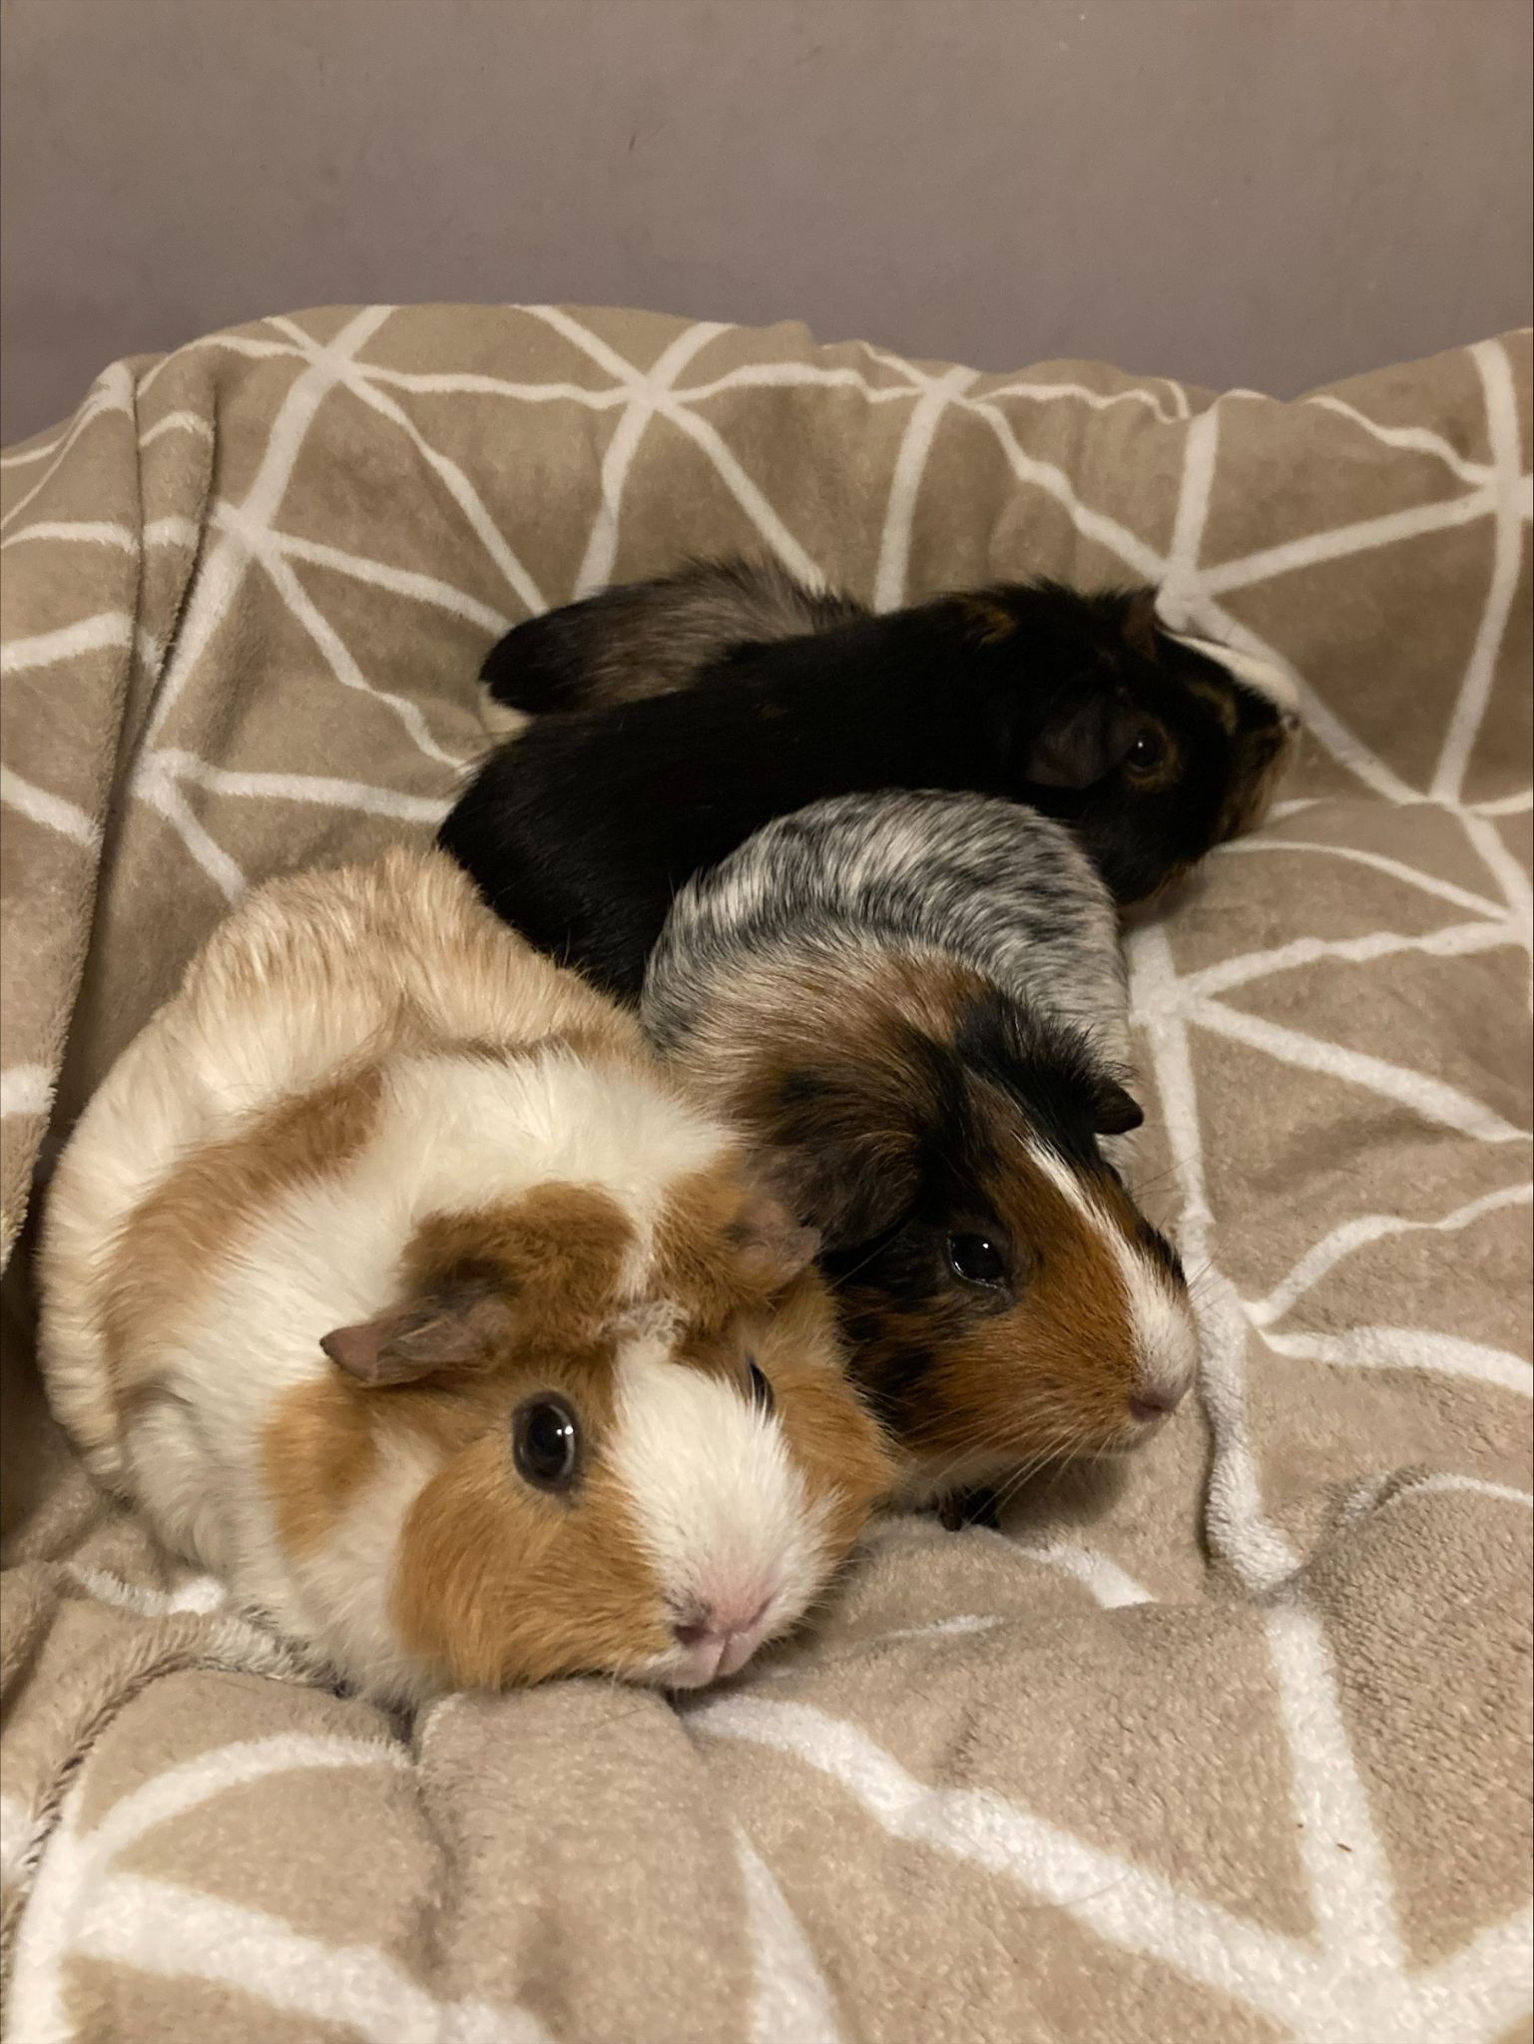
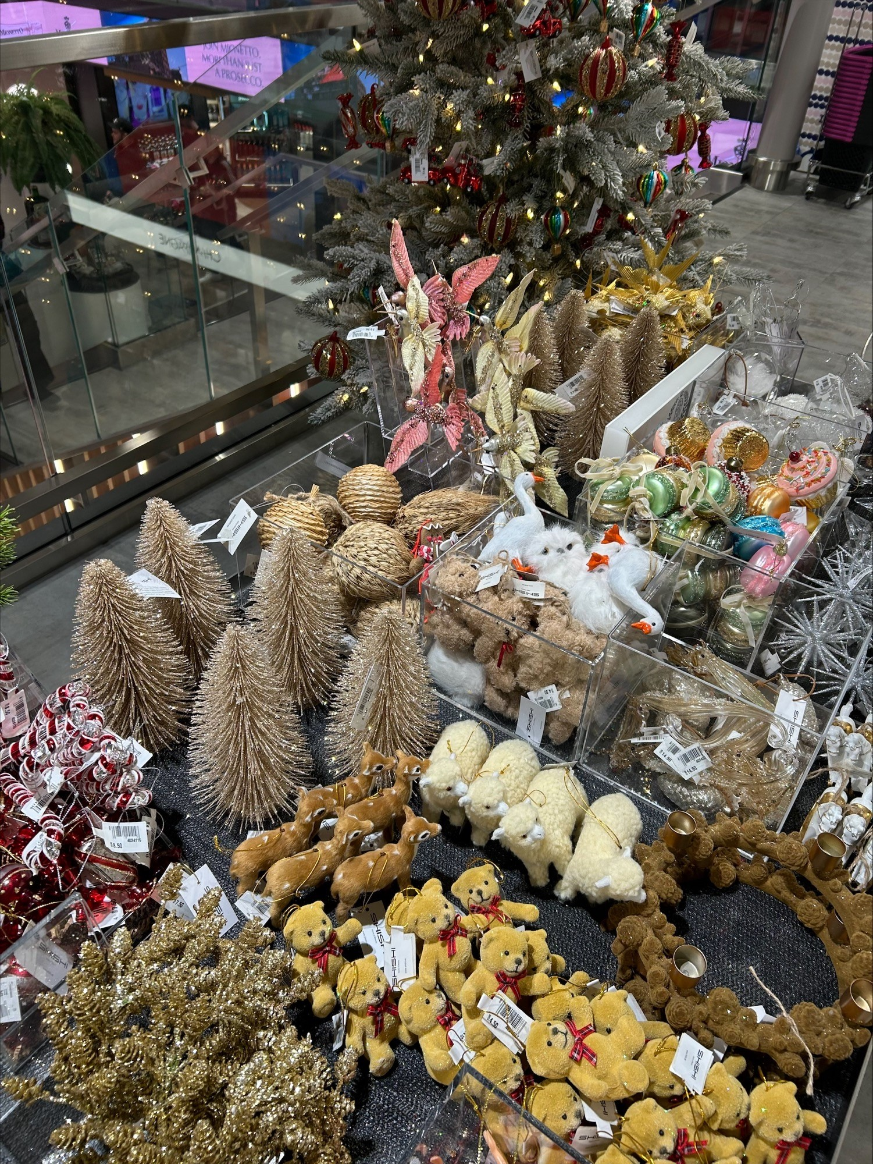
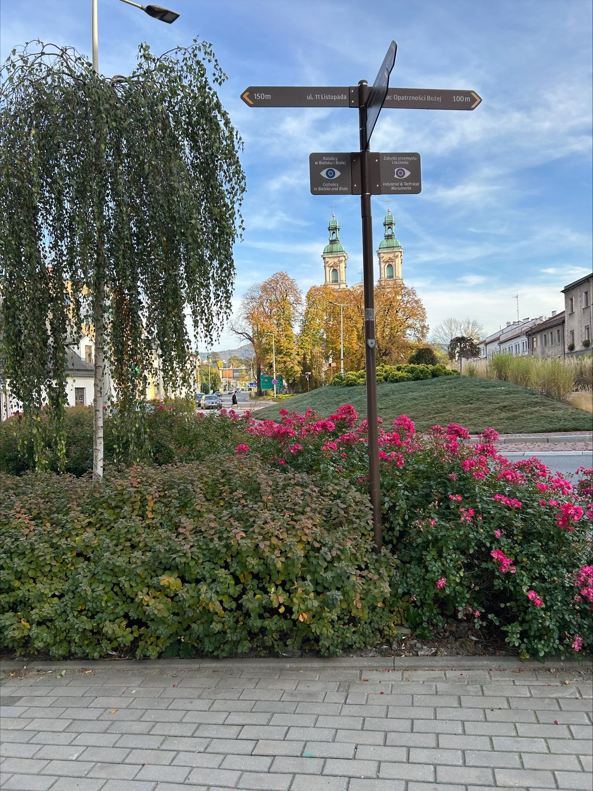
Hi! My name is Janika Isabella Itkonen. I’m 15 year old and I live in Lohja. In my family there are 6 of us and 8 guinea pigs. I have 3 younger brothers, mum and a dad. My brother all play football and they go to the same school as I. Also I have grandparents and other family around Finland. I live in a townhouse and I have my own room. Our family has a summer cottage in Kuhmalahti and it awesome.

Slide 3
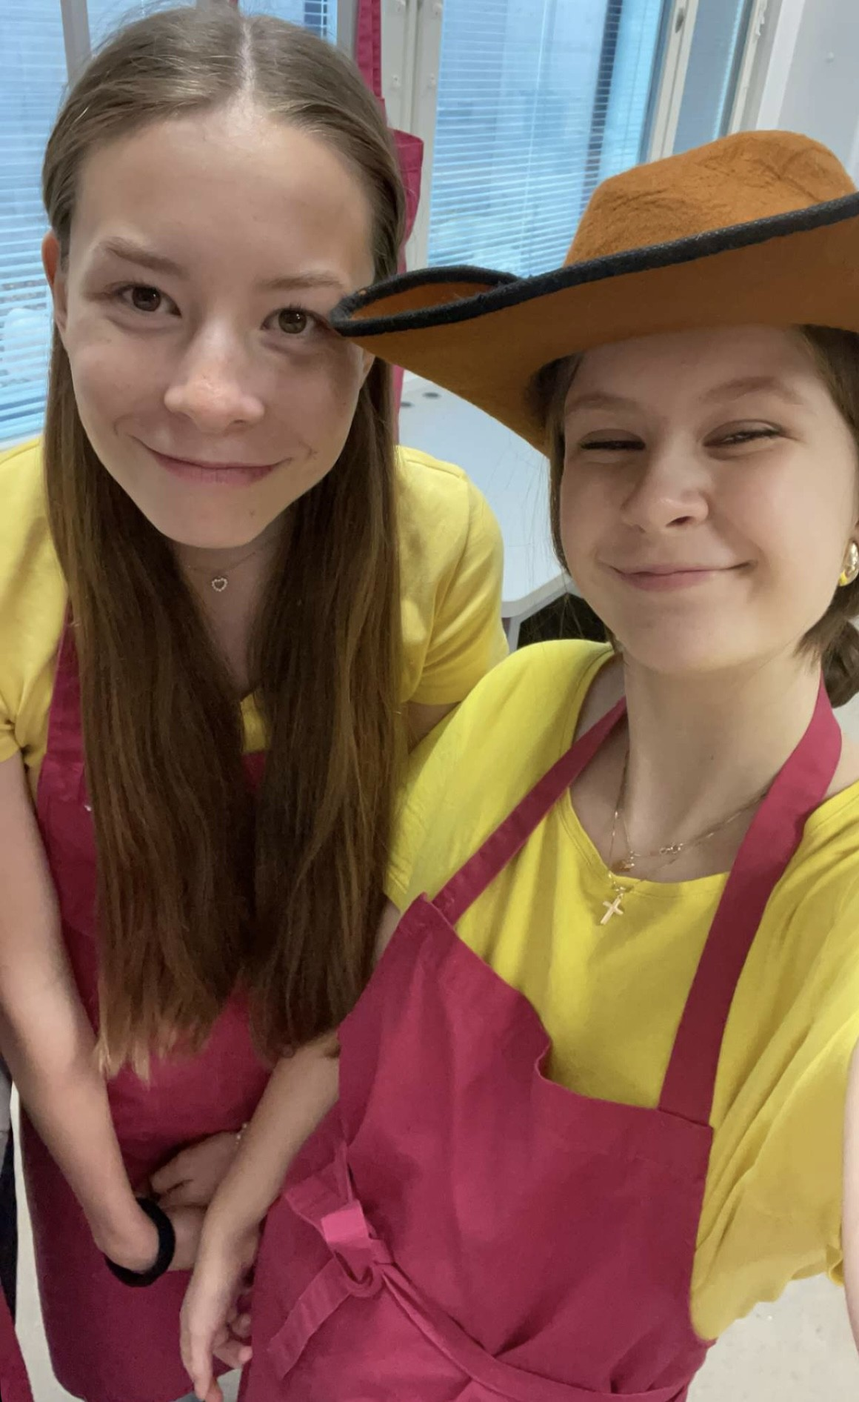
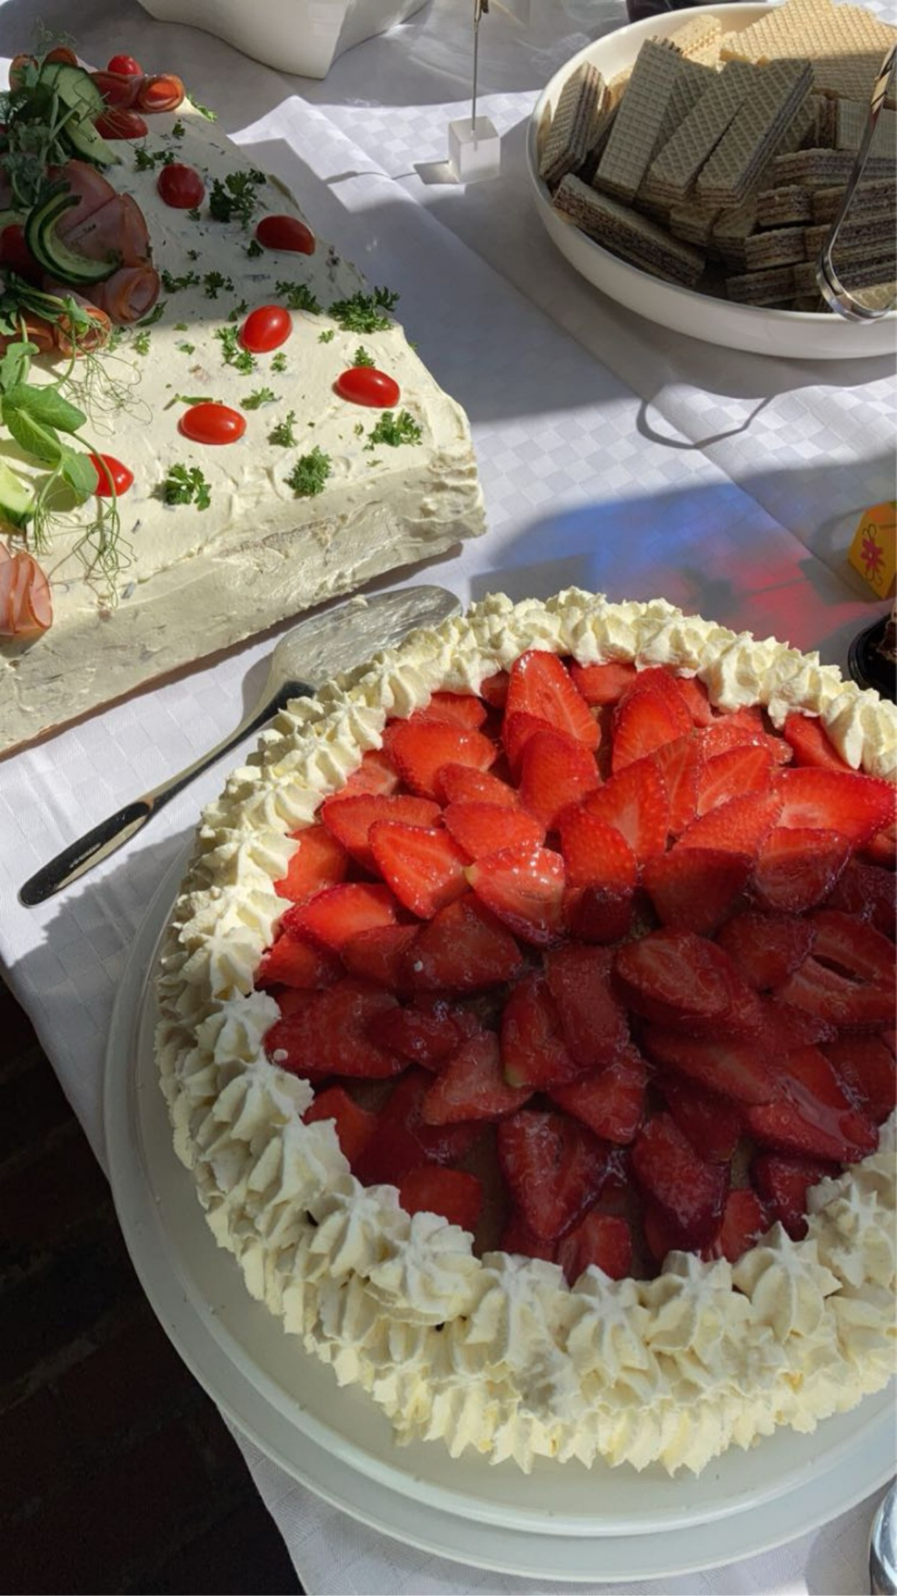
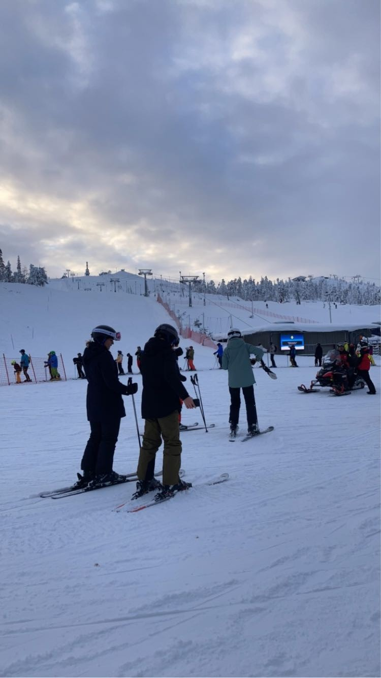
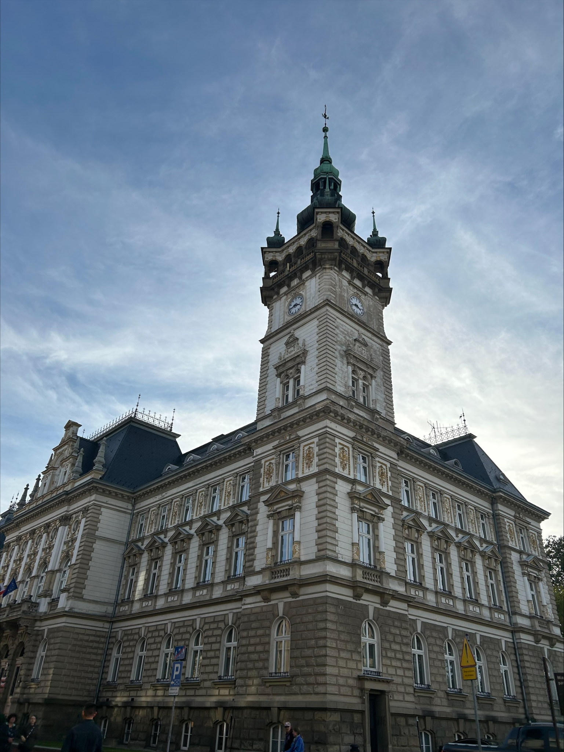
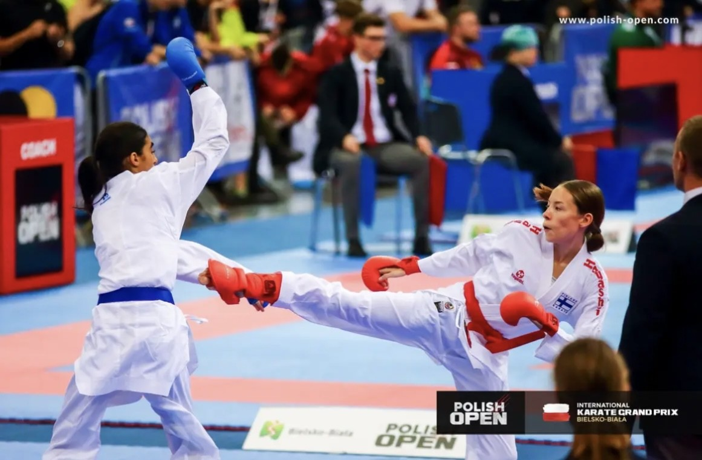
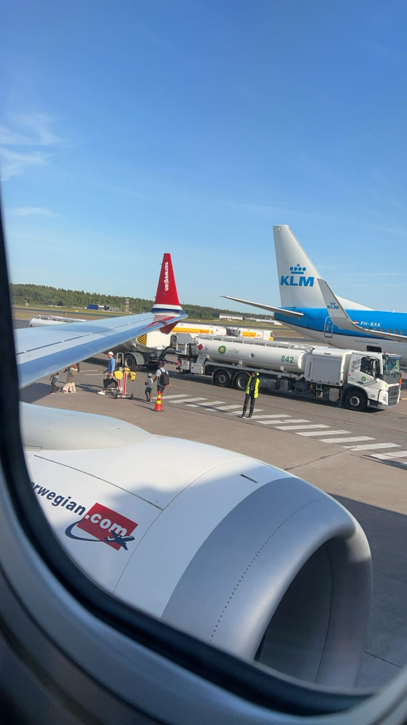
Things I like
My hobby is karate and I train 3-5 times a week. Also I go to competitions and camps with Finnish national team. In free time I like to go out with my friends and family, train a lot, bake different kinds of things and I also like snowboarding in the winter. I have travelled to different places in Europe, but mostly it’s just in the north. I don’t listen music so much, but sometimes it’s fun. I like to eat finnish foods and desserts, because they are super delicious. I love Christmas time and snow. Christmas is wonderful and you get to see everyone, do fun things with them and eat Finnish traditional Christmas dishes.

Slide 4
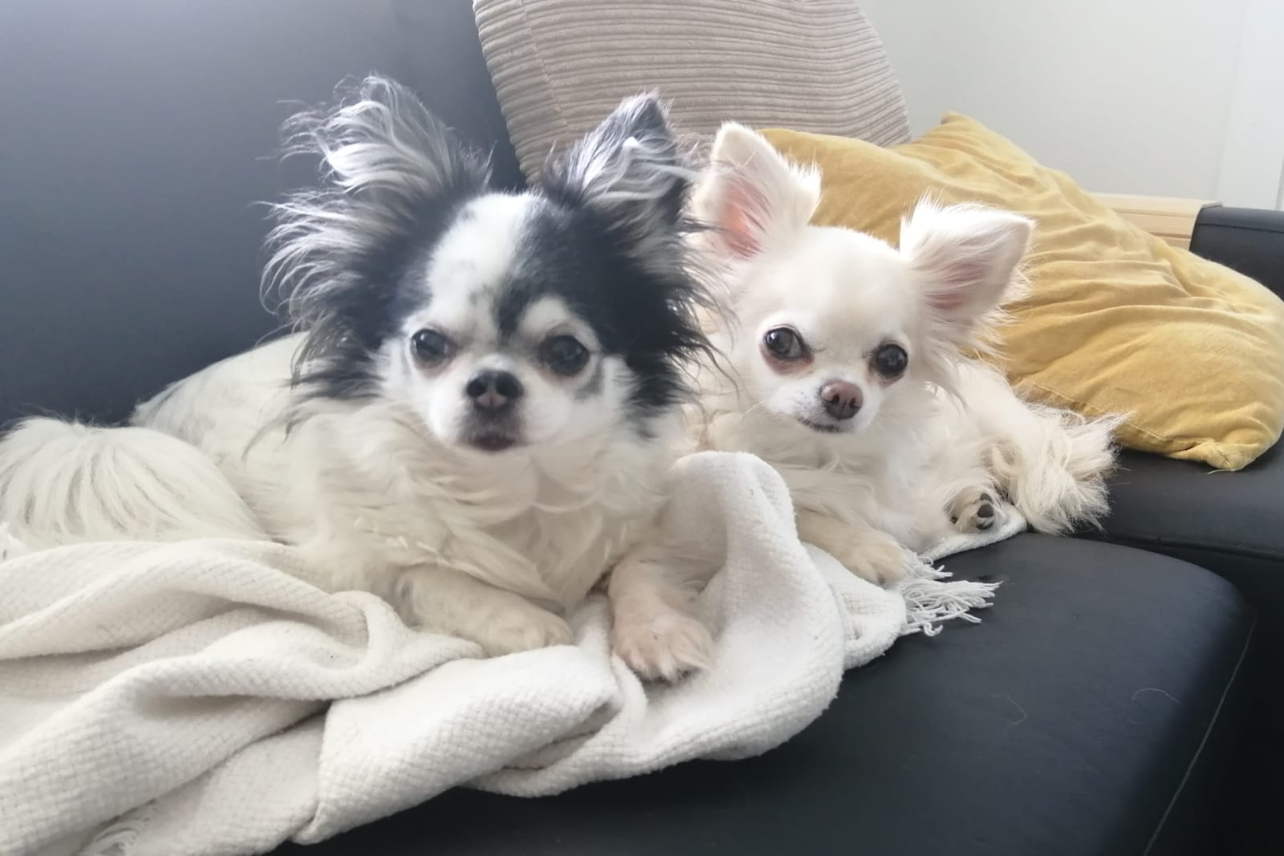
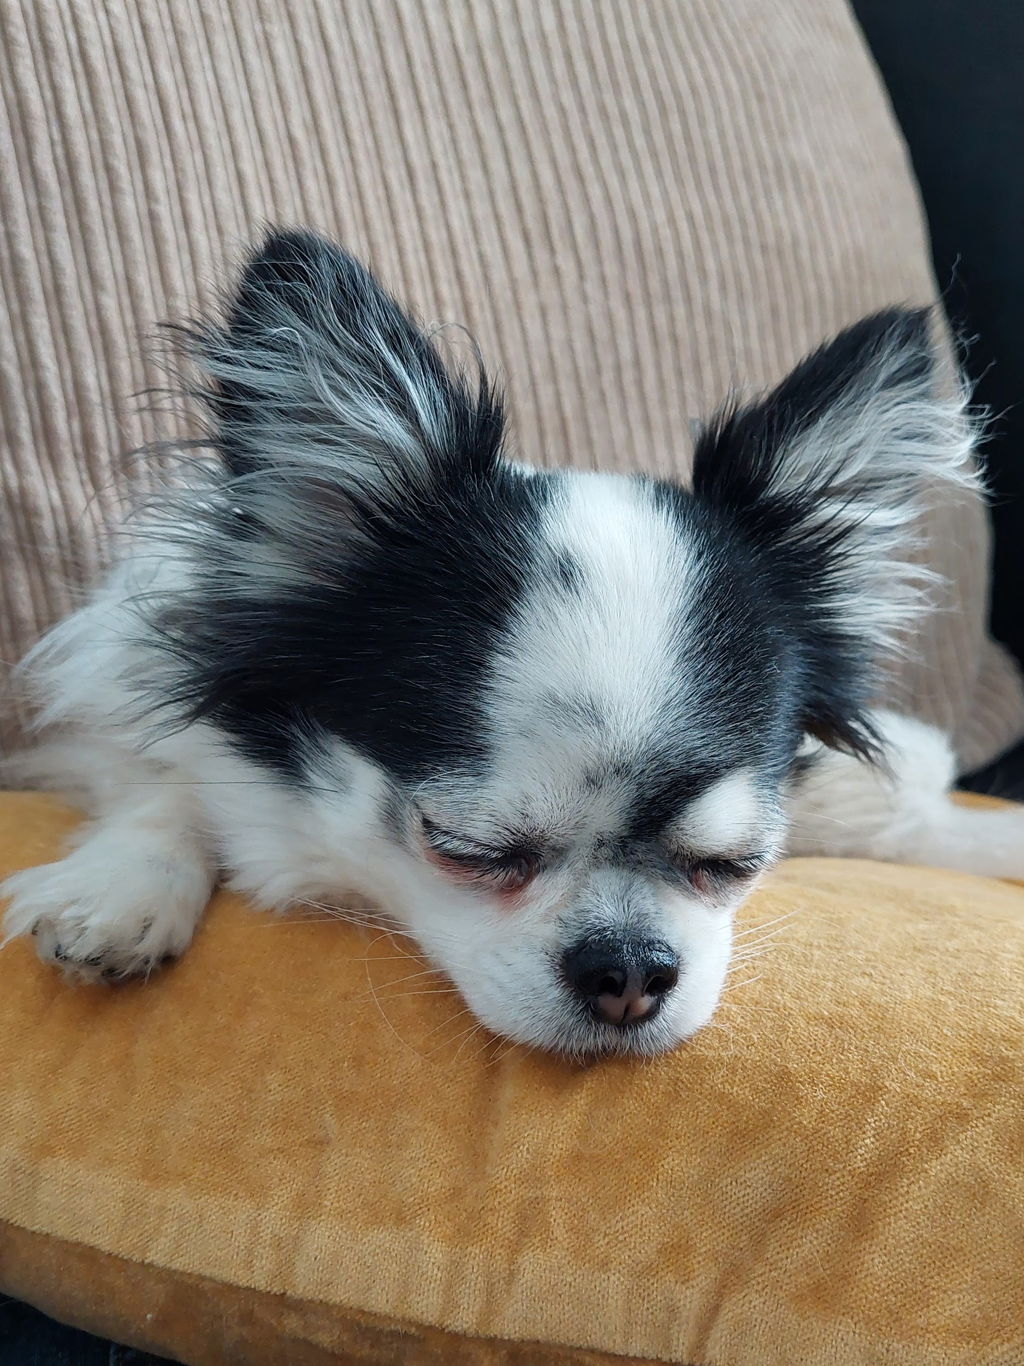
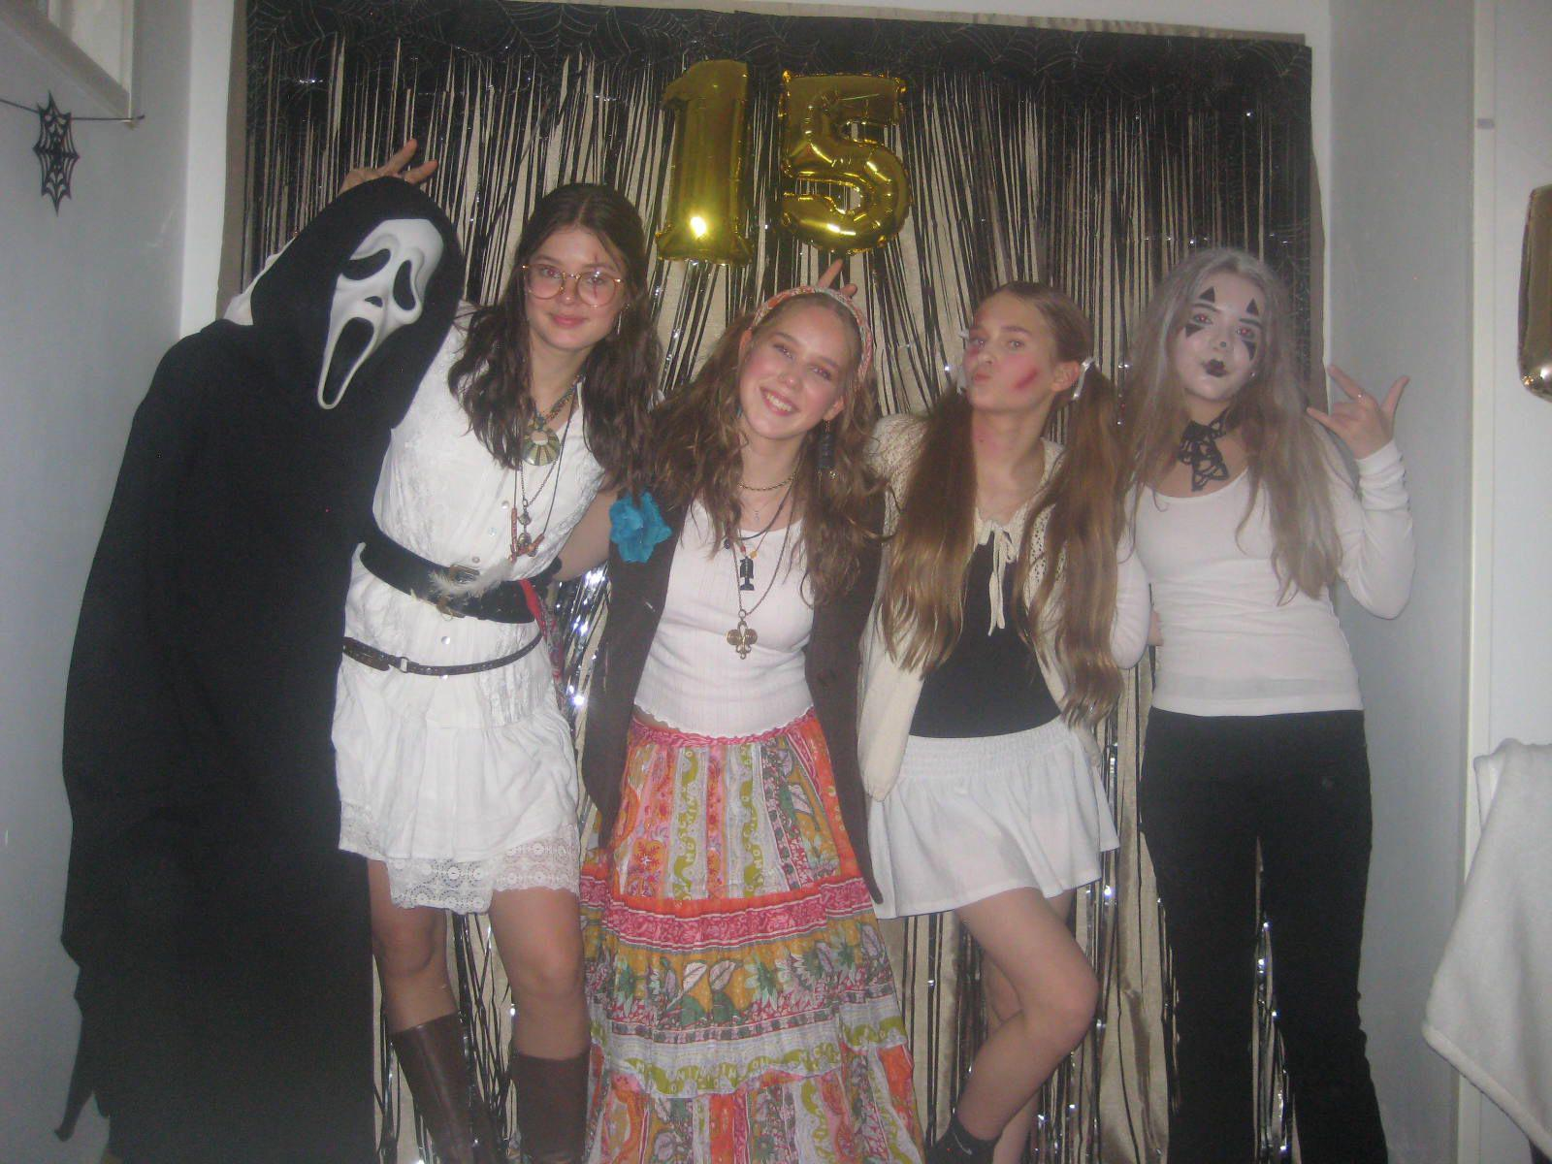
Hello! My name is Iida Maria Lamminpelto.
I’m 15 years old and I’m in 9th grade. I have a mom, dad, older sister, stepdad and 2 small dogs.
I live in a rowhouse 4,2km away from our school. I have my own room and bathroom but we have a guest room too.

Slide 5
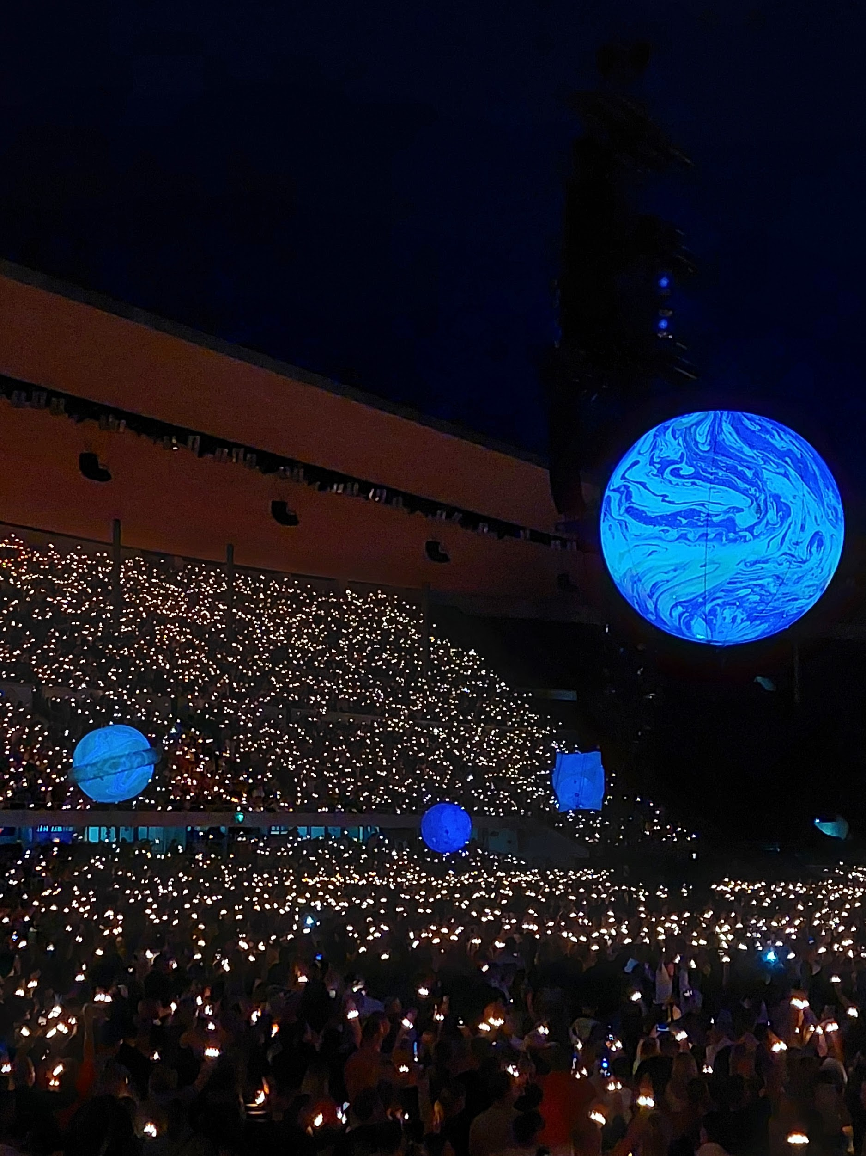
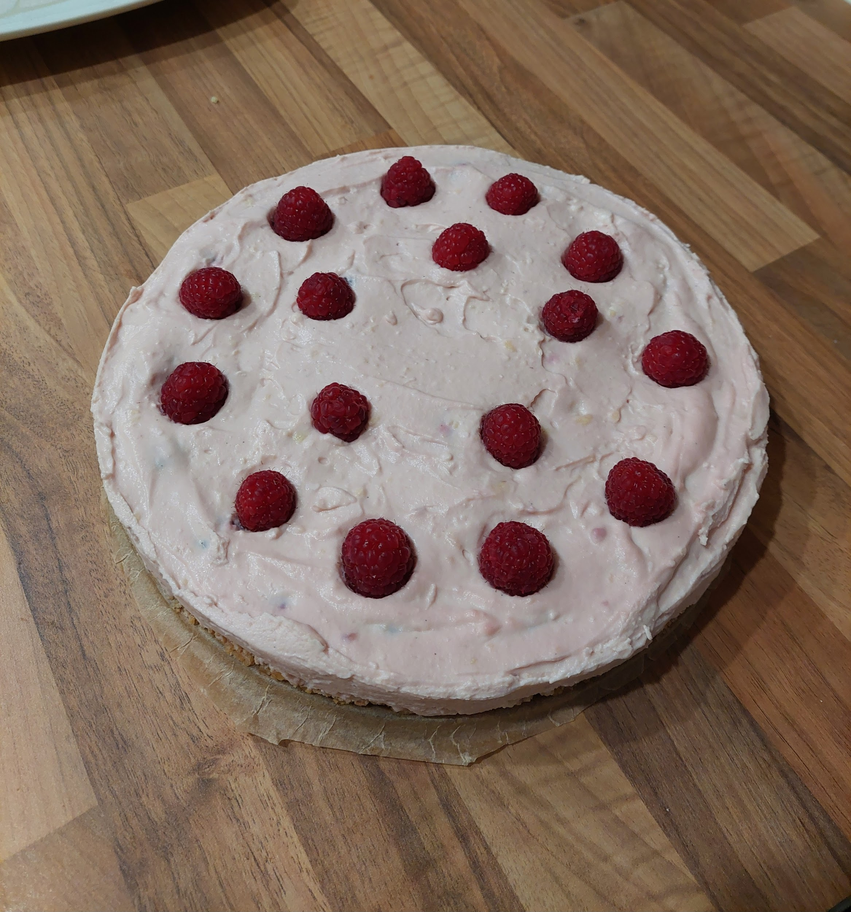
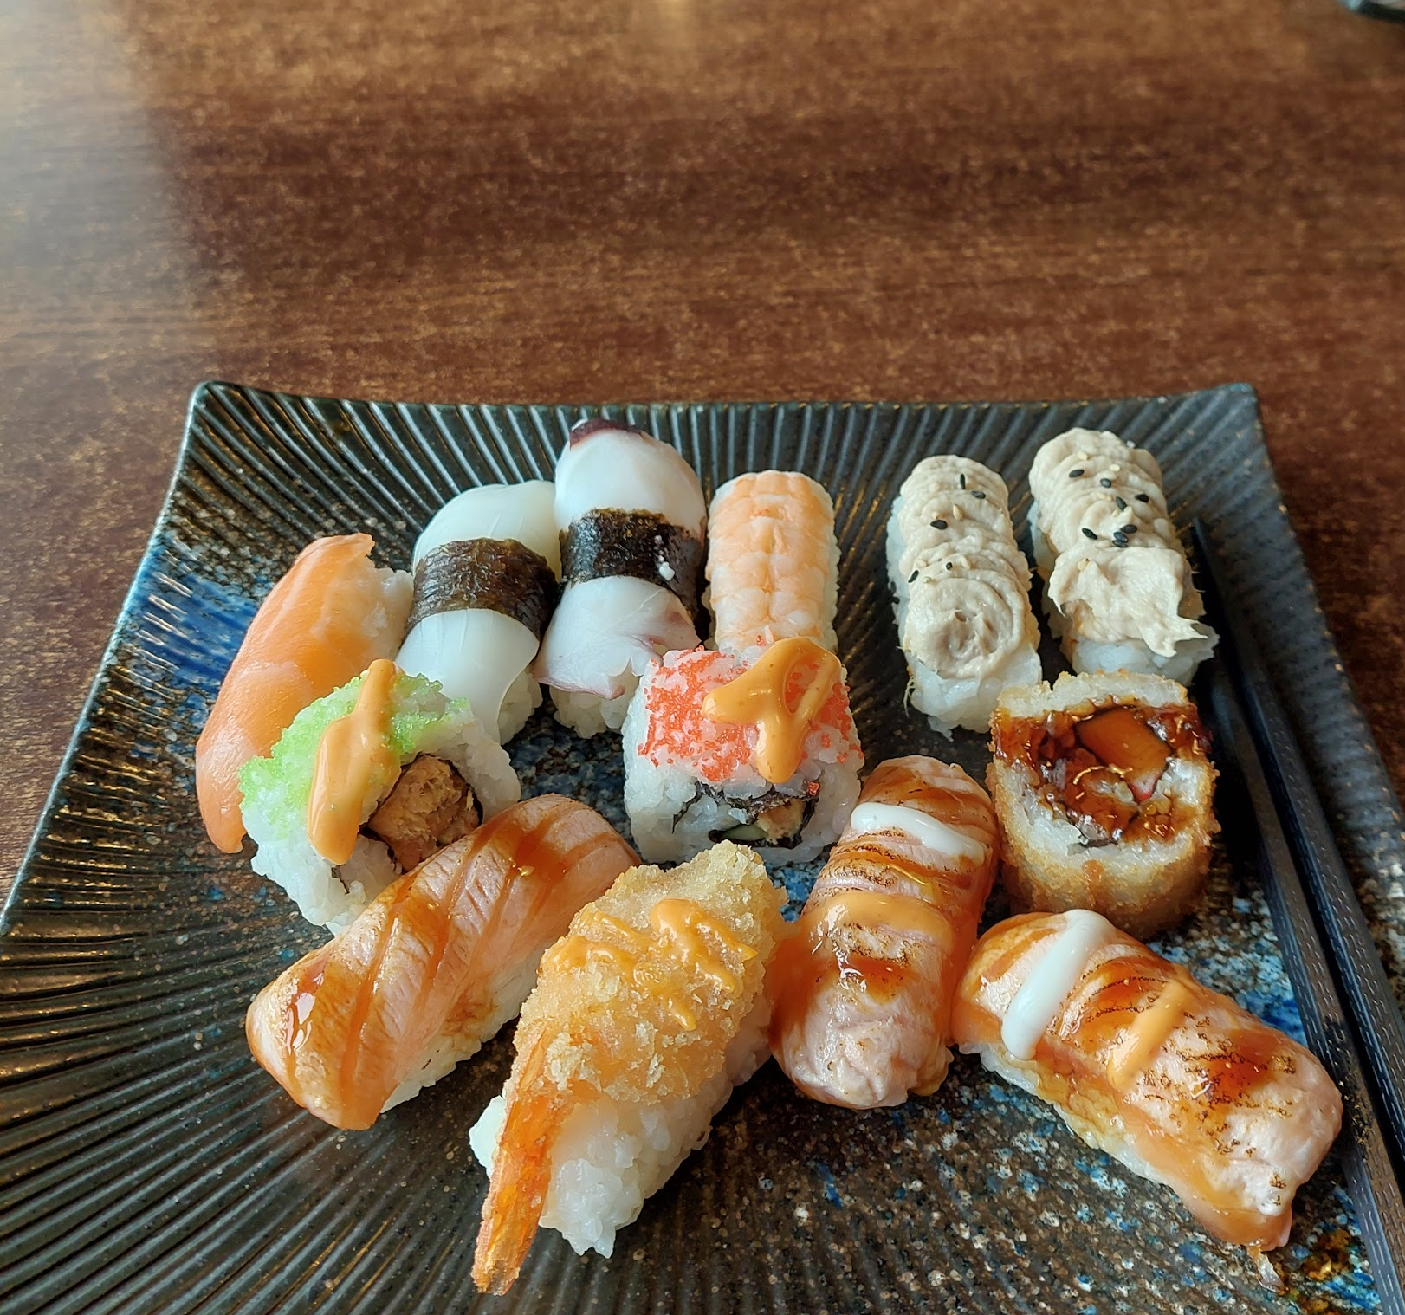
I go to an artschool on Mondays and in my freetime I like to bake or watch tv. I like (true) crime shows/movies. I also like scary movies. I like to hangout with my friends and just talk about anything. If the weather is good I also like to go outside for a walk. I love music but I listen to almost anything.

Slide 6
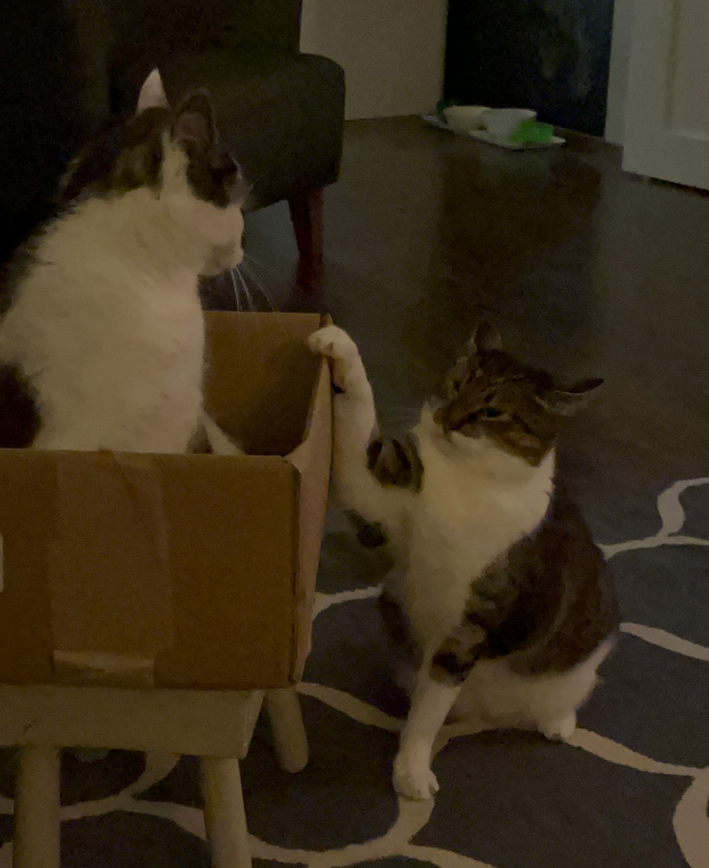
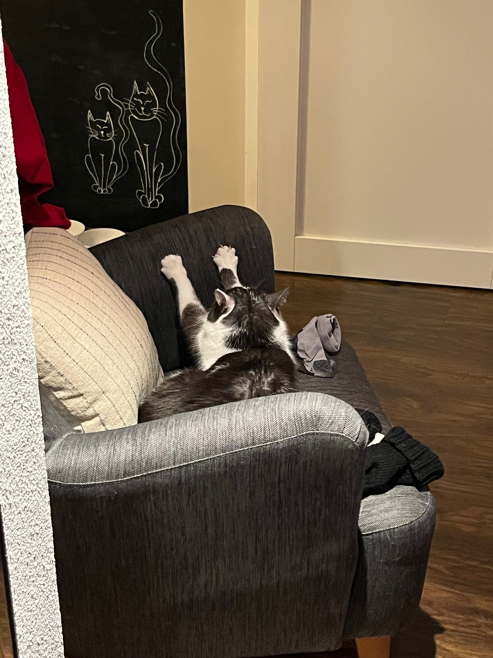
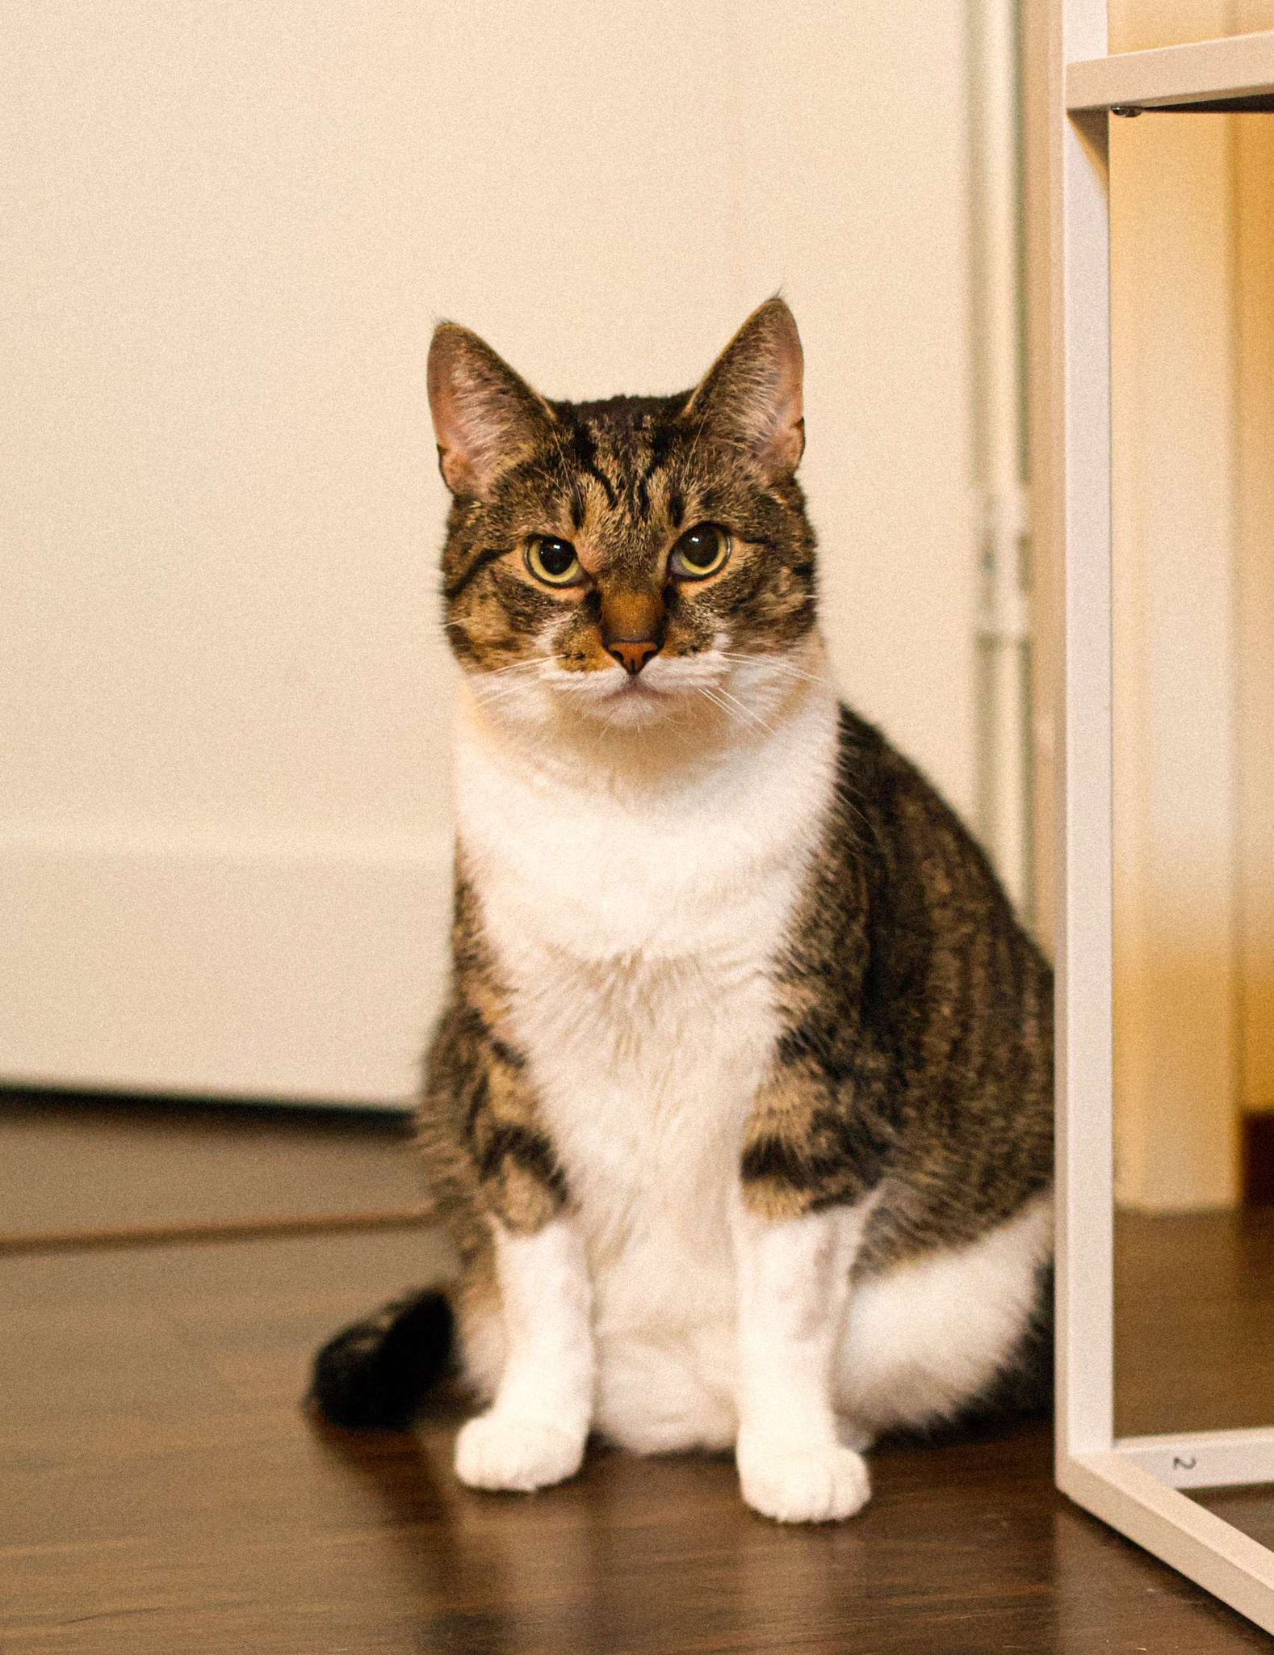
Me and my family
Hi my name is Bea IIda Karoliina Korhonen. I’m 15 years old. I live with my parents and I have a big sister but she doesn’t live with us. We also have 2 cats, Simba and Piina. Simba is more extroverted but shy and Piina is more introverted but not shy. I live in a two-story town house about 15 minutes away from the school.

Slide 7
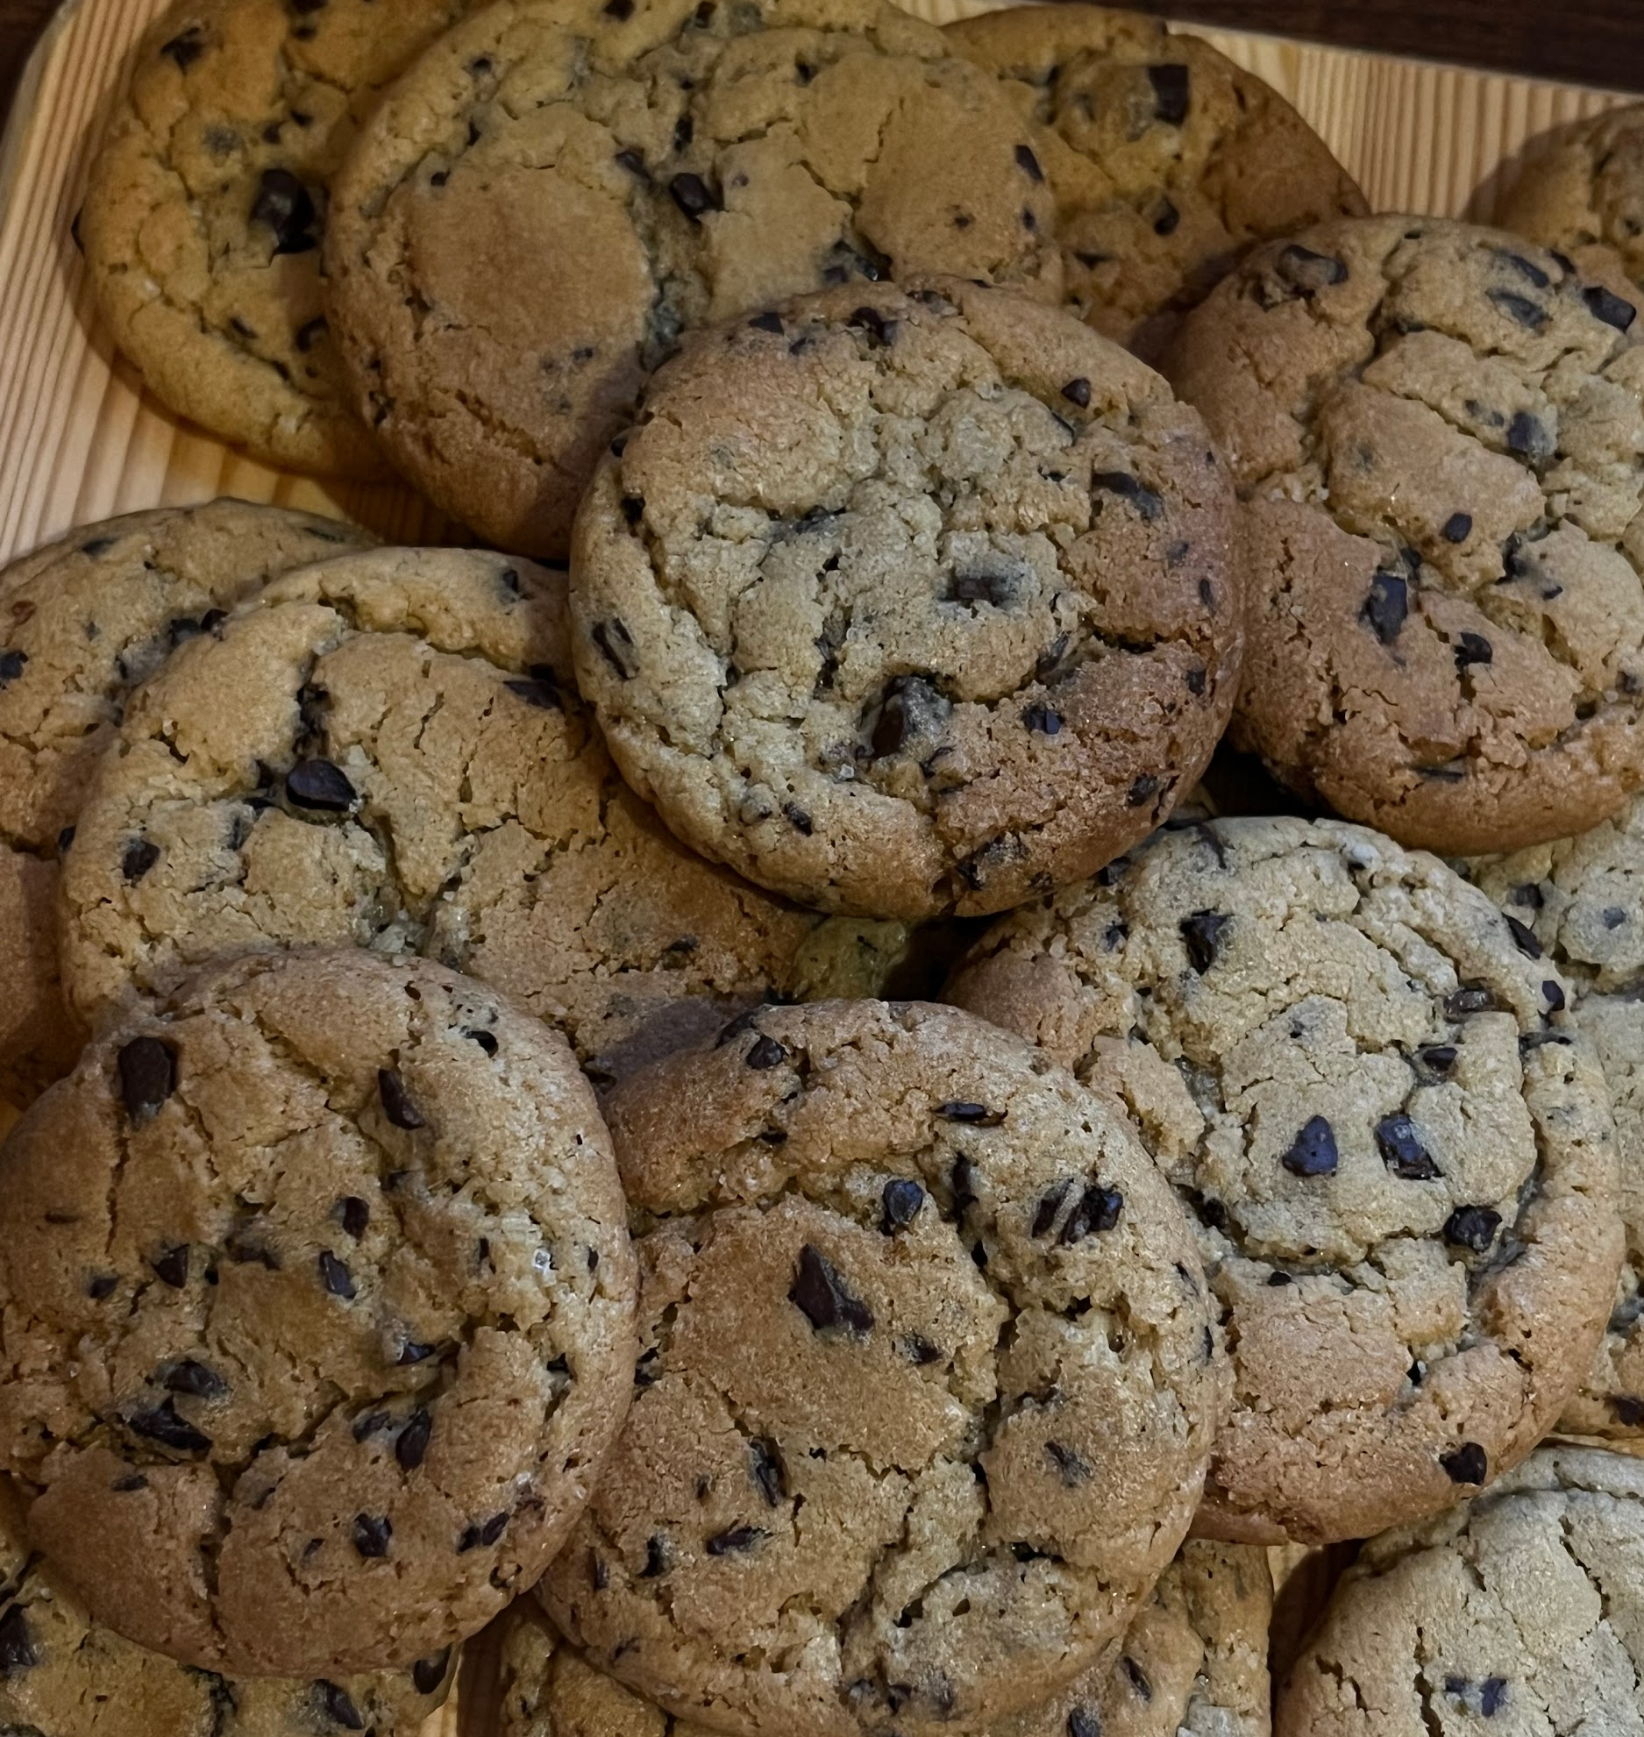
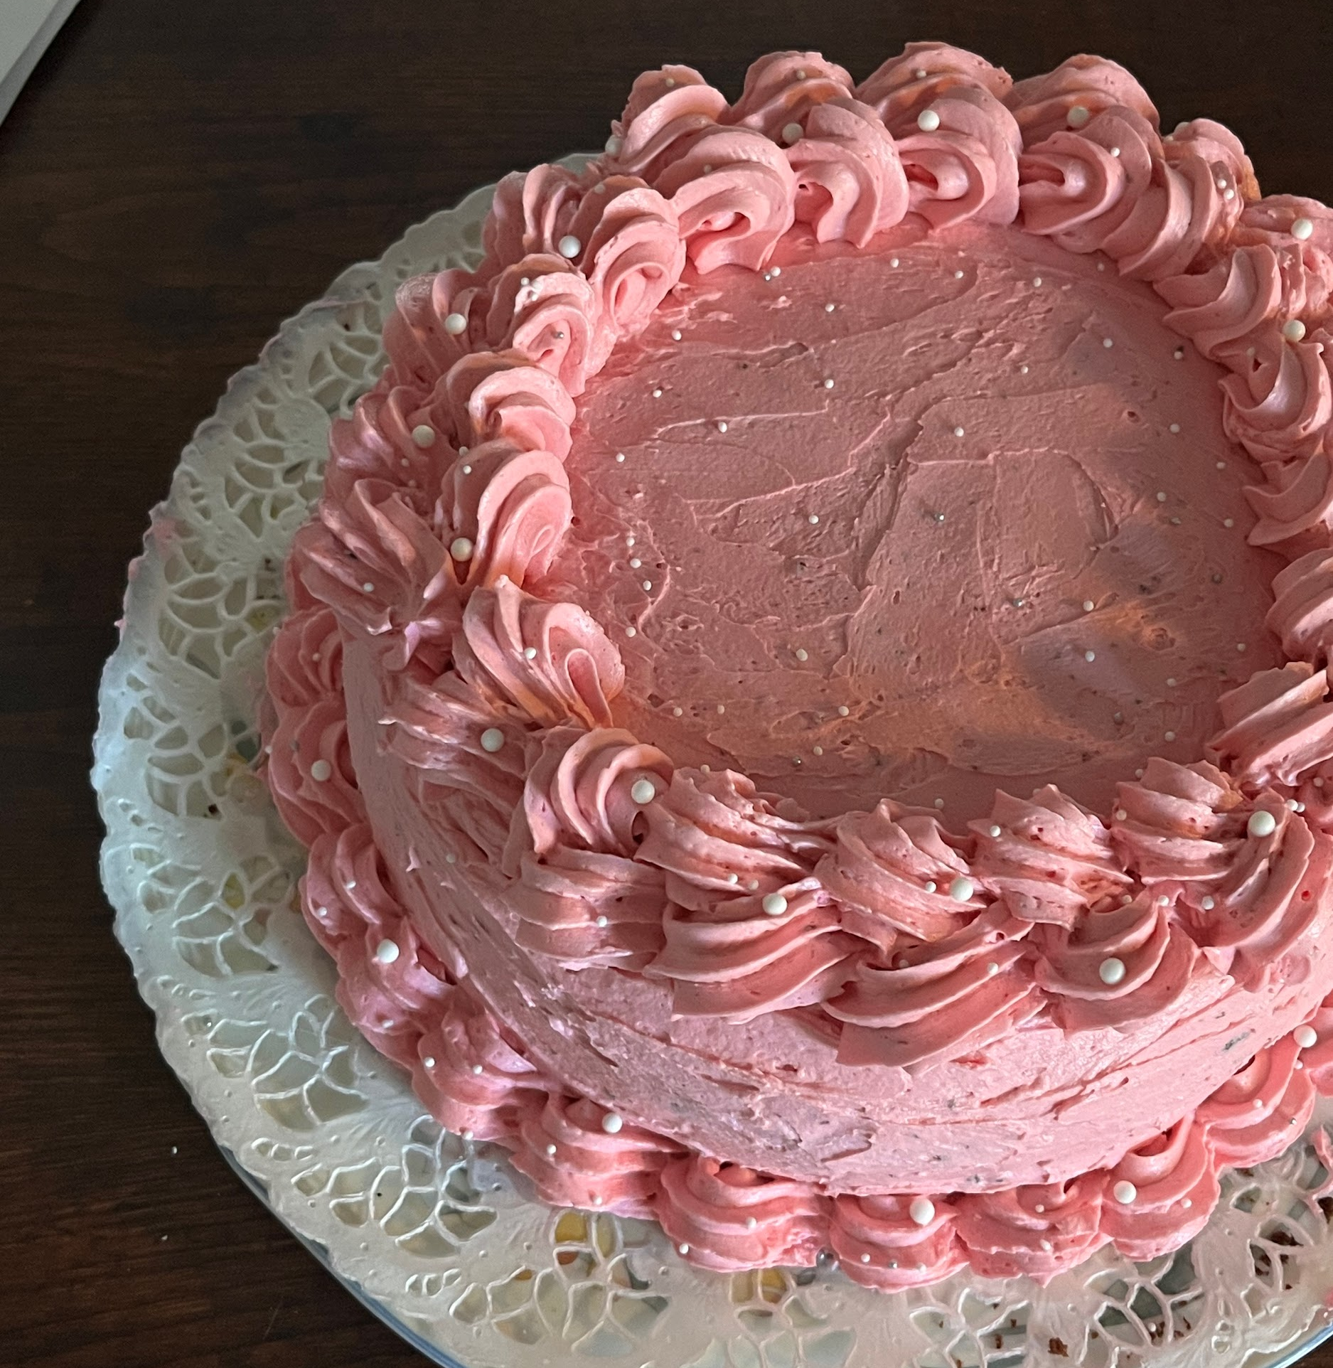
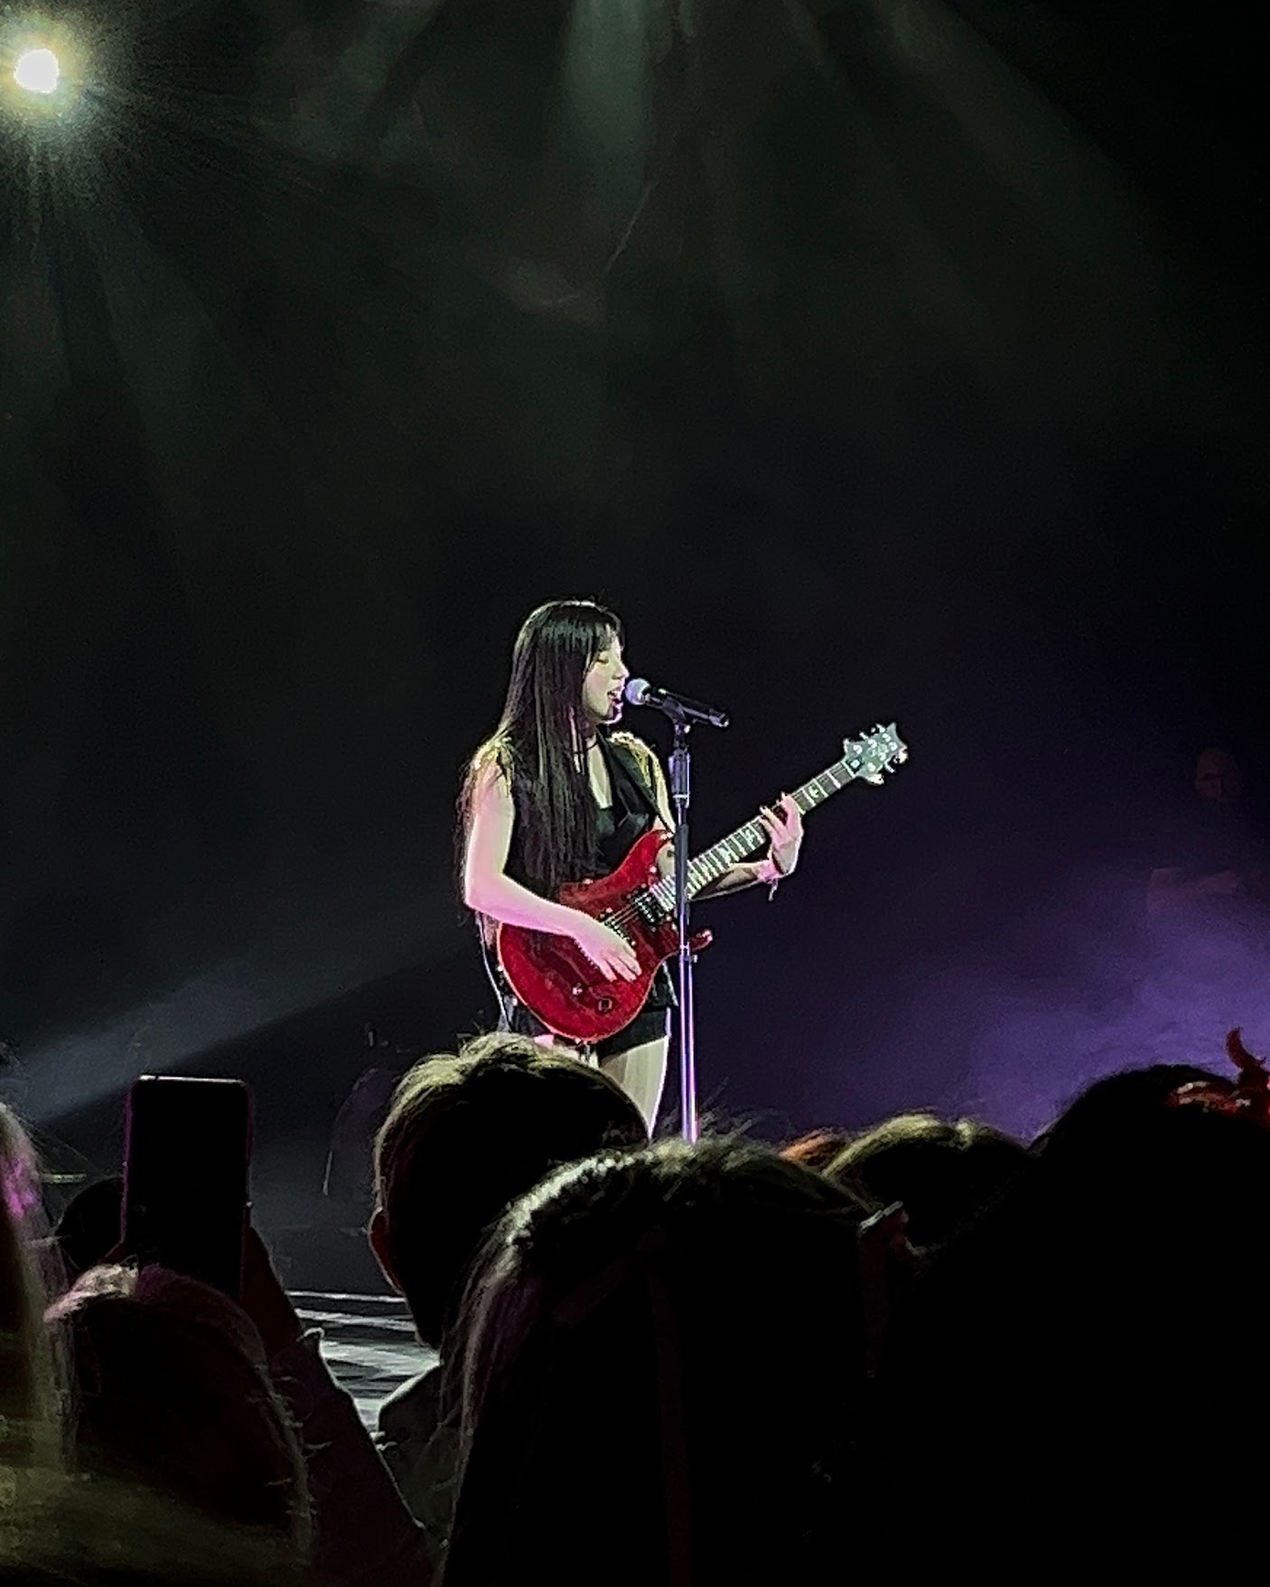
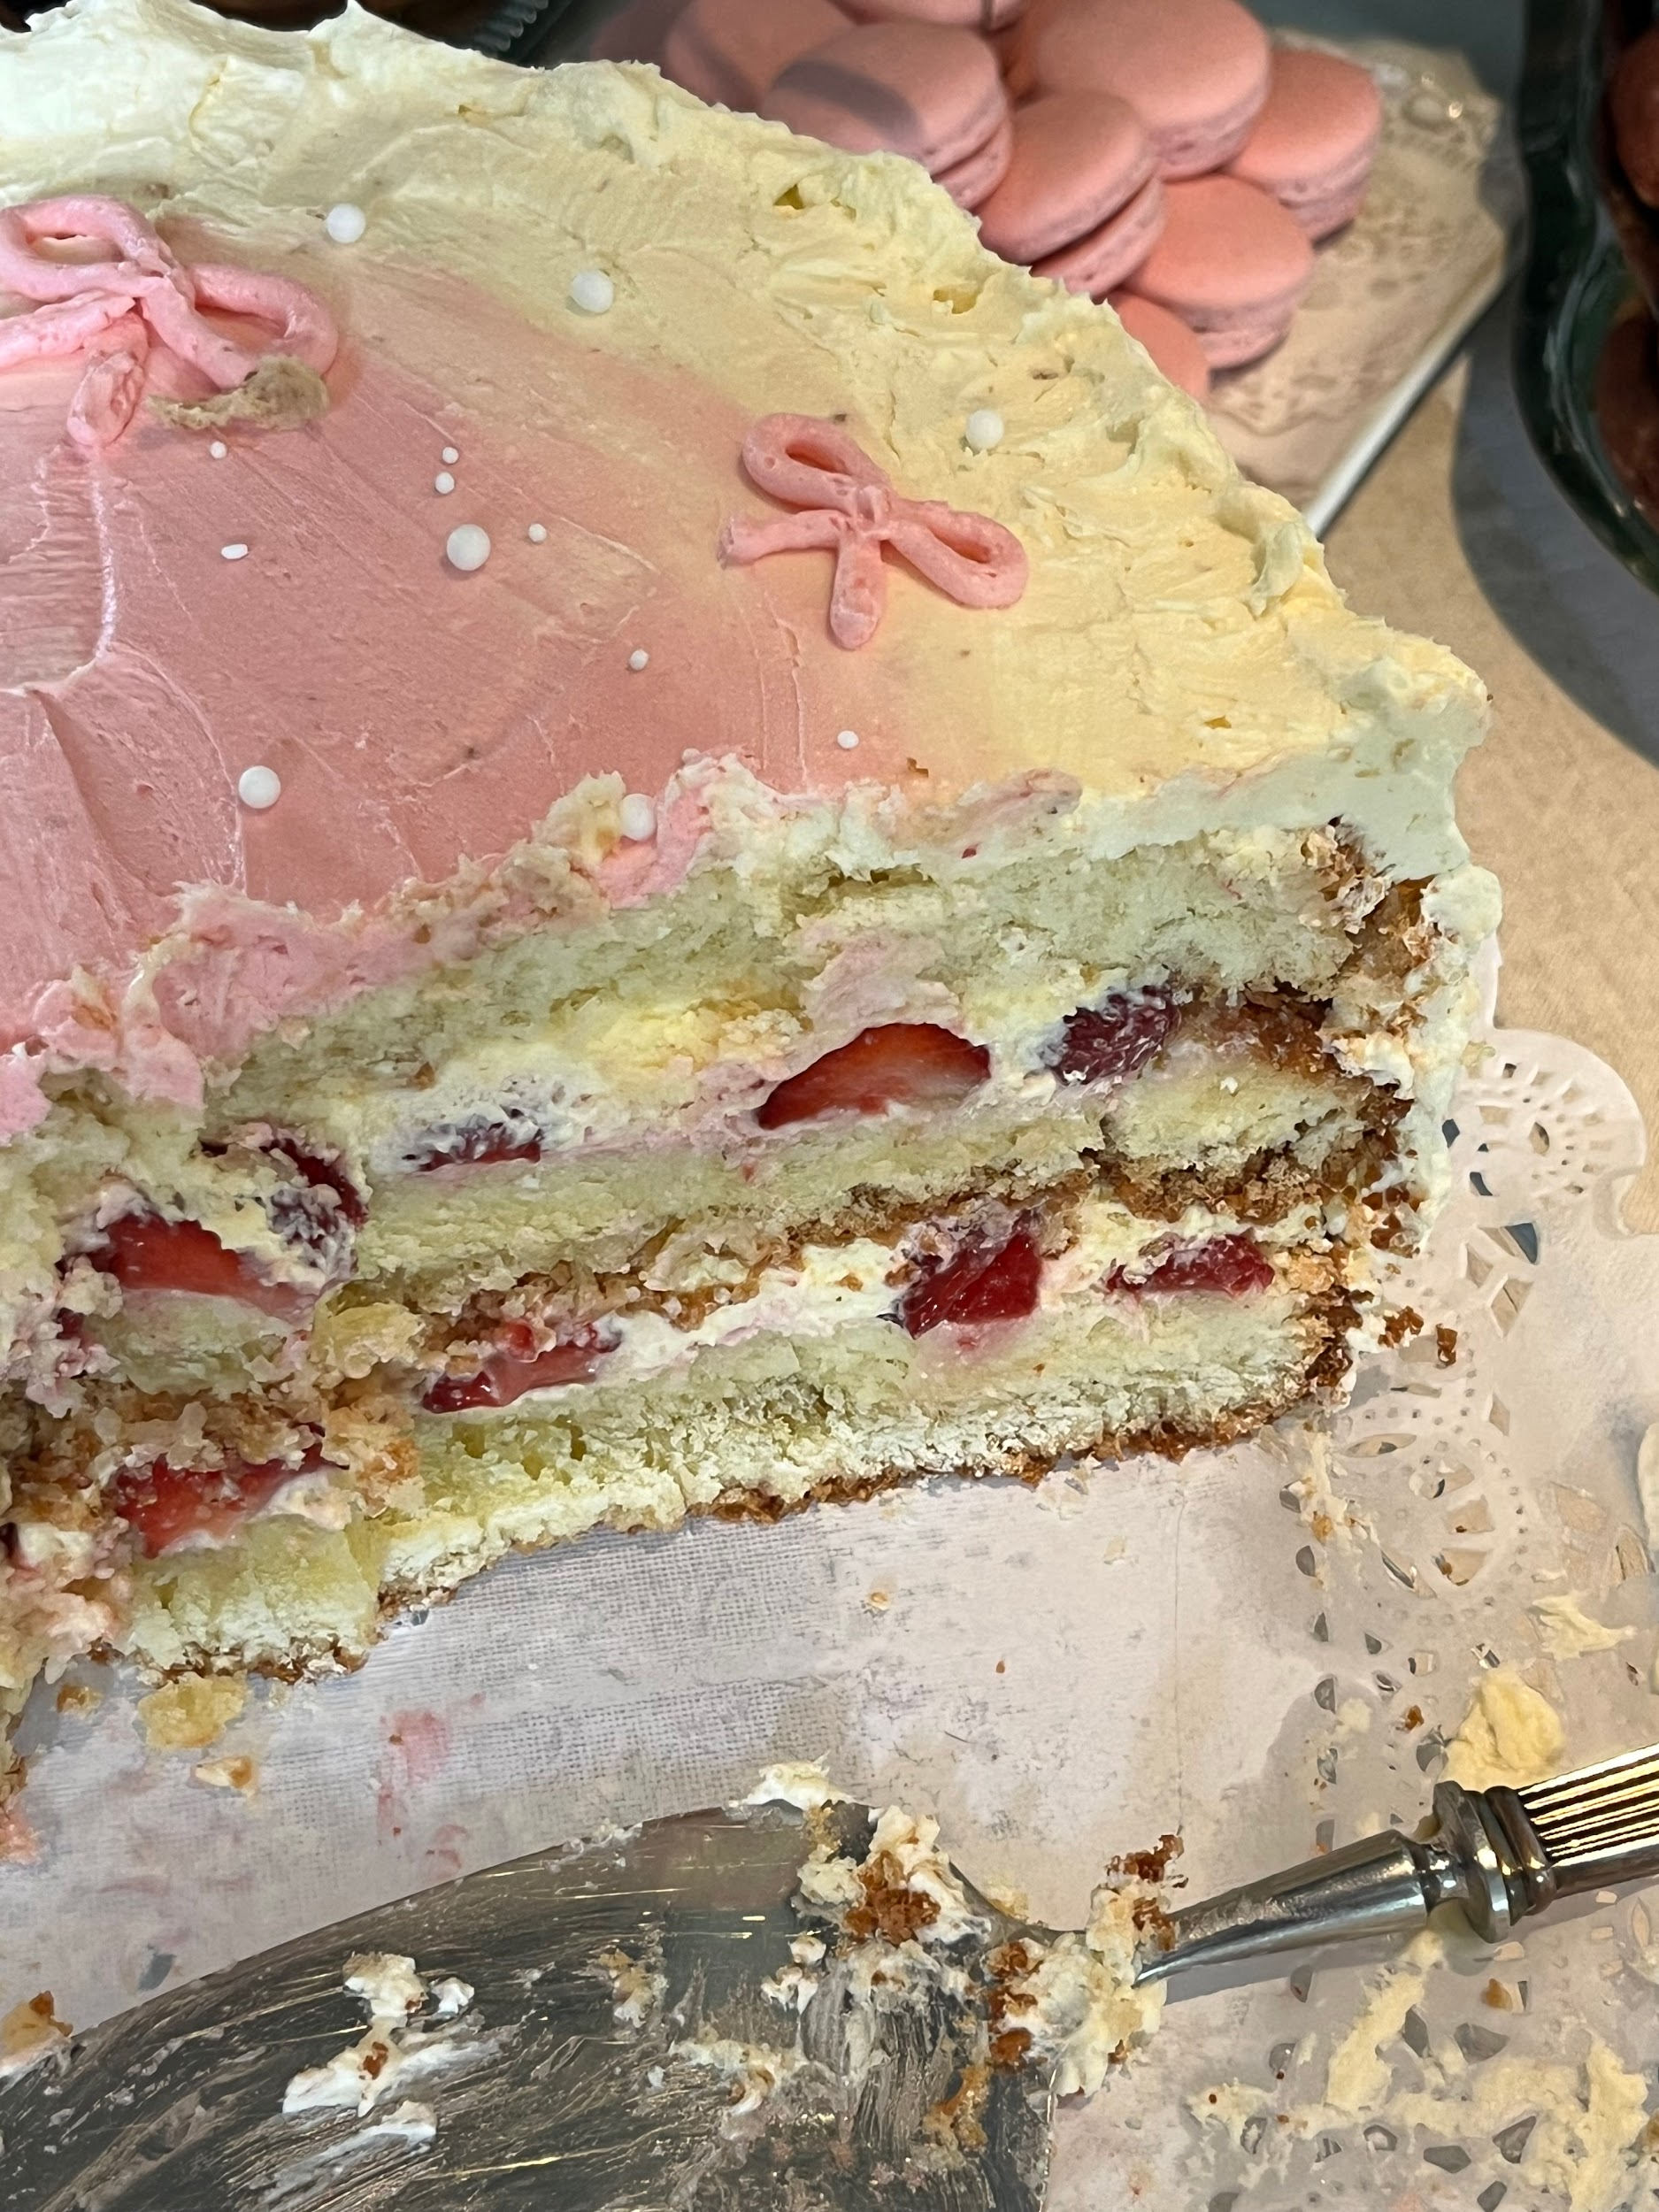
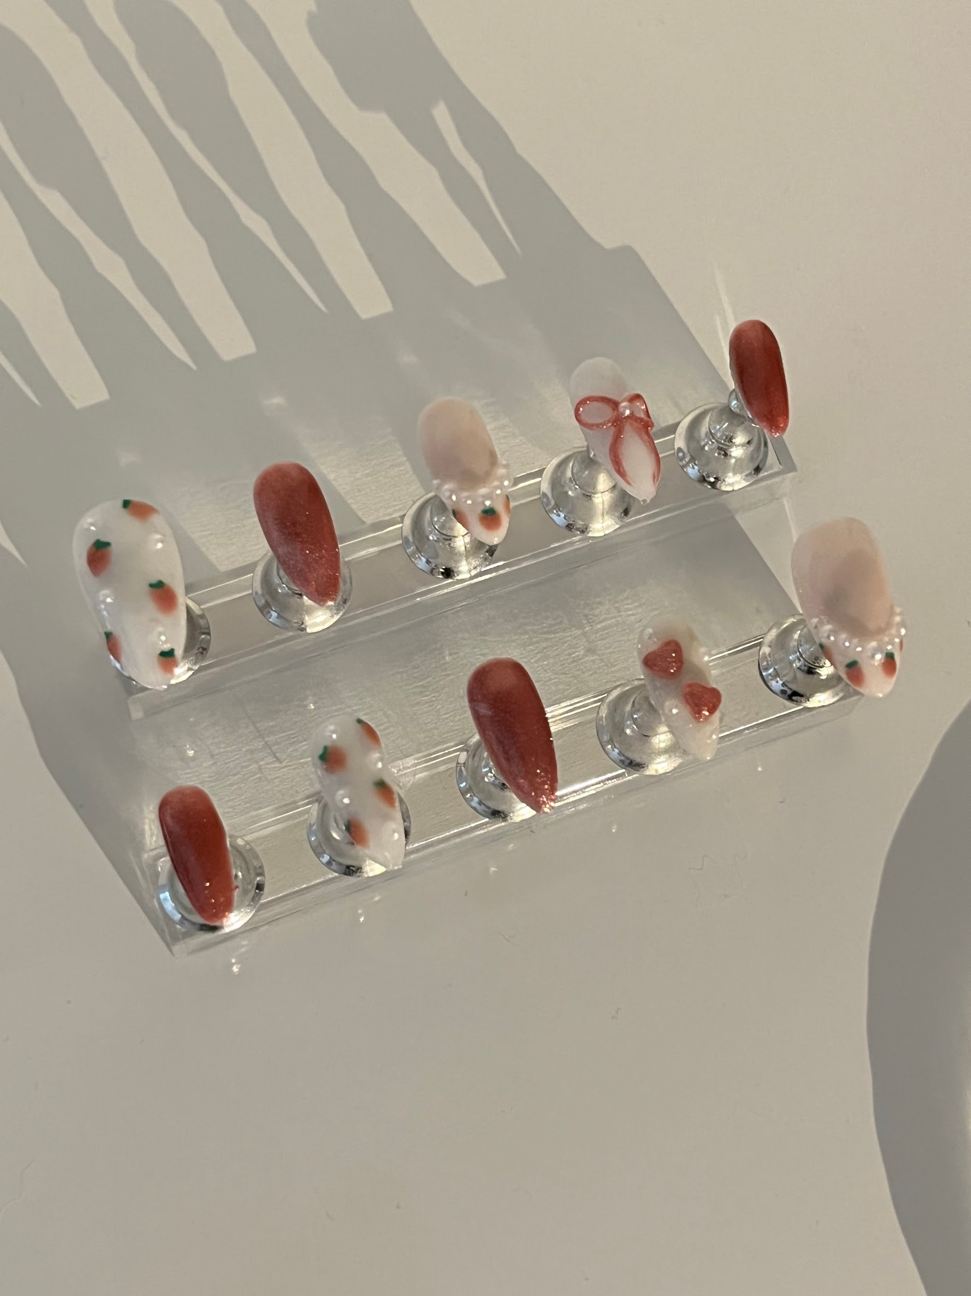
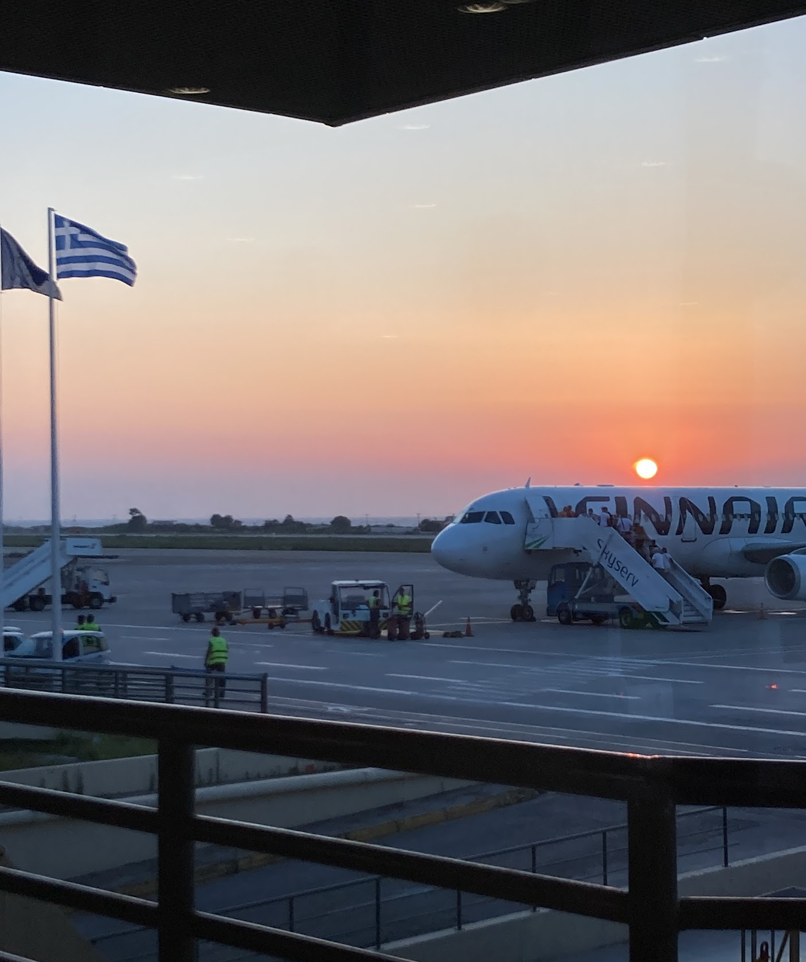
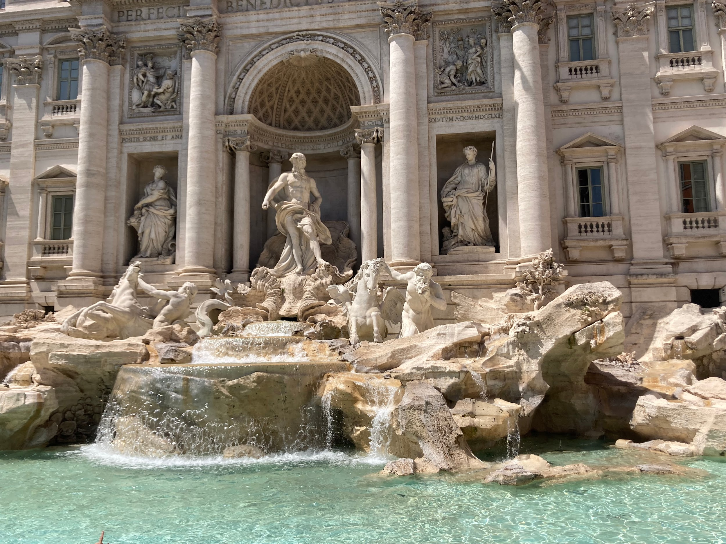
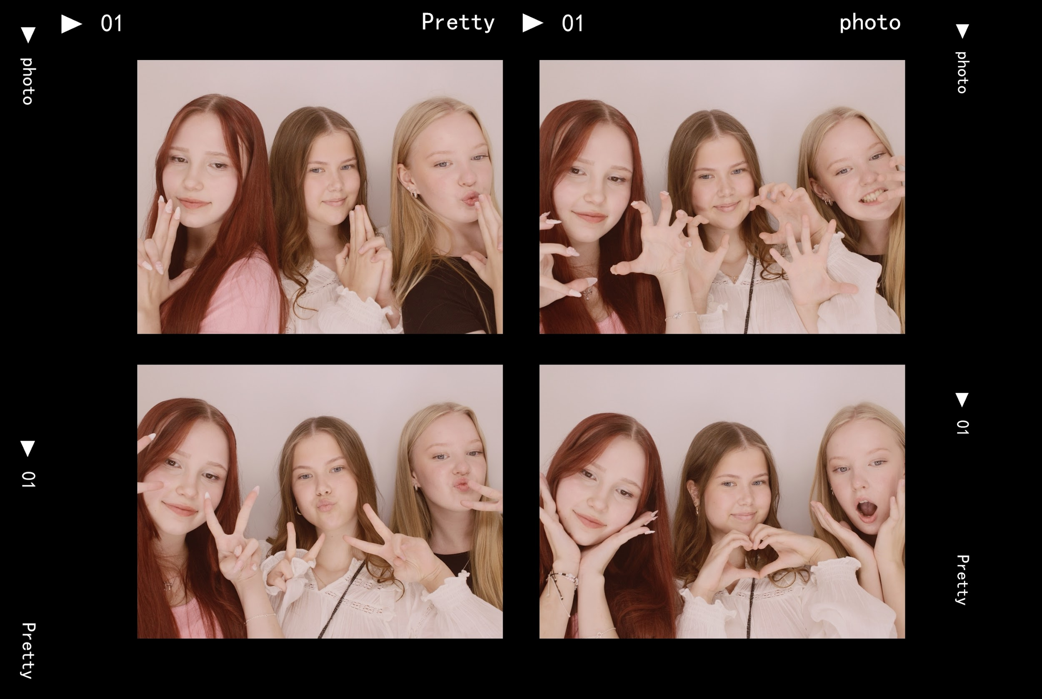
Things I like
I have dance practice twice a week but I also dance at home. I also like to bake and make press on nails. I listen to music a lot, some of my favorite artists are Enhypen, Ariana Grande, Frank Ocean, Jhene Aiko, Lana Del Rey, Sza and Brent Faiyaz. I also listen to true crime podcasts and I like watching true crime documentaries. I like to try different foods and my favorite food is sushi. I love traveling cause I´ve been traveling since i was little. In my free time I like to play games or go shopping or to the movies with my friends or my sister.

Slide 8
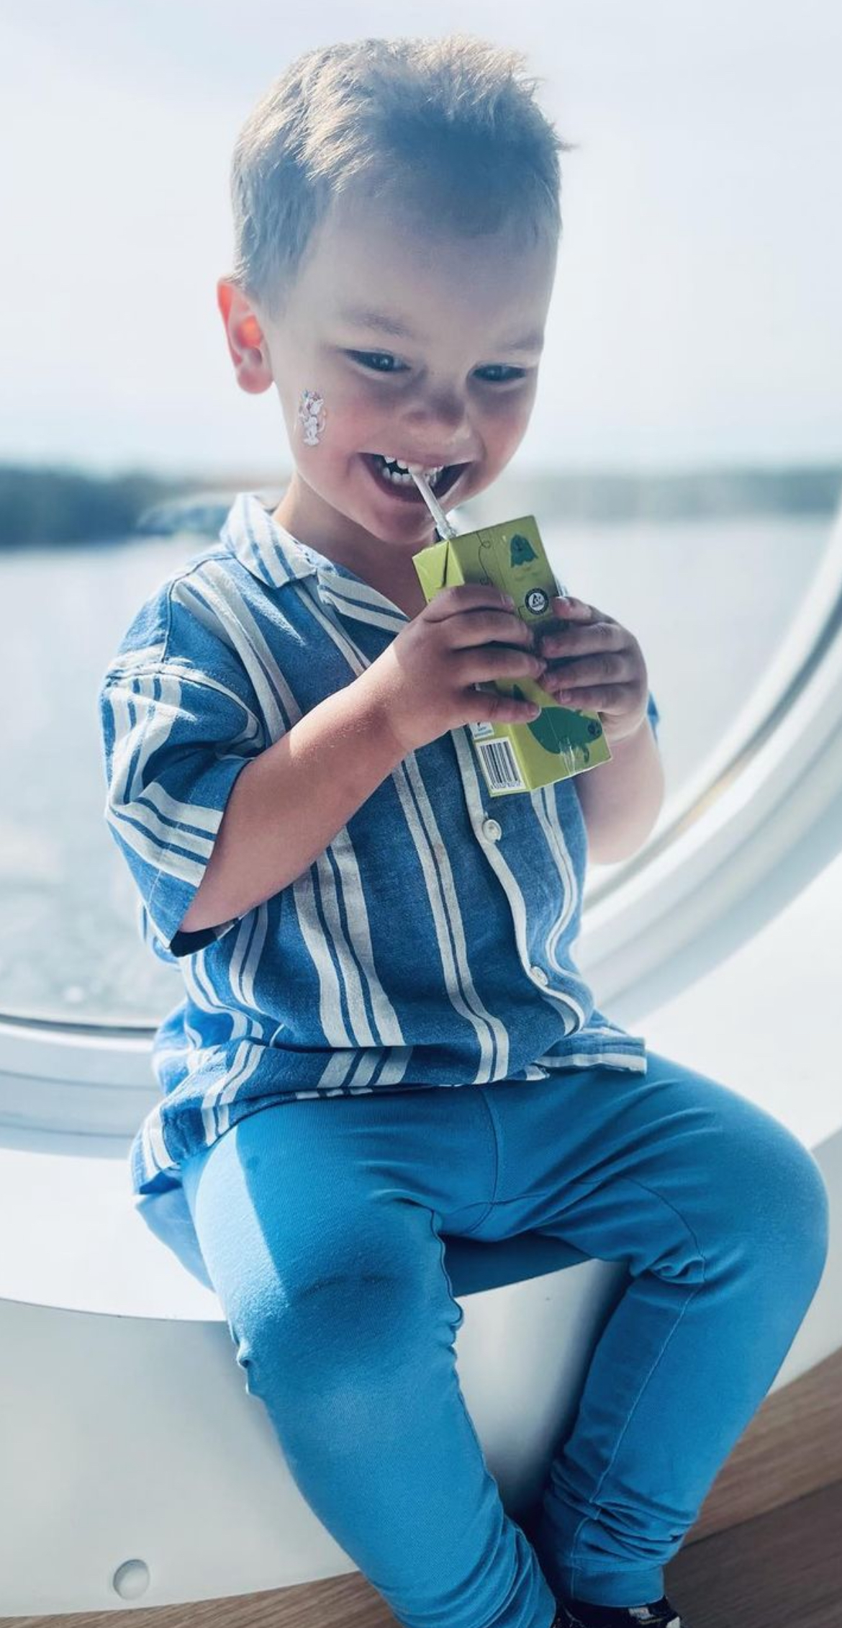
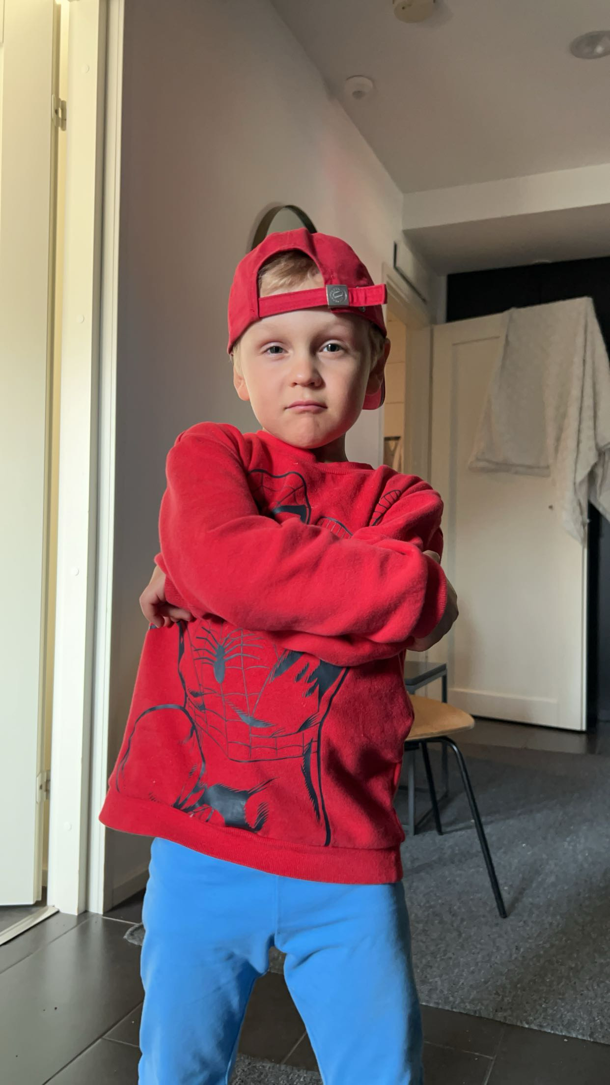
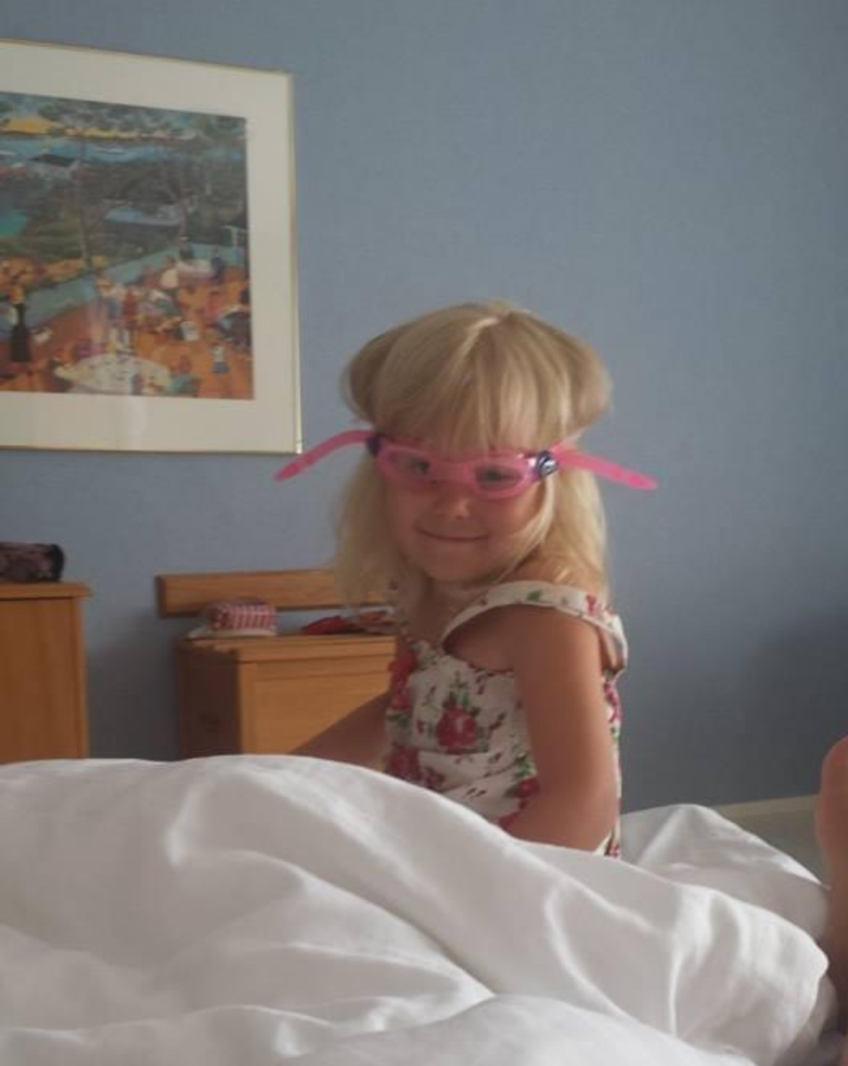
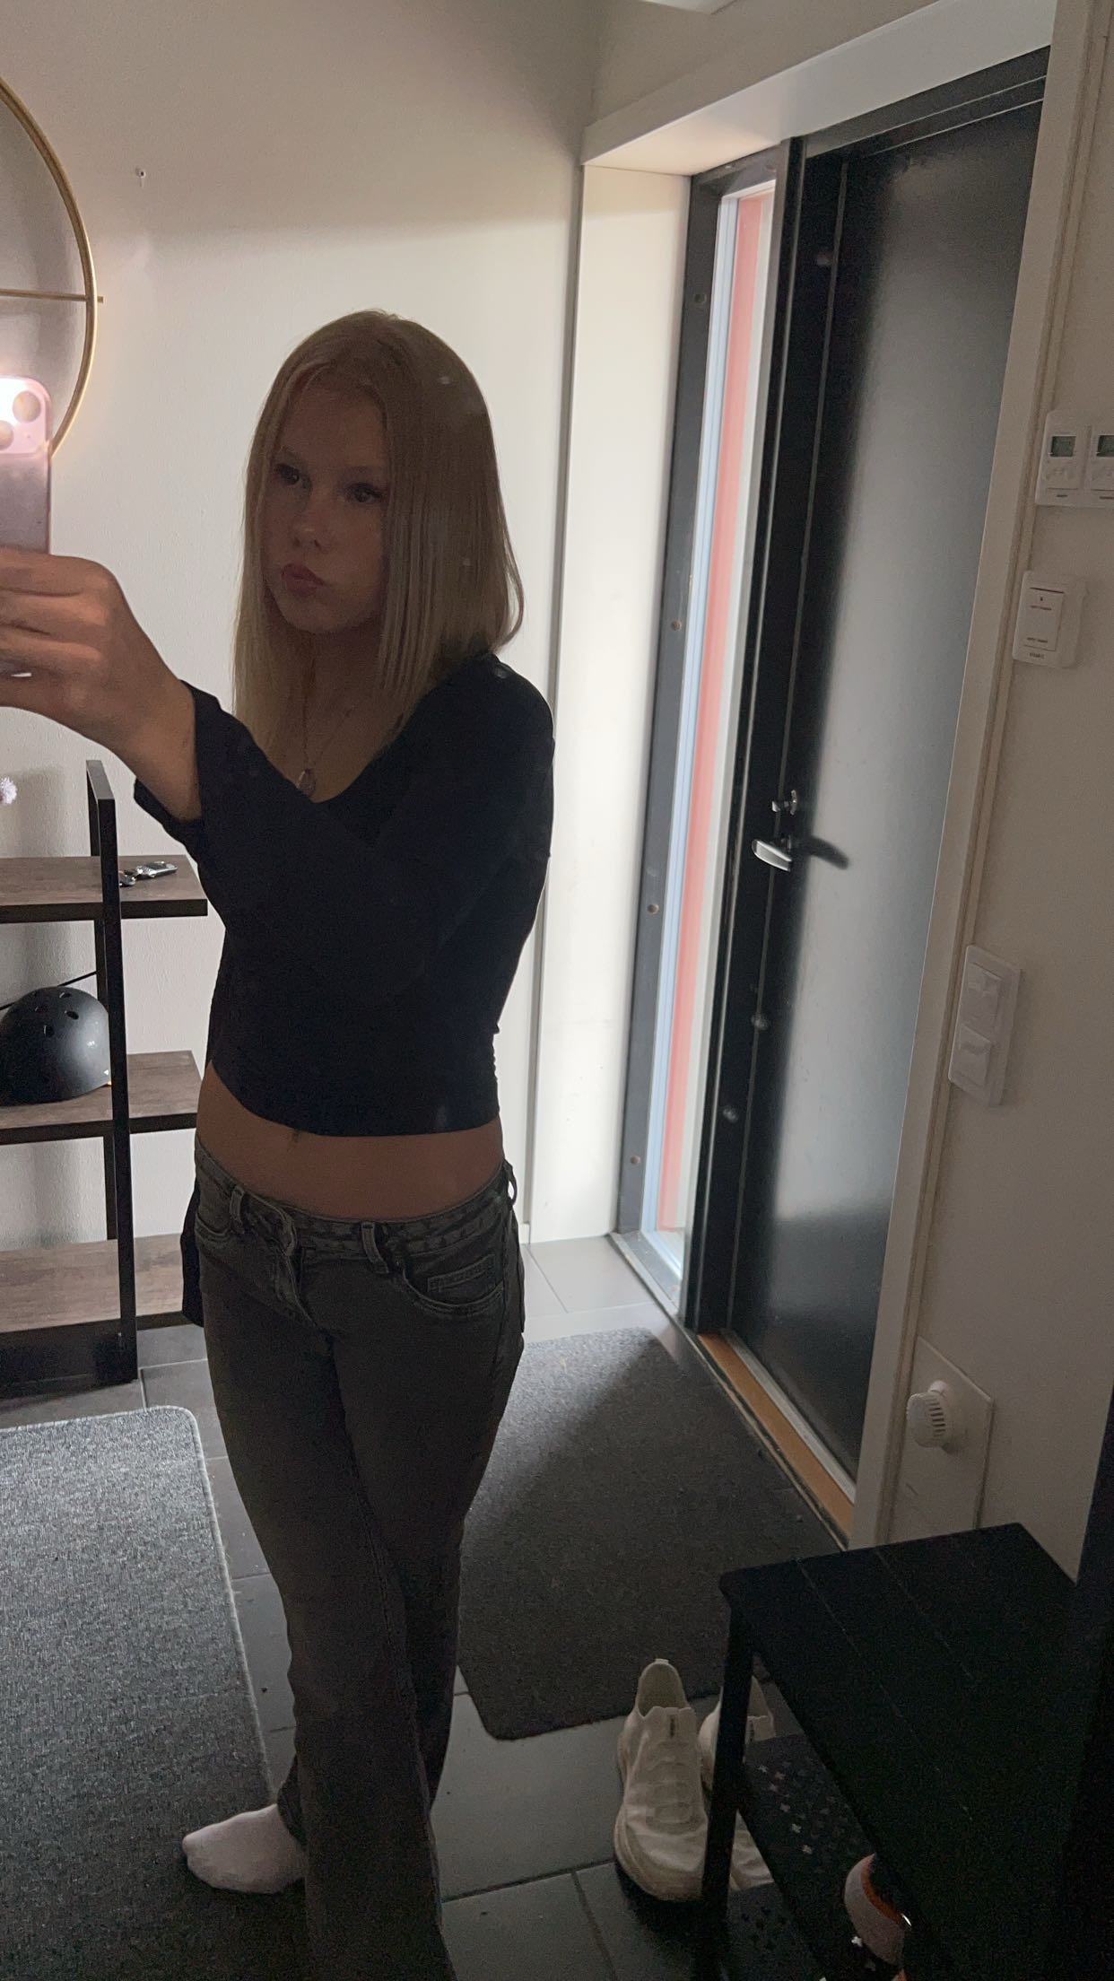
About me
Hi! My name is Viivi Maria Voipio. I’m 14 years old girl from Lohja, Finland.
My family
I live in a row house with my mom Heidi, my step dad Iiro and my two little brothers Elias (4 years old and Emil (2 years old). I also have five big brothers and one big sister, but they live on their own homes. Our home has three floors.

Slide 9
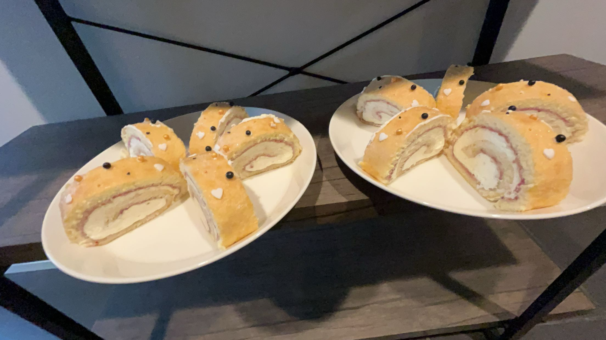
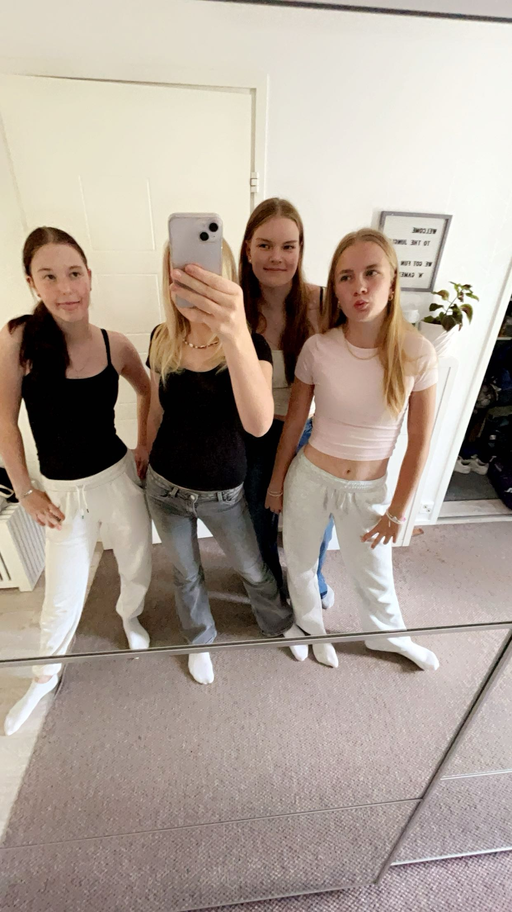
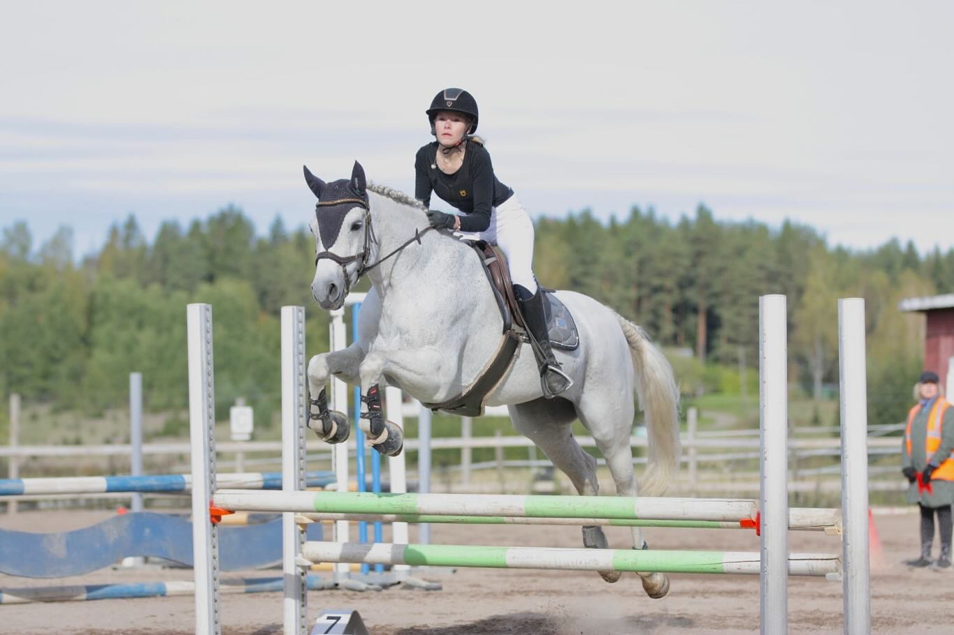
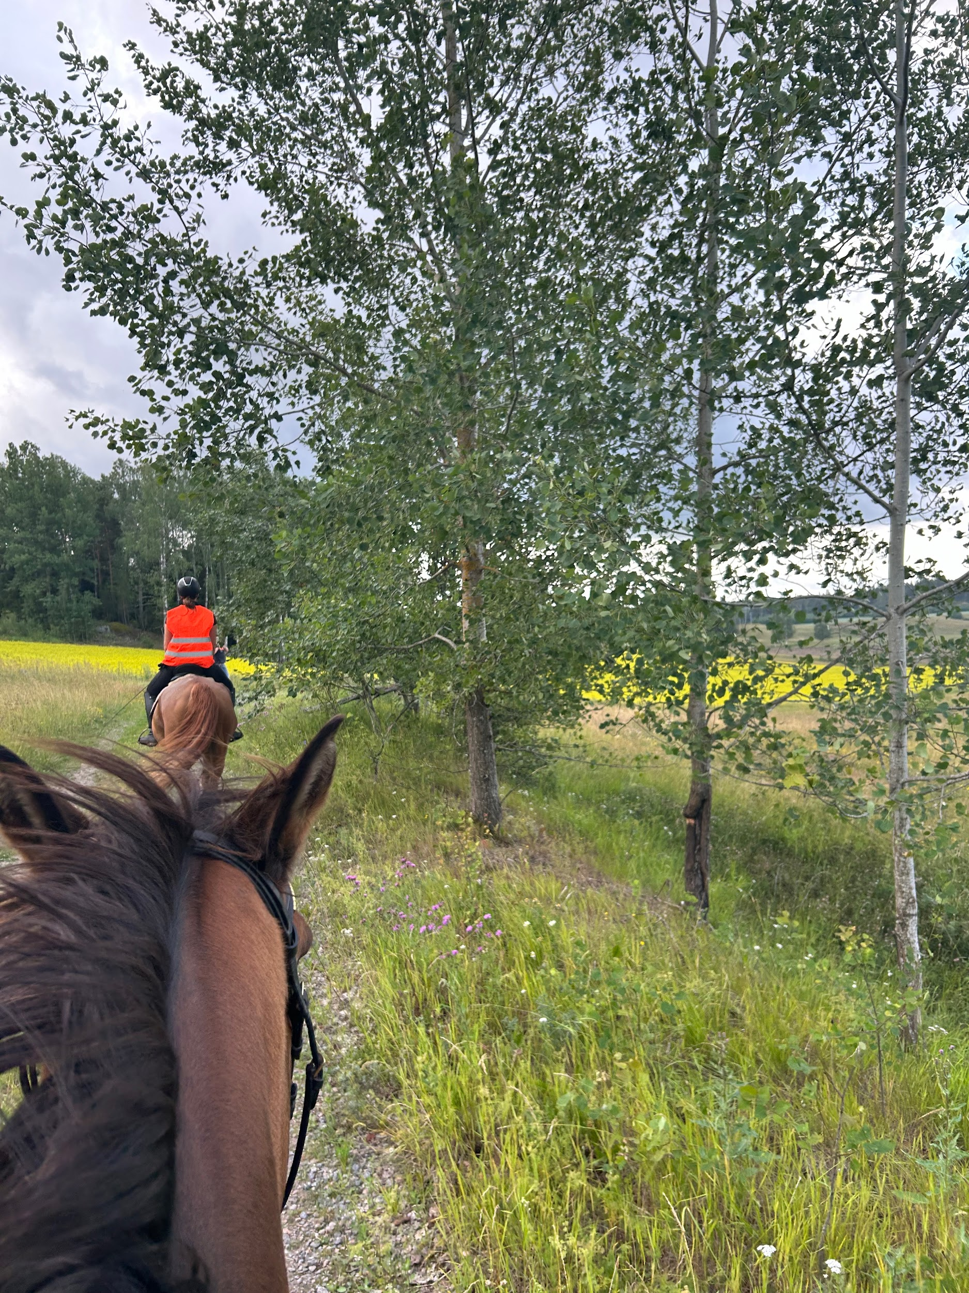
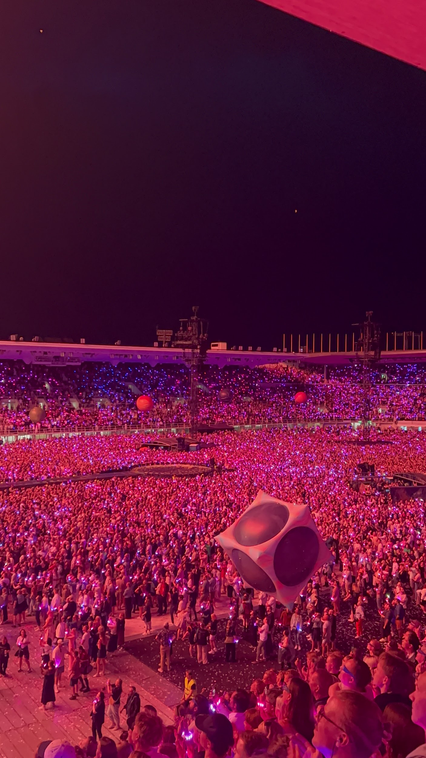
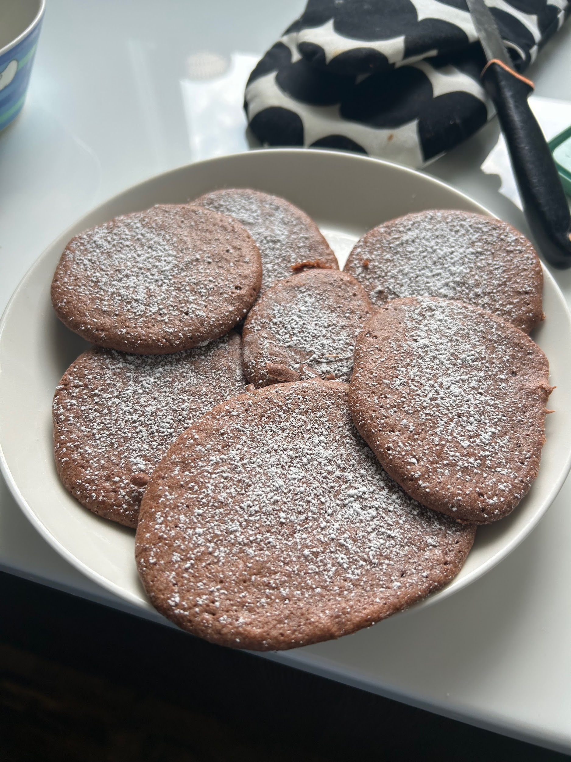
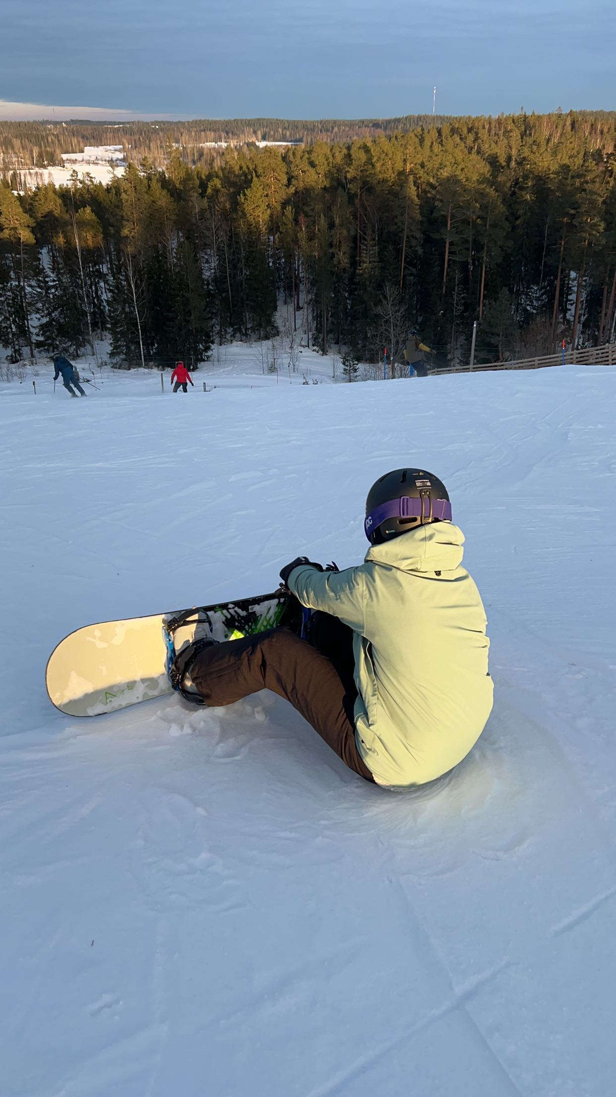
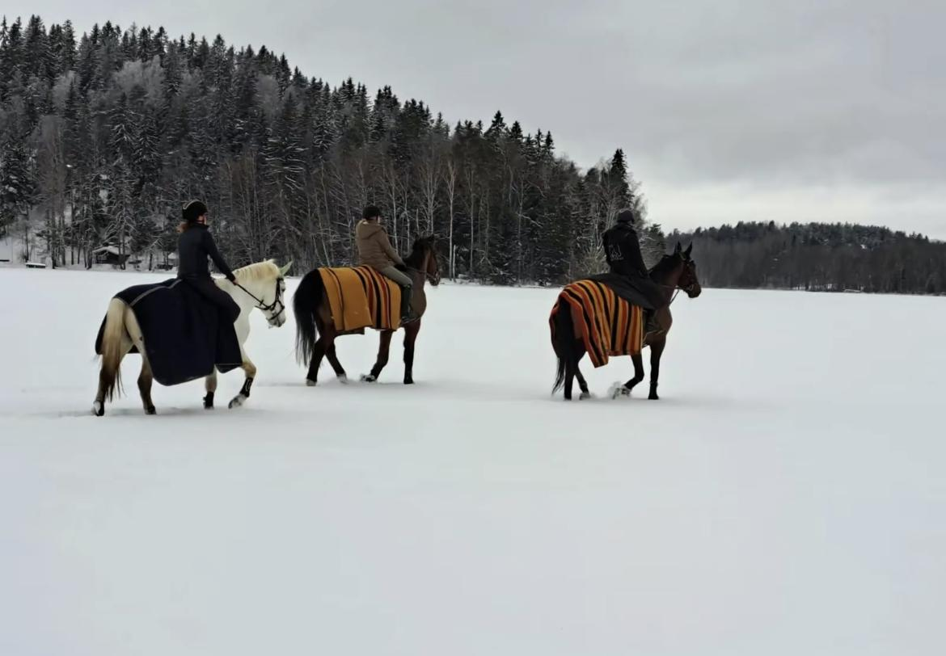
My favourite things
*My favourite food is bread, nuggets and salads.
*In my free time I like to ride horses, baking and shopping.
*My favourite school subject is home economics.
*I like listening to music and play Hay Day.
*I love most of fruits especially apples and grapes.
*I love to travel.

