Slide 1
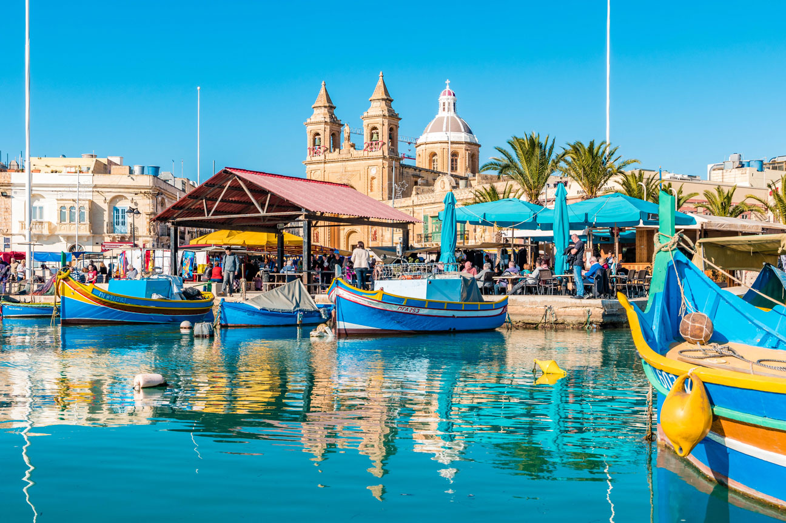
Discover
Malta

Slide 2
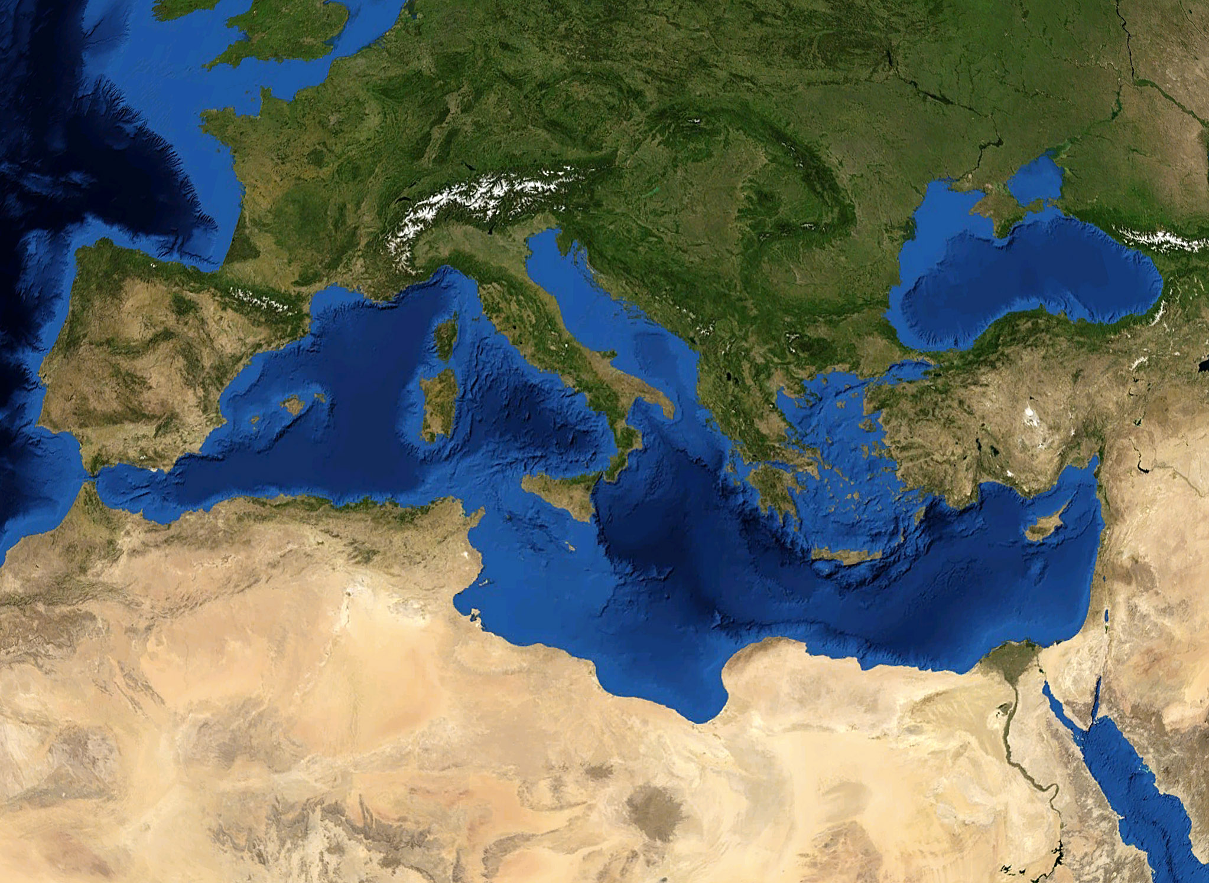


Slide 3
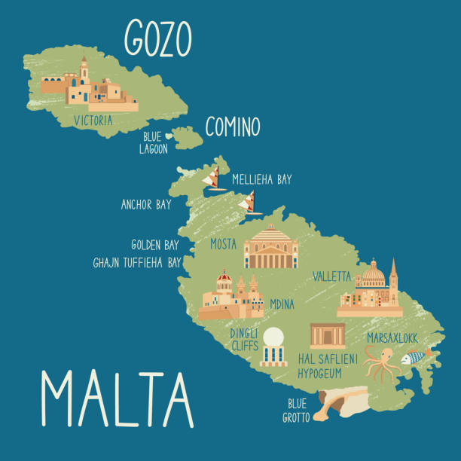
An archipelago of 3 major islands: Malta, Gozo and Comino (Total 316 sq km)
Population: 580, 000
Languages: Maltese and English
Notes:
You can fit 1000 Maltas in Finland

Slide 4
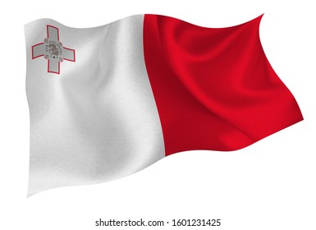
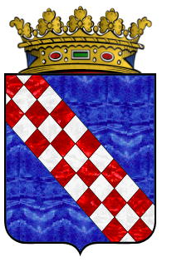
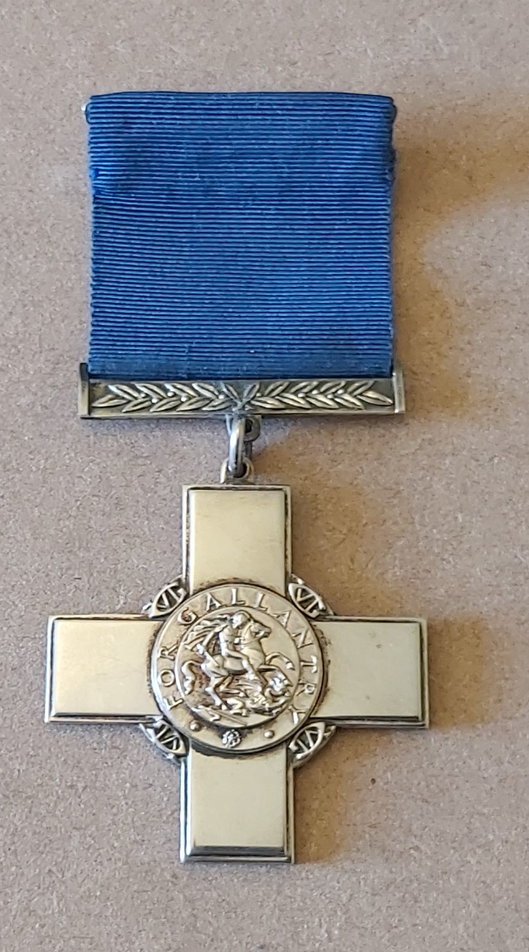
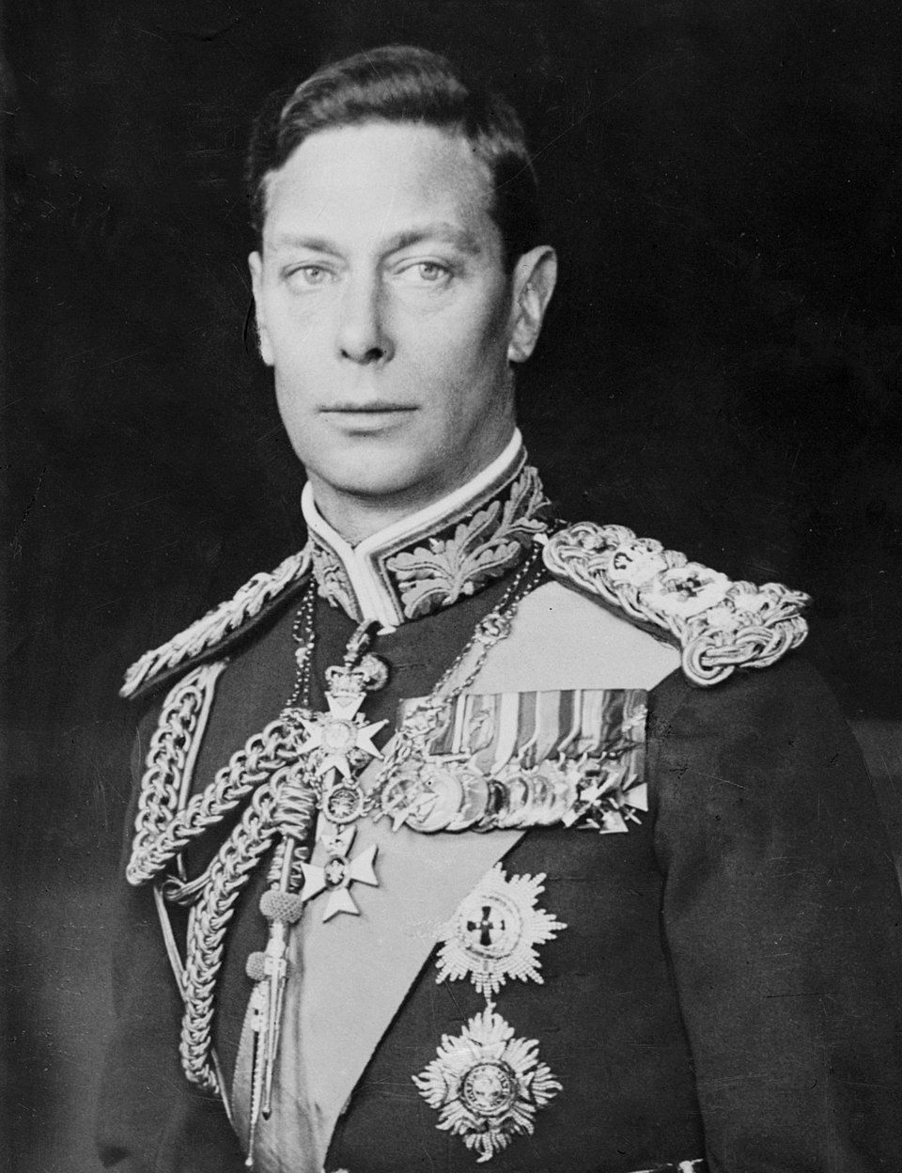
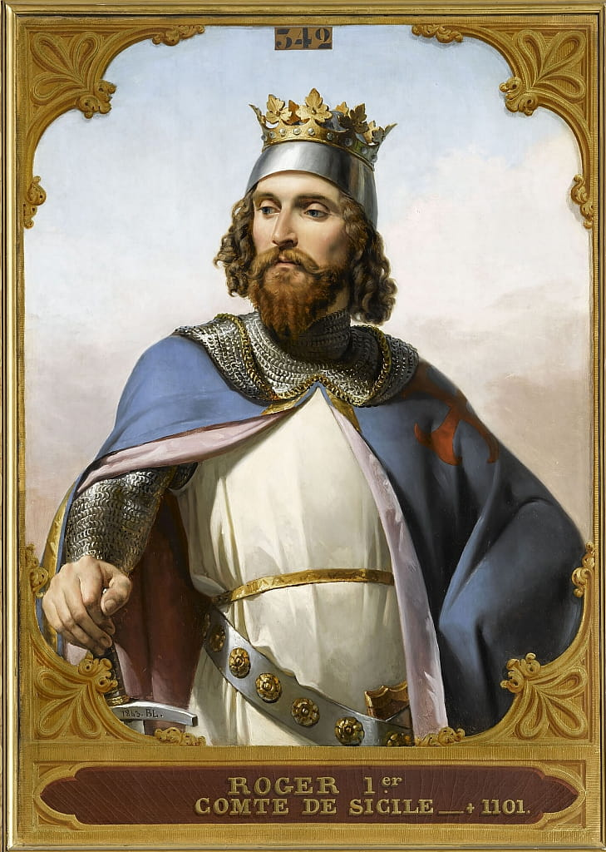
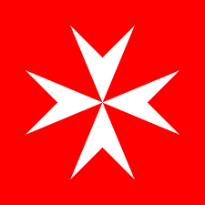
Notes:
The main legend of the Maltese flag attributes its red and white colors to Count Roger the Norman, who supposedly gave the Maltese a piece of his own banner in 1090 after liberating them from Arab rule; however, historians view this as a myth, with the colors likely established by the Knights of Malta (who used them) or later gifted by King Alfonso V. The flag also features the George Cross, awarded for wartime bravery, added in 1942 and retained at independence in 1964, symbolizing courage and resilience.

Slide 5
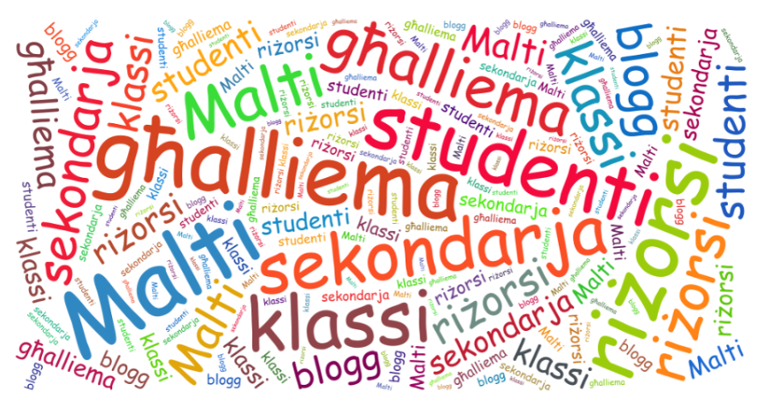
Notes:
Maltese (il-Malti) is a unique Semitic language with Arabic roots but written in the Latin script, making it the EU's only official Semitic language and Malta's national language, characterized by its Arabic-based grammar (root-and-template system) and significant lexical borrowing from Sicilian, Italian, and English, reflecting Malta's history. Its structure retains core Semitic features, but its vocabulary is heavily European, creating a distinct blend that allows for code-switching and a strong cultural identity.

Slide 6
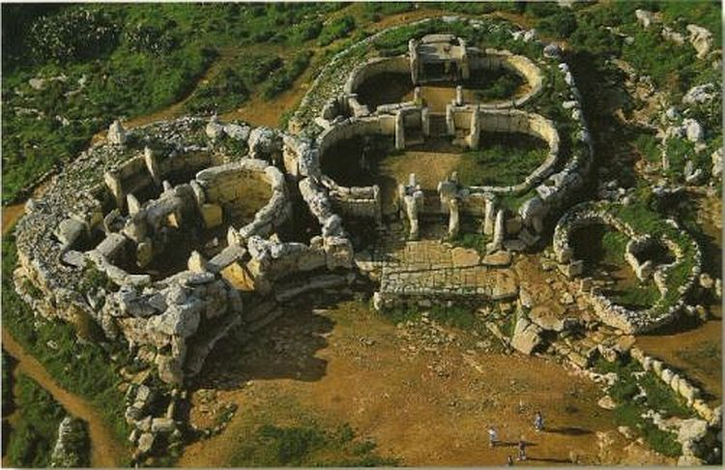
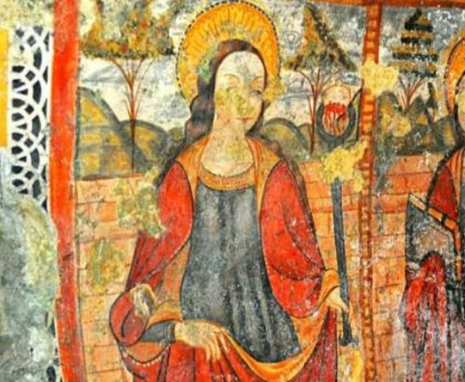
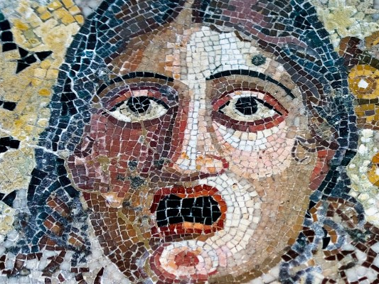
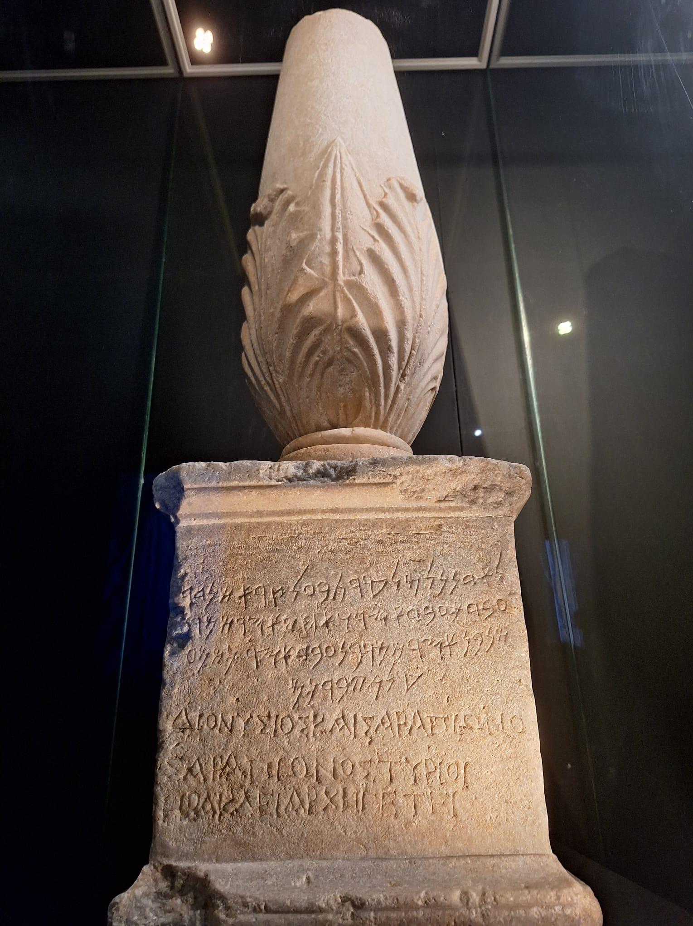
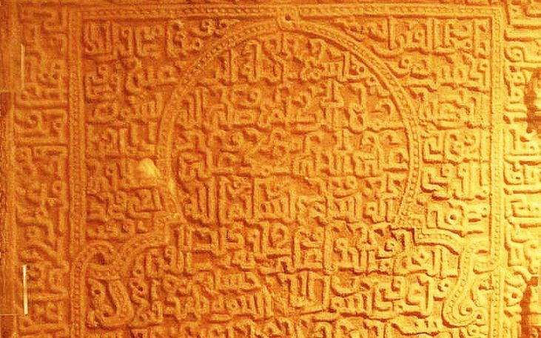
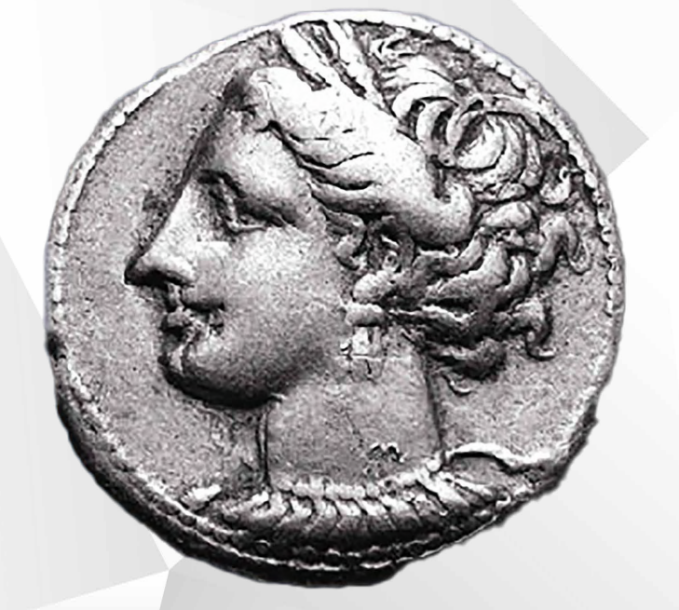
Notes:
History Timeline
Prehistory
Phoenicians
Carthaginians
Romans
Byzantines
Arab
Normans
Aragonese
Knights of Malta
French Rule
English Rule
Independence
EU Membership

Slide 7
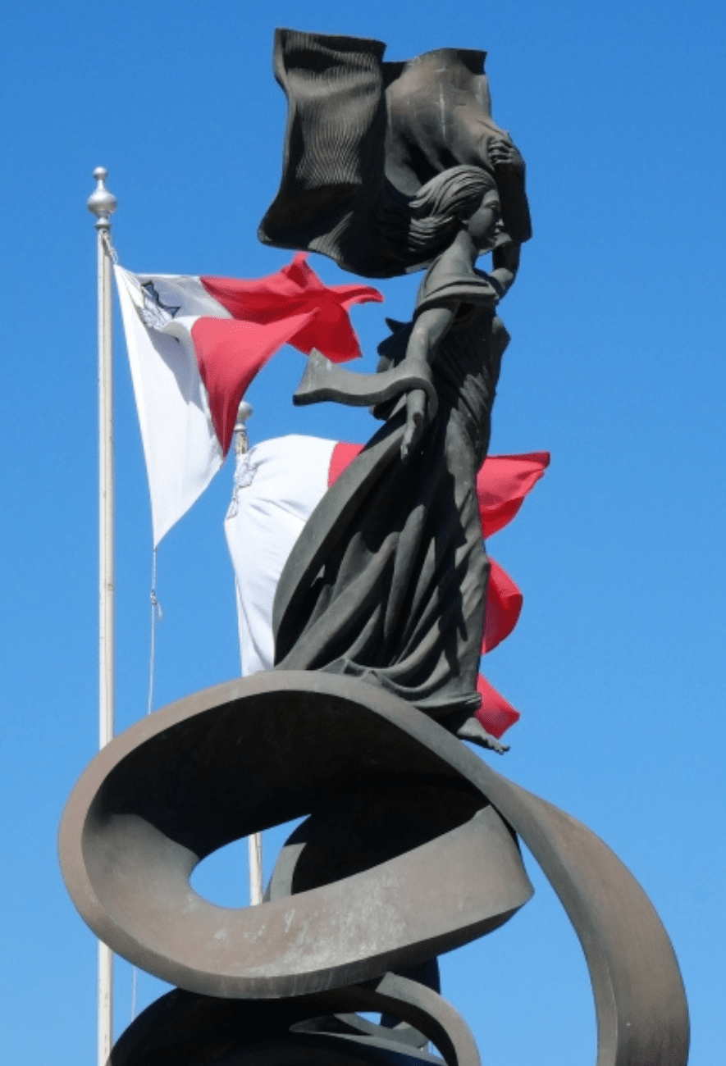
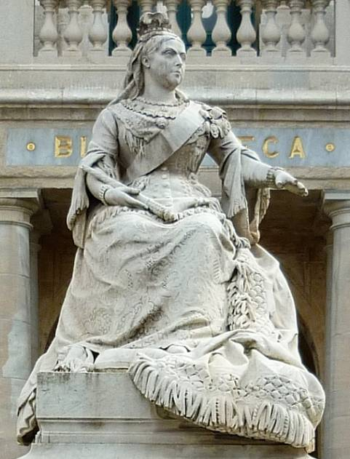
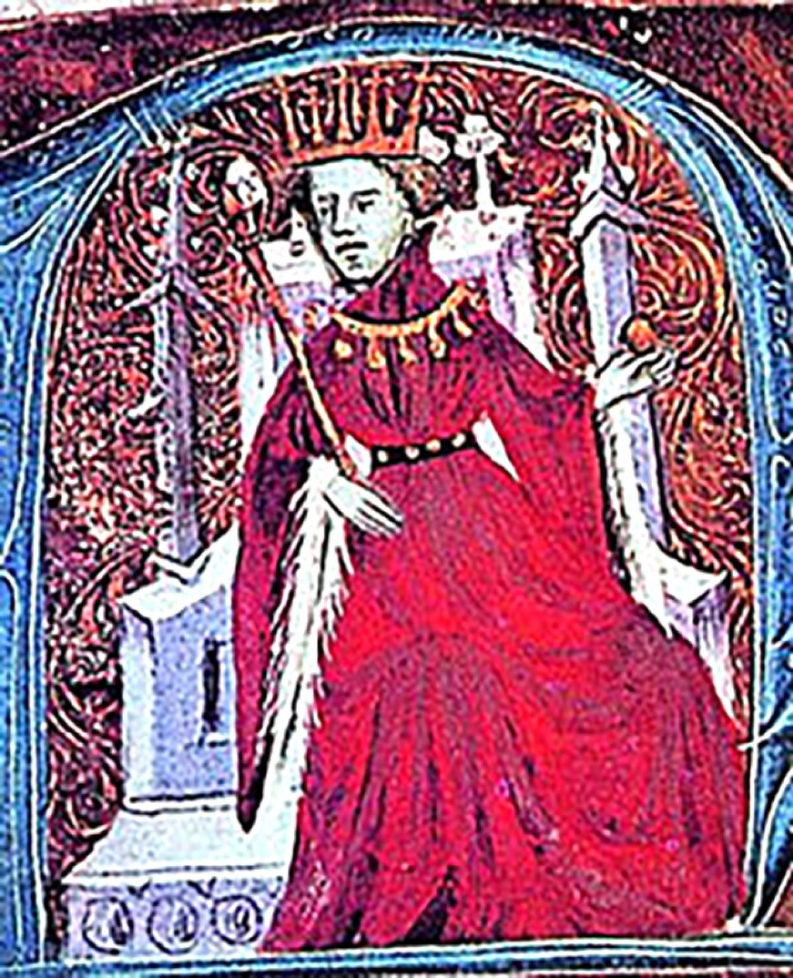
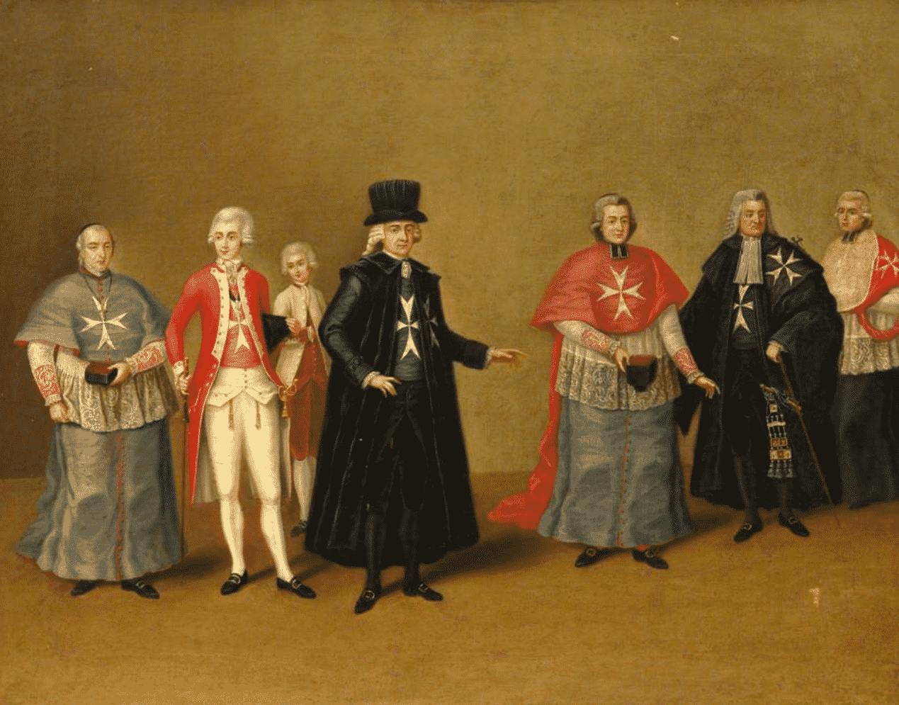
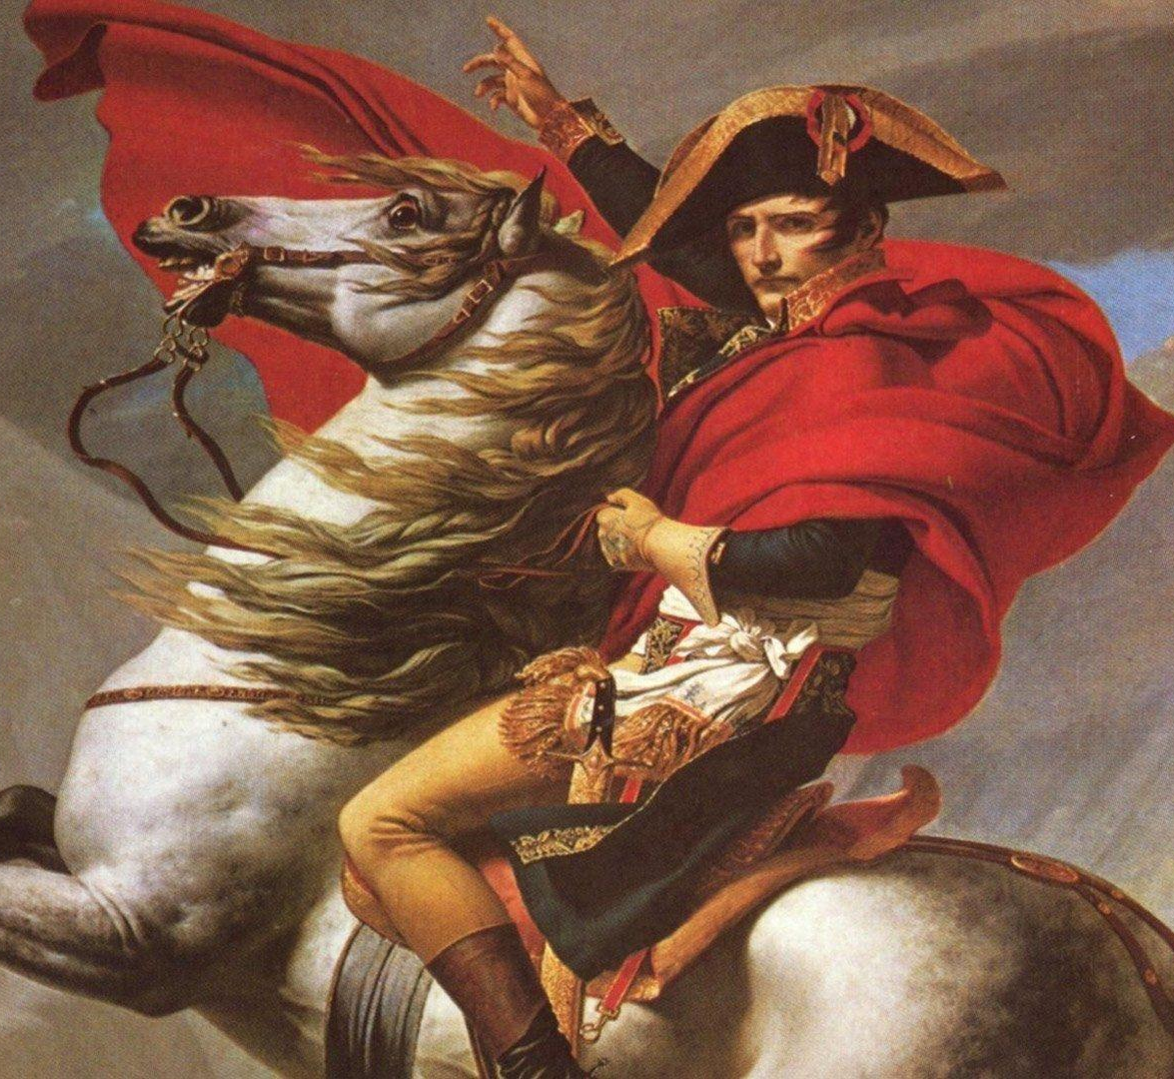
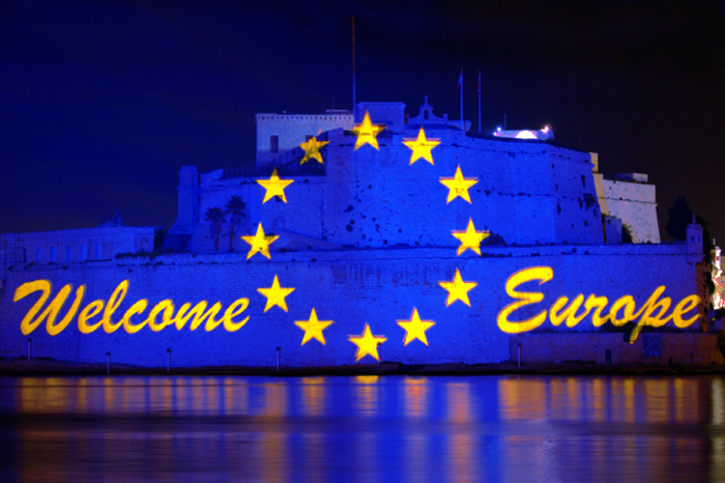
Notes:
History Timeline
Prehistory
Phoenicians
Carthaginians
Romans
Byzantines
Arab
Normans
Aragonese
Knights of Malta
French Rule
English Rule
Independence
EU Membership

Slide 8
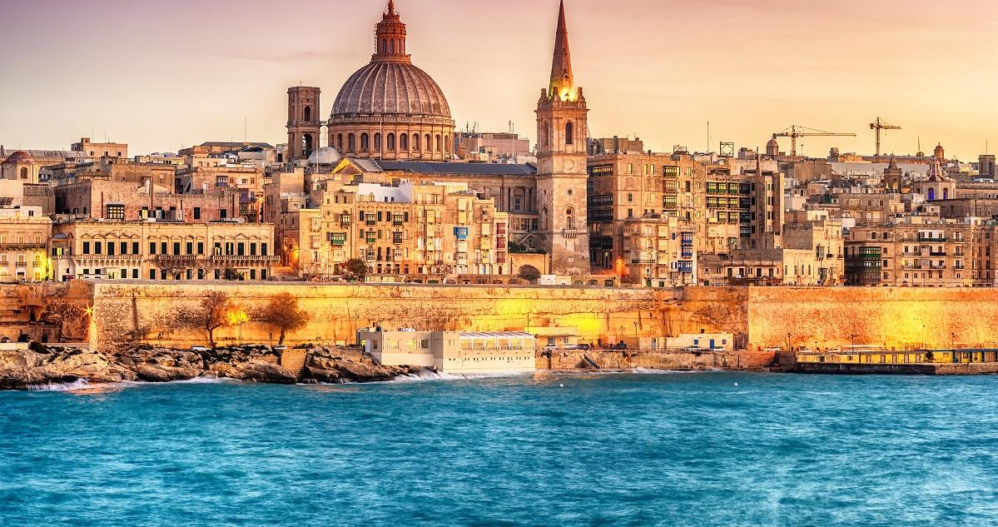
Valletta

Slide 9
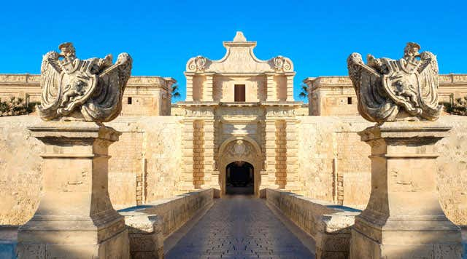
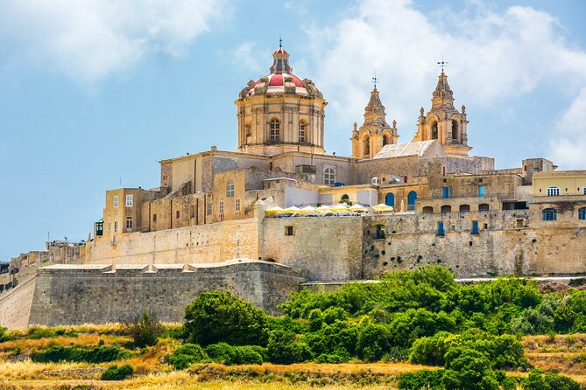
Mdina

Slide 10
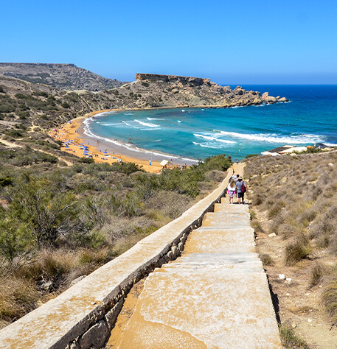
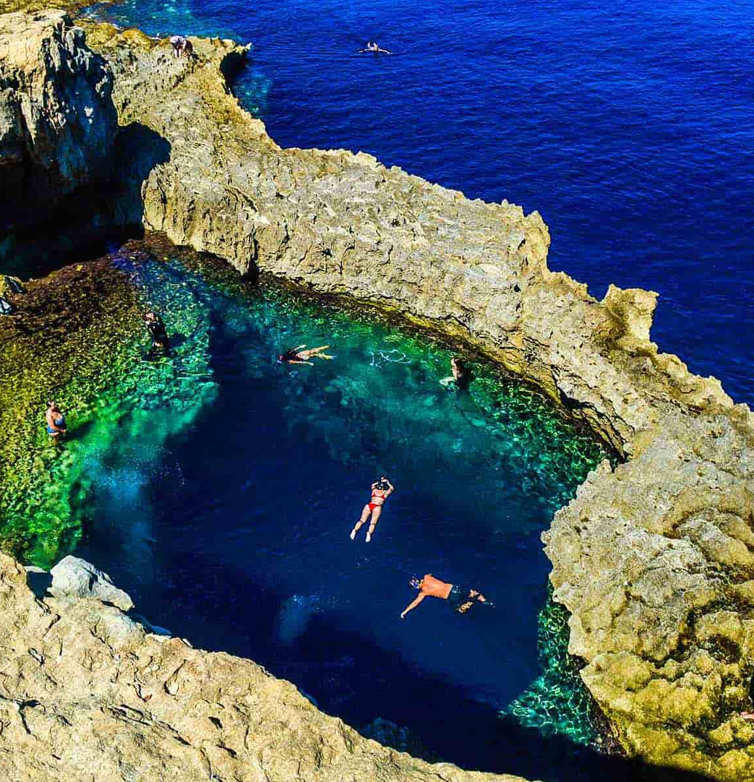
Our beaches

Slide 11
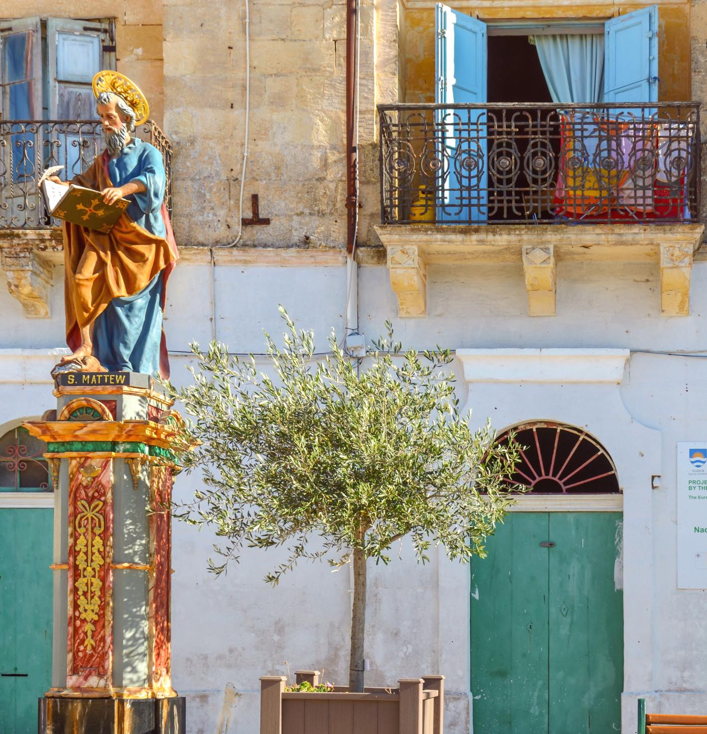
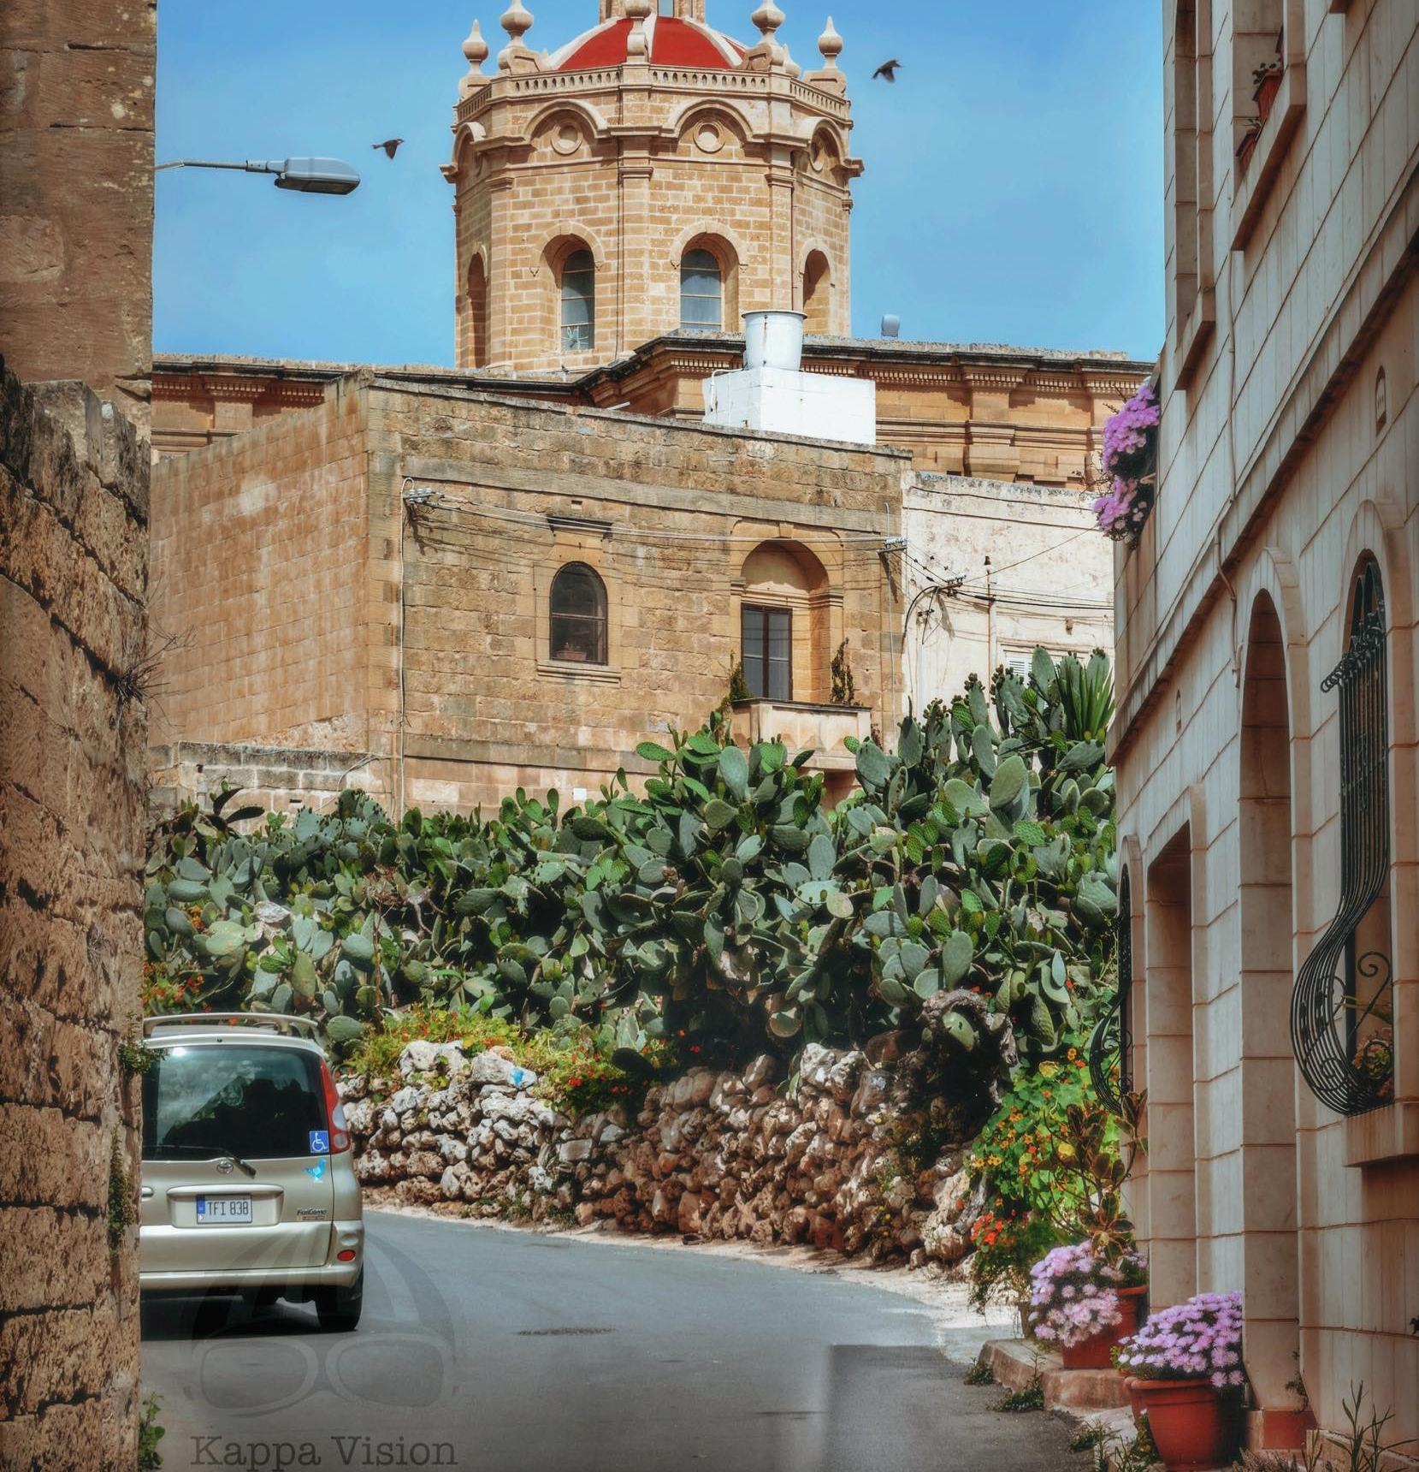
Village Life

Slide 12
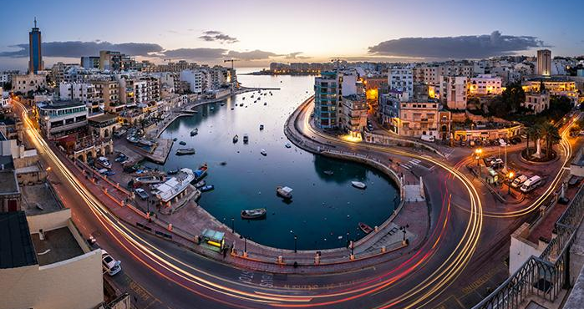

Slide 13
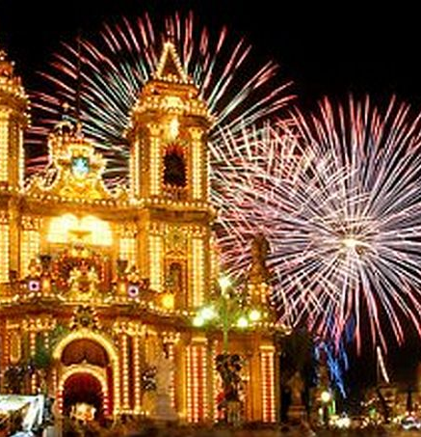
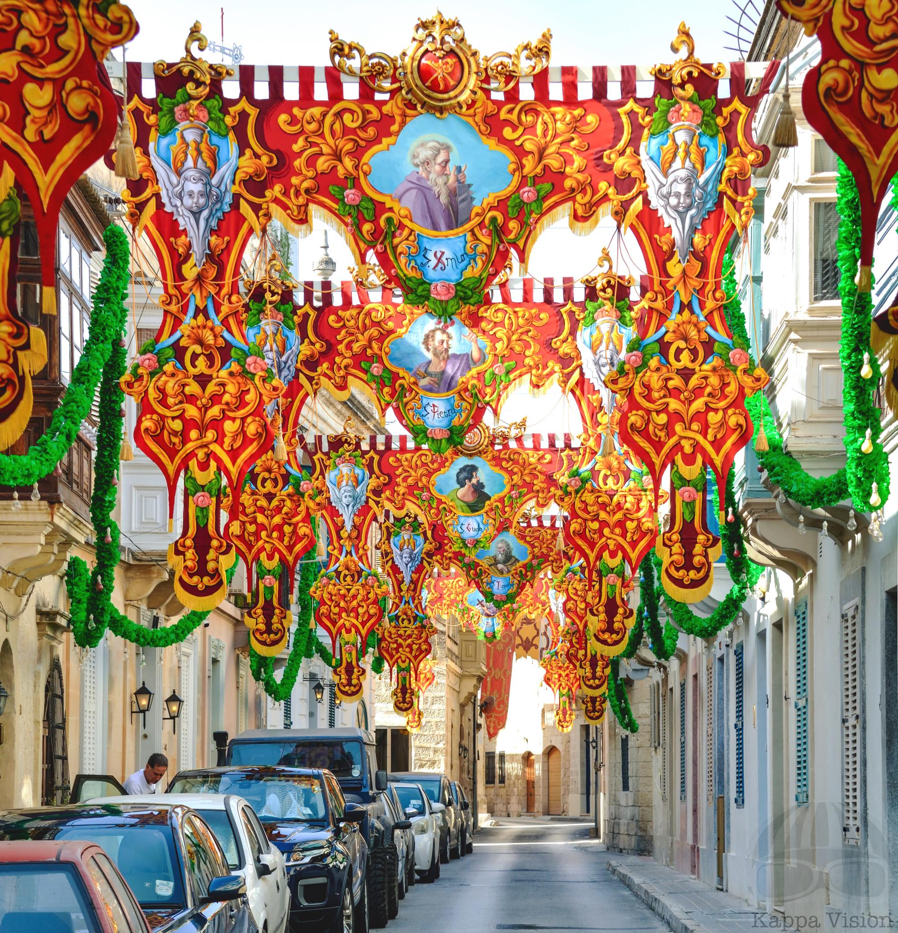
Village Festa
Notes:
The festa is a community event of religious origin held annually in village parishes across Malta and Gozo. Festa weeks entail concerts, band marches, firework displays and bell ringing. Typical festa food, such as nougat, is sold from street stalls. The practice is transmitted informally through participation in the preparation and events. Despite its increased secularisation, the festa remains an important part of cultural heritage in Maltese villages, uniting families, outsiders and local communities in a celebration of popular religiosity and local identities.

Slide 14
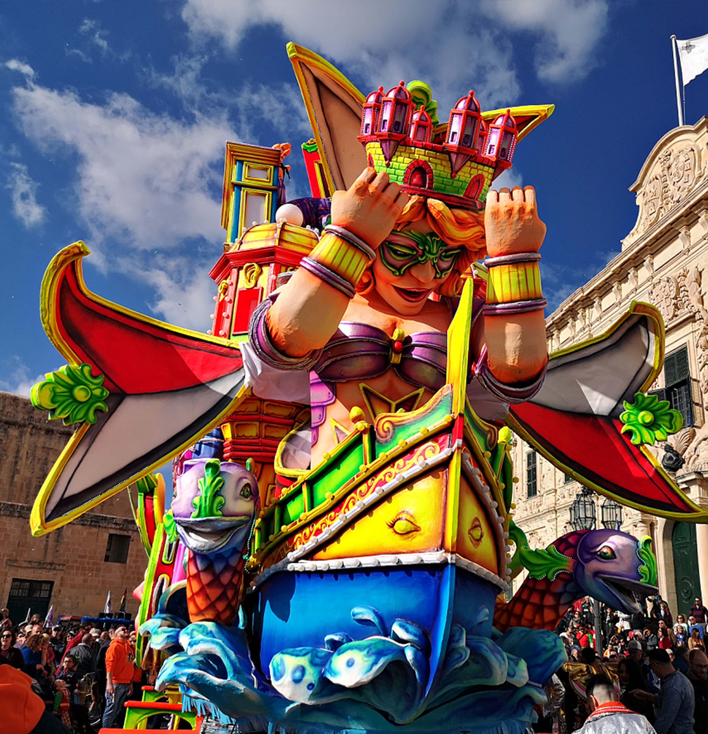
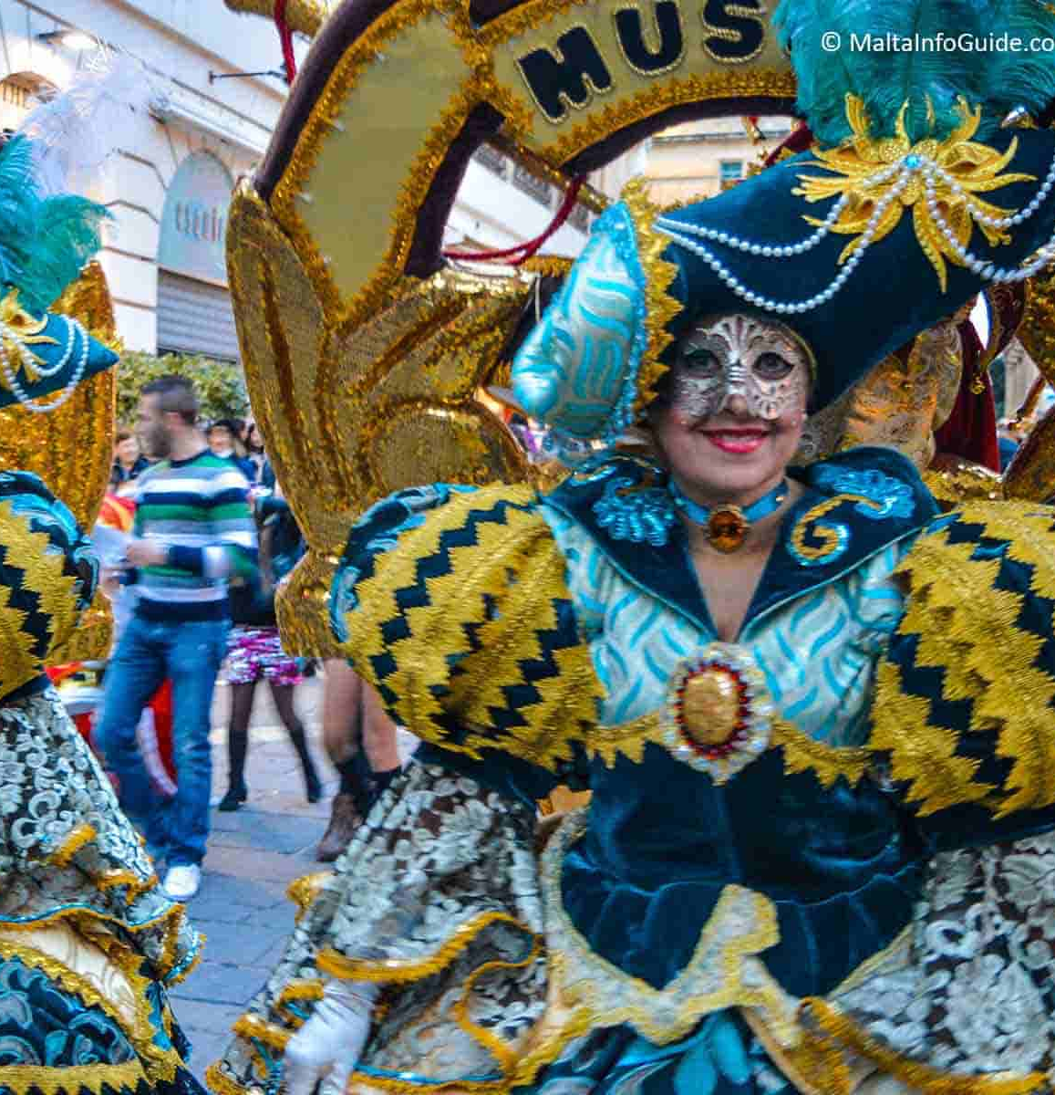

Slide 15
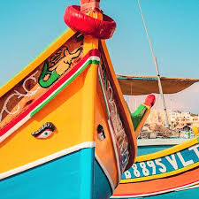
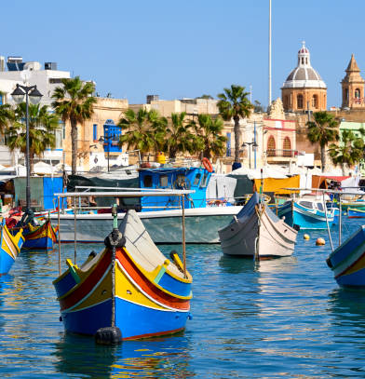
Traditional Fishing Boats
Il- Luzzu

Slide 16
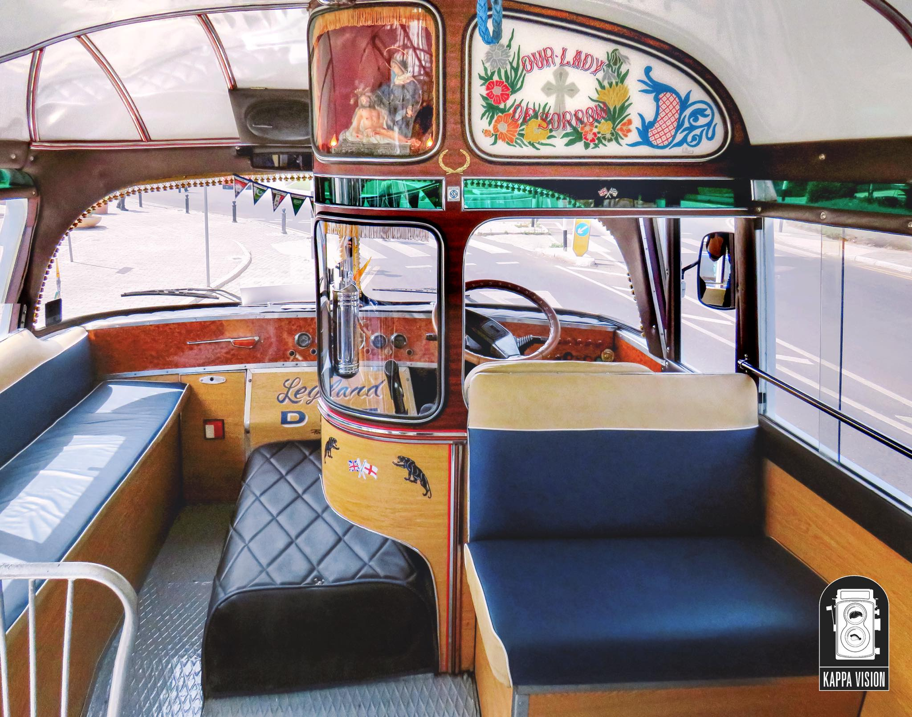
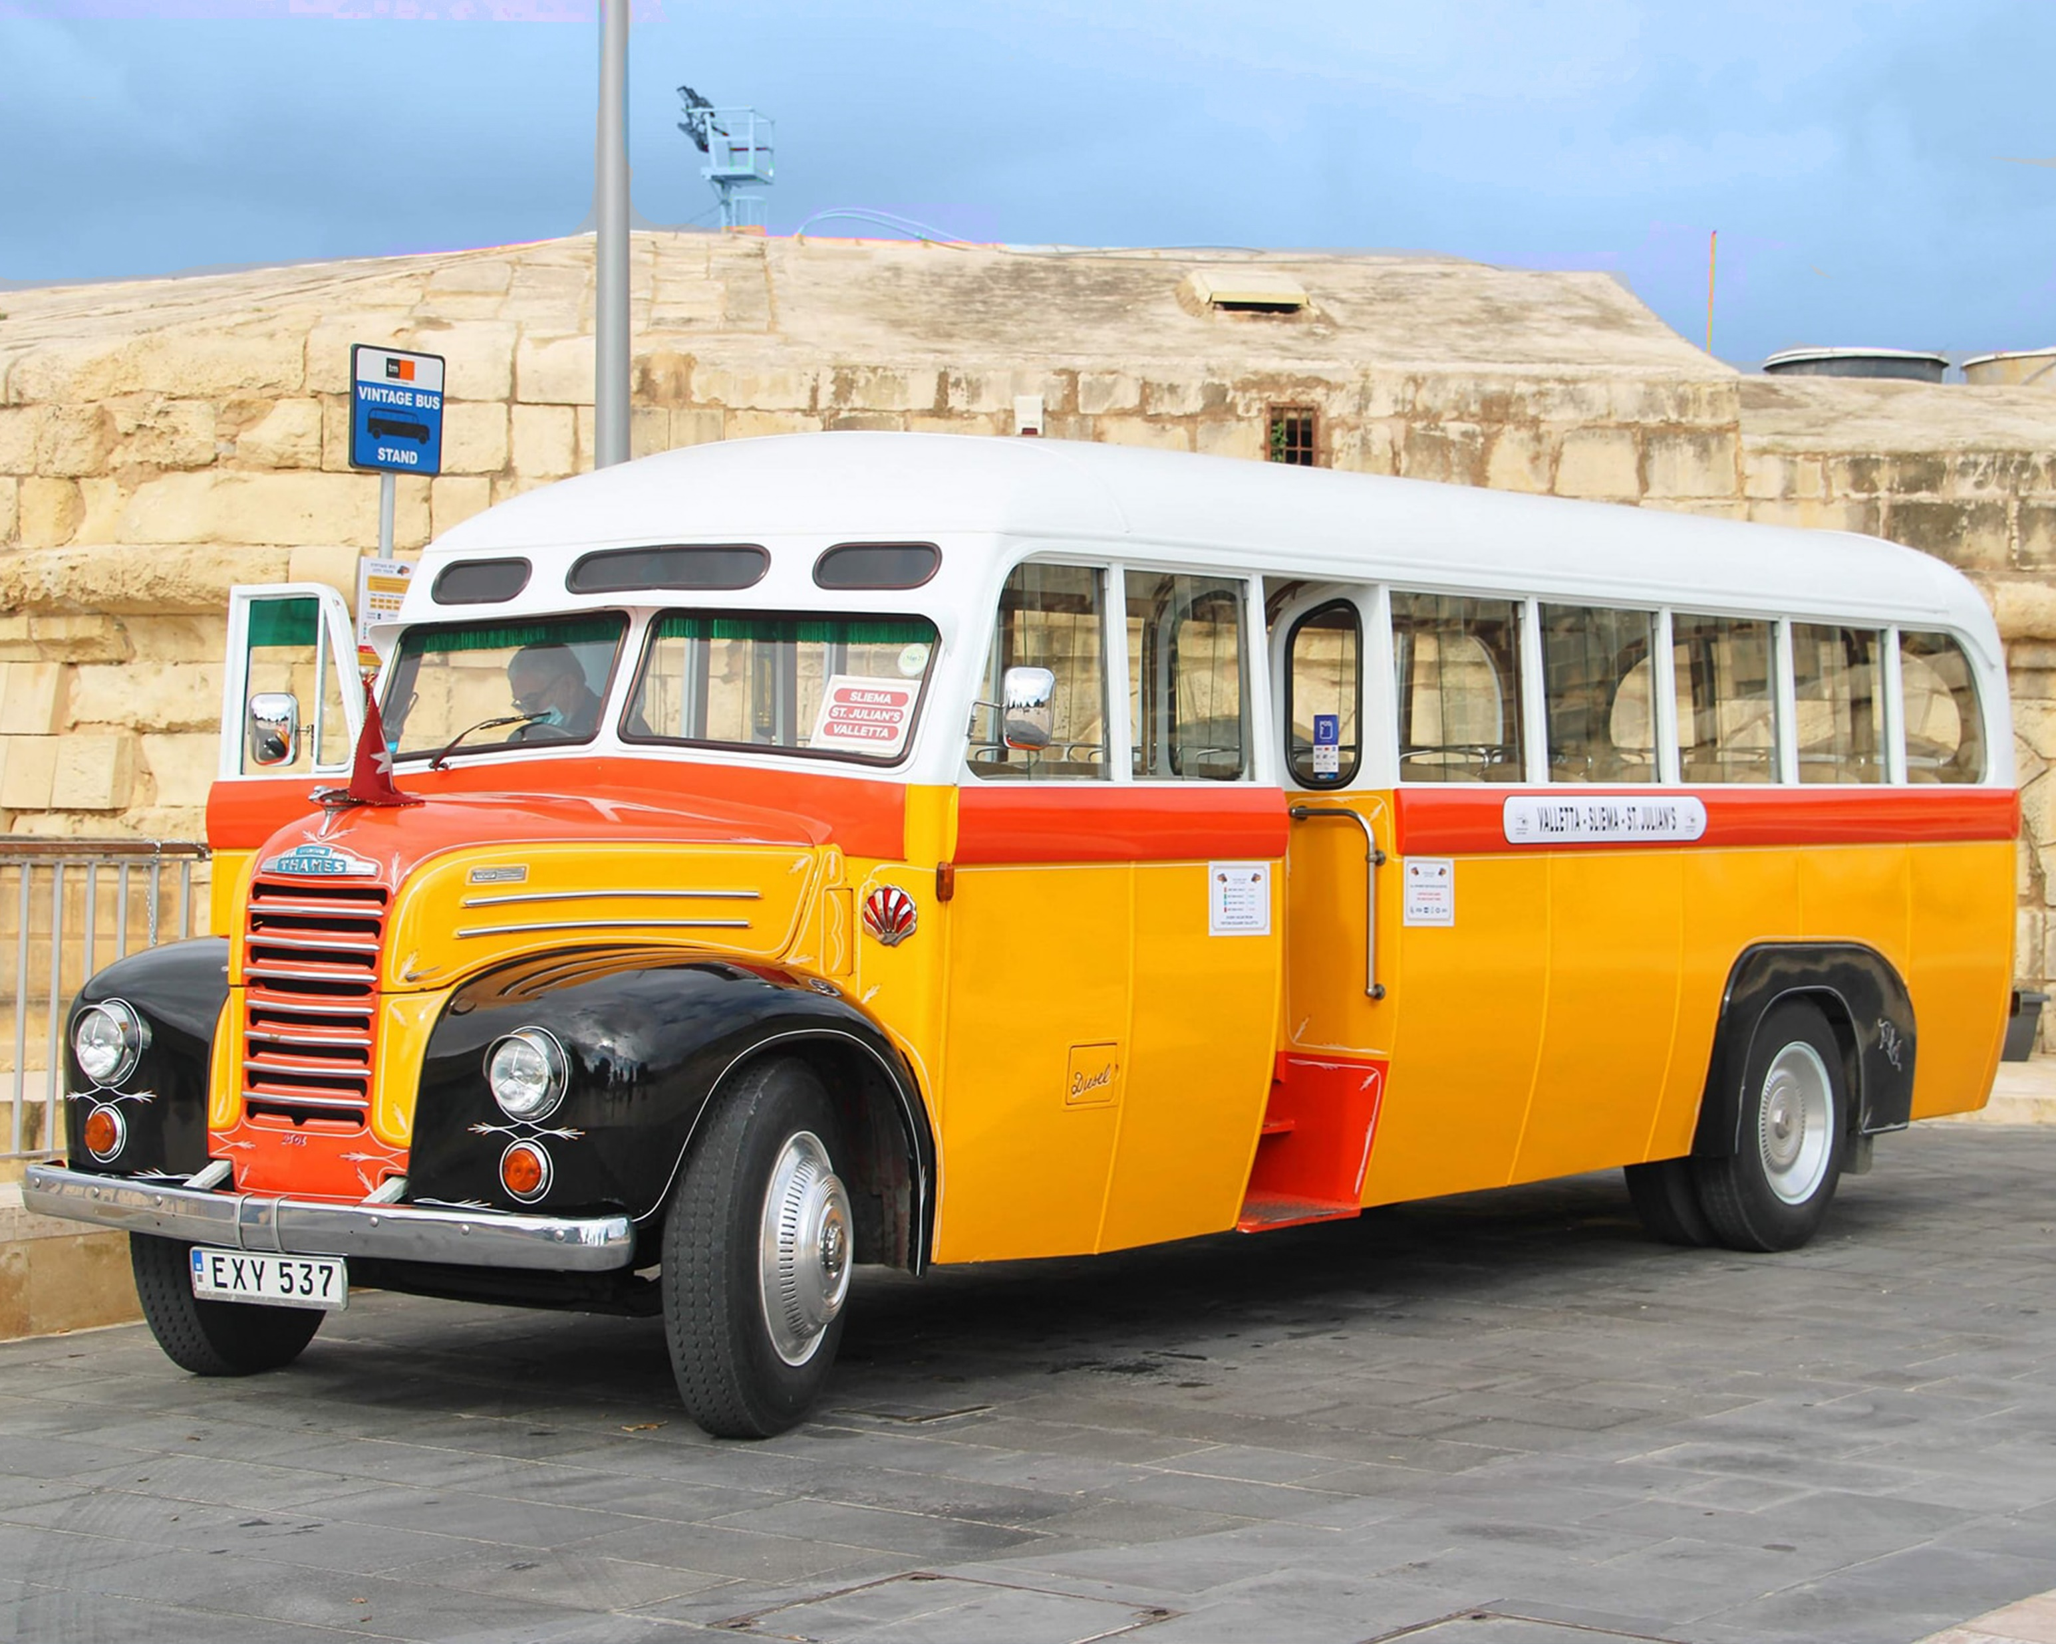

Slide 17
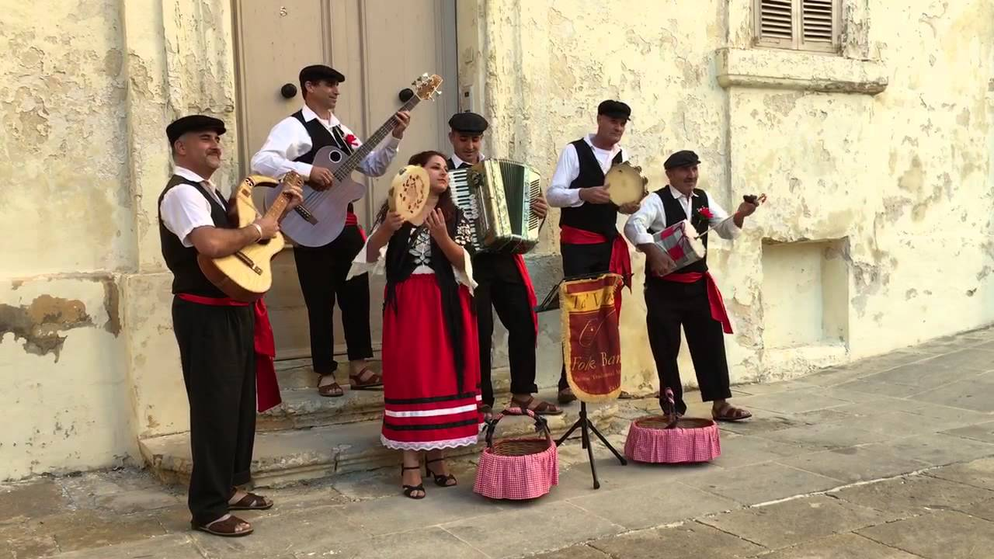
Traditional music

Slide 18
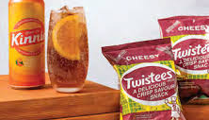
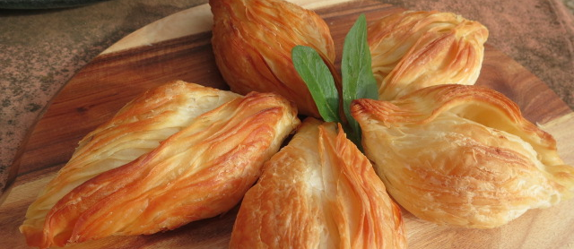
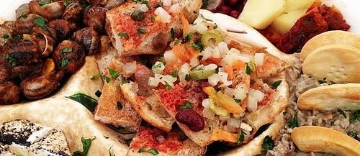
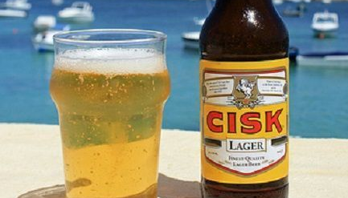

Slide 19
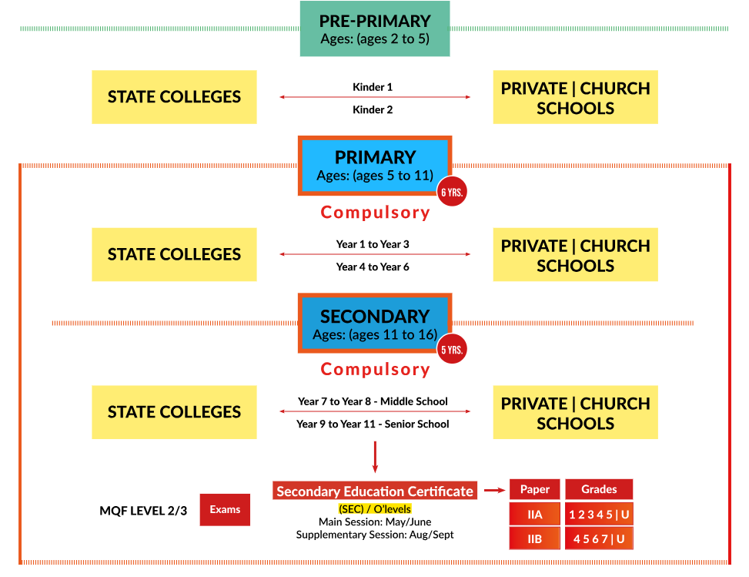
Maltese Educational System

Slide 20
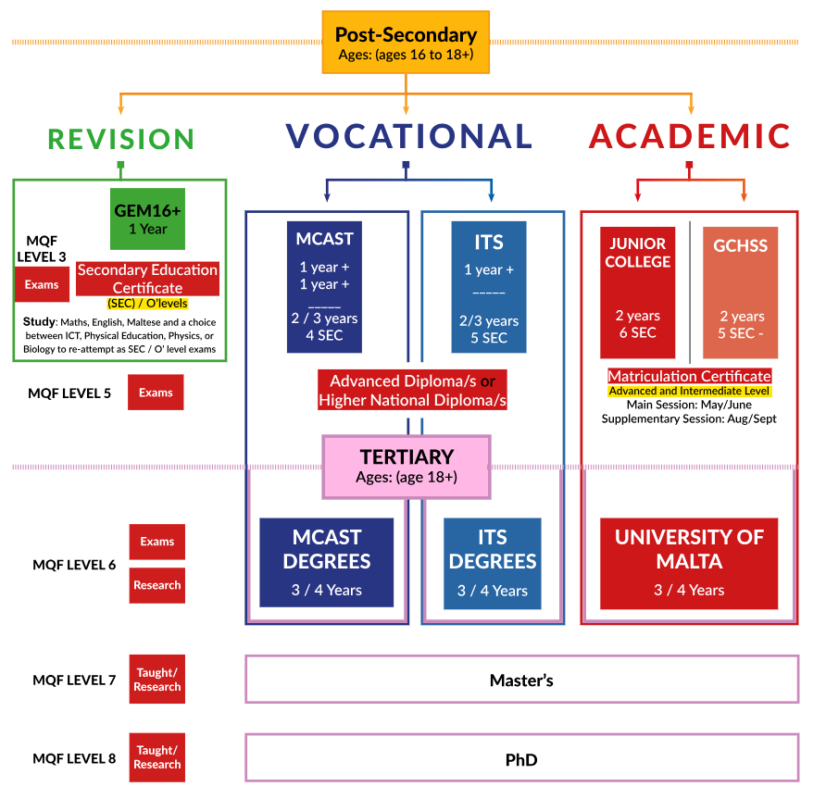
Maltese Educational System

Slide 21
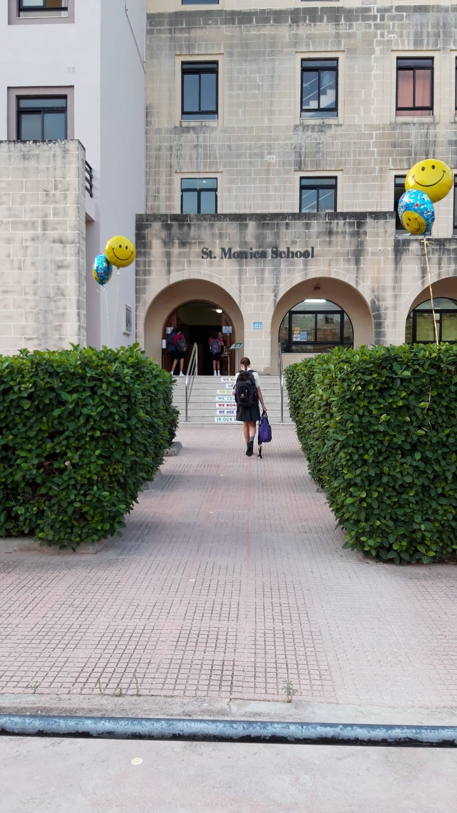
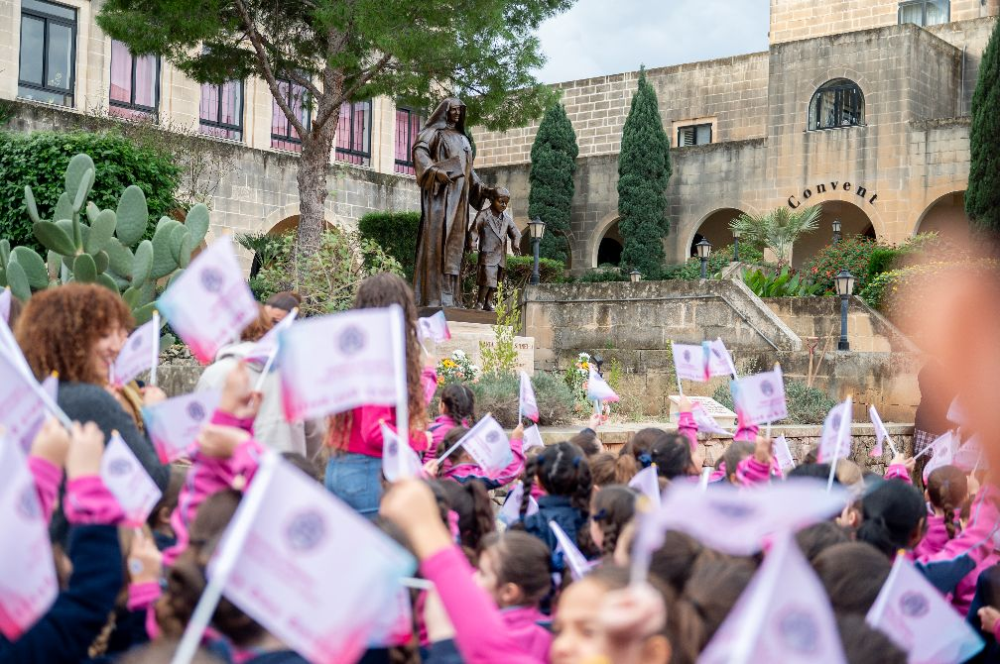

St Monica School
Notes:
School Day: 7.50 -13.40
End of September to End of June
Language of instructions – Maltese and English (code switching)
Assessment – Up to grade 3 (only formative assessment methods); Grade 4 onwards (a combination of formative and summative assessment along the scholastic year + an end of year exam)
Subjects in the primary : Maths, Maltese, English, Religion, Social Studies, Science, ICT, PE, PSCD, Gymnastics, Drama, Art

Slide 22
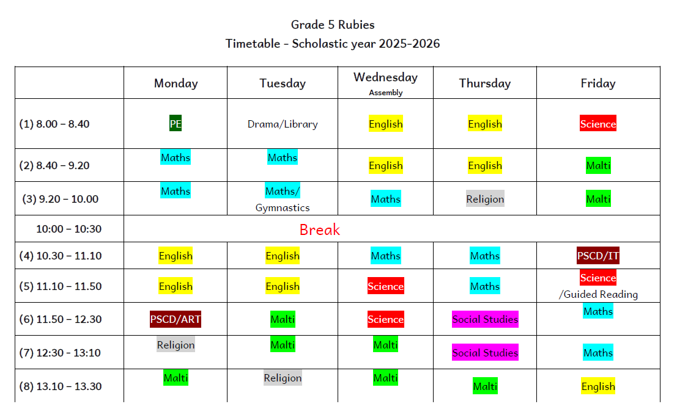
Typical timetable

Slide 23
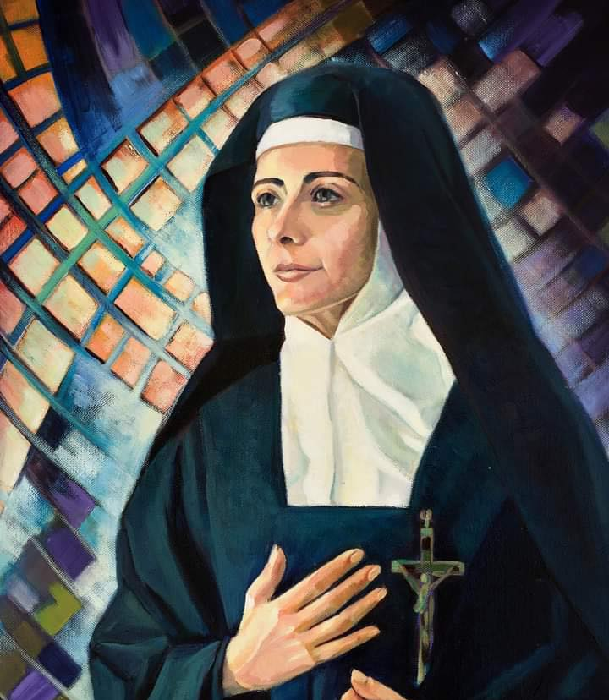
“Treat them as princesses endowed with an eternal destiny. Lavish on them all the love, care and respect due to them.”
-Maria Teresa Spinelli

Slide 24
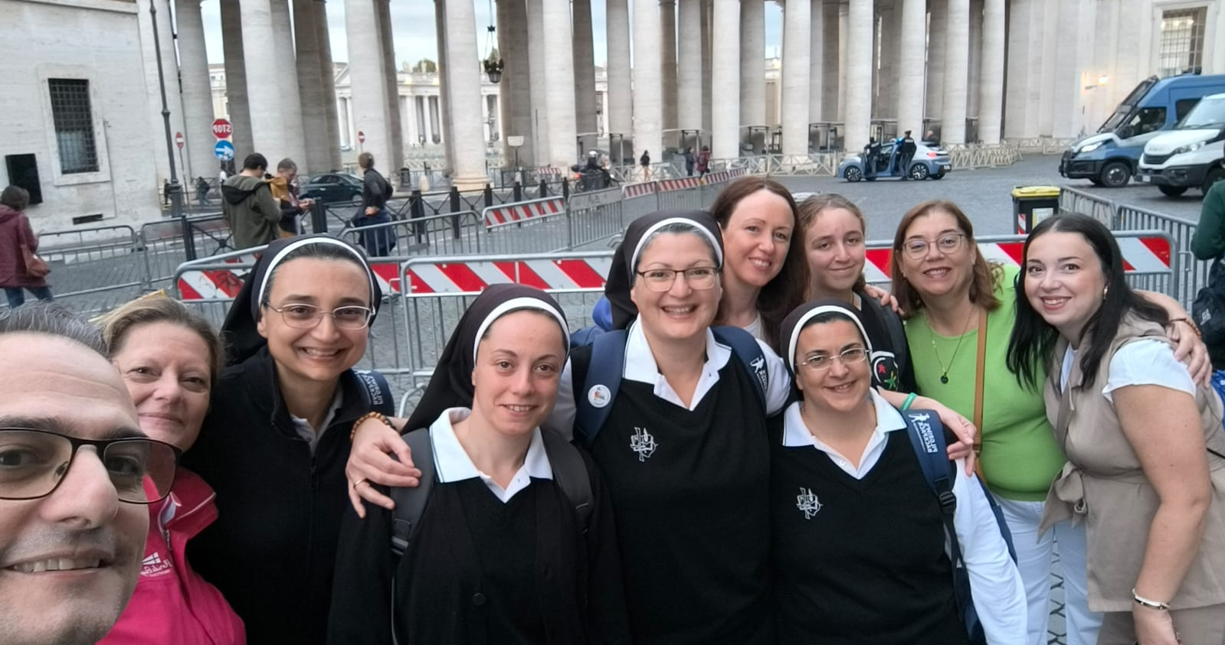

Slide 25

School Life

Slide 26

School Life

Slide 27


School Life

Slide 28


School Life

Slide 29

School Life

Slide 30

School Life

Slide 31

School Life

Slide 32


School Life

Slide 33


School Life

Slide 34


School Life

Slide 35


School Life

Slide 36



Sensory Room

