Slide 1
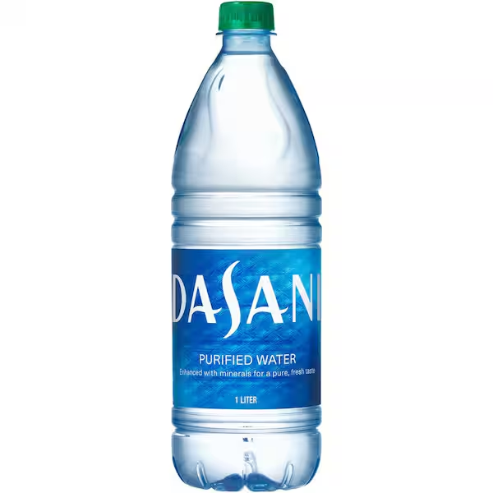
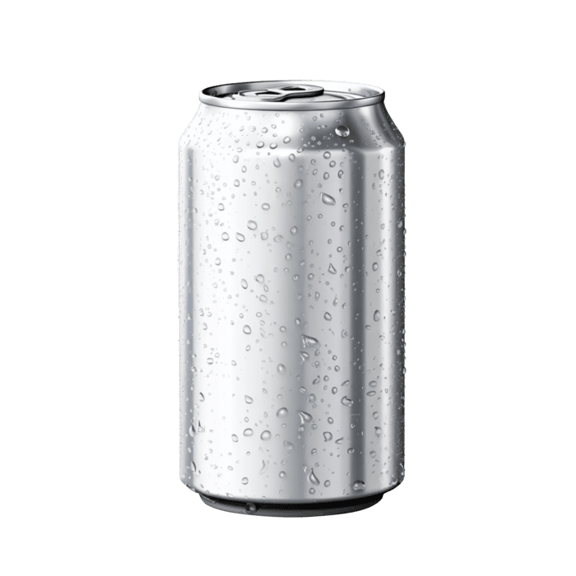
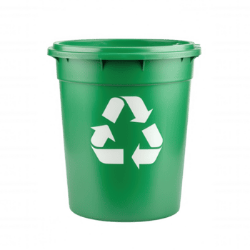
Bottle
Collecting / Recycling
Maria, Anna, Anniina, Lotte

Slide 2

What we did
We did trashcan where students can put their bottles and then the school would get the money from it and use it for scholarships or donations.

Slide 3

What went good
we got some bottles there
we got a lot of people helping us with the projeckt

Slide 4
what went wrong
we would need something to cover the trashcan so people wouldn’t steal from there
we didn't get lots of bottles

Slide 5

What we could have done better
we could have started earlier
we could have gotten a better cover for the can

