Slide 1
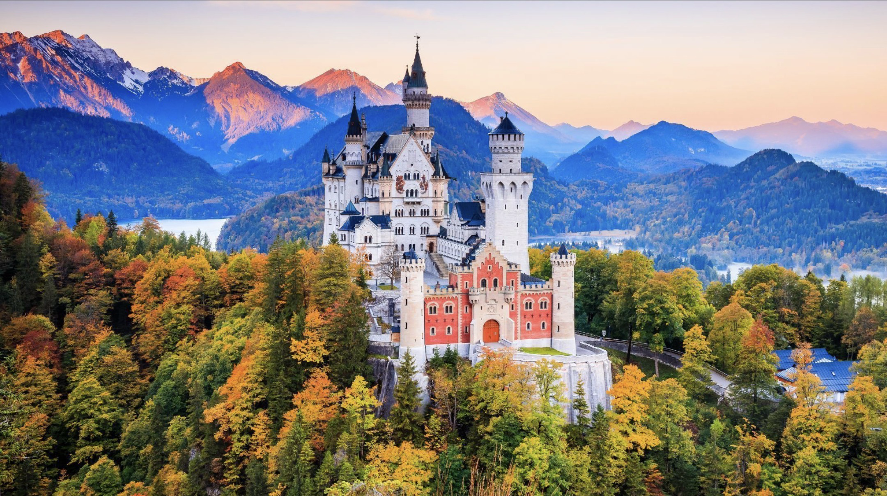
Germany
By Miranda, Hajar, Lotte and Paula

Slide 2
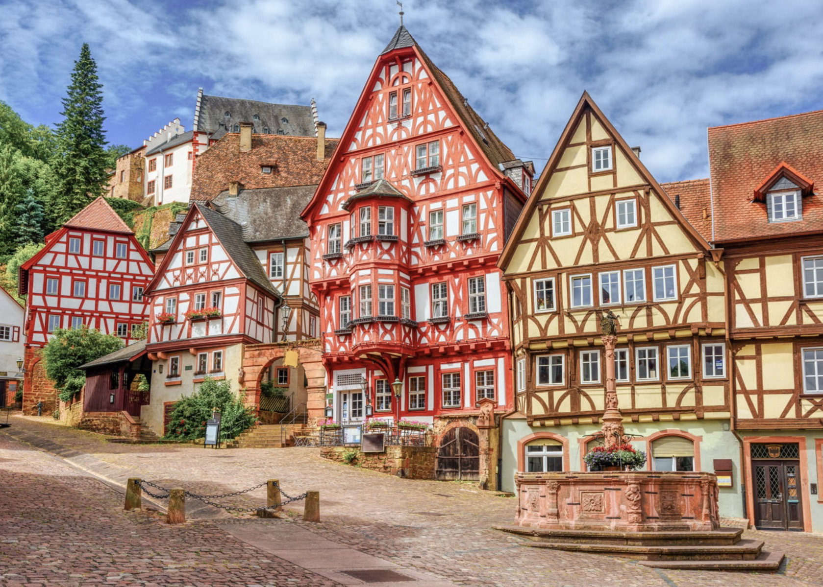
Table of contents
Culture
Food
Festivals
Traditions
Quiz

Slide 3
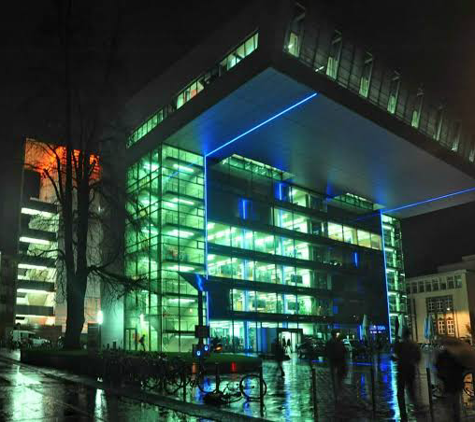
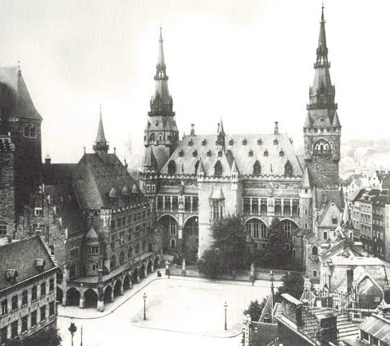
Culture of Aachen
Historic culture: Aachen Cathedral
Museums: Centre Charlemagne, Suermondt-Ludwig-Museum
Theatre and music: Theater Aachen
International student culture at RWTH Aachen University
Border culture near Belgium and the Netherlands

Slide 4
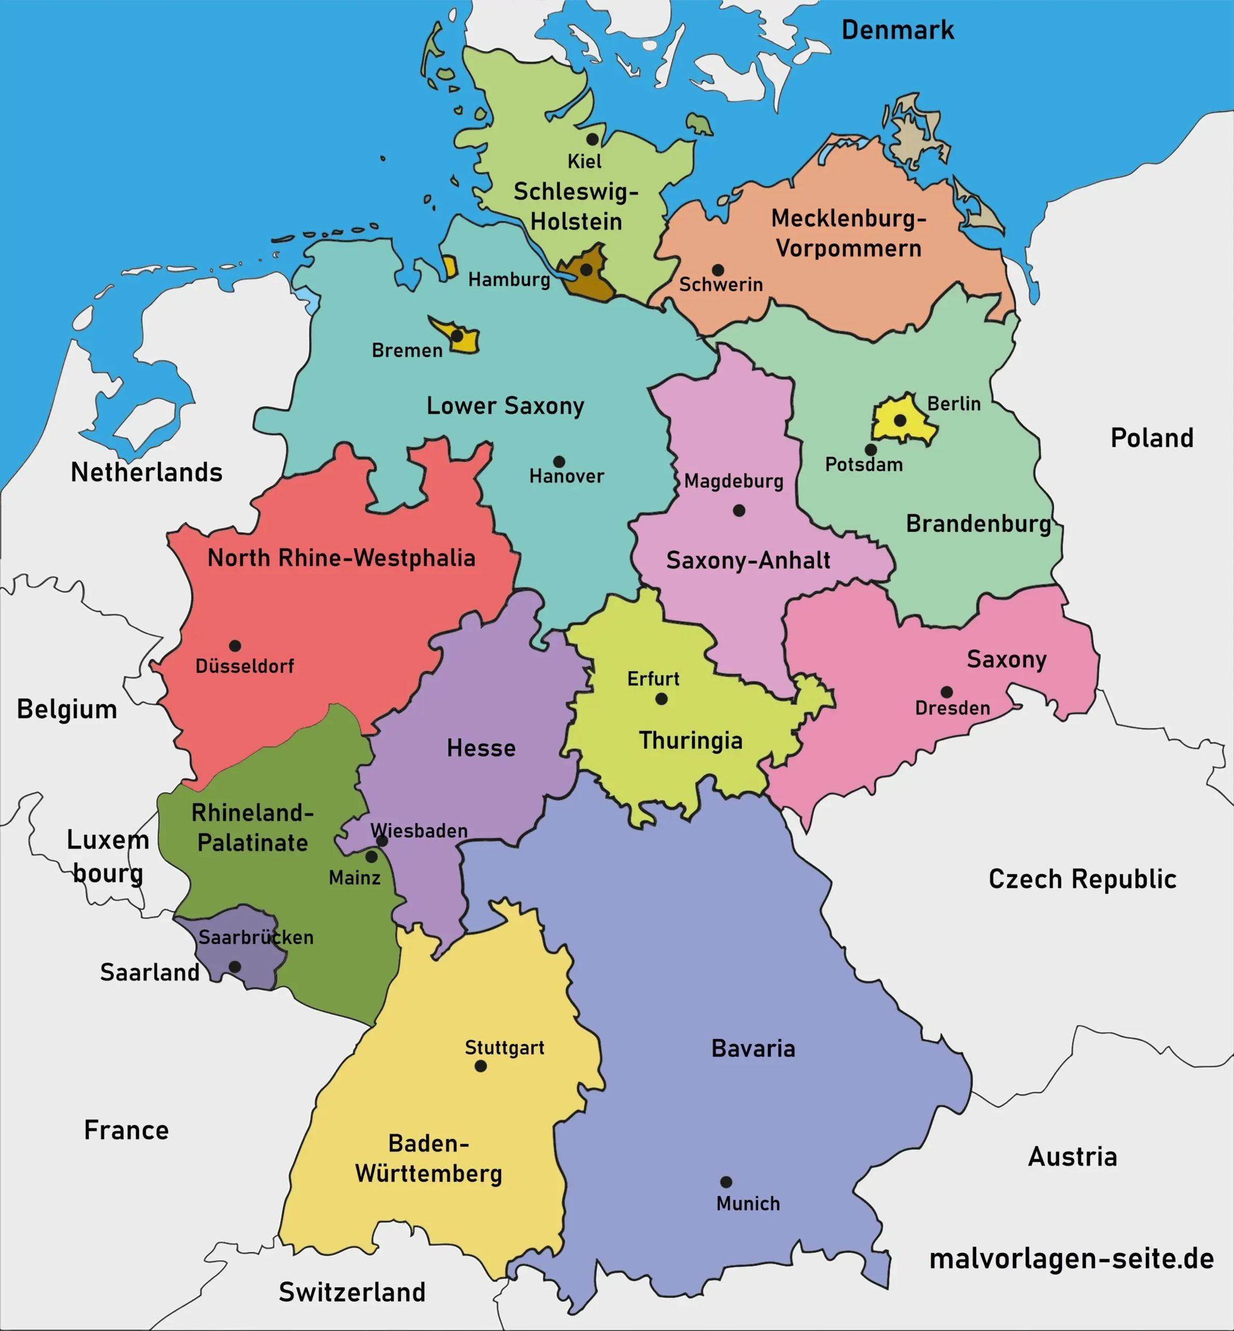
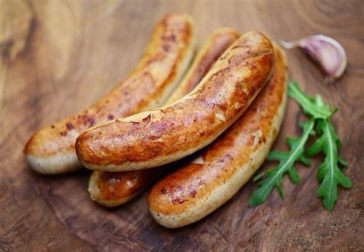
Food
Bratwurst
Grilled sausage made from pork
often with rolled bread + mustard (hot dog)
Common at street food stands, markets, festivals

Slide 5
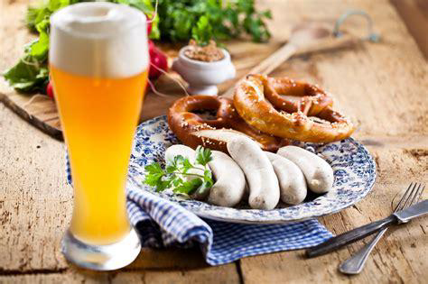
Food
Weißwurst
Sausage made from veal and pork back bacon
flavored with lemon, onions and spices
morning, before noon
With pretzels, mustard and white beer

Slide 6
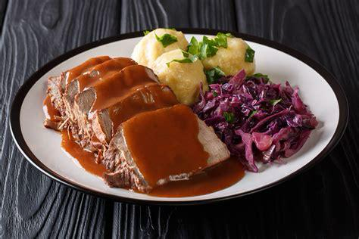
Food
Sauerbraten
Pot roast marinated in vinegar, wine and spices (for several days)
Slow cooked until tender
Served with a rich sauce, red cabbage and potatoe dumplings

Slide 7
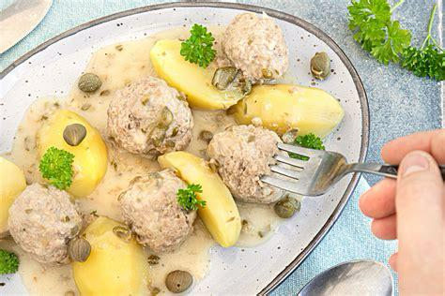
Food
Königsberger Klopse
Meat ball made from minced beef mixed with bread and spices
Cooked in broth
Served with a creamy white sauce, capers and boiled potatoes

Slide 8
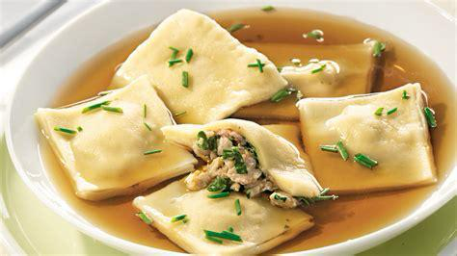
Food
Maultaschen
Large dumplings filled with minced meat, spinach, onions and bread
In a broth or sliced and fried with onions
Traditionally eaten on Good Friday

Slide 9


Slide 10
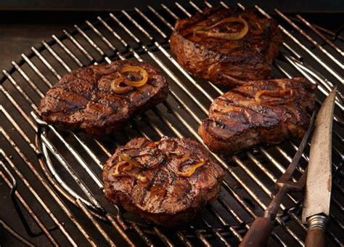
Food
Saarländer Schwenkbraten
Marinated pork steak grilled over an open fire
On a special swinging grill called „Schwenker“
With bread, salads or garlic

Slide 11
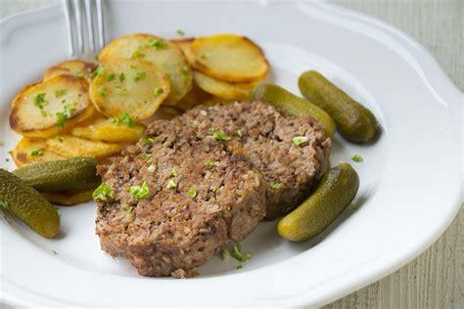
Food
Knipp
pork, groats and spices formed into a loaf, sliced and fried in a pan
Served with fried potatoes and pickles
Considered a „rustic farmer‘s meal“

Slide 12
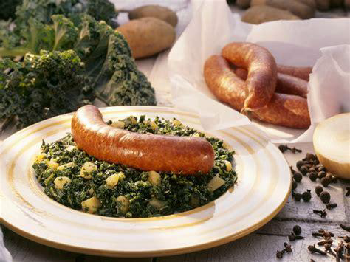
Food
Grünkohl mit Pinkel
Kale stew cooked with smoked sausages, bacon and the sausage „Pinkel“
Winter dish
Served with potatoes

Slide 13
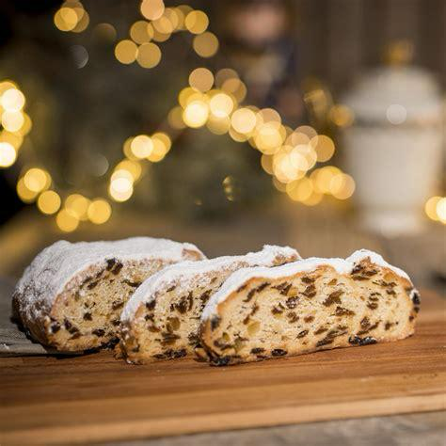
Food
Dresdner Stollen
Rich Christmas bread with dried fruits, nuts, spices and powdered sugar
Baked during advent season
1-3 weeks to bring full flavour

Slide 14
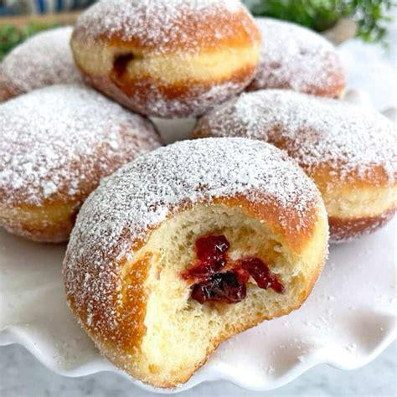
Food
Berliner
Deep-fried pastry filled with jam
Covered with powdered sugar
Eaten during carnival season
Known by different names in different regions

Slide 15
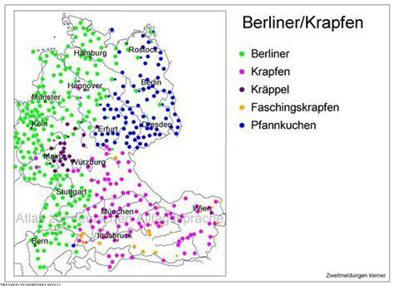

Slide 16
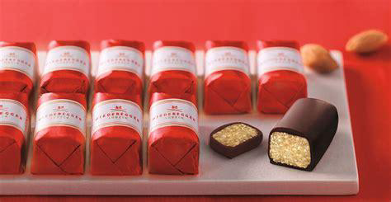
Food
Lübecker Marzipan
high-quality marzipan made mainly from almonds and sugar
Very high almond content
Shaped into sweets, prakines or cake decorations
Associated with christmas

Slide 17
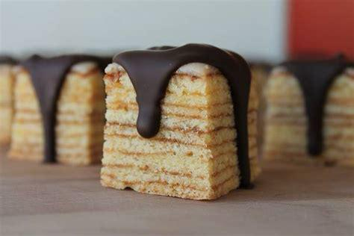
Food
Baumkuchen
Layered cake
Each layer is added one at a time -> ring patterns
Often coated with chocolate

Slide 18
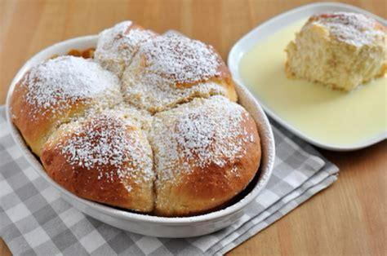
Food
Dampfnudeln
Fluffy yeast dumplings steamed in a pot
Sweet (with vanilla sauce) or savory (with soup)
Main dish or dessert

Slide 19
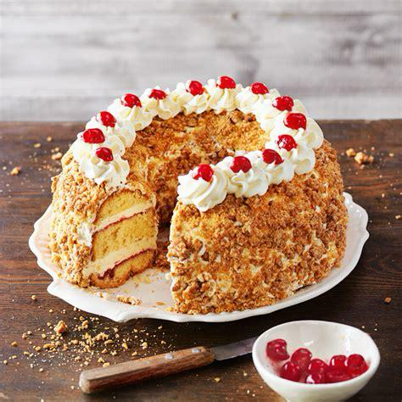
Food
Frankfurter Kranz
Sponge cake layered with buttercream and jam
Covered with crunchy caramelized hazelnut britzle
Decorated with buttercream and cherries

Slide 20
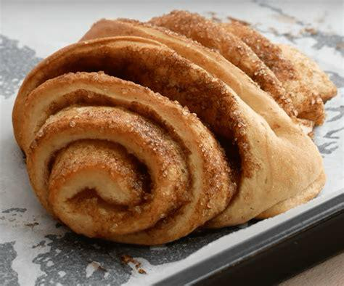
Food
Franzbrötchen
Sweet pastry made from laminated dough with sugar and cinnamon
Flattened and twisted before baking
Similar to a cinnamon roll

Slide 21
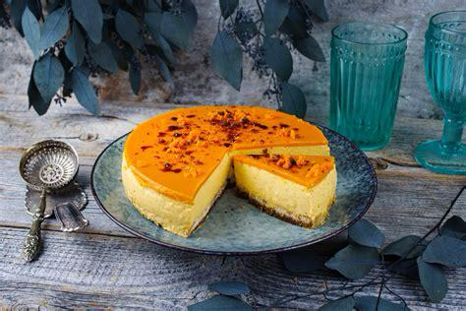
Food
Sanddorntorte
Cake layered with cream and sea bruckthorn fruit filling
Known for slightly sour + fruity taste

Slide 22
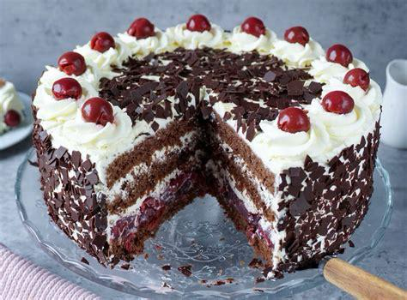
Food
Schwarzwälder Kirschtorte
Chocolate cake with layers of cream, cherries and sponge cake
Decorated with chocolate shavings and cherries

Slide 23
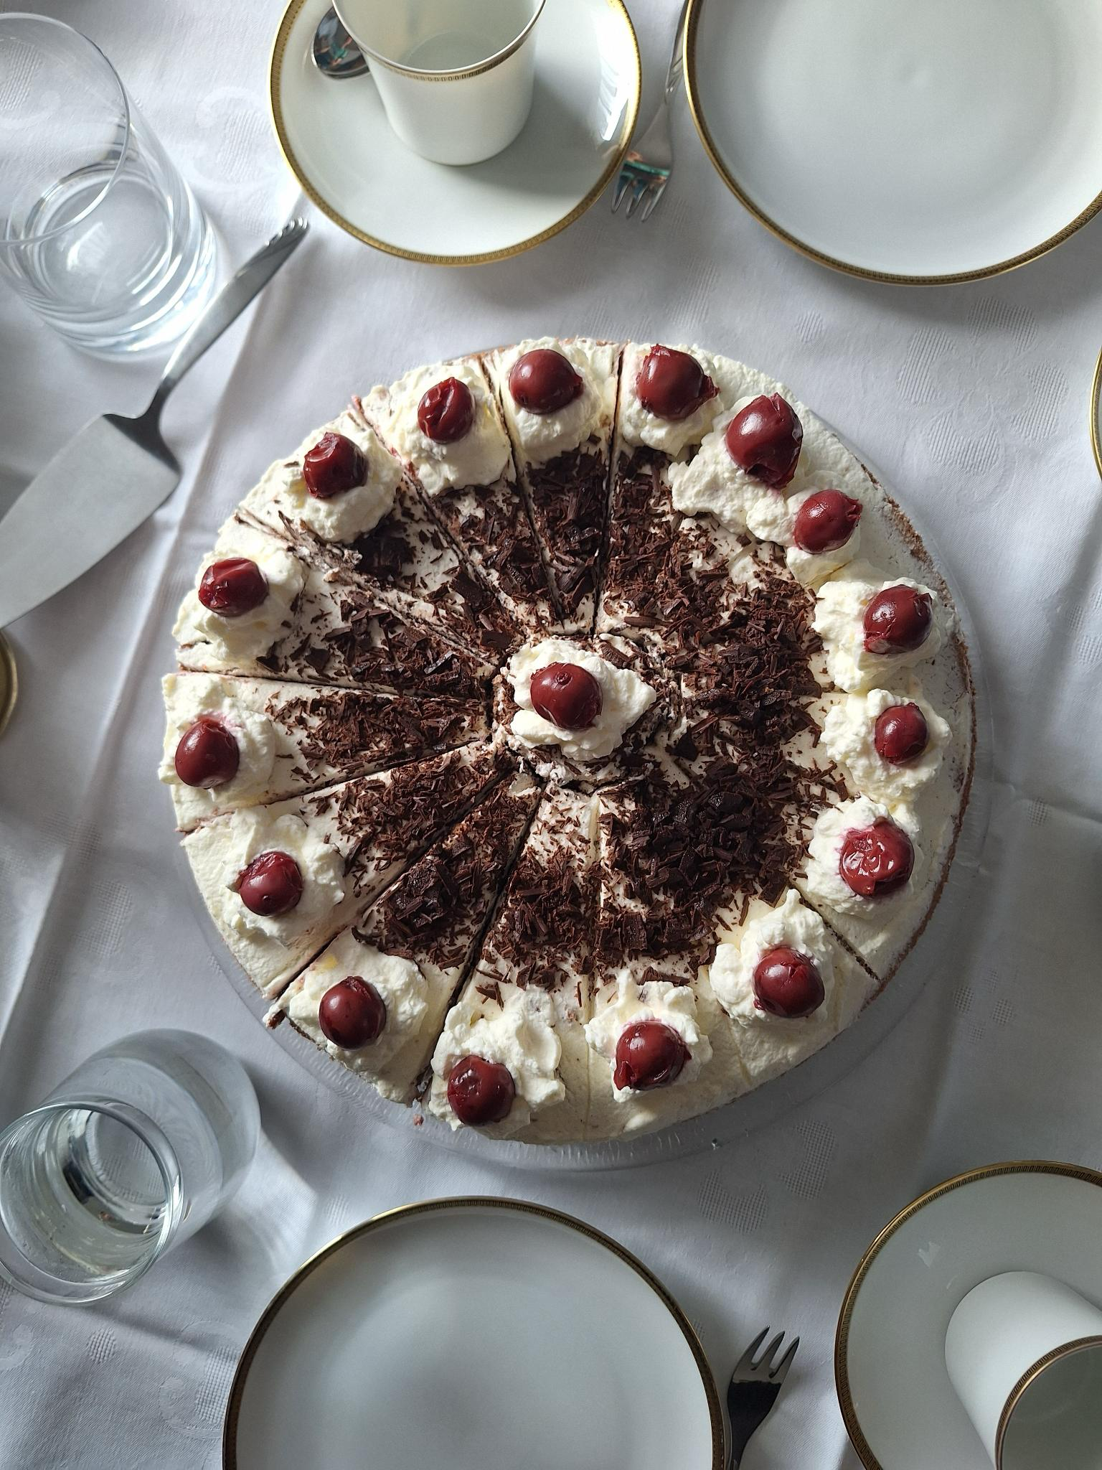
Food
Schwarzwälder Kirschtorte
Chocolate cake with layers of cream, cherries and sponge cake
Decorated with chocolate shavings and cherries

Slide 24


Slide 25
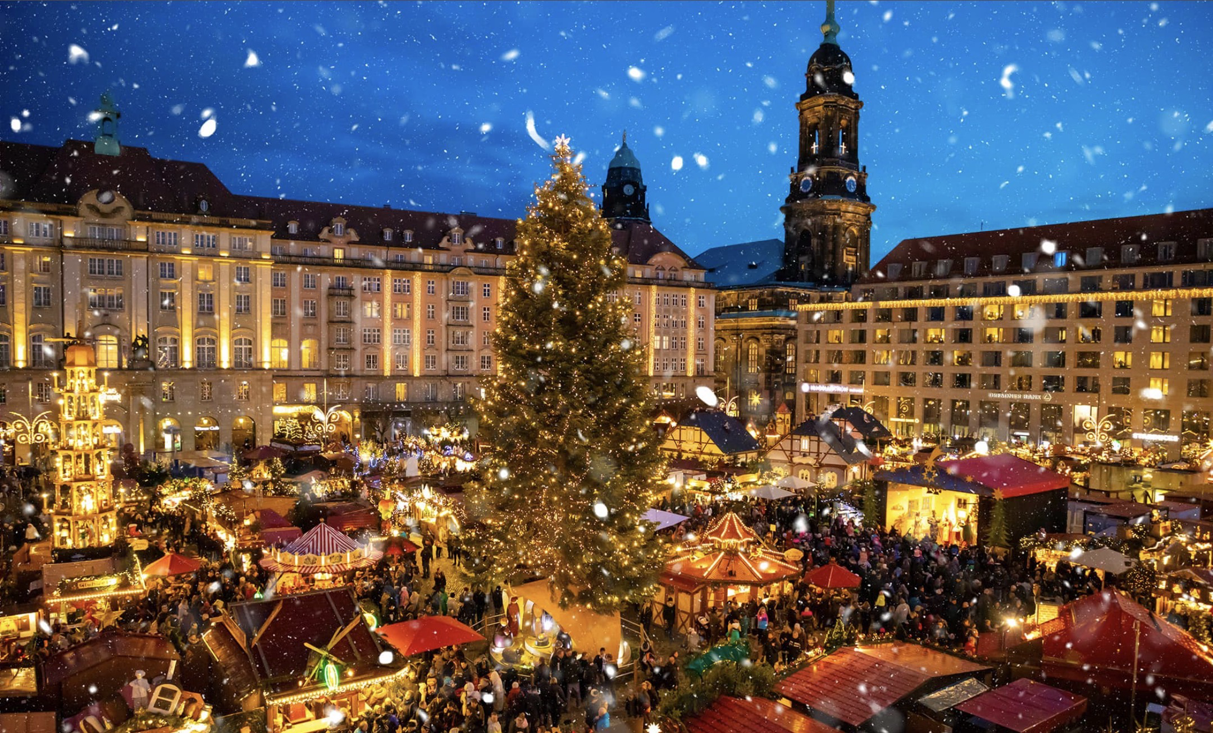
Festivals:
Christmas markets:
-> Festive markets with crafts, mulled wine, and seasonal treats
Oktoberfest:
-> Bavarian beer festival with traditional music and costumes
Carnival:
-> festival has parades, costumes, and lively street parties
St. Martins day:
-> Lantern processions and songs celebrating generosity
Mai Tag:
-> Giving decorated trees or maypoles with streamers to loved ones

Slide 26
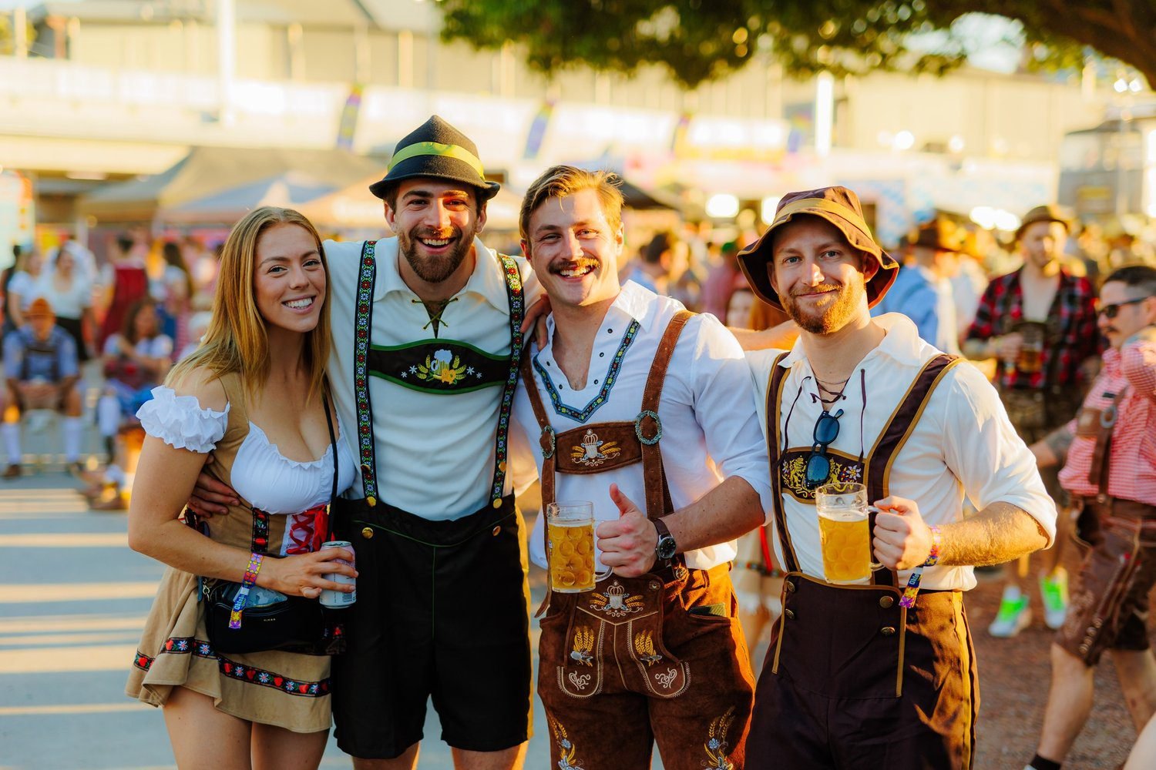
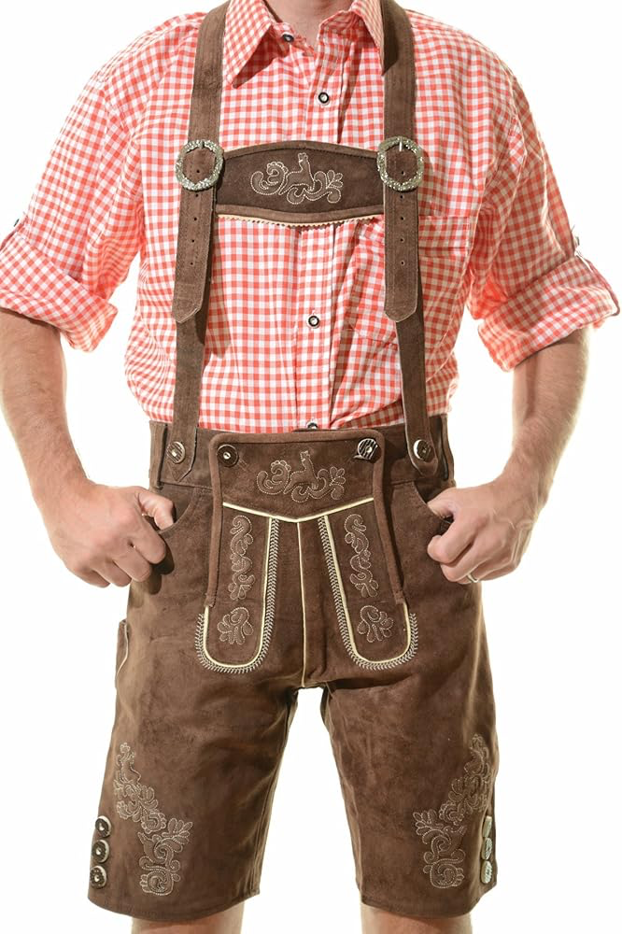
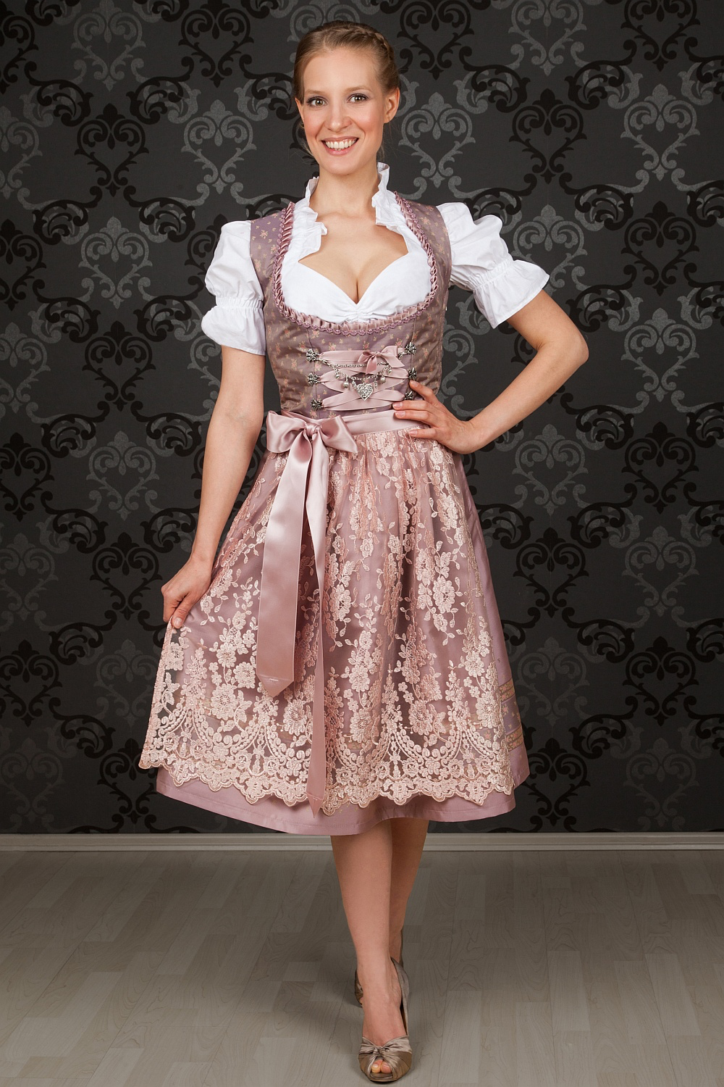
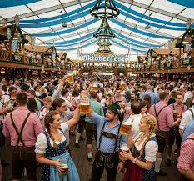
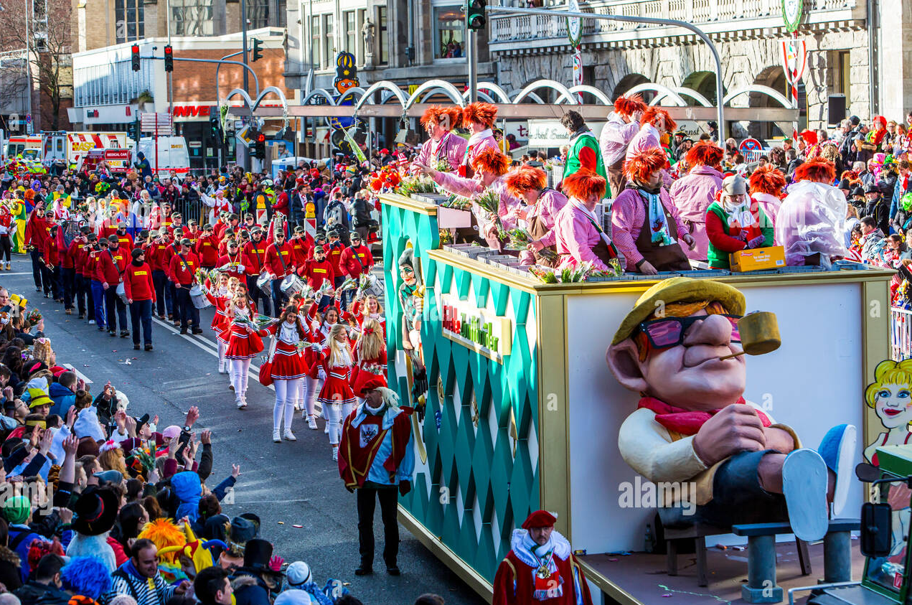
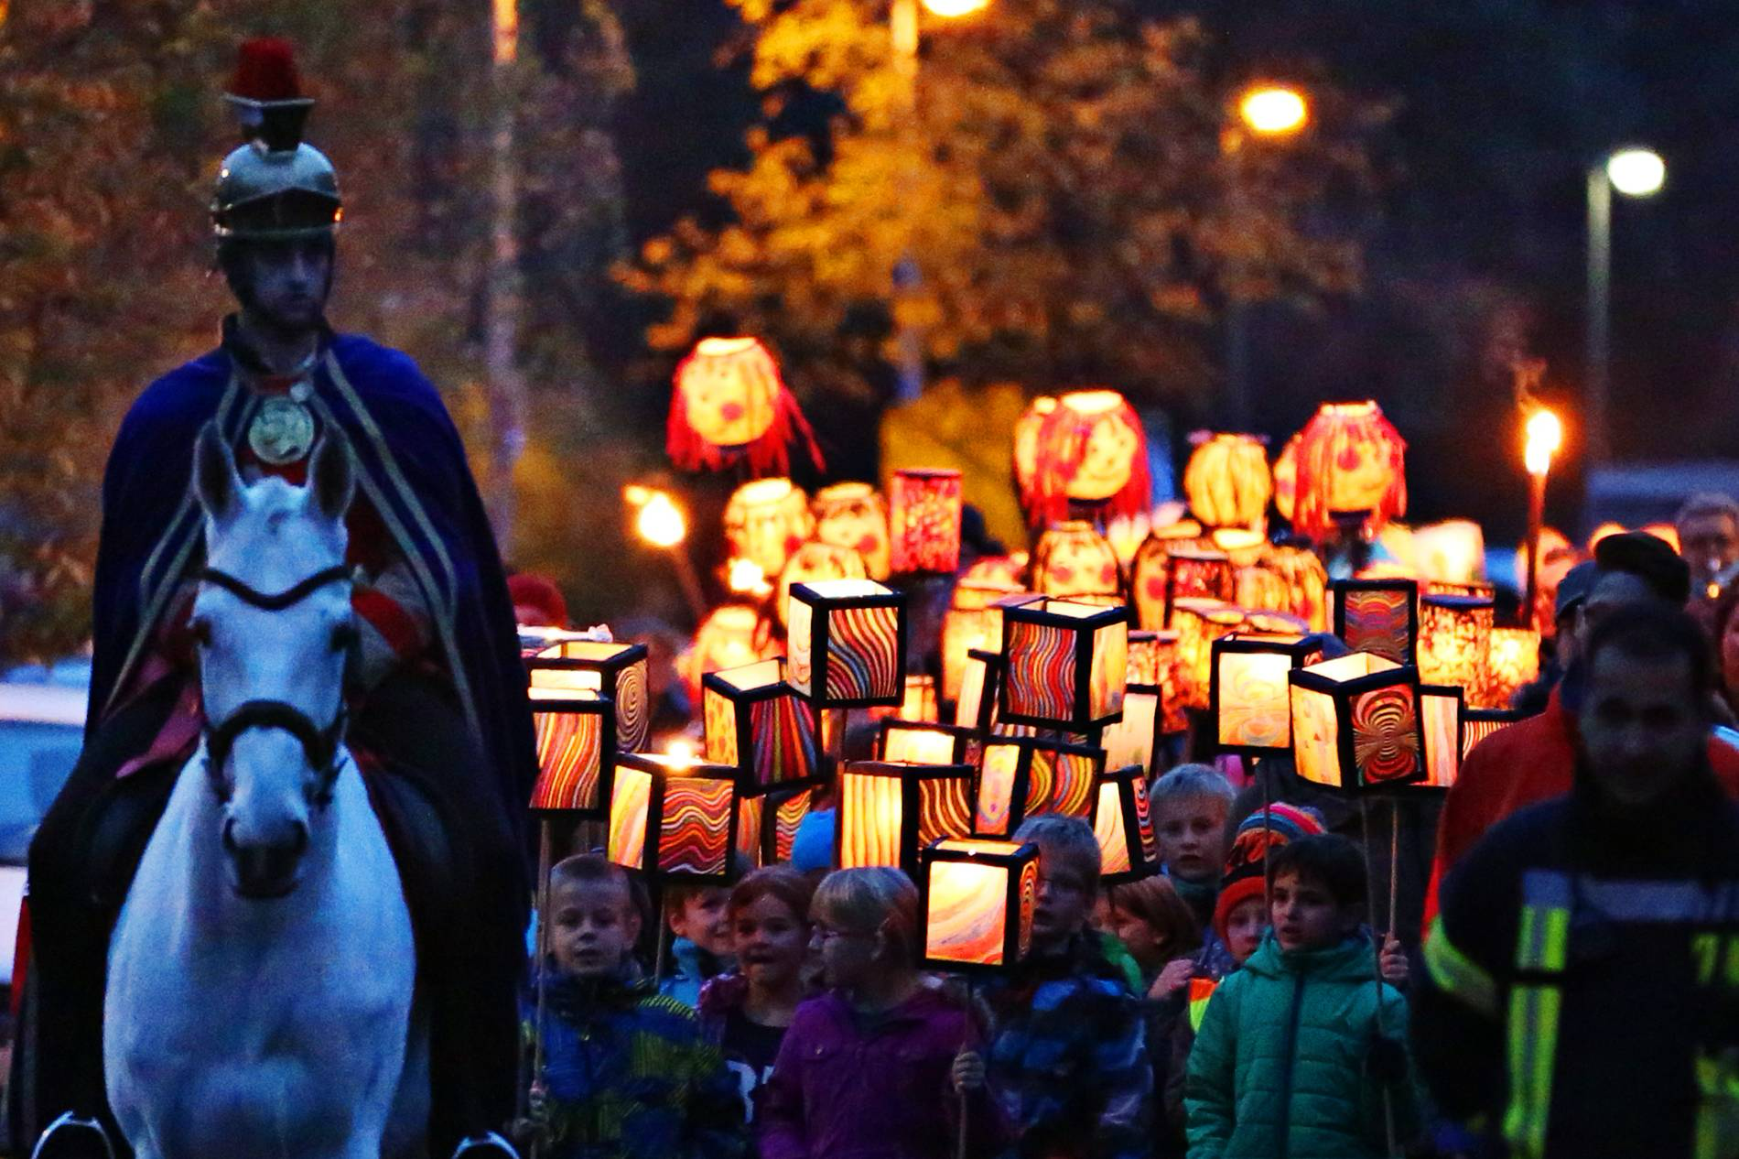
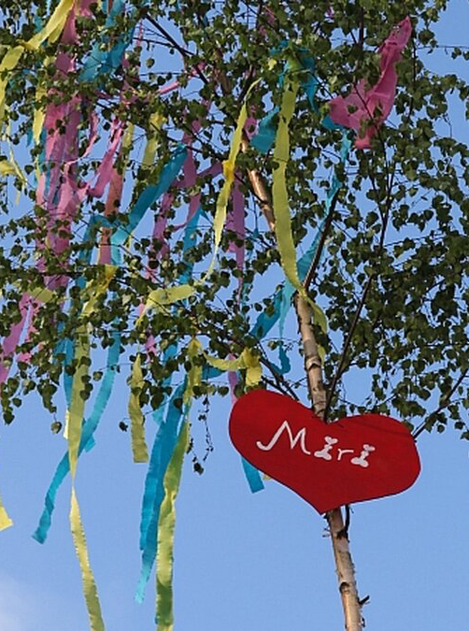
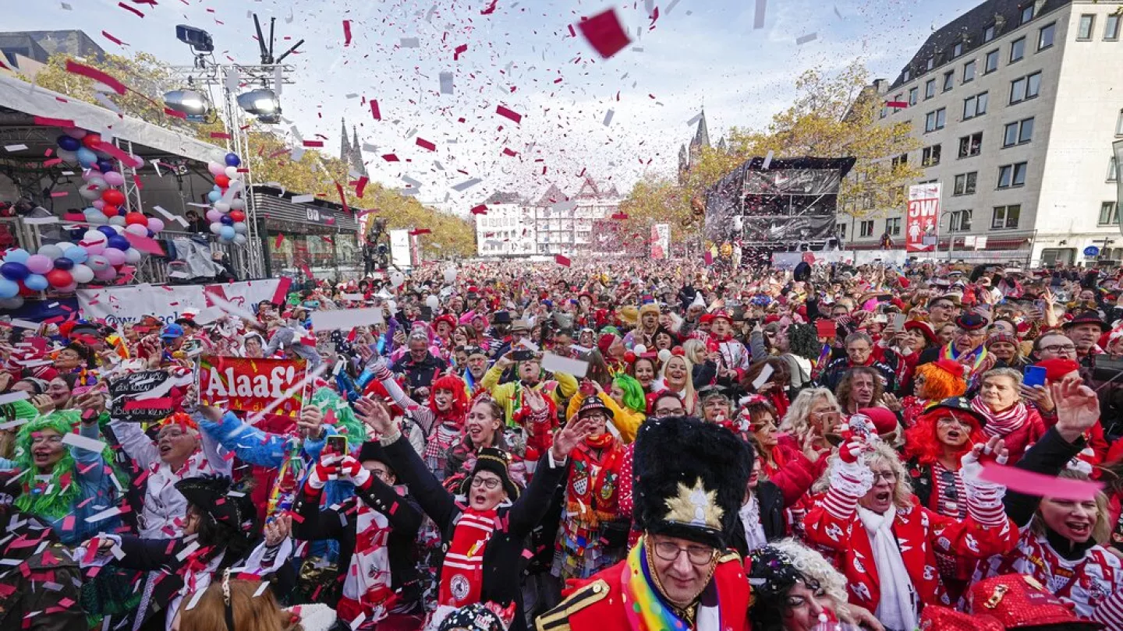
Traditions
Oktoberfest
Carnival
Traditional clothing (Dirndl,Lederhosen…)
May Day
St. Martin

Slide 27
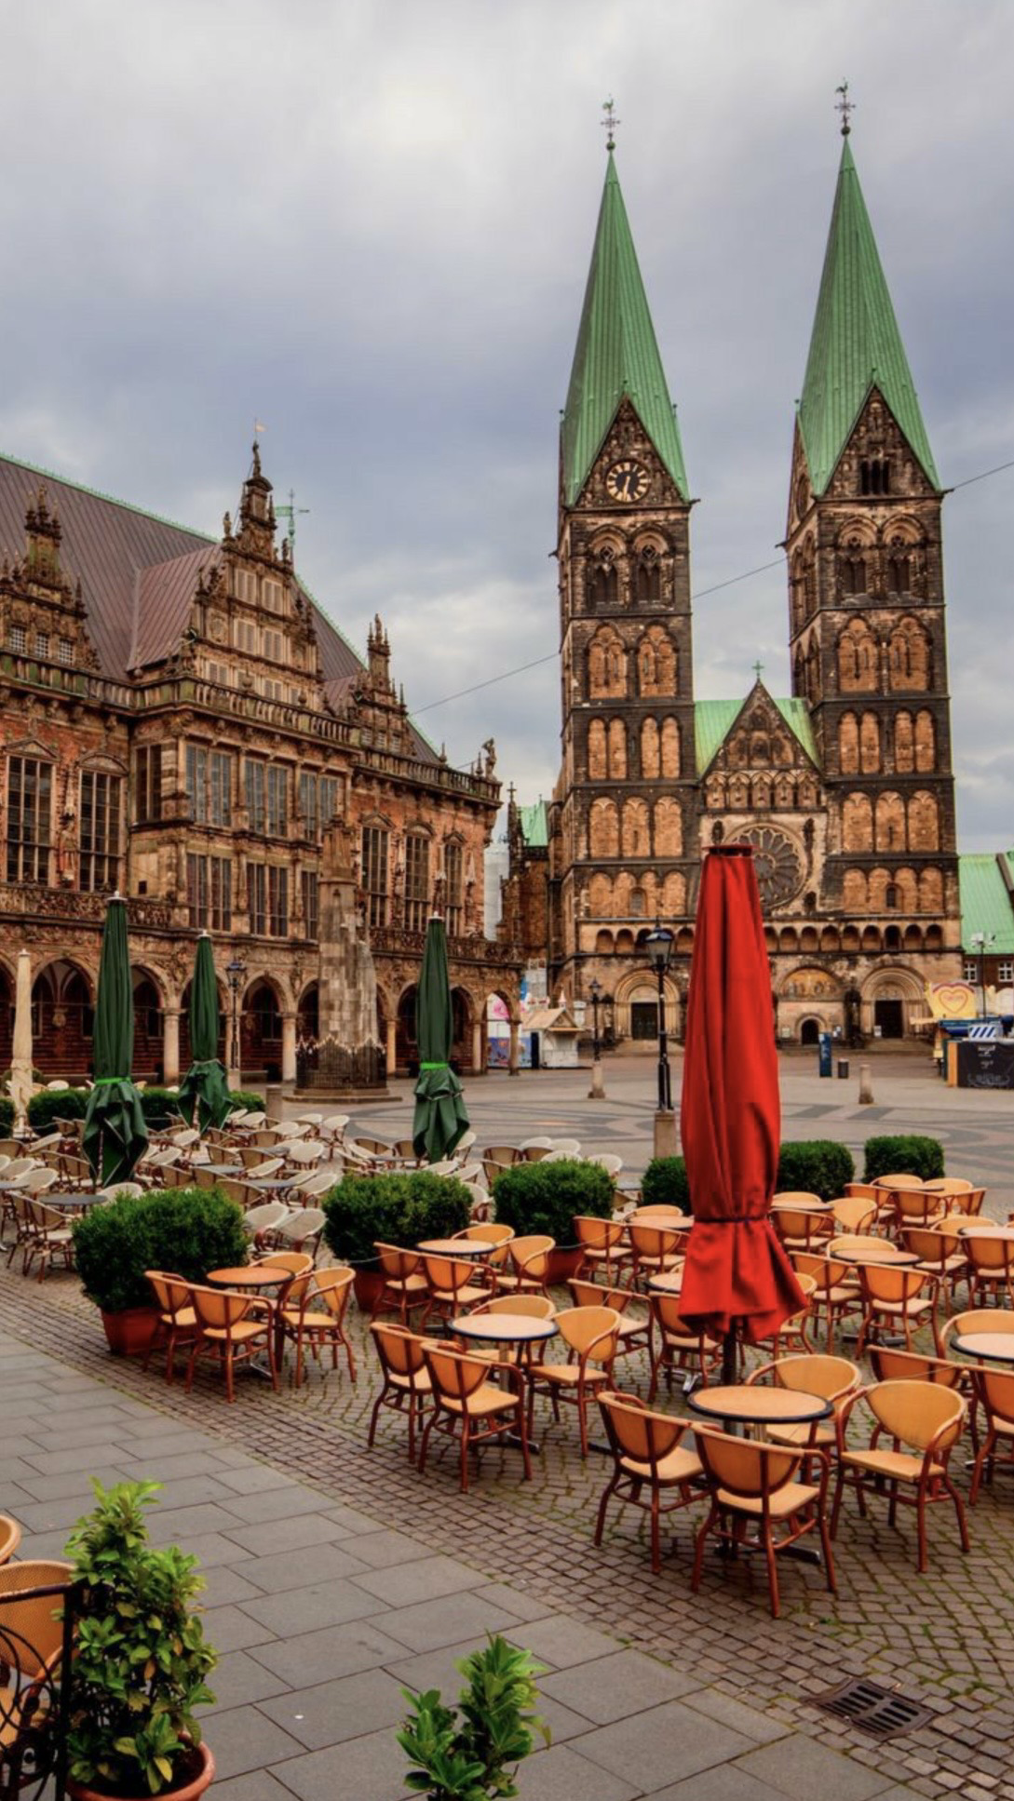
Quiz
Which two countries touch Aachens borders?
Which two sausages are typical in Germany?
What is a Berliner?
What happens on Carneval?

Slide 28
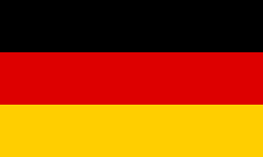
Thank you for your attention! :)

