Slide 1
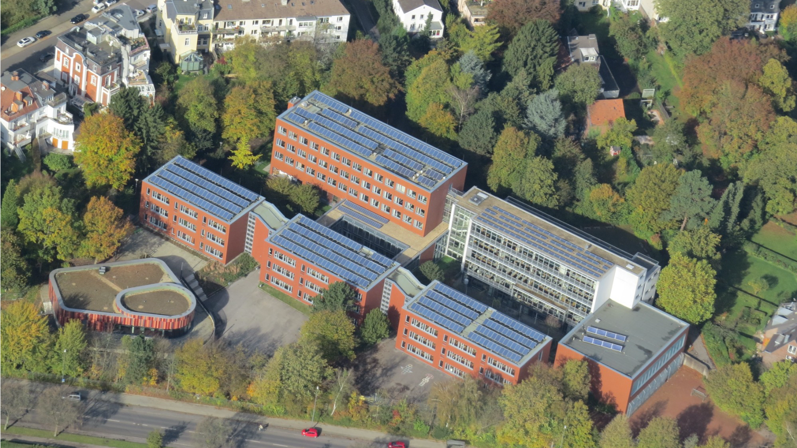
Couven Gymnasium Aachen

Slide 2
General information
Grades:
13 Grades in total
Grades 5 and 6 (Unterstufe)
2. Grades 7–10 (Mittelstufe):
Students can choose additional subjects (for example languages)
3. EF, Q1, Q2 (Oberstufe):
Students learn in courses instead of fixed classes
Preparation for the Abitur (final exam for university entrance)
A total of 1129 Students and 101 Teachers
Clubs: Choir, Orchestra or music groups, Anti discrimination –Team

Slide 3
MINT- and Billingual - Profile
MINT:
Maths, Informatics (Computer sciences), Naturesciences, Technology
participation in projects with that focus
Billingual:
students have more English lessons
some subjects are taught in English
For example: History and Geography

Slide 4
Students Council (SV)
What is the SV?
The SV (Student Council) represents the interests of the students at the school
Its main goal is to give students a voice and help improve school life
SV Team Members
Students from different classes or grade levels help organize projects and activities
Main Tasks of the SV
Representing Students
The team works on ideas to make school better
The SV helps organize school activities such as:
school festivals
tcharity events

