Slide 1
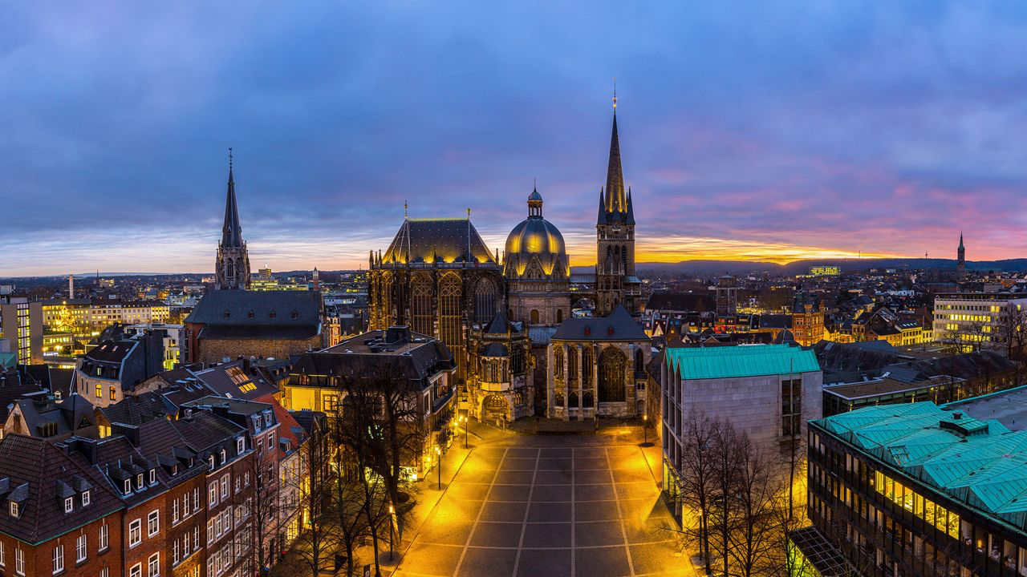
The city of Aachen
By Viola, Erandi, Ole and Noah

Slide 2
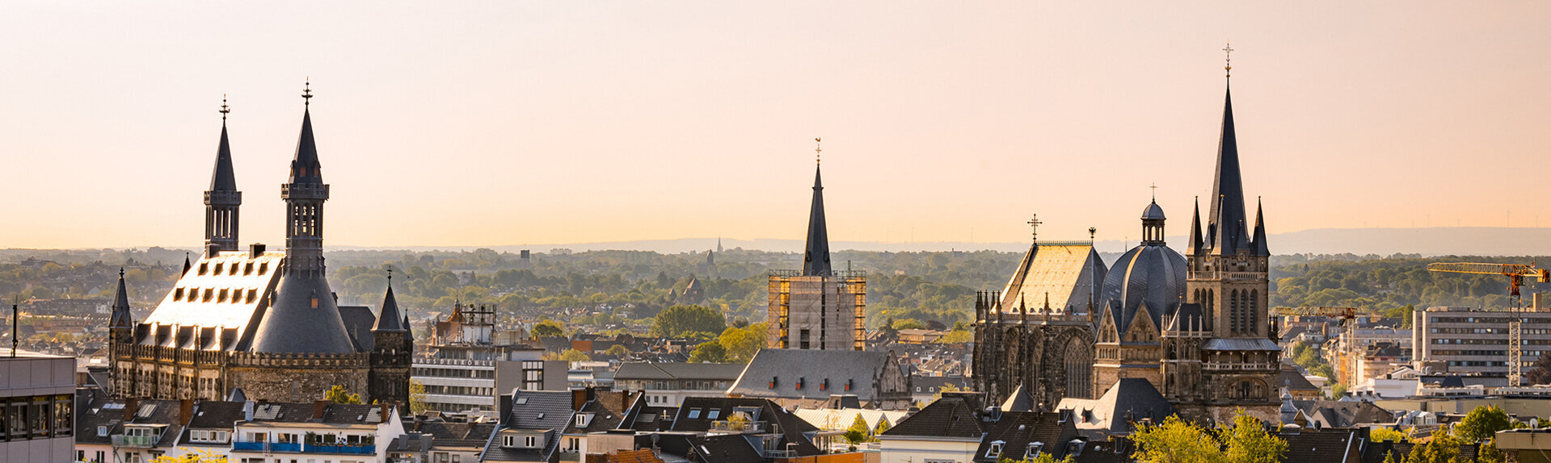
Table of content
1. General informations
2. History
3. Sights:
-Aachen Cathedral
-Aachens town hall
-Elisenbrunnen
-Ponttor
-Carolus Thermen
-The Tivoli
-The RWTH

Slide 3
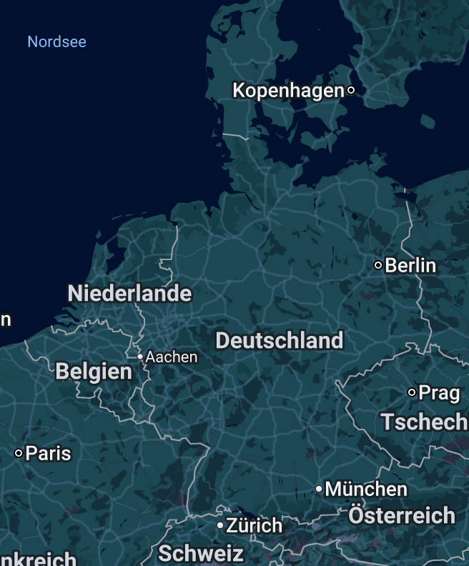
General Information
Location:
Next to the border between Belgium, the Netherlands and Germany
The State of NRW
Founding year: 1307
Population: 262.000

Slide 4
History
1st century: started of with thermal baths Beeing build (by the Romans)
8th century: Karl der Große choose Aachen as his main recidense
Karl der Große built the Aachen Cathedral
The cathedral was used to crown many kings
12th century: Barbarossa declarers Aachen a free imperial city
1656: a large fire destroyed big parts of the city
1794 to 1814: Aachen is under Napoleons rule
1815: Aachen became a part of Prussia
1944: first German city to be liberated by the allies (largely destroyed)
Present: Aachen is a strong point of eduction (later more)
Free imperial cities: a city has it‘s own local government and therefore more control (mostly given to important cities)

Slide 5
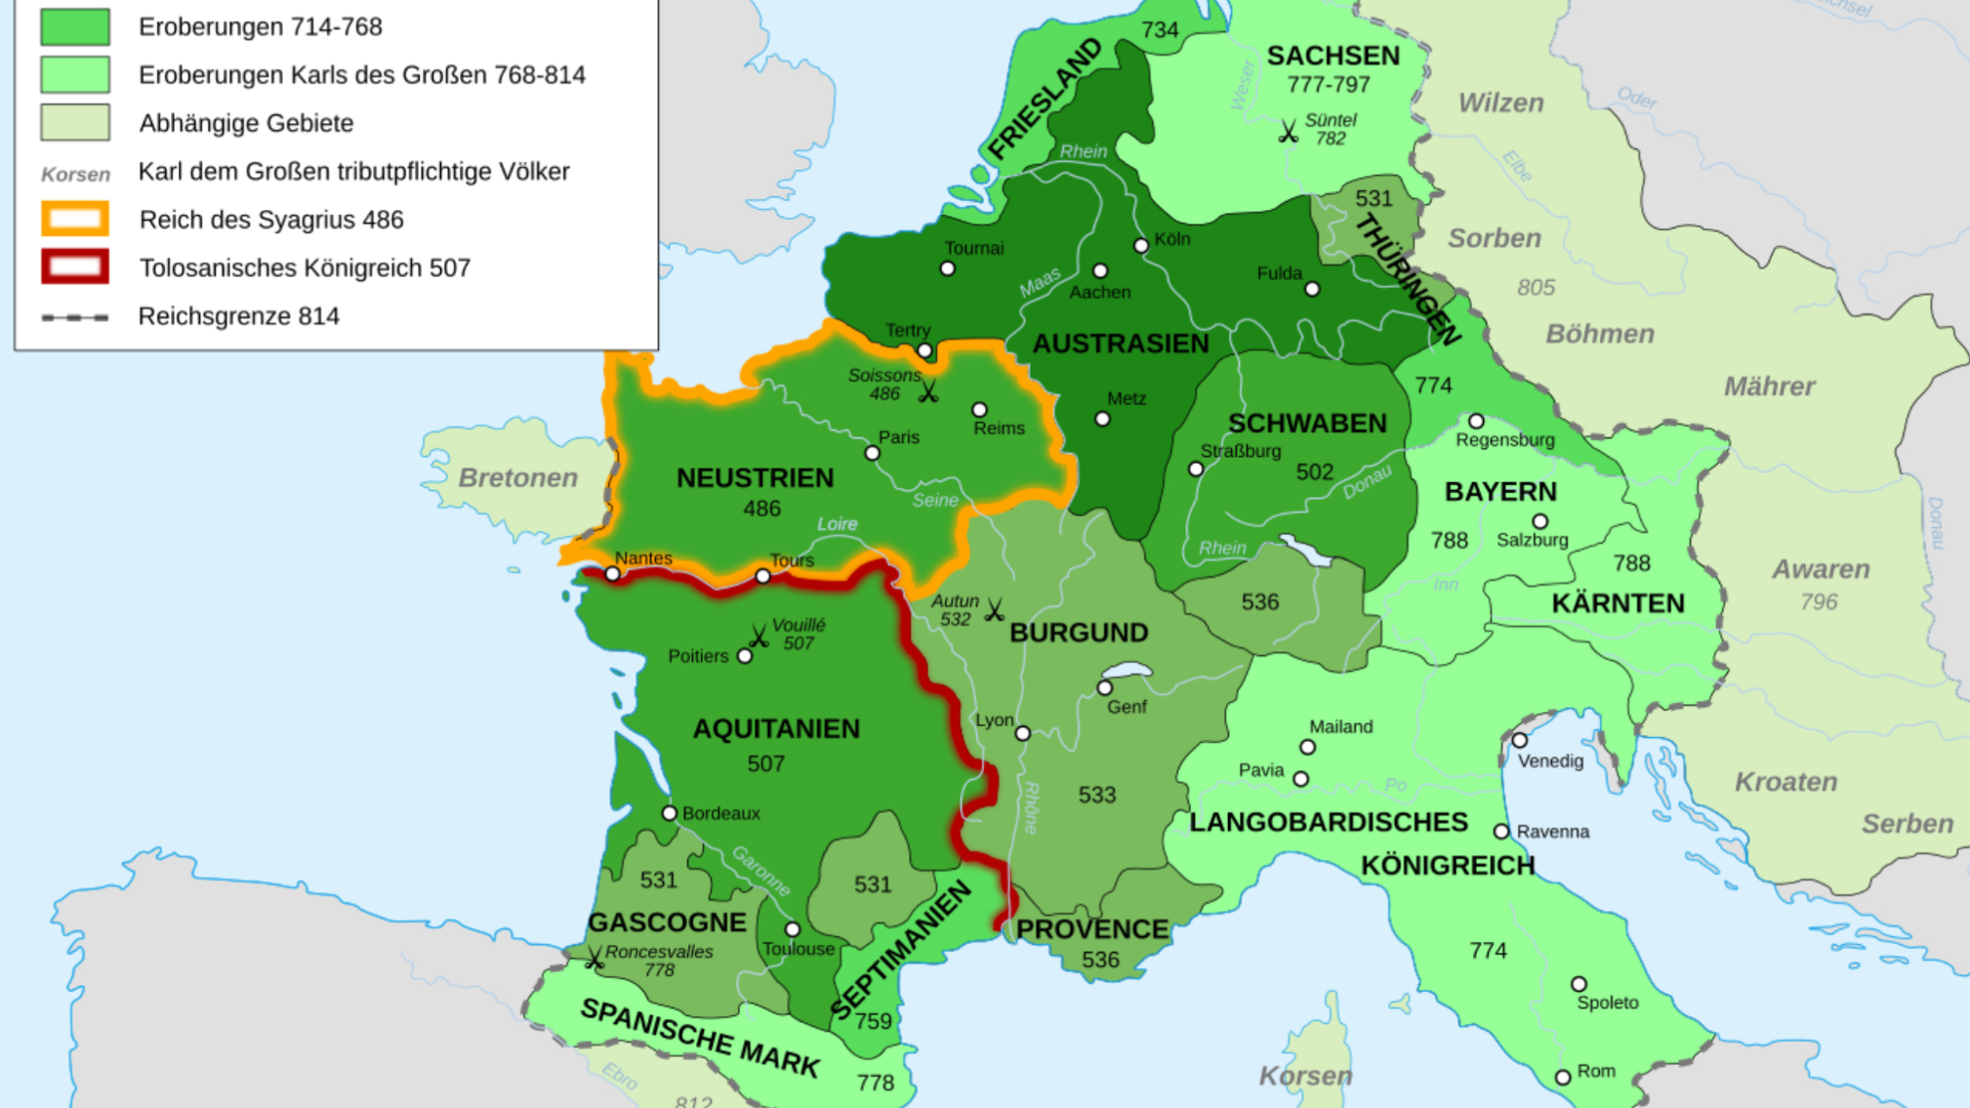
Fränkisches Reich (Franconian Empire)
The land that was controlled by Karl des Großen (in Aachen)

Slide 6
The sights of Aachen

Slide 7
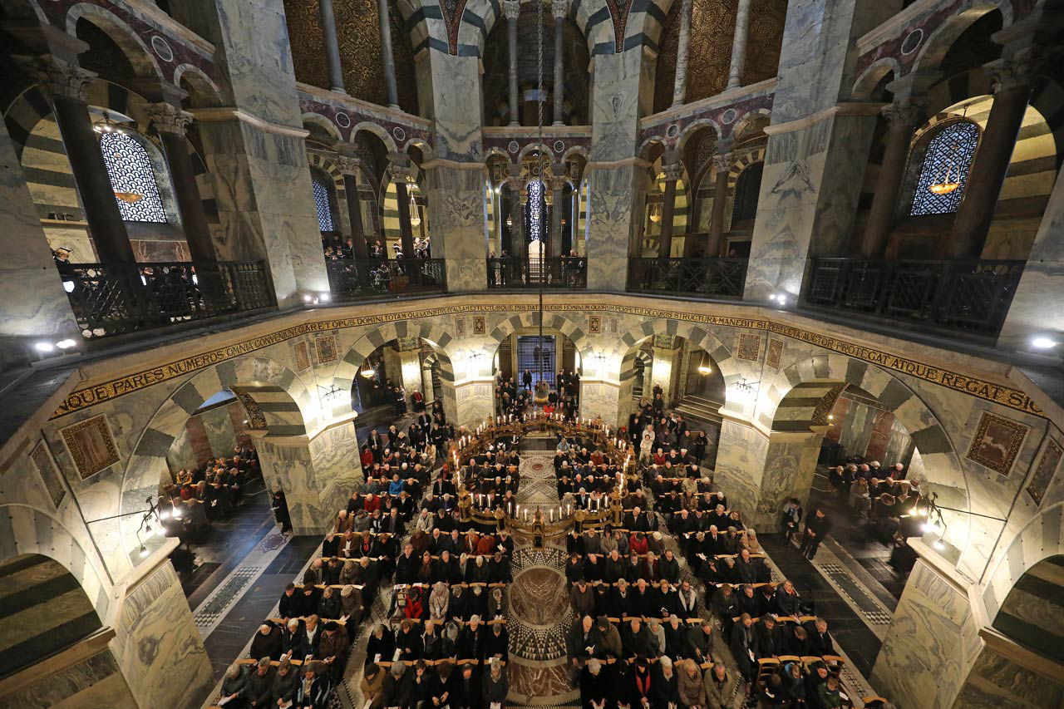
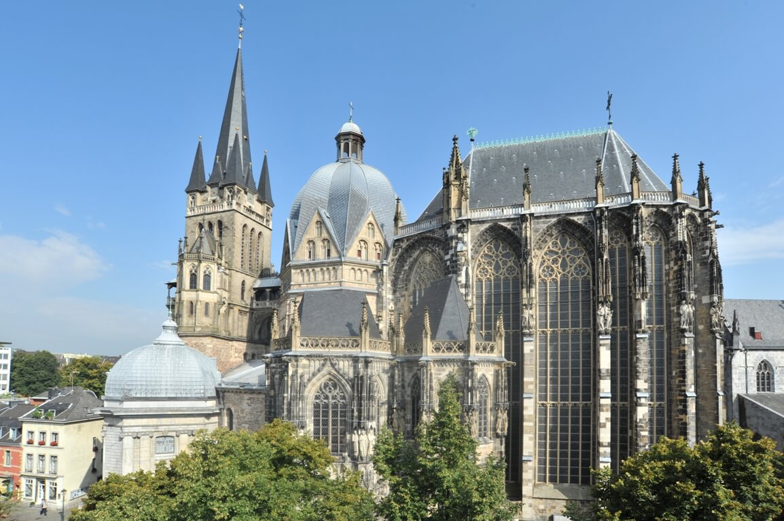
Aachen cathedral
Built by Karl dem Großen
One of the oldest cathedrals in Europe
Crowning place for 30 kings
First German UNESCO world Heritage site

Slide 8
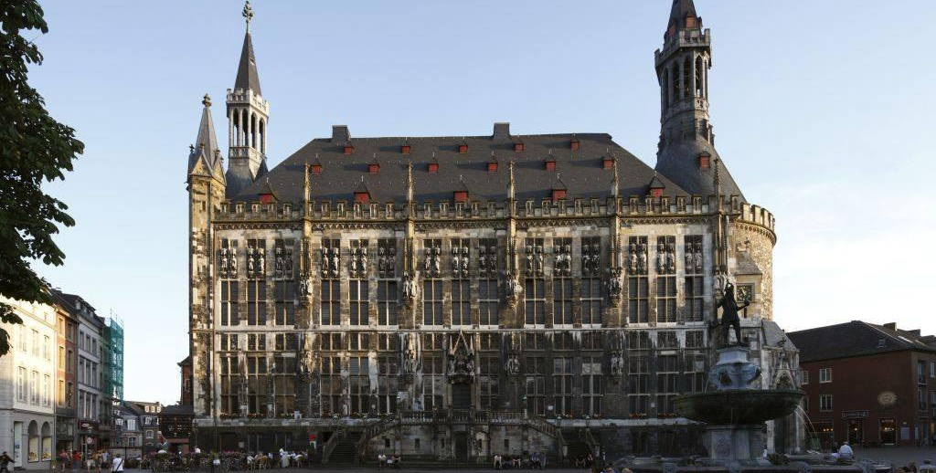
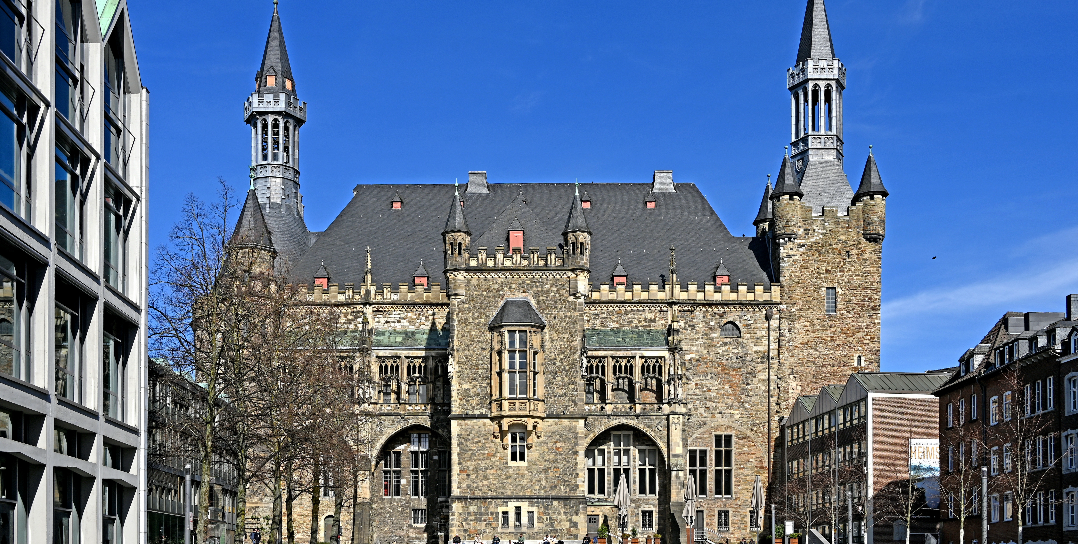
Aachen‘s town hall
Built in the 14th century
Mostly used for ceremonial events
The international Karl’s Prize ceremony in held here

Slide 9
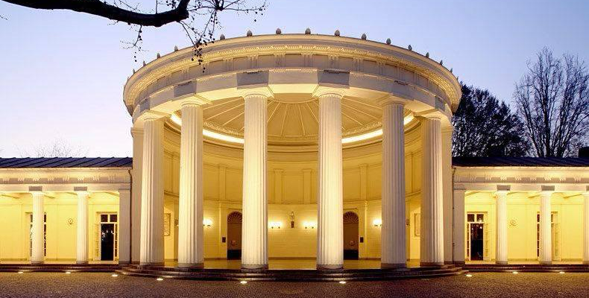
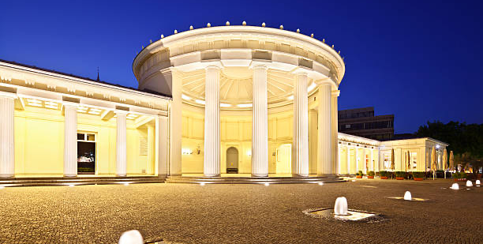
Elisenbrunnen
Famous thermal spring fountain
Built in 1827
The water contains Sulfur (reason for the smell)

Slide 10
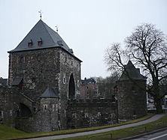
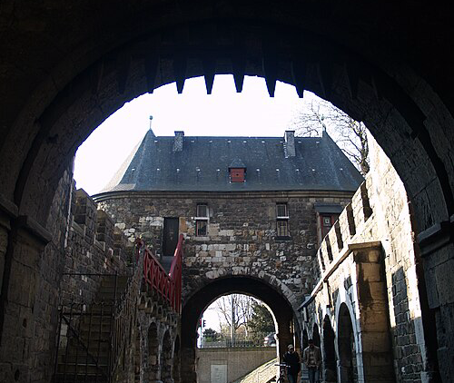
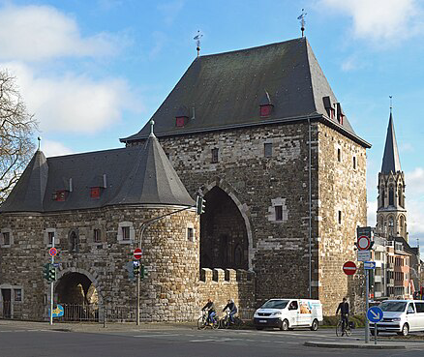
Ponttor
Built in the 14th century as part of the city wall
One of the best preserved medival city gates in Germany
Sign of the medial defenses

Slide 11
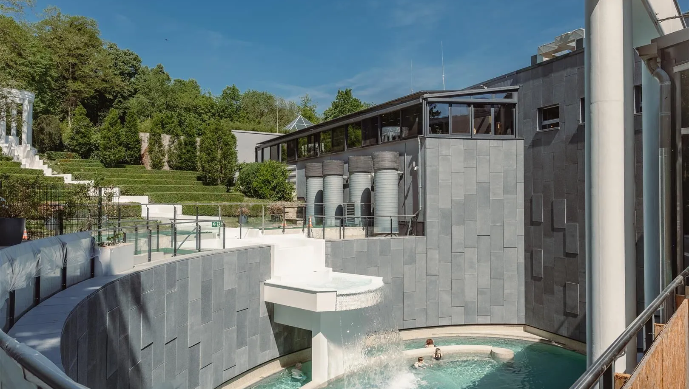
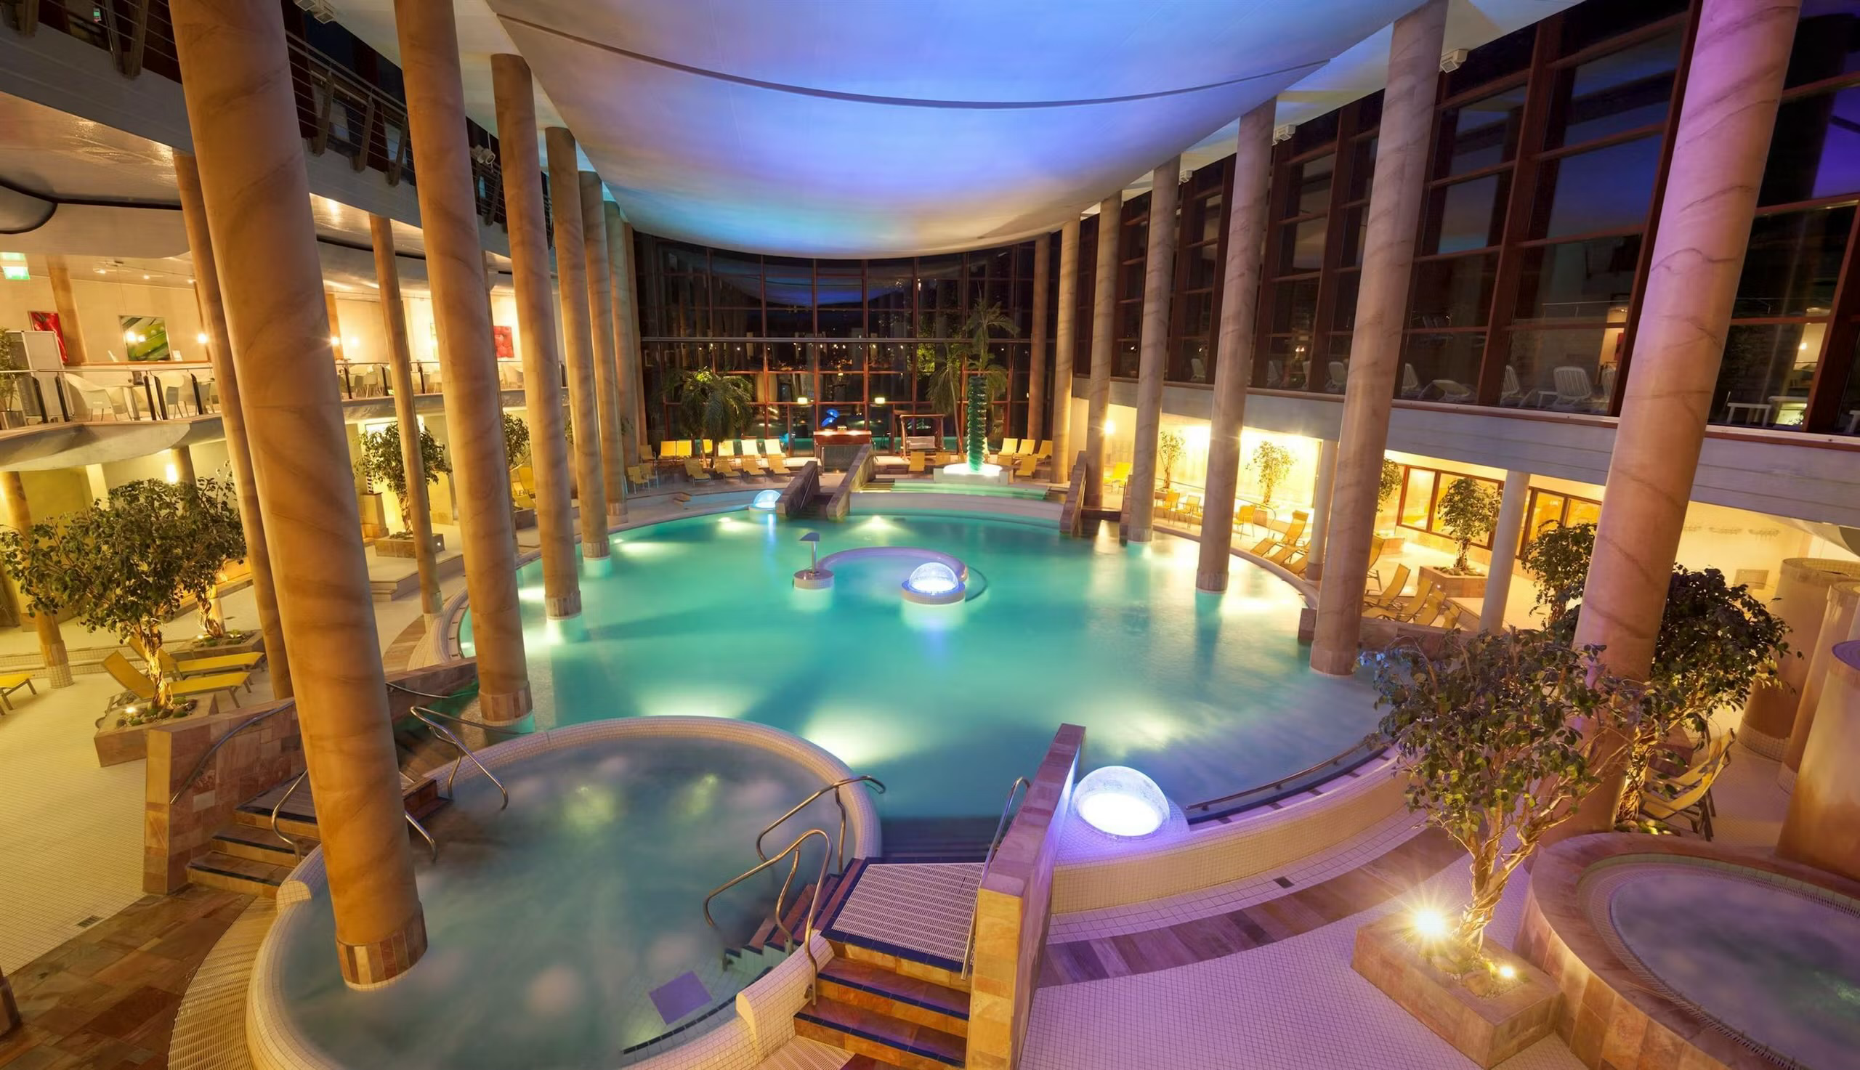
Carolus Thermen
Modern thermal bath house
Using Aachen‘s hot springs

Slide 12
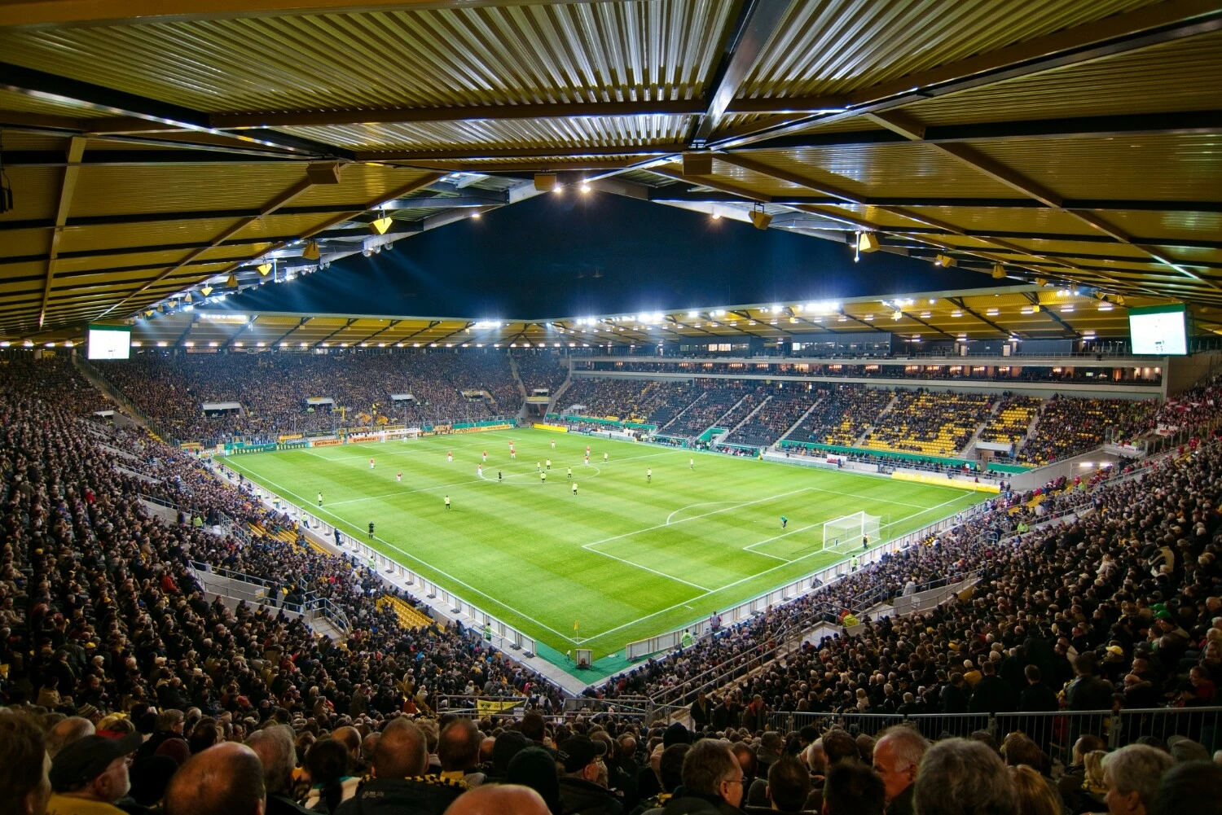
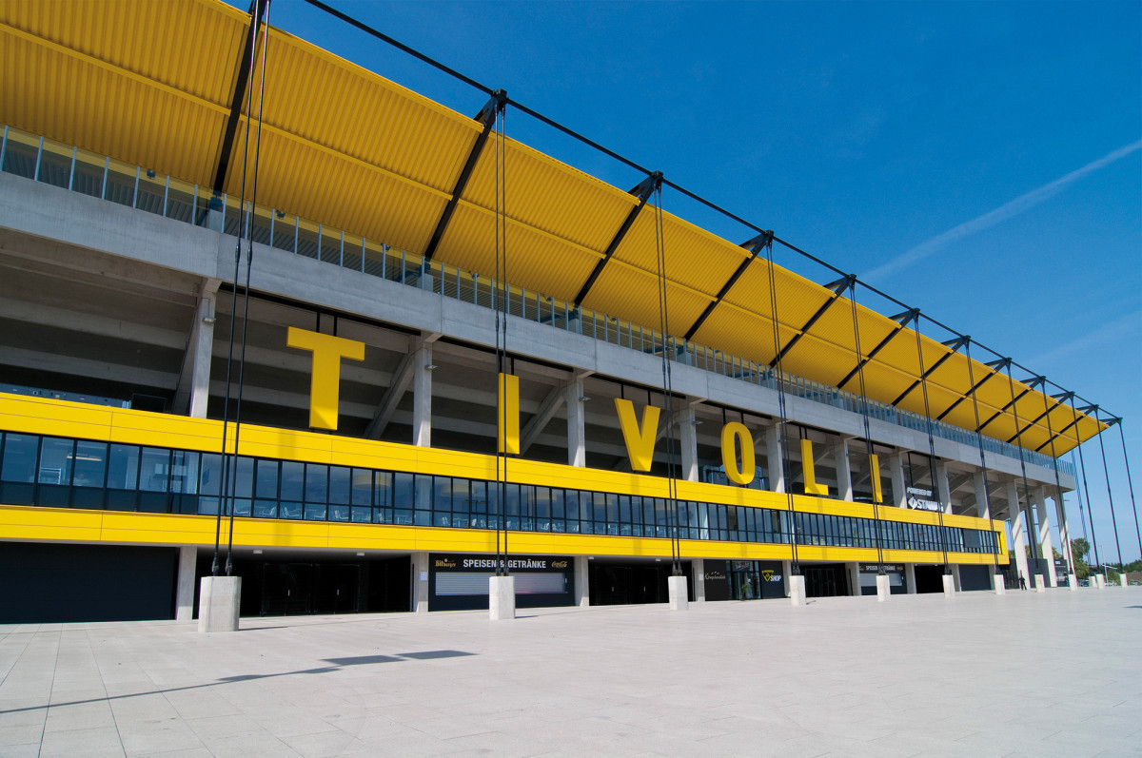
The Tivoli
Main football stadium
Home to Alemannia Aachen
The new stadium replaced the old one in 2009
Can hold 33000 spectators

Slide 13
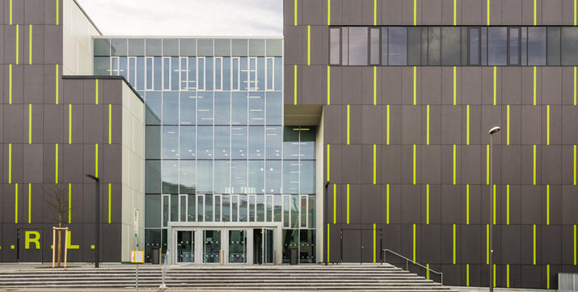
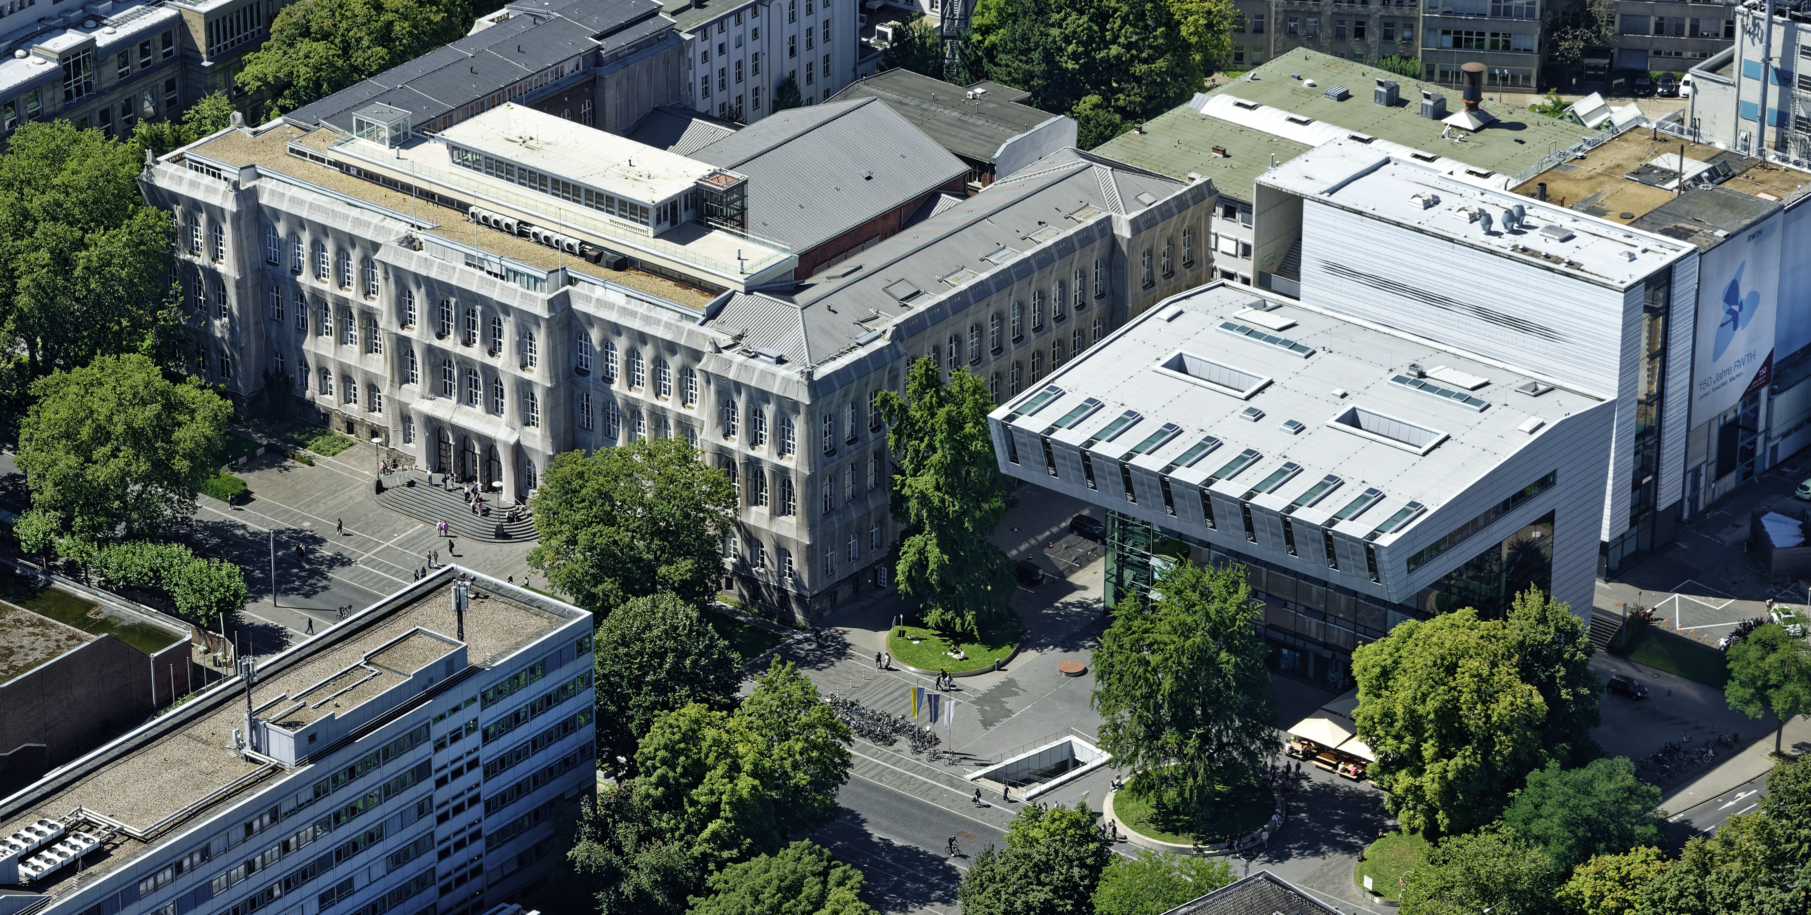
The RWTH
Founded in 1870
One of the largest technical universities in Germany
Around 45000 students
Famous for: technology, engineering and science

Slide 14

Thanks for watching

Slide 15
Sources
https://www.merian.de/deutschland/nordrhein-westfalen/aachen-sehenswuerdigkeiten
https://de.wikipedia.org/wiki/Fränkisches_Reich
https://www.gerit.org/de/institutiondetail/10293
https://www.rwth-aachen.de/go/id/a/
https://stadion-tivoli.de
https://www.eifel.info/pois/carolus-thermen-bad-aachen
https://www.kempenkrause.de/aachen-carolus-therme/
https://de.wikipedia.org/wiki/Ponttor
https://www.baukunst-nrw.de/objekte/Rathaus-Aachen--641.htm
https://de.wikipedia.org/wiki/Datei:Rathaus_%28Aachen%29_16.jpg
https://welterbedeutschland.de/40-jahre-welterbe-aachener-dom-festwoche-vom-22-bis-30-september-2018/
https://www.rwth-aachen.de/cms/root/wir/karriere/~lxdm/leben-in-aachen-und-der-region/
https://www.istockphoto.com/de/fotos/waving-hand-emoji

