Slide 1
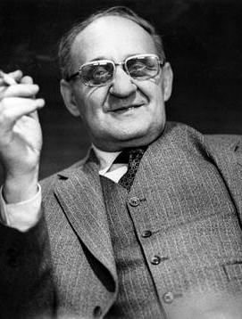
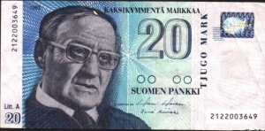
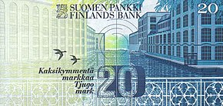
Väinö Linna
Finnish war author

Slide 2
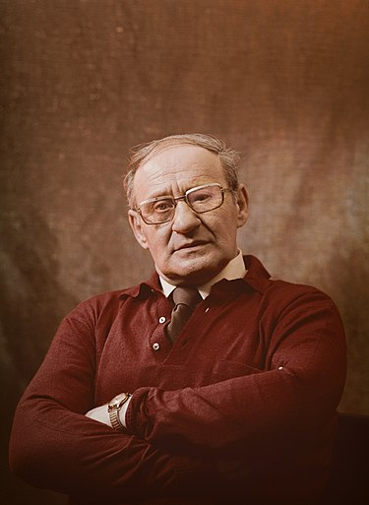
Basic information
Full name: Väinö Valtteri Linna
Known as: Finnish war author. Have written famous Finnish books e.g. The Unknown Soldier.
Born: 20.12.1920, Urjala
Died: 21.4.1992, Kangasala (71 years-old)
Childs: 2
Wife: Kerttu Linna. Married 1945-1992
Linna was born to poor rural family, in 1920. His father died when Väinö was just 7 years-old. During the Winter war Linna was soldier in the war. He began writting while he was working in factory as a carder. Linna wrote a few books before breaktrough (The Unknown Soldier). He died because of lung cancer.
His face could've been seen in old finnish 20 mark-bill. Mark was currency of Finland till year 2002.

Slide 3
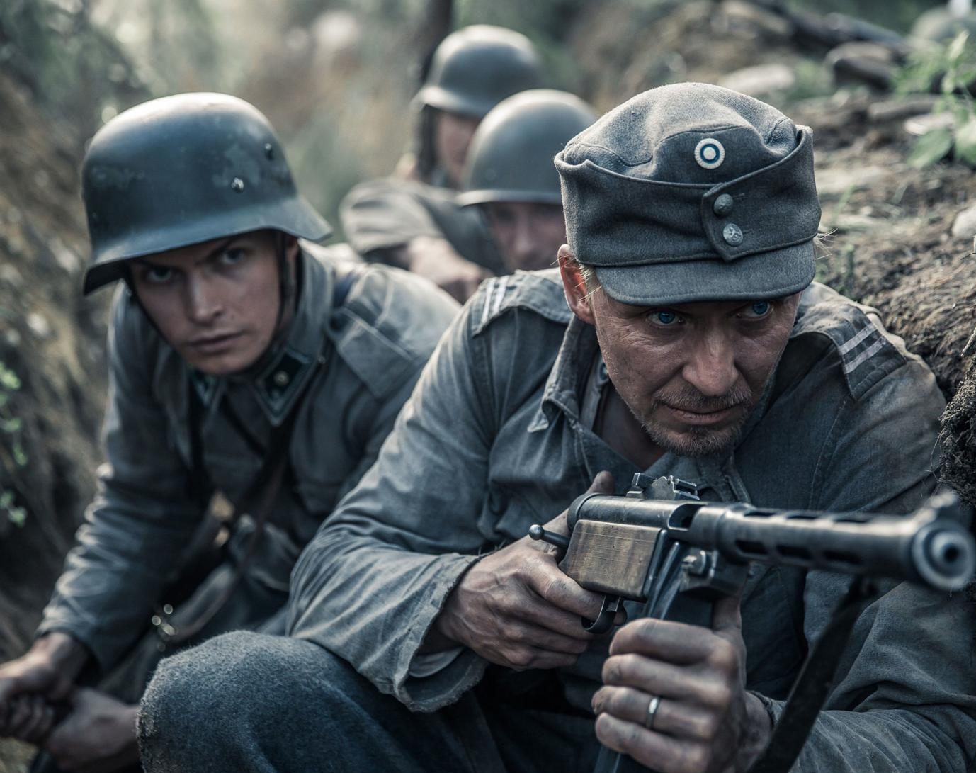
The Unknown Soldier (fin. Tuntematon sotilas)
This book and movie tells story of finnish machine gun company during Continuation war (1941-1944). It's very realistic description about events that happened during finnish wars. It has been filmed 3 times before. I recommend watching the latest movie from 2017.
The Unknown Soldier begins with famous words, which are based on The Bible. During wars Finns have always been pretty religional which can be noticed from Linna's books.
Fact: The book starts from place called: "Paloaukea". Our school is in Paloaukea, same place! In 20th century, there was real garrison called "Pohjois-Karjalan patteristo", which means "North-Karelian artillery". Garrison was determined in 90's. Nowdays old casarm is used as an elementary school. Writers of this dia used to study there.

Slide 4
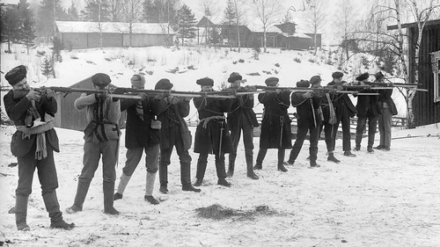
Here under the North Star (Fin: Täällä Pohjantähden alla)
This book tells story of Koskela family during big events in finnish history for example the Finnish civil war (from january to may in 1918) and Winter war. And just like The Unknown Soldier, this is also very realistic. And it is also filmed many times. When book was released, it was a cultural shock. Reason of it was because the Civil war was very bloody and many families were sent to prison camps after war. It is still taboo not to speak about the Civil war in Finland.
This book first, famous words are: "In the beginning, there was swamp, hoe and Jussi". Jussi is father of the main character.

Slide 5
Others
The trailer of The Unknown Soldier (YouTube)
Täällä Pohjantähden alla-song (YouTube)
The trailer of Täällä pohjantähden alla- movie (YouTube)
Sources:
Wikipedia
Youtube
Ps. See you :D

