Slide 1
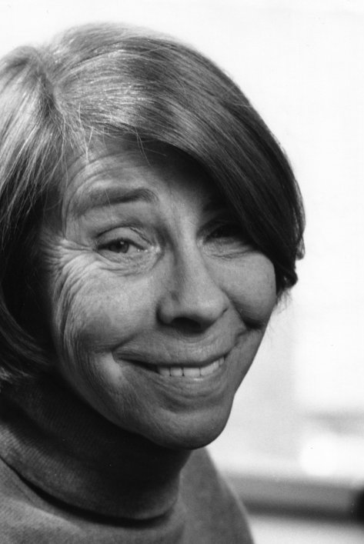
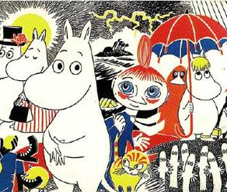
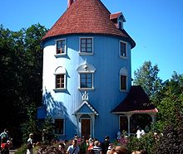
Tove Jansson
Very famous Finnish Swedish author

Slide 2
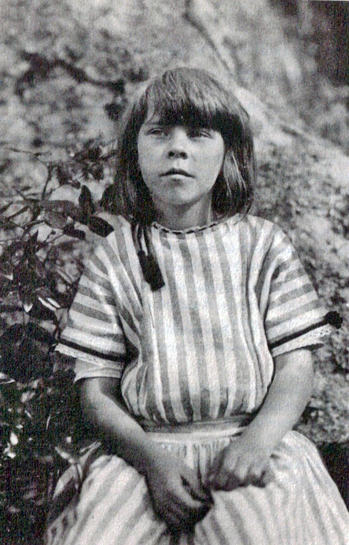
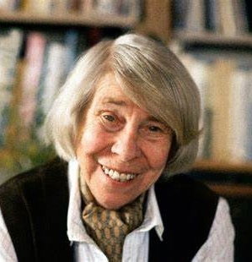
Tove Jansson
Young Tove -->
She was born in Helsinki 9 August 1914.
Tove Marika Jansson was a Swedish-speaking Finnish author, novelist, painter, illustrator and comic strip author.
Tove lived in cultural family when she was little.
Her father was a sculptor and mother was graphic designer and illustrator.
Tove died 27 June 2001 (Aged 86).
Old Tove -->

Slide 3
Tove´s Personal life
Her first love was Sam Vanni. He was painter.
Second relationship was 1940 with Tapio Tapiovaara. He was intellect and politician.

Slide 4
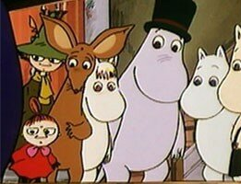
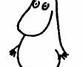
Moomins
Moomins are funny and empathic creatures.
They live in Moominvalley.
As you can see the Moomintroll is very simple and friendly.

