Slide 1
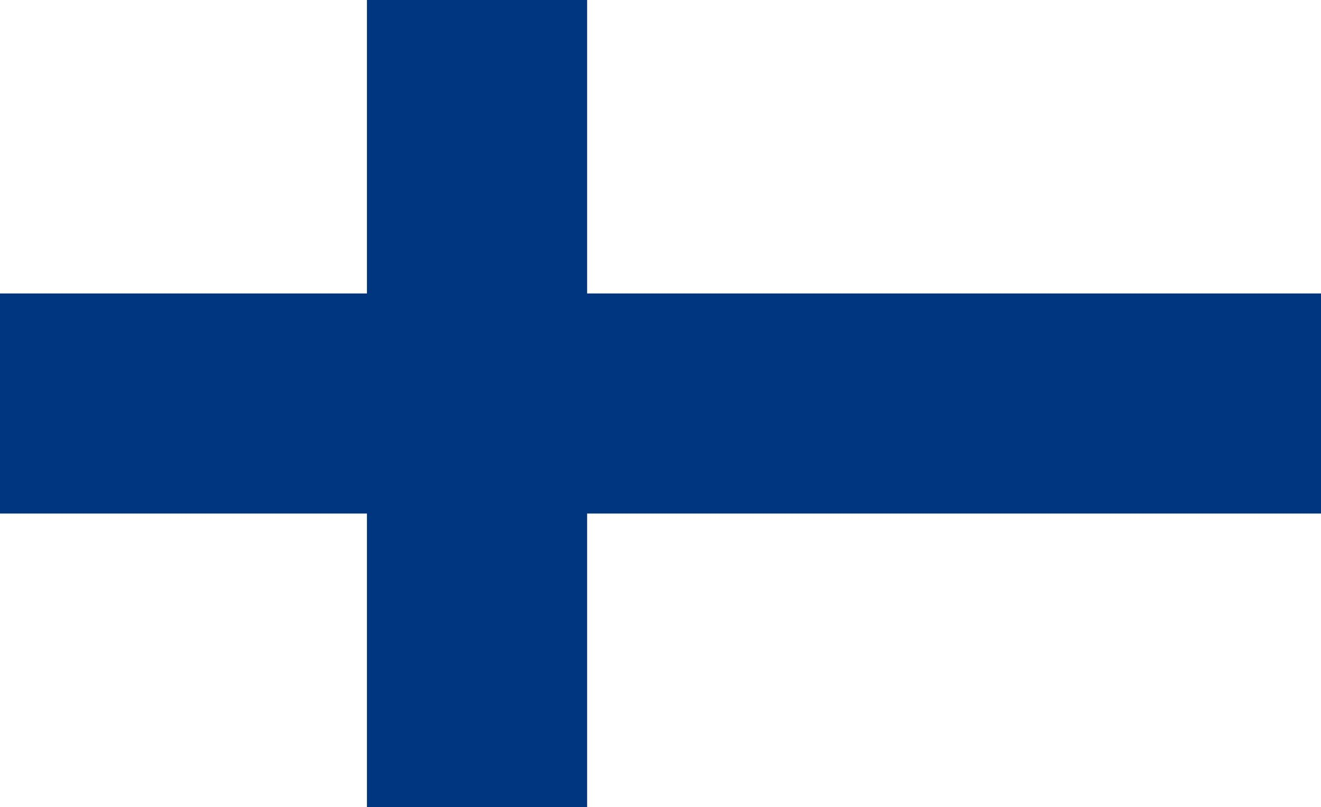
Finland

Slide 2
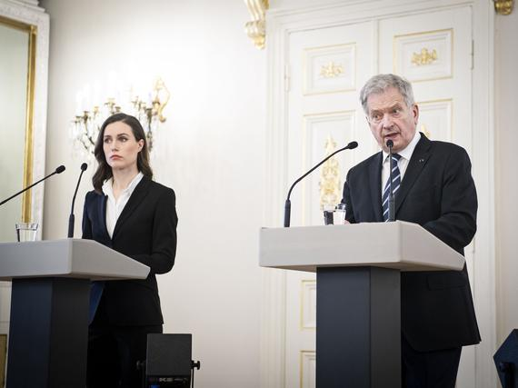
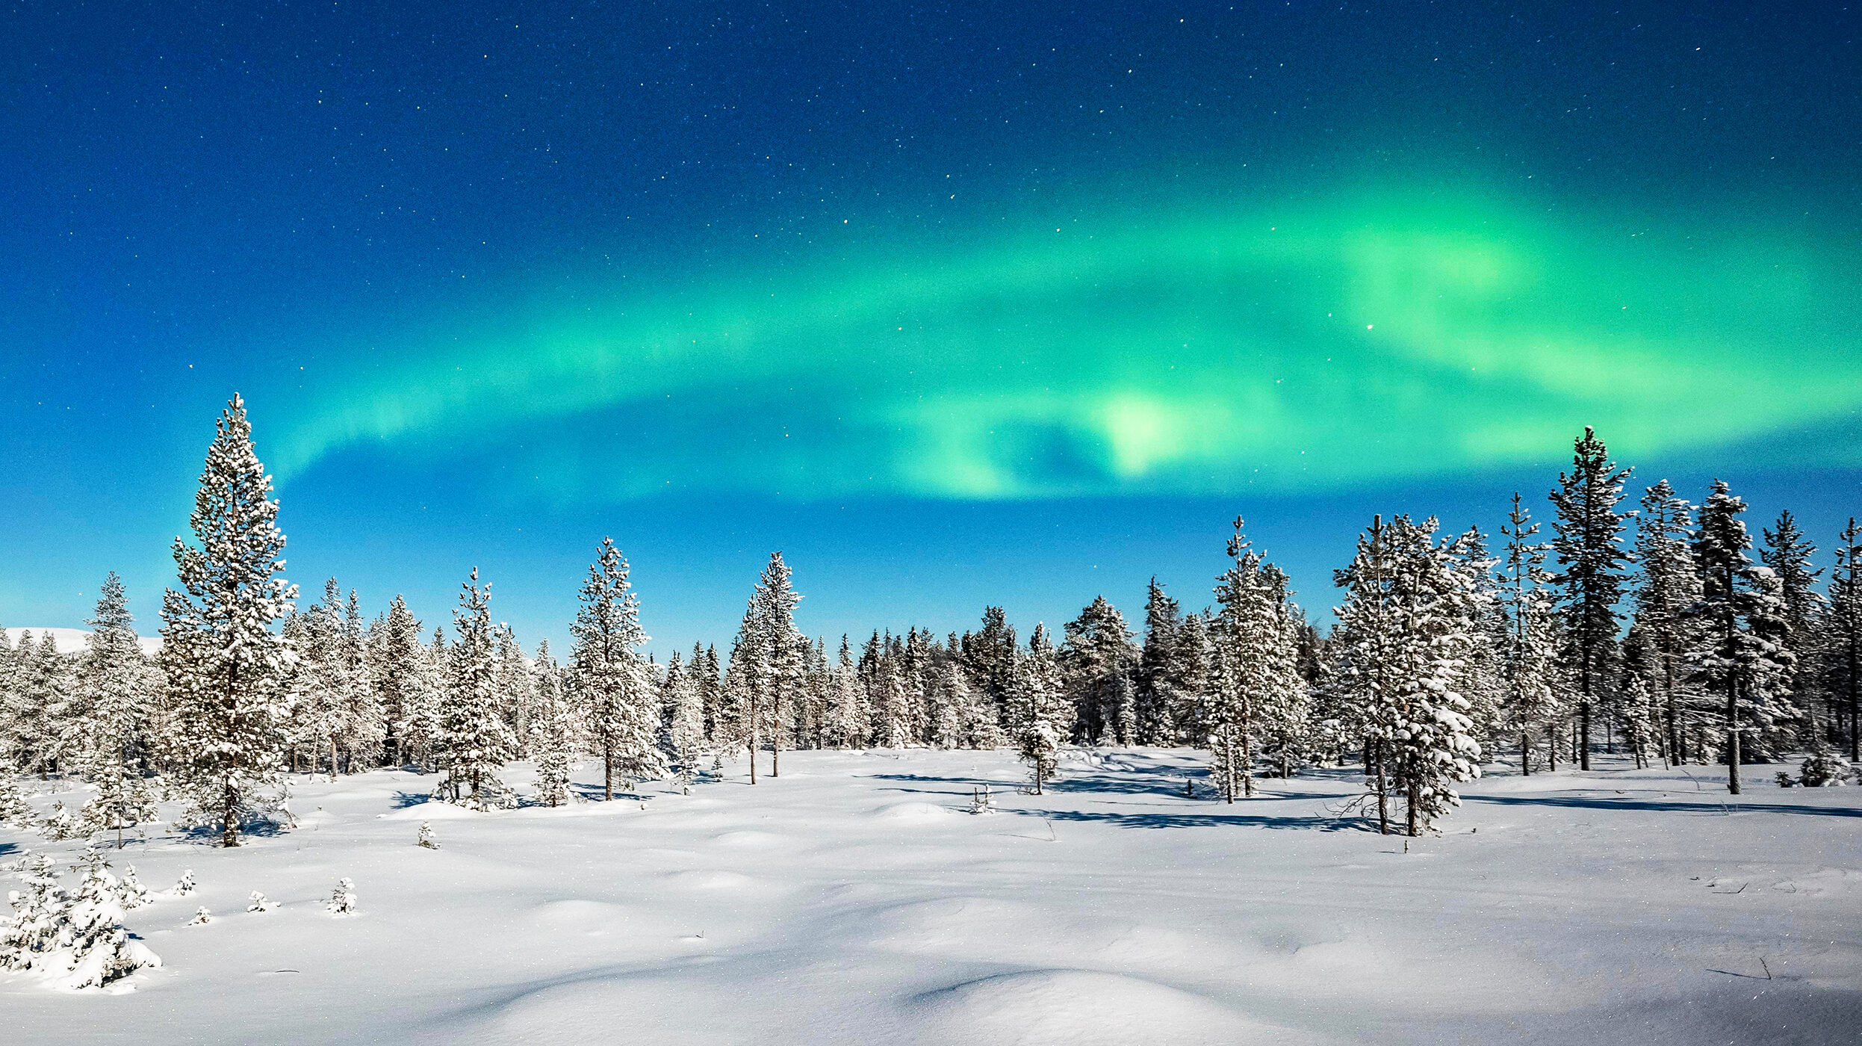
General knowledge about Finland
Capital: Helsinki
Independence day: 6.12
President: Sauli Niinistö
Prime minister: Sanna Marin
Area (km^2): about. 338 000
Population: about. 5.5 million
Climate and vegetation: 4 seasons, temperature -30°C - +25°C, lot of pines and birches and spruces.

Slide 3
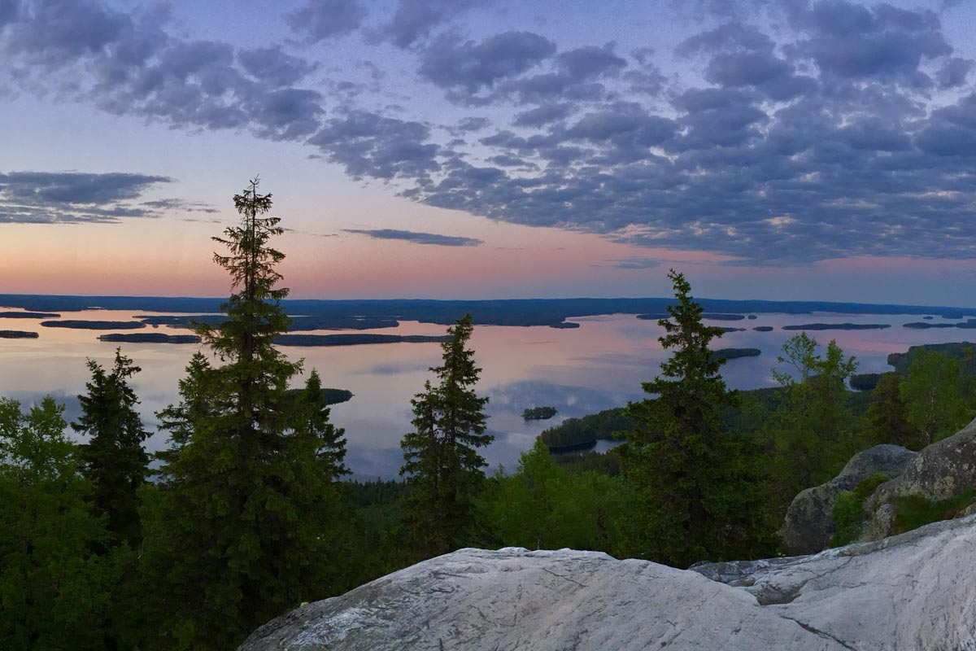
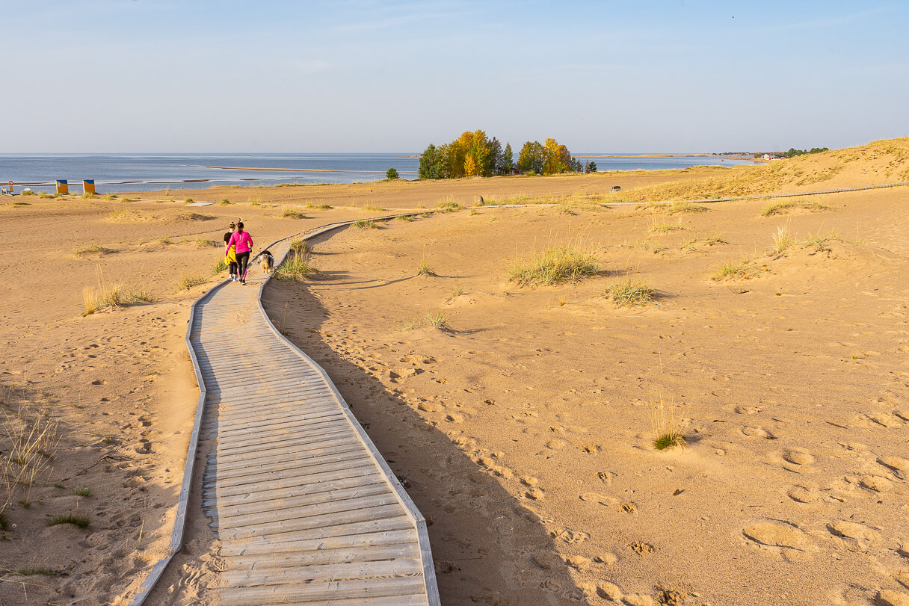
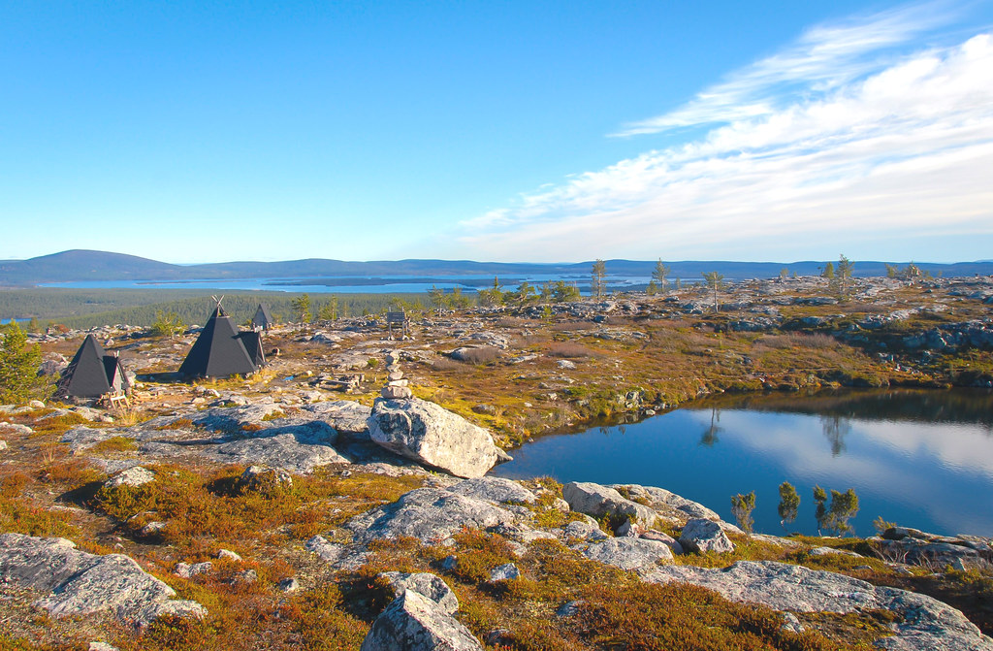
Famous places in Finland
Koli (national Park)
Särkitunturi
Halti (highest point in Finland)
Olavinlinna (castle)
Kalajoki (famous beach)
Korvatunturi (Santa lives here)
Ahvenanmaa (Åland)

Slide 4
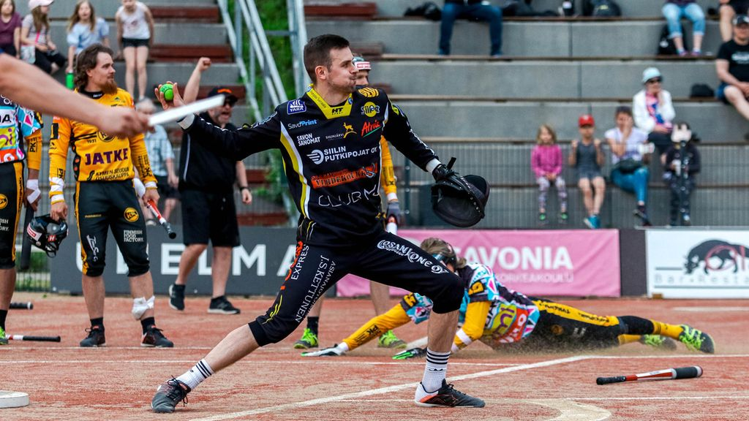
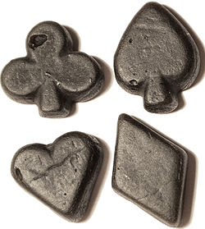
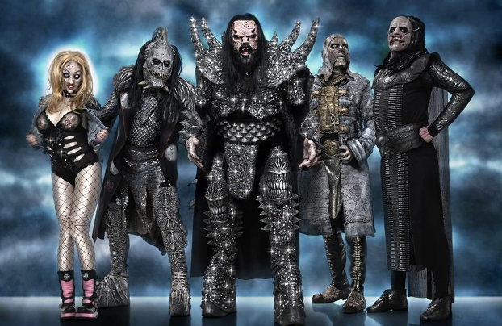
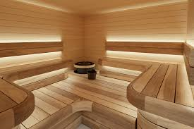
What is Finland known about
Winning Eurovision Song Contest 2006 (Lordi: Hard Rock Hallelujah)
Salmiakki (candy)
Xylitol-gum
Sauna
Young prime minister
Ice Hockey (1995, 2011, 2019)
Finnish baseball
Nokia

Slide 5
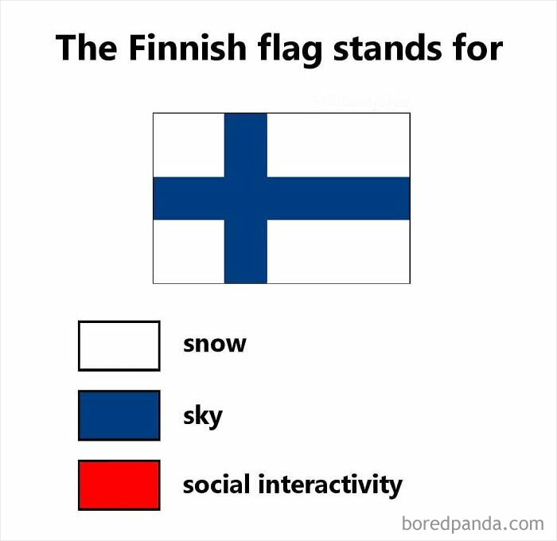
Finnish surviving vocabulary
Hello! = Hei!
Thank you = Kiitos
How are you? = Mitä kuuluu?
I’m fine = Hyvää kuuluu
How old are you? = Kuinka vanha olet?
I’m __ years old = Olen __ vuotias
1, 2, 3, 4, 5 = yksi, kaksi, kolme, neljä, viisi
13, 14, 15, 16 = kolmetoista, neljätoista, viisitoista, kuusitoista
Oh, shit = voi saakeli
Sorry = Anteeksi

