Slide 1


MOI!
MINUN NIMENI ON SHAFIGA ☺

Slide 2




HELLO!
MOi!
SALAM!

Slide 3
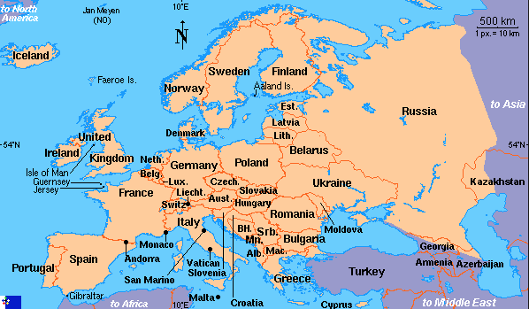
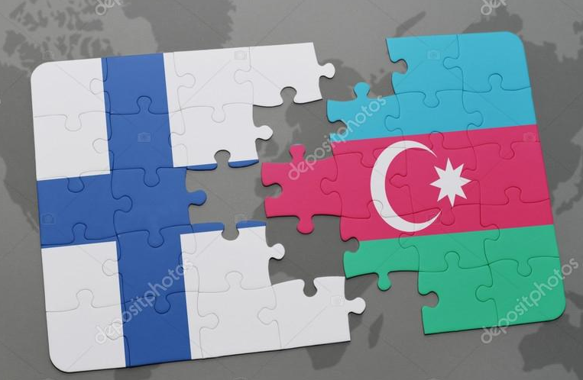
Azerbaidzan
Azerbaijan
Suomi
Finland

Slide 4

FLAG OF AZERBAİJAN
AZERBAIDŽANIN LIPPU

Slide 5
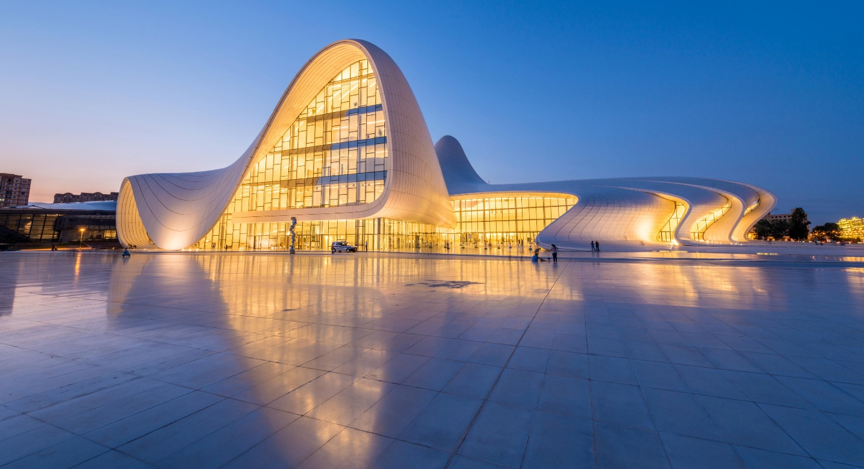
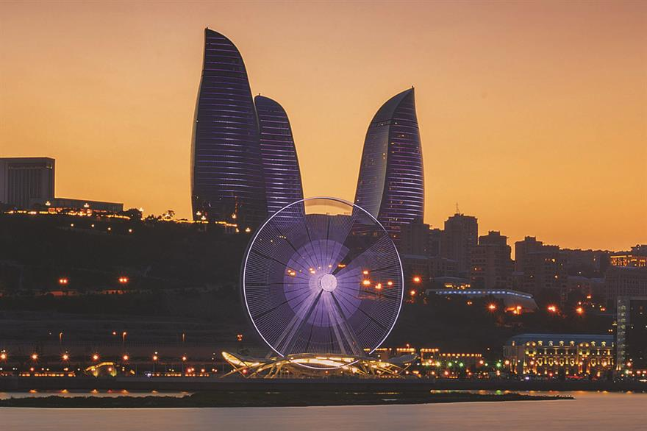
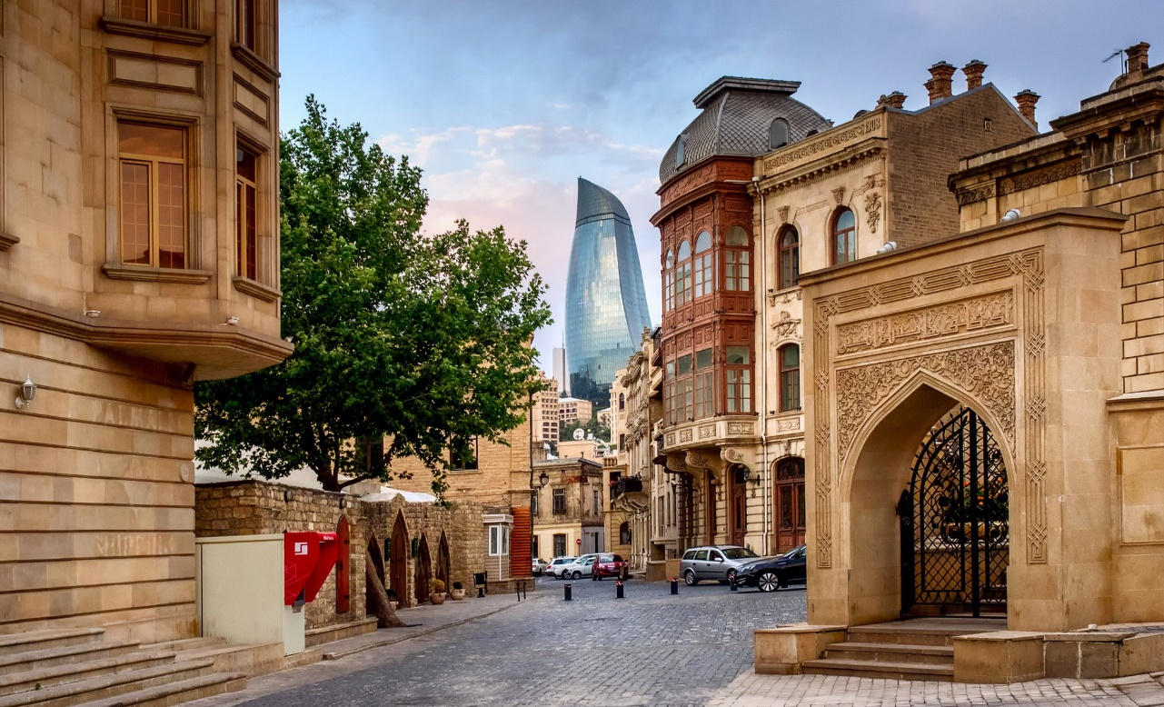
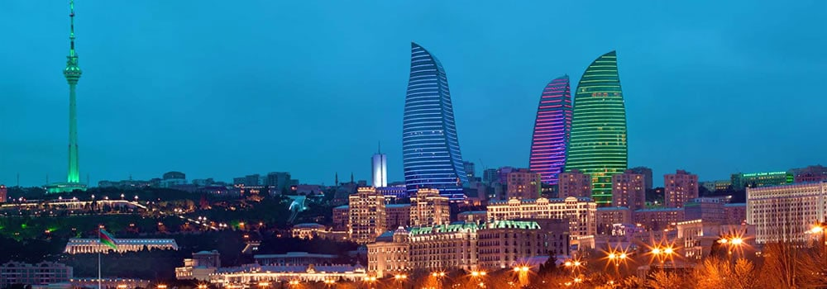
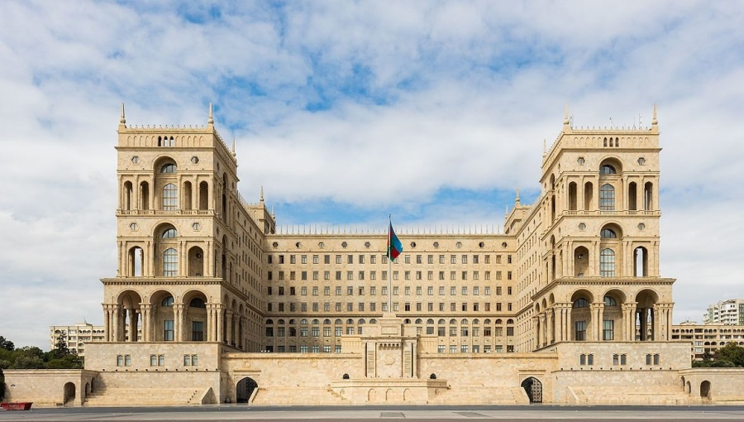
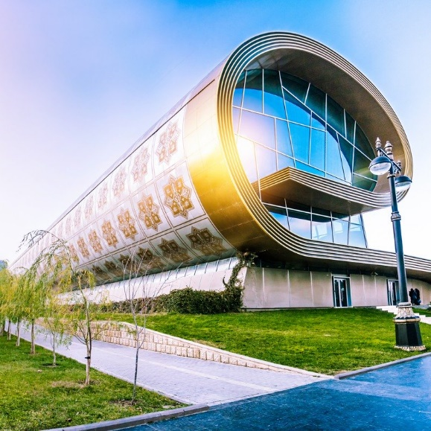
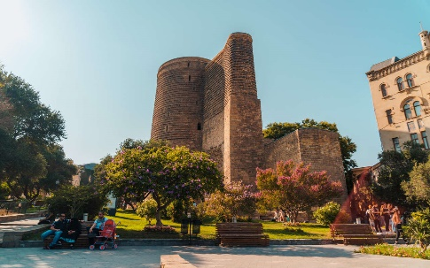
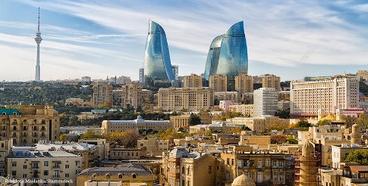

Baku is the capital city of Azerbaijan
Baku on Azerbaidzanin
pääkaupunki

Slide 6
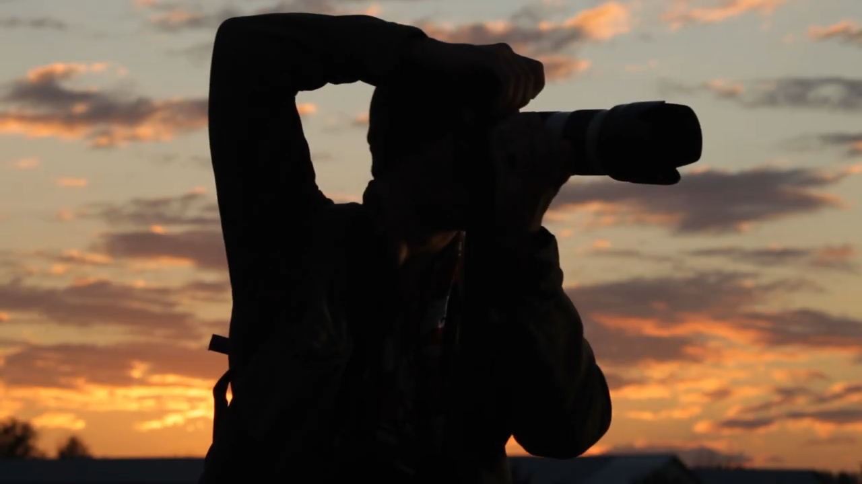
LET’S WATCH THE VIDEO AND
GET TO KNOW AZERBAIJAN

Slide 7
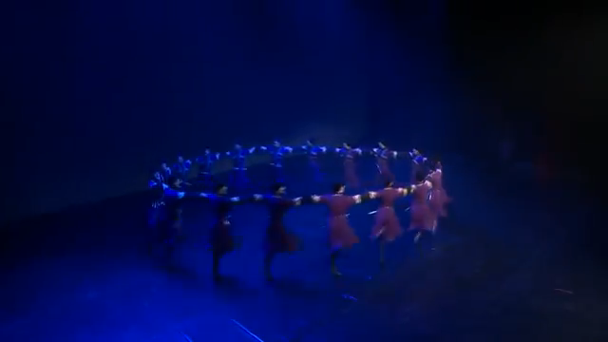
THIS VIDEO SHOWS AZERBAIJANI NATIONAL DANCE
NATIONAL MUSIC AND NATIONAL COSTUMES

Slide 8

LET’S GO TO THE LINK BELOW AND HAVE A LOOK AT AZERBAIJANI CUISINE
CLICK HERE TO KNOW MORE ABOUT AZERBAIJANI FOOD
AND THEN TELL ME
DO THEY LOOK DELICIOUS?

Slide 9
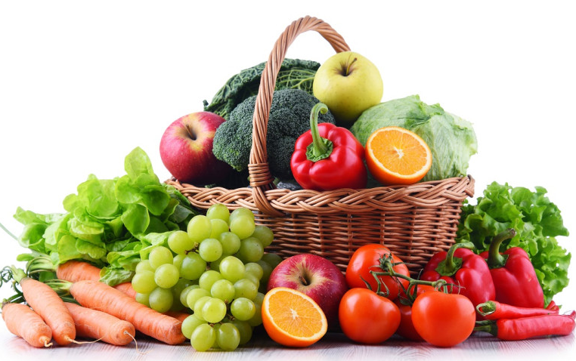
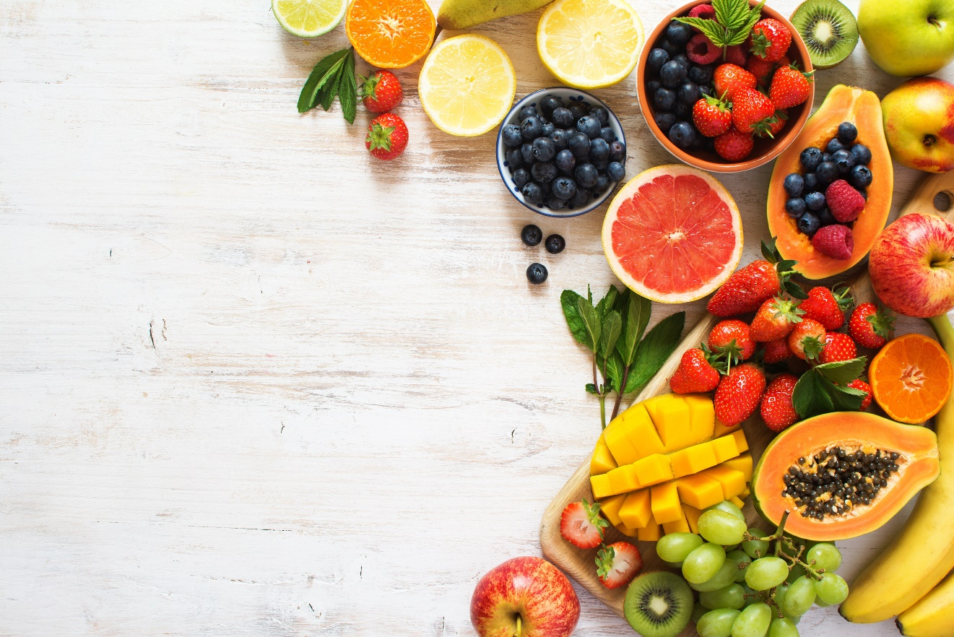
TODAY WE WILL LEARN
THE NAMES OF FRUITS AND VEGETABLES
IN AZERBAIJANI LANGUAGE

Slide 10


Azerbaijani alphabet is almost similar with Finnish alphabet, but still there are some differences. Let’s see what different letters we have. .

Slide 11

Ə
Q
Ü
X
Y
I

Slide 12
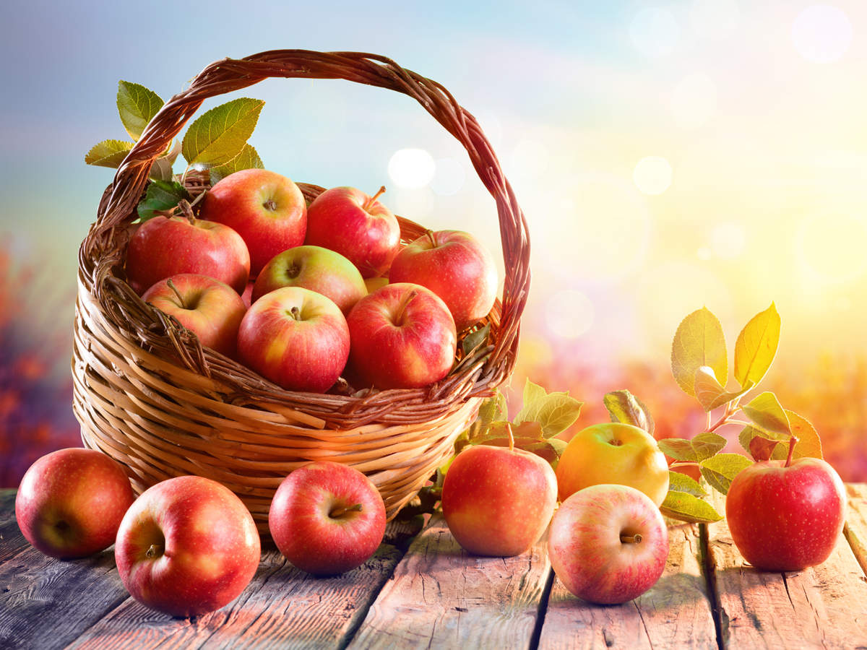
ALMA

Slide 13
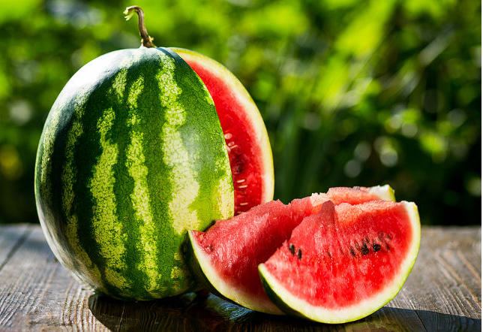
QARPIZ

Slide 14
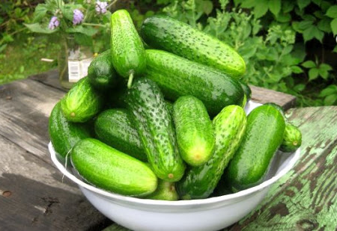
XİYAR

Slide 15
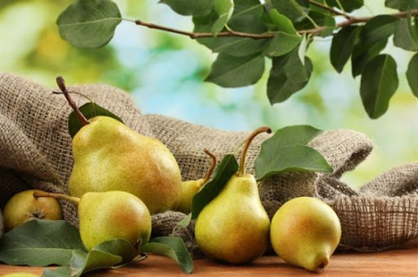
ARMUD

Slide 16
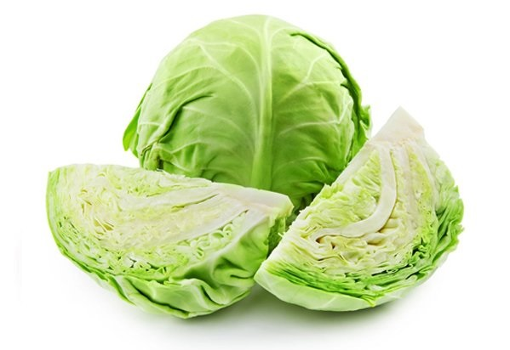
KƏLƏM

Slide 17
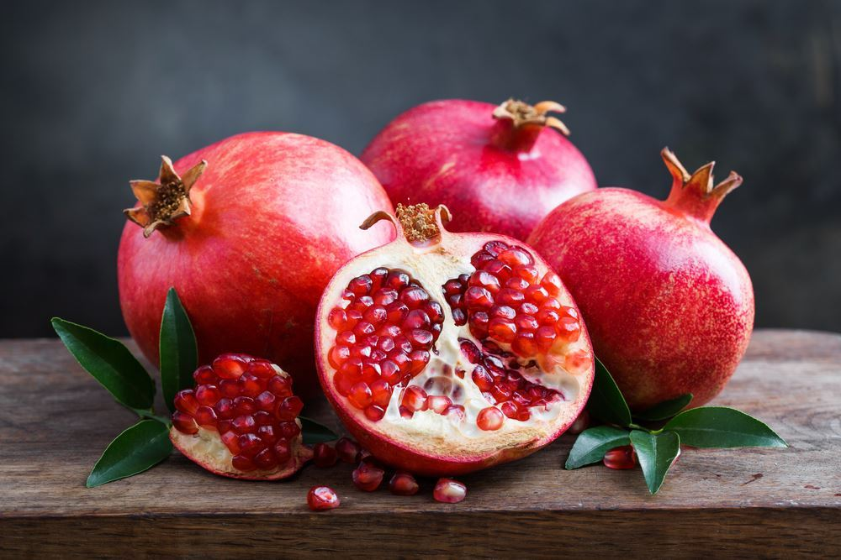
NAR

Slide 18
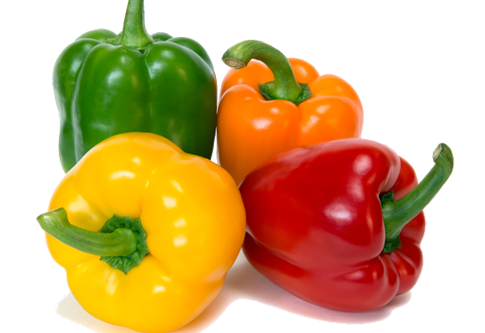
BİBƏR

Slide 19
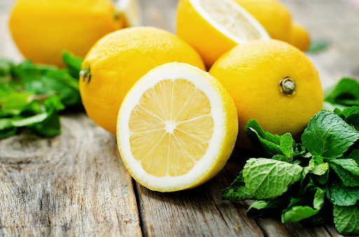
LiMON

Slide 20
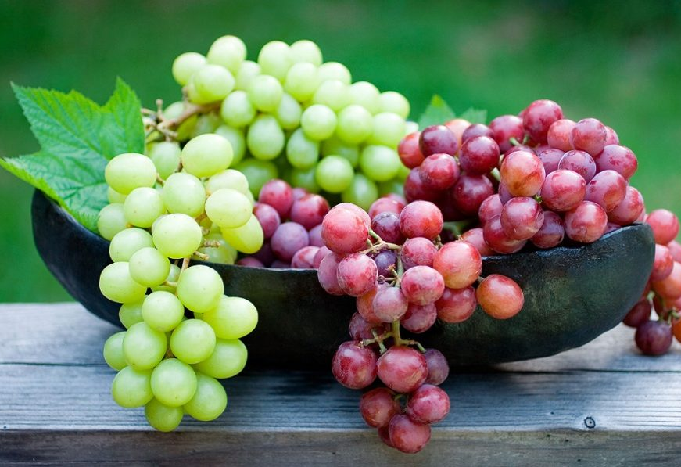
ÜZÜM

Slide 21
LOOK, READ AND REPEAT
REPEAT EVERY WORD FOR 5 TIMES

Slide 22
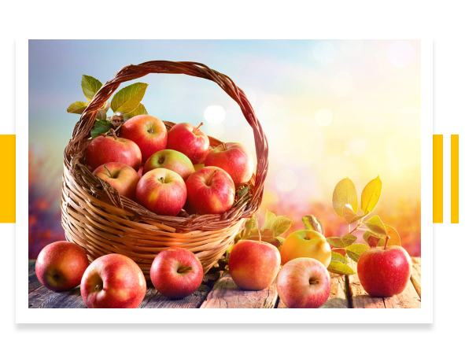
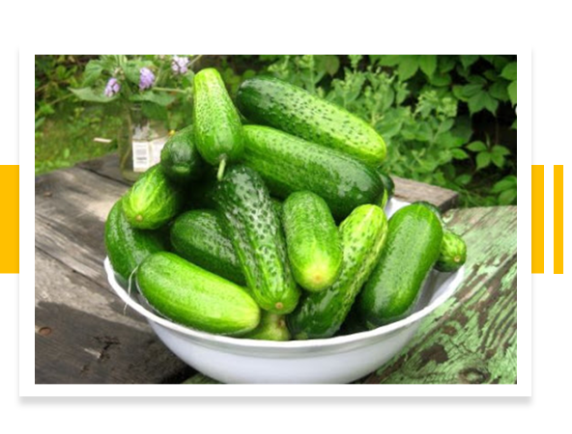
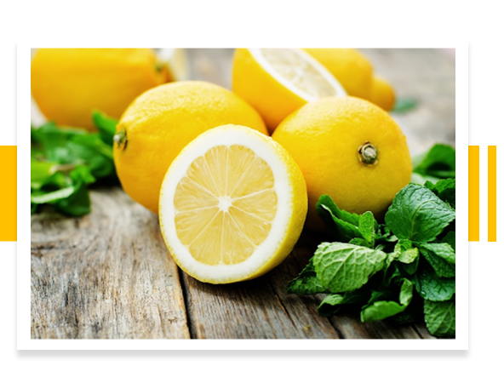
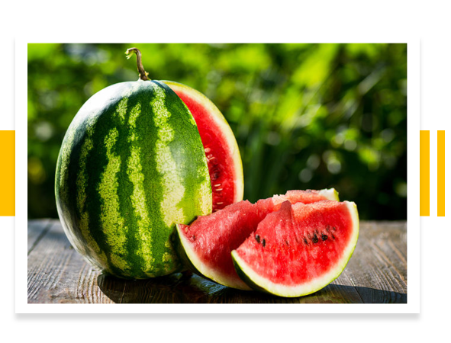
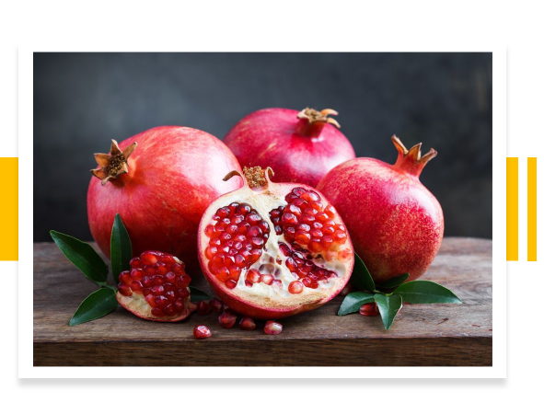
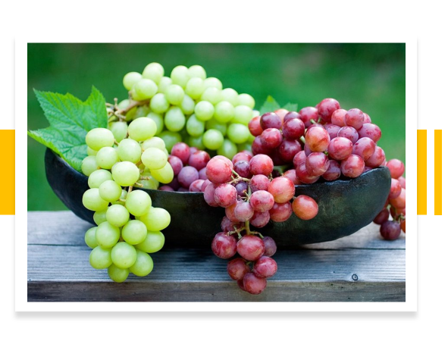
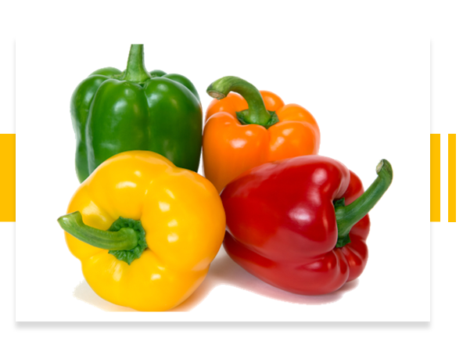
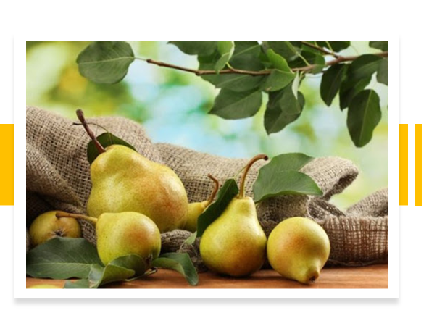
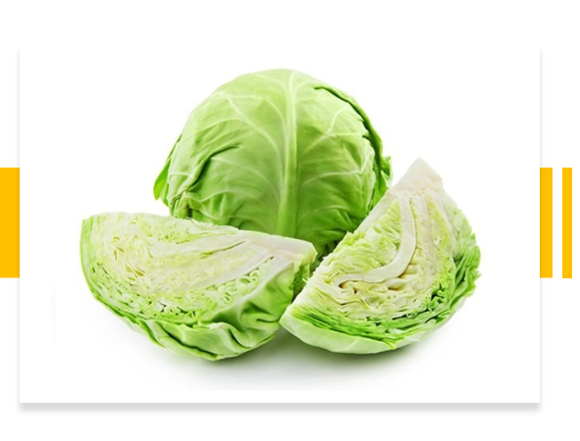
ALMA
XİYAR
LİMON
QARPIZ
NAR
ÜZÜM
BİBƏR
ARMUD
KƏLƏM

Slide 23
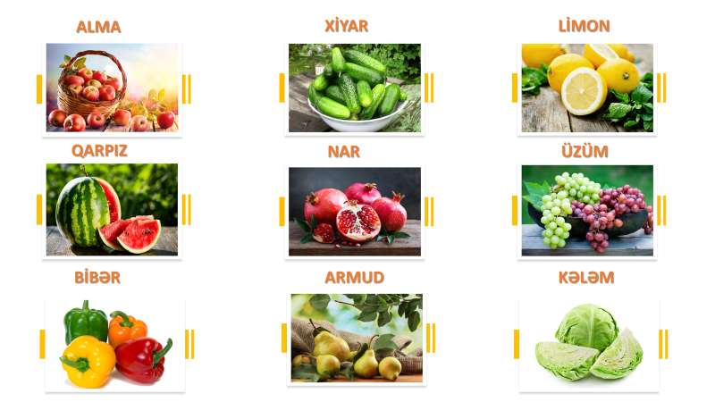
TRY TO REMEMBER THESE WORDS AND THEN WE WILL PLAY A GAME
YOU HAVE 4 MINUTES TO REMEMBER THEM ☺

Slide 24


Slide 25
CHOOSE THE RIGHT PICTURE
XIYAR

Slide 26
XIYAR

Slide 27
CHOOSE THE RIGHT PICTURE
LİMON

Slide 28
LİMON

Slide 29
CHOOSE THE RIGHT PICTURE
ARMUD

Slide 30
ARMUD

Slide 31
CHOOSE THE RIGHT PICTURE
QARPIZ

Slide 32
QARPIZ

Slide 33
CHOOSE THE RIGHT PICTURE
ÜZÜM

Slide 34
ÜZÜM

Slide 35
CHOOSE THE RIGHT PICTURE
BİBƏR

Slide 36
CHOOSE THE RIGHT PICTURE
BİBƏR

Slide 37
CHOOSE THE RIGHT PICTURE
NAR

Slide 38
NAR

Slide 39
CHOOSE THE RIGHT PICTURE
KƏLƏM

Slide 40
KƏLƏM

Slide 41
CHOOSE THE RIGHT PICTURE
ALMA

Slide 42
ALMA

Slide 43

CONGRATULATİONS!
NOW YOU KNOW SO MANY WORDS IN AZERBAIJANI LANGUAGE!
THANK YOU!
BYE-BYE!

