Slide 1
Nature observation with a periscope
Ic Pablo Neruda, Rome

Slide 2
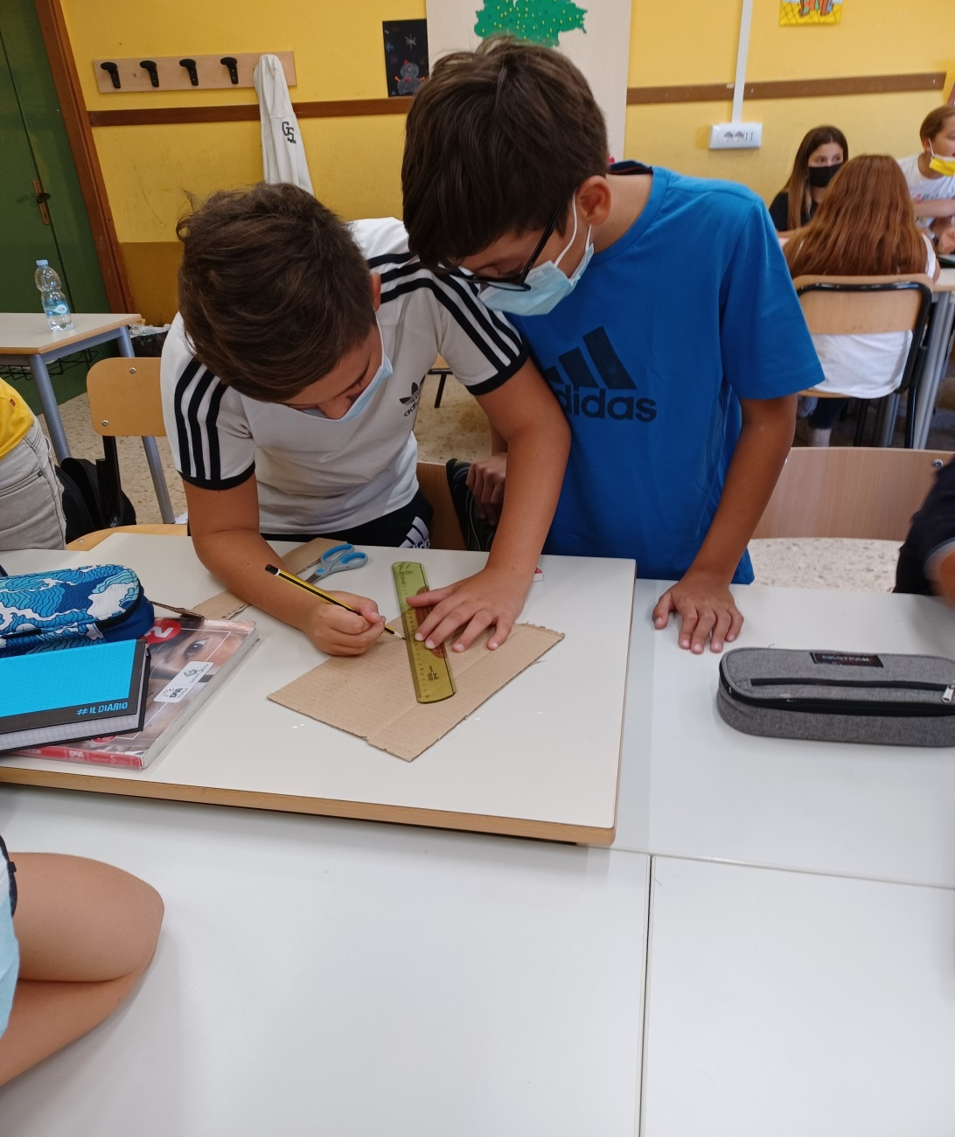
With
recycled
Paper
they are
making
the
periscope

Slide 3
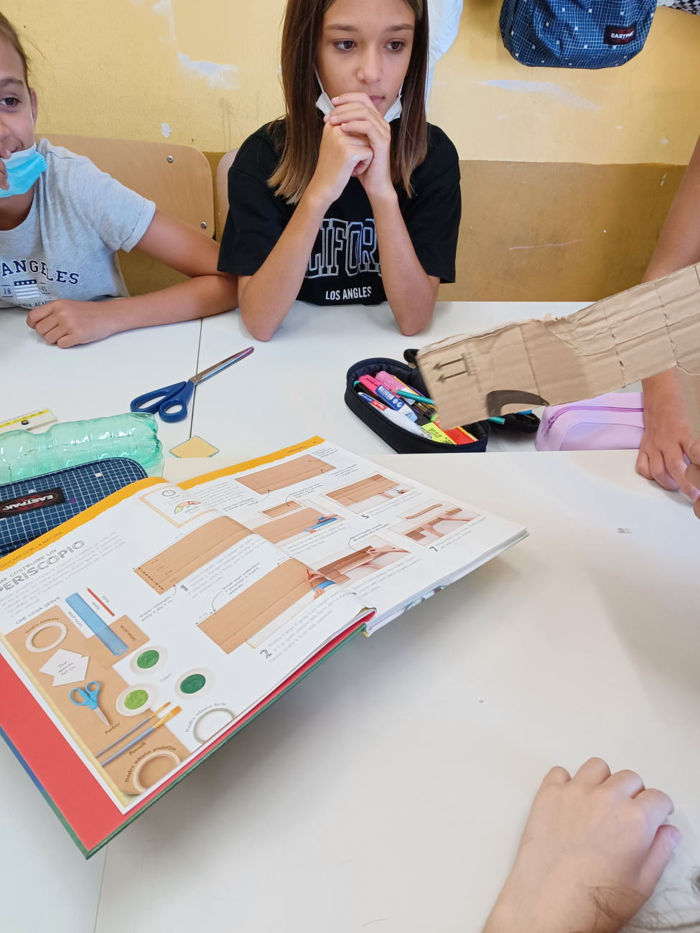
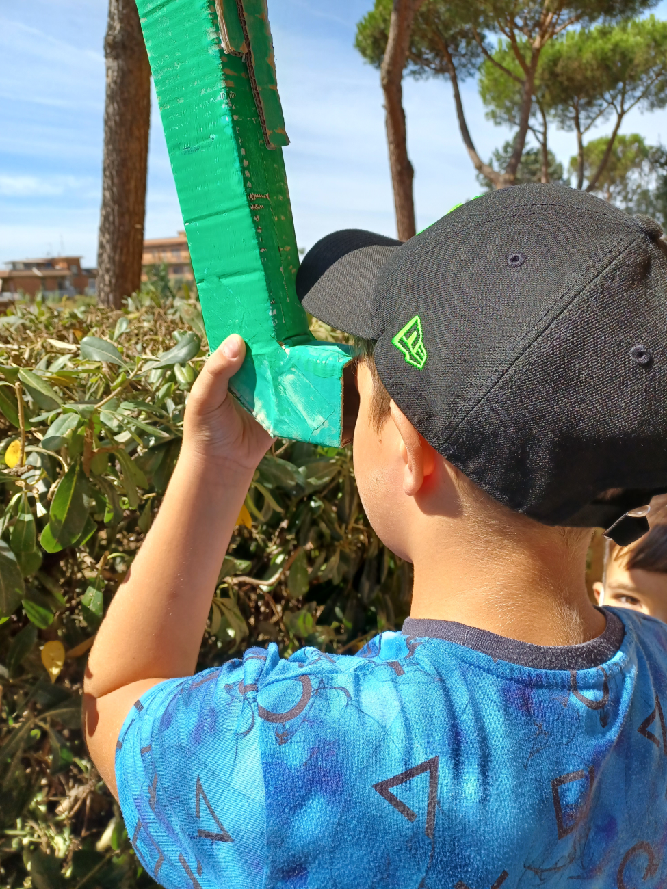

Slide 4
A simple experiment
about erosion: one bottle is with vegetation and the other not.
They have put the water in the bottles

Slide 5
