Slide 1
A model of a sustainable city
Rome Italy

Slide 2
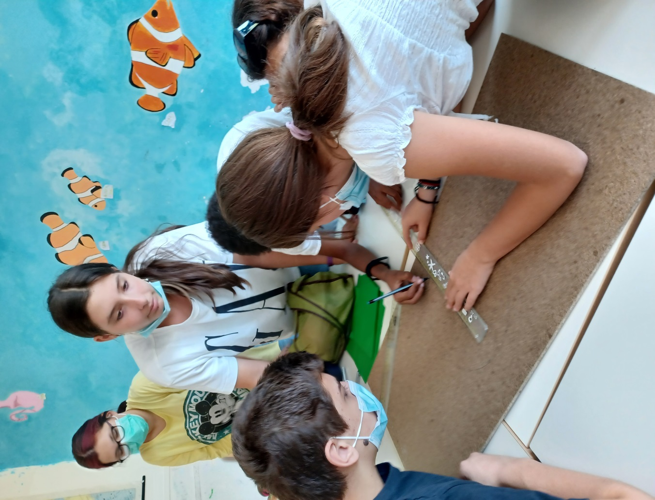
Working at the model
made only with recycled materials

Slide 3
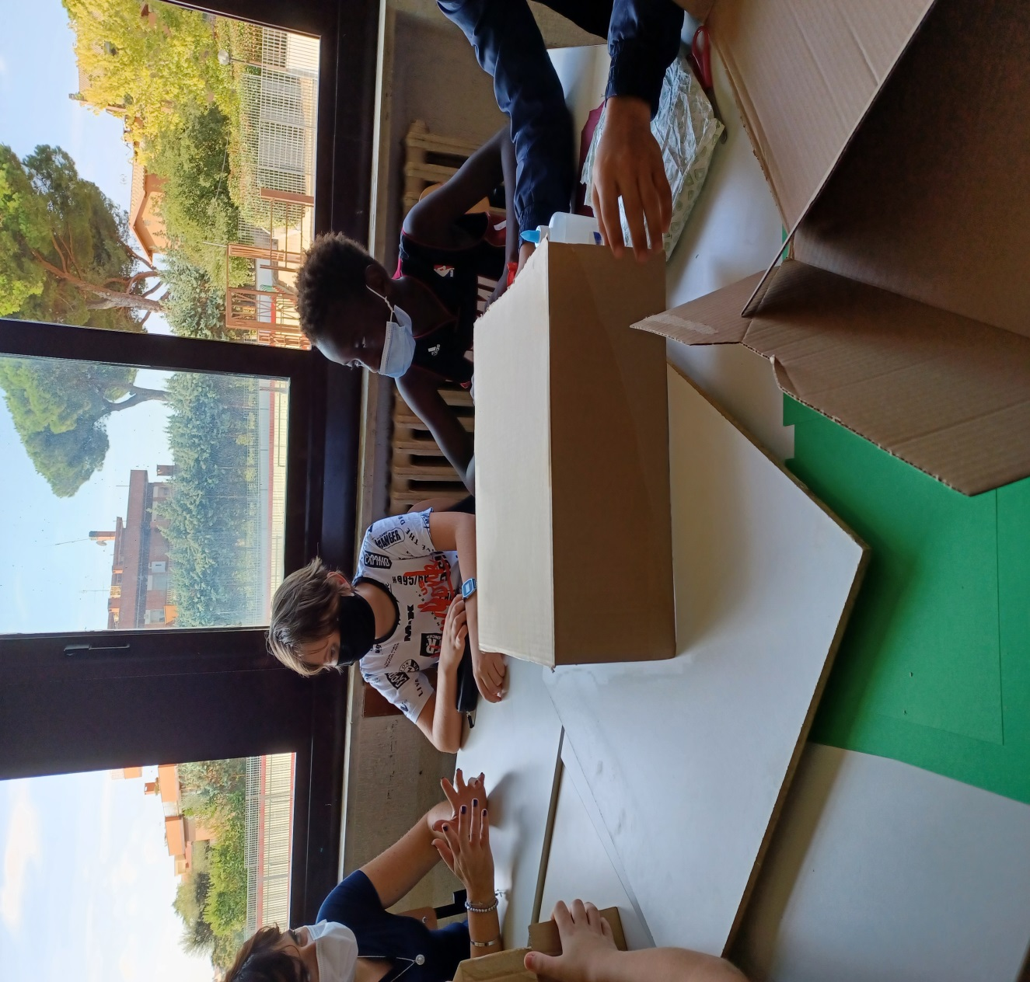
The classroom
is
divided in
two teams

Slide 4
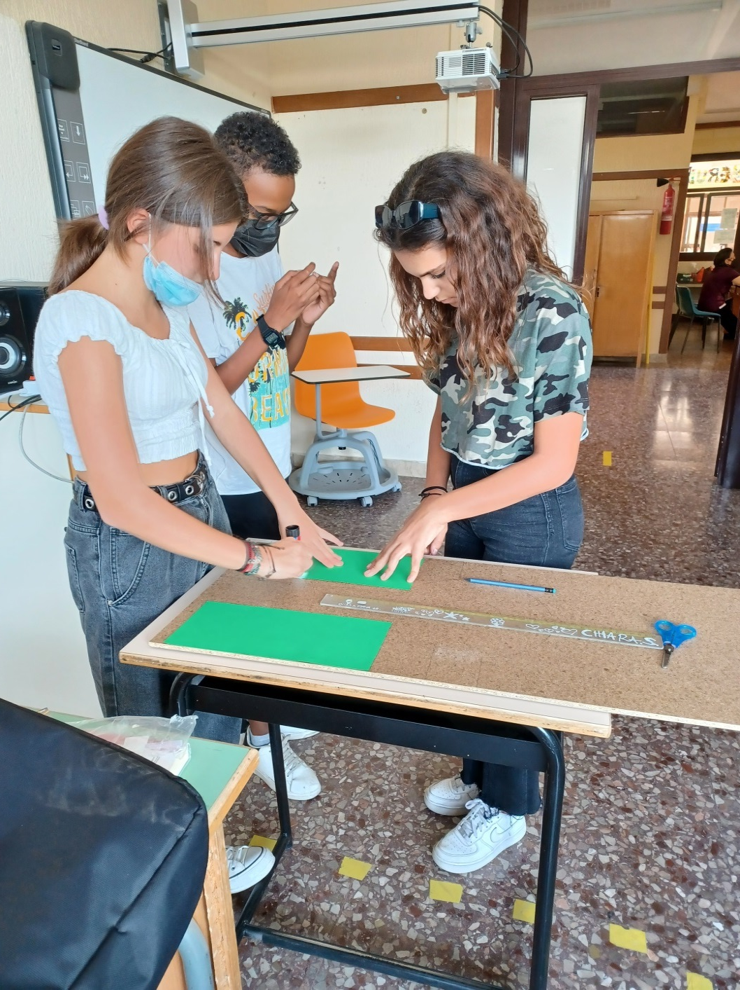
The students
are
working to
the green
areas of the
city model

Slide 5
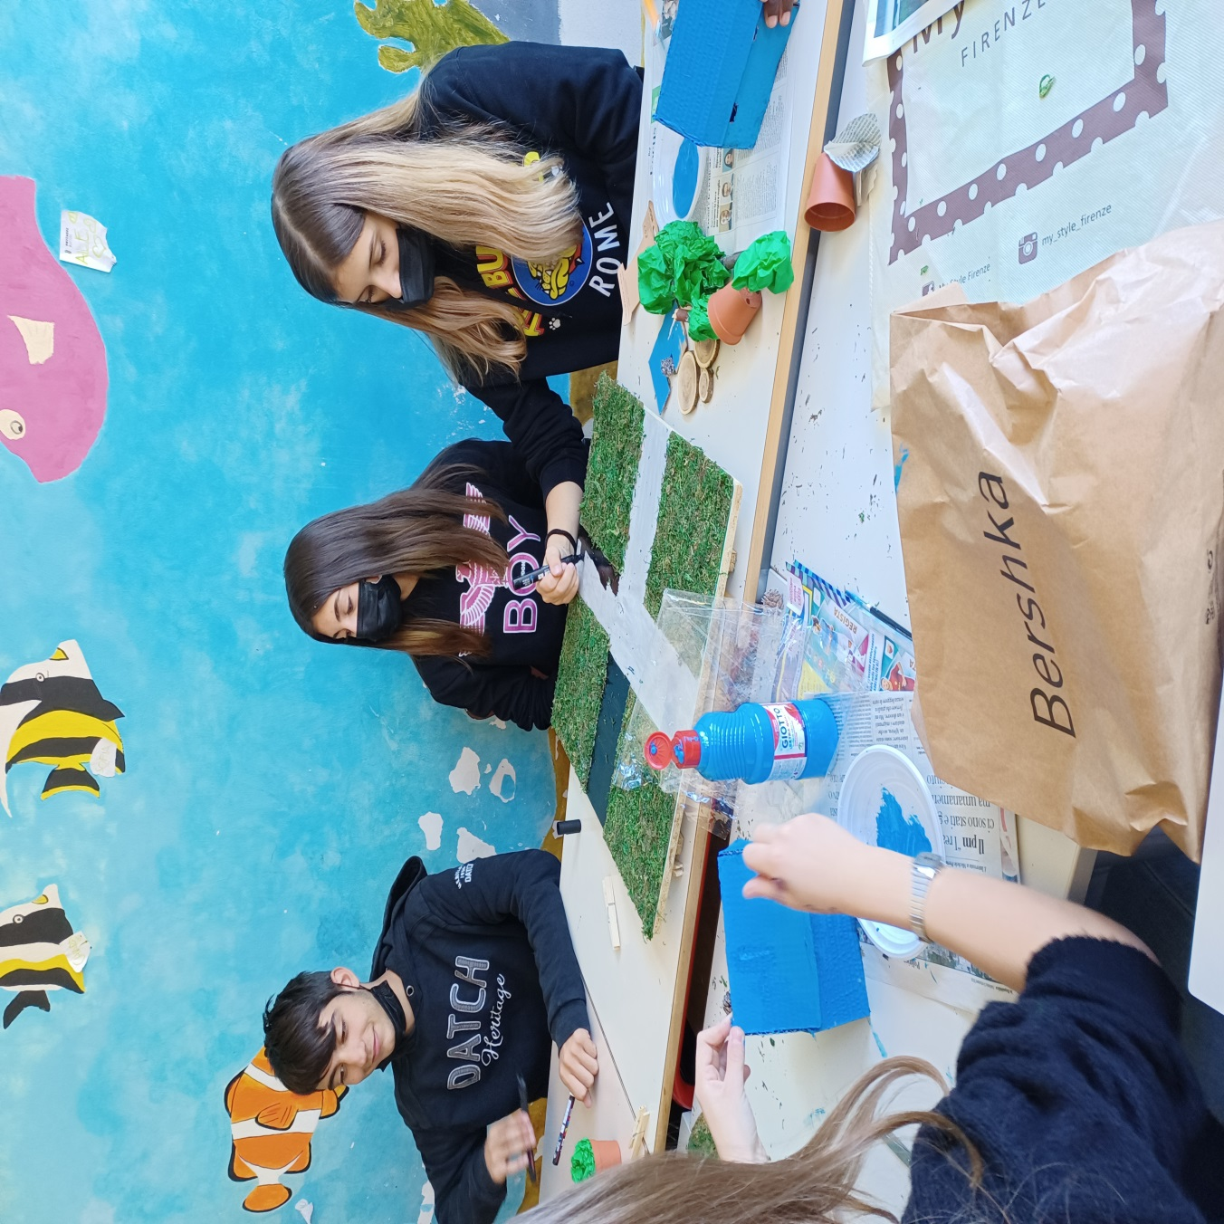

Slide 6
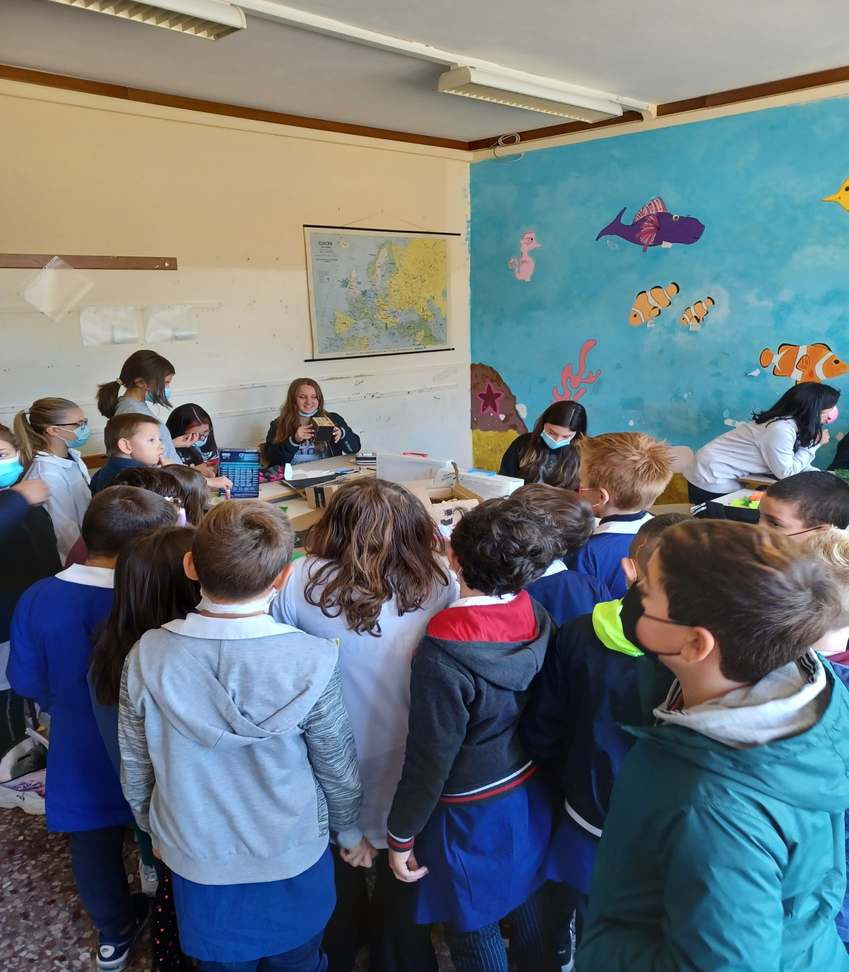
The students
are
telling about
the project
with the
children
of the
primary
school

Slide 7
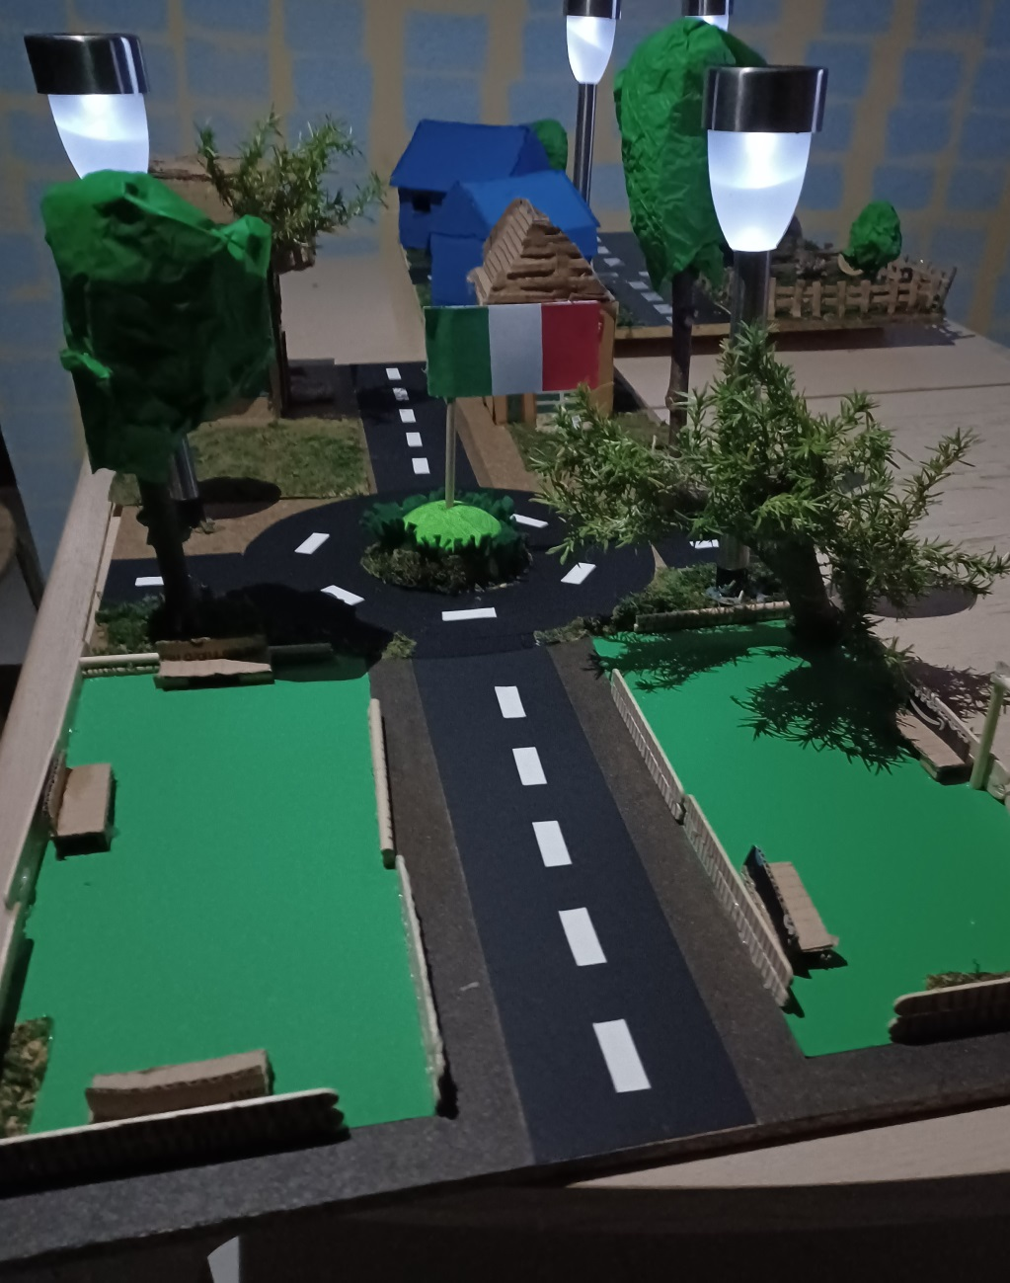
Completed with light
from the sun
Good erasmus days!

