Slide 1
At the end of the project, did you learn new thing about the environment?

Slide 2
Where you interested in the carried out activities?

Slide 3
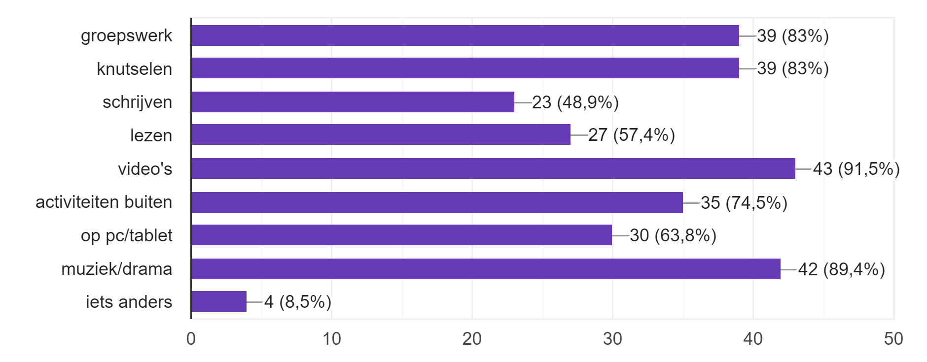
In which ways did you learn about the topics during this project?

Slide 4
If you answered "Something else", please describe in your own words how you learned.
We wrote what we did on a poster
Picking up the litter
Making a snowflake
We made a newspaper with the class

Slide 5
Mention one interesting thing you have learnt while working on GEAR project?
crafts
Water
gardening
Learning about earth
Picking up the trash in the streets
Learning a song
Learning about the planets and the solar system
That we have to take care of our planet
Wind
The solarsystem
About waste
Plastic soup
we made a newspaper

Slide 6
What kind of topics would you like to learn about in this type of projects in the future?
How it all began
About other countries
Wind
waste
sun
Planets
Water
space
history
The environment
animals
war
cars
windmills
How nature works
gardening
socker
Healthcare in other countries

Slide 7
How would you like to participate in future projects with other countries?
socker
talking
Singing a song
Making crafts
Learning another language
Playing games
Learning things about the other countries
Helping eachother out
Fixing cars
Going to Disneyland together
Picking up trash together

