Slide 1
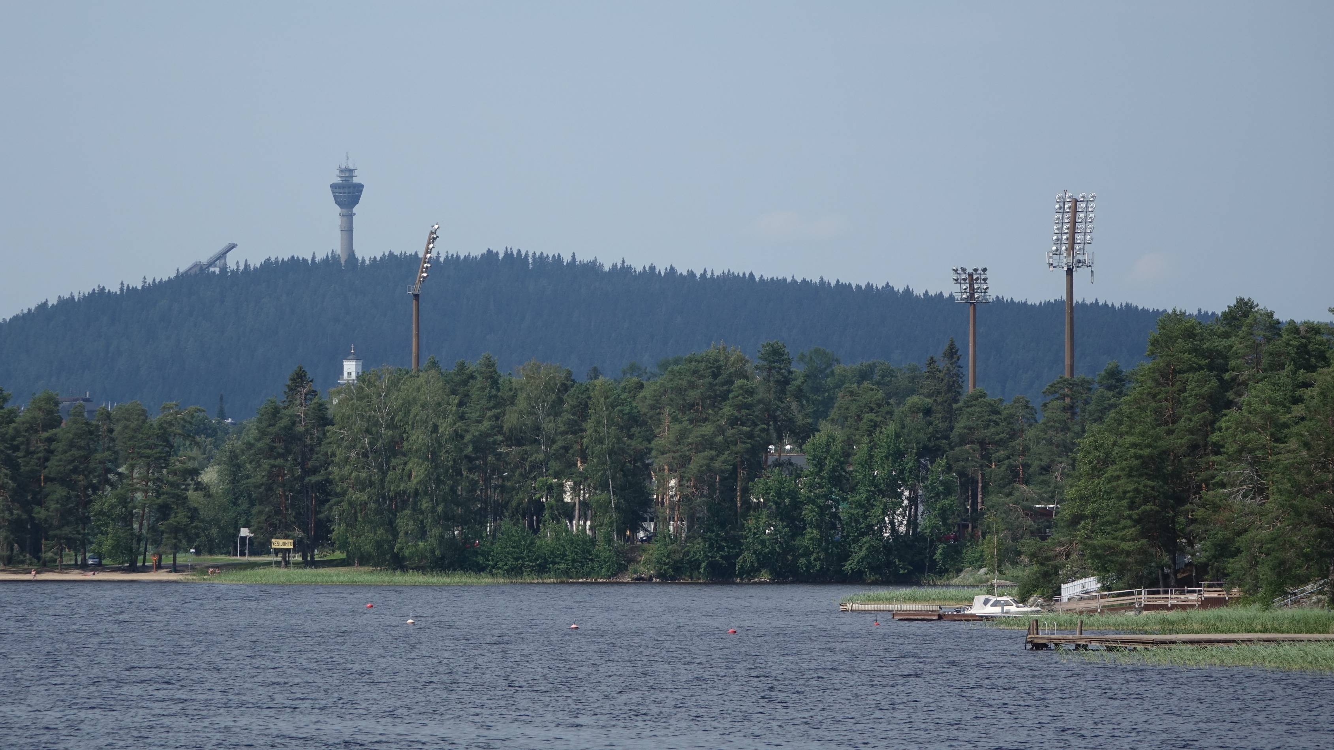
Out and About in our Local Environment
Making Mandalas at Puijo

Slide 2
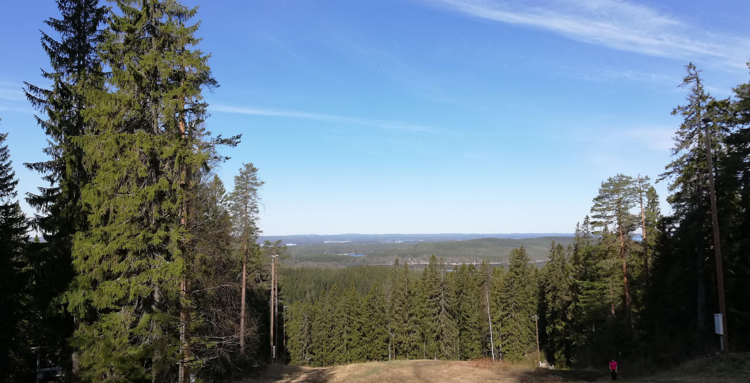
Notes:
The Puijo nature area is very close to our school.
The area includes a primeval forest with nature paths.
The total area of Puijo is about 660 hectares.

Slide 3
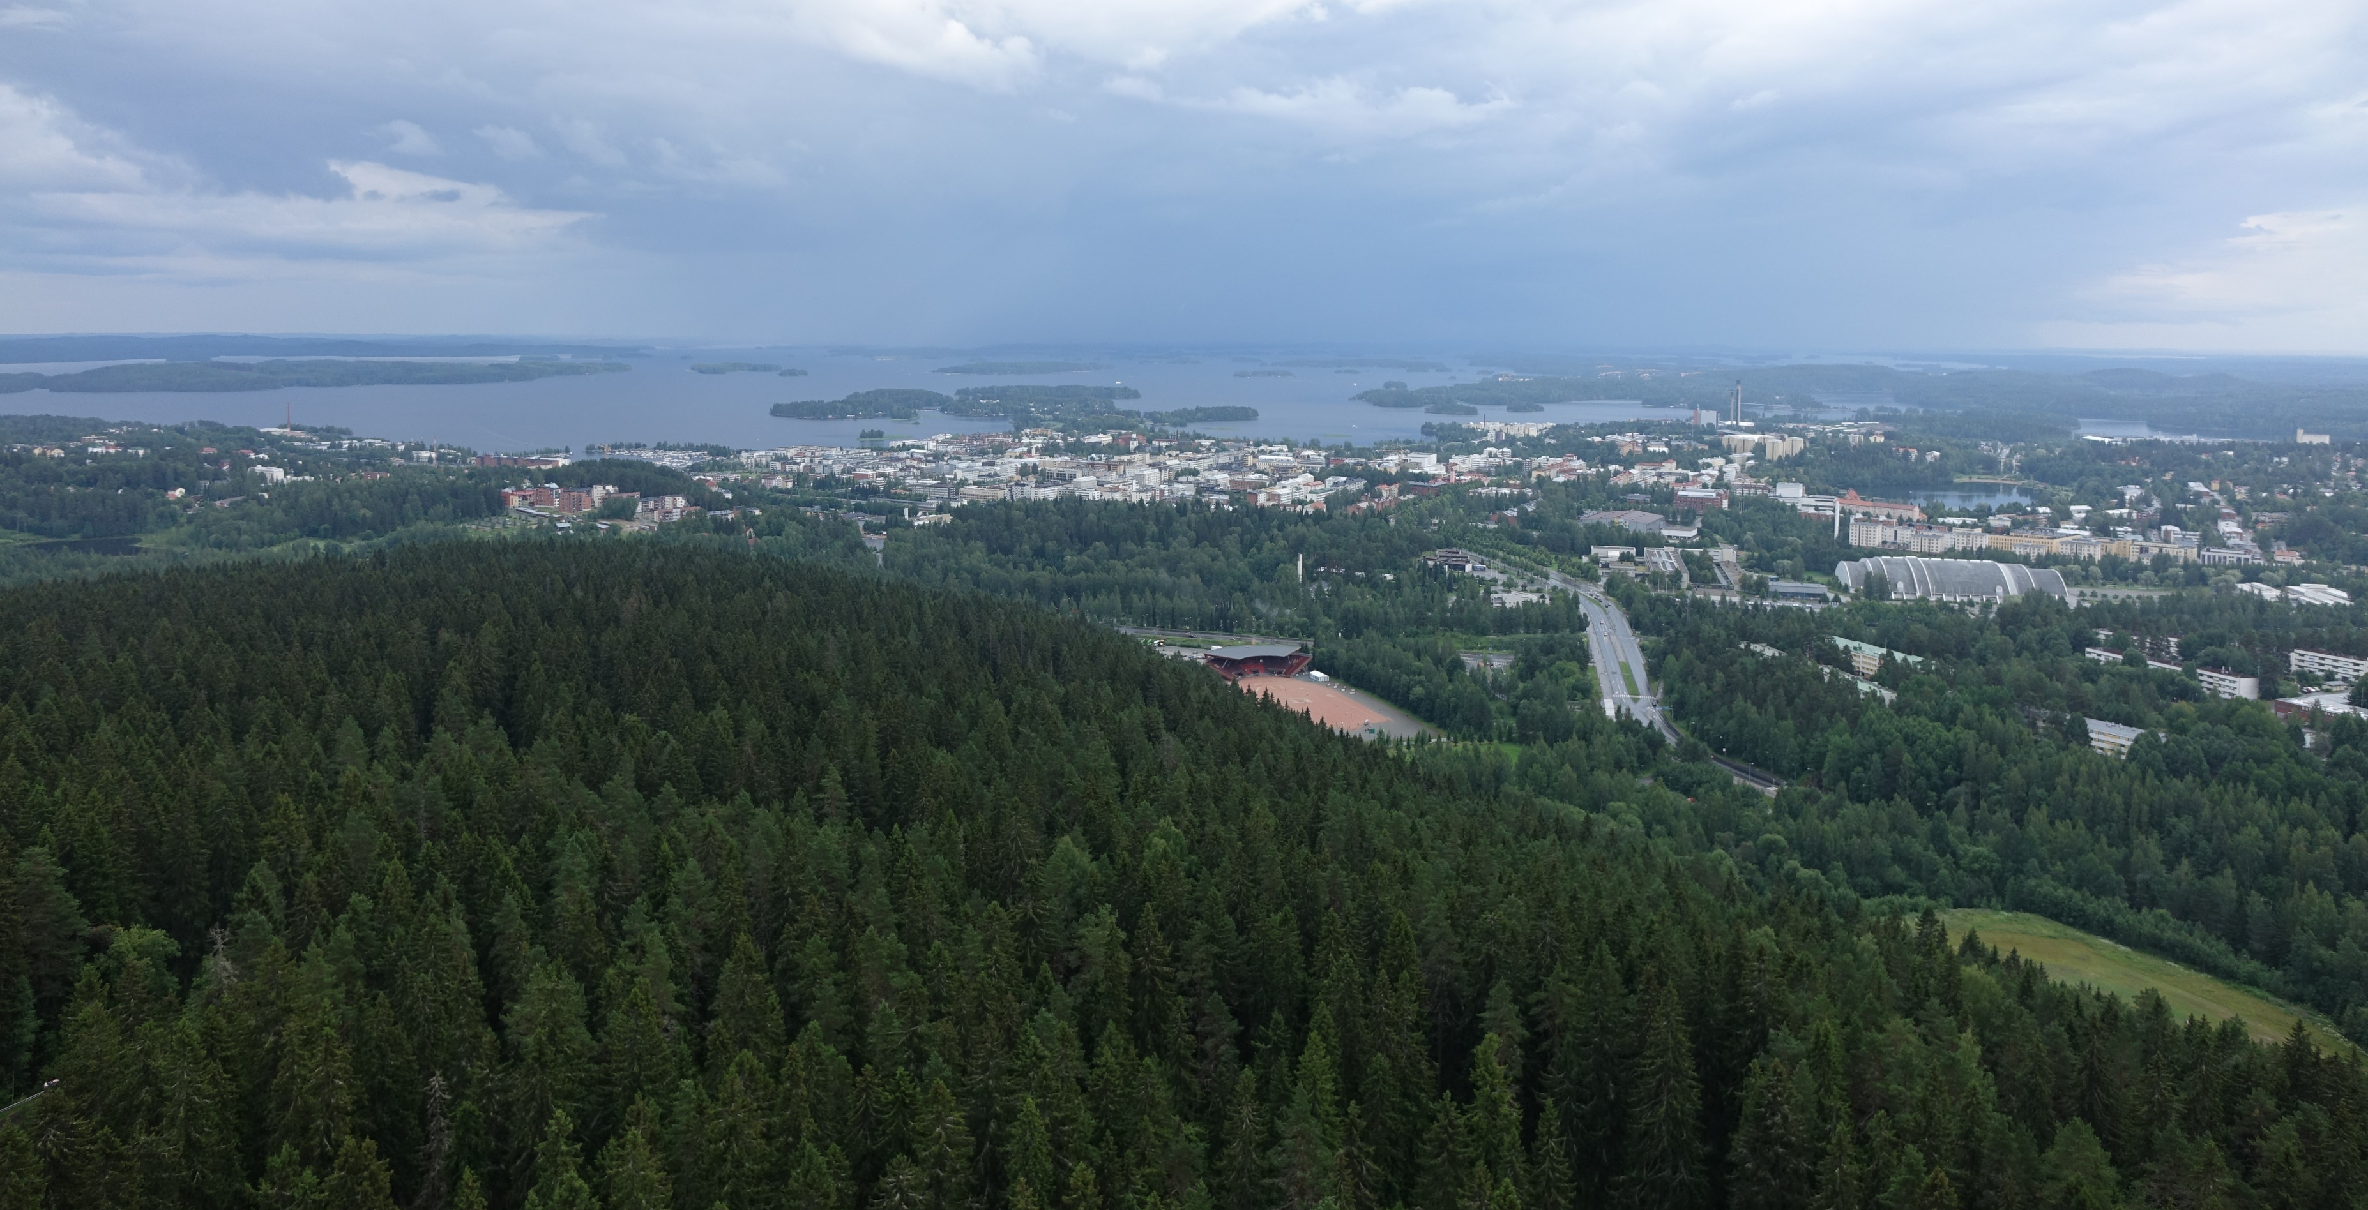
Notes:
There is a tower that is used as a viewing tower.
It also has a café and a revolving restaurant where you can have a nice meal and see views of the whole city.
Sometimes in the winter, they organise different activities for kids here, like sledging.

Slide 4
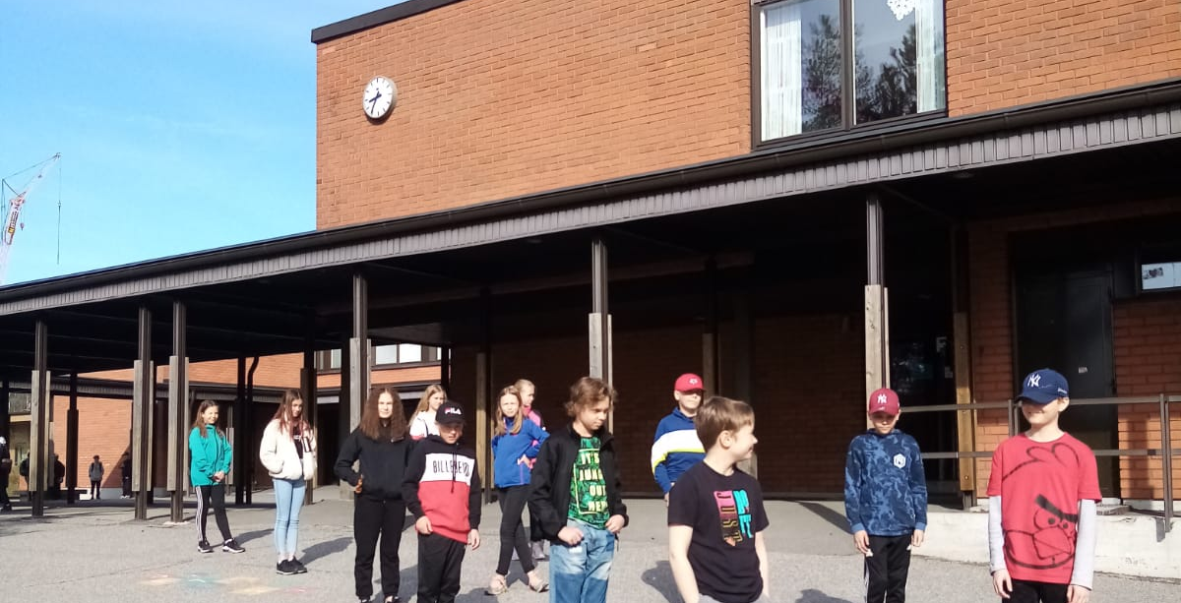
Notes:
We set off from school one day to use Puijo as our classroom for the day.
We had to keep a safety distance.
It took us about 15 minutes to walk there.
This picture only shows the school building, but we have lots of trees and green areas as well as swings.

Slide 5
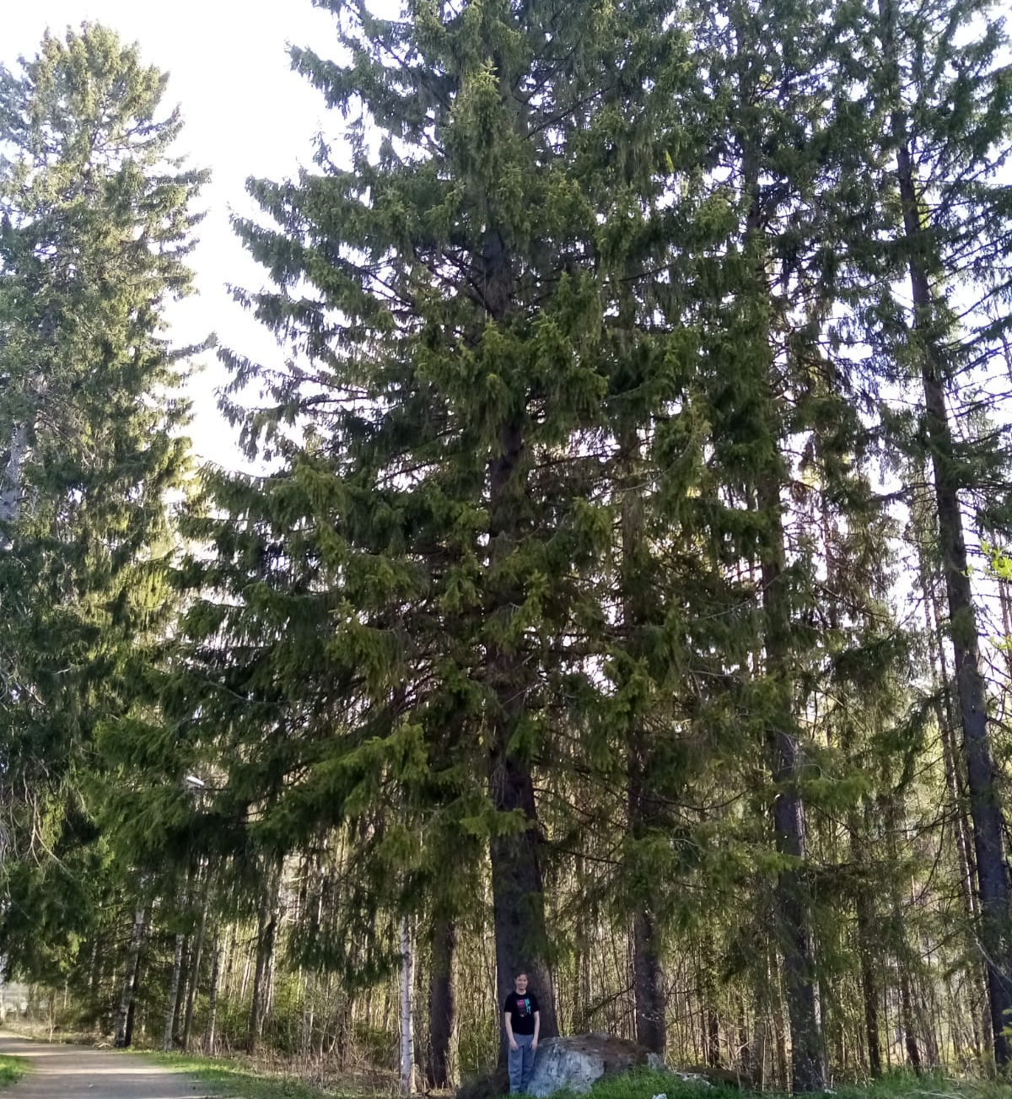
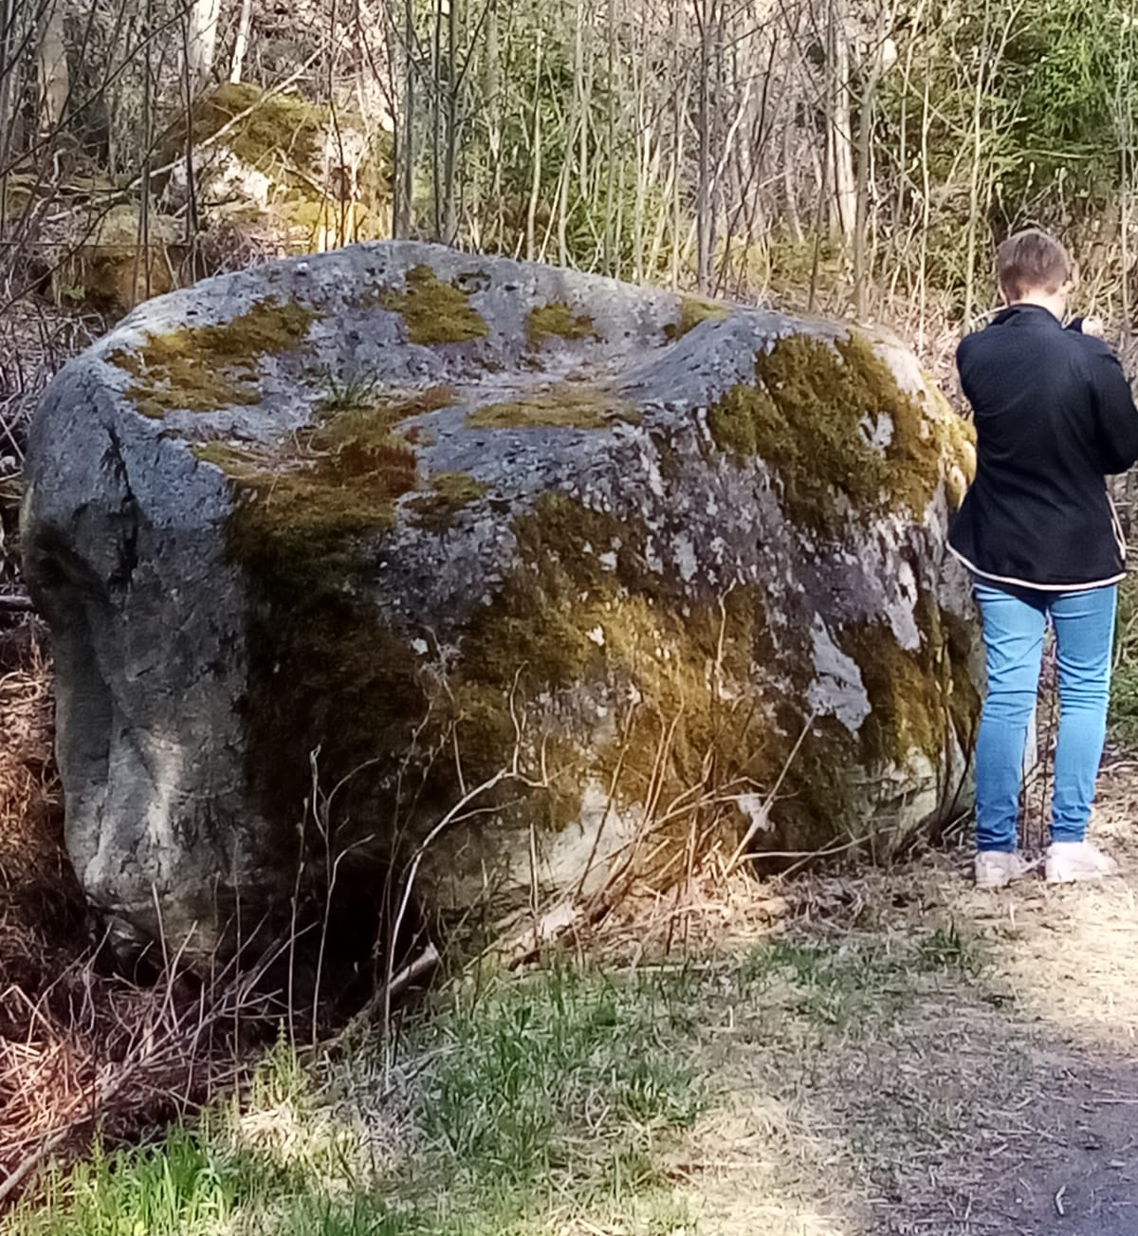
Notes:
On the way to Puijo, we passed some very tall trees and some boulders.
The tree is at least ten times bigger than our classmate. Can you see him in the picture?
In the old days, people used to think that the boulders in the middle of forests had been left behind by giants.
Today we know that they were left behind by the melting ice after the Ice Age.

Slide 6
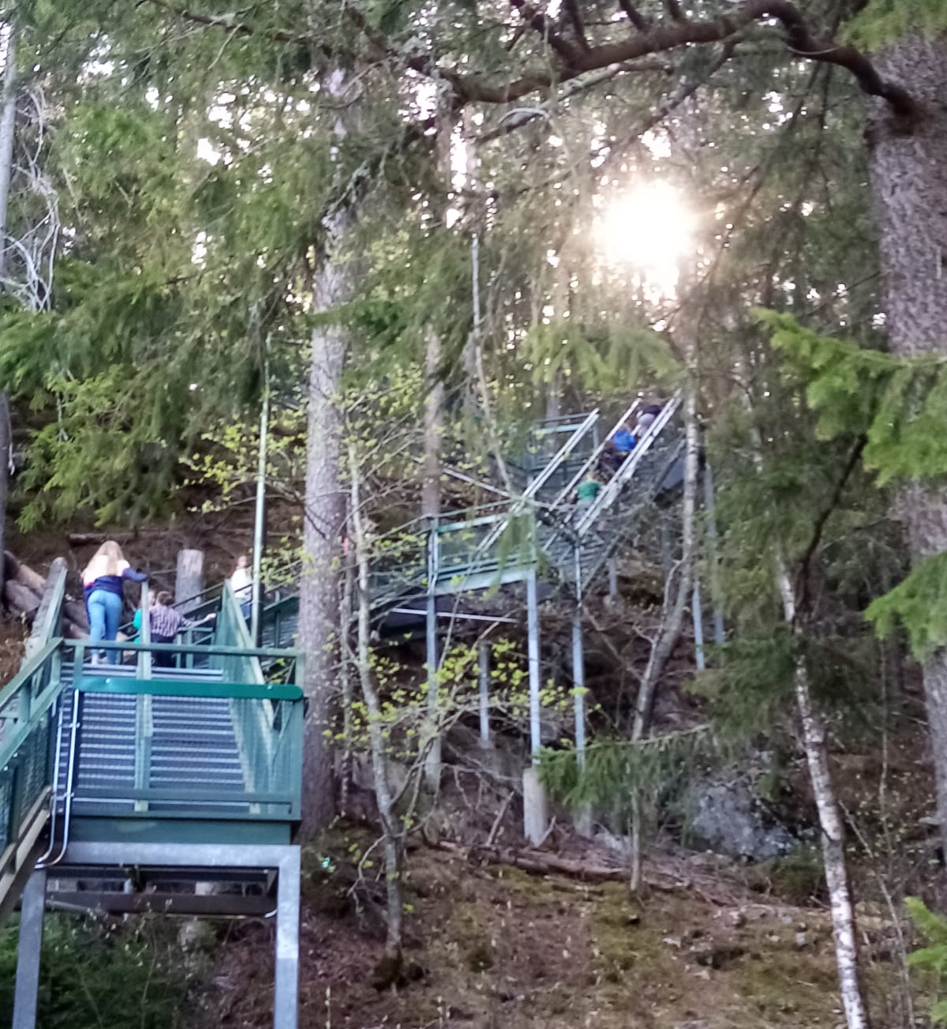
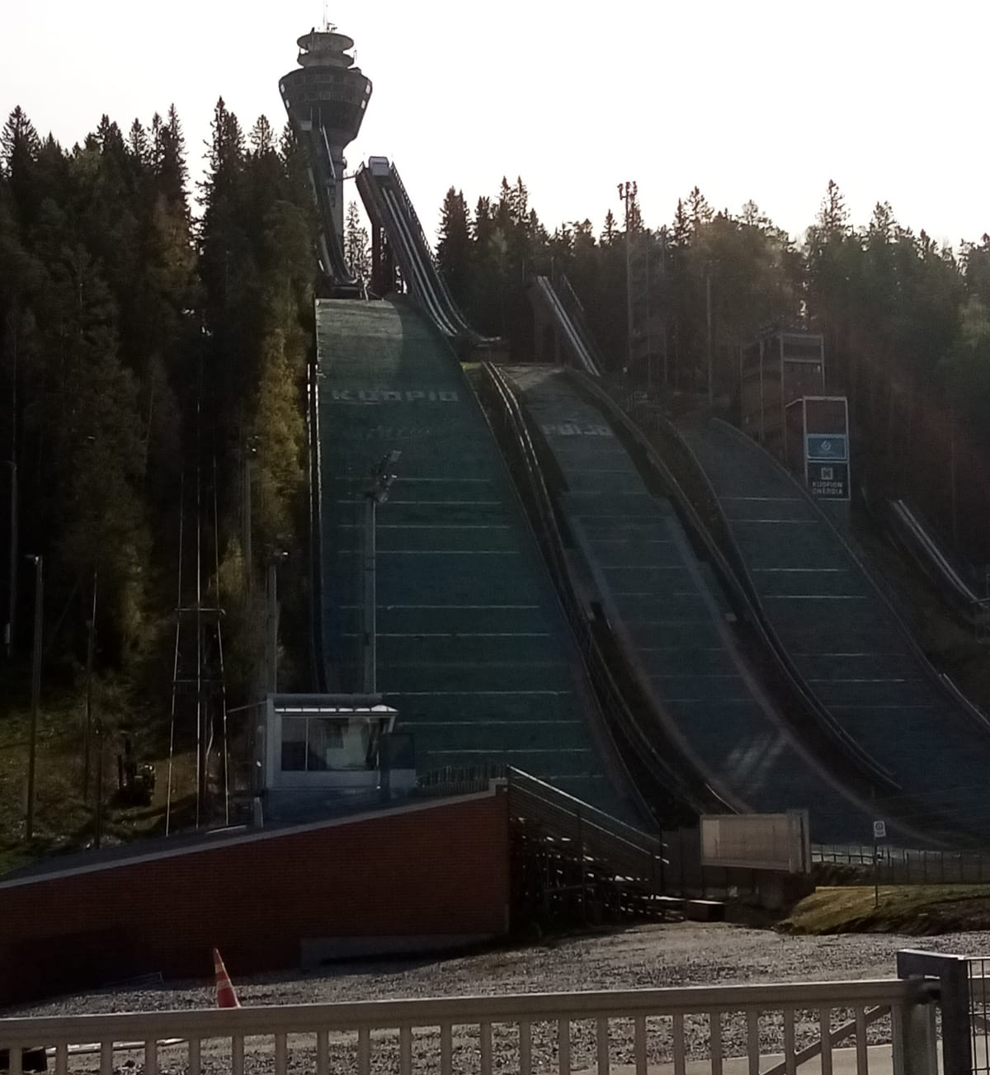
Notes:
When we got to Puijo, we passed the three ski jumps.
We had to climb the Puijo stairs to get to the top of the hill.
There are 376 stairs right beside the ski jumps.
Lots of people use the stairs to train and exercise.
When you are training on the stairs, you can see beautiful nature all around you.

Slide 7
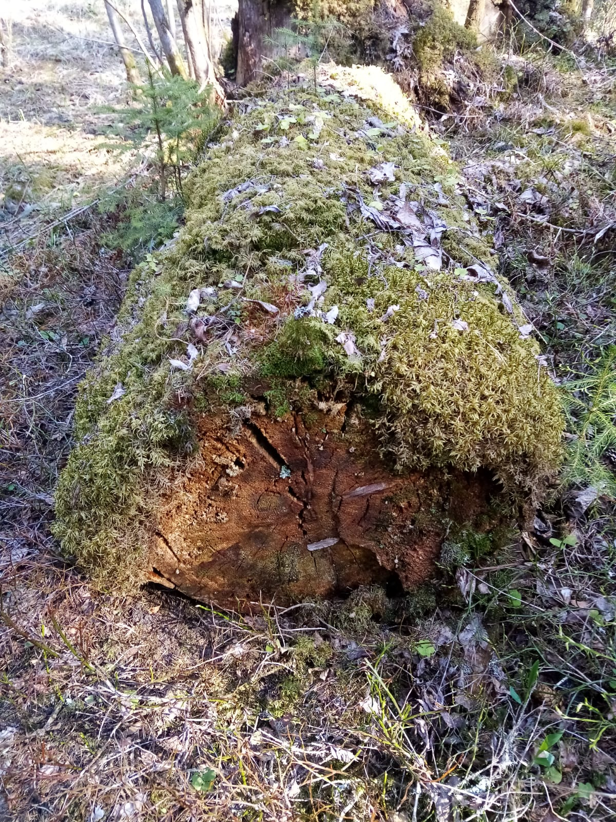
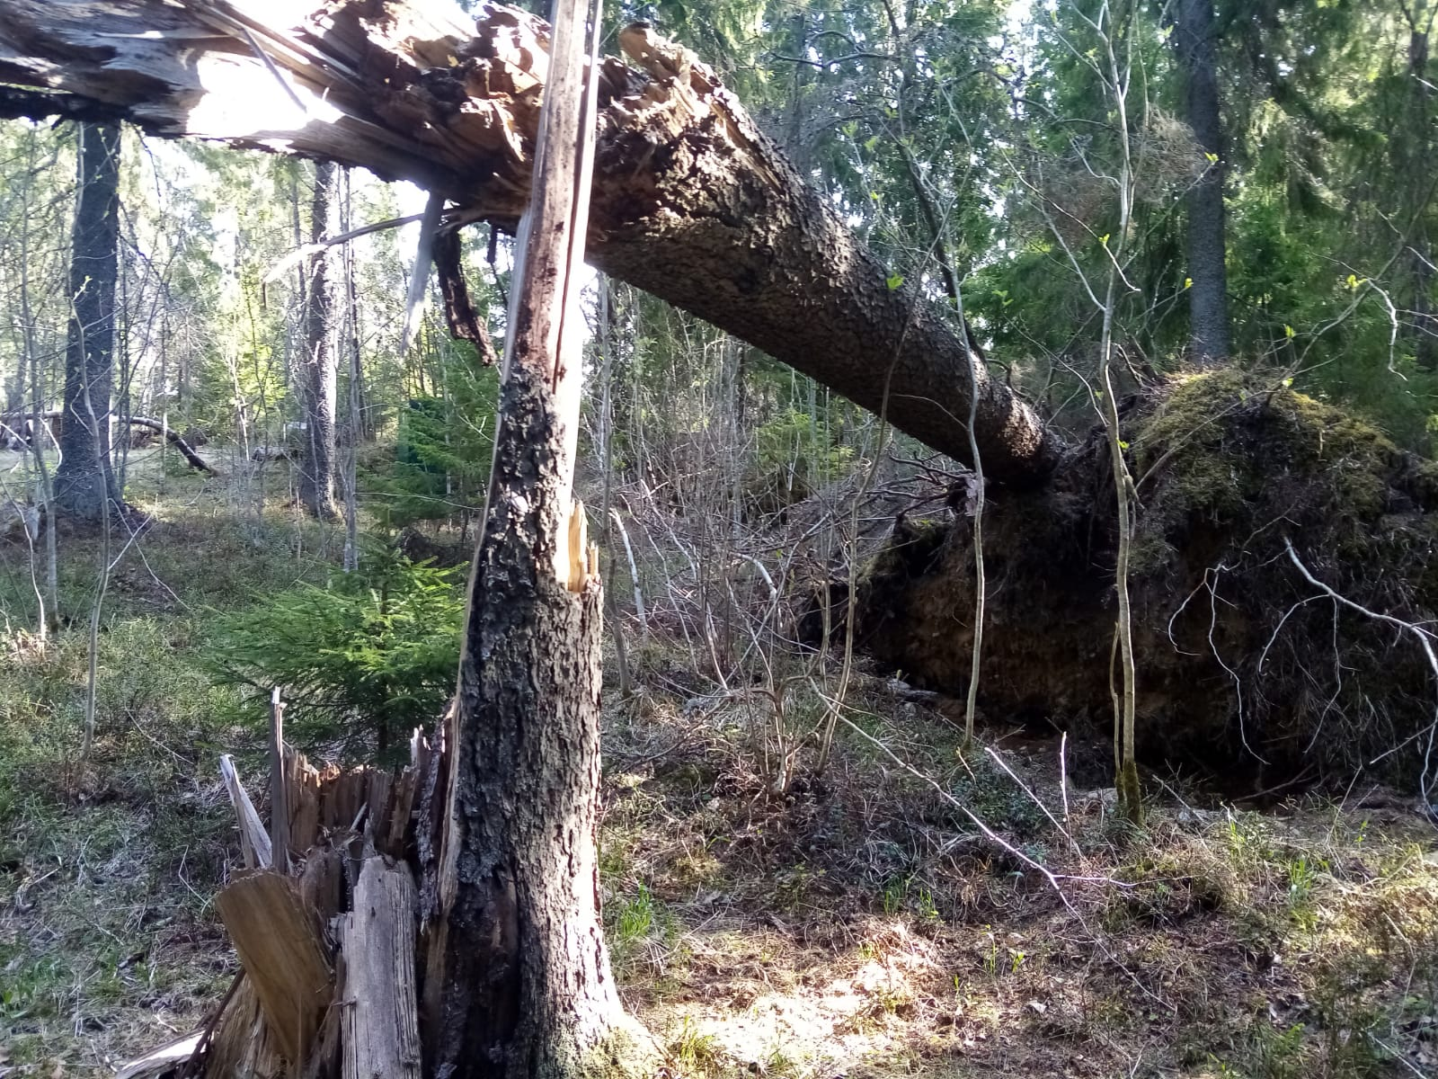
Notes:
Because the Puijo forest is primeval, when a tree fall down, they do not clear it away.
They just leave it where it falls.
These fallen trees provide shelter and homes for different types of animals.

Slide 8
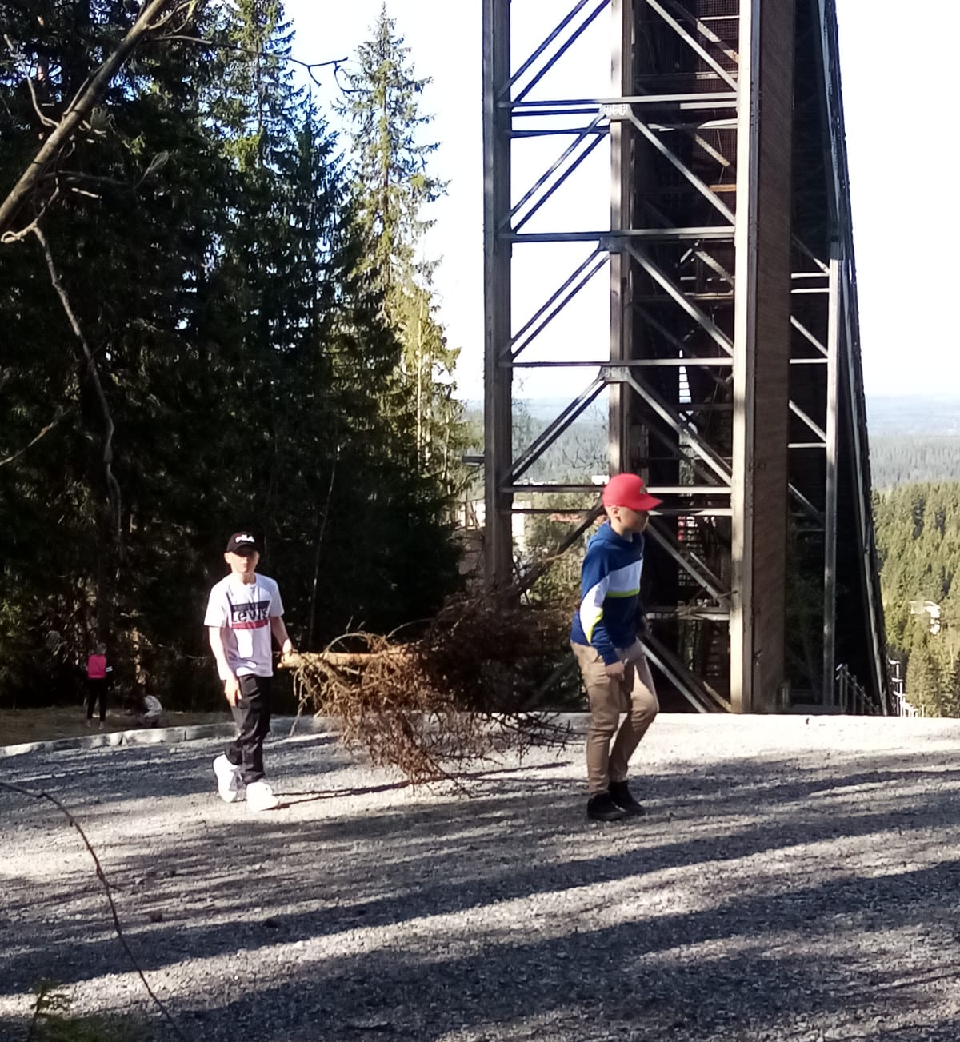
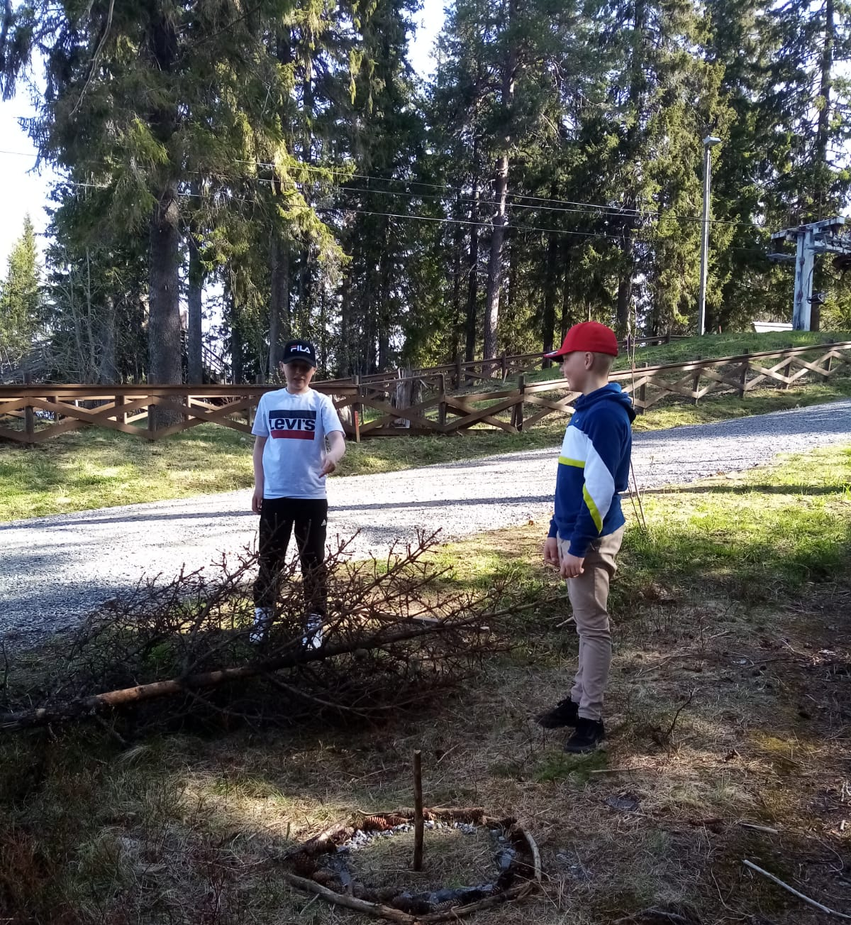
Notes:
We had gone to Puijo to make mandalas from what we could find in the forest.
We were going to make circle patterns, so we go to work finding the materials that we would use.

Slide 9
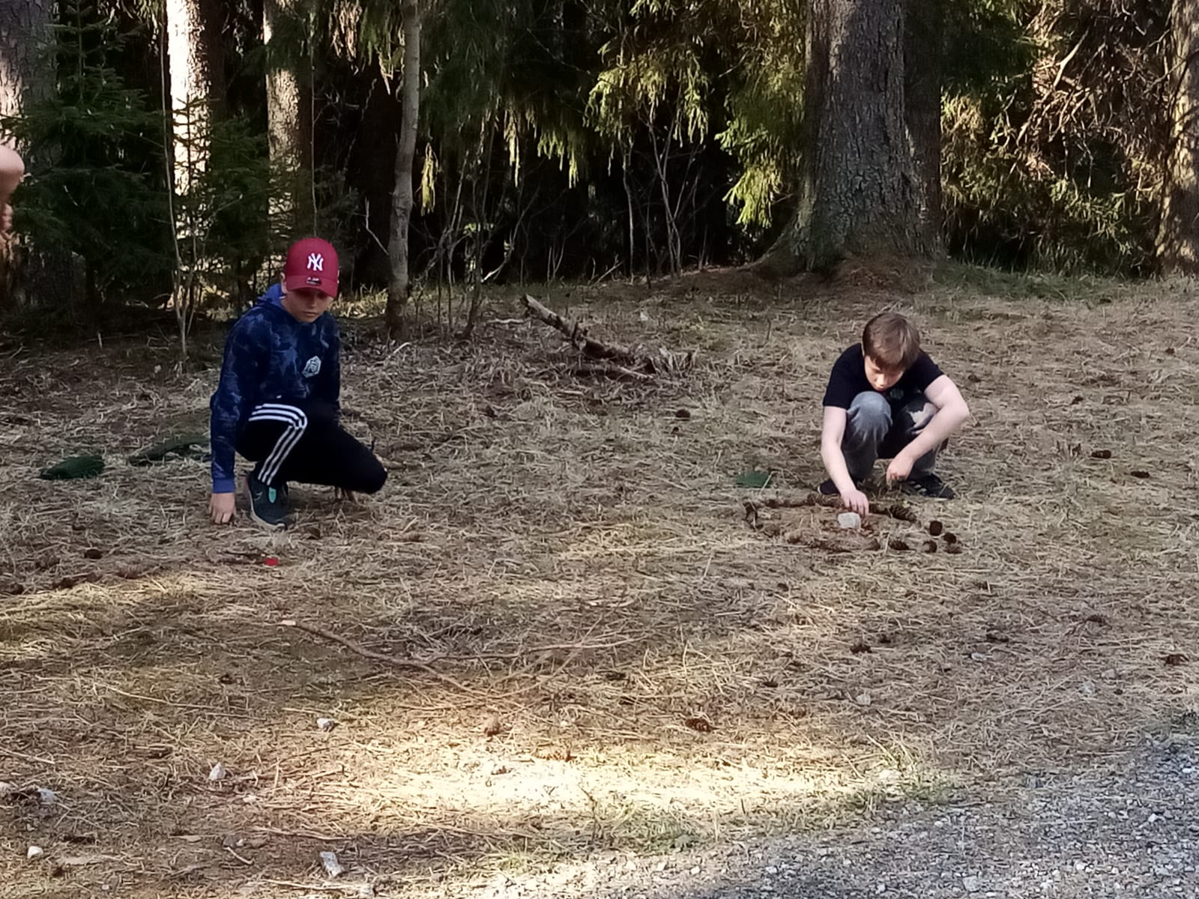
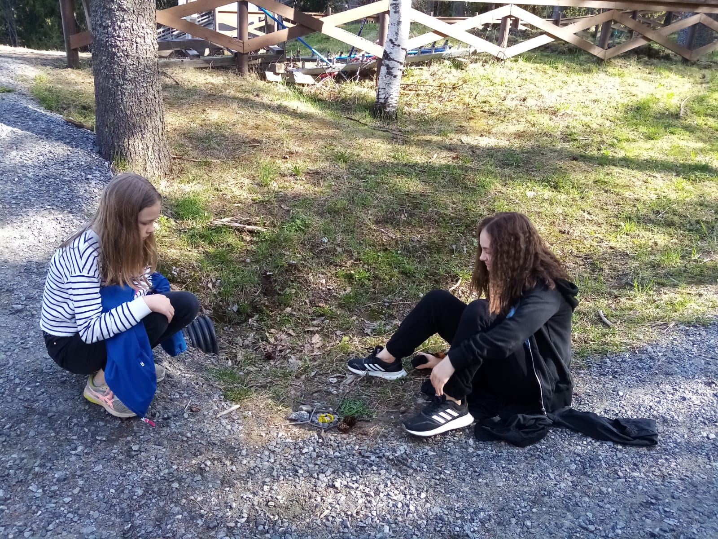
Notes:
We worked in pairs to create our mandalas.
Mandala is a Sanscrit word that means ‘circle'.

Slide 10
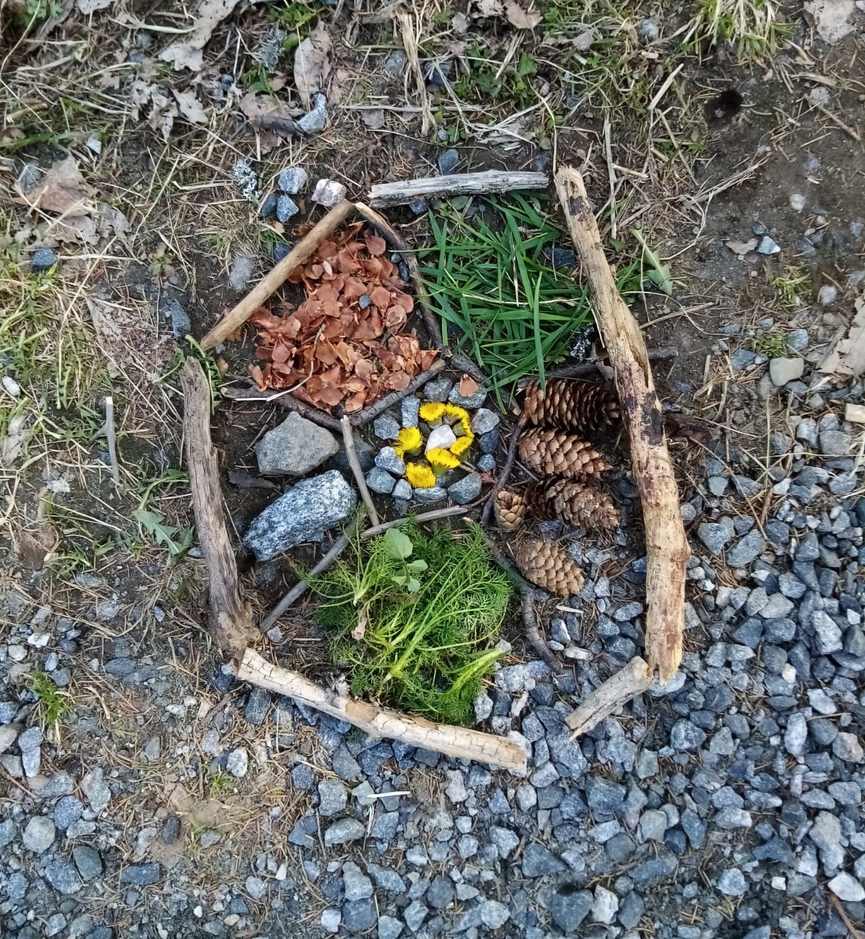
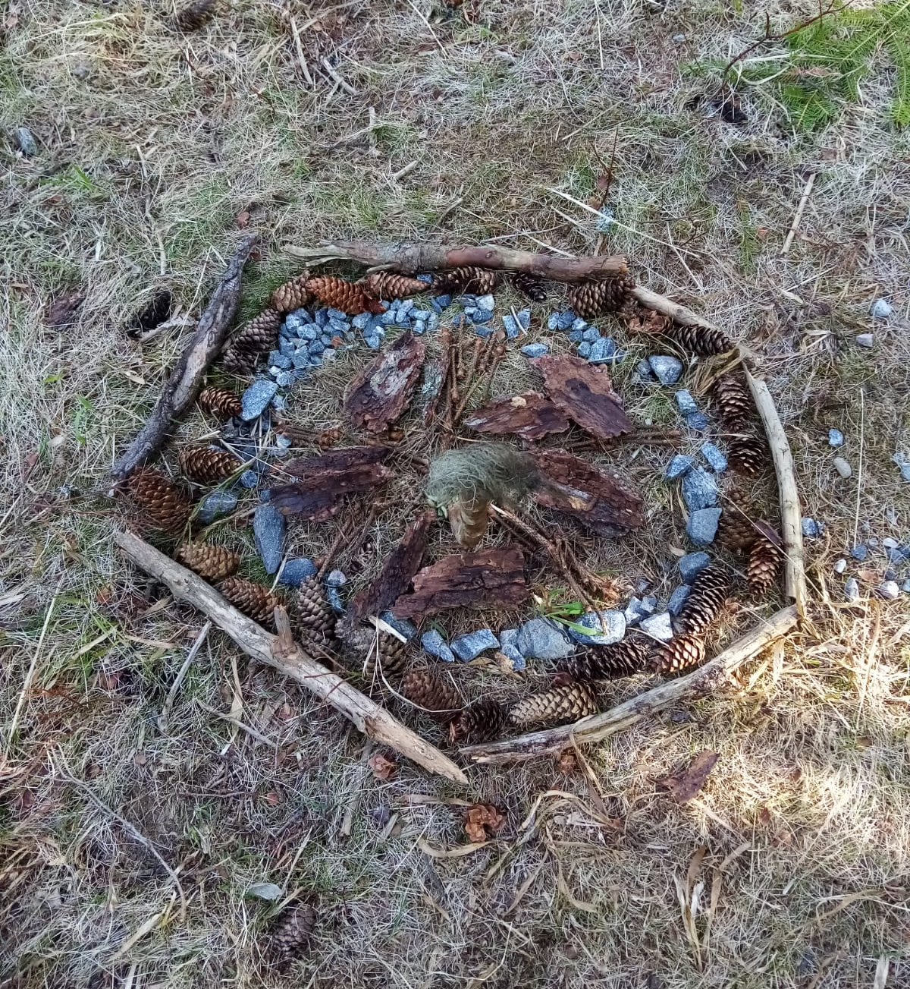
Notes:
Here are the mandalas that we made.
Many of us used wood, fir cones, and stones to make them.

Slide 11
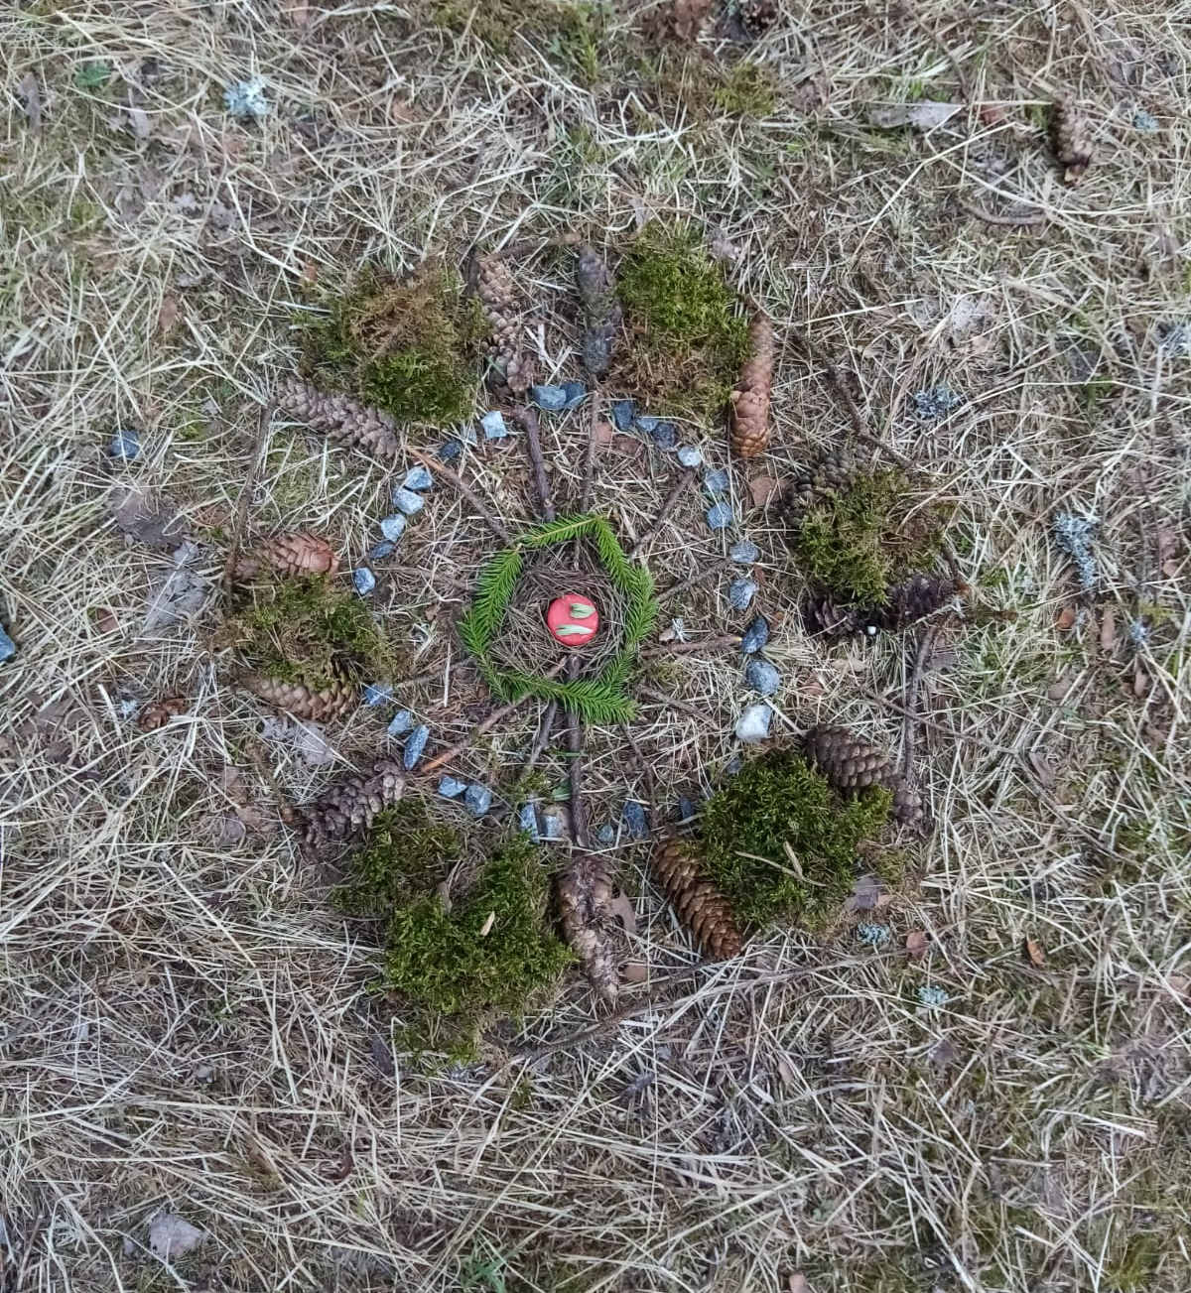
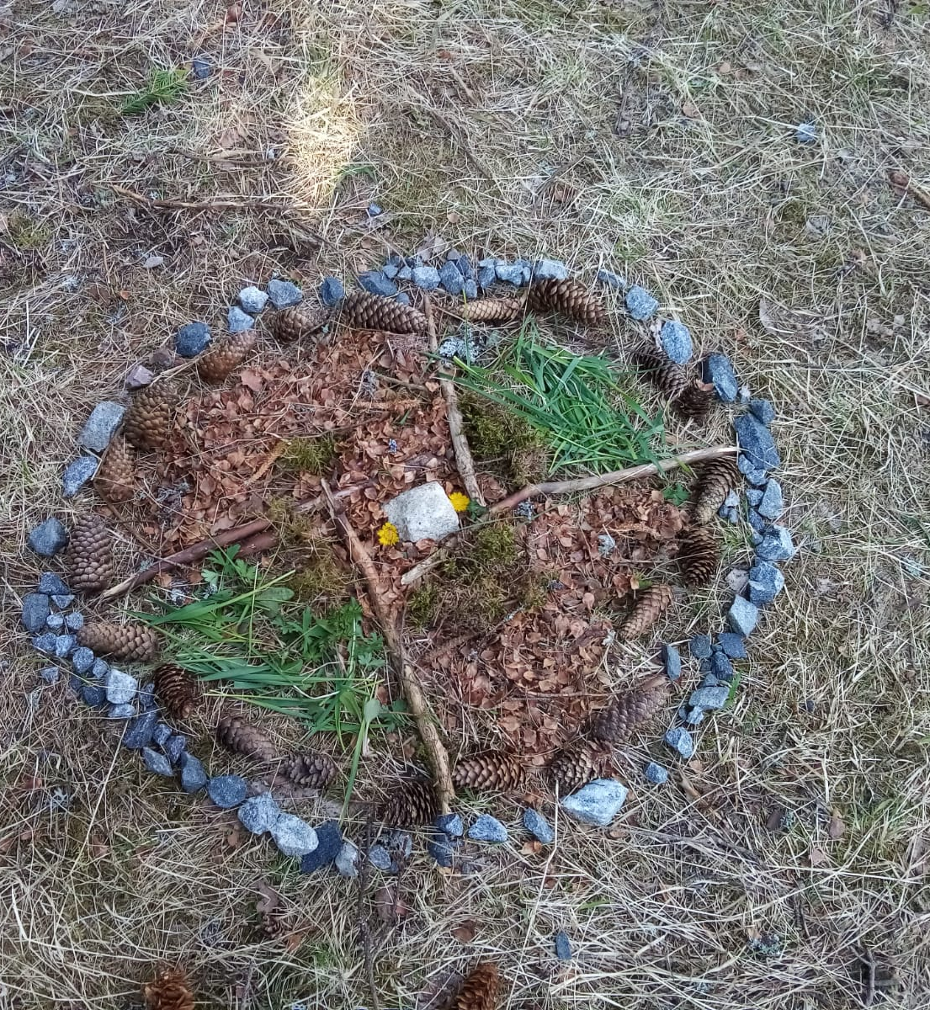

Slide 12
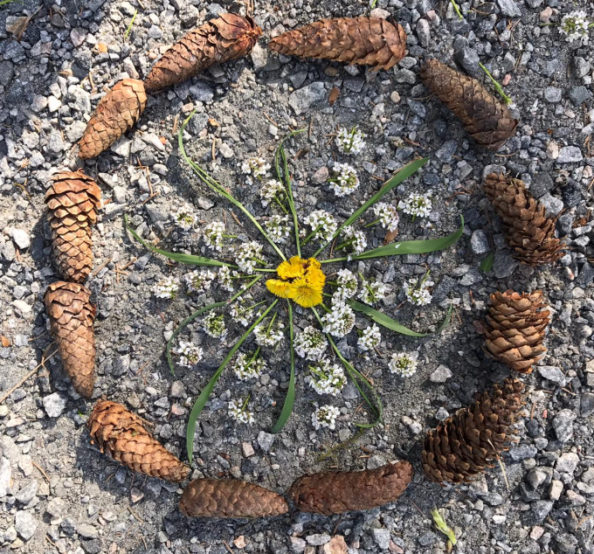
Notes:
The mandalas turned out really nicely and we had fun making them.

Slide 13
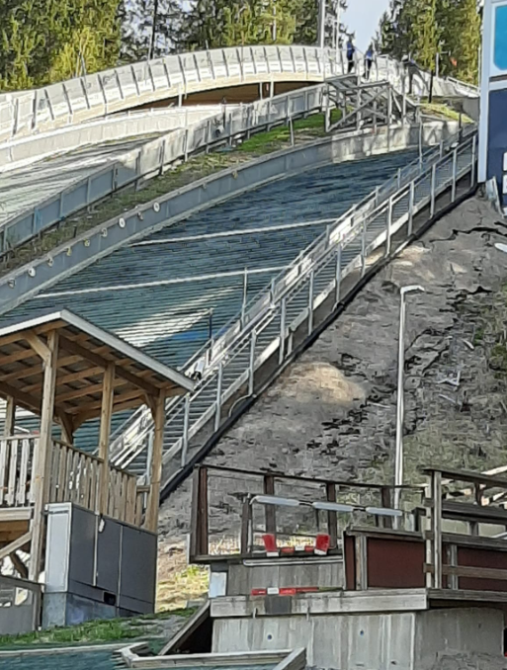
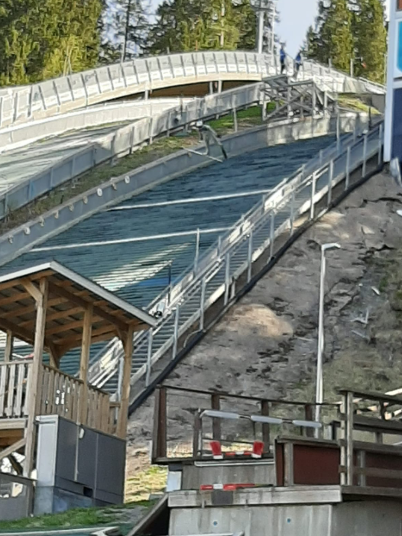
Notes:
On the way back to school, we were treated to some ski jumping.
People come from different countries to train on the Puijo ski-jump hills.
We were watching men training, but women also come here to train for ski jumping.

Slide 14
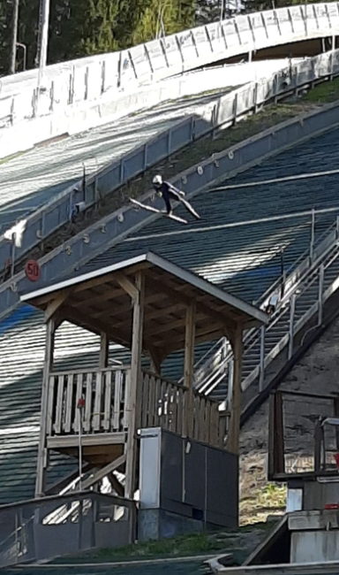
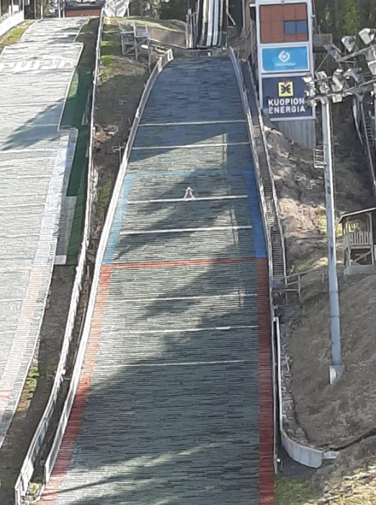
Notes:
In the winter, the ski hills are covered with snow, but people can still train during the summer months.
They use a special plastic cover and water.
Now you know a little bit about Puijo.
We are really lucky to have such a big outdoor classroom nearby.
Thank you for listening.

Slide 15
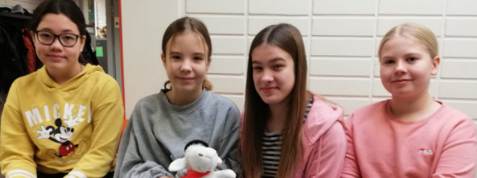
Thank you for listening

