Slide 1
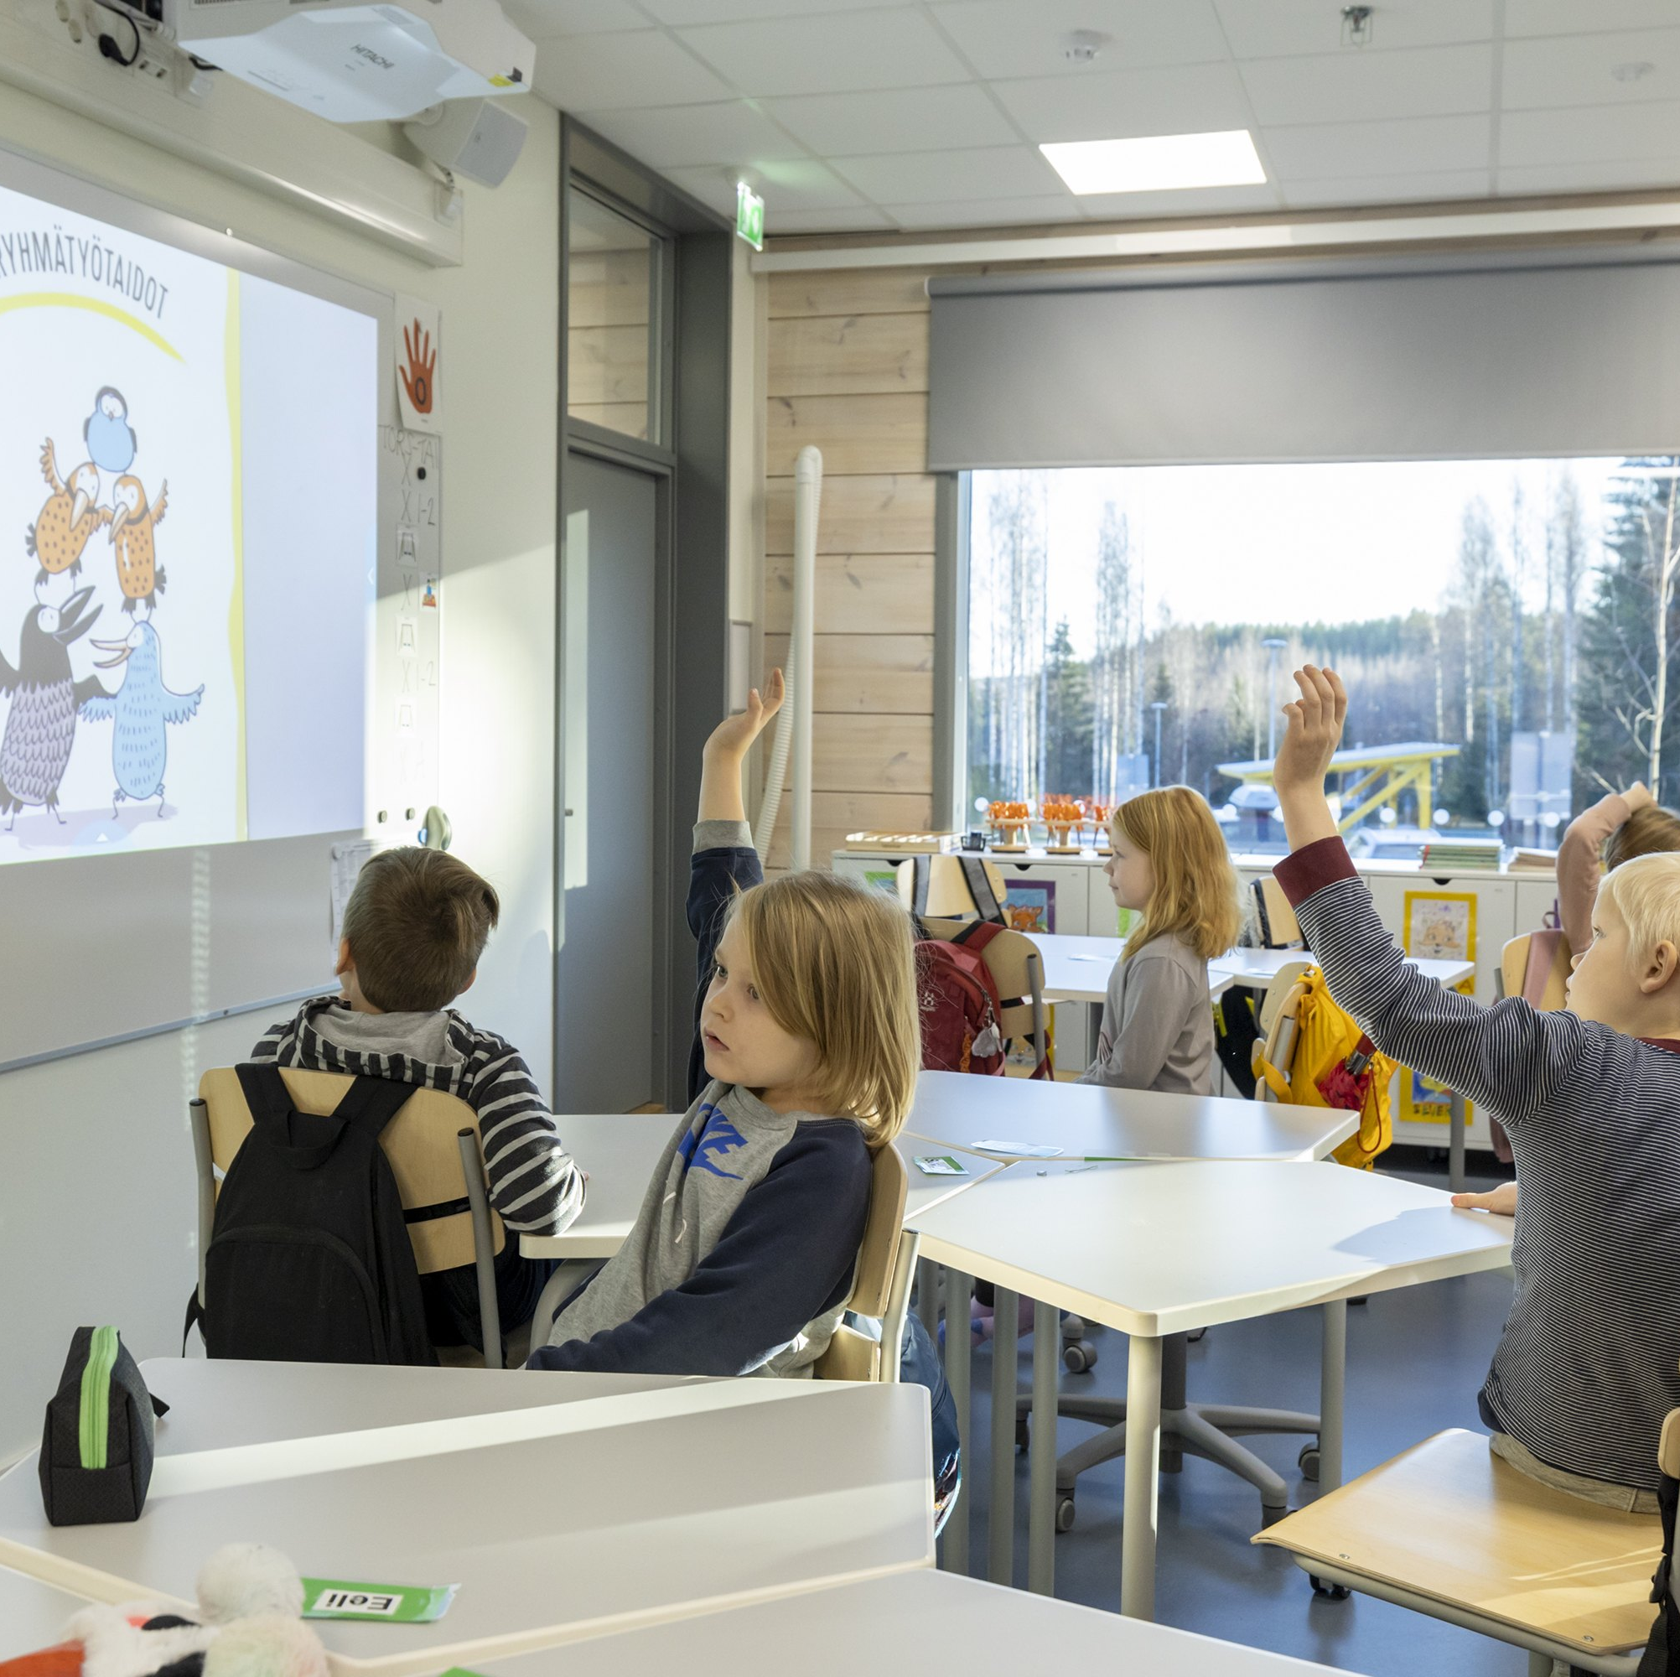
Preparatory education in Kuopio
2025-2026

Slide 2
Preparatory education
Preparatory education is for students
  age group 7–17 in basic education, age group 6 in early childhood education
  whose Finnish/Swedish skills are not sufficient to study in their local school
  – who are going to stay in Finland for a while
• The aim of the preparatory education is to develop students' Finnish language skills and general readiness for Finnish school integrate students into Finnish society.
• Preparatory education has its own curriculum, and it is not class or year based.
• The group size in preparatory education classes is approximately 10 students.
• Preparatory education lasts approximately one school year (900–1000 hours).
• Preparatory education is given in permanent preparatory education classes in Hatsala Classical school (age group 13-17) and Rajala school (age group 7-12). There are also temporary preparatory education classes in Snellman/Niirala (age group 7-12), and Neulamäki (age group 7-17) Comprehensive schools.
• After preparatory education students will usually go to their local school

Slide 3
Preparatory education in early childhood education
For 6-years-old students there is preparatory education in Kuopio and it is implemented in pre-school.
Preparatory education in pre-school is inclusive; the student is integrated in the mainstream pre-school group.
In Kuopio:
Preparatory education in early childhood education is carried out 5 hours per day

Slide 4
Preparatory education in Rajala school
Rajala Comprehensive school is located in Puijonlaakso (Sammakkolammentie 14)
Rajala school has weighted-curriculum education:
  Grades 3-6: Music
  Grades 1-6: Bilingual Finnish-English programme
Rajala Comprehensive school has three preparatory education classes
  teacher Mrs. Laura Kamunen
  teacher Mrs. Sanna Laitinen
  teacher Mrs. Katja Koskela

Slide 5
Preparatory education in Snellman School
Snellman Comprehensive school has two different school buildings
  Snellman school (Maaherrankatu 13)
  Niirala school (Huuhankatu 2)
Niirala Comprehensive school has one preparatory education class with teacher Mrs. Maria Normi

Slide 6
Hatsala Classical School is a comprehensive school for grades 7–9
Hatsala Classical School is a comprehensive school for grades 7–9.
Hatsala Classical School has four preparatory education classes which operate in three different buildings:
  Hatsala Classical School (Opistotie 5)
  Kuopio Community Collage (Puistokatu 20)
Preparatory education teachers:
Mrs. Sanna Tikkanen, Hatsala Classical School
Mrs. Laila Finska-Linna, Hatsala Classical School
Mrs. Niina Tirkkonen, Kuopio Community Collage
Mrs. Tuija Eira, Kuopio Community Collage

Slide 7
Preparatory education in Neulamäki Comprehensive School
Neulamäki Comprehensive School is located in Neulamäki (Pinokuja 6).
The school has appr. 460 students
The school offers education for grades 1-9
There are 2 preparatory education classes (age 7-16).
  Preparatory education teachers are Mrs. Kaisa Lähtevänoja and Mrs. Mari Knuutila

Slide 8
Preparatory education in Pyörö School
Pyörö Comprehensive School is located in three different units:
  Pitkälahti School (Pitkälahdentie 4)
  Ala-Pyörö School (Kulmakatu 7)
  Ylä-Pyörö School (Blominkatu 2)
The school offers education for grades 1-9
Preparatory education class in located in Pitkälahti school
  Teacher Mrs. Tiina Lommi

Slide 9
Contact informations
Coordinator Alexandra Vikeväinen, +358 44 718 8942
Principal, Snellman Primary School
  Riikka Karttunen, +358 44 718 4371
Principal, Rajala Primary School
  Saila Tirkkonen, +358 44 718 4351
Principals, Hatsala Classical Comprehensive School
  Heikki Pulkkinen, +358 44 718 4501
  Mikko Stranden, +358 44 718 4502
Principal, Neulamäki Comprehensive School
  Martti Kettunen, +358 44 718 4681
Principals, Pyörö Comprehensive School
  Outi Karikoski, +358 44 718 4801
  Anne Peltola-Juvonen, +358 447184441

